Slide 1

Applied Machine Learning (BUAN 6341) Lecture Clustering

Slide 2
Agenda
Overview of Unsupervised Learning
Clustering

Slide 3
Unsupervised Learning

Slide 4
Goals
To discover interesting things from the data:
Is there an informative way to visualize the data?
Can we discover subgroups among the variables?
Models:
Clustering
K-means
DBSCAN
Hierarchical Clustering

Slide 5
Clustering

Slide 6
What is Clustering?
Notes:
customers

Slide 7
What is Clustering?

Slide 8
What is Clustering?
2
1
3

Slide 9
Clustering
Partition data into groups (clusters)
Points within a cluster should be “similar”
Points in different clusters should be “different”
Notes:
Principles

Slide 10
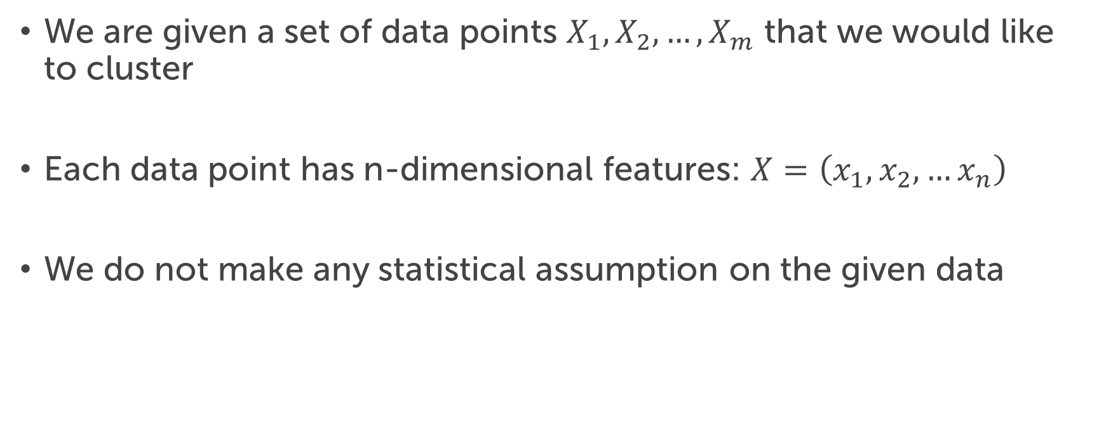
The Clustering Problem
We are given a set of data points $X_{1},X_{2},…,X_{m}$ that we would like to cluster
Each data point has n-dimensional features: $X=\left(x_{1},x_{2},…x_{n}\right)$
We do not make any statistical assumption on the given data

Slide 11
K-Means

Slide 12
Overview
K-means (MacQueen, 1967)
Each cluster has a cluster center, called centroid
K is specified by the user

Slide 13
K-means Algorithm
Given k:
Choose k (random) data points (seeds) to be the initial centroids, cluster centers
Assign each data point to the closest centroid
Re-compute the centroids using the current cluster memberships
If a convergence criterion is not met, repeat steps 2 and 3

Slide 14
Measure the Distance
Similarity measure (distance measure)
Euclidean distance $d\left(x,y\right)=\sqrt{{\left(x−y\right)}^{2}}=\sqrt{\sum_{i=1}^{d}{{\left(x_{i}−y_{i}\right)}^{2}}}$
Manhattan distance $d\left(x,y\right)=\left|x−y\right|=\sum_{i=1}^{d}{\left|x_{i}−y_{i}\right|}$
Notes:
scaling

Slide 15
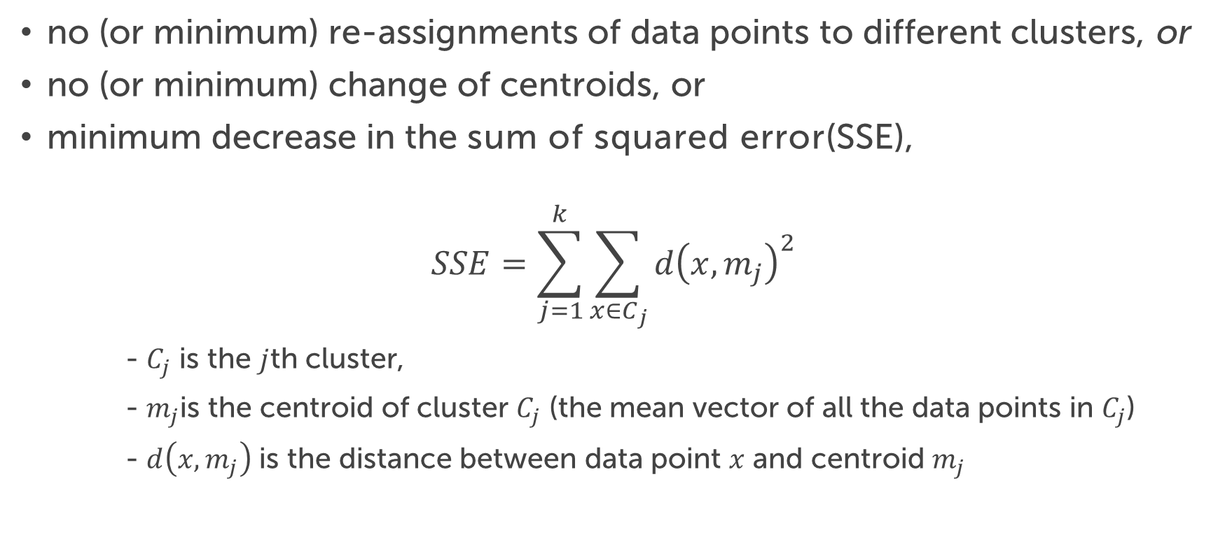
Stopping Criterion
no (or minimum) re-assignments of data points to different clusters, or
no (or minimum) change of centroids, or
minimum decrease in the sum of squared error(SSE),
$$SSE=\sum_{j=1}^{k}{\sum_{x∈C_{j}}{d{\left(x,m_{j}\right)}^{2}}}$$
- $C_{j}$ is the $j$th cluster,
- $m_{j}$is the centroid of cluster $C_{j}$ (the mean vector of all the data points in $C_{j}$)
- $d\left(x,m_{j}\right)$ is the distance between data point $x$ and centroid $m_{j}$

Slide 16
Illustrative Example
Given a set of data points

Slide 17
Illustrative Example
Select initial centers at random (k=3)

Slide 18
Illustrative Example
Assign each point to its nearest center

Slide 19
Illustrative Example
Recompute optimal centers given a fixed clustering

Slide 20
Illustrative Example
Assign each point to its nearest center

Slide 21
Illustrative Example
Recompute optimal centers given a fixed clustering

Slide 22
Illustrative Example
Assign each point to its nearest center

Slide 23
Illustrative Example
Recompute optimal centers given a fixed clustering

Slide 24
How to choose k?
Elbow method:
run k-means clustering on the dataset for a range of values of k
for each value of k calculate the sum of squared errors (SSE)
If the line chart looks like an arm, then the "elbow" on the arm is the value of k that is the best

Slide 25
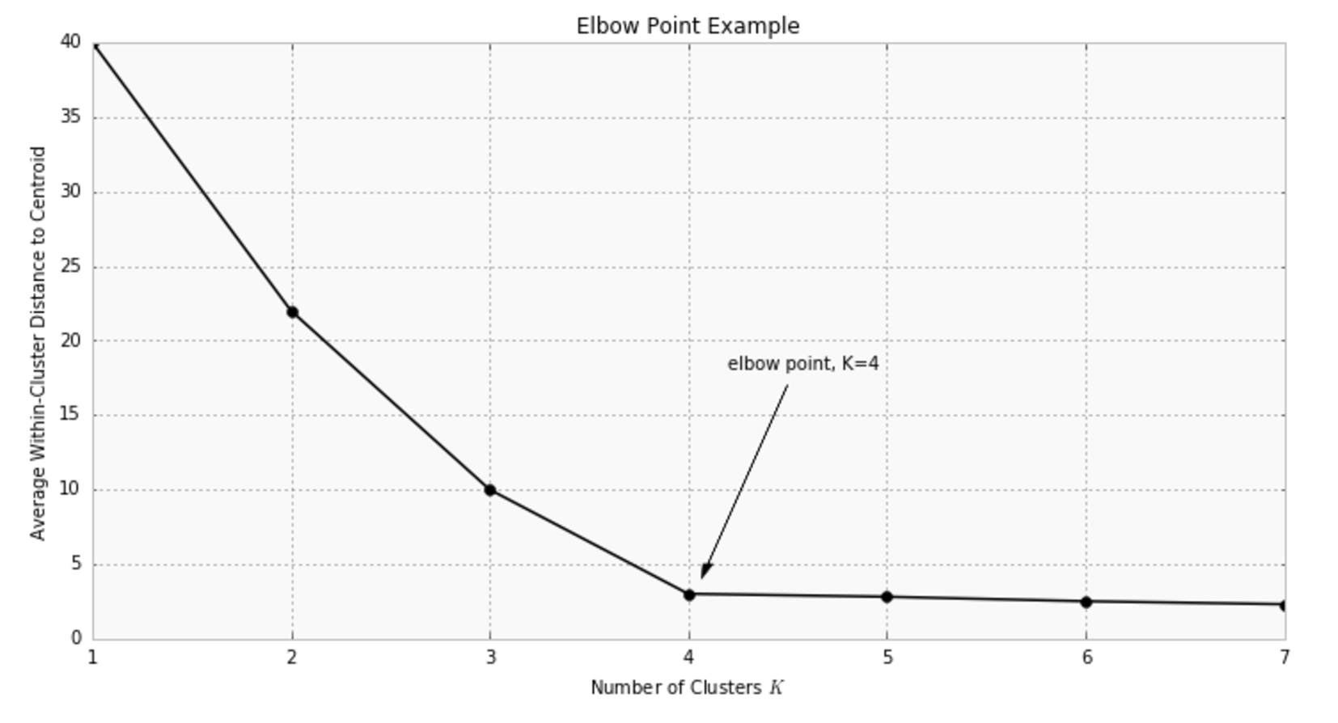

Slide 26
Pros and Cons
Strengths:
Simple: each to understand and to implement
Efficient
Weakness:
The algorithm is sensitive to outliers
it terminates at a local optimum if SSE is used. The global optimum is hard to find due to complexity
Might be sensitive to initial seeds
Only simple cluster shapes
Clusters can be empty
Notes:
The algorithm is only applicable if the mean is defined. For categorical data, k-mode – the centroid is represented by most frequent values.

Slide 28
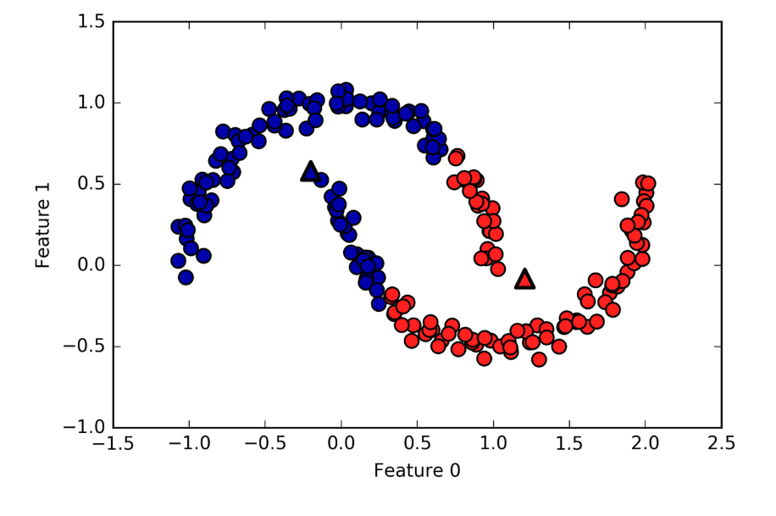
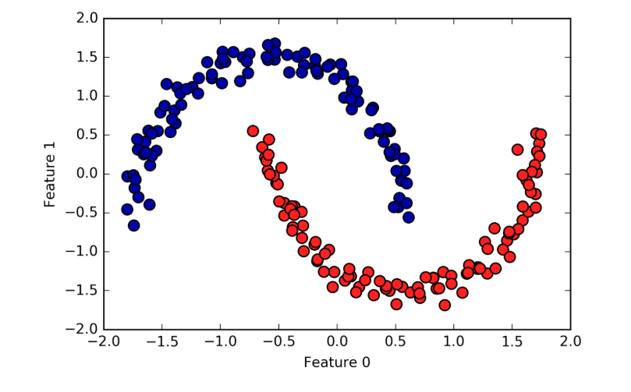
Notes:
Two half-moon shapes

Slide 29
DBSCAN
Density-Based Spatial Clustering of Applications with Noise
Source: https://cse.buffalo.edu/~jing/cse601/fa12/materials/clustering_density.pdf

Slide 30
Density-based Clustering
Basic Idea:
Clusters are dense regions in the data space, separated by regions of lower object density
A cluster is defined as a maximal set of density-connected points

Slide 31

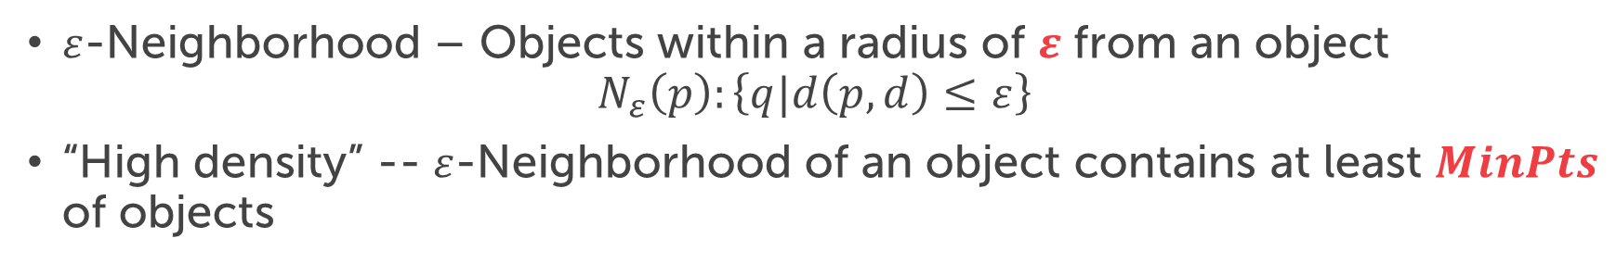
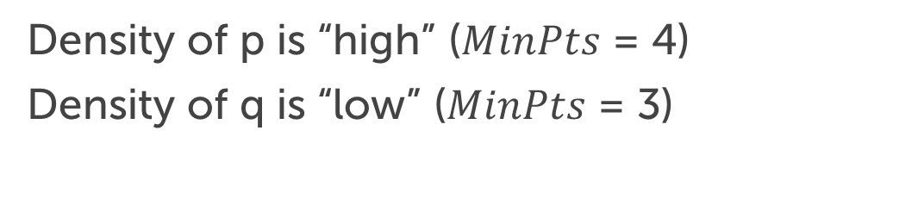

Density Definition
$ε$-Neighborhood – Objects within a radius of $ε$ from an object
$$N_{ε}\left(p\right):\left\{q|d\left(p,d\right)≤ε\right\}$$
“High density” -- $ε$-Neighborhood of an object contains at least $MinPts$ of objects
$$ε$$
q
Density of p is “high” ($MinPts$ = 4)
Density of q is “low” ($MinPts$ = 3)
$$ε$$
p

Slide 32
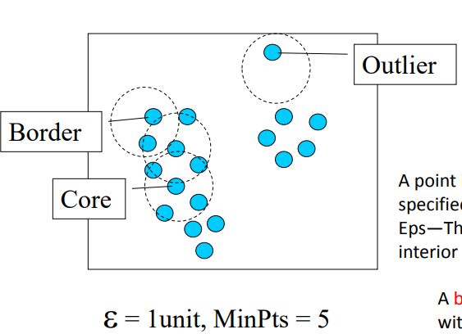
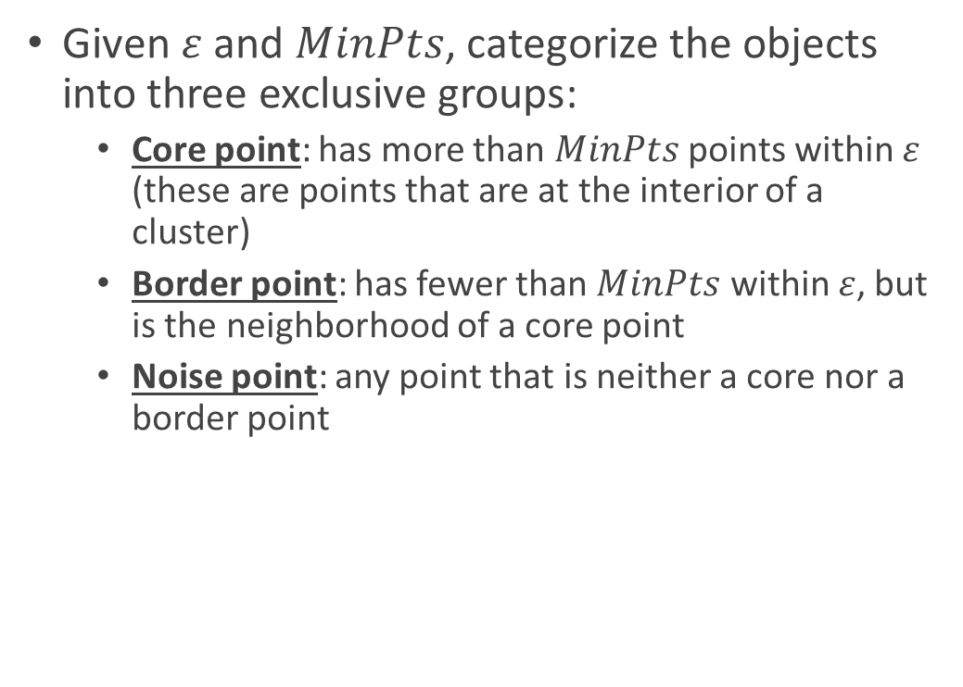
Core, Border, Outlier
Given $ε$ and $MinPts$, categorize the objects into three exclusive groups:
Core point: has more than $MinPts$ points within $ε$ (these are points that are at the interior of a cluster)
Border point: has fewer than $MinPts$ within $ε$, but is the neighborhood of a core point
Noise point: any point that is neither a core nor a border point

Slide 33



Density-reachability
An object q is directly density-reachable from object p if p is a core object and q is in p’s $ε$-neighborhood.
q is directly density-reachable from p
p is not directly density-reachable from q
Density-reachability is asymmetric
$$ε$$
q
$$ε$$
p
$MinPts$=4

Slide 34
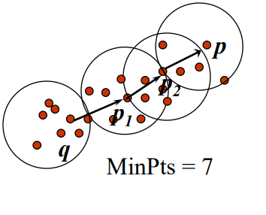
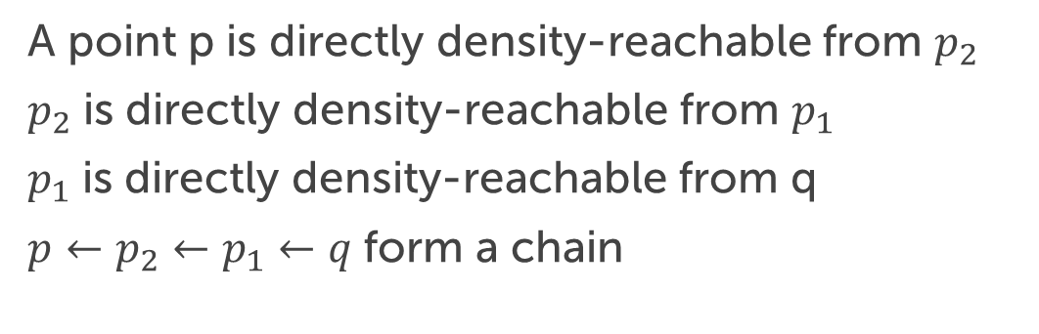
Density-reachability
A point p is directly density-reachable from $p_{2}$
$p_{2}$ is directly density-reachable from $p_{1}$
$p_{1}$ is directly density-reachable from q
$p←p_{2}←p_{1}←q$form a chain

Slide 35
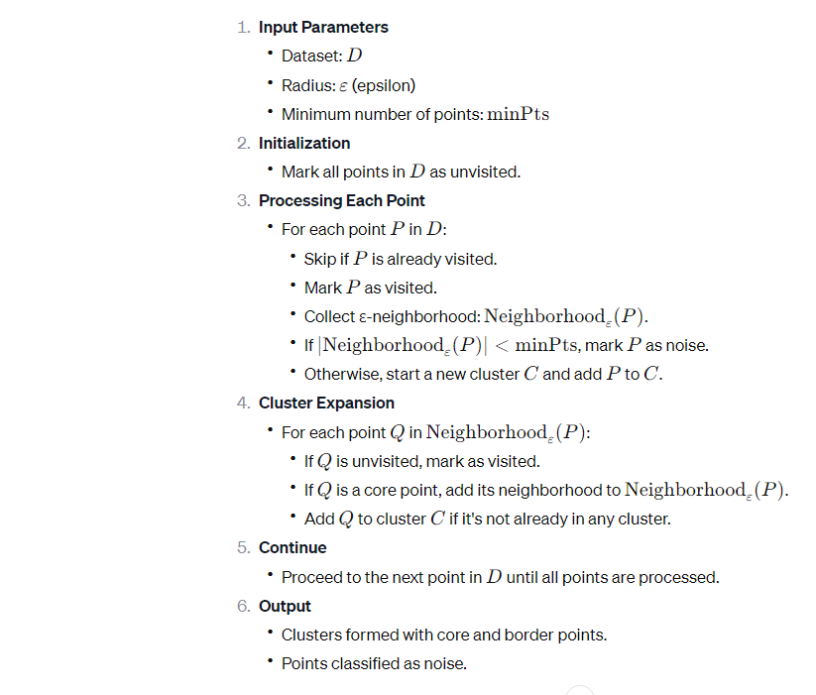
DBSCAN Algorithm

Slide 36
Pros and Cons
Can learn arbitrary cluster shapes (resistant to noise)
Can detect outliers
Needs two parameters to adjust

Slide 37
Hierarchical Clustering
https://cse.buffalo.edu/~jing/cse601/fa12/materials/clustering_hierarchical.pdf

Slide 38
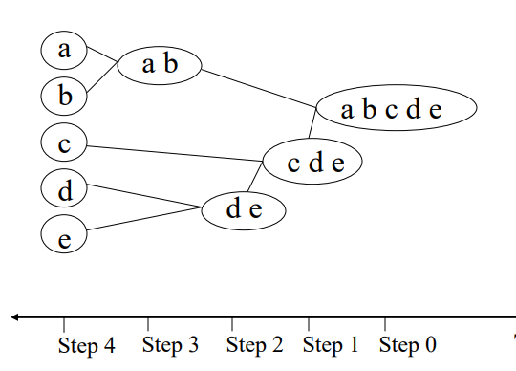
Types
Divisive (top-down) clustering
All objects in one cluster
Select a cluster and split it into two sub clusters
Until each leaf cluster contains only one object

Slide 39
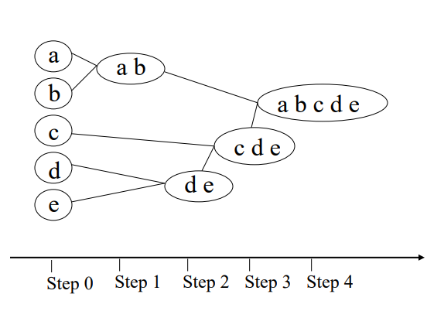
Types
Agglomerative (bottom-up) clustering
Each object is a cluster
Merge two clusters which are most similar to each other
Until all objects are merged into a single cluster

Slide 40
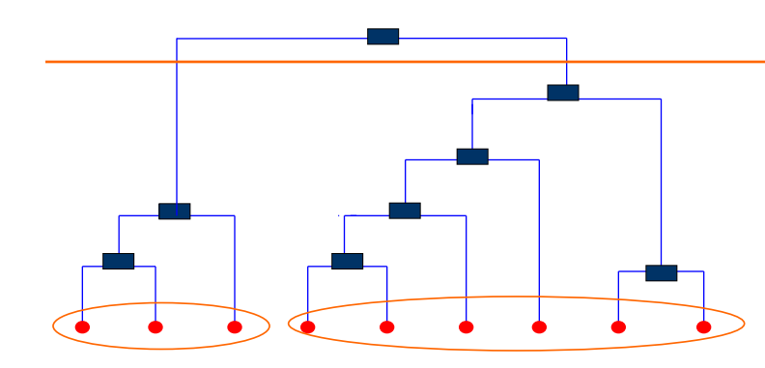
Dendrogram
A tree that shows how clusters are merged/split hierarchically
Each node on the tree is a cluster; each leaf node is a singleton cluster
A clustering of the data objects is obtained by cutting the dendrogram at the desired level, then each connected component forms a cluster

Slide 41
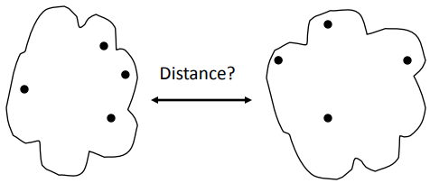
Inter-Cluster Distance

Slide 42
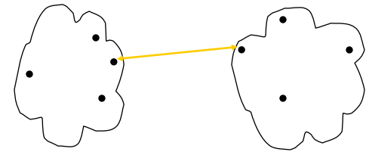
MIN (Single Link)
The distance between two clusters is represented by the distance of the closest pair of data objects belonging to different clusters.
Determined by one pair of points, i.e., by one link in the proximity graph
Limitation: sensitive to noise/outliers

Slide 43
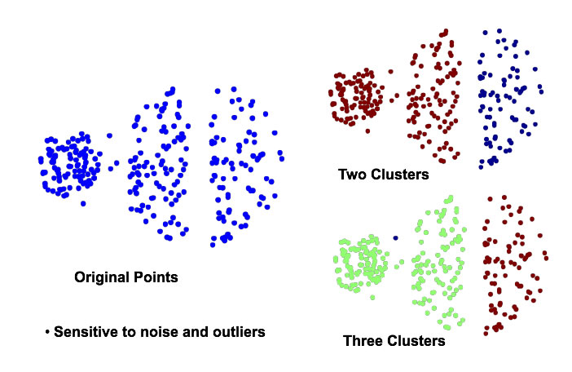

Slide 44
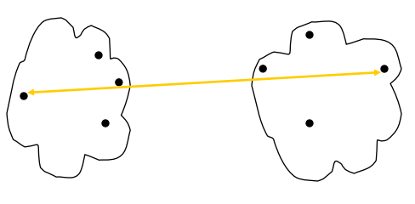
MAX (Complete link)
The distance between two clusters is represented by the distance of the farthest pair of data objects belonging to different clusters

Slide 45
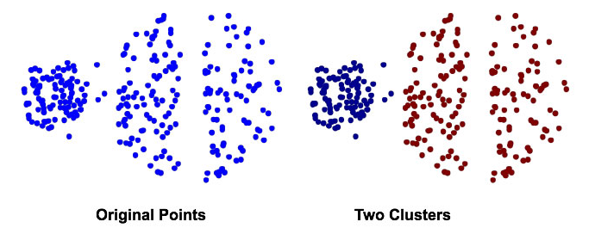
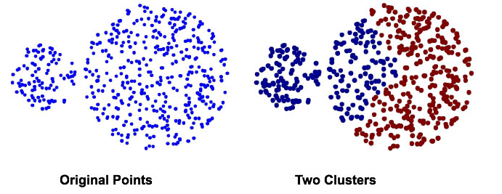
MAX (Complete link)
Strength: less sensitive to noise/outliers
Limitations: tends to break large clusters

Slide 46
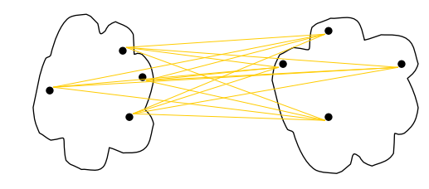
Group average
The distance between two clusters is represented by the average distance of all pairs of data objects belonging to different clusters
Determined by all pairs of points in the two clusters

Slide 47
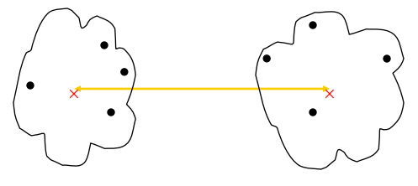
Centroid Distance
The distance between two clusters is represented by the distance between the centers of the clusters
– Determined by cluster centroids

Slide 48
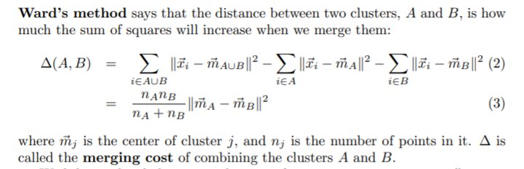
Ward’s Method
Similarity of two clusters is based on the increase in squared error when two clusters are merged
Similar to group average if distance between points is distance squared
Less susceptible to noise and outliers
Source: https://www.stat.cmu.edu/~cshalizi/350/lectures/08/lecture-08.pdf

Slide 49

Python Practice

Slide 50
Questions?

