Slide 1
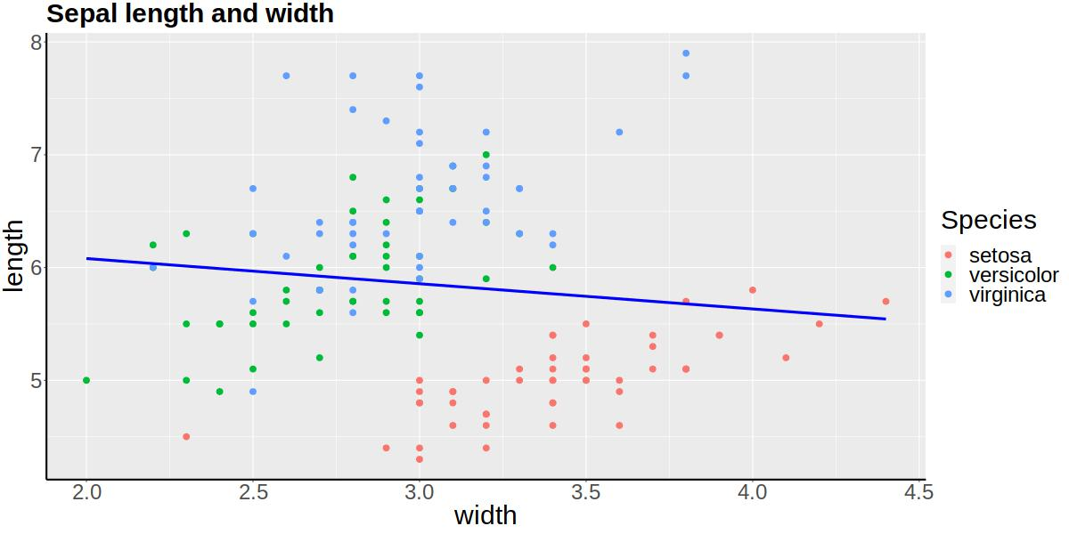
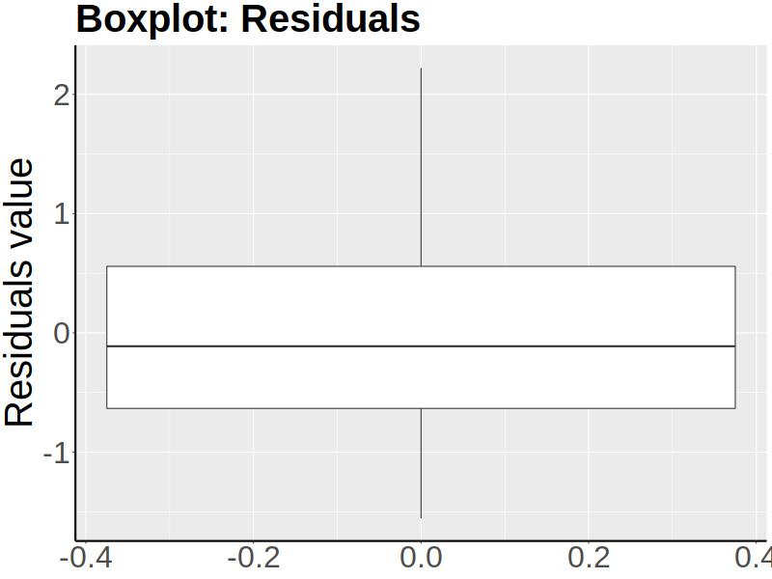
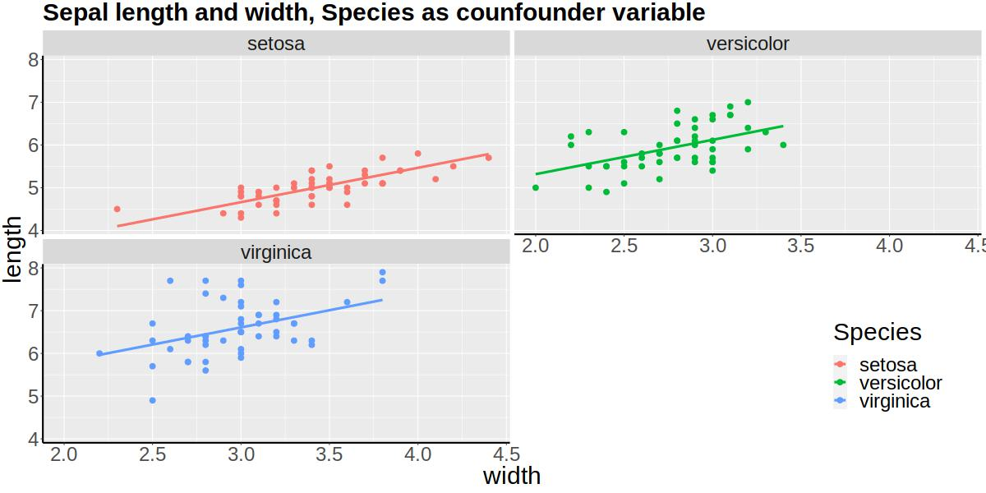
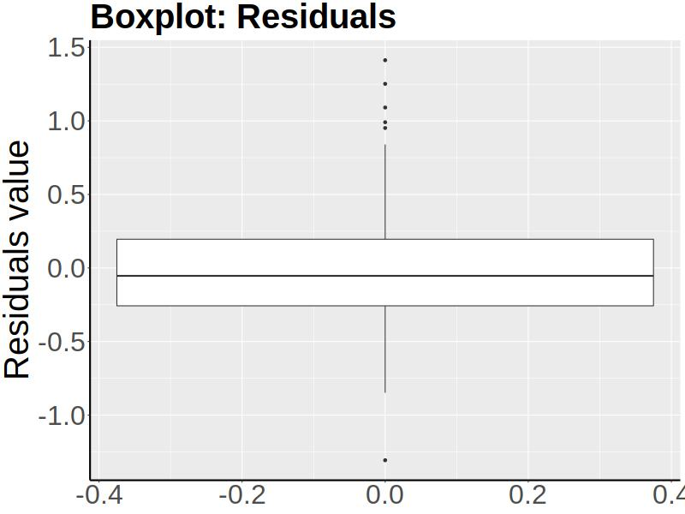
Variables confundidoras en dataset Iris
COEFICIENTES
 | Estimate | Std. Error | t value | Pr(>|t|)
Intercept | 6.5262 | 0.4789 | 13.63 | <2e-16 ***
Sepal.Width | -0.2234 | 0.1551 | -1.44 | 0.152
EVALUACIÓN DEL AJUSTE
Residual standard error: 0.8251 |  | F-statistic: 2.074
Multiple R-squared: 0.01382 |  | Adjusted R-squared: 0.007159 |  | p-value: 0.1519
Modelo 1: Sepal.Length ~ Sepal.Width
COEFICIENTES
 | Estimate | Std. Error | t value | Pr(>|t|)
Intercept | 2.2514 | 0.3698 | 6.089 | 9.57e-09 ***
Sepal.Width | 0.8036 | 0.1063 | 7.557 | 4.19e-12 ***
Species = versicolor | 1.4587 | 0.1121 | 13.012 | < 2e-16 ***
Species = virginica | 1.9468 | 0.1000 | 19.465 | < 2e-16 ***
EVALUACIÓN DEL AJUSTE
Residual standard error: 0.438 |  | F-statistic: 128.9
Multiple R-squared: 0.7259 |  | Adjusted R-squared: 0.7203 |  | p-value: 2.2e-16
Modelo 2: Sepal.Length ~ Sepal.Width + Species
 | Res. Df | RSS | Df | Sum of Sq | F | Pr(>|t|)
modelo 1 | 148 | 100.75610 | NA | NA | NA | NA
modelo 2 | 146 | 28.00366 | 2 | 72.7524 | 189.6512 | 2.55787e-41
ANOVA

