Slide 1








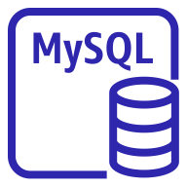
Over-all architecture
Region
Availability Zone a
Availability Zone c
Virtual private cloud (VPC)
Internet gateway
Public subnet
Public subnet
AWS RDS Multi- AZ는 Active DB와 Standby DB가 다른 AZ에 구성
Auto Scaling Group이 실행되는
서브넷과 DB 서브넷을 분리하여
보안 강화
Bastion Host를 통해 외부 관리자가 DB서버에 접속할 수 있는
jump Server 생성
Bastion Host
NAT Instance
NAT Instance
Application Load Balancer
Private subnet
Private subnet
Auto Scaling group
Instance
Instance
Private subnet
Private subnet
Amazon RDS
(Master)
Amazon RDS
(Standby)

Slide 2
S/W 구성도
Availability Zone a
Availability Zone c
Bastion Host
Linux 2
Nat Instance
VPC-nat
Nat Instance
VPC-nat
Web Server
Linux 2
Web Server
Linux 2
Master DB
Standby DB
AWS MySQL RDS
(Master)
AWS MySQL RDS
AWS MySQL RDS

