Slide 1
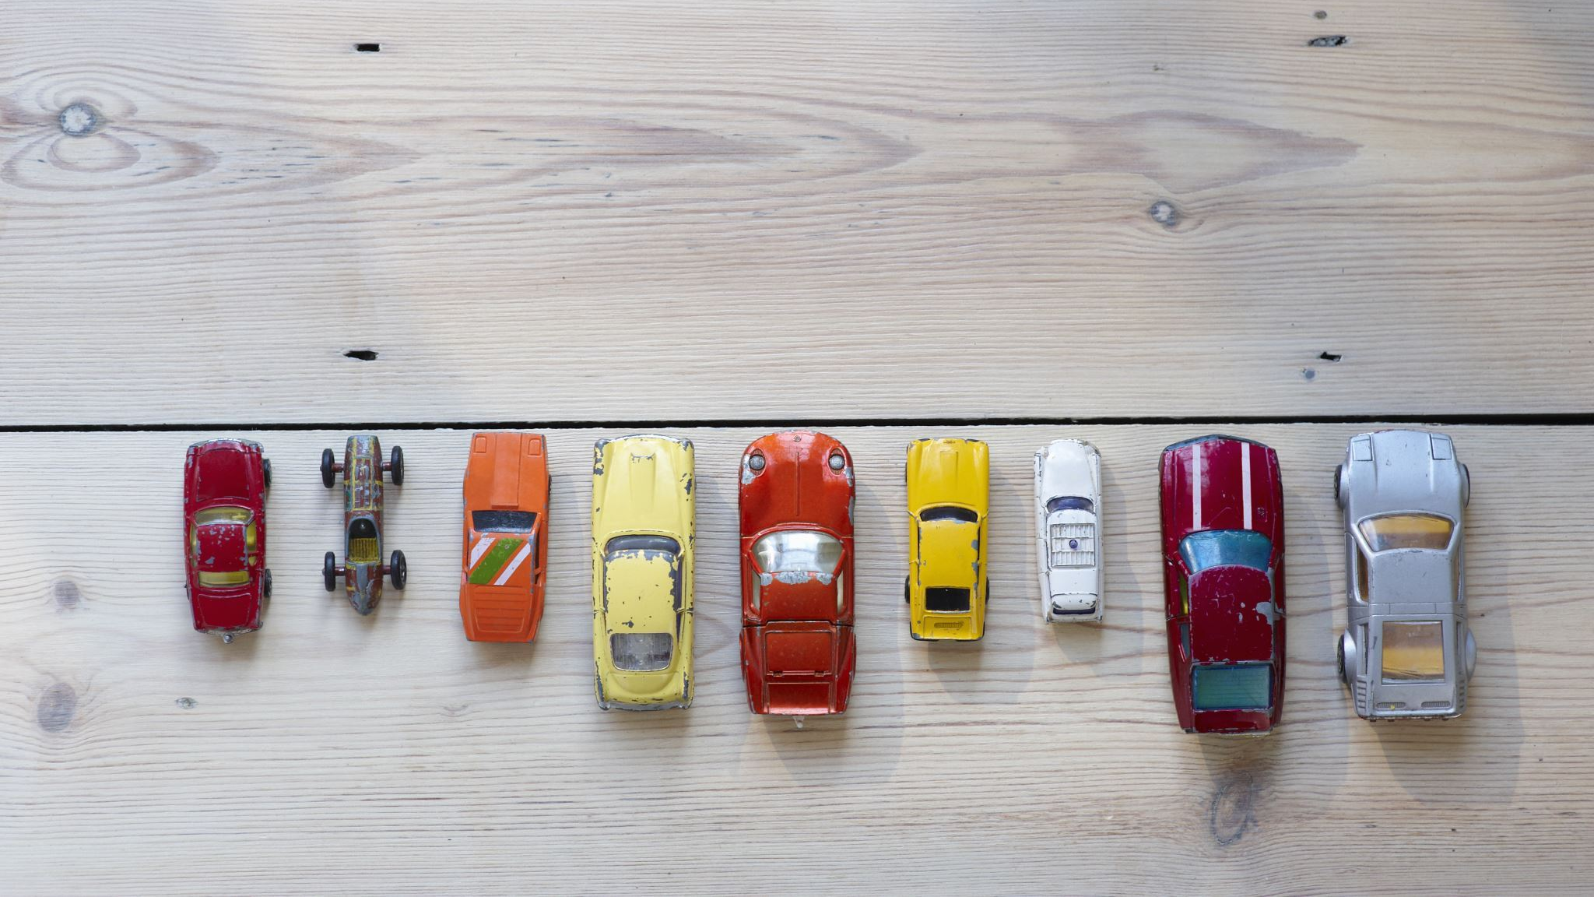

Used Cars: Big data analytics
Big Data Engineering
Master in Data Science and Engineering, 2022/23
Group composed by:
Henrique Ribeiro
Ian Karkles
Luís Henriques
Miguel Veloso
Paulo Portela
Vitor Pereira

Slide 2

Project description
Obtain, Analyze and Process the Used Cars dataset
The project aims to predict prices of vehicles using Spark machine learning techniques
Additionally, a recommendation system based on several parameters was developed

Slide 3
Dataset profiling
Craigslist is one of the biggest platforms where a customer can purchase or sell a car;
A huge amount of transaction takes place every day in more than 70 countries and 700 different cities;
The Craigslist dataset consists of 1.3 GB of data and has 26 columns;
Dataproc -> Cluster, Jobs and Buckets -> Jupyter Notebook, Py Files and PNG Images

Slide 4
Dataset profiling
N
Type | Variable | Description
Categorical | Model | Model of the vehicle
Categorical | Region | Region information of the car sale
Categorical | Condition | Condition of the vehicle
Numerical | Odometer | The mileage information of the vehicle
Numerical | Year | Production year of the vehicle
Numerical | Price | Price of the vehicle (Target variable in this research)
The data both consist of categorical features like model, region, condition, and numerical features like odometer (mileage information), year, and price;
The target variable will be the price information.

Slide 5
Data Understanding
Some questions were made, in order to have a better understanding of the data.

Slide 6
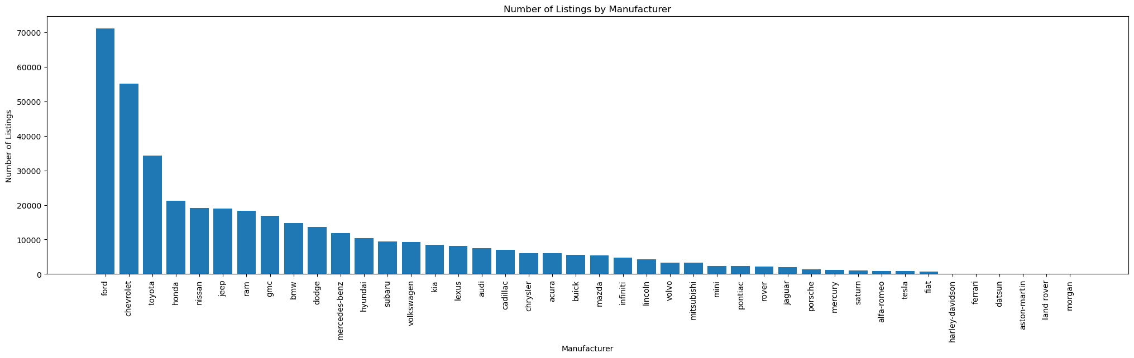
What's the total number of listings for each car manufacturer?

Slide 7
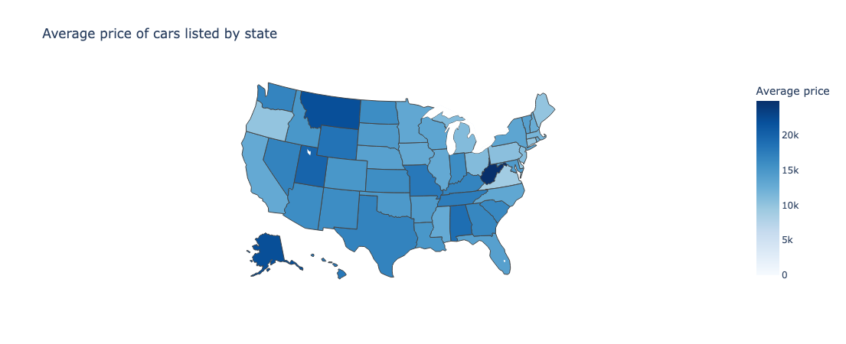
What's the car's average price by state?

Slide 8
Data Visualization & Cleaning
Visualizing the data reveals patterns that are not obvious to the human eye when reviewing raw data that should be considered and removed.

Slide 9
Data Visualization & Cleaning
The following steps were made:
Removed MV’s & duplicates;
Price between 2k and 50k;
Odometer between 100 and 200k;
Filtering the dataset between 2000 and 2021;
Removing new cars + parts only.

Slide 10
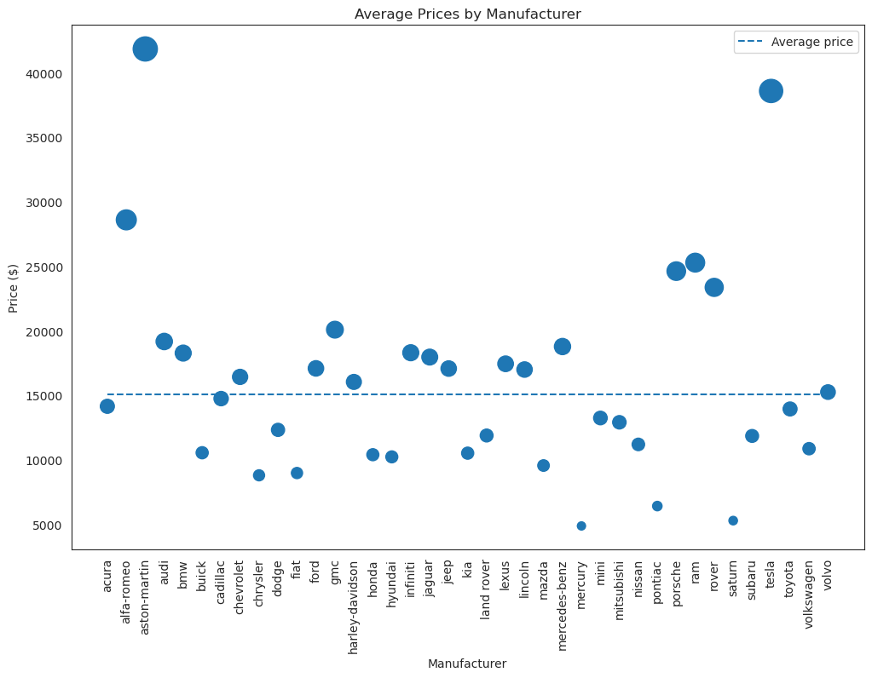
Average Prices by Manufacturer

Slide 11
Price Prediction
Generating price predictions is a crucial aspect of the project and represents one of its most significant objectives.

Slide 12

Price Prediction
Price prediction is a regression problem and involves applying machine learning algorithms.
The algorithms considered were:
Linear, Lasso and Ridge Regression
Isotonic Regression
Factorization Machines Regression
Decision Tree
Random Forest
Gradient Boosting Regressor
Generalized Linear Regression

Slide 13
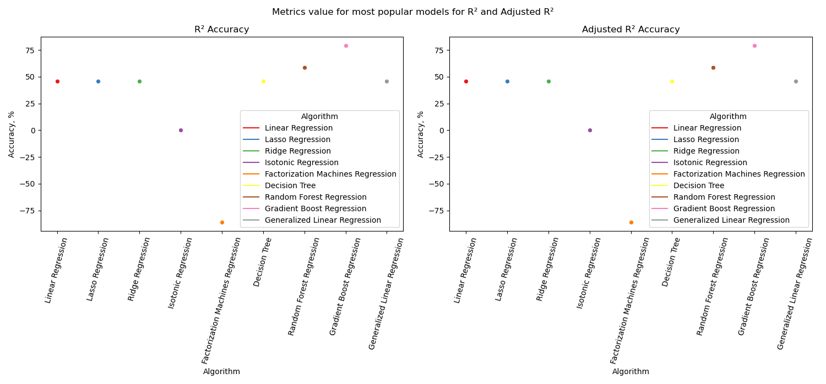
R² and Adjusted R² Evaluation
Algorithm | R²
Linear Regression | 0.46
Lasso Regression | 0.45
Ridge regression | 0.45
Isotonic Regression | 0.09
Factotization Machine R. | -0.86
Decision Tree | 0.46
Random Forest R. | 0.59
Gradient Boost R. | 0.80
Generalized Linear R. | 0.47

Slide 14
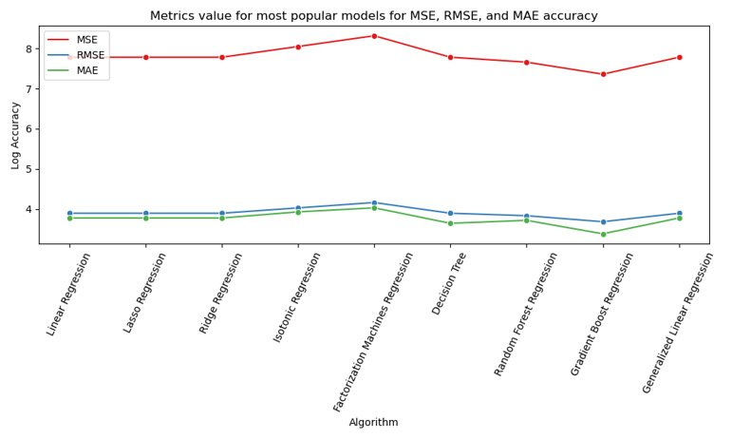
MSE, RMSE and MAE evaluation
Algorithm | MSE | RMSE | MAE
Linear Regression | 56053213.75 | 7486.87 | 5624.39
Lasso Regression | 56053216.92 | 7486.87 | 5624.39
Ridge Regression | 56053181.06 | 7486.87 | 5624.39
Isotonic Regression | 104616186.54 | 10228.21 | 8094.63
Factorization Machines | 193995209.83 | 13928.22 | 10185.99
Decision Tree | 80185198.27 | 8954.62 | 4672.3
Random Forest Regression | 48737255.76 | 6981.21 | 5250.69
Gradient Boost Regression | 101917001.54 | 10095.4 | 4409.38
Generalized Linear Regression | 56053177.83 | 7486.87 | 5624.39

Slide 15
Performance Evaluation
We will be looking at various metrics such as Cores and Instances, Dataset Size, Execution Time, and CPU Usage, to analyze and evaluate the performance of our system.

Slide 16

Performance Evaluation
Metrics evaluated:
Cores and Instances
Dataset Size
Execution Time
CPU Usage

Slide 17
Performance Evaluation
2 cores
2 & 4 Workers
6 & 12 instances
100 MB
1.3 GB
700 MB
Sample loading
3 Queries
3 Algorithms
Execution time
CPU Usage
-Execution time;
- CPU Usage;
Notes:
To compare our results, we decide to do several test with several configurations:
First we choose 2 cores and we manipulate the number of instances, from 6 to 18, and the number of workers from 2 to 4
Then, we created 3 sample sizes (100MB, 700MB and the whole dataset)
To evaluate the CPU Usage and the Execution time we made tests on sample loading, queries and machine learning algorithm

Slide 18
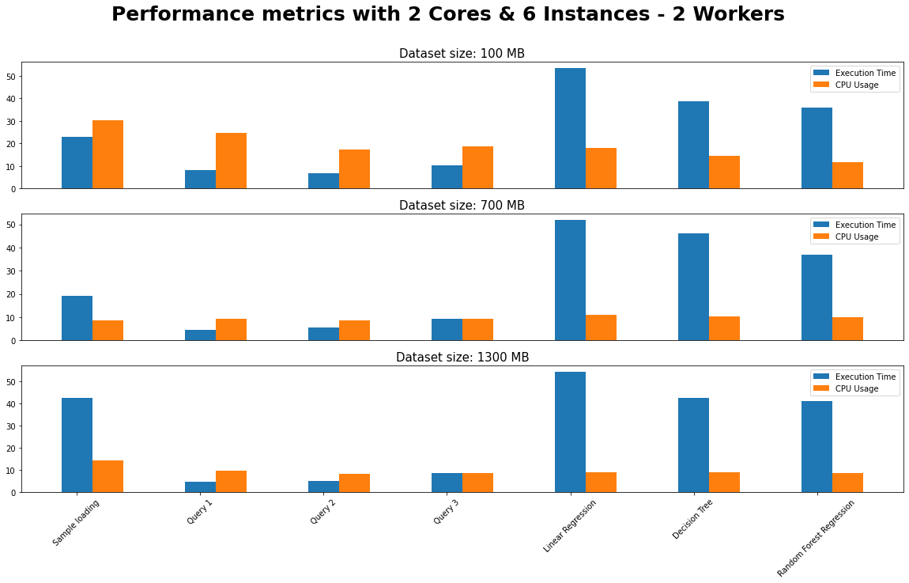
2 workers & 6 instances
The dataset size has significant impact on the execution time;
Among all the models considered, LR takes the longest time to run;
Query 1 took the least time to run in all Query/Model combinations.

Slide 19
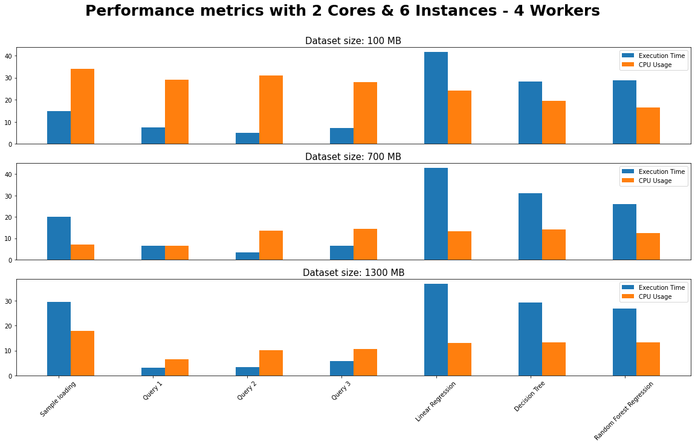
4 workers & 6 instances
The sample loading showed was faster than the previous test.
Querying and modelling also performed better.
On the other hand, CPU Usage was higher, on average.

Slide 20
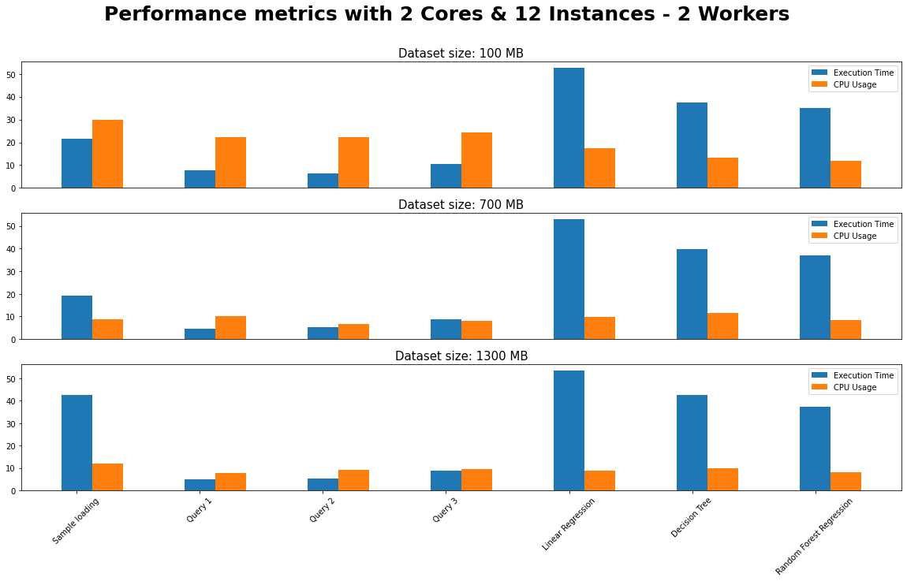
2 workers & 12 instances
For the same number of workers, with 12 instances, the results were slightly faster regarding the execution time and CPU Usage;
In this case, Query 1 were also the least in time consuming;

Slide 21
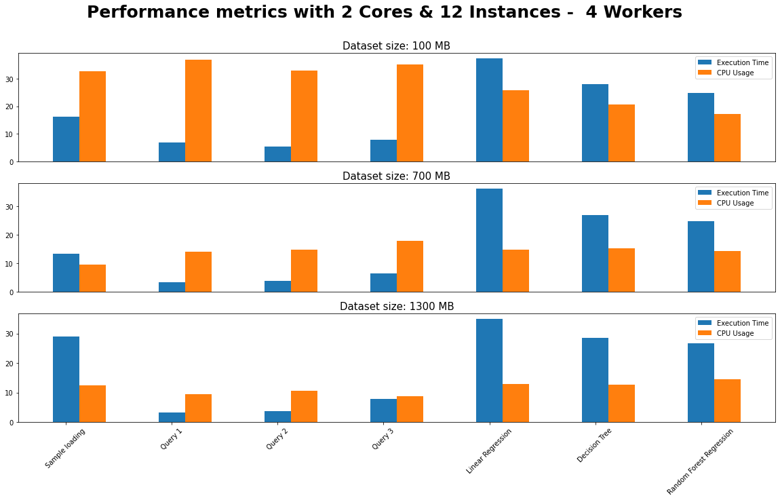
4 workers & 12 instances
Some improvements were noticed regarding the sample loading execution time;
In general, larger datasets leads to longer execution times;
In ML models, the results were not satisfactory.

Slide 22
Recommendation System
Enhancing the sales of pre-owned cars on Craigslist through the implementation of a recommender system that suggests related listings to potential buyers based on their current viewing activity

Slide 23
Recommendation System
In addition, a recommendation system was developed for which the following parameters were defined:
A Made column (with the Country) based on the manufacturer of a car;
The Cars age (Actual Year – Construction Year) based on the construction year of a car;
A Luxury Division based on the type group of a car:
Luxury small, luxury large, non-luxury small and non-luxury large;
Cars colors division:
Dark color and light color.

Slide 24
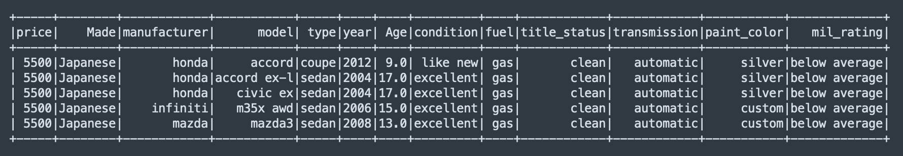
Recommendation System
Japanese car, with light color, from luxury small group with a price range between 5500 and 6000;
Displays the results with the lowest price.

Slide 25
Conclusion & future work
In general, the performance increased with the number of instances, cores, and the dataset size;
Sample sizes of 100 MB took more CPU usage than bigger sample sizes;
As expected, the algorithm’s training process was more time-consuming than the other tested tasks;
Datasets with bigger sizes were also more time-consuming than smaller datasets;
In future work, we would like to perform more tests with different cores and different, and hopefully larger, dataset sizes.

