Slide 1







Number of terms added
Number of terms added
$$\frac{3n}{2}$$
$$\frac{3n}{2}−1$$
$$n$$
$$n$$
Degree of terms
Degree of terms
$$0$$
$$n−1$$
$$0$$
$$\frac{n}{2}−1$$
$$\frac{n}{2}$$
$$n−1$$
modular reduction steps in $R_{q}=ℤ_{q}\left[x\right]/\left\langle x^{n}+1\right\rangle$
modular reduction steps in $R_{q}=ℤ_{q}\left[x\right]/\left\langle x^{n}−x^{n/2}+1\right\rangle$

Slide 2











Number of terms added
Number of terms added
Number of terms added
$$\frac{3n}{2}$$
$$\frac{3n}{2}$$
$$\frac{3n}{2}−1$$
$$\frac{3n}{2}−1$$
$$n$$
$$n$$
$$n$$
$$e_{1}$$
$$e_{2}$$
$$e_{3}$$
$$e_{1}$$
$$e_{2}$$
$$e_{3}$$
$$e_{3,1}$$
$$e_{1}$$
$$e_{2}$$
$$e_{3,2}$$
Degree of terms
Degree of terms
Degree of terms
$$0$$
$$n−1$$
$$0$$
$$\frac{n}{2}−1$$
$$\frac{n}{2}$$
$$n−1$$
$$0$$
$$\frac{n}{2}−1$$
$$\frac{n}{2}$$
$$n−1$$
modular reduction steps in $R_{q}=ℤ_{q}\left[x\right]/\left\langle x^{n}+1\right\rangle$
modular reduction steps in $R_{q}=ℤ_{q}\left[x\right]/\left\langle x^{n}−x^{n/2}+1\right\rangle$
modular reduction steps in $R_{q}=ℤ_{q}\left[x\right]/\left\langle x^{n}−x^{n/2}+1\right\rangle$

Slide 3
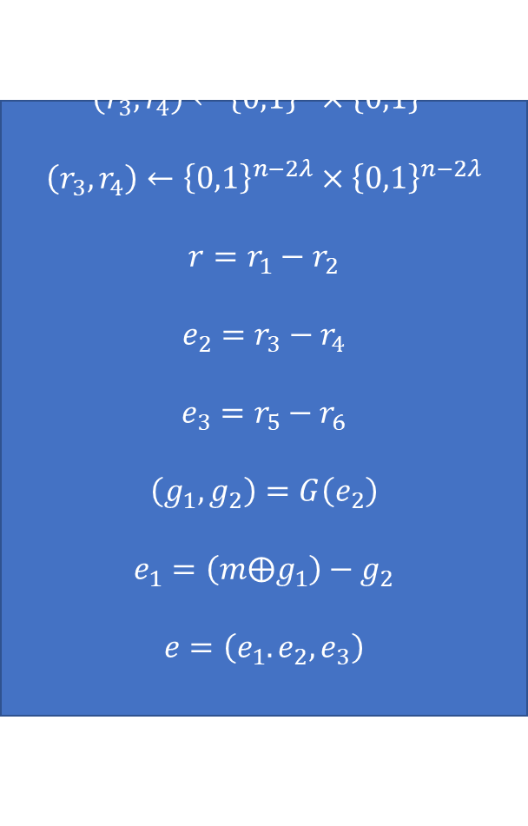
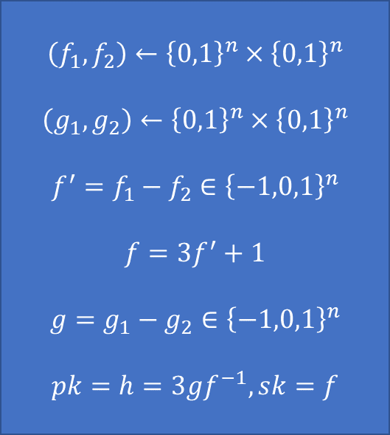
$$\left(f_{1},f_{2}\right)←{\left\{0,1\right\}}^{n}×{\left\{0,1\right\}}^{n}$$
$$\left(g_{1},g_{2}\right)←{\left\{0,1\right\}}^{n}×{\left\{0,1\right\}}^{n}$$
$$f^{′}=f_{1}−f_{2}∈{\left\{−1,0,1\right\}}^{n}$$
$$f=3f^{′}+1$$
$$g=g_{1}−g_{2}∈{\left\{−1,0,1\right\}}^{n}$$
$$pk=h=3gf^{−1},sk=f$$
$$\left(r_{1},r_{2}\right)←{\left\{0,1\right\}}^{n}×{\left\{0,1\right\}}^{n}$$
$$\left(r_{3},r_{4}\right)←{\left\{0,1\right\}}^{λ}×{\left\{0,1\right\}}^{λ}$$
$$\left(r_{3},r_{4}\right)←{\left\{0,1\right\}}^{n−2λ}×{\left\{0,1\right\}}^{n−2λ}$$
$$r=r_{1}−r_{2}$$
$$e_{2}=r_{3}−r_{4}$$
$$e_{3}=r_{5}−r_{6}$$
$$\left(g_{1},g_{2}\right)=G\left(e_{2}\right)$$
$$e_{1}=\left(m⨁g_{1}\right)−g_{2}$$
$$e=\left(e_{1}.e_{2},e_{3}\right)$$
$$c=hr+e$$

Slide 4










$$m$$
$$H$$
$$h$$
$$e_{2}$$
$$e_{3}$$
$$r$$
$$G$$
$$e_{1}$$
$$e_{2}$$
$$e_{3}$$

Slide 5














































$$m$$
$$e_{2}$$
$$G$$
XOF
$$⊕$$
$$g_{1}$$
$$g_{2}$$
$$m$$
$$H$$
$$−$$
$$G$$
$$e_{1}$$
$$e_{1}$$
$$e_{2}$$
$$r$$
$$m$$
$$e_{2}$$
$$e_{1}^{′}$$
$$e_{2}^{′}$$
$$m$$
$$G$$
$$G^{−1}$$
$$H$$
$$F$$
$$F$$
XOF
$$+$$
$$⊕$$
$$g_{1}$$
$$g_{2}$$
$$g_{1}^{′}$$
$$g_{2}^{′}$$
$$f_{1}$$
$$f_{2}$$
$$f_{3}$$
$$f_{4}$$
$$f_{5}$$
$$f_{6}$$
$$−$$
$$⊕$$
$$−$$
$$−$$
$$−$$
$$e_{1}$$
$$m^{′}$$
$$e_{2}$$
$$e_{3}$$
$$r$$

Slide 6
$$m$$
$$e_{2}$$
$$G$$
XOF
$$⊕$$
$$g_{1}$$
$$g_{2}$$
$$m$$
$$H$$
$$−$$
$$G$$
$$e_{1}$$
$$e_{1}$$
$$e_{2}$$
$$r$$
$$e_{1}^{′}$$
$$e_{2}^{′}$$
$$m$$
$$G^{−1}$$
$$H$$
$$F$$
XOF
$$+$$
$$g_{1}^{′}$$
$$g_{2}^{′}$$
$$f_{1}$$
$$f_{2}$$
$$f_{3}$$
$$f_{4}$$
$$f_{5}$$
$$f_{6}$$
$$⊕$$
$$−$$
$$−$$
$$−$$
$$m^{′}$$
$$e_{2}$$
$$e_{3}$$
$$r$$

Slide 7











$$m$$
$$H$$
$$σ_{1}$$
$$σ_{2}$$
$$σ_{3}$$
$$σ_{4}$$
$$−$$
$$−$$
$$G$$
$$e_{1}$$
$$e_{2}$$
$$r$$

Slide 8












































$$m$$
$$H$$
$$σ_{1}$$
$$σ_{2}$$
$$σ_{3}$$
$$σ_{4}$$
$$σ_{5}$$
$$σ_{6}$$
$$σ_{7}$$
$$σ_{8}$$
$$+$$
$$+$$
$$+$$
$$+$$
$$−$$
$$−$$
$$G$$
$${mod}^{±} 3$$
$${mod}^{±} 3$$
$$e_{1}$$
$$e_{2}$$
$$r$$
$$e_{1}$$
$$e_{2}$$
$$m$$
$$e_{2}$$
$$G^{−1}$$
$$G$$
XOF
XOF
$$+$$
$$⊕$$
$$g_{1}$$
$$g_{2}$$
$$g_{3}$$
$$g_{4}$$
$$−$$
$$+$$
$$+$$
$$+$$
$$g_{1}$$
$$g_{2}$$
$$g_{3}$$
$$g_{4}$$
$${mod}^{±} 3$$
$$−$$
$$⊕$$
$$e_{1}$$
$$m$$

Slide 9





























$$m$$
$$e_{2}$$
$$e_{1}$$
$$e_{2}$$
$$m$$
$$G$$
$$G^{−1}$$
$$H$$
XOF
XOF
XOF
$$+$$
$$⊕$$
$$g_{1}$$
$$g_{2}$$
$$g_{1}$$
$$g_{2}$$
$$f_{1}$$
$$f_{2}$$
$$f_{3}$$
$$f_{4}$$
$$f_{5}$$
$$f_{6}$$
$$−$$
$$⊕$$
$$−$$
$$−$$
$$−$$
$$e_{1}$$
$$m$$
$$e_{2}$$
$$e_{3}$$
$$r$$

Slide 10



































$$m$$
$$h$$
$$H$$
$$σ$$
$$F$$
$$f_{1}$$
$$f_{2}$$
$$f_{3}$$
$$f_{4}$$
$$f_{5}$$
$$f_{6}$$
$$−$$
$$−$$
$$−$$
$$G$$
$$⊕$$
$$g_{1}$$
$$g_{2}$$
$$−$$
$$e_{1}$$
$$e_{2}$$
$$e_{3}$$
$$r$$
$$×$$
Encode
$$e_{1}$$
$$e_{1}$$
$$e_{2}$$
$$e_{3}$$
$$r$$
$$+$$
$$G$$
$$⊕$$
$$g_{1}$$
$$g_{2}$$
$$m$$

Slide 11












$$m$$
$H$
$$σ_{1}$$
$$σ_{2}$$
$$σ_{3}$$
$$σ_{4}$$
$+$
$+$
$G$
$$e_{1}$$
$$e_{2}$$
$$r$$

Slide 12







$$m$$
$$e_{2}$$
$G$
$F$
$⊕$
$$g_{1}$$
$$g_{2}$$
$−$
$$e_{1}$$

Slide 13


$$e_{1}$$
$$e_{2}$$
$G^{−1}$
$F$
$+$
$$g_{1}$$
$$g_{2}$$
$⊕$
$$m$$

Slide 14








$$m$$
$H$
$$σ_{1}$$
$$σ_{2}$$
$$σ_{3}$$
$$σ_{4}$$
$$σ_{5}$$
$$σ_{6}$$
$+$
$+$
$+$
$G$
$$e_{1}$$
$$e_{2}$$
$$e_{3}$$
$$r$$

Slide 15
$$m$$
$$e_{2}$$
$G$
$F$
$⊕$
$$g_{1}$$
$$g_{2}$$
$−$
$$e_{1}$$

Slide 16
$$e_{1}$$
$$e_{2}$$
$G^{−1}$
$F$
$+$
$$g_{1}$$
$$g_{2}$$
$⊕$
$$m$$

Slide 17











$$m$$
$H$
$$σ_{1}$$
$$σ_{2}$$
$$σ_{3}$$
$$σ_{4}$$
$$σ_{5}$$
$$σ_{6}$$
$$σ_{7}$$
$$σ_{8}$$
$+$
$+$
$+$
$+$
$−$
$−$
$G$
$${mod}^{±} 3$$
$${mod}^{±} 3$$
$$e_{1}$$
$$e_{2}$$
$$r$$

Slide 18



$$m$$
$$e_{2}$$
$G$
$F$
$⊕$
$$g_{1}$$
$$g_{2}$$
$$g_{3}$$
$$g_{4}$$
$+$
$+$
$−$
$${mod}^{±} 3$$
$$e_{1}$$

Slide 19


$$e_{1}$$
$$e_{2}$$
$G^{−1}$
$F$
$⊕$
$−$
$⊕$
$${mod}^{±} 3$$
$$g_{1}$$
$$g_{2}$$
$$g_{3}$$
$$g_{4}$$
$⊕$
$$m$$

