Slide 1
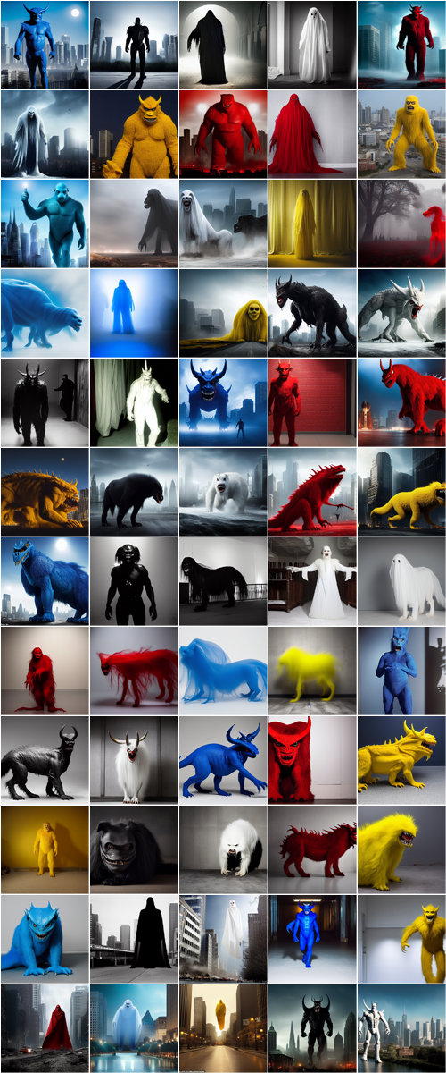
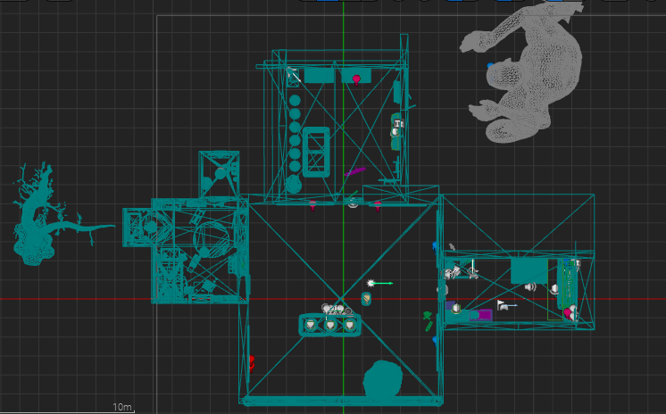
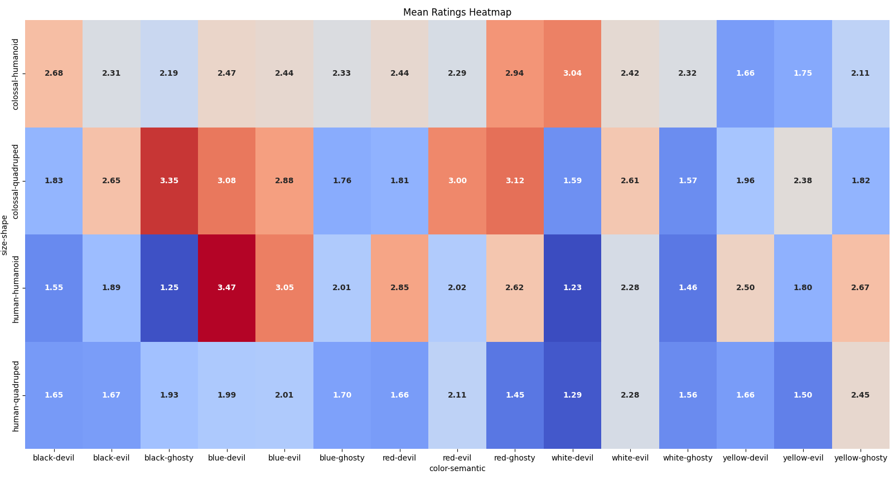


Investigating the Perception of Scariness in Monsters
Student: Junye Qian, Supervisor: Dr. Anne Roudaut
University of Bristol, Department of Computer Science
Introduction
The perception of scariness in monsters has been a topic of interest for researchers and artists alike. This study aims to explore the factors that contribute to the perception of scariness in monsters, as well as to understand the psychological and sociocultural aspects that may influence these perceptions. Through a mixed-methods approach, including questionnaires, game development, and player feedback, this research will provide insight into the elements that make monsters scary and the potential implications for entertainment, media, and mental health.
After obtaining the results from a questionnaire, I developed a VR horror game called "Nightmare Canvas" using the UE5.1 engine. The game focuses on the category of monsters identified as the most frightening in the questionnaire, and aims to evoke a sense of fear in players through the immersive environment of VR.
Game level design map
1. Project Introduction
2. Main Problem/Deliverable
This project is significant as it can help game developers and designers create more immersive and engaging horror experiences for their audience. While previous studies have explored the perception of fear, this project focuses on the factors that contribute to the perception of scariness in monsters and utilizes mixed-methods, including questionnaires and game development.
The end goal of this project is to provide valuable insights into the elements that make monsters scary and apply these findings to create an immersive VR horror game. This game will then serve as a basis for validating research findings and improving player experience in horror games.
The main problem this project addresses is determining which factors contribute to the perception of scariness in monsters. By analyzing participant responses to a questionnaire and incorporating the findings into a VR horror game, the project aims to deliver an immersive and terrifying gaming experience that validates the research results. This includes factors such as monster size, shape, color, and semantic associations.
4. Progress and Status
Completed:
Conducted a questionnaire to identify factors contributing to the perception of scariness in monsters
Analyzed the questionnaire results
Developed a game outline based on research findings
Developed the VR horror game
Incomplete:
Conducting player testing and gathering feedback
Analyzing player feedback and heart rate data
Finalizing the game based on feedback and research findings
Open questions or problems:
Refining the image generation process for future research
Exploring the role of sound and music in enhancing the perception of scariness in monsters
Determining the effectiveness of different game design elements in amplifying the fear-inducing aspects of monsters
3. Preliminary Results
Preliminary results from the questionnaire show that factors such as larger monster size, humanoid shapes, and fear-inducing colors (blue and red) contribute to the perception of scariness in monsters. Semantic associations also play a role, with a potential trend indicating that evil semantics may be perceived as more terrifying than ghostly semantics.

