Slide 1
Repeat Buyers Prediction for E-Commerce
CECS 550: Pattern Recognition​
Spring 2023
Group: 5
Nikita Lalwani
Reema Pandya
Rishwa Patel
Rohan Borad
Varun Gunda
​
Instructor: Professor Mahshid Fardadi

Slide 2
Agenda
Introduction
Data Visualization
Feature Engineering
Data Statistics and Feature Ranking
Prediction Model
Model Evaluation

Slide 3
Introduction
Merchants attract a significant volume of new customers through promotions.
Although promotions can bring in a large number of new customers, many of them may only be interested in the deals and not become regular shoppers. To make the most of their marketing budget, it's crucial for merchants to distinguish between one-time deal seekers and potential loyal customers, and focus on cultivating the latter to improve the ROI.
B2C e-commerce websites possess the clickstream data and purchasing records of customers across all the merchants on their platform. This enables them to analyze the past behaviour and preferences of new customers and forecast their likelihood of making future purchases from a specific merchant.
Notes:
CDC data
death
Early detection . (fixing).
ML based soltions.
1 Minute

Slide 4
Data Visualization
Prediction Model
Model Evaluation
Feature Engineering
Data Statistics and Feature Ranking

Slide 5
Data Pre-processing
Feed data into pandas dataframes
Rename the seller_id column in user behavior logs to merchant_id
Take dataset from item id 641 to 800 inclusively
Combine user behaviour logs with user_profile and training data

Slide 6
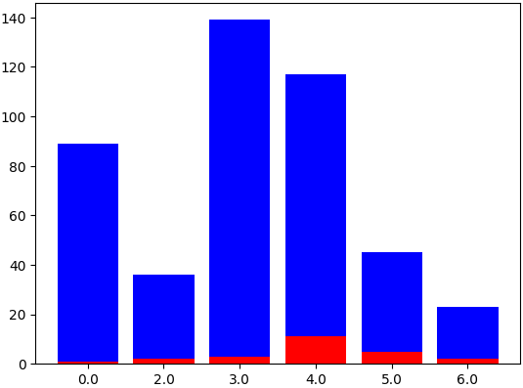
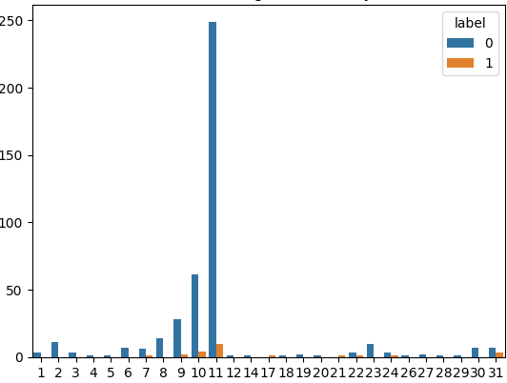
Data Visualization
Distribution of target variable by Gender
Distribution of target variable by Day
label
0
1
age_range
Day

Slide 7
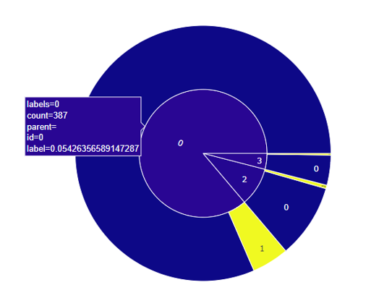
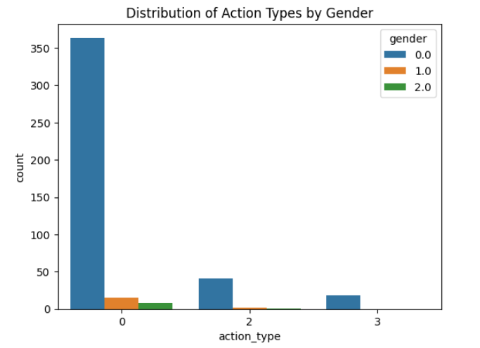
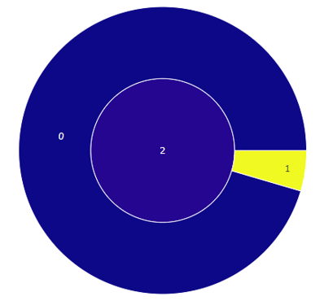
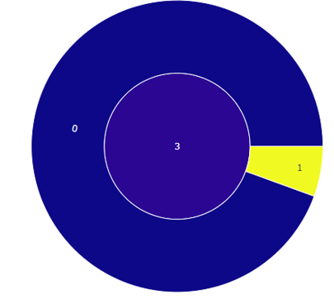
Count Plot for action_type and label
Distribution of action_type by Gender

Slide 8
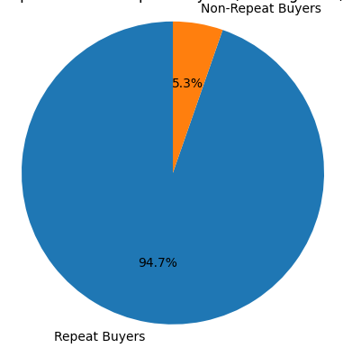
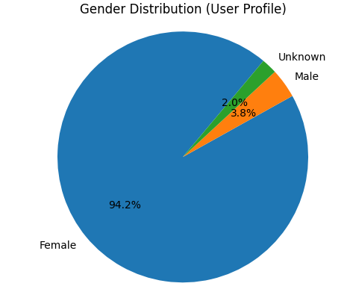
Repeat vs Non-Repeat buyers (Training Data)
Gender Distribution (User Profile)

Slide 9
Feature Engineering
user_info
user_id
age_range
gender
age_range
0 and NULL for unknown
1 for <18
2 for [18,24]
3 for [25,29]
4 for [30,34]
5 for [35,39]
6 for [40,49]
7 and 8 for >=50
gender
0 for female
1 for male
2 and NULL for unknown

Slide 10
Feature Engineering
action_type
0 for click
1 for add-to-cart
2 for purchase
3 for add-to-favorite
user_log
user_id
item_id
cat_id
merchant_id
brand_id
time_stamp
action_type
time_stamp
day
month
action_type
activity_count

Slide 11
Feature Engineering
user_id, merchant_id, day
cat_id (user_merchant_day_cat_count)
merchant_id
item_id (merchant_item_count)
brand_id (merchant_brand_count)
cat_id (merchant_cat_count)
user_id
merchant_id(user_merchant_count)
cat_id (user_cat_count)
brand_id (user_brand_count)

Slide 12
Feature Engineering
merchant_id
item_id
brand_id
cat_id
user_id
merchant_id
cat_id
brand_id
user_id, merchant_id
brand_id (user_merchant_brand_count)
cat_id (user_merchant_cat_count)

Slide 13
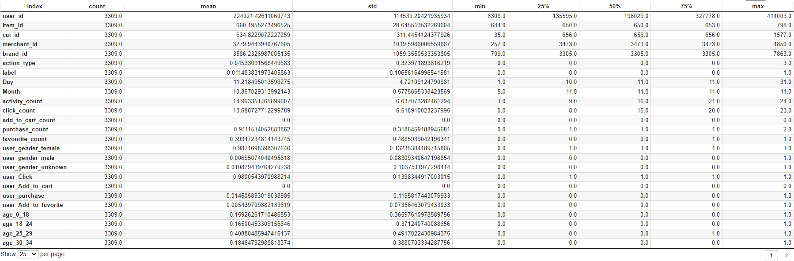
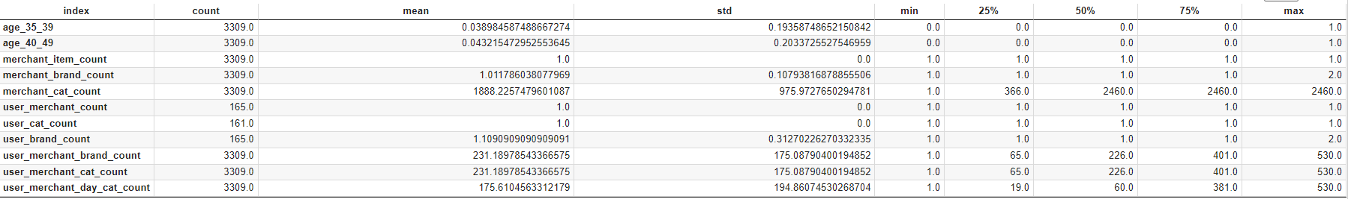
Statistical Analysis

Slide 14
Mutual Information Classifier
Mutual information(MI)between two random variables is a non-negative value, which measures the dependency between the variables. It is equal to zero if and only if two random variables are independent ,and higher values mean higher dependency.
In short, it is the amount of information one variable gives about the other.

Slide 15
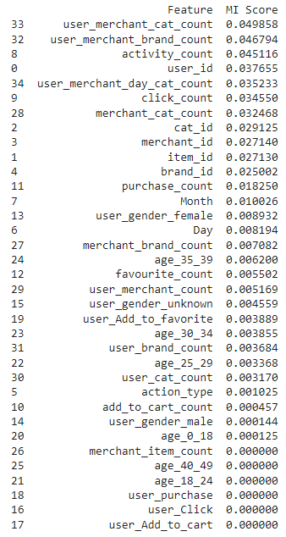
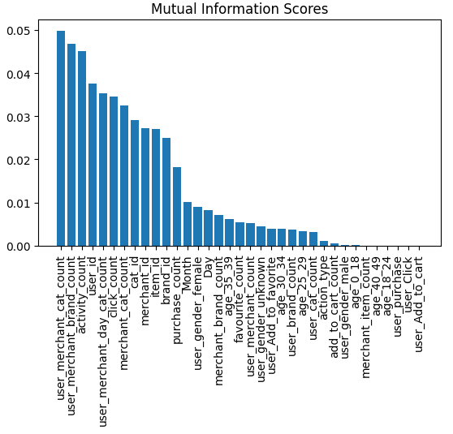
Mutual Information Classifier

Slide 16
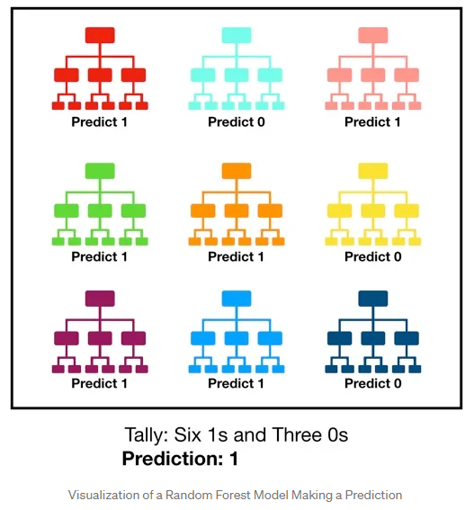
Random Forest Classifier
Random forest, like its name implies, consists of a large number of individual decision trees that operate as an ensemble. Each individual tree in the random forest spits out a class prediction and the class with the most votes becomes our model’s prediction.

Slide 17
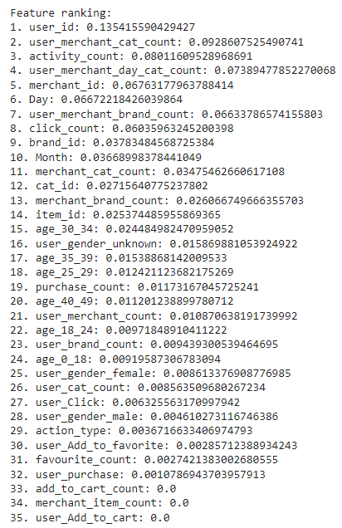
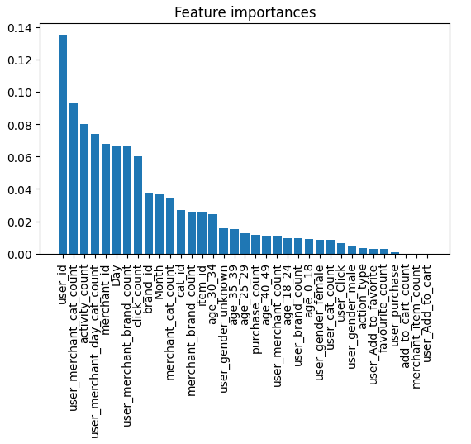
Random Forest Classifier

Slide 18
XGB Classifier
XGBoost is also useful for finding feature importance because it provides a way to calculate the relative importance of each feature in the dataset.
The algorithm calculates a score for each feature based on how much it contributes to reducing the error in the model. The higher the score, the more important the feature is.
This information can be used to identify which features are most relevant to the target variable and to simplify the model by removing less important features.
Overall, XGBoost's ability to handle complex datasets and provide feature importance scores make it a useful tool for identifying important features in a dataset.

Slide 19
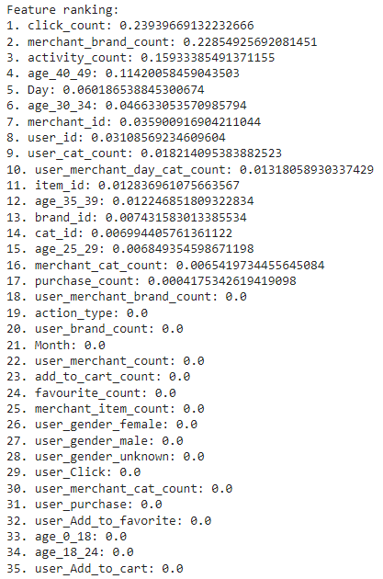
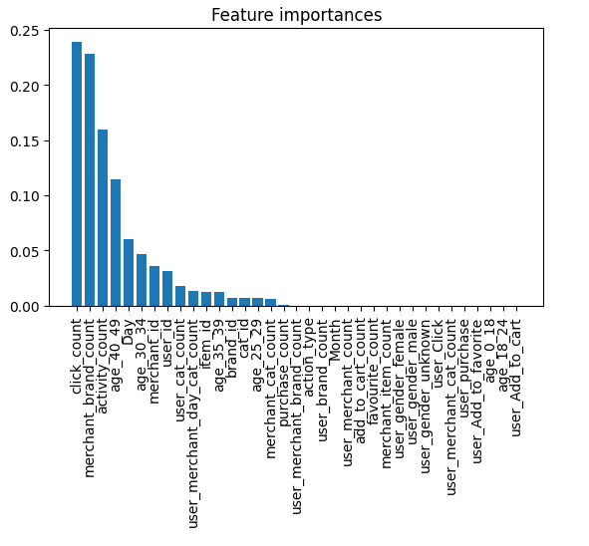
XGB Classifier

Slide 20
Permutation Feature Importance
Permutation feature importance is a useful technique for finding feature importance because it provides an estimate of how much each feature contributes to the model's performance.
It works by randomly shuffling the values of a feature and measuring the resulting decrease in the model's performance. The greater the decrease in performance, the more important that feature is to the model.

Slide 21
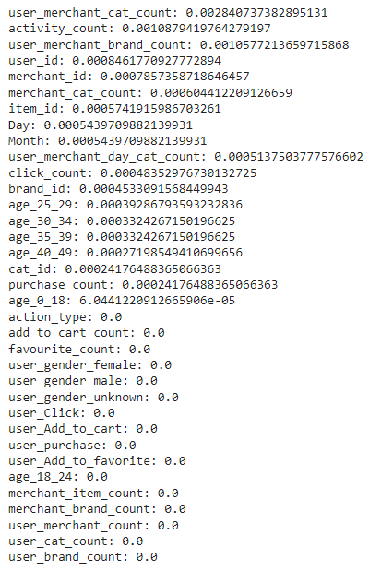
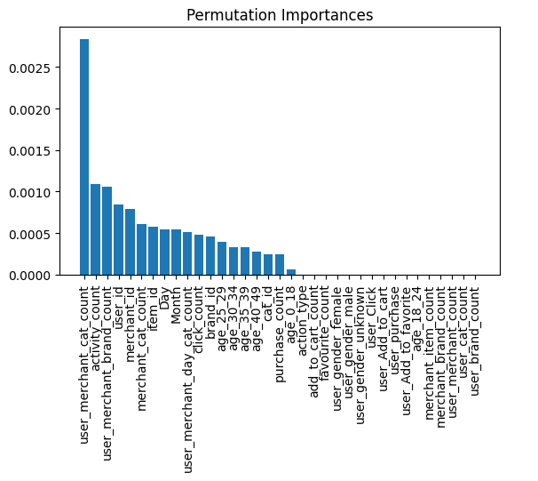
Permutation Feature Importance

Slide 22
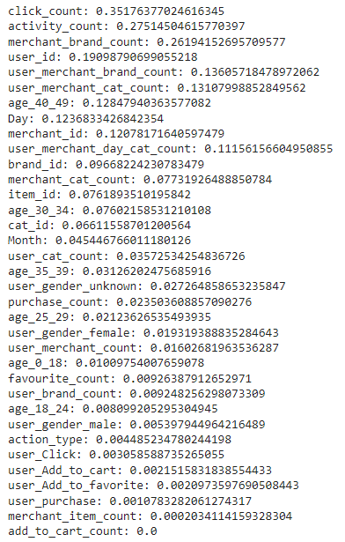
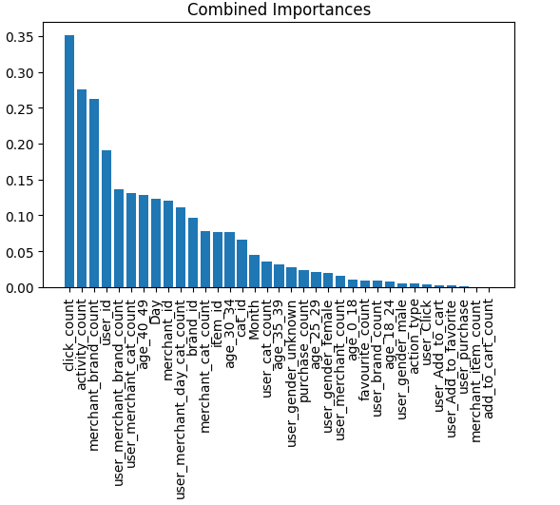
Combined Feature Importance

Slide 23
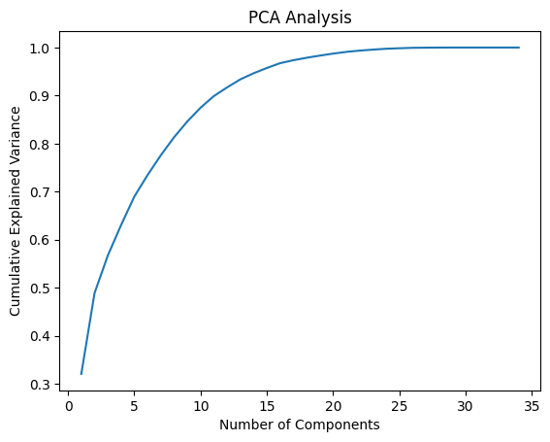
Principal Component Analysis
Based on the plot generated, the optimal number of components selected are 15.

Slide 24
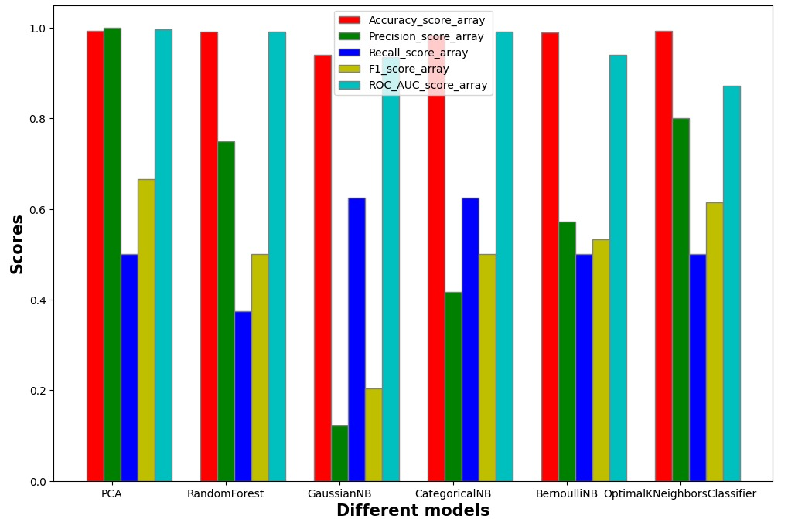
Model Evaluation

Slide 25
References
https://towardsdatascience.com/understanding-random-forest-58381e0602d2
https://medium.com/@techynilesh/xgboost-algorithm-explained-in-less-than-5-minutes-b561dcc1ccee
https://scikit-learn.org/stable/modules/permutation_importance.html#:~:text=The%20permutation%20feature%20importance%20is,model%20depends%20on%20the%20feature.
Notes:
Trustworthy predictions for high-risk decision making.
Algorithm agnostic – use any algorithm; only requirement is designing a non-conformity score for each algorithm.
optimization of density estimation based on neural networks.

Slide 26
https://towardsdatascience.com/understanding-random-forest-58381e0602d2https://towardsdatascience.com/understanding-random-forest-58381e0602d2

