Slide 1
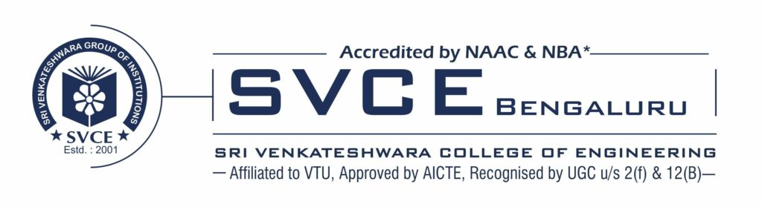

Name- PUSHKAR RANJAN
Registered maid-id- pushkarranjan.2502@gmail.com
College Name - Sri Venkateshwara College of Engineering
College State - Bangalore, Karnataka- 562157
Internship domain, Start date & End date - Cyber Security, 13th Oct ,2023 to 26th Nov,2023

Slide 2
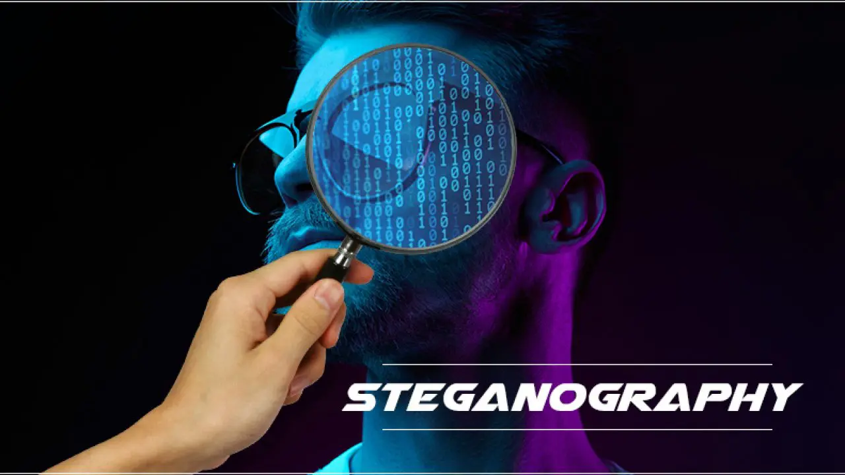
PROBLEM STATEMENT/ PROJECT TITLE: Hide the text in an Image (Steganography)

Slide 3
AGENDA:
The purpose of steganography is to conceal and deceive. It is a form of covert communication that can involve the use of any medium to hide messages. Steganography is not a form of cryptography, because it doesn't involve scrambling data or using a key. Instead, it is a form of data hiding.
The main motive of steganography is to hide the intended information within any image/audio/video that doesn't appear to be secret just by looking at it. For example, a steganography technique involves hiding sensitive information within an ordinary, non-secret file or message, so that it will not be detected. The sensitive information will then be extracted from the ordinary file or message at its destination, thus avoiding detection.
Digital steganography is one of the important components in the toolboxes of spies and malicious hackers, as well as human rights activists and political dissidents.

Slide 4
PROJECT OVERVIEW
Purpose
Scope
Objectives

Slide 5
Purpose:
The primary purposes of steganography include:
Concealment: The main purpose of steganography is to hide the fact that communication is taking place, rather than hiding the content of the communication. This can be useful in situations where revealing the existence of a message could be detrimental.
Covert Communication: Steganography provides a means for covert communication. By embedding messages within seemingly innocuous data, individuals or organizations can exchange information without attracting attention.
Security: Steganography can enhance the security of communications by providing an additional layer of concealment. If an adversary is not aware that hidden information exists, they are less likely to attempt to intercept or manipulate it.
Digital Watermarking: Steganography is often used for digital watermarking, where information is embedded within multimedia files (such as images or audio) to identify the creator or authenticate the content. This can be useful for copyright protection and digital forensics.
Data Integrity: Steganography can be employed to ensure the integrity of data by embedding additional information that can be used to verify the authenticity of the original data.

Slide 6
Scope:
Communication Security:
Military and Intelligence: Steganography can be used by military and intelligence agencies for covert communication, allowing them to exchange information without attracting attention.
Law Enforcement: Investigative agencies may use steganography to hide communication during surveillance or undercover operations.
Digital Forensics:
Evidence Authentication: Steganography is employed in digital forensics to authenticate digital media and ensure that it has not been tampered with.
Watermarking: Digital watermarking, a form of steganography, is used to embed information in multimedia files to identify the source or owner.
Copyright Protection:
Steganography is used for embedding invisible watermarks in digital content, such as images, videos, and audio, to protect intellectual property and trace unauthorized use.

Slide 7
Objective:
Data Protection:
Digital Watermarking: Steganography is employed for digital watermarking, where information is embedded in multimedia content to protect intellectual property, prove ownership, or trace unauthorized use.
Authentication:
Digital Forensics: In the realm of digital forensics, steganography is used to authenticate digital media by verifying the integrity of files and ensuring they have not been tampered with.
Privacy Preservation:
Personal Privacy: Individuals may use steganography to protect their privacy by concealing sensitive information within seemingly innocuous data.
Anti-Forensics:
Evasion of Detection: Malicious actors may use steganography to hide malicious code or communication to evade detection by security systems and forensic tools.

Slide 8
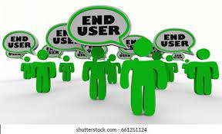
Who are the end users?
Military and Intelligence Agencies:
These organizations may use steganography for covert communication to exchange sensitive information without drawing attention.
Law enforcement:
Investigative agencies may employ steganography for surveillance and undercover operations to conceal communication and gather intelligence.
Corporate Sector:
Companies may use steganography for securing confidential business information, trade secrets, or communication between different branches.
4.Journalists and Activists:
Individuals operating in environments with restricted freedom of speech may use steganography to communicate sensitive information discreetly.
5.Individuals Concerned with Privacy:
Everyday individuals may use steganography to protect their personal privacy by hiding sensitive information within seemingly harmless files.

Slide 9
My solutions & its value preposition:
Text Steganography:
Embedding information within a text document by subtly altering the characters, words, or formatting. This can include hiding messages in whitespace, changing the font style, or using less noticeable characters.
Image Steganography:
Hiding information within digital images. Common methods include altering the least significant bits (LSB) of the pixel values, hiding text in the color channels, or using frequency domain techniques like discrete cosine transform (DCT).
Audio Steganography:
Concealing information within audio files. This can be achieved by modifying the least significant bits of the audio samples, exploiting the imperceptible changes to the human ear.
Video Steganography:
Similar to image steganography, but applied to video files. Concealing information within the frames or altering specific frames subtly to embed a message.
Steganography provides a new solution using a sensitive approach providing protection to the covert communication between the trusted parties. Thus, digital steganography makes the information transfer involved in the covert communication more reliable and secure.

Slide 10
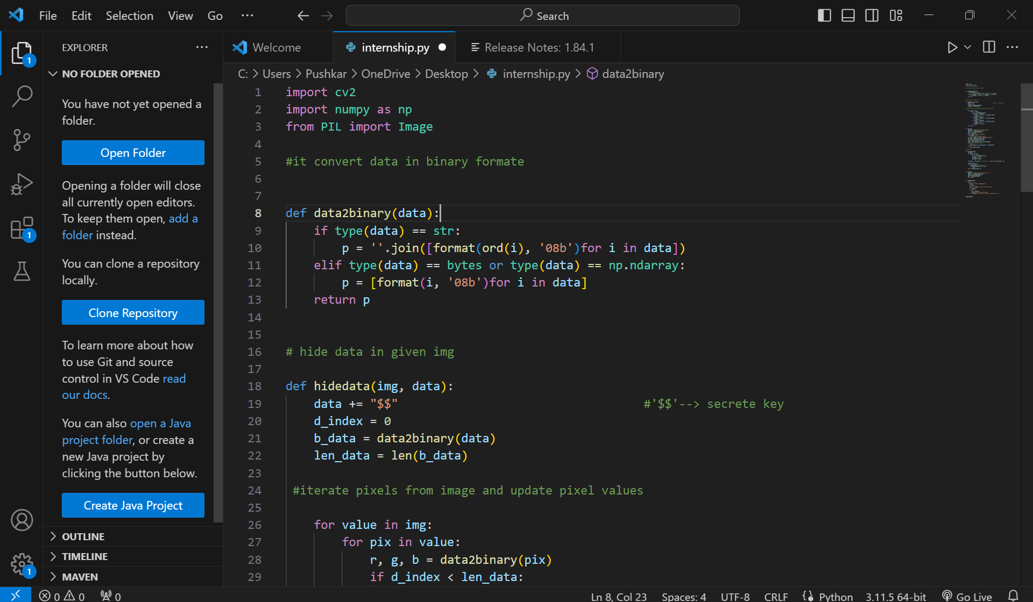
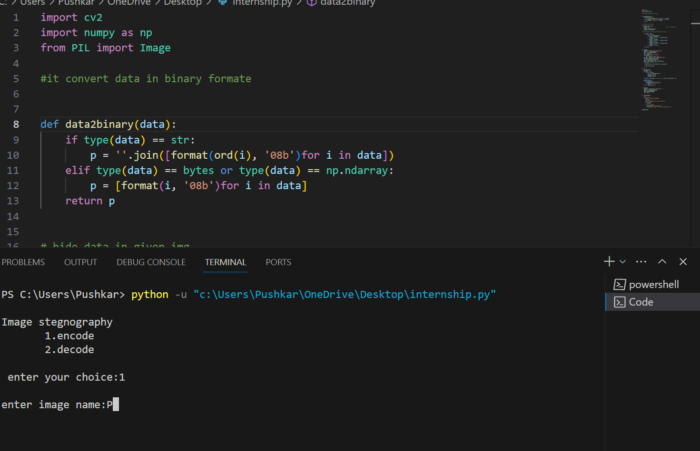
Modelling: I have used the VISUAL CODE STUDIO software to design my project which helps me to create an effective project.

Slide 11
Result for the Project:
Security and Privacy:
Positive Result: Steganography can be used as a tool for enhancing security and privacy. By hiding messages within innocent-looking carriers (such as images or audio files), individuals or organizations can communicate without drawing attention to the fact that a hidden message exists.
Negative Result: Criminals and malicious actors can also use steganography to hide malicious code or data within seemingly harmless files, making it difficult for security systems to detect and prevent unauthorized activities.
Cybersecurity Threats:
Positive Result: Steganalysis, the practice of detecting and analyzing hidden messages, is a growing field in cybersecurity, helping organizations identify and prevent potential threats hidden through steganographic techniques.
Negative Result: As steganography techniques advance, there is an ongoing cat-and-mouse game between those who seek to hide information and those who aim to detect it.

Slide 12
Google Drive Link for Project:
https://drive.google.com/file/d/1vZgXyhbksoxJ5M-bD8VkOM5fmvBWuADo/view?usp=drive_link

