Slide 1
Quickly Computing the Mandelbrot Numbers
MA553 – Dr. Khanal
Fall 2022 Final Project
Tyler Procko

Slide 2

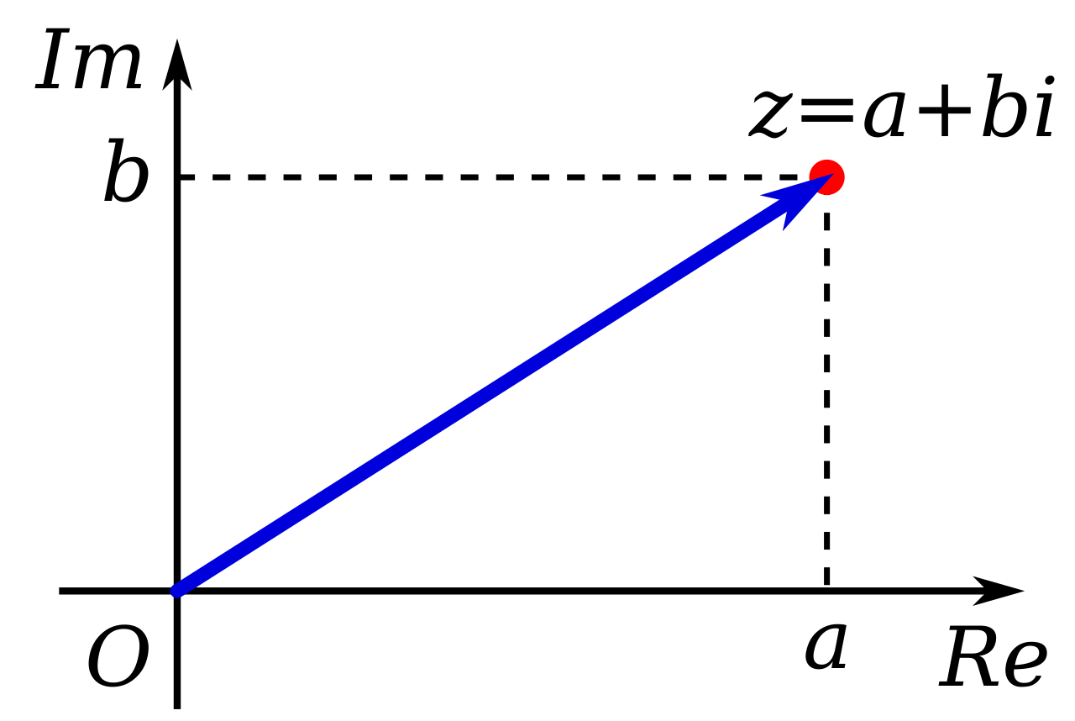

The Mandelbrot Set
A set of complex numbers that forms a repeating fractal when plotted on the complex plane
  Complex numbers are represented as a pair of numbers (a, b), of the form
  c = a + bi, where i is the imaginary number
To know if a complex number, c, is part of the Mandelbrot set, perform the following calculation:
$$\left\{\begin{aligned}&z_{0}= 0 \\ &z_{n+1}=z_{n}^{ 2}+c\end{aligned}\right.$$
The complex number, c, is part of the Mandelbrot set if, for all n > 0, the absolute value of z does not diverge to infinity
The number of iterations it takes for z to diverge is called the escape count
Interesting to note:
  On the complex plane, the Mandelbrot set fits within a circle of with a radius of 2, (the radius of divergence) which can be used as a hard limit for stopping computation

Slide 3
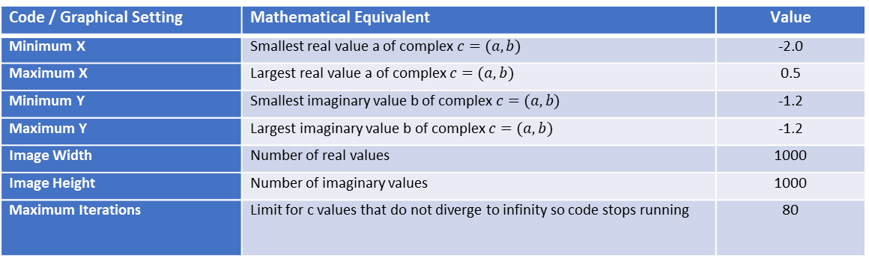
Input Values
The Mandelbrot set is not very interesting unless we plot it, so we need a large amount of values
Baseline is an image of 1000x1000 (1-million individual) pixels
In code, each pixel is a complex number that is checked as being part of the Mandelbrot set
So, 1,000,000 complex numbers are checked up to 80 times each
  Or until the number escapes (diverges to infinity)
Code / Graphical Setting | Mathematical Equivalent | Value
Minimum X | Smallest real value a of complex $c=(a,b)$ | -2.0
Maximum X | Largest real value a of complex $c=(a,b)$ | 0.5
Minimum Y | Smallest imaginary value b of complex $c=(a,b)$ | -1.2
Maximum Y | Largest imaginary value b of complex $c=(a,b)$ | -1.2
Image Width | Number of real values | 1000
Image Height | Number of imaginary values | 1000
Maximum Iterations | Limit for c values that do not diverge to infinity so code stops running | 80

Slide 4
Quick Summary

Slide 5
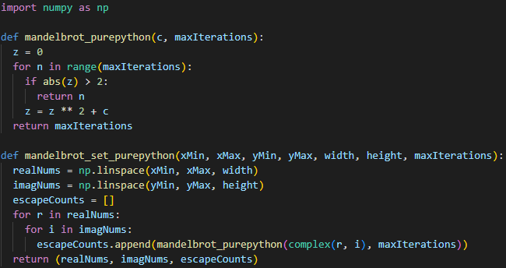
Baseline Pure Python – 5.3 seconds
Pretty slow…
Uses Python’s built-in complex type, which is an object
  Equivalent to doing real + imaginary * 1j
    Python recognizes j after a number as meaning imaginary
  Keep this in mind
Changing z = z ** 2 + c to z = z * z + c improved speed around 40%, to 3.6 seconds
  This is a low-level optimization; Python square exponent calculations are slower than just multiplying the number by itself

Slide 6
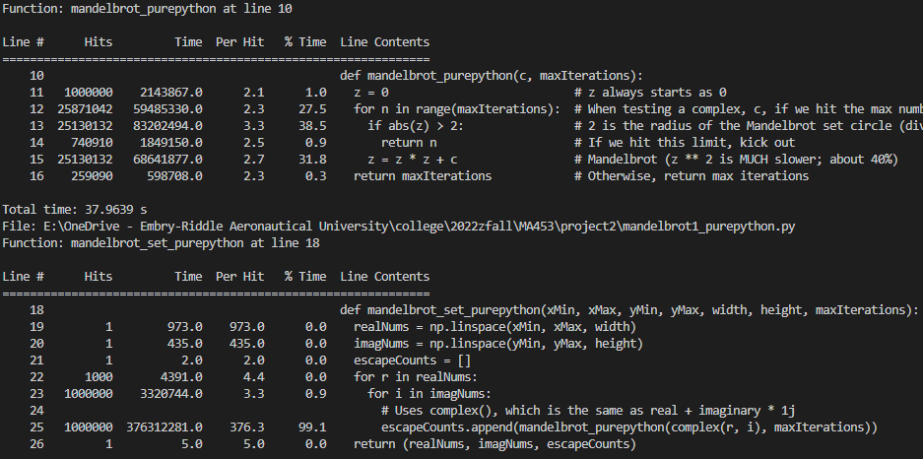
Profiling
Baseline acquired; now we profile
The first function is the actual Mandelbrot code
The second is the array setup
In the first:
  We can speed things up using NumPy array elementwise operations instead of a double for loop on a list
In the second:
  The if statement Mandelbrot divergence check takes up most of the time, followed by the calculation of the new z
    We can optimize if statements
    We can optimize the calculation of the new z

Slide 7
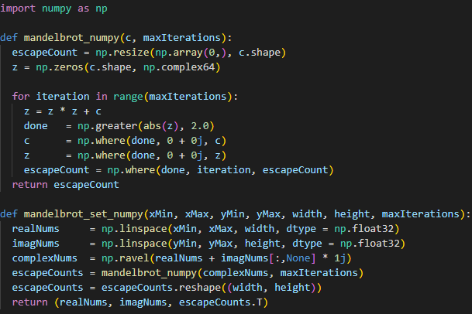
NumPy – 1.85 seconds
Uses the np.where function, which returns an array given a Boolean condition
  Faster than if statements
Does not use Python’s complex object type, and instead constructs complex numbers manually
  Less Python class overhead means faster execution
Uses a NumPy array for the complex numbers instead of a list
  Now we can call the Mandelbrot function on the entire array
    Fast!
Specifying dtype declarations of np.float32 improved speed to 1.23 seconds
  This is because it was defaulting to np.float64

Slide 8
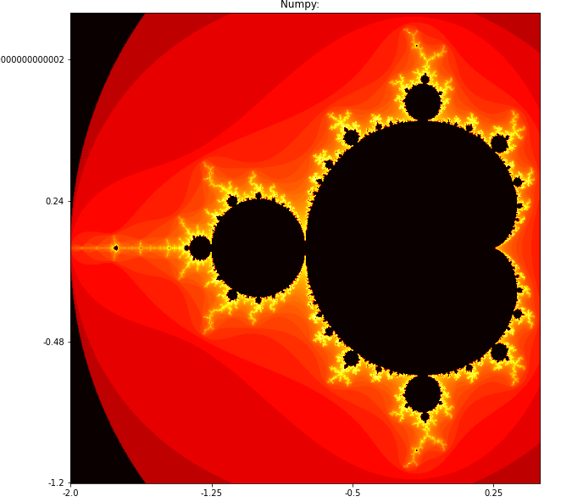
Visualizations
Validation of the code’s accuracy with the default input values
Yay ☺

Slide 9
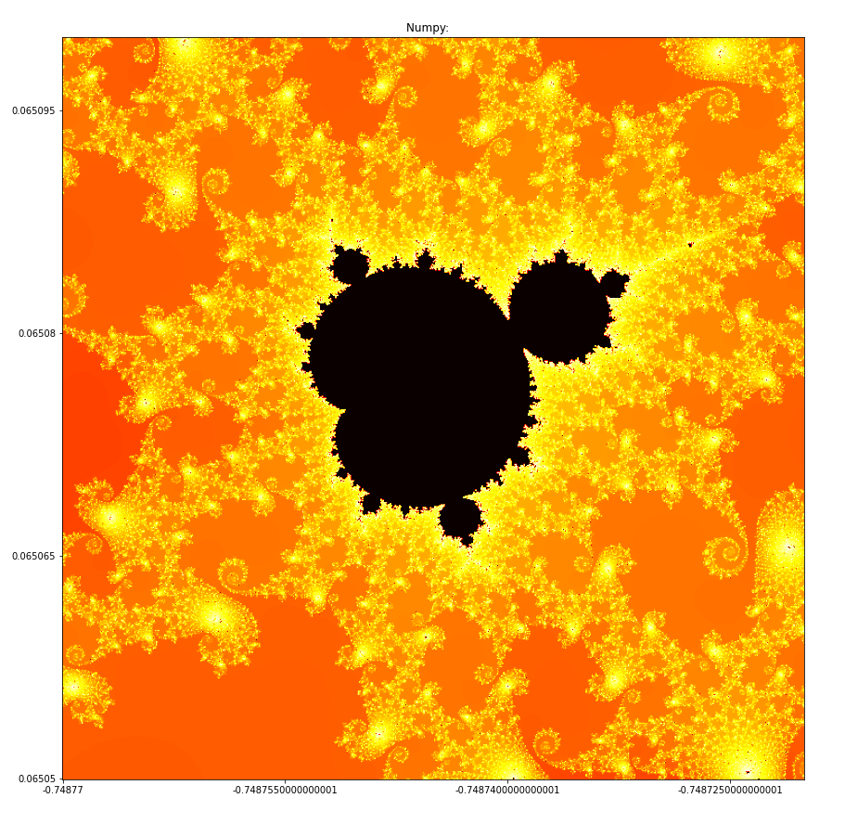
Visualizations (Cont.)
You must Google interesting input values to get prettier visualizations
Just trying random numbers often provides boring visualizations

Slide 10
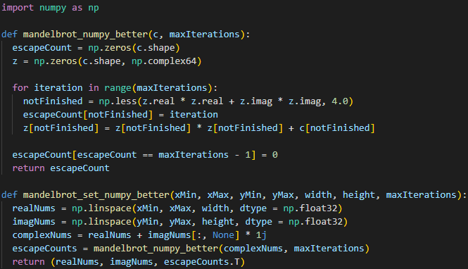

Better NumPy - .85 seconds
The biggest optimization here is in redoing the check if abs(z) > 2
  Python’s abs() function has overhead and is very slow
Recall, this is the divergence check: when the function is greater than 2 from the origin, it diverges to infinity
We can replace this check with:
if $x^{2}+y^{2}>4$
This comes from the Pythagorean theorem
We optimize it further by using NumPy’s less() function in place of standard > or <

Slide 11
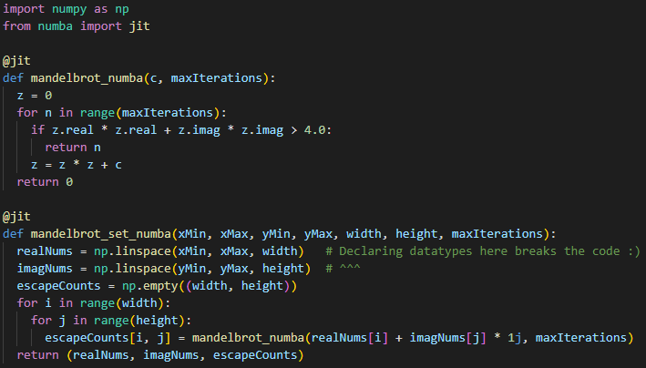
Numba - .24 seconds
Essentially the same as the pure Python code
Uses the Pythagorean theorem trick
Just adding the @jit decorator makes the code faster than anything thus far

Slide 12
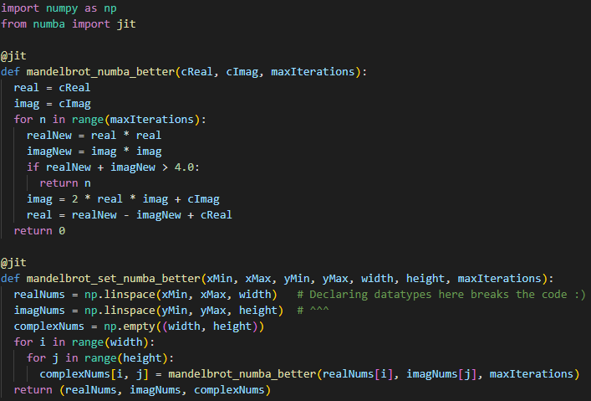

Better Numba - .14 seconds
Breaks up the complex into its real and imaginary parts
  Makes computing z = z * z + c faster
Consider a complex number, a + bi
  Squaring it produces
  $$\left(a^{2}−b^{2}\right)+\left(2ab\right)i$$
  To calculate the next z:
  $$\left(a^{2}−b^{2}\right) ≡realNew−imagNew+cReal$$
  $$\left(2ab\right)i ≡2∗real∗imag+cImag$$

Slide 13
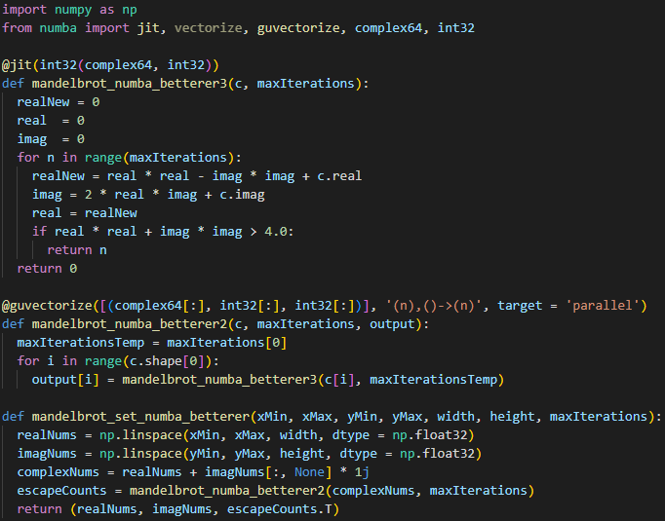
Guvectorized Numba - .01 seconds
The @guvectorize decorator is Numba’s generalized universal function decorator, built specifically for parallelizing multi-dimensional array operations
  I.e., it’s exactly what we want
Made a wrapper function because @guvectorize only takes arrays as input
  Everything else is the same as the last Numba code
Recall, the pure Python code took over 5 seconds
  Numba magic ☺

Slide 14
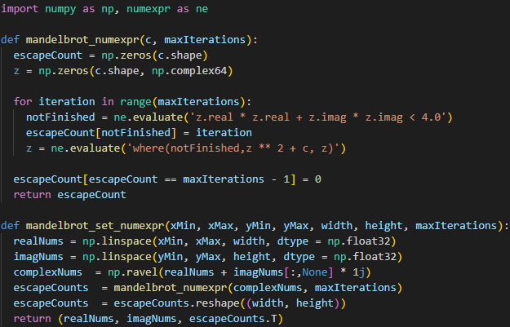
Numexpr - .45 seconds
Similar to the NumPy code
Just uses Numexpr
Decently fast

Slide 15
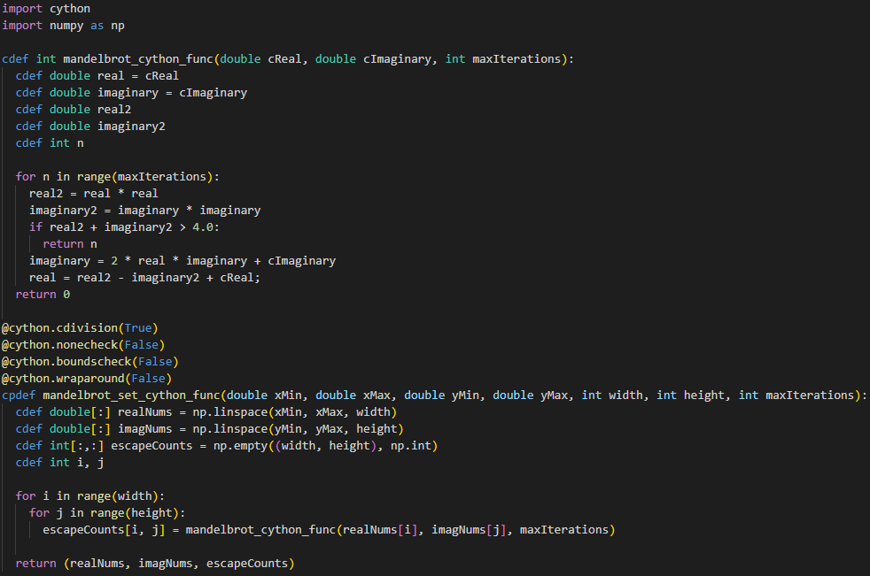
Cython - .06 seconds
Typical Cython code
Extremely fast with minimal effort
Just takes a mapping of the Python code to cdefs
Not parallelized (e.g., with prange)
  Kept getting classic GIL errors
Could definitely be made much faster

Slide 16
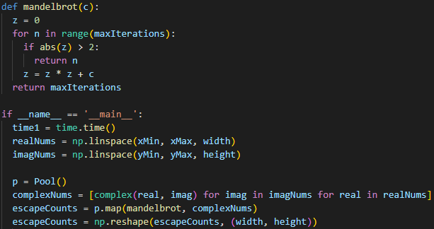


Multiprocessing – 1.34 seconds
All the codes thus far use a double for loop to generate complex numbers to be checked
These complex numbers can be calculated independently of one another
  I.e., it is an embarrassingly parallel array population problem
  And the parallel map function can be used to aggregate all the results for every complex number
  became...

Slide 17
Initial Timings
Using my test suite, each technique was run 5x to get an average execution time instead of just one, to be more representative
Guvectorized Numba took .28% of the time as the pure Python code, a speedup of 360x
Technique | Initial Timing (seconds) | % decrease from original | x speedup from original
Pure Python | 3.6 | -
Numpy | 1.23 | 65.83% | 2.93x
Better Numpy | .85 | 76.39% | 4.24x
Numba | .24 | 93.33% | 15x
Better Numba | .14 | 96.11% | 25.71x
Betterer (guvectorized) Numba | .01 | 99.72% | 360x
Numexpr | .45 | 87.5% | 8x
Cython | .06 | 98.33% | 60x
Multiprocessing | 1.34 | 62.78% | 2.69x

Slide 18
Scalability
Wrote some code to iteratively increase image size to see how the different methods scale
Took 30 minutes each run so I had to stop eventually ☺

Slide 19
Scalability (Cont.)
Pure Python is slowest in all cases
Guvectorized Numba is best in all cases
Cython did very well in all cases
Multiprocessing began to do better with larger images
  Parallelization scales well, it seems
Technique | Timing in seconds (smallest input value) | Technique | Timing in seconds (largest input value)
Pure Python | 3.46 | Pure Python | 1781.76
Multiprocessing | 1.34 | Numpy | 773.96
Numpy | 1.24 | Better Numpy | 497.83
Better Numpy | .77 | Numexpr | 243.92
Numexpr | .45 | Multiprocessing | 83.27
Numba | .31 | Numba | 41.07
Better Numba | .18 | Cython | 40.20
Cython | .07 | Better Numba | 39.97
Guvectorized Numba | .01 | Guvectorized Numba | 6.99

Slide 20
Guvectorized Numba
With an image of 32,000x32,000 pixels, guvectorized Numba only took 6 minutes
  This is 1-billion complex numbers
  Recall, Pure Python took 6 minutes for a 5000x5000 image
We get the benefit of an embarrassingly parallel array-heavy problem coupled with a JIT compiler
Guvectorized Numba is incredibly fast
  It beat every other optimization technique across every image size

Slide 21
Biggest Future Optimization
Split horizontally, the Mandelbrot set is symmetrical
I.e., we only need to compute half the Mandelbrot numbers, then mirror them, effectively cutting our number of computations in half!
In code, compute the array of complexes like normal, but stop halfway through, then flip the array and append it to itself
+
=

Slide 22
Conclusion
Computer specs:
  OS: Windows 10
  CPU: i9-9900k @5.0GHz
  GPU: RTX 3080 10GB GDDR6
  RAM: 32GB DDR4 @3200MHz
Pretty fun problem with a nice visualization to check accuracy with
Embarrassingly parallel problem, but with many low-level optimizations that were done
A lot of potential future work
  E.g., Pythran/PyPy Interpreter, PyCUDA, PyOpenCL, Tensorflow, etc.
In the end, parallel Numba was the simplest and easiest
  Basically, just adding decorators and adhering to function input templates
    No significant change of code
  JIT compiler + automatic parallelization on large, independent array operations = blazing speed
Thank you ☺

