Slide 1


Dissertation Defense: On the Provenance of Software Systems: Automating Software Traceability with Knowledge Graph and Large Language Model Synergy
Tyler Thomas Procko
Advisor: Dr. Omar Ochoa
Committee: Dr. Nicholas Del Rio, Dr. Massood Towhidnejad, Dr. Keith Garfield, Dr. Alex Vargas
April 21st, 2025 - 1pm EST
Embry-Riddle Aeronautical University, LB373
Daytona Beach, Florida

Slide 2
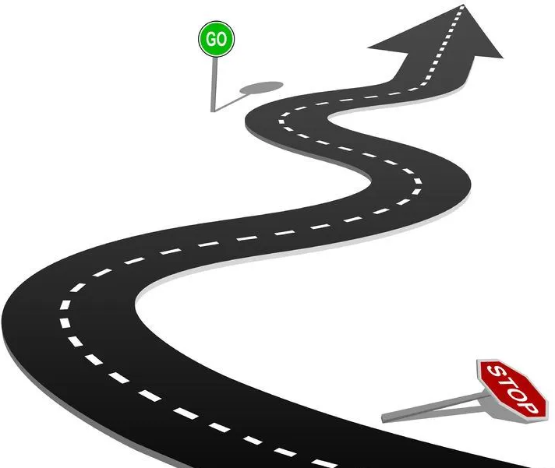
Presentation Outline
Introduction
Research Questions
Background
Implementation: ProvTracer
Evaluation: Case Studies
Research Questions Answered
Addressing NFRs
Related Work
Limitations and Concerns
Future work
Conclusion

Slide 3
Acronyms
GPT: Generative Pre-trained Transformer
KG: Knowledge Graph
MLLM: Multimodal Large Language Model

Slide 4
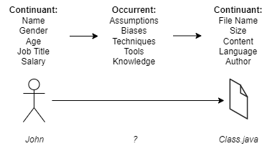
Introduction: Artifact and Process
Software artifacts are delivered daily…
But there is no record of their creation
Developer motivations, influences, etc.
In philosophical terms:
Continuant: artifacts created
Occurrent: processes of artifact creation
Artifacts are visible
Processes are invisible
We are blind to how code is born

Slide 5
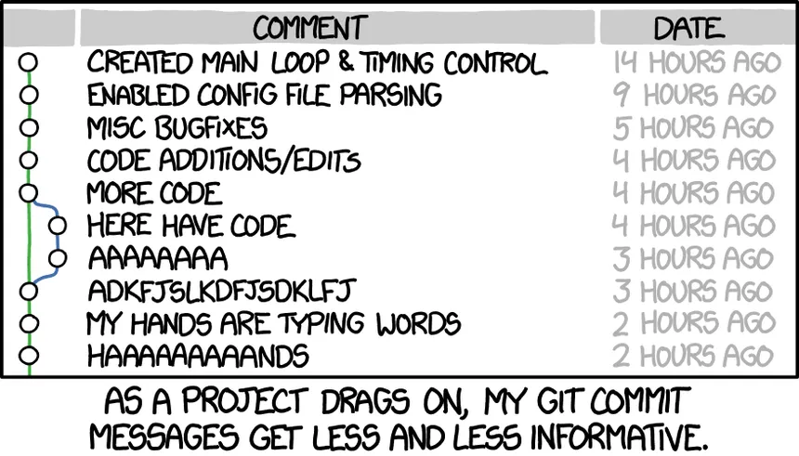
Introduction: An Example
A developer spends 6 hours on code and pushes it to GitHub with a commit message “lots of changes”
Where is the provenance? The explanation? The reasoning?
Gone, because of a poor commit message
Otherwise it is in code comments (BAD)
So…
Can we record provenance in real-time as the developer works so they don’t have to?
Notes:
Seems exaggerative, but common

Slide 6
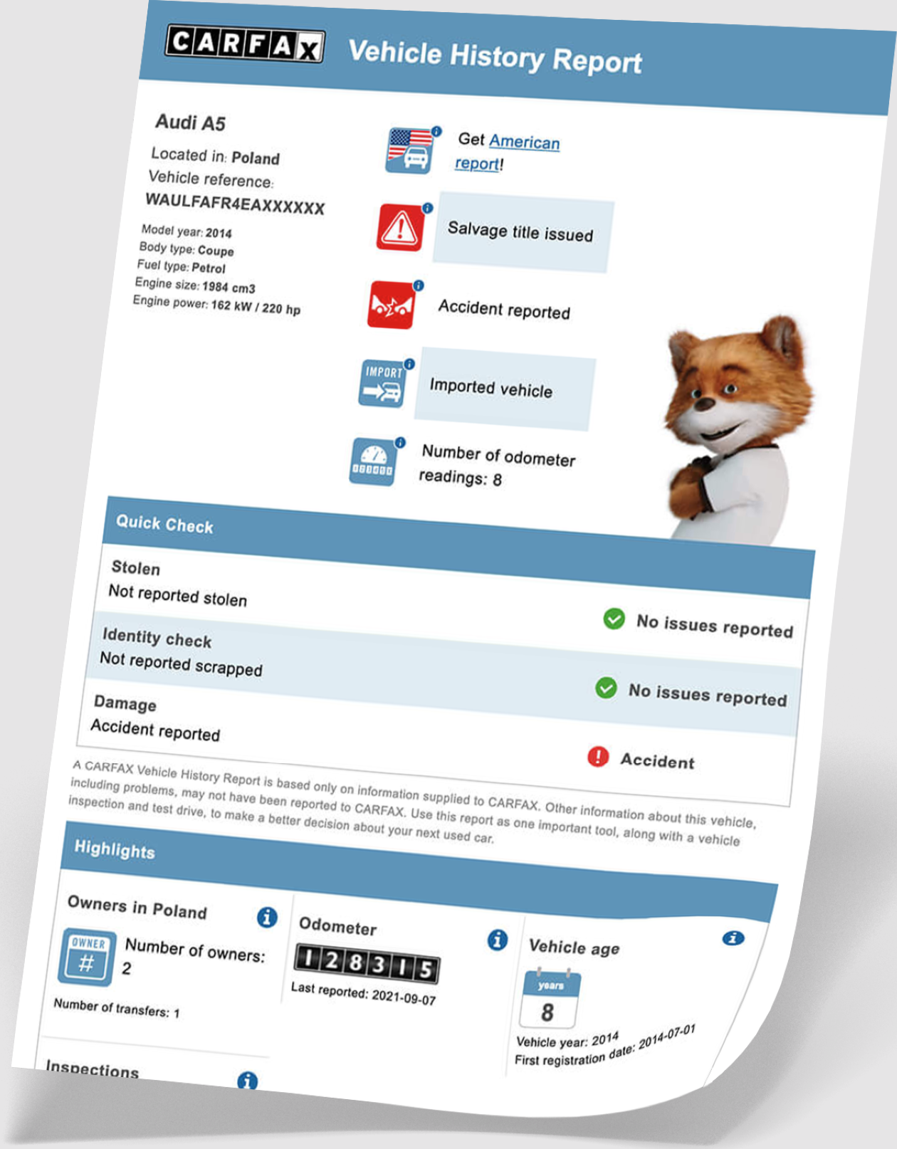
Introduction: Provenance
The World Wide Web Consortium (W3C) defines provenance as the:
“… information about entities, activities, and people involved in producing a piece of data or thing, which can be used to form assessments about its quality, reliability or trustworthiness”
L. Moreau, P. Missier, K. Belhajjame, R. B'Far, J. Cheney, S. Coppens, S. Cresswell, Y. Gil, P. Groth, G. Klyne, T. Lebo, J. McCusker, S. Miles, J. Myers, S. Sahoo and C. Tilmes, "PROV-DM: The PROV Data Model," W3C, 2013. [Online]. Available: https://www.w3.org/TR/2013/REC-prov-dm-20130430/.

Slide 7
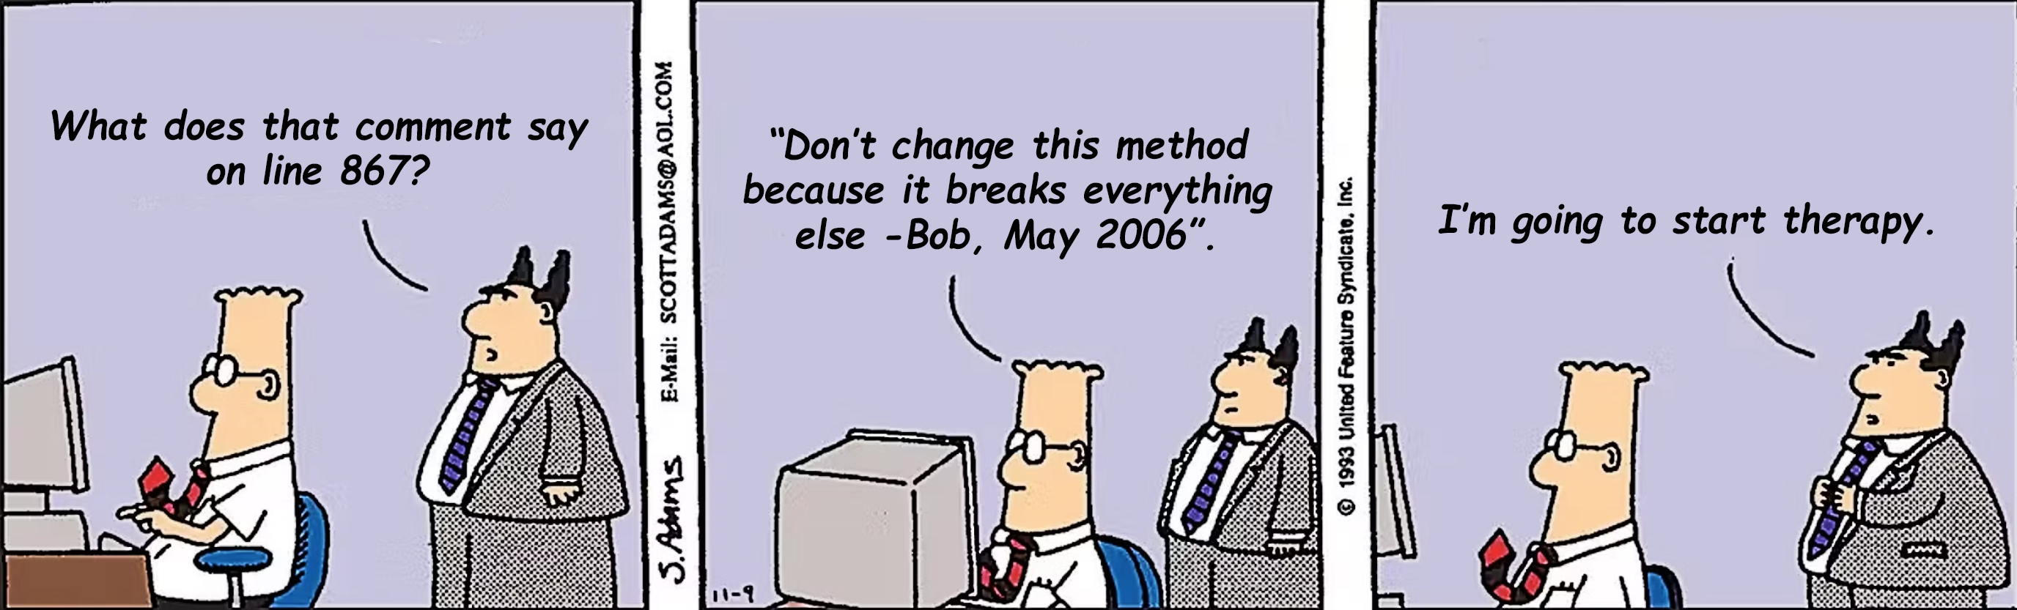
Introduction: Get It?

Slide 8
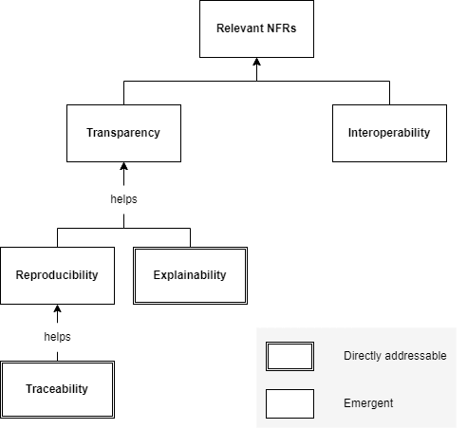
Introduction: Goal NFRs
Traceability: the ability to link software artifacts and traces to understand a product and its development process
Explainability: the degree to which a trace can be understood by humans to explain why something happened
Information Overload: the condition where the volume/complexity of data exceeds a user's ability to process it
These are “freebies”:
Reproducibility: How easy is it to reproduce?
Transparency: How available or open is it?
Interoperability: How easy is it to integrate?
Notes:
Reproducibility: How easily can the results or artifacts be recreated using the captured process and data?
Transparency: How accessible and understandable are the process, data, and decisions involved?
Interoperability: How easily can the system or data integrate with other tools, standards, or platforms?

Slide 9
Introduction: Goal Statement
The goal of this work is summarized in the goal format of Wohlin et al.:
To analyze the digital research process, in particular, the SDLC, for the purpose of evaluating and capturing relevant provenance sources with respect to their ability to engender transparency through explainable provenance traces, while avoiding information overload from the point of view of the software developers in the context of personal computer work.
C. Wohlin, P. Runeson, M. Höst, M. C. Ohlsson, B. Regnell and A. Wesslén, "Experimentation in software engineering," Springer Science & Business Media, 2012.
Notes:
This entire dissertation documents the reasoning behind a prototypical, experiment software application, so the reputable goal definition for experimental software is used.

Slide 10
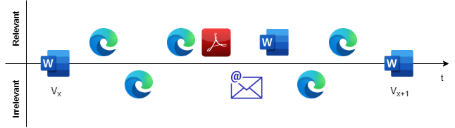
RQ 1
How can relevant provenance sources be distinguished from noise during digital software development work?
There are various artifacts interacted with during digital work
Not all of them are relevant; some are noise
Separating the two is essential for the future success of the work

Slide 11
RQ 2
How can the integration of a knowledge graph-based provenance system enhance the traceability and explainability of artifact development and maintenance within the SDLC?
Existing provenance tools often lack both semantic depth and human-readable explanations
None are automated…

Slide 12
RQ 3
What are the technical challenges and limitations in developing a system for the automatic, real-time serialization of SDLC provenance, and how can these challenges be mitigated?
Because of the novelty of the system, challenges and limitations are inevitable
This RQ is important for guiding future research

Slide 13


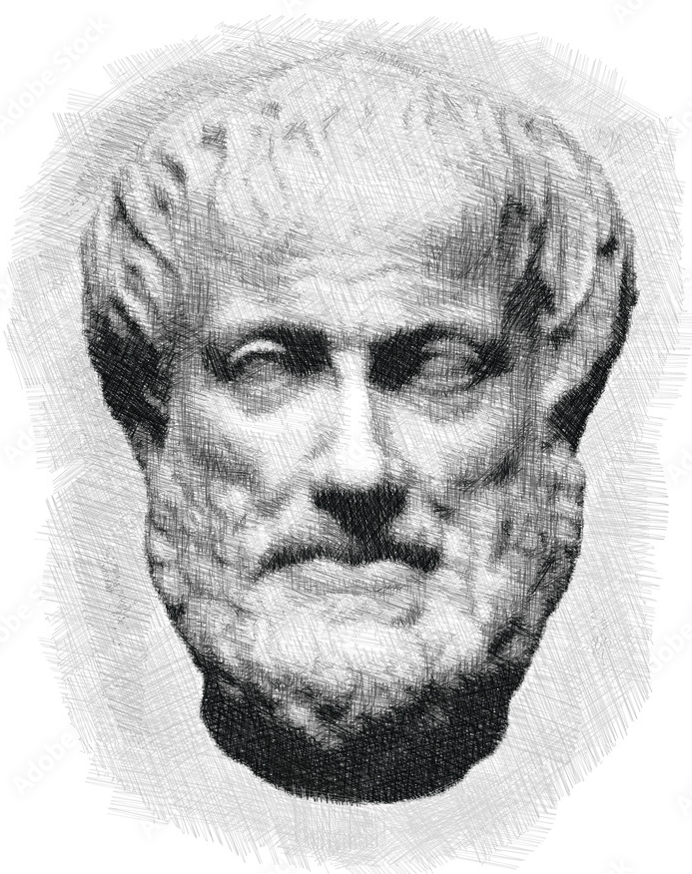

Background

Slide 14
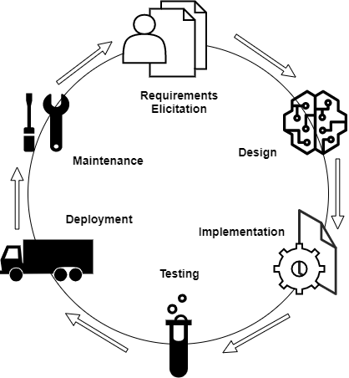
Background: The SDLC
Requirements phase: documents like SRSs are early sources of software provenance
Design phase: visual artifacts, e.g., diagrams, lack built-in context, so they are hard to trace without explainable annotations
Implementation phase: code commits, comments, external references, e.g., Stack Overflow, give rich traceable provenance
Later phases: testing, deployment, and maintenance produce fewer artifacts but rely heavily on traceability to understand changes

Slide 15
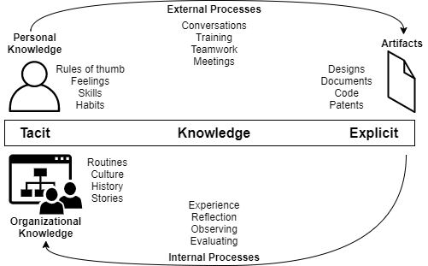
Background: Knowledge
Knowledge cycles through two forms
Tacit: unsaid, buried in know-how and expertise
Explicit: serialized, e.g., files, books, etc.
This dissertation intends to make the tacit explicit

Slide 16
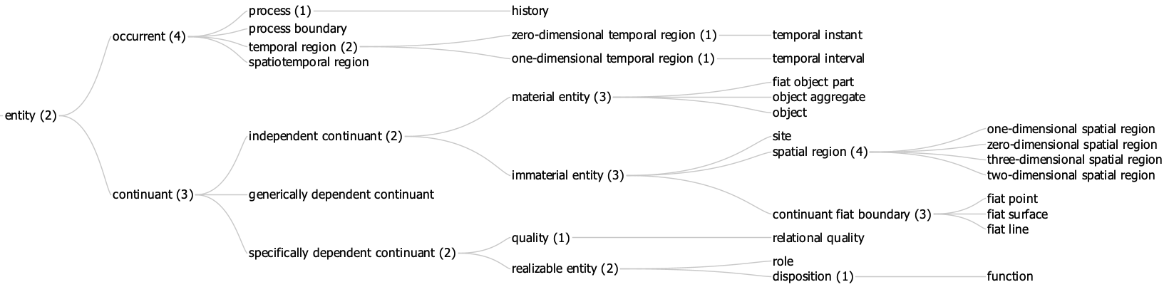
Background: Ontology
Ontologies: ontologies allow formal knowledge by defining entities and relationships, supporting consistent interpretation across systems
Basic Formal Ontology (BFO): BFO divides all entities into Continuants and Occurrents, giving a structured model of reality
Traceable graphs: ontologies underpin knowledge graphs, making them well-suited for representing software traces

Slide 17
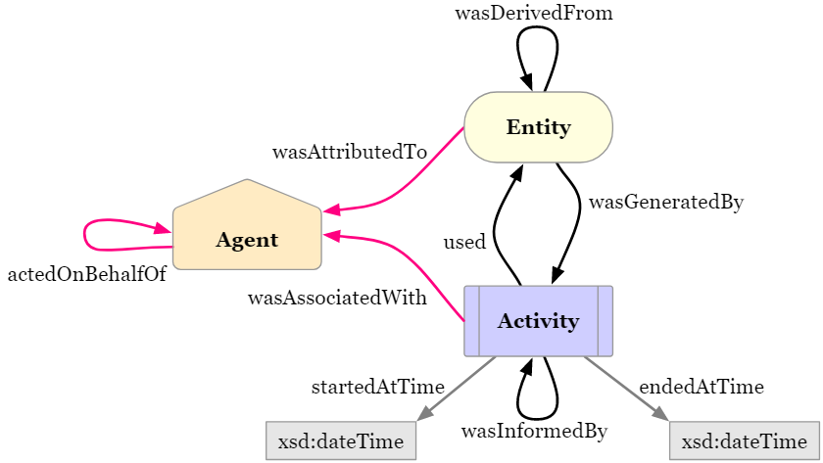
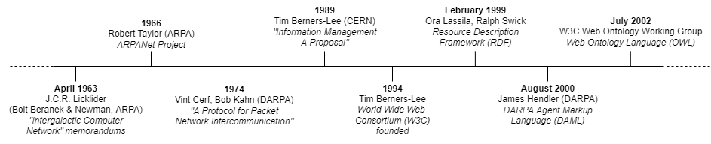
Background: Knowledge Graphs
Semantic Web: a vision for a Web where information is structured for humans and machines
RDF (Resource Description Framework): a standard for data interchange using triples (subject–predicate–object)
RDFS (RDF Schema): RDF extension for class hierarchies and relationships between data types
Knowledge graphs: flexible structures that represent information, enabling intuitive and extensible modeling

Slide 18
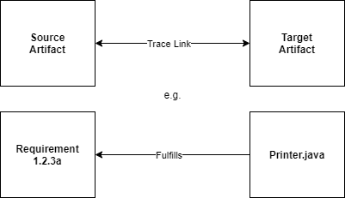
Background: Software Traces
In the simplest case, a software trace is a link from a source to a target
E.g., a spreadsheet with requirements numbers in one column, and class name / method name in another
Traces operationalize explainability
If you can trace some requirement to its implementation, you can explain it better
But traces still need to be explainable

Slide 19
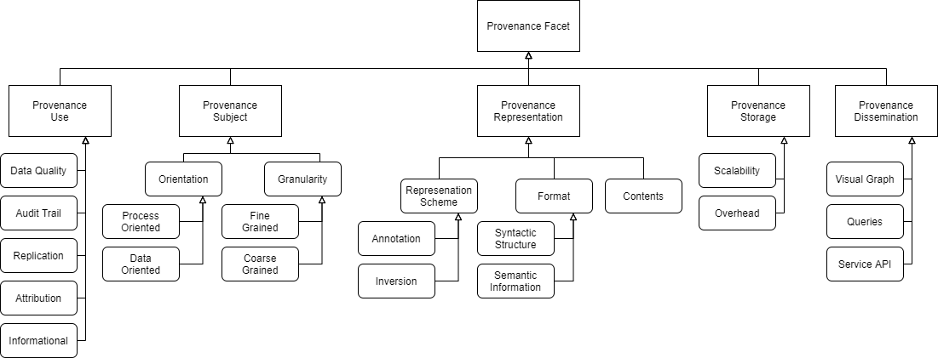
Background: Provenance Hierarchy
Generating provenance is easy (lots of sources)
Capturing provenance is hard (lots to sift through)
Actively using provenance is hardest (lots to ask)
Usually dictated by personal or business concerns
Simmhan, Yogesh L., Beth Plale, and Dennis Gannon. "A survey of data provenance techniques." Computer Science Department, Indiana University, Bloomington IN 47405 (2005): 69.

Slide 20
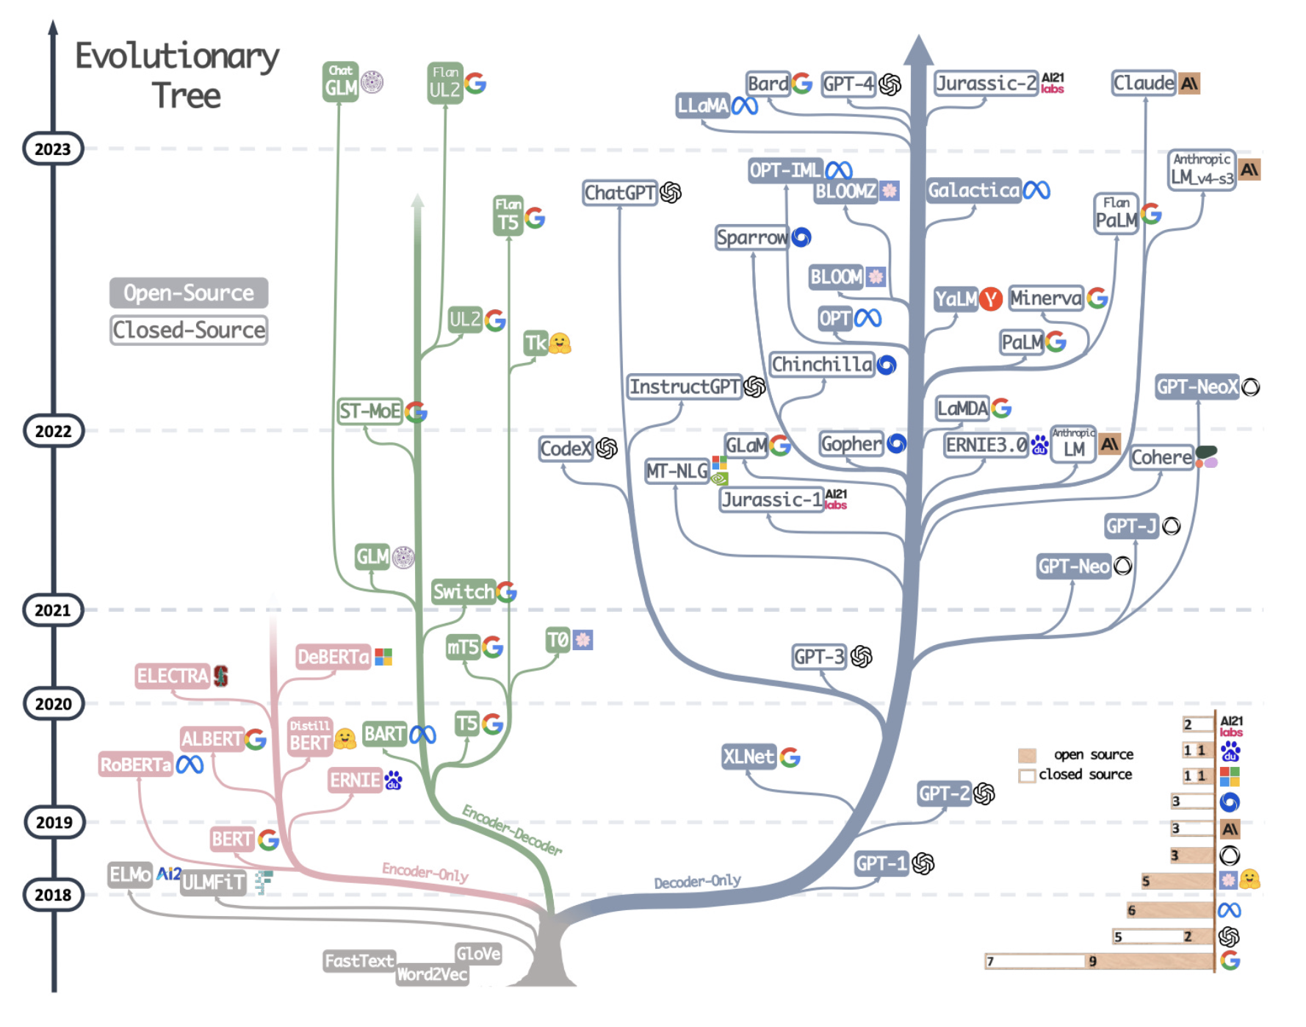
Background: MLLMs
Rise of LLMs: language models evolved from probabilistic to powerful transformer architectures like GPT
Prompt engineering: steering LLM output effectively requires prompt techniques to minimize hallucinations
Retrieval-Augmented Generation (RAG): combining external knowledge with models improves explainability, especially with structured KGs
Multimodal capabilities: MLLMs can reason across text and images
Yang, Jingfeng, et al. "Harnessing the power of llms in practice: A survey on chatgpt and beyond." ACM Transactions on Knowledge Discovery from Data 18.6 (2024): 1-32.

Slide 21
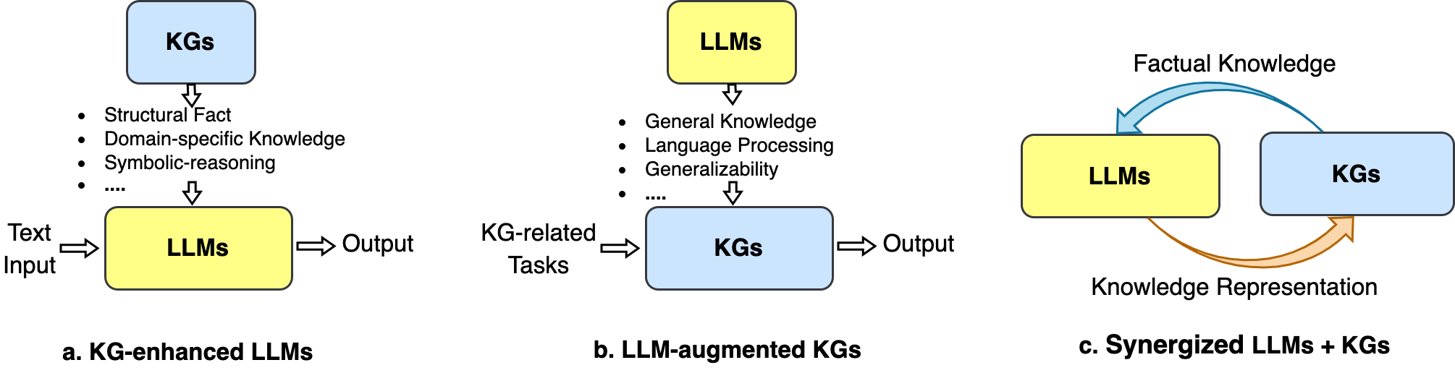
Background: KGs + LLMs
Complementary strengths: KGs offer structured knowledge while LLMs bring generalization; together, they allow traceable, explainable representations of development processes
Synergistic architectures: current models integrate KGs and LLMs with RAG, probing, or co-training, improving reasoning and reducing hallucinations
Hierarchical reasoning: both natural language and software artifacts follow hierarchical patterns, which aligns well with taxonomy-driven KGs
Pan, Shirui, et al. "Unifying large language models and knowledge graphs: A roadmap." IEEE Transactions on Knowledge and Data Engineering 36.7 (2024): 3580-3599.

Slide 22
Dissertation Implementation

Slide 23

ProvTracer
Purpose: automates digital provenance capture by reconciling traceability (software engineering) with provenance (Semantic Web) via MLLMs and KGs
Implementation: written in Python using open-source libraries means low overhead and modularity
Core Function: captures screenshots and selected contexts at intervals, sends to MLLM, captures natural language traces
Output: generates structured knowledge graphs in PROV-O + BFO; supports SPARQL querying and natural language RAG interrogation

Slide 24
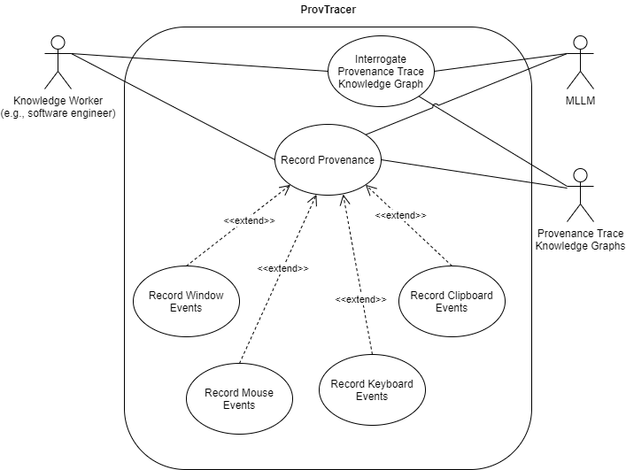
ProvTracer: Use Cases
Capturing provenance: a user starts a session, picks what context they want, e.g., mouse events, and ProvTracer records it into a KG
Asking questions later: after the session, the user can explore the output in two ways:
Graph database for querying in SPARQL
Asking a language model directly

Slide 25
ProvTracer: Context Sources
Primer Context: user describes planned work to the MLLM
Mouse Events: captures all mouse clicks since last screenshot
Keyboard Events: reconstructs input strings from aggregated keystrokes since last screenshot
Window Events: captures changes in active window titles since last screenshot
Clipboard Events: captures clipboard content since last screenshot

Slide 26
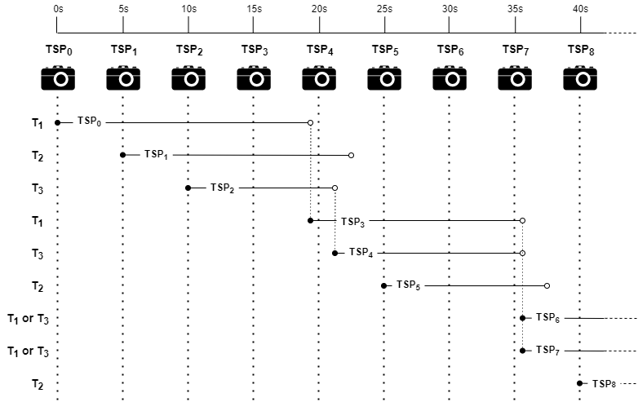
ProvTracer: Threadpool
ProvTracer operates on a threadpool
Screenshot (timeslice packet) loop runs every 5 seconds
We have, e.g., a threadpool of size 3
Each thread awaits the MLLM response, which can take a variable amount of time
Notes:
ProvTracer operates on a threadpool for management of prompts and responses
All values adjustable by user

Slide 27
ProvTracer: Chosen MLLMs
Three flagship OpenAI MLLMs were made available for use in ProvTracer
Average response times over 50 runs:
GPT-4-Turbo: 5.40 seconds
GPT-4o: 4.46 seconds
GPT-4o-mini: 3.74 seconds
Notes:
GPT-4o-mini is fastest and cheapest; it was used in most of the evaluations

Slide 28
ProvTracer: MLLM Evaluation
Through documented tests, several things were found:
Screenshot interpretation: the MLLM summarizes desktop activity, but sometimes hallucinates unobservable content, e.g., browser states
Spatial reasoning: the MLLM cannot perform spatial reasoning, e.g., locating mouse clicks
Delta detection: the MLLM can detect textual differences across screenshots, but struggles with UI changes, e.g., scrolled code views
Knowledge graph generation: direct RDF generation by the MLLM is error-prone
Notes:
Because of ProvTracer’s novelty, the MLLMs underlying had to be tested
Programmatic conversion of plaintext summaries into KGs is more reliable
Latency benchmarks: response time seemed to improve with more constrained structured prompts

Slide 29
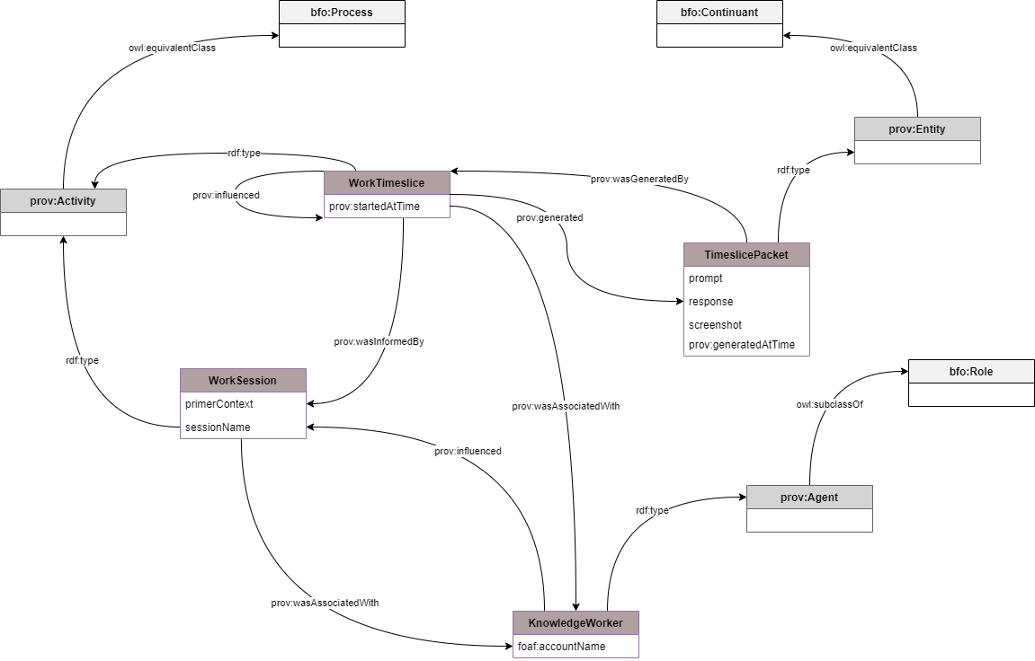
ProvTracer: Ontology
ProvTracer uses a PROV-BFO ontology
Maps ProvTracer terms directly to PROV-O
Lightweight links to the BFO to maintain:
Interoperability
Futureproofing
BFO is a ISO/IEC standard

Slide 30
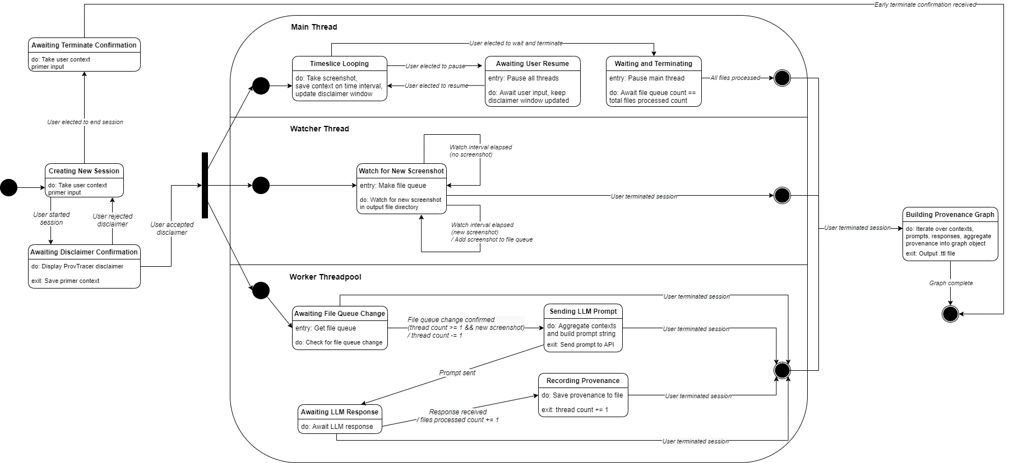
ProvTracer: Design

Slide 31
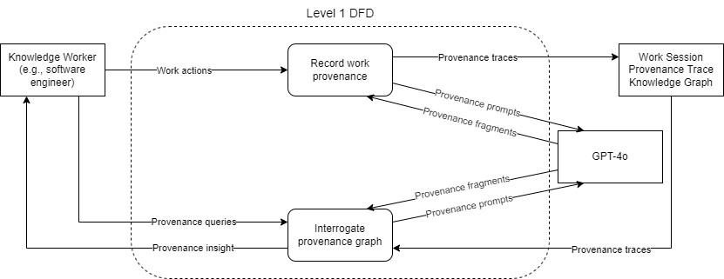
ProvTracer: Design

Slide 32
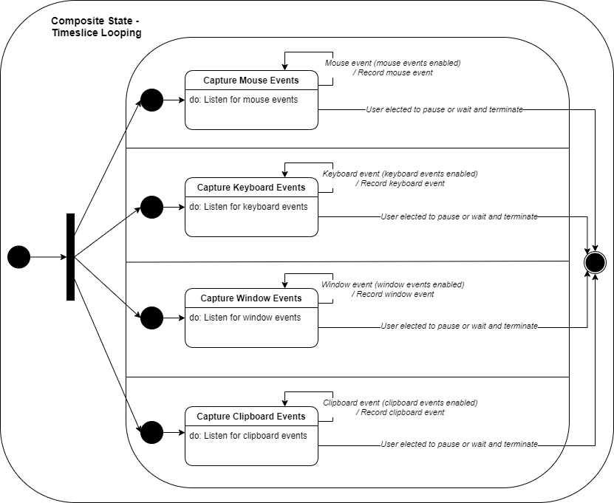
ProvTracer: Design

Slide 33
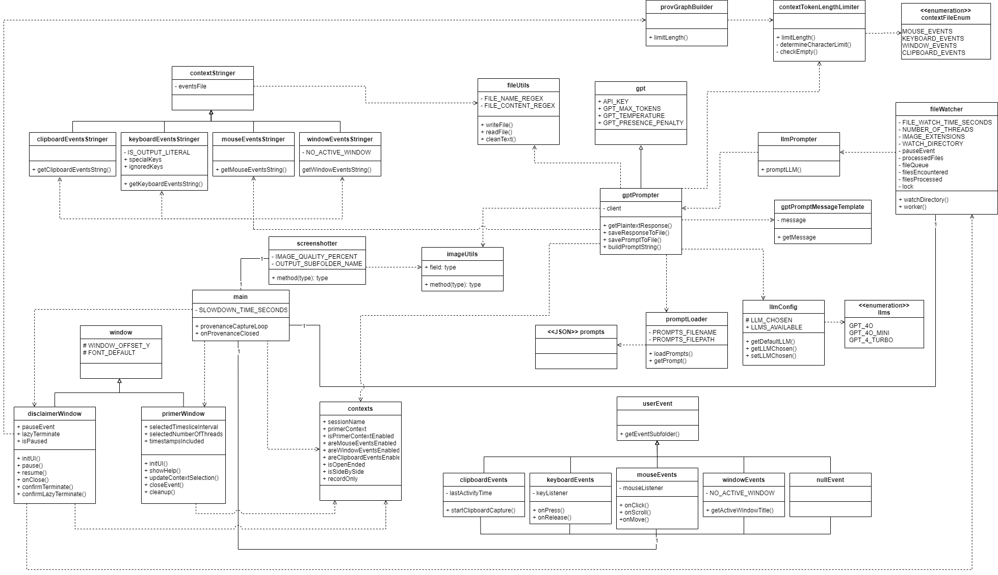
ProvTracer: Design

Slide 34
ProvTracer: MLLM Prompt Structure
Prompt Section | Used? | Content
Preface | Always | The provided image is a screenshot of a user's computer as they are working. Describe what they are doing in detail. Do not use newlines. Avoid describing personal information, such as passwords. Answer in 3-5 sentences.
Open-Ended Transition | If selected | The user has stated that their screen use is open-ended, i.e., they may use many windows in various areas of the screen.
Side-by-Side Transition | If selected | The user has stated that one side of the screen is the 'source' artifact or artifacts, and the other side is the working area. In general, the 'source' artifact(s) influence(s) the development of the working side, which may include several artifacts.
Context Transition | If 1+ context source selected | Below is some additional context provided by the user.
Primer Context Modifier | If primer context selected | Here is what the user stated they were working on when this screenshot was taken:
Window Events Modifier | If window events selected | Here is a list of application window titles that the user opened since the last screenshot:
Mouse Events Modifier | If mouse events selected | Here is a list of user mouse events since the last screenshot:
Keyboard Events Modifier | If keyboard events selected | Here is a list of user keyboard events since the last screenshot. Compare what they typed with what is present in the screenshot:
Clipboard Events Modifier | If clipboard events selected | Here is what the user copied/pasted into their clipboard since the last screenshot. It is trimmed to 500 characters:

Slide 35
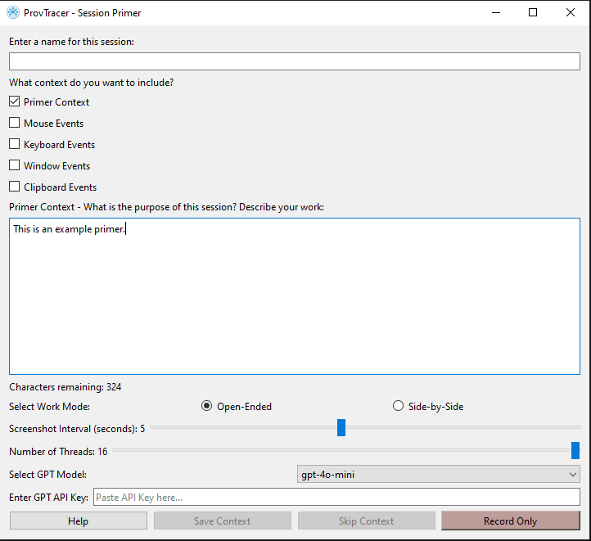
ProvTracer: Primer Window
Session primer: user selects contexts and provides a short primer about their planned work
Work mode & capture settings: user selects screenshot interval, thread count, and work mode
MLLM: user selects the GPT model and gives an API key
Execution Options:
Save Context: record screenshots and context, send to MLLM
Skip Context: send only screenshots to MLLM
Record Only: capture provenance locally without prompting

Slide 36
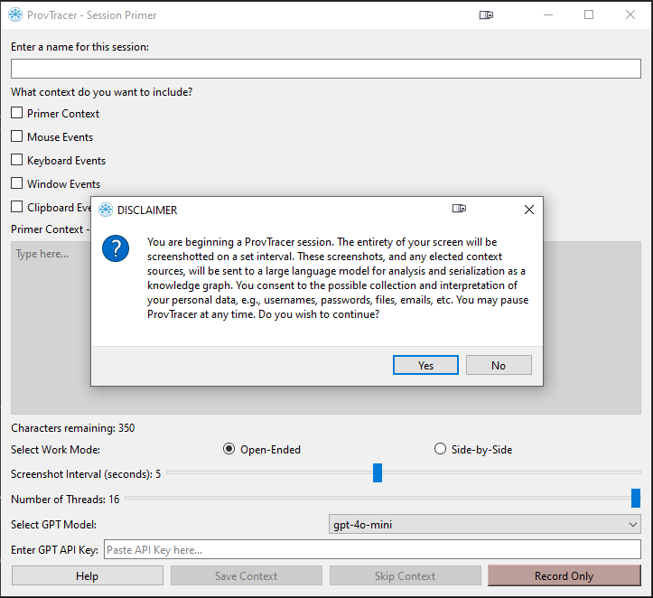
ProvTracer: Informed Consent
ProvTracer is, from one point of view, a keylogger
To retain a level of informed consent, an explicit disclaimer message is displayed before the start of any work session

Slide 37
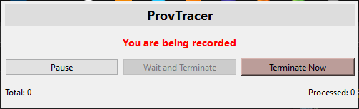
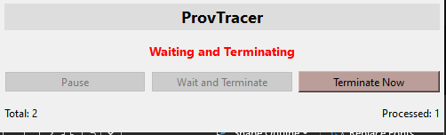
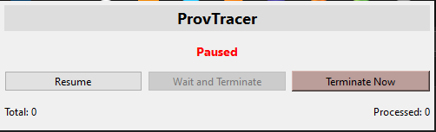
ProvTracer: Informed Consent
The active ProvTracer window always displays a disclaimer message

Slide 38
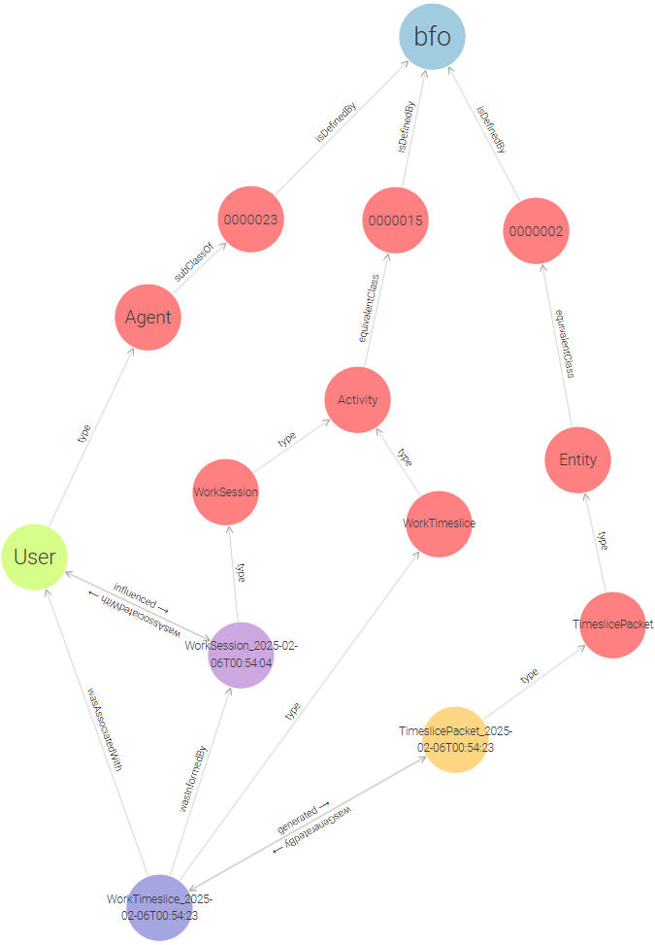
ProvTracer: Work Timeslice
A schematic view of a real ProvTracer output
A Work Session is started by a User
A Work Session contains 1..n Work Timeslices
A Work Timeslice contains 1 Timeslice Packet
Hierarchy adherence all the way to PROV-O and BFO terms
Generated each screenshot interval

Slide 39
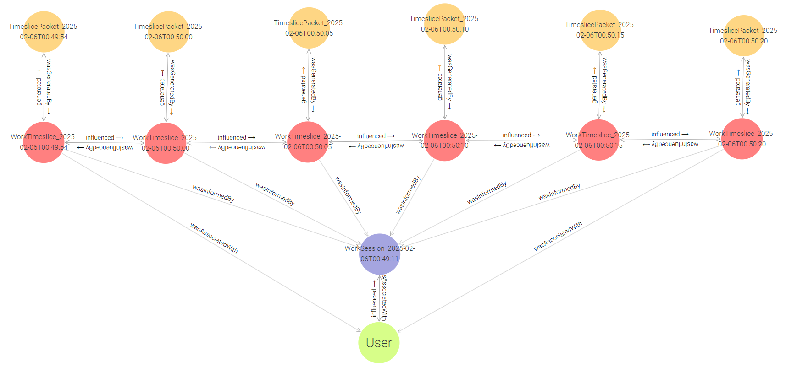
ProvTracer: Work Timeslice Chains
Notes:
This is 30 seconds worth of graph

Slide 40
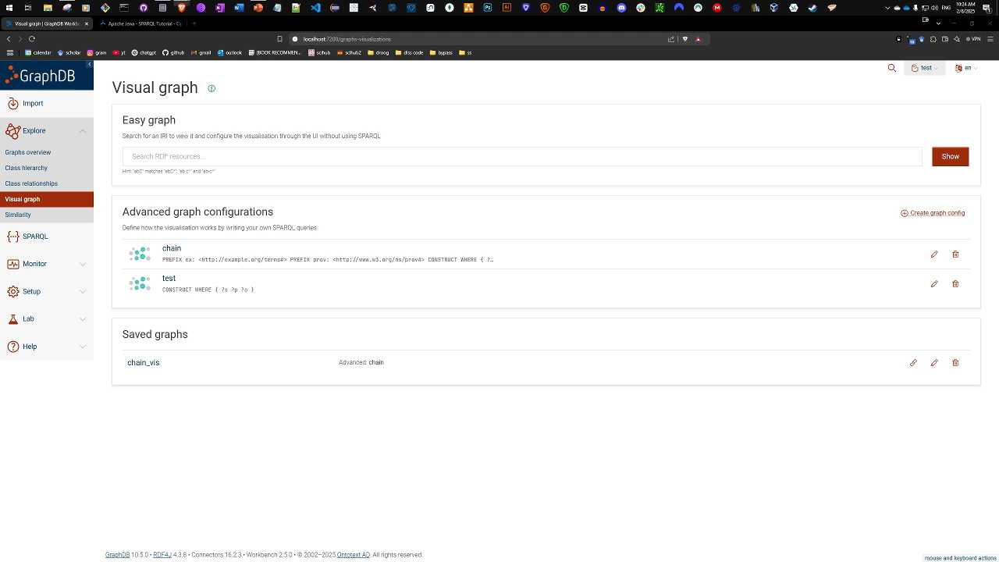
ProvTracer: GraphDB Demonstration

Slide 41
Dissertation Evaluation

Slide 42
Grounded Theory
Evaluating the system is difficult, because output is non-numerical
Grounded theory: allows structure and insight to emerge from data without presupposing an interpretation framework
Open coding: identify recurring terms in the generated descriptions and group them into low-level conceptual labels
Axial coding: cluster related concepts into broader themes that reflect semantic or rhetorical patterns
Selective coding: distill the themes into theoretical claims about the system’s behavior or output characteristics

Slide 43
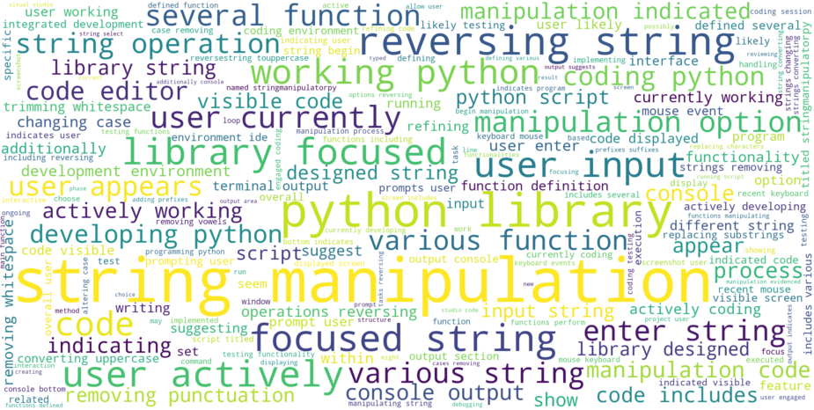
Case Study 1: Python Programming
Session focus: User worked in VS Code for ~30 minutes on Python functions for string manipulation
Provenance capture: 298 timeslices
MLLM description patterns: MLLM framed user as an intentional actor, identified code semantics and inferred task-level activity
Observed insights: Provenance descriptions lacked spatial awareness and sometimes over-interpreted minimal input
Notes:
This highlights challenges in visual context reasoning

Slide 44
Case Study 1: Theoretical Proposition
MLLM-generated provenance descriptions in ProvTracer abstract low-level interface events into high-level user intentions by emphasizing semantic operations and inferred actions, constructing narratives that anthropomorphize the user and prioritize task-oriented reasoning over raw interaction data, while being limited by a lack of spatial awareness.

Slide 45
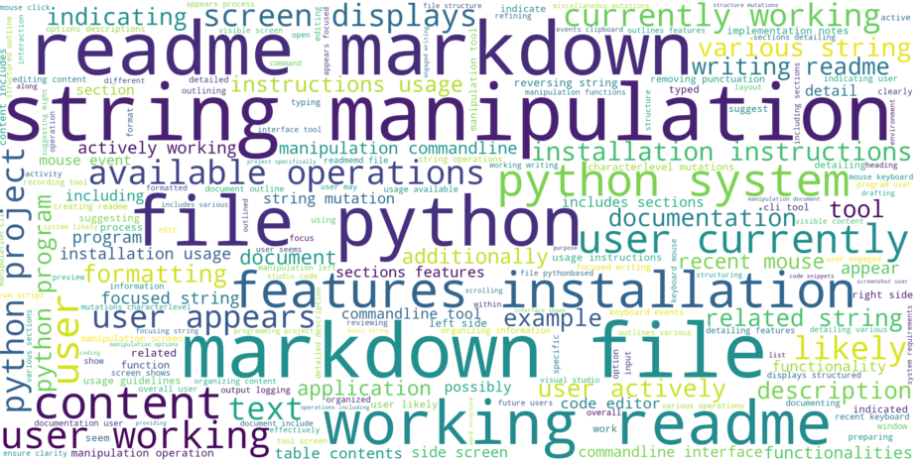
Case Study 2: Code Documentation
Session focus: User spent ~20 minutes creating a README
Provenance capture: 376 timeslices
MLLM description patterns: MLLM identified structural elements like headings, documentation tone, and feature descriptions, inferring task intent
Observed insights: Provenance descriptions reflected instructional writing genre, highlighting versatility beyond coding scenarios
Notes:
Several applications used
More clipboard and window activity compared to programming due to web browsing and reference material

Slide 46
Case Study 2: Theoretical Proposition
In the context of code documentation, the provenance descriptions generated by ProvTracer’s chosen MLLM infer higher-order tasks of instructional writing, extrapolating semantic structure, e.g., features, usage, installation, and rhetorical intent, e.g., guiding, informing, and explaining, from low-level context sources. The framing of the MLLM seems to depend on structural cues, e.g., markdown syntax and keywords, to generate coherent summaries that mirror conventional documentation practices.

Slide 47
Combined Theoretical Proposition
Across various SDLC tasks, the MLLM-generated provenance descriptions of ProvTracer abstract low-level user behavior into meaningful narratives by leveraging contextual cues to infer task type, user intent, and domain structure, using hedging language to frame these inferences with interpretive caution.
Example MLLM trace:
The user is working on developing a Python library focused on string manipulation. They have written a function called `reverse_string` that appears to be designed to reverse a given string. The code in the screenshot shows the initial steps of defining this function and returning a reversed string using slicing. Additionally, the user is likely planning further options for string manipulation, indicating an intent to expand the functionality of their library. The overall environment suggests they are actively coding and testing their ideas.
Notes:
Appears to be, may, consists of, etc.

Slide 48
Ablation Study
Context | Importance | Reasoning
Primer context | High importance for any task | Provides the MLLM with a general understanding of the intent of a work session
Mouse events | Low applicability | The chosen MLLMs cannot properly make use of spatial context
Keyboard events | High importance for any task | Provides a simplistic “delta” for text from the previous timesliced screenshot
Window events | High importance for any task, particularly those employing multiple application windows | Provides general semantic cues for the work being performed
Clipboard events | High importance for particular tasks, e.g., those with large amounts of boilerplate or repeated text that is copied-and-pasted to save time | Provides a direct working cue for the work being performed
To establish the importance of the used context sources:
Performed a baseline (no context) run with ProvTracer
Performed runs with each context type individually
Performed a run with all context sources

Slide 49
RQ 1: Answer
How can relevant provenance sources be distinguished from noise during digital software development work?
A taxonomy of digital distractions, e.g., idle input, system popups, was created to classify common noise sources in digital work
Whitelisting SDLC-relevant provenance, e.g., commits, test logs, READMEs, is preferred over blacklisting noise, as it ensures only trusted, meaningful artifacts are included in trace link graphs
These two taxonomies can be used for future bootstrapping of ProvTracer use in industry use cases (see next two slides)

Slide 50
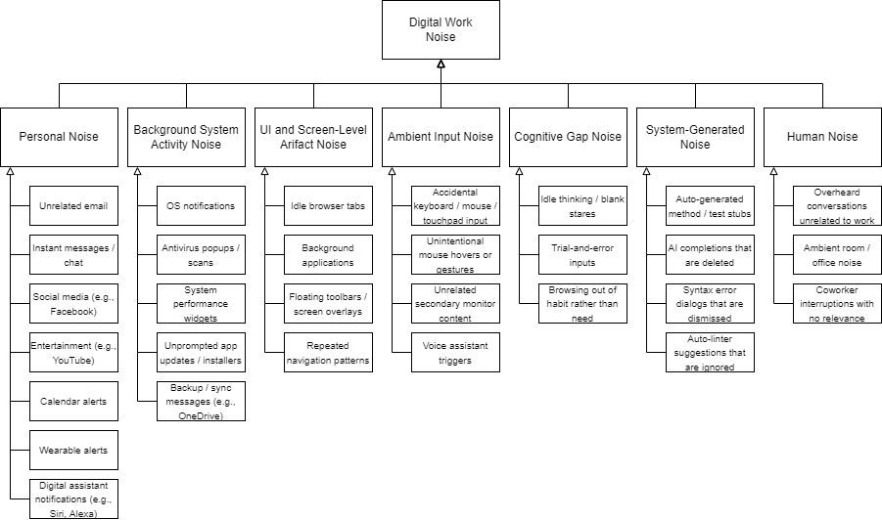
RQ 1: Digital Work Noise Taxonomy

Slide 51
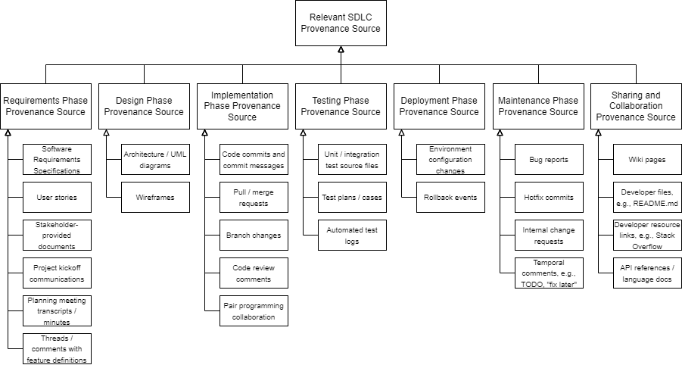
RQ 1: Relevant SDLC Provenance Taxonomy

Slide 52
RQ 2: Answer
How can the integration of a knowledge graph-based provenance system enhance the traceability and explainability of artifact development and maintenance within the SDLC?
Traceability: Structured graph links enable tracking of what happened and how artifacts evolved over time
Explainability: Embedded natural language summaries clarify why actions occurred, supporting human understanding and auditability

Slide 53
RQ 3: Answer
What are the technical challenges in developing a system for the automatic, real-time serialization of SDLC provenance, and how can these challenges be mitigated?
Next slide…

Slide 54
RQ 3: Answer
Challenge | Details | Mitigation
Information overload | Generating timeslice data on a set interval, e.g., 5 seconds, results in a significant amount of information that may be hard to digest | TTL KGs are terse, prompt responses are shortened aggregates, KG analysis by a LLM returns plaintext
Context sources | There are various possible influencing sources, where only a distinct subset of them can be captured consistently on a computer | Define and implement the selection of the distinct subset of context sources able to be feasibly captured
Privacy | Automatic provenance capture using screenshots may introduce privacy concerns, e.g., passwords that are seen and captured | Limit ProvTracer use to work machines with designated work applications
Automation | Automatically capturing provenance as it is witnessed is a complex semantic action | Low-level metadata is captured with basic code libraries, high-level provenance with a MLLM
Hallucination | LLMs may produce inaccurate or fabricated provenance descriptions | Add consistency checks; fine-tune prompts with domain- or task-specific constraints
Computational scalability | Frequent screenshot processing and LLM prompting may stress system performance | Optimize prompt granularity; use local caching; employ batch processing where latency allows
Fiscal scalability | Repeated API calls to LLMs are costly at scale | Reduce snapshot frequency, e.g., with ProvTracer settings; explore open-source or locally hosted LLMs
Provenance use and analysis | Once provenance is generated, its use / analysis / dissemination has no general heuristic, is primarily qualitative, and specific to domains | Use LLM to analyze provenance in a RAG workflow
Noise differentiation | Irrelevant inputs may be interpreted as provenance, e.g., Spotify, background apps | Apply whitelist-based filtering; use taxonomy of known noise categories
Temporal disconnect | Measuring work deltas between screenshot intervals is difficult | Send two screenshots at once and adjust prompt accordingly
User trust | Users may distrust generated traces, especially if incorrect or involving personal information | Enable user correction or annotation

Slide 55
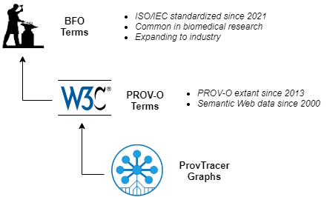
Addressing Interoperability
Standards-based modeling: ProvTracer uses PROV-O for compatibility with ~30% of scientific provenance systems
Cross-ontology mapping: maps PROV-O terms to BFO, an ISO/DoD standard
Aligned with trends: supports PROV-O adoption for large ML systems
Future-proof design: uses structured, extensible knowledge graphs to support evolving techniques, tools and systems

Slide 56
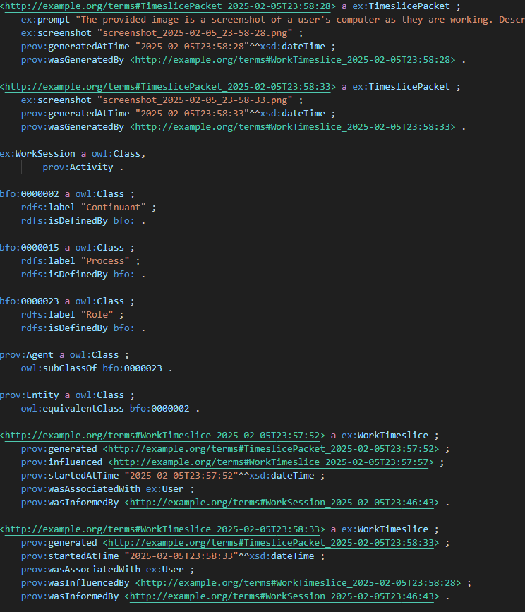
Addressing Information Overload
ProvTracer mitigates information overload in several ways:
User configurability: adjustable timeslice intervals and optional context sources let users control data volume
MLLM summarization: prompts return high-level summaries, reducing overload
Structured output: provenance is encoded in queryable knowledge graphs for focused, relevant retrieval

Slide 57
Addressing Transparency and Reproducibility
These NFRs come for free with ProvTracer
We record everything, so… transparency!
We establish informed consent with the disclaimer present while the application is running (this is an effort in transparency itself)
Reproducibility is in the same vein
We record keyboard strokes so comparison to screenshots can be done with text deltas

Slide 58
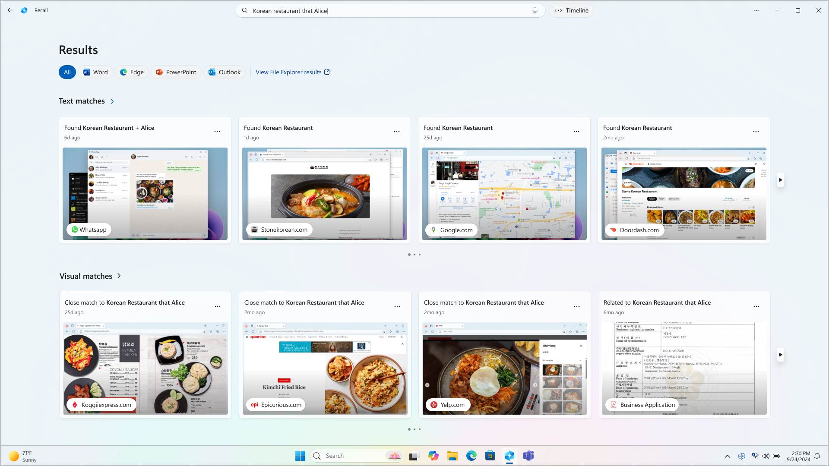
Related Work: Microsoft Recall
Microsoft Recall captures and stores screen activity as image snapshots
Closed system: Recall is closed and non-extensible; ProvTracer is open and customizable
Fuzzy storage: Recall stores fuzzy image timelines; ProvTracer uses KGs
No artifact linking: Recall lacks linkage between activity and artifact; ProvTracer links provenance to artifact evolution
High cognitive load: Recall risks overwhelming users with noise; ProvTracer uses named, user-defined sessions with filtered inputs

Slide 59
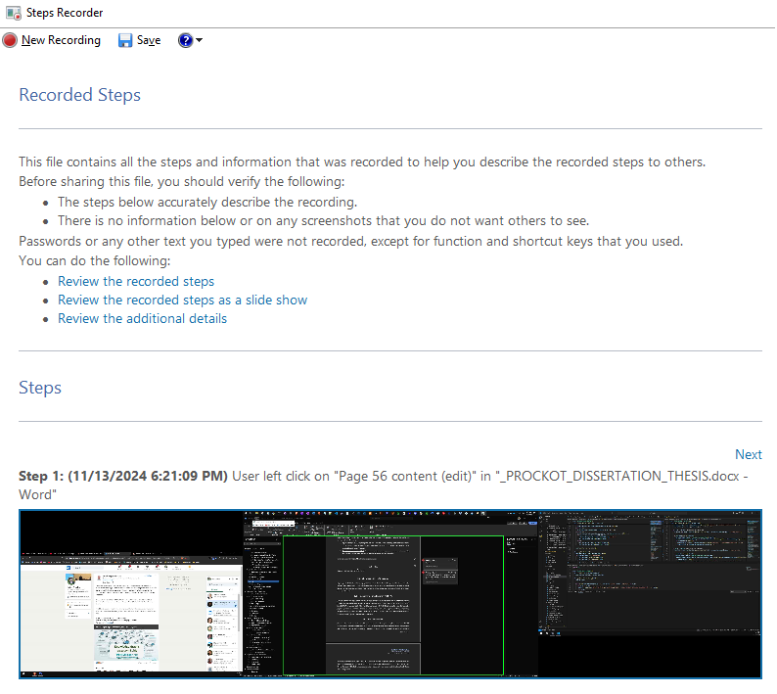
Related Work: Microsoft Steps Recorder
Records screenshots and user actions like clicks for manual troubleshooting
Limited annotation: some apps receive richer annotations, but most steps are generic and require manual explanation
No semantic analysis: lacks automated interpretation or structured outputs; users analyze themselves

Slide 60
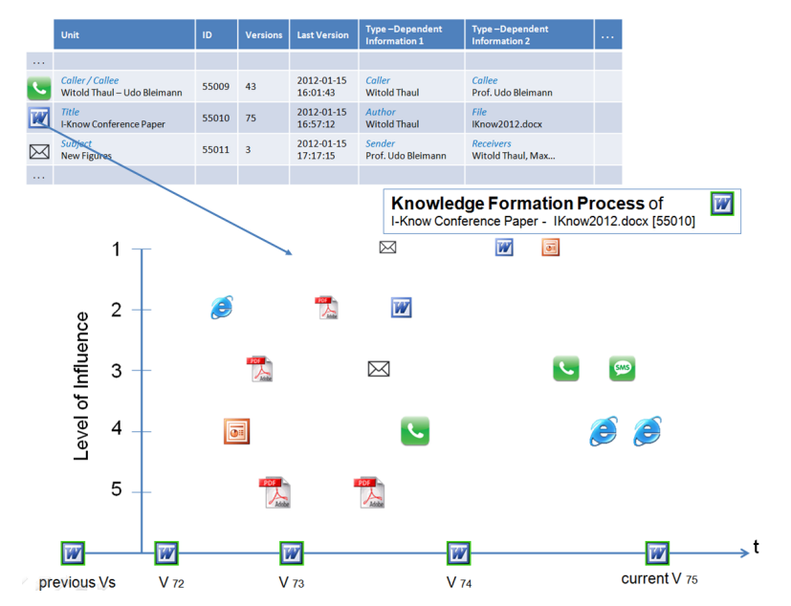
Related Work: Holistic Knowledge Formation System
Thaul’s system is a theoretical wireframe that depends on manual user annotation
Event tracing layer: Thaul’s system logs user interactions
Weighted influence scoring: each captured event can be assigned an influence score to model its contribution to knowledge artifacts
Version management: uses snapshots to track evolving artifacts without overwhelming the user
User-centric controls: users decide what gets recorded and when to annotate, enabling privacy and personalization
Thaul, Witold. "Supporting learning by tracing personal knowledge formation." (2014).

Slide 61
Limitations: User Interface Variance
ProvTracer inherently faces several limitations specific to personal UIs:
UI variability: differences in operating systems, layouts, and tools may affect trace quality
Language dependence: system is only tested on English interfaces and prompts
Device separation: activity on secondary devices, e.g., phones, is missed in provenance capture
Noise inclusion: background activity and distractions can introduce irrelevant data into traces

Slide 62
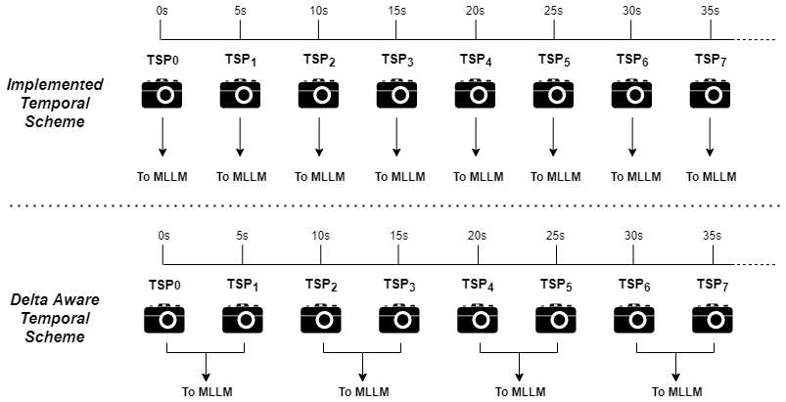
Limitations: Temporal Disconnect
ProvTracer has limitations regarding the MLLM and its temporal scheme of prompting and responding:
No screenshot deltas: Sending only single screenshots limits continuity and may miss task transitions
Performance tradeoffs: Including previous slices will slow the system and increase token usage
Partial visual coverage: Switching between windows can lead to missed interactions not in view

Slide 63
Concerns
ProvTracer automatically records screen activity, so concerns abound
Privacy risks: screenshots may inadvertently capture sensitive data, e.g., passwords, emails, raising ethical concerns
Data leaks: prompts to MLLM may include sensitive information
Informed consent and transparency: system is voluntary, clearly notifies users, and can be paused or canceled anytime

Slide 64
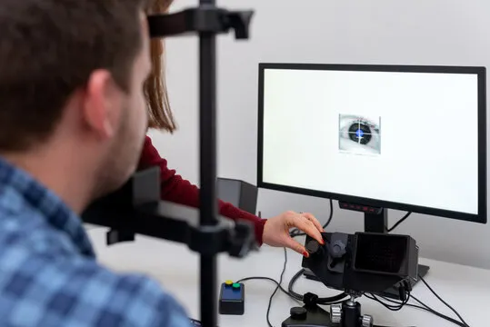
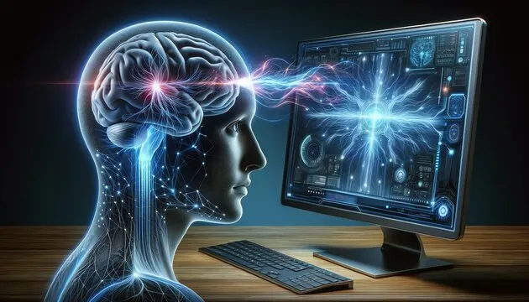
Future Work: Other Context Sources
Narrator audio: let the user speak while working, voicing their thoughts and intentions
Workplace recording: remote digital meetings, e.g., Zoom, enable high-fidelity, transcribable provenance capture with consent
Eye tracking: eye tracking could enhance provenance by revealing real-time cognitive focus and user intent
Brain computer interfaces: could enhance provenance by capturing cognitive intent directly, but require strict informed consent

Slide 65
Future Work: Evaluation
Current grounded theory results are promising, but a full usability study and survey across real teams is essential to validate ProvTracer’s practical impact
Ideally, a longitudinal study over a period of weeks for a scoped software project
Agile sprints provide a good framework for this
Agile standups and retrospectives provide exceptional processual provenance

Slide 66
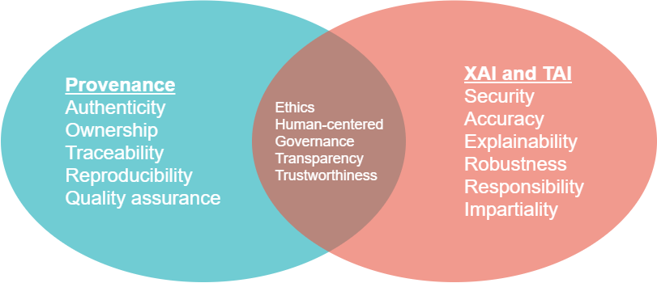
Future Outlook: FAIR ML
ML is ubiquitous and becoming larger, with massive datasets; ProvTracer is beneficial to future ML workflows, not just the basic SDLC:
Boosts reproducibility: automatically captures detailed, structured provenance for ML workflows, aiding FAIR and transparent AI
Supports explainability: documents key actions and decisions throughout ML lifecycles, enabling more trustworthy and interpretable models
Scales with digital work: ProvTracer’s agnostic design makes it well-suited to evolving, large-scale ML development environments

Slide 67
Conclusion
The present dissertation presents a few research contributions:
Bridges two fields: connects Semantic Web provenance research, e.g., PROV-O, with practical software traceability in the SDLC
Implements a novel system: demonstrates ProvTracer, an automated, system/tool agnostic provenance capture tool generating BFO-aligned trace link knowledge graphs using MLLMs
Addresses underexplored areas: focuses on Occurrent aspects of digital work (how software artifacts are created) not just the artifacts themselves
Supports broader goals: advances explainability, traceability, and FAIR principles, with applications beyond software to general digital work, including the burgeoning field of massive ML

Slide 68
Thank you!
Special thanks to my committee:
Dr. Omar Ochoa
Dr. Nicholas Del Rio
Dr. Massood Towhidnejad
Dr. Keith Garfield
Dr. Alex Vargas

Slide 69


