Slide 1
India CPI Inflation Case Study
What drives inflation in India, how it changed over time,
and how economic shocks impacted prices
Priyanshu Kamal | Data Analyst

Slide 2
Context & Objective
Understanding CPI structure and defining analytical questions

Slide 3
India’s CPI measures inflation using a broad consumption basket
CPI captures price movement across essential and discretionary spends
Includes food, housing, fuel, transport, healthcare, education
Urban (CPI-U), Rural (CPI-R), and General indices analyzed
Equal category weights assumed for analytical simplicity

Slide 4
The objective was to uncover inflation drivers and shock impact
Analysis focused on structural, cyclical, and external inflation forces
Category contribution to CPI
Long-term and short-term inflation trends
COVID-19 and global crude oil price impact

Slide 5
Analysis 1: Category Contribution
Which categories drive headline inflation?

Slide 6
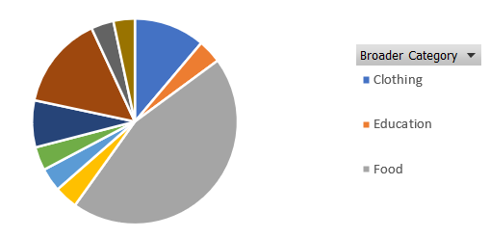
Food dominates India’s inflation basket
Inflation is highly sensitive to food price movements
Food is the single largest contributor to CPI
Luxury-related categories form the second-largest share
Transportation & communication contribute the least

Slide 7
Analysis 2: Long-Term Inflation Trend
How has inflation evolved over time?

Slide 8
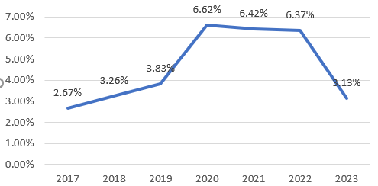
Inflation accelerated sharply during the COVID period
2020 marked the peak inflation year in recent history
YoY CPI inflation shows an upward trend post-2017
Pandemic disrupted supply chains and labor markets
Demand–supply imbalance drove price pressures

Slide 9
Analysis 3: Food Inflation Deep Dive
Why food prices remain volatile

Slide 10
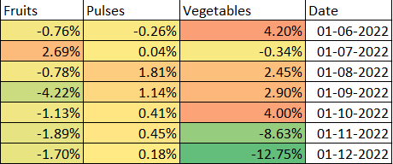
Vegetables are the biggest source of food inflation volatility
Seasonality plays a critical role in food price movements
Vegetables show the highest month-on-month fluctuation
Fruits show moderate volatility; pulses remain stable
Vegetable prices drop sharply during Nov–Dec due to harvest cycles

Slide 11
Analysis 4: COVID-19 Impact
How the pandemic reshaped inflation dynamics

Slide 12
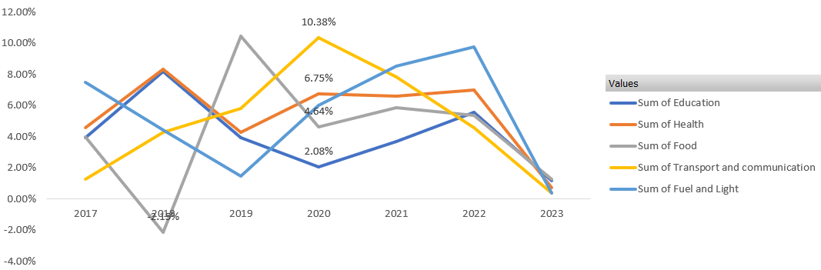
Mobility restrictions reshaped sector-wise inflation
Impact varied significantly across categories
Transportation & communication impacted the most
Fuel & light inflation declined due to demand collapse
Food and healthcare inflation moderately affected

Slide 13
Analysis 5: Global Oil Price Shock
Impact of imported crude oil price fluctuations

Slide 14
Transportation inflation is highly exposed to oil price shocks
Energy price transmission is uneven across sectors
Strong correlation between oil prices and transport inflation
Health sector inflation shows minimal sensitivity
Global events transmit inflation via logistics-intensive sectors

Slide 15
India’s inflation is structurally food-driven and shock-sensitive
Policy response must be targeted, not uniform
Food price management is critical for inflation control
Seasonality and supply-side measures matter more than demand tightening
External shocks primarily affect transport and fuel-linked sectors

Slide 16
Conclusion
This project demonstrates the use of Excel to derive
policy-relevant insights from CPI inflation data in India.

