Slide 1

E-Commerce Sales & Customer Analytics
(SQL Case Study)
Driving business decisions using data-driven insights
Priyanshu Kamal
callmepriyanshu4@gmail.com

Slide 2
Business Context
Analyze e-commerce data to support strategic decision-making
Focus areas: Customer Insights, Product Performance, Sales Optimization, Inventory Management
Objective: Convert raw data into actionable business insights

Slide 3
Dataset Overview
Customers: customer_id, name, location
Products: product_id, name, category, price
Orders: order_id, order_date, customer_id, total_amount
OrderDetails: order_id, product_id, quantity, price_per_unit

Slide 4
Methodology & SQL Techniques
Joined relational tables using primary and foreign keys
Used CTEs for structured and readable queries
Applied window functions for MoM analysis
Calculated KPIs using aggregations and distinct counts

Slide 5
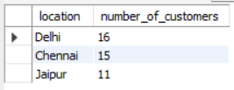
Top Customer Cities
Delhi, Chennai, and Jaipur have the highest customer concentration
These cities are key markets for targeted marketing
Logistics optimization can improve delivery efficiency

Slide 6
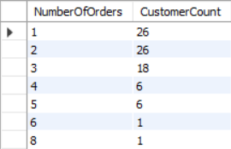
Customer Engagement Analysis
Most customers place a low number of orders
Customer count decreases as order frequency increases
Indicates dominance of occasional shoppers

Slide 7

Premium Product Trends
Identified products with average purchase quantity of 2
Product 1 generates the highest total revenue
Represents premium, high-value products

Slide 8

Category-Level Customer Reach
Electronics category has the highest unique customer count
Indicates strong demand and wide appeal
Should be prioritized in inventory and promotions

Slide 9
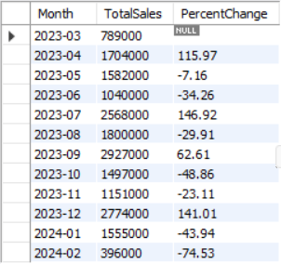
Sales Trend Analysis
February shows the largest decline in sales
Sales fluctuated between March and August
Indicates seasonality and unstable growth

Slide 10
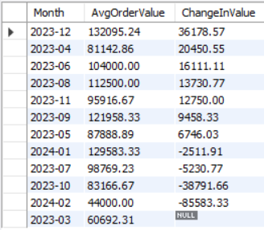
Average Order Value (AOV)
December has the highest increase in AOV
Likely driven by festive demand and promotions
Pricing strategies can be replicated in other months

Slide 11
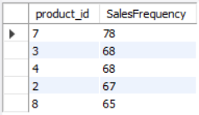
Inventory Turnover
Product ID 7 has the highest sales frequency
Indicates high demand and fast inventory turnover
Requires frequent restocking to avoid stockouts

Slide 12

Low Adoption Products
Smartphones and Wireless Earbuds purchased by <40% customers
Indicates low customer penetration
Targeted marketing campaigns recommended

Slide 13
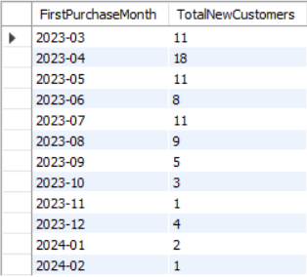
Customer Growth Trend
Month-on-month new customer growth is declining
Marketing campaigns may be less effective
Requires optimization of acquisition strategies

Slide 14

Peak Sales Months
September and December record the highest sales volume
Advance inventory and staffing required
Marketing spend should align with peak demand

Slide 15
Key Takeaways
Strong regional and category-level demand patterns identified
Premium products contribute significantly to revenue
Customer retention and acquisition need improvement
Clear seasonality impacts sales performance

Slide 16
Project Resources
Full SQL queries available in GitHub repository
Includes CTEs, window functions, and aggregations
Project demonstrates SQL-driven business insights

