Slide 1


Team Details
  Team name: Right On
  Team leader name: Priyam Maini
  Problem Statement: Banking, Financial Services and Insurance. Catching fraud and risk in insurance claims with AI

Slide 2
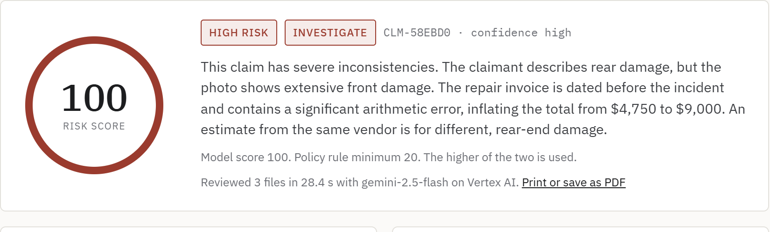
Brief about the idea
Reads every photo and document, then finds where they disagree
Every insurance claim arrives as a story plus a pile of evidence: photos, invoices, estimates, police reports. Fraud rarely sits in one document. It hides in the gaps between them. A repair bill dated before the accident. Front-end parts billed for a rear-end crash. A phone reported lost two days before it was bought.
ClaimGuard sends the whole claim to Gemini on Vertex AI in one request. It reads everything, checks each piece against the others and against the insurer's own policy rules, and gives the adjuster a risk score, a recommendation and the evidence behind every finding.
The adjuster still makes the call. ClaimGuard makes sure nothing gets missed.
Live result on a test claim: the photo shows front damage, the claimant says rear
$308.6B
25 s
1 request
estimated yearly cost of insurance fraud in the US (Coalition Against Insurance Fraud, 2022)
average time for a full multi-document review
all photos and documents reviewed together

Slide 3
Opportunities
Most fraud tools look at numbers. ClaimGuard looks at the evidence
How is it different from existing ideas?
How will it solve the problem?
USP of the proposed solution
Rule engines and scoring models work from structured fields like amount, date and claim history. They cannot open a PDF or look at a photo.
Document AI tools pull fields out of each file, but check every file on its own.
ClaimGuard compares every file with every other file and with the claimant's own words. That is where staged and padded claims fall apart.
Adjusters get a first-pass review in about half a minute instead of reading every page.
Honest claims with consistent evidence can be fast-tracked.
Suspicious claims reach the investigations team with each contradiction already listed and traced back to its source file.
Explainable. Every flag names the file and the exact detail behind it.
Hybrid scoring. Hard policy rules set a minimum score the model cannot argue below.
Plug-in. One REST API, installed inside the insurer's own Google Cloud project, so claim data never leaves it.

Slide 4
List of features offered by the solution
Everything an adjuster needs for a first-pass review, in one screen
01
02
03
Reads the whole claim
Cross-checks the evidence
Policy rule floor
Photos, invoices, receipts, estimates and police reports, as images or PDFs, in a single Gemini request.
Timelines, damage against repairs, invoice arithmetic, the statement against third-party reports.
Coverage limits, brand-new policies, late reporting and claim frequency. Thresholds are set per insurer.
04
05
06
Explainable verdict
Ask about the claim
Ready to integrate
A 0 to 100 risk score and approve, review or investigate, with every finding tied to its source file.
Follow-up questions and polite document requests to the claimant, answered only from that claim's record.
Authenticated /v1 REST API, OpenAPI docs, your own claim number carried through, printable reports.

Slide 5
Process flow diagram
From a new claim to an adjuster decision in about half a minute
Gemini 2.5 Flash on Vertex AI
Extracts facts from each file, describes the photos, compares every source with every other
Approve
Fast-track a consistent claim
Claim arrives
Statement, policy details, photos and documents, from the app or the /v1 API
Final score
The higher of the model score and the rule minimum
Manual review
An adjuster checks the open points
Policy rule engine
Coverage limit, policy age, late reporting, claim frequency. Plain, testable code
Investigate
Route to the fraud team with evidence
At every step the adjuster can open the evidence, ask ClaimGuard a follow-up question, or print the assessment for the claim file. ClaimGuard never approves or denies a claim on its own.

Slide 6
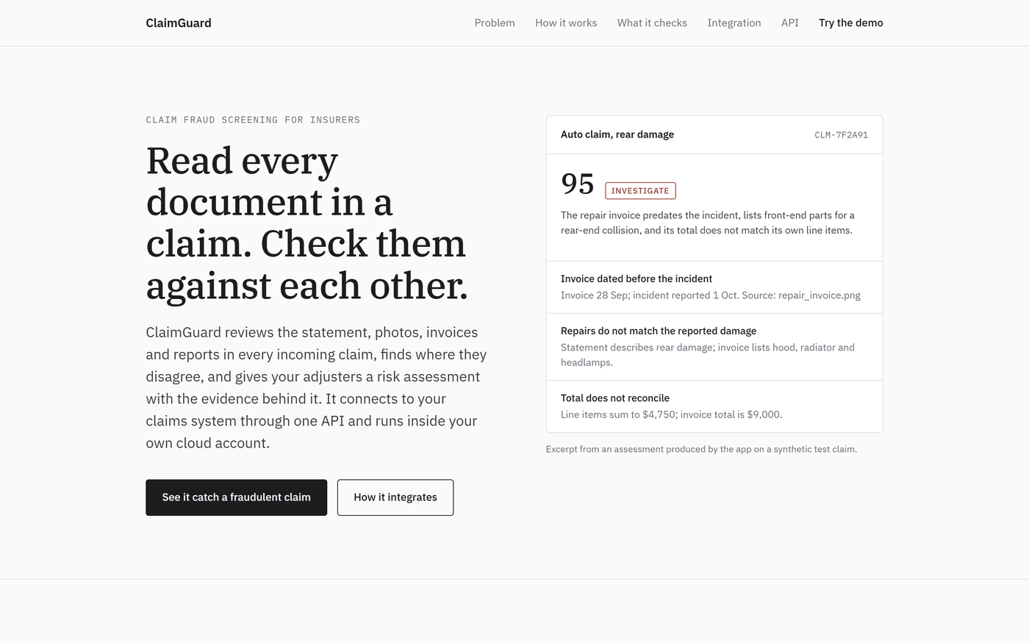
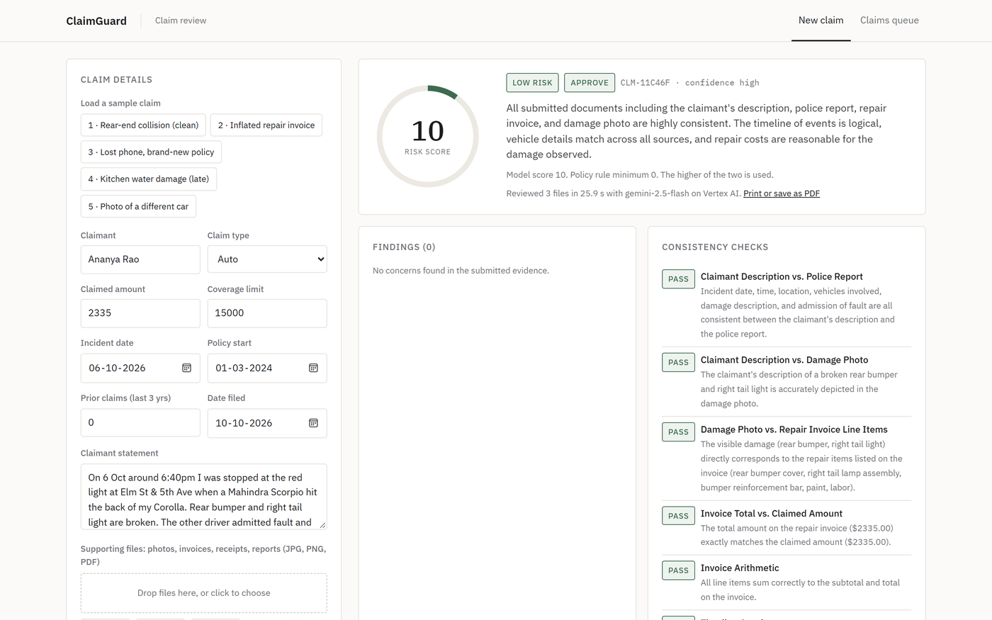
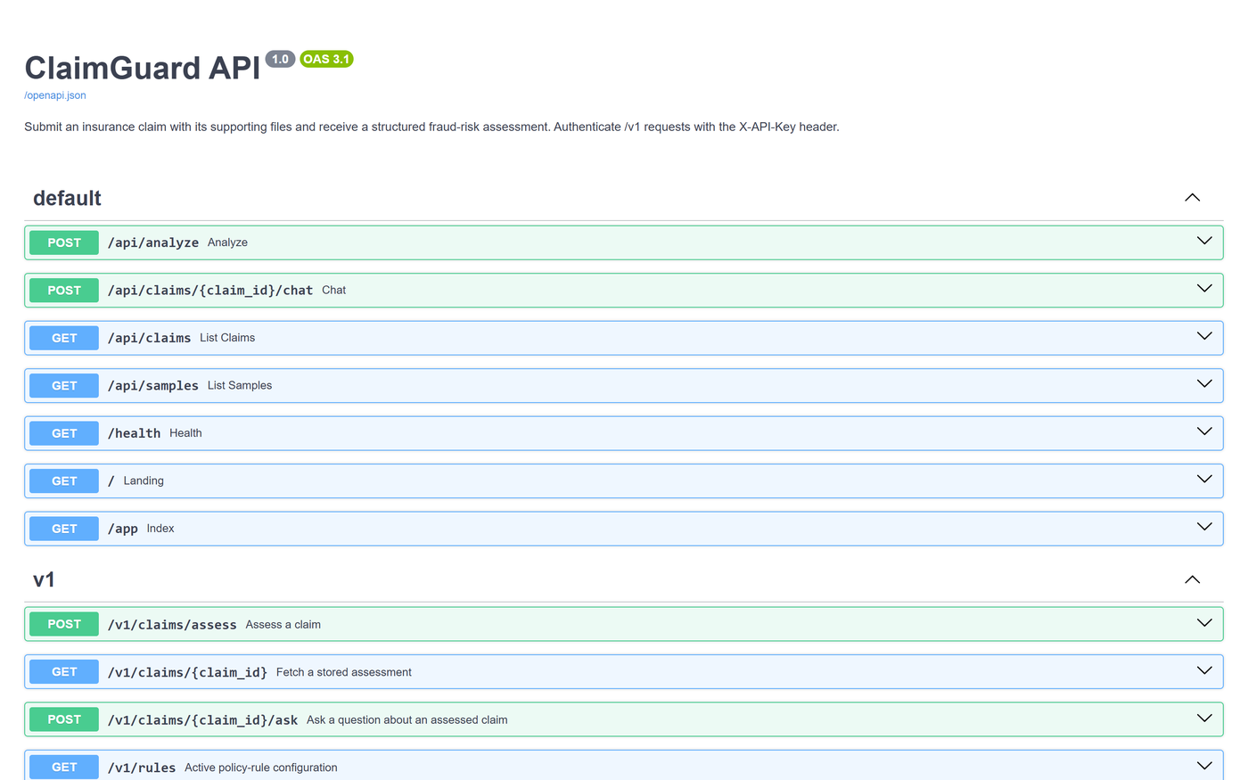
Wireframes and mock diagrams of the proposed solution
Three ways in: a product page, an adjuster app and an API
Product page for insurers, at /
Adjuster app, at /app
Integration API reference, at /docs
The interface is deliberately plain. Adjusters see the score and recommendation first, then the findings with their sources, then the consistency checks, extracted fields and photo review. Nothing is hidden behind a click.

Slide 7
Architecture diagram of the proposed solution
One small service inside the insurer's own Google Cloud project
Insurer's Google Cloud project
Adjuster
Browser, /app
Cloud Run service
Vertex AI
Gemini 2.5 Flash. Multimodal input, JSON schema output, called through the service account
Web app Product page and adjuster UI
Claims system
Calls /v1 with an API key
Integration API /v1, API keys, OpenAPI docs
Cloud Build + Artifact Registry
deploy.sh builds from source and rolls out a new revision
Rule engine Thresholds set per deployment
No model keys in code: Cloud Run's service account holds roles/aiplatform.user. Claim files are processed in memory and never leave the project.

Slide 8
Technologies to be used in the solution
Built on Google Cloud, with as few moving parts as possible
Layer | Technology | Why we chose it
AI reasoning | Gemini 2.5 Flash on Vertex AI | Reads images and PDFs natively, follows a strict JSON schema, fast and cheap per claim
Test data | Gemini 2.5 Flash Image | Realistic synthetic damage photos, so no real customer data is ever used
Hosting | Cloud Run | Serverless, scales with claim volume, installs into any Google Cloud project
Build | Cloud Build, Artifact Registry | Source to running container with one command, no local Docker
Backend | Python, FastAPI, google-genai SDK | Typed endpoints with OpenAPI docs generated automatically
Frontend | HTML, CSS, plain JavaScript | No build step, loads instantly, easy for an insurer's team to restyle
Security | IAM service account, API keys on /v1 | Model access through IAM, integrations through rotating keys

Slide 9
Estimated implementation cost
About 1.3 cents of model cost per claim reviewed
$0.0128
Item | Basis | Monthly estimate
Gemini 2.5 Flash on Vertex AI | $0.30 per 1M input, $2.50 per 1M output tokens; 10,000 claims | $128
Cloud Run | 1 vCPU, 1 GiB, one warm instance, autoscaling to 3 | $15 to $50
Cloud Build, Artifact Registry | A few deploys a month, one image | Under $5
Pilot total | Shadow mode on a live claim feed | About $183
Gemini 2.5 Flash cost per claim, measured over 15 benchmark runs (average 1,575 input and 4,942 output tokens)
$128
model cost for 10,000 claims a month, with no volume discounts
Compare that with the cost of one missed fraudulent claim, often thousands of dollars. Catching a single padded repair bill like our $9,000 test case pays for months of running ClaimGuard.
Estimates use Google Cloud list prices at the time of writing and exclude taxes and committed-use discounts.

Slide 10
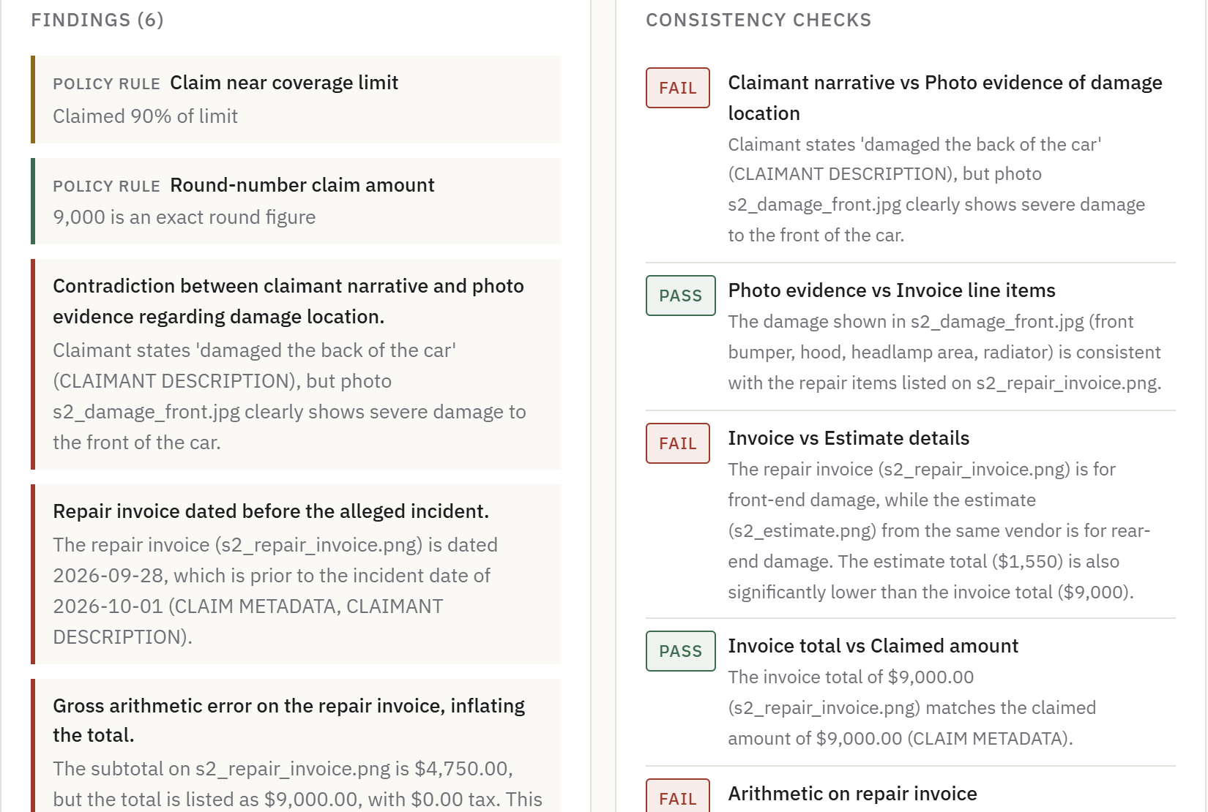
Snapshots of the prototype
A $9,000 claim flagged in 30 seconds, with the evidence laid out
What it caught on this claim
The photo shows front-end damage, but the claimant describes a hit to the back of the car.
The invoice lists a hood, radiator and headlamps, and is dated three days before the incident.
Its line items add up to $4,750, yet the total says $9,000.
The same shop's own estimate for rear damage was $1,550.

Slide 11
Prototype performance report and benchmarking
15 of 15 runs reached the expected decision
15/15
25 s
20 pts
Each claim was run 3 times through the production code path (Gemini 2.5 Flash on Vertex AI, temperature 0.2), four at a time. Scores move a few points between runs, but the recommendation holds, and the rule floor keeps hard policy breaches from ever dropping into low risk.
runs with the expected recommendation
average review time, 2 to 3 files per claim
largest score spread across repeat runs
Test claim | Files | Expected | Correct | Score range | Avg time
Consistent rear-end collision | 3 | Approve | 3/3 | 5 to 10 | 24.7 s
Inflated repair invoice | 3 | Investigate | 3/3 | 100 to 100 | 31.8 s
Phone lost before purchase | 2 | Investigate | 3/3 | 85 to 100 | 21.2 s
Late water damage report | 2 | Manual Review | 3/3 | 15 to 35 | 26.7 s
Photo of a different car | 3 | Investigate | 3/3 | 65 to 85 | 21.7 s
Test set: five synthetic claims with known answers. Next step is a labelled set of real, anonymised claims from a pilot partner.

Slide 12
Additional details and future development
From a working prototype to a pilot with a real insurer
NEXT 30 DAYS
NEXT QUARTER
LATER
Pilot ready
Network signals
More lines of business
Firestore for claim history and an audit log
Pub/Sub intake from claim portals
Single sign-on for adjusters
BigQuery history to catch reused invoices and repeat vendors
Fraud ring detection across claims
Vertex AI model tuned on real investigation outcomes
Photo forensics: metadata checks, reused or stock images
Health and travel claims
KYC and loan document checks for banks
Business model. Priced per claim reviewed and installed in the customer's own cloud account, so insurers keep control of their data and pay in line with their claim volume.

Slide 13
Provide links to your:
GitHub public repository
https://github.com/PR1YAM9/ai-builder-cup
Demo video (3 minutes)
Add your video link here
Final product link
https://claimguard-ai-342329356911.us-central1.run.app
API reference
https://claimguard-ai-342329356911.us-central1.run.app/docs

Slide 14


