Slide 1
Understanding tf
ROSCON 2012
Tully Foote tfoote@willowgarage.com

Slide 2
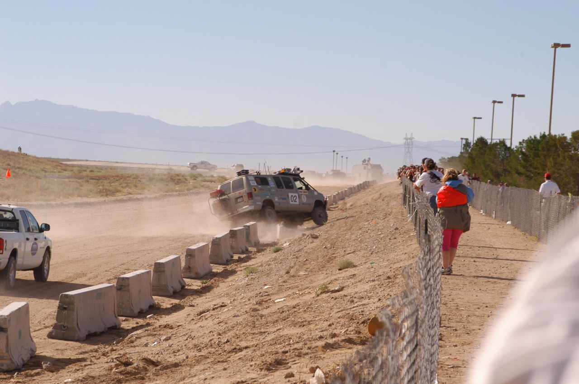
Motivation for tf

Slide 3
Goals of tf
Do it well and never have to think about it again.
  Save others from thinking about it too
Encode positional association in data to facilitate logging and playback and reprocessing.
Preserve data in it's original form and only operate on it if required.

Slide 4
What is tf?
A library which keeps track of coordinate frames.
  A standardized protocol for publishing transform data to a distributed system
  Helper classes and methods for:
    Publishing coordinate frame data
    Collecting transform data and using it to manipulate data - Transformer, TransformListener, tf::MessageFilter, ...

Slide 5
How do I interact with tf?
There are two main ways to interact with tf:
Listeners – listen to /tf and cache all data heard up to cache limit in memory
Publishers – publish transforms between coordinate frames on /tf

Slide 6
tf is for distributed systems
Distributed systems have latency.
tf itself is designed to be distributed.
There is no central source of tf information
  This means there is no history before a node started listening to /tf topic

Slide 7
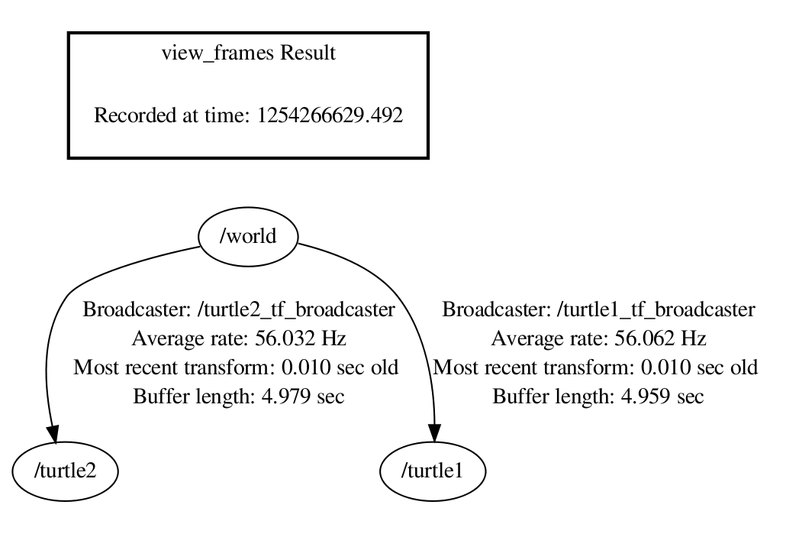
tf Data Model
Each link in the tree is cached in memory
10 seconds is default cache time
It will work with multiple disconnected trees
Only for transforms within the same tree

Slide 8
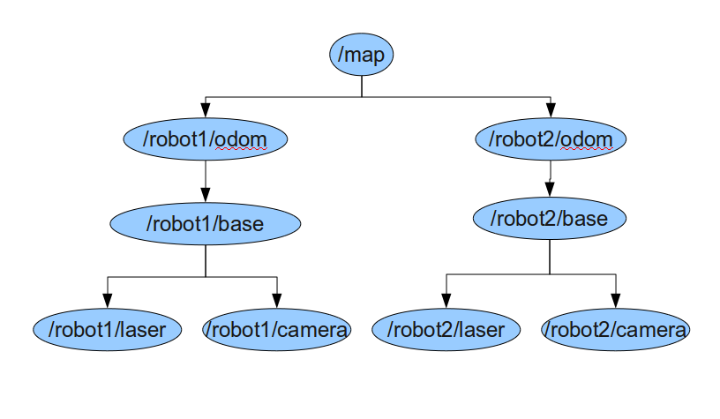
How to look up a transform?
T3
T4
T2
T1
T = lookupTransform(“/robot1/laser”, “/robot2/base”, 123.4)
T = T1 x T2 x T3 x T4⁻¹

Slide 9
Looking up Time in a Chain
Success
Failure
Query
Time
Query
Time
Failure
Failure
Query
Time
Query
Time

Slide 10
Looking up Time in a Chain
This can also fail if you ask for the latest time using time 0
  Which asks for the latest common time.
Failure
Query Time = Latest
No Common Time

Slide 11
Inside the Cache
Each transform has a sorted linked list of the history of transforms for that link.
When looking up a transform in that link at time, the two closest points will be found on either side.
Spherical linear interpolation will be used to compute the best approximation of the value at the requested time.

Slide 12
Values of tf
Transform data only once
  No computational cost of intermediate data transformations
  No compounding rounding errors
The user does not need to worry about which frame their data was collected
  They just transform it into the coordinate frame they want it in.
  Most users don't need to know anything about 3D transform math.

Slide 13
Values of tf
Information about past locations is also stored and accessible
Capable of dealing with delayed data

Slide 14
Core Methods of Transformer
All methods are built on top of these two core methods.
LookupTransform
  Get the transform between two coordinate frames
CanTransform
  Test if a transform is possible between to coordinate frames

Slide 15
Helper Methods
For common datatypes.
  TransformPoint
  TransformVector
  TransformPose
  TransformQuaternion
  transformPointcloud

Slide 16
Dealing with latency
In distributed networks, transfering knowledge takes time
tf data may arrive first
  Then the cached data will allow transformations
    A common failure is to not create the Listener and allow time to fill the buffer, or let it go out of scope.
tf data may arrive after the primary data
  How do we deal with this?

Slide 17
Syncronization Methods
There are two ways to wait for a transform to come available
WaitForTransform
  Block until timeout or transform is available.
tf::MessageFilter
  Subscribe to a topic an provide the callbacks only when there is enough tf messages to tansform the data.

Slide 18
Transformer::waitForTransform
Dangers
No data coming in if in single thread
Blocks all progress, can make all processing late
Protection in Transformer class usingSeperateThread method
Using this method can delay the whole system unnecessarily
But it's very convenient for scripting/sequencing

Slide 19
tf::MessageFilter
Purpose
Provide a non blocking way to queue data pending transform data availability
Usage
Register a target frame and an incoming topic
Receive a callback when transforms are available
Notes:
Why
Non blocking
Non polling

Slide 20
Introduction to Time Travel

Slide 21
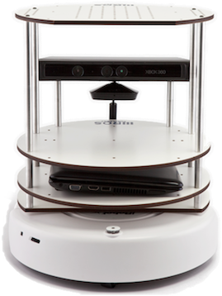

Advanced API
The TurtleBot observes an apple while driving past
5 seconds later the TurtleBot is asked to plan a path around all known obstacles.
Time

Slide 22
Advanced API
An apple is observed falling on the TurtleBot
5 seconds later the TurtleBot is asked to plan a path around all known obstacles.
Time

Slide 23
Advanced API
Construct transform from first frame to fixed frame at data timestamp
Jump to query time in the fixed frame
Compute the transform from fixed frame to query frame at query time
Return the product of these transforms

Slide 24
Avanced API Walk Through
1) Apple Observed in TurtleBot frame
5) Apple available for obstacle avoidance in the Target Frame at Target Time
TurtleBot
TurtleBot
Ttime=0
Ttime=5
World
World
2) Apple Transformed into Fixed Frame at Observation Time
4) Apple Transformed into Target Frame At Target Time
3) Apple Assumed Static in Fixed Frame

Slide 25
Debugging Tools
Command Line Tools
  tf_echo – Print a specific transform to the screen
  tf_monitor – Display statistics about transforms
  roswtf (tf_plugin) Debug common tf configuration errors

Slide 26
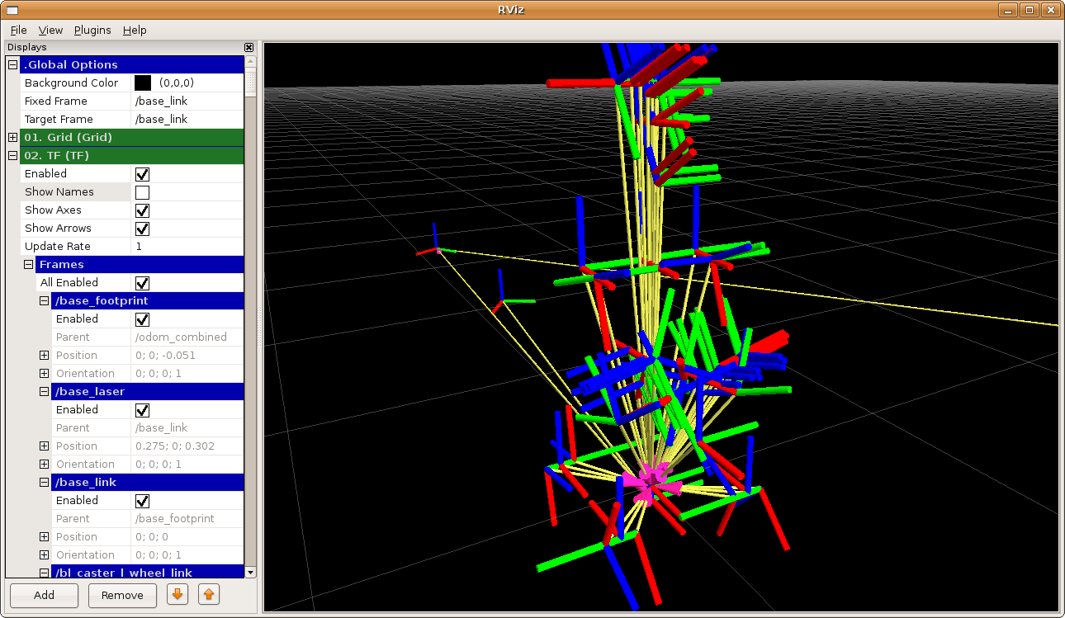
Debugging Tools
Visualizations
  Rviz
  view_frames

Slide 27
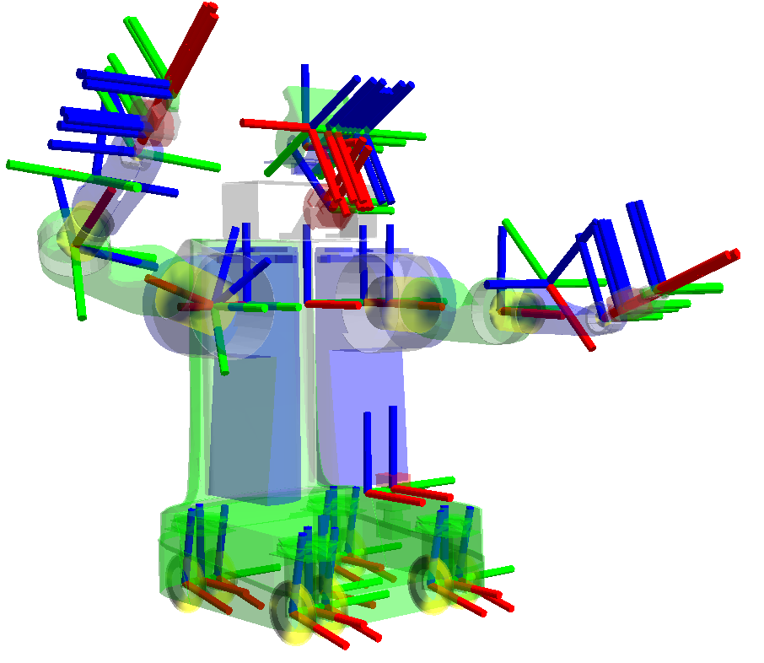
Coordinate Frames in a Robot
Every Link has a frame_id the same name as in the URDF
Each sensor has a frame_id in which it takes measurements
Data is broadcast in the frame in which it was observed.

Slide 28
Coordinate Frame Conventions
Managing coordinate frames is a challenge.
Some Standards:
REP 105 Mobile Platforms
REP 120 Humanoids
Mostly by convention, please try to reuse existing names.

Slide 29
Challenges with the current tf
Transmission over wifi
Disambiguation of frame_ids with multiple homogeneous robots
Infrequent queries without latency requirements still require a subscription to tf
It uses a lot of bandwidth in general
To make it easy to use it has a lot of dependencies.

Slide 30
Goals for tf in the future
Rewrite the tf library
  Core C++ library with only message datatype dependencies
  Templated API to allow extensions to custom message data types
Fully featured Python library as well
Provide first class support to static transforms, no need to republish
Provide a server/client interface for querying remote buffers

Slide 31
tf2 exists!
It is in geometry_experimental
We're using it in several projects already.
It's documented! (ros.org/wiki/tf2)
It has more unit tests than tf with better coverage.
All that remains to do is to merge it into the geometry stack and convert tf to call through to tf2 for backwards compatability.

Slide 32
Shameless BOF Plugs
Over lunch, The Future of tf BOF.
  There are more possiblities, uncertainty has been discussed, so has graphs instead of trees. What are you interested in?
At 3:30, New build and release systems.
  We have a new build and release system beta tested in Fuerte on Willow maintained packages. Any requests or requirements while it's still in beta?

Slide 33
Thank you!
Questions?

