Slide 1

PR2 Simulator
John Hsu

Slide 2

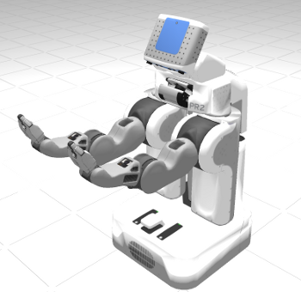
Workshop Outline
Simulator Overview
Modeling PR2
Physics Simulation
Simulation Interfaces
PR2 Interfaces
Working with PR

Slide 3
Simulator Overview
Main Software Components
  Gazebo (ODE/Ogre)
  ROS (as plugins in Boxturtle release)
Collision Detection
Create contact Joints
Robot Model Update
PID controllers, executives,
GUI, etc.
Physics Update
Solve constraint forces
Velocities, positions
Sensor Generation
Image, range sensors
(imu, contact...)

Slide 4
Simulator Overview
Constrained Dynamics
  Prismatic, revolute with explicit damping. Fixed joints.
  Contact modeling
    Allows interpenetration with restorative forces.
    Decoupled x-y dry friction pyramid.
Integrator
  LCP formulation.
  First order semi-implicit integrators.

Slide 5
Modeling PR2
Δt = 1ms (matches real-time pr2_etherCAT)
Force controlled joints
Gravity compensation → turn gravity off
All I/O through ROS

Slide 6
Gazebo World Configuration
<world>
<physics:ode/>
<rendering:gui/>
<rendering:ogre/>
<model:physical/>
...
<model:physical/>
...
</world>
Integrator
Time step size
Dissipation, stabilization parameters
GUI window Properties
Ambient lighting
Sky description
Ground grid
GUI rendering update rate
Shadow technique
Physical Models
Lights, etc.

Slide 7
Sample Physics Configuration
<physics:ode>
<stepTime>0.001</stepTime>
<gravity>0 0 -9.8</gravity>
<cfm>0.0000000001</cfm>
<erp>0.2</erp>
<quickStep>true</quickStep>
<quickStepIters>10</quickStepIters>
<quickStepW>1.3</quickStepW>
<contactMaxCorrectingVel>100.0</...>
<contactSurfaceLayer>0.001</...>
</physics:ode>

Slide 8
Example Rigid Body Model
<model:physical name=”model1” [xmlns:...]>
<body:box name="box1">
<mass>1</mass>
<ixx>1</ixx> [ixy,iyy,iyz,izz]
<geom:box name="geom1">
<visual>
<size>1 1 1</size>
<material>Blue</material>
<mesh>unit_box</mesh>
</visual>
</geom:box>
</body:box>
</model:physical>

Slide 9
Gazebo Internal Data Structure
World
  Model
    Body (Rigid bodies / links)
      Inertias
      Geom (Collision Meshes)
        OgreVisual (Visual Meshes)
    Joint (Constraints between rigid bodies)

Slide 10
Physics Simulation
3D rigid body dynamics in the inertial frame
  f=Ma
Constraint forces based on velocity constraints
  Equality constraints (revolute, prismatic)
    J₁v₁+J₂v₂=c
  Unilateral constraints (contacts)
    LCP formulation J_{c}v ≥ c.
    Contact joints are created and destroyed at every time step.

Slide 11
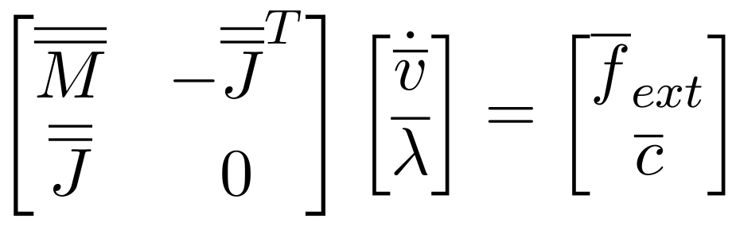
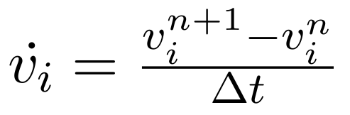

Physics Simulation
Governing Equations with velocity based LCP formulation.
First order discretization
Solve for constraint forces

Slide 12
Physics Simulation
Contact Modeling
  Gazebo friction example
    Coulomb's friction pyramid – larger friction forces off principal friction axis.
  Future work
    Friction direction alignment
    Implicit surfaces

Slide 13
Physics Simulation
Choosing a solver
  Pivot – Dantzig's algorithm, currently less stable, but provides “exact” solution
  Iterative – Projected Gauss-Seidel with successive over relaxation, not “exact solution” but more stable and convergence is good in practice

Slide 14
Physics Simulation
Solution existence and uniqueness
  Model Stability - physically unstable models?
Numerical stability, consistency/convergence
  Time step size
  Iterations per time step
  Relaxation parameter (w)
  Constraint “stiffness”, condition numbers, CFM, ERP (K_{p},K_{d}) – adding to numerical stability by artificially modifying the system of equations
Accuracy O(dt)

Slide 15
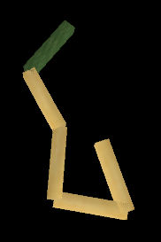
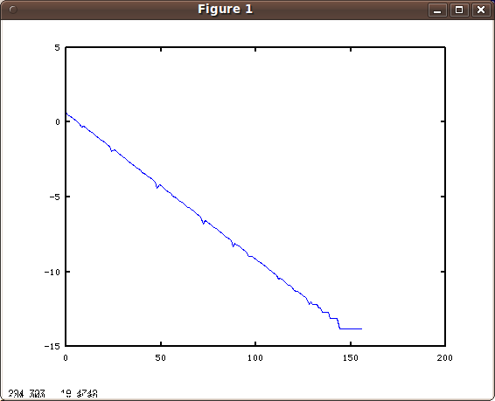
Example
Example of inner iteration convergence (rms of Δλ vs. iteration #) for 5 link pendulum.

Slide 16
Examples
Single Pendulum Example
  Time Step Size vs. Numerical Error
  Inner Iterations vs. Numerical Error
  Inner Iteration Convergence
  Effects of CFM and ERP
Double pendulum Example
  Simulation vs. analytical solution

Slide 17
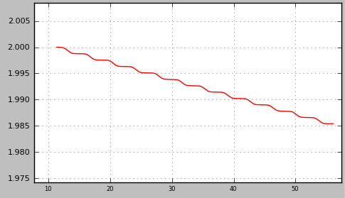
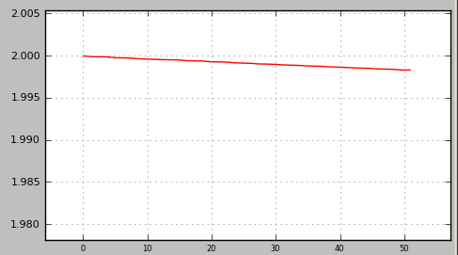
Pendulum without ERP
Single point mass pendulum (100kg) without error correction (ERP). Plots of hinge z-location vs. time.
1kHz Simulation
10kHz Simulation

Slide 18
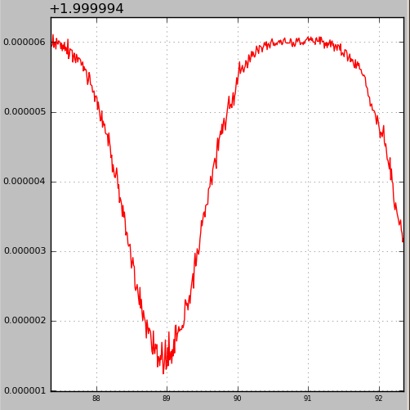
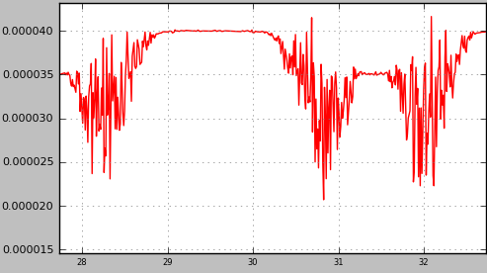
Pendulum with ERP
Single point mass pendulum with error correction (ERP=0.2) at 1kHz. Plots of hinge z-location vs. time.
10kg mass
100kg mass

Slide 19
Contact Modeling
Interpenetration with fixed time stepping
d

Slide 20
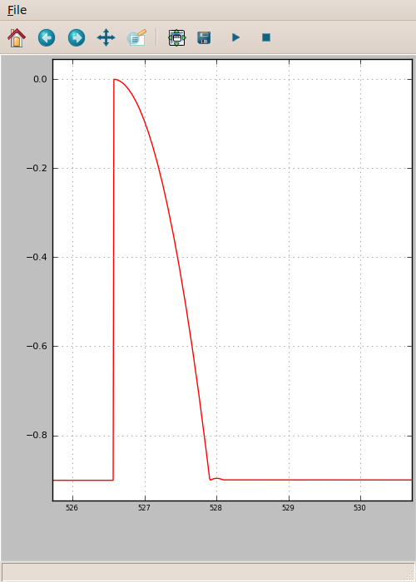
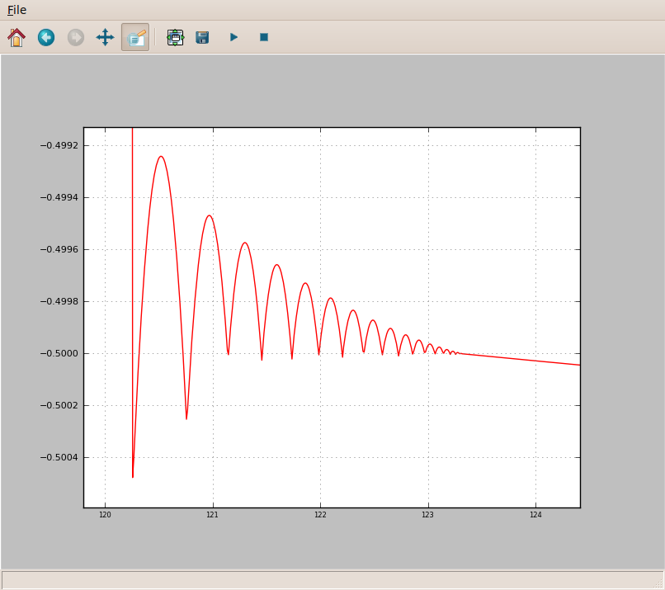
Contact Modeling
Overshoot from collision model trying to correct interpenetration:

Slide 21
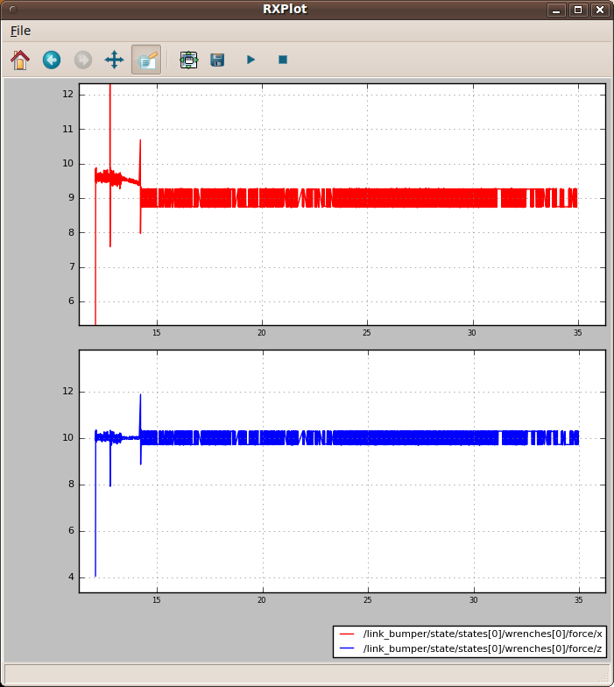
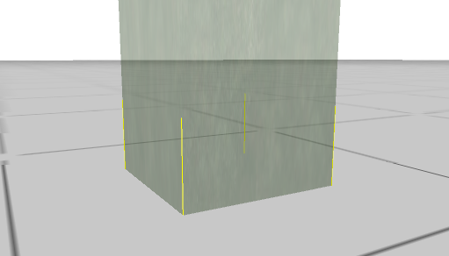
Contact Friction Modeling
10 Kg box on ground
plane with 1G lateral
acceleration.
Dry friction coefficient
0.9.

Slide 22
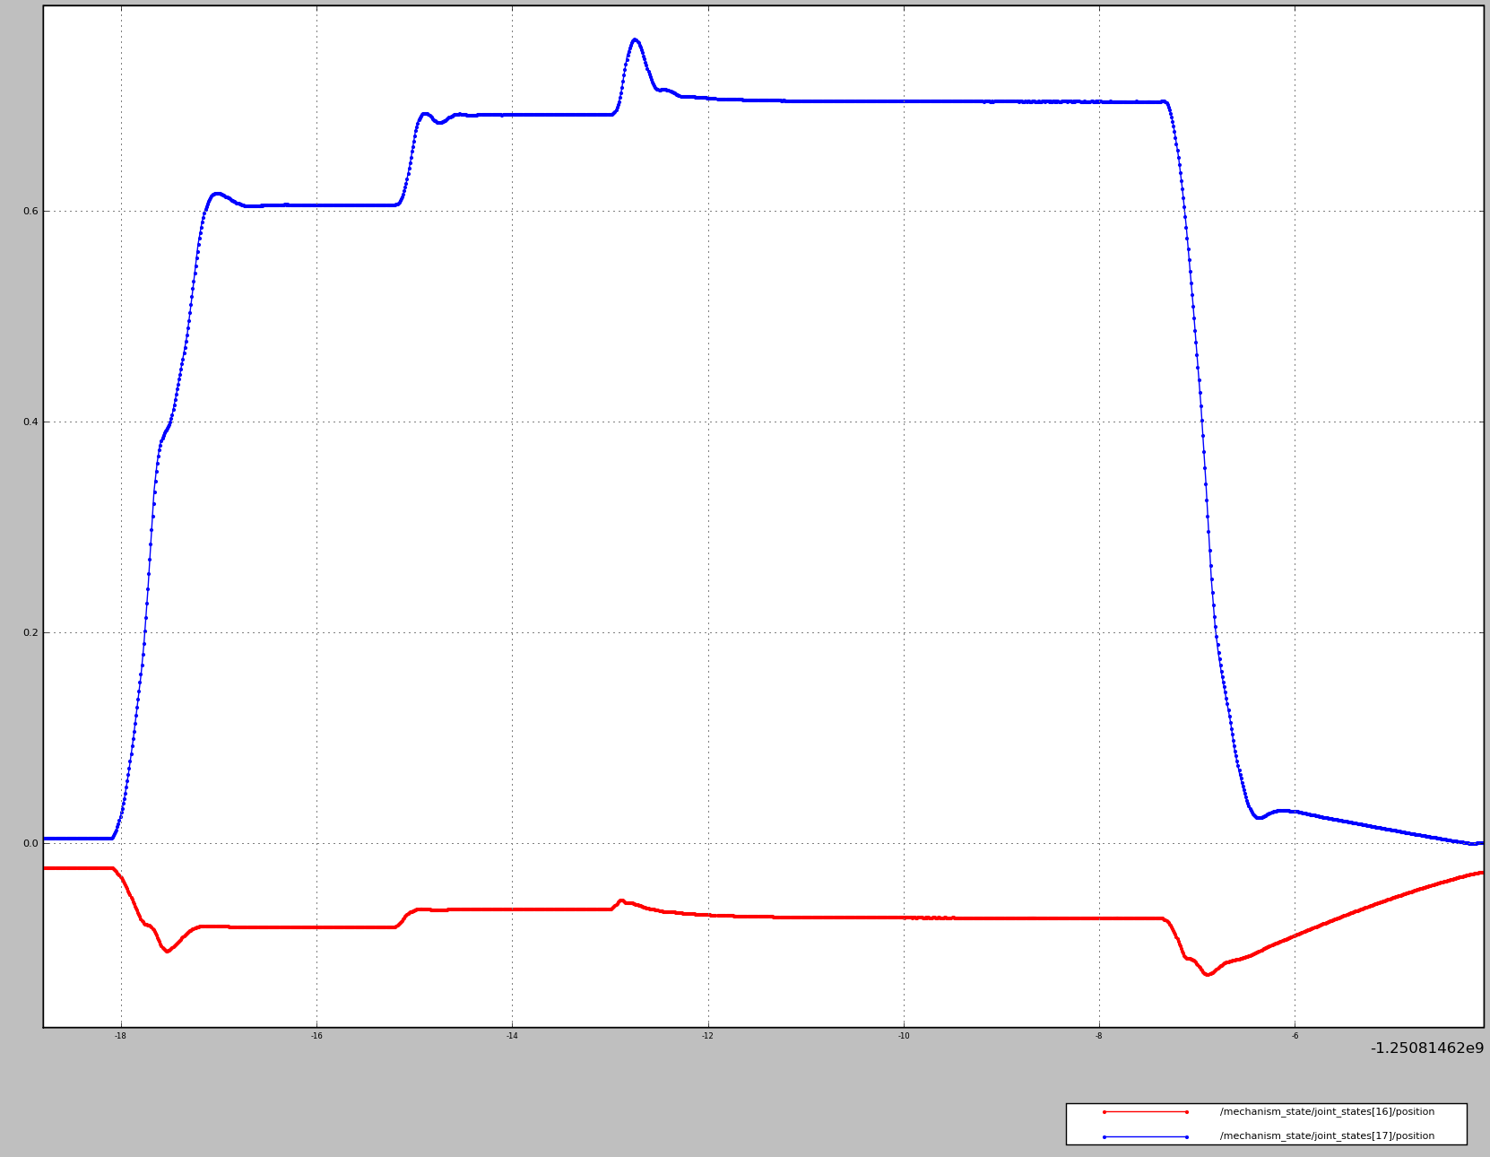
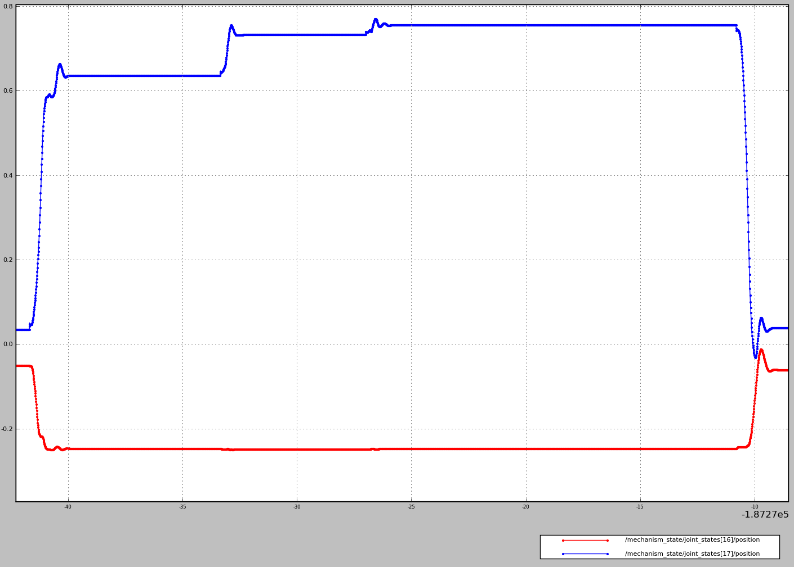
Joint Trajectory Example
Same command to the PR2 arm in simulation and on the hardware:
PR2
Simulation

Slide 23
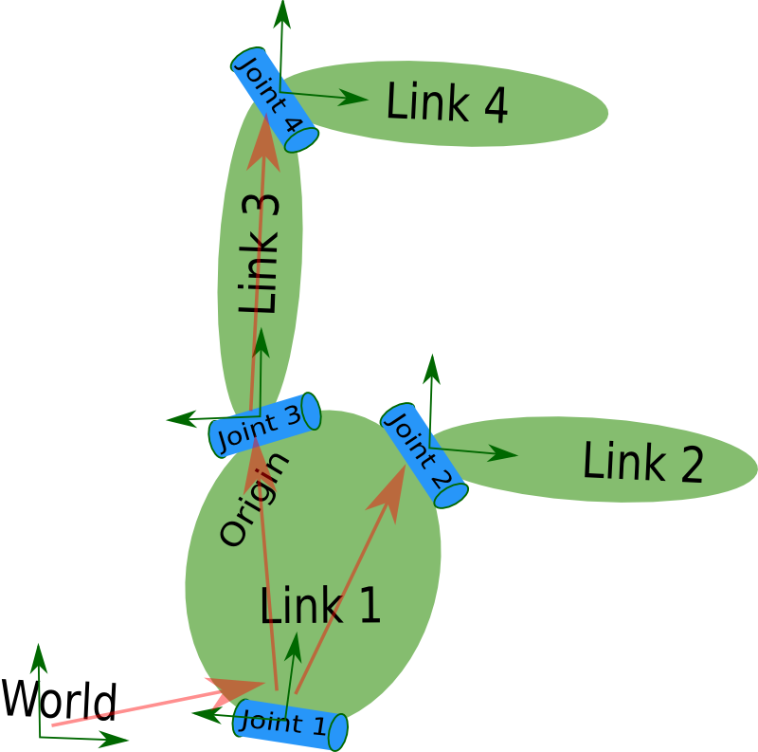
URDF
Description of the robot as a set of rigid linkages and joints.
Must be a tree (single parent).

Slide 24
URDF
Links
  Inertial element – provides M in f=Ma.
  Visual element – for visualization and camera sensors.
  Collision element – enables collision detection for contact joint creation and range sensor simulation.

Slide 25
URDF
Joints
  Prismatic, revolute, continuous, fixed.
  Specify joint axis for prismatic and revolute joints.
  Dynamics – damping force is proportional to velocity.
  Transmissions
    Maps joint state ↔ actuator(motor) states
    ROS package pr2_mechanism_model contains SimpleTransmission, Pr2GripperTransmission, WristTransmission.

Slide 26
Simulation Interface
Spawn simple objects
http://www.ros.org/wiki/simulator_gazebo/Tutorials/AddingObjectsToTheWorld

Slide 27
PR2 Interface
Controlling PR2 in simulation
https://docs.google.com/a/willowgarage.com/Doc?docid=0AXzTiNaRWL7fZGc4ZDd0N3hfMjFjZ3puZHdkYw&hl=en

Slide 28
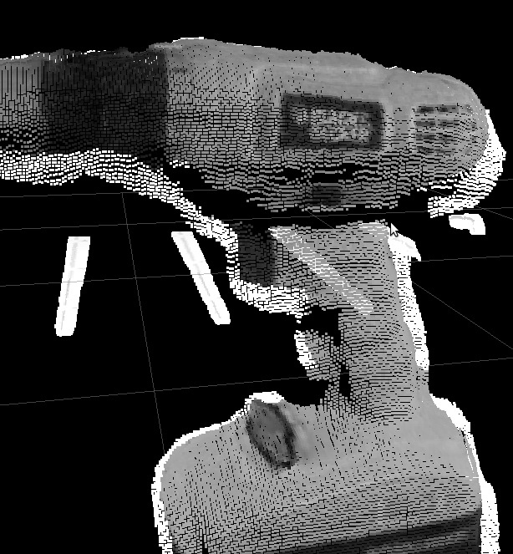
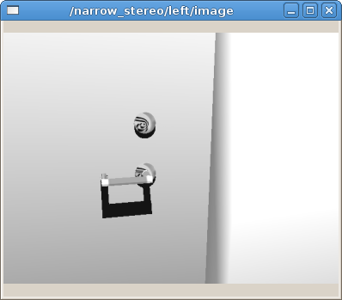
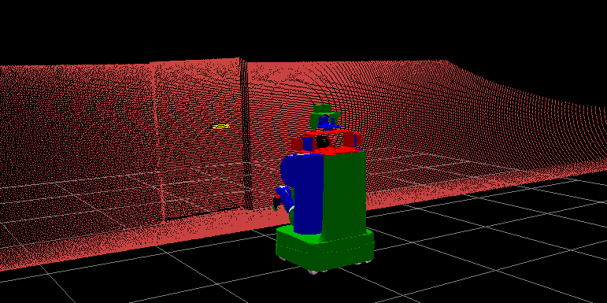
PR2 Interface
Sensor plugins ROS topics
  /base_scan
  /tilt_scan
  /narrow_stereo/*
  /wide_stereo/*
  /l_forearm_cam/*
  /r_forearm_cam/*

Slide 29
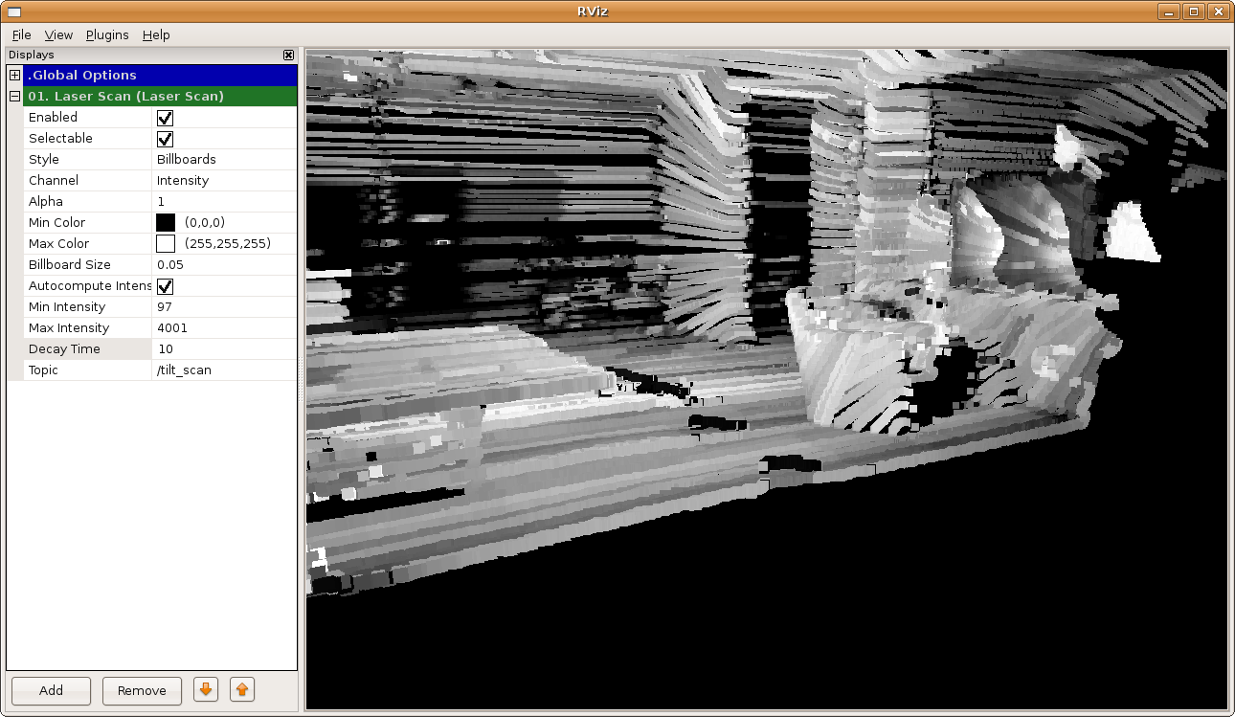
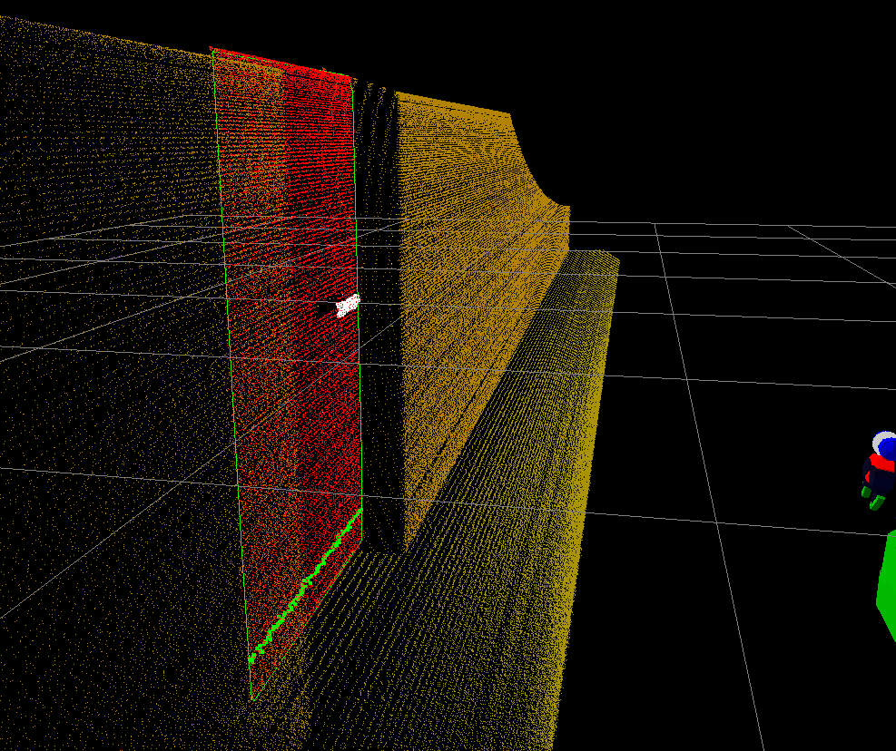
Simulation vs. Real World
Laser scan example: real world sensor reading (left) is usually much more cluttered / noisier than simulation results (right).

Slide 30
Mechanism Controller
Simulating a single controlled joint
(gazebo_benchmark + google doc for work flow to be completed)

Slide 31
PR2 Interface
Starting the PR2 simulatorhttp://www.ros.org/wiki/pr2_simulator/Tutorials/StartingPR2Simulation
Browse rostopics, parameters and services
Mechanism control through ROS
  controller_manager plugin
  /joint_states

Slide 32
Simulation Interface
Manipulate simple objects
(To be created, using set_pose.py)

Slide 33
Gazebo Plugins
Writing you own gazebo plugins
  Example: gazebo_plugins/src/gazebo_ros_template.cpp
    GZREGISTER_DYNAMIC_CONTROLLER()
    LoadChild()
    InitChild()
    UpdateChild()
    FiniChild()

Slide 34
PR2 Interface
Power state (power_monitor) simulation
  power_state
  plugged_in
IMU simulation
  torso_lift_imu/data

Slide 35
Simulation Debugging
Running Gazebo with GDB

Slide 36
Simulation vs. Real World
How well should one expect simulation / real world physics
  Contact – simulator is preset to inelastic collisions. Some contact instabilities with constraint repair approach.
  Contact friction – friction pyramid, not accurate if resulting friction force is not aligned with the principle directions.

Slide 37
Simulation vs. Real World
Summary cont'd:
  Sensors – shading is interpolated across trimeshes. Per-pixel light is currently experimental.
  Joint damping – explicit, hence limited.
  Joint Efforts / Positions – ideal motors and encoders.
  Joint friction and efficiency not modeled.

Slide 38
Slide Title

Slide 39
Slide Title

