Slide 1
PR2 Maintenance
ROS + PR2 Training Workshop

Slide 2
Overview
Robot Overview:
  Review slides of the front, rear, and sides of the robot.
  Show the parts we will be focusing on specifically:
    Filter
    Counter Balance adjustment (CB)
    Gripper tips
Review safety and ESD protocols.
Review power requirements.
Review Accessory and Tool Kits:
  Review items and tools in general
  Show how to use torque tools + why and how to apply Loctite
Hands on demos:
  Filter R/R
  CB adjustment
  Video of Gripper Sensor Tips R/R
  Gripper Sensor tips R/R
See support.willowgarage.com to order replacement parts.

Slide 3
Robot Overview
Robot Overview:
  Review slides of the front, rear, and sides of the robot.
  Show the parts we will be focusing on specifically:
    Filter
    Gripper Tips
    Top covers and Shoulder for CB adjustment
  Point out:
    Power Switch
    A/C breaker
    Run – Stop button
    Where to plug in the ESD strap on Accessory Mounting plates

Slide 4
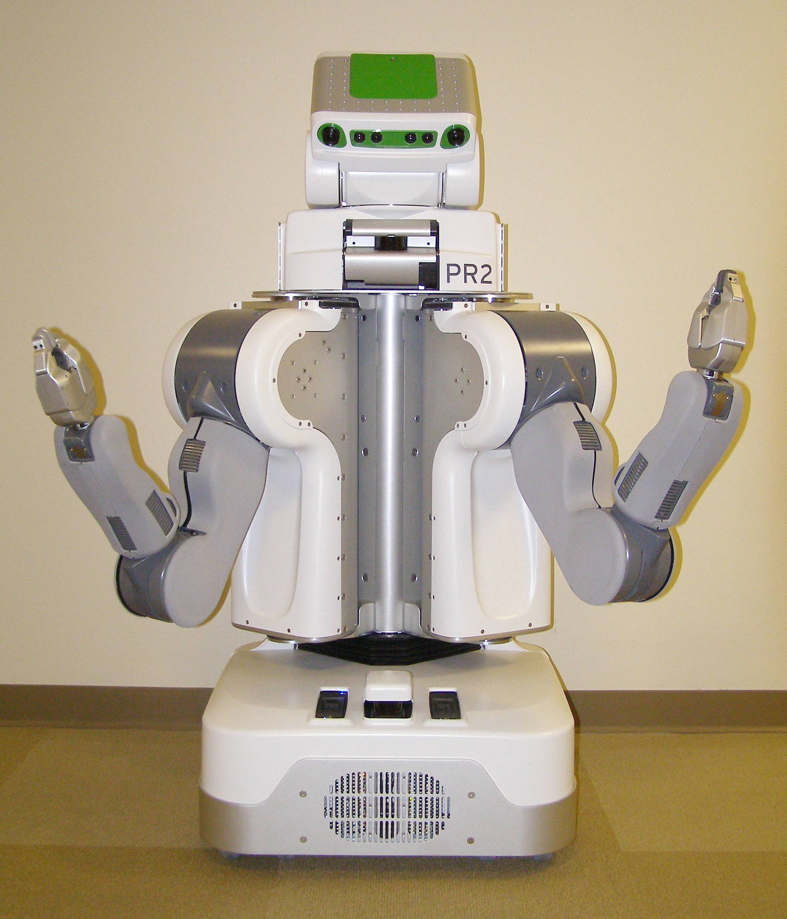
Robot Overview – Front View
Head Tilt Stage Panels
Top Front Panel
Laser Sled
Head Pan Stage Panels
ShoulderCovers
Center Trim
Gripper
Fore Arm
Upper Arm
Front Bellows
Front Bottom Panel
Base Skirt Front

Slide 5
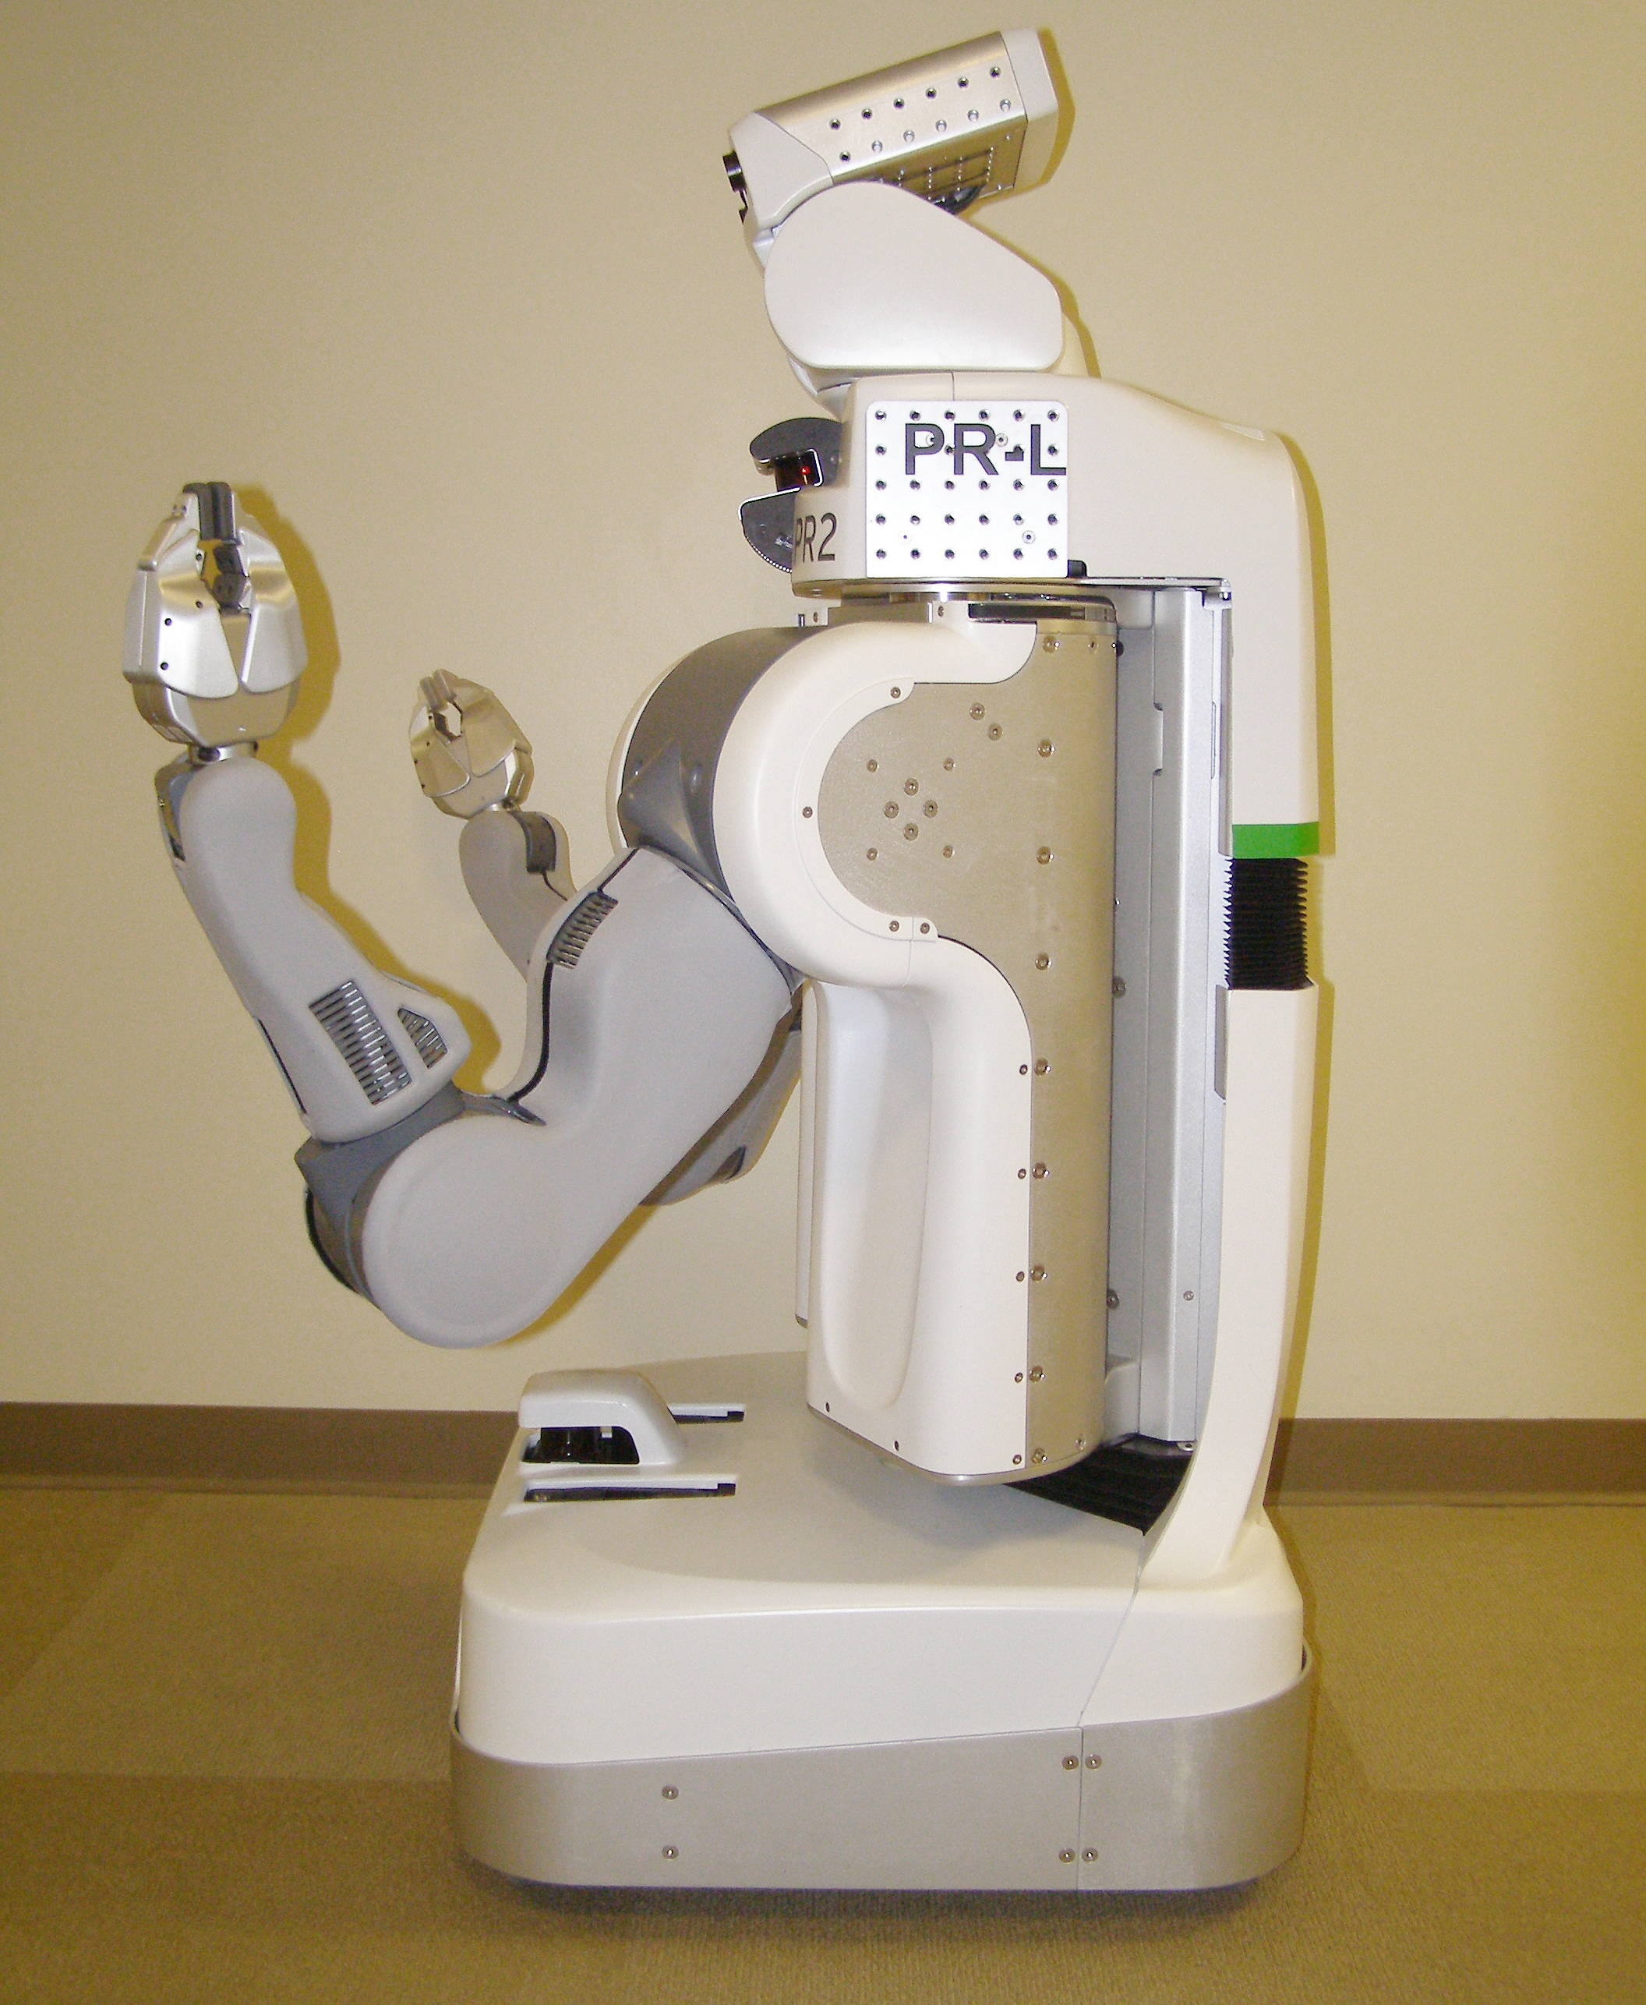
Robot Overview – Side View
Head Tilt Stage Panels
Head Pan Stage Panels
Gripper
Laser Sled
Top Front Panel
Rear Top Panel
Shoulder Covers
Rear Bellows
Rear Bottom Panel
Fore Arm
Left Body Trim
Upper Arm
Hokuyo
Front Bottom Panel
Front Bellows
Base Skirt Front
Base Skirt Rear

Slide 6
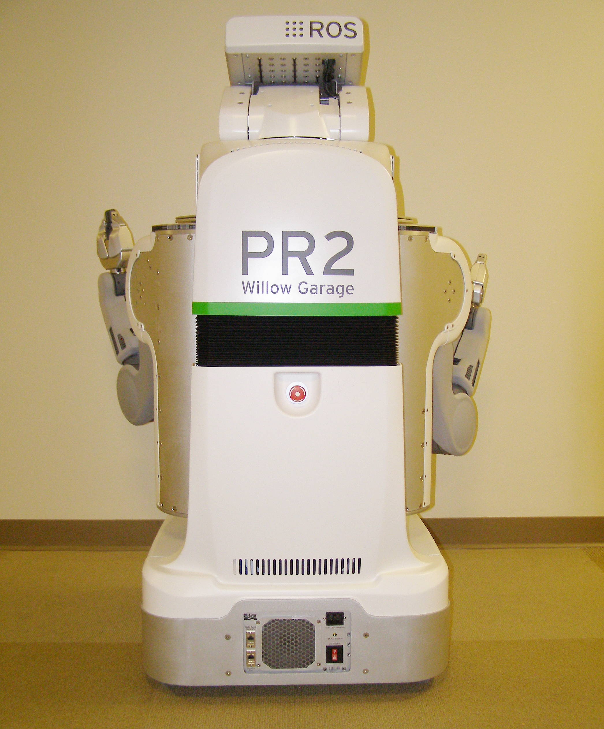
Robot Overview – Rear View
Head Tilt Stage Panel
Head Pan Stage Panel
Rear Top Panel
Rear Bellows
Rear Bottom Panel
Run – Stop
Button
Base Skirt Rear
DC Breaker
Fan Filter

Slide 7
Safety and ESD protocols
When performing maintenance work on the robot:
  Disconnect AC power from the wall socket.
  Turn off power, even when just removing covers.
  The only exceptions are when running the CB check program after doing CB adjustments and when replacing the Fan Filter.
  Always use an ESD strap, even when just removing covers.
ESD straps are in the Accessory Kit pouch.
The strap should go around the bare wrist.
The jack should be plugged into the Accessory Panel.

Slide 8
Robot Power requirements
Robot internal power, precautions, safety features:
  Battery power is “live” within the robot even when power is off.
  The Power Board controls all power to the Robot systems. This is accessable and controllable from ROS.
  There are as many as 7 levels of protection, but you cannot assume they will prevent damage or injury.
  Always turn off the robot power when servicing except when specifically required to complete a procedure such as the CB adjustment.
Plug into a dedicated 15A minimum circuit.
Only use supplied power cord.
Only use supplied self plug-in cord.
Runtime is indefinite with wall power.
Runtime on batteries is 2 hours stationary, less when moving.

Slide 9
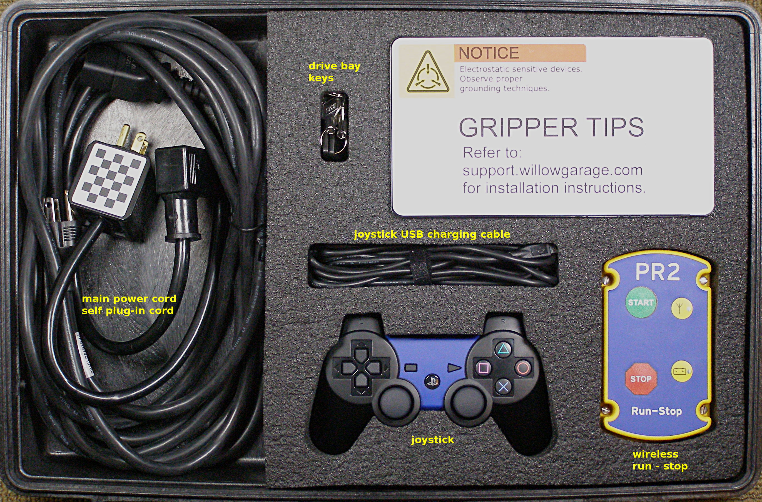
Accessory Kit
Contents:
  15 FT Power Cord, 68-06167
  (Use only this power cord!)
  Self Plug in Cable, 68-06153
  Joystick, 68-02985
  Hard drive bay keys, 68-03337
  Run-Stop Transmitter, 68-01059
  USB Joystick charging cable, 68-03533
  User Manual
  Checkerboard (small), 68-03823
  Air Filters (30PPI pakage of 5), 68-02802
  ESD strap, 68-03024
  Base Station Recovery DVD
  Gripper Box:
    Sensored fingertips, 68-03840 (x5) (use only with boots!)
    Fingertip boots, 68-03347 (x20)
- See support.willowgarage.com to order replacement parts.
Notes:
- Contents Walk Through

Slide 10
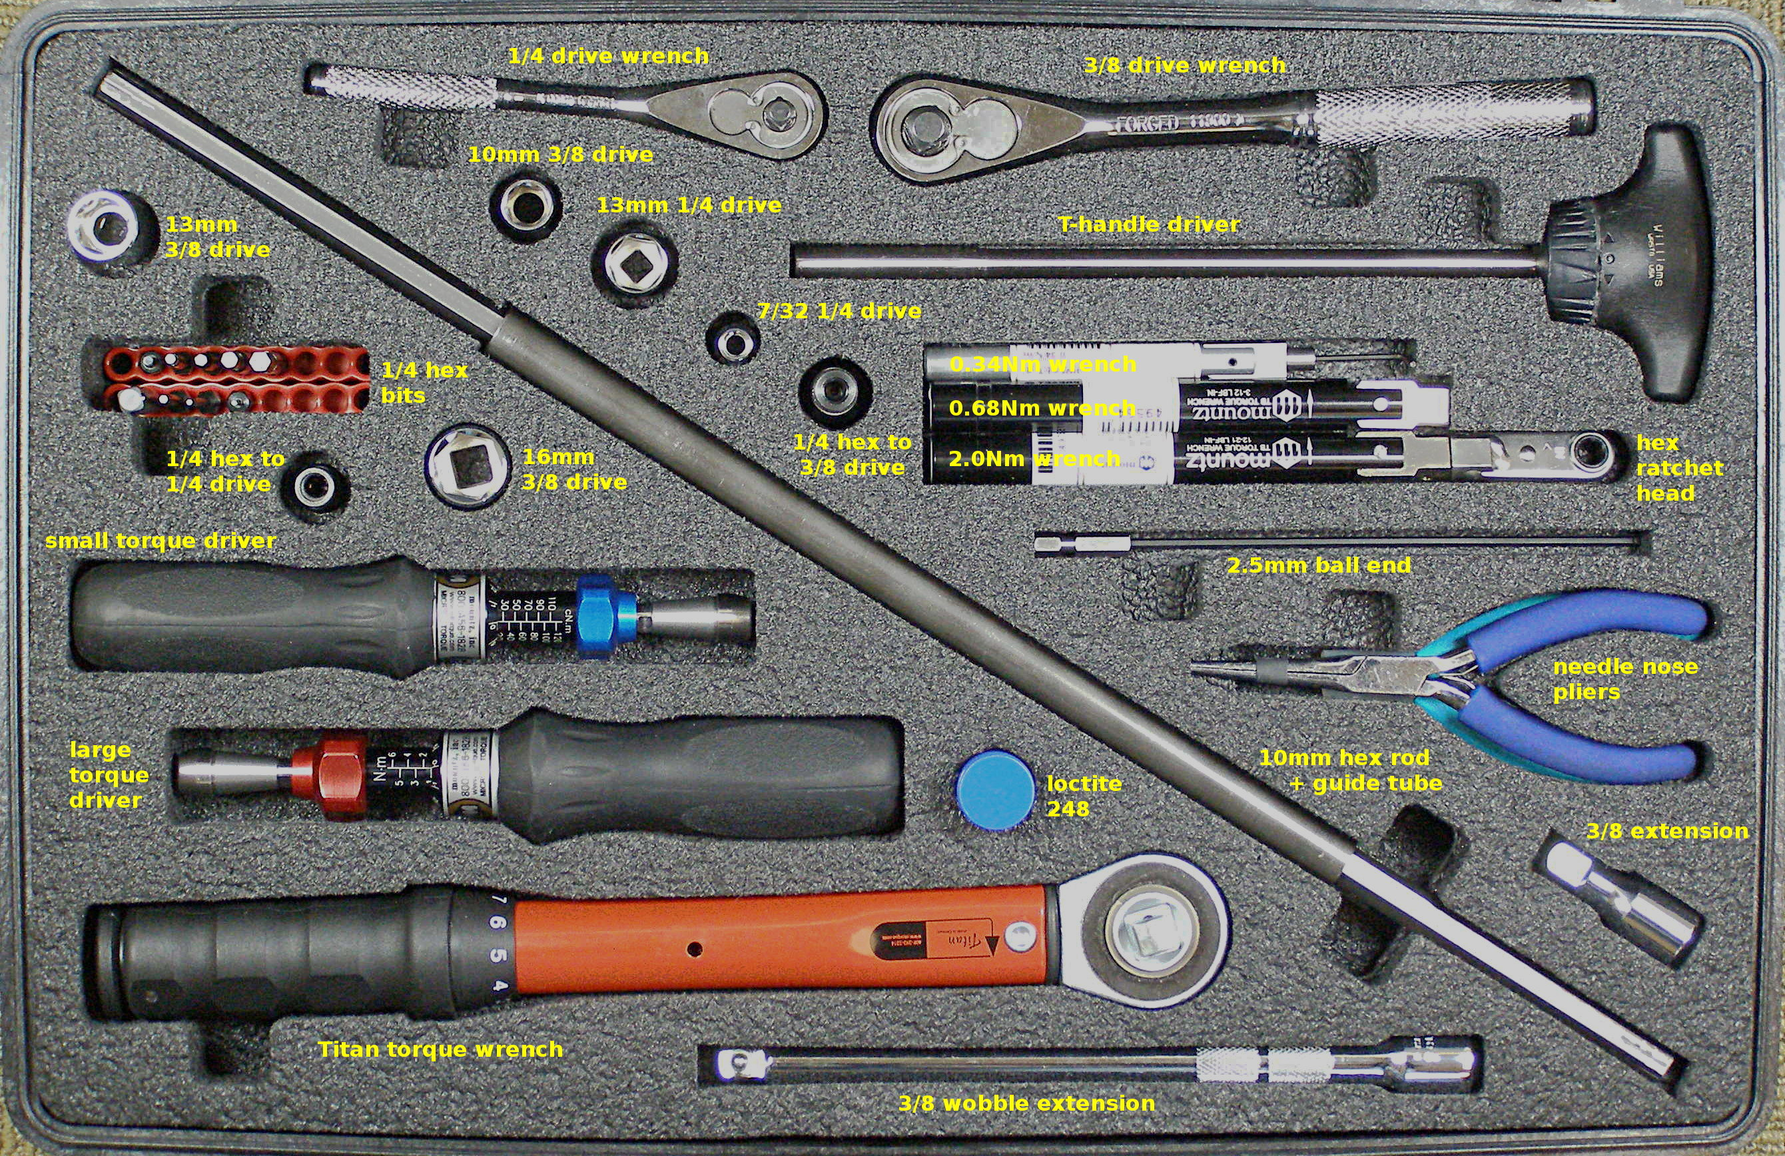
Tool Kit (1)
Contents:
  Counterbalance adjustment rod - 10mm hex, 68-07034
  Counterbalance adjustment tube, 68-07147
  Ratchet head bits: 1.5mm - 68-07040, 2.5mm – 68-07042
  Driver bits:
    1.5mm, 68-07062
    2mm, 68-07063
    2.5mm, 68-07064
    2.5mm ball end, 68-07059
    3mm, 68-07065
    4mm, 68-07066
    5mm, 68-07067
  1/4 square male to 1/4 hex male adapter, 68-07075
  1/4 square drive to 1/4 hex female dapter, 68-07077
  3/8 square drive to 1/4 hex female adapter, 68-07078
  10mm 3/8 drive socket, 68-07079
  13mm 1/4 drive socket, 68-07085
  13mm 3/8 drive socket, 68-07086
  16mm 3/8 drive socket, 68-07142 (needed for crate)
  7/32 1/4 drive socket, 68-07090
  3/8 drive short extension, 68-07116
  3/8 drive wobble extension, 68-07118
  1/4 drive quick release extension, 68-07140
  1/4 drive flex joint, 68-07141
  1/4 drive ratchet wrench, 68-07138
  3/8 drive ratchet wrench, 68-07139
  Needle Nose pliers, 68-07112
  Diagonal Cutters, 68-07146
  Zip-ties, 68-07150
- See support.willowgarage.com to order replacement parts.
Notes:
- Contents Walk Through
- ESD Strap
- Video: Adjusting Torque Tool
- Video: Loctite Application

Slide 11
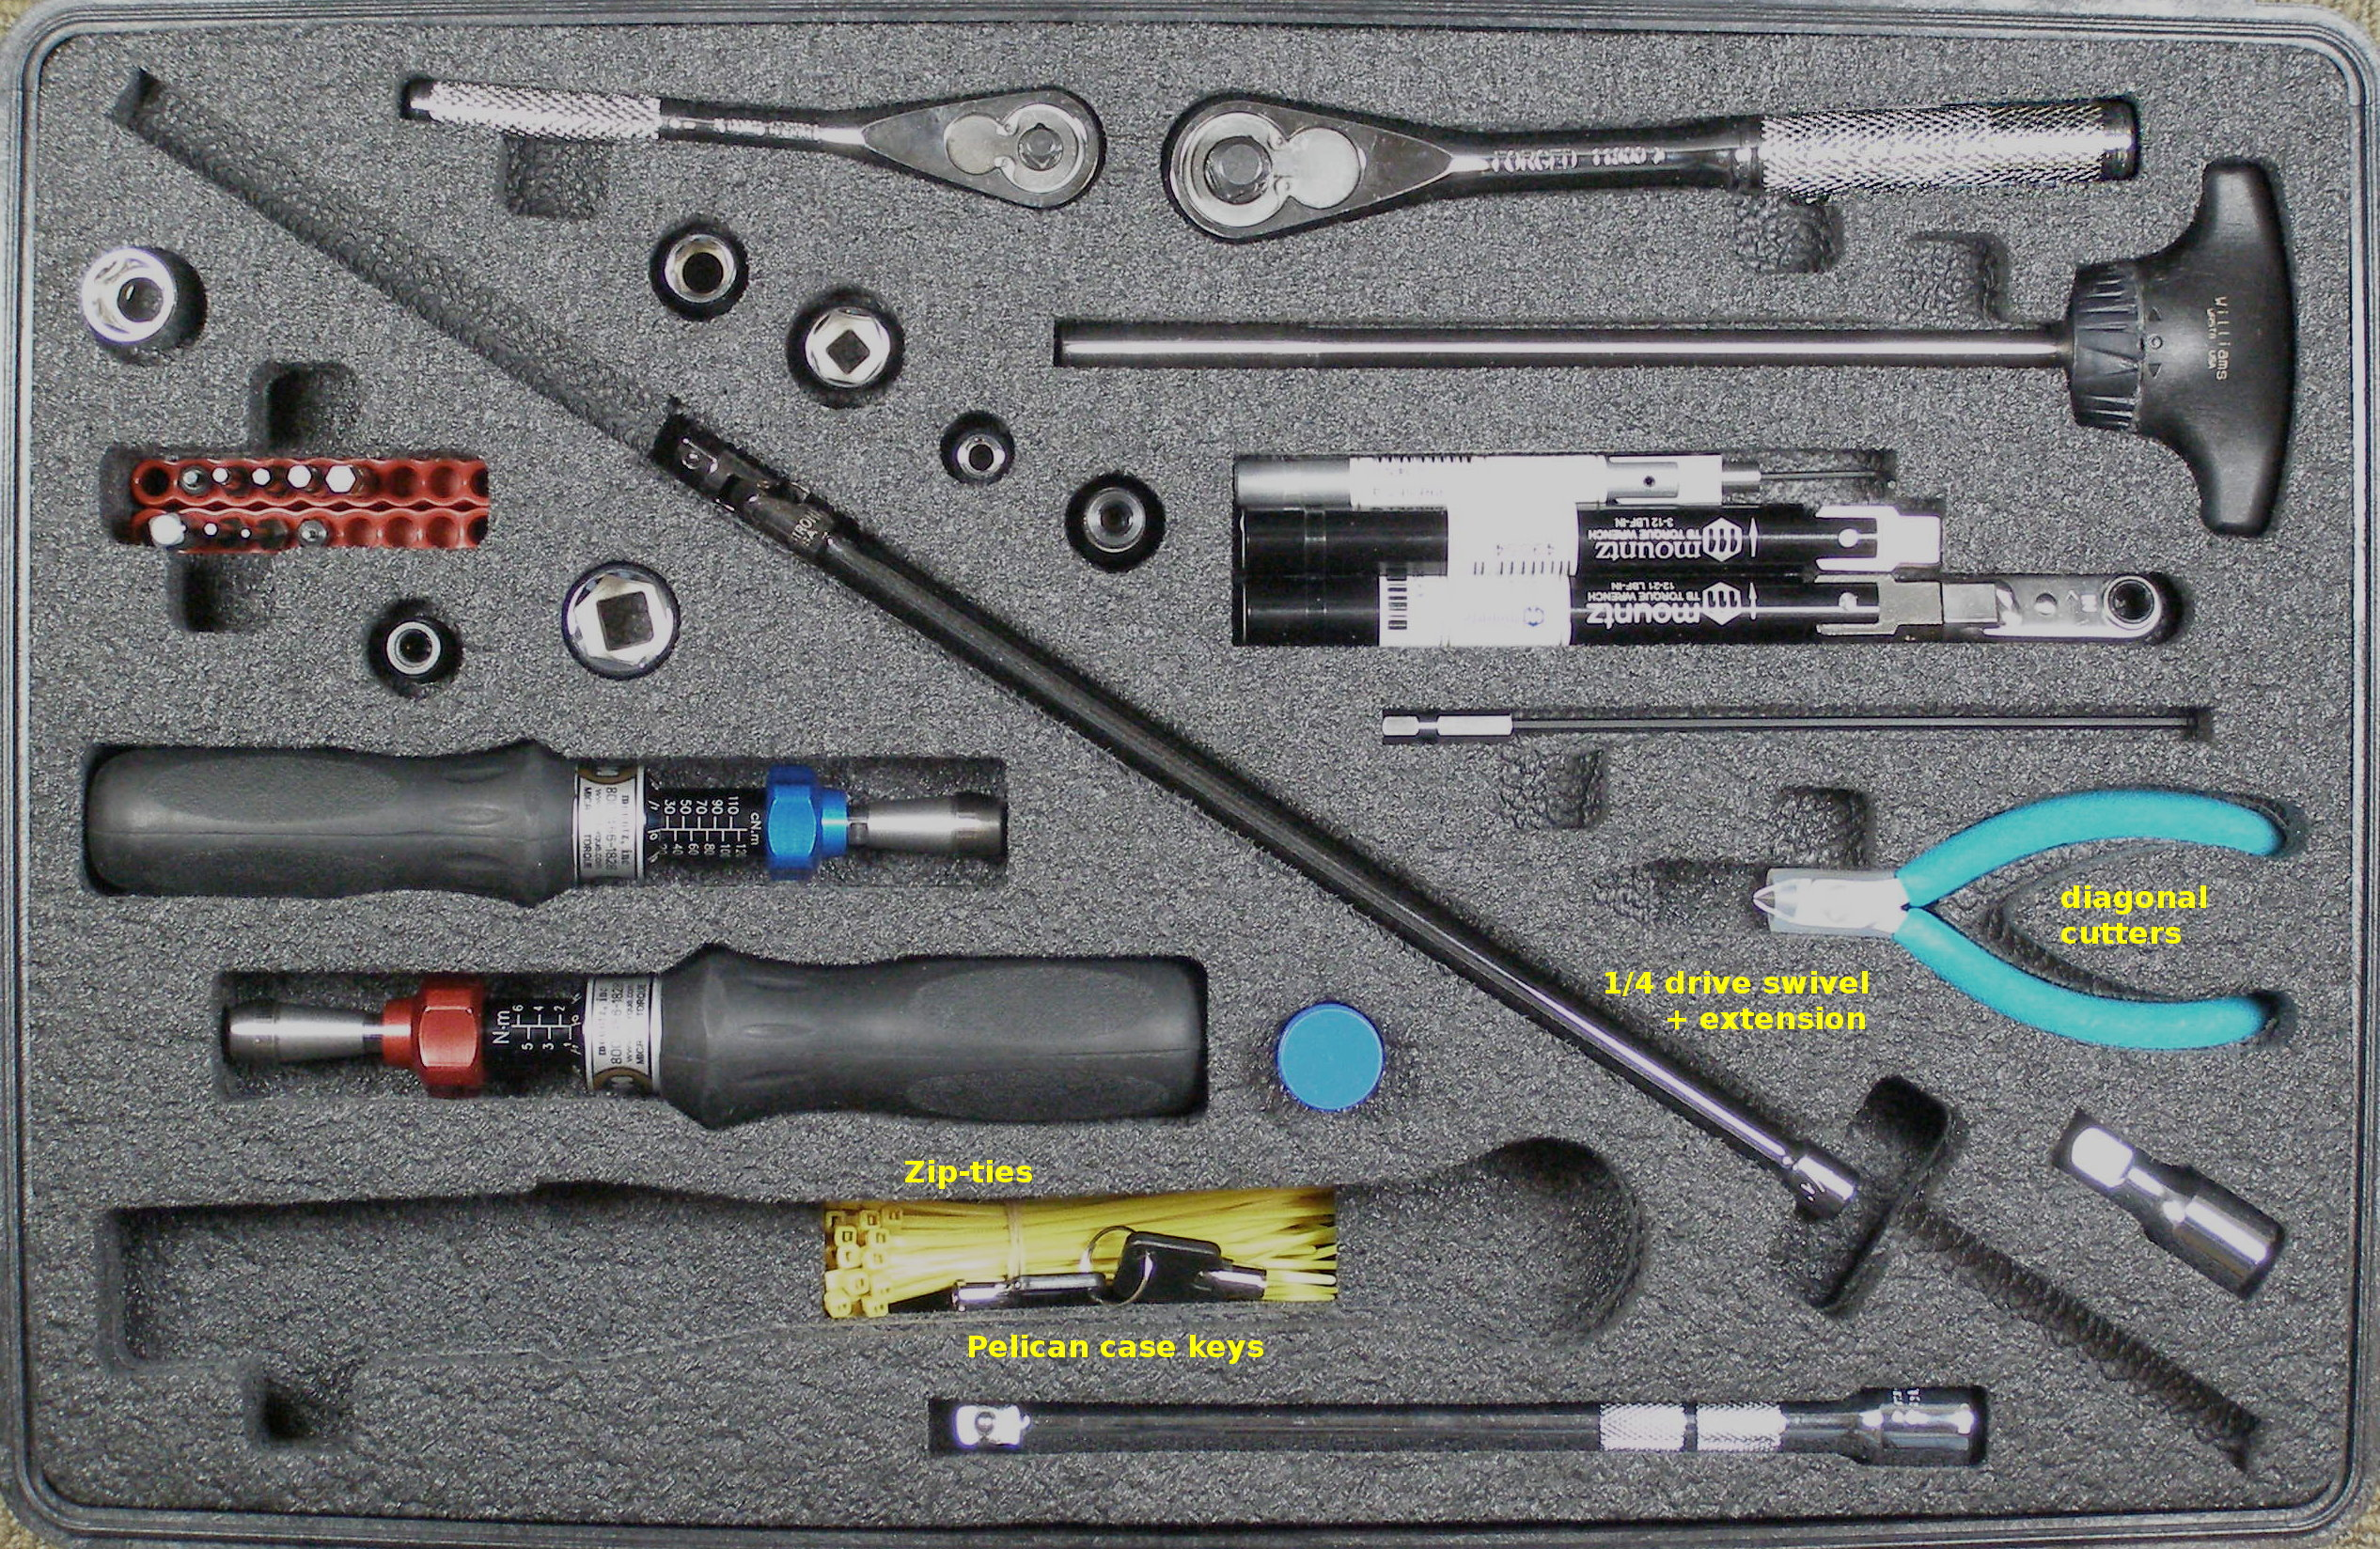
Tool Kit (2)
Contents:
  Mountz wrench and driver tools:
    Fixed 0.34Nm wrench, with 1.5mm right angle Allen, 68-07025
    Fixed 0.68Nm wrench, 68-07028
    Fixed 2.0Nm wrench, 68-07029
    1/4 hex ratchet head, 68-07033 (for use with 0.68 ans 2.0 Nm wrenches)
    0.20 – 1.20 Nm torque tool, 68-07014 (small)
    1 – 6 Nm Torque tool, 68-07015 (large)
    Titan250I 5.6 – 28 Nm Torque wrench, 68-07020
- See support.willowgarage.com to order replacement parts.
Notes:
- Contents Walk Through
- ESD Strap
- Video: Adjusting Torque Tool
- Video: Loctite Application

Slide 12
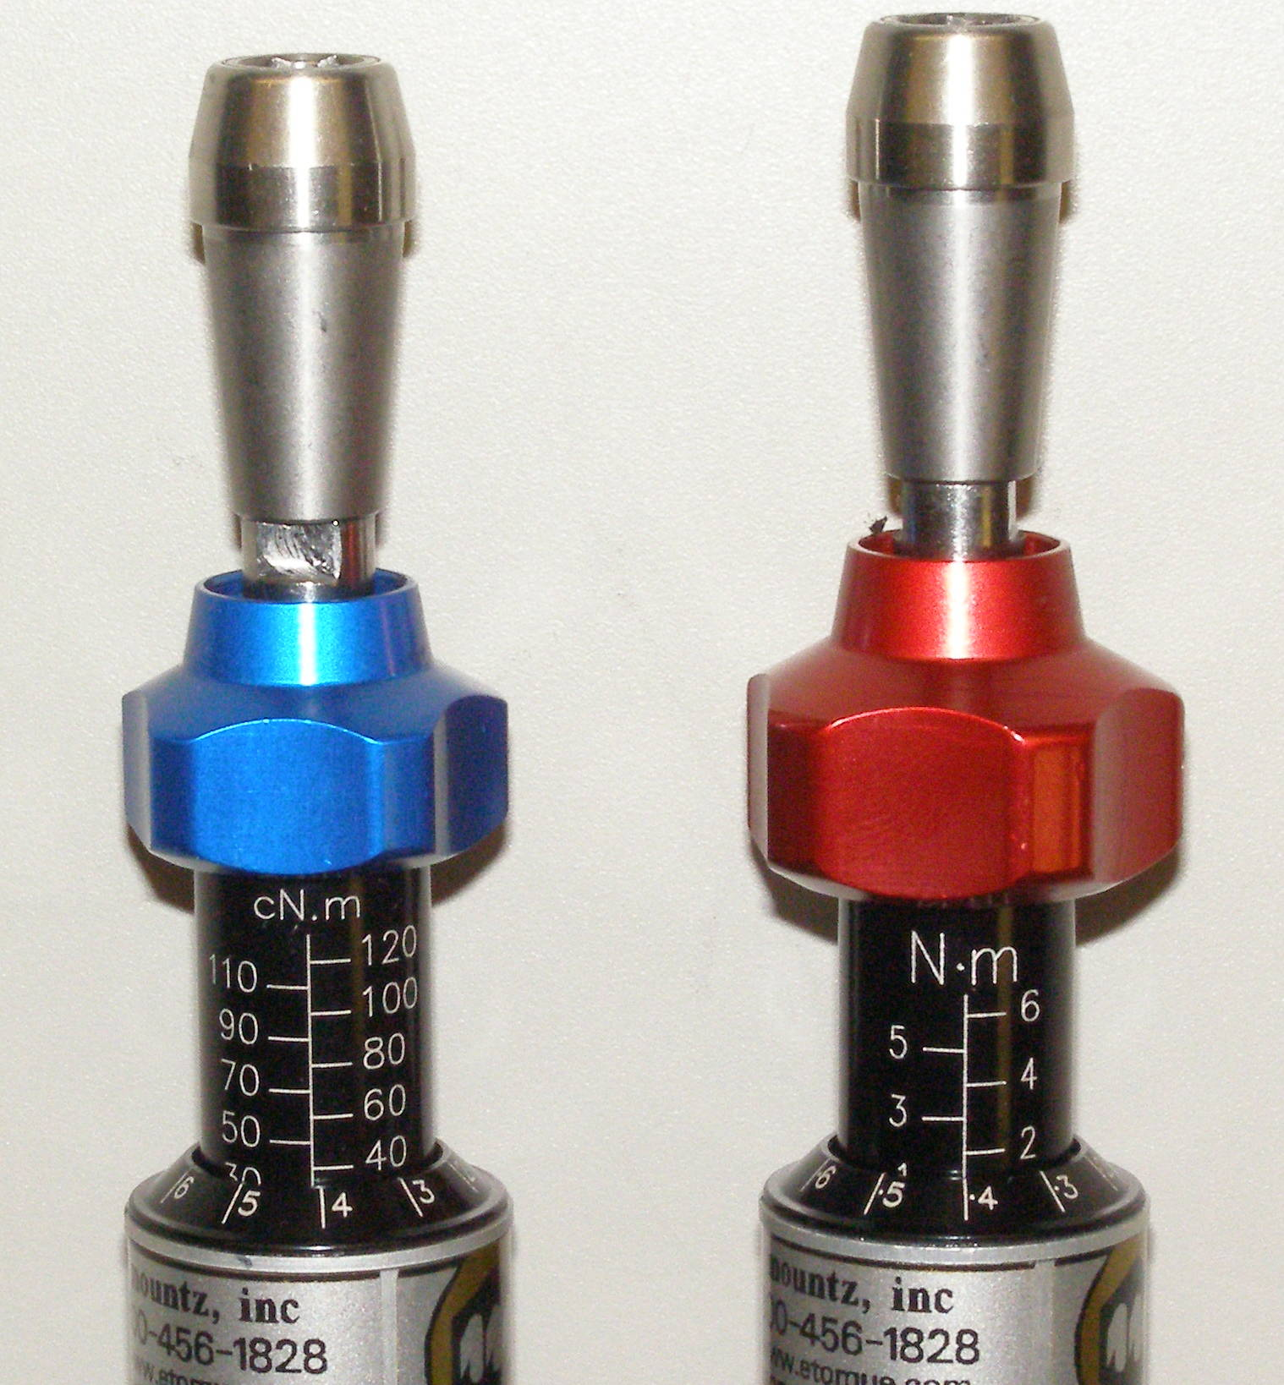
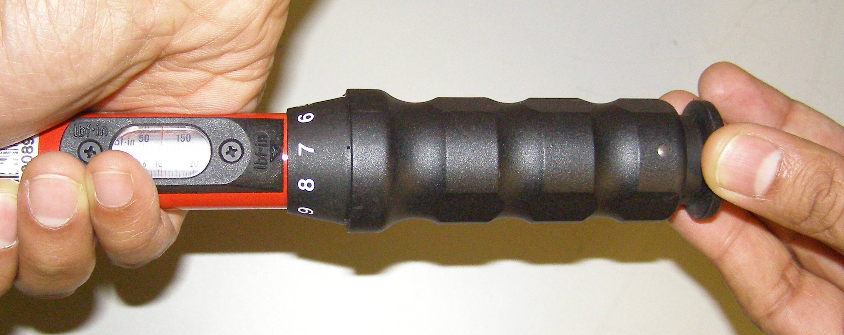
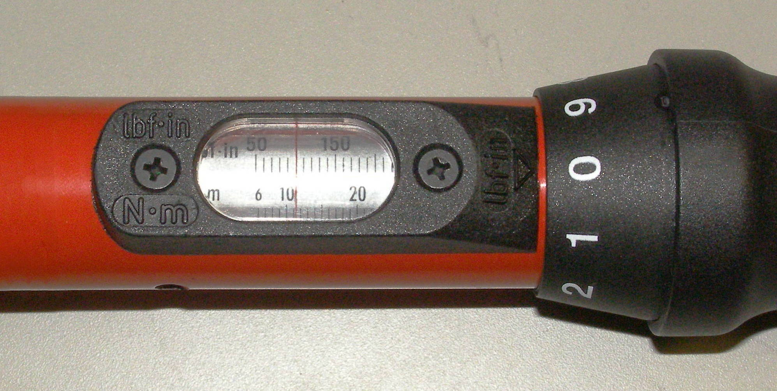
Using the Torque Tools + Locktite
Show how to use torque tools:
  Small driver
  Large driver
  Titan wrench
  Special stack-ups for clearance (driver+1/4 square+1/4 hex+bit)
Loctite:
  Why we use it?
  How to apply it
  Do we need to clean the old?
Adjustment unlocked
Blue Adjustment Nob – Small Torque Driver
Red Adjustment Nob – Large Torque Driver
To unlock Driver
and enable torque adjustment
Rotate
0.34 Nm
1.36 Nm (1.4)
11.0 Nm
Rotate to adjust torque

Slide 13
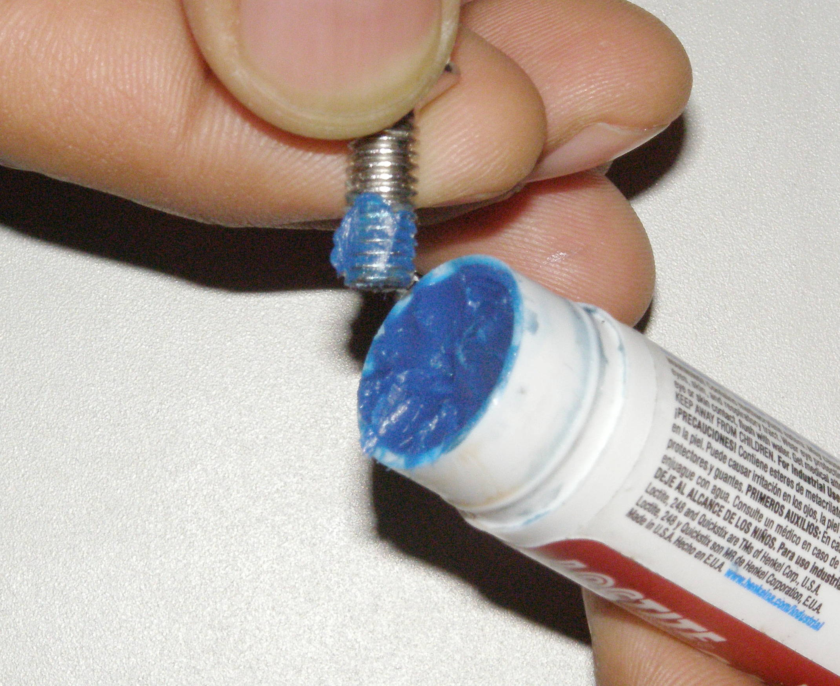
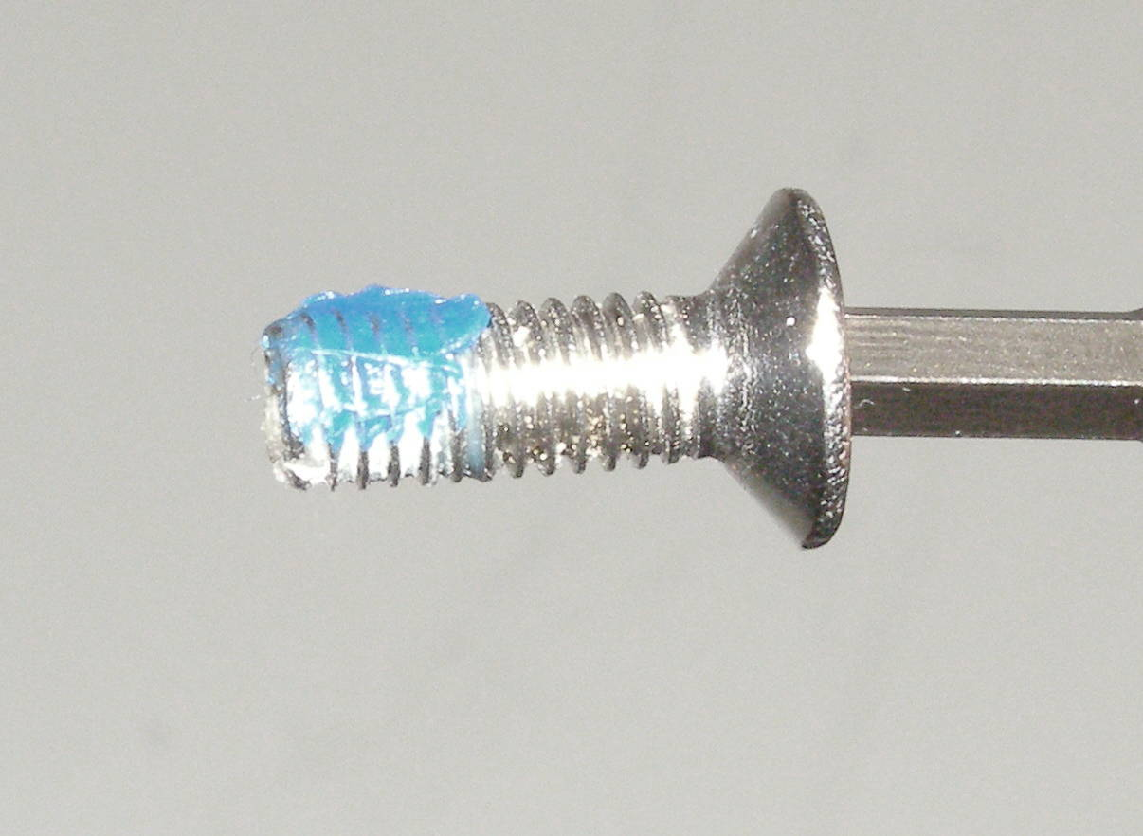
Using the Torque Tools + Locktite
Adjustment unlocked
Only a small “patch” of Loctite is needed.
Rotate
11.0 Nm
Old Loctite.

Slide 14
Maintenance and Replacement Demos
Hands on Maintenance demos:
  Filter R/R
  CB adjustment
  Gripper Sensor tips R/R
Replacement demo Videos:
  Gripper Sensor tips R/R
  <See support.willowgarage.com for maintenance and repair>

Slide 15
Maintenance – Fan Filter Demo
Fan Filter Cleaning:
  Robot power can remain on.
  Regular cleaning required
    Every 1 to 4 weeks?
    As the filter gets clogged the fan speed will tend to increase, it gets noisy.
  Vacuuming
    be careful not to tear filter.
  Washing
    remove cover plate, Doc15
    Wash and dry filter.
    Having the robot fan on helps when placing the filter.
    Re-install the cover plate.
  Replacement filter, order direct.

Slide 16
Maintenance – CB Adjust Demo
The object of the Counter Balance (CB) adjustment is to compensate for the weight of the Arm assembly so that it has neutral balance in all positions, with the Gripper extended.
This is without any motor actuation. The motors are not powered.
The two adjustments are the Arm Gimbal Shaft adjustment and the Secondary Spring.
The Arm Gimbal Shaft adjustment is designed to affect the overall Arm balance while the Secondary spring adjustment is intended to normalize the Fore Arm balance, but it will affect the overall Arm balance as well.
Turning the Secondary spring adjustment clockwise increases the Fore Arm lift in relation to the Arm, while lifting the Arm as well.
Turning the Arm Gimbal Shaft counter-clockwise will raise the Arm.
Counter Balance Adjustment:
  If it appears that the Arms will not hold position, then run CB Check program.
    Run CB Check program, Doc5
    If adjustment required greater than 2 turns for the Secondary or 0.8 turns for the Arm Gimbal Shaft then do CB adjustment.
Good to have 2 people preform procedure, one to hold Arm.
Observe safety and ESD protocols.
Watch out for pinch points.
Remove top covers, Doc6
Remove Shoulder Covers, Doc16
Adjust counter balance, Doc5
Re-run the check program and adjust the CB if needed, Doc5
Re-install the covers, Doc6

Slide 17

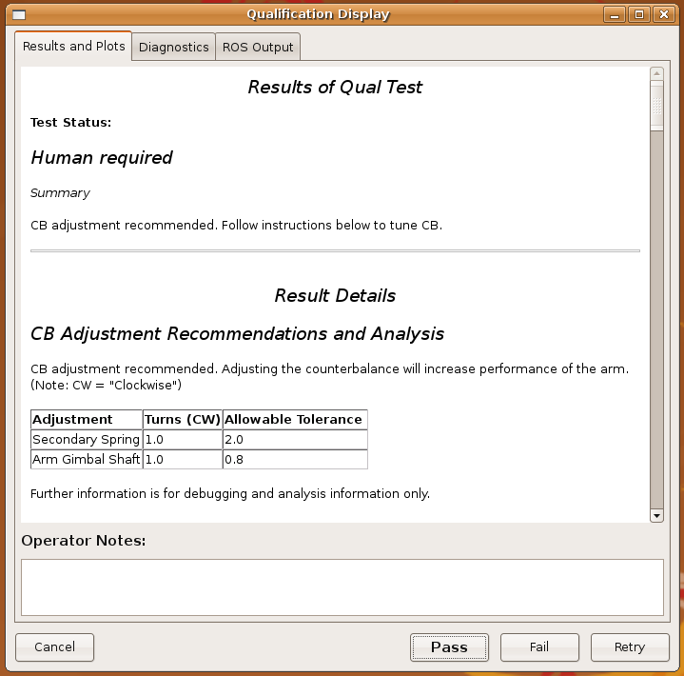
Maintenance – CB Adjust Demo
Check program:
  Run CB Check program, Doc5
  If adjustment is required greater than 2 turns for the Secondary or 0.8 turns for the Arm Gimbal Shaft then do the CB Adjustment.
Fig 1
Right
Secondary
Arm Gimbal Shaft

Slide 18
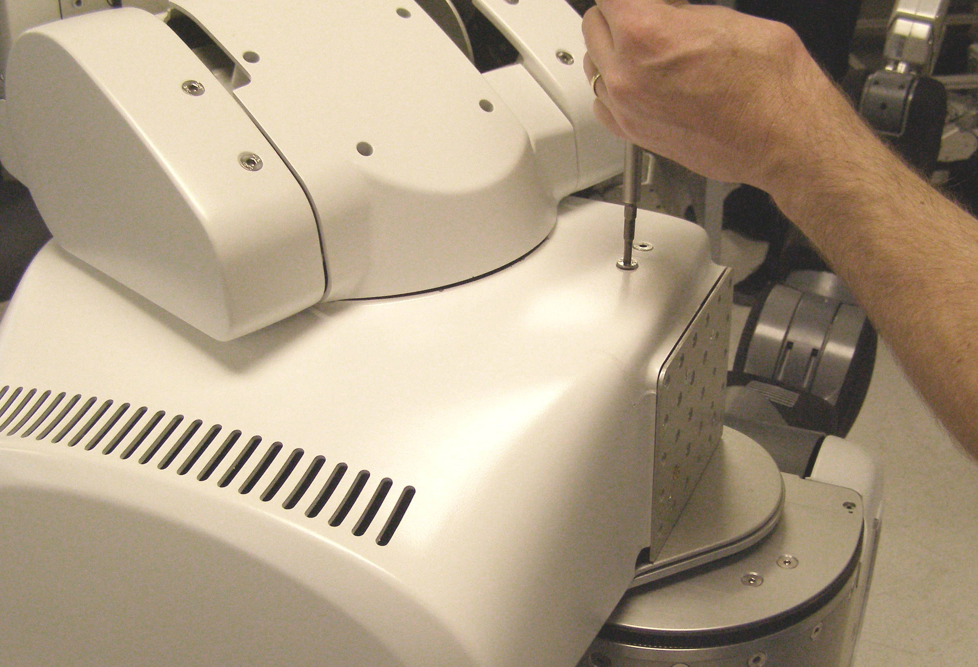
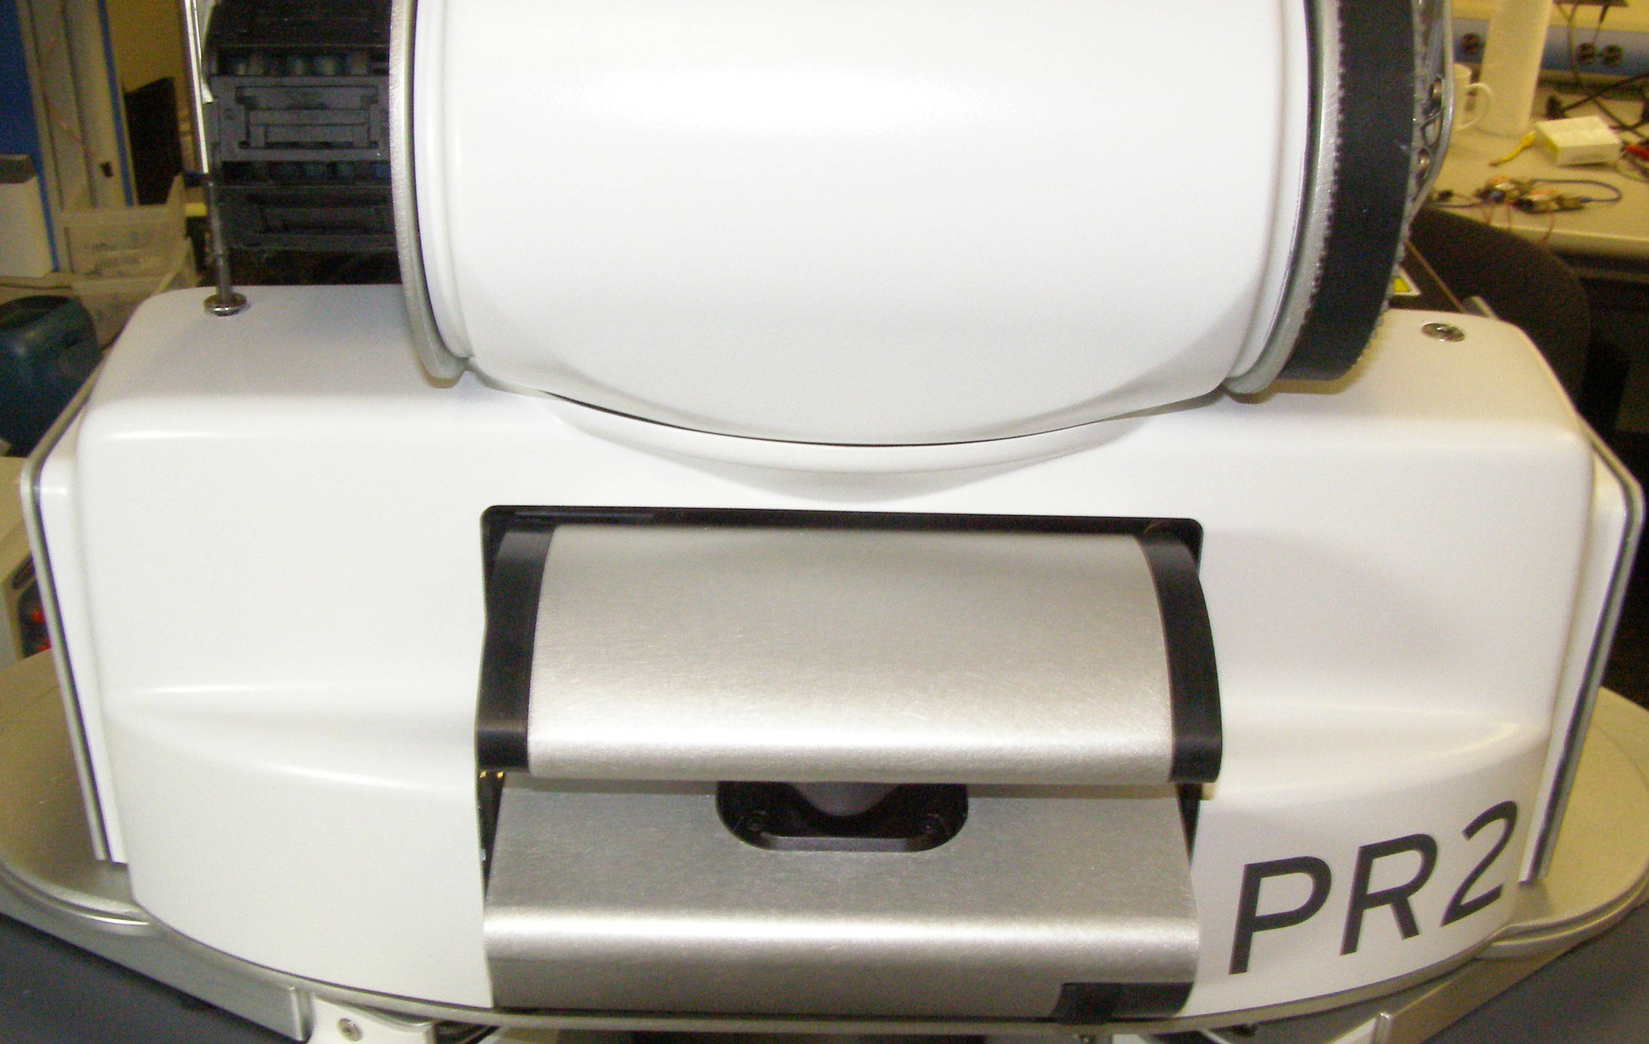
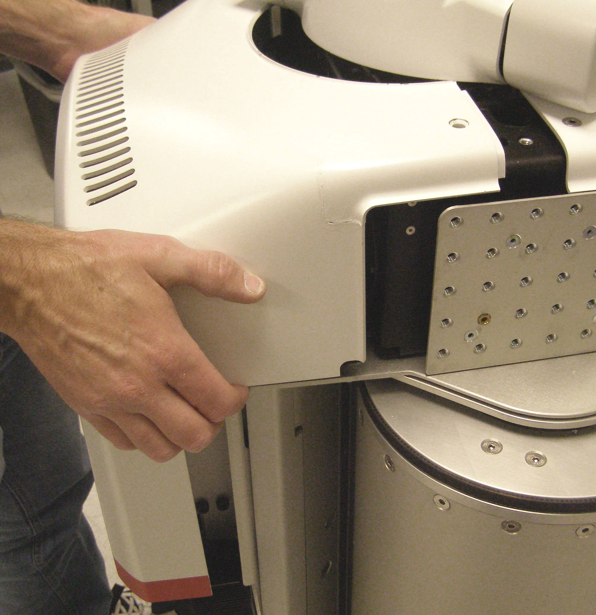
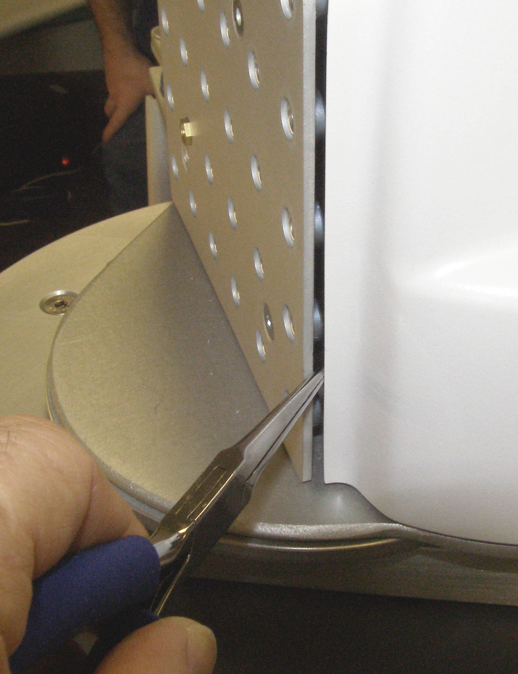
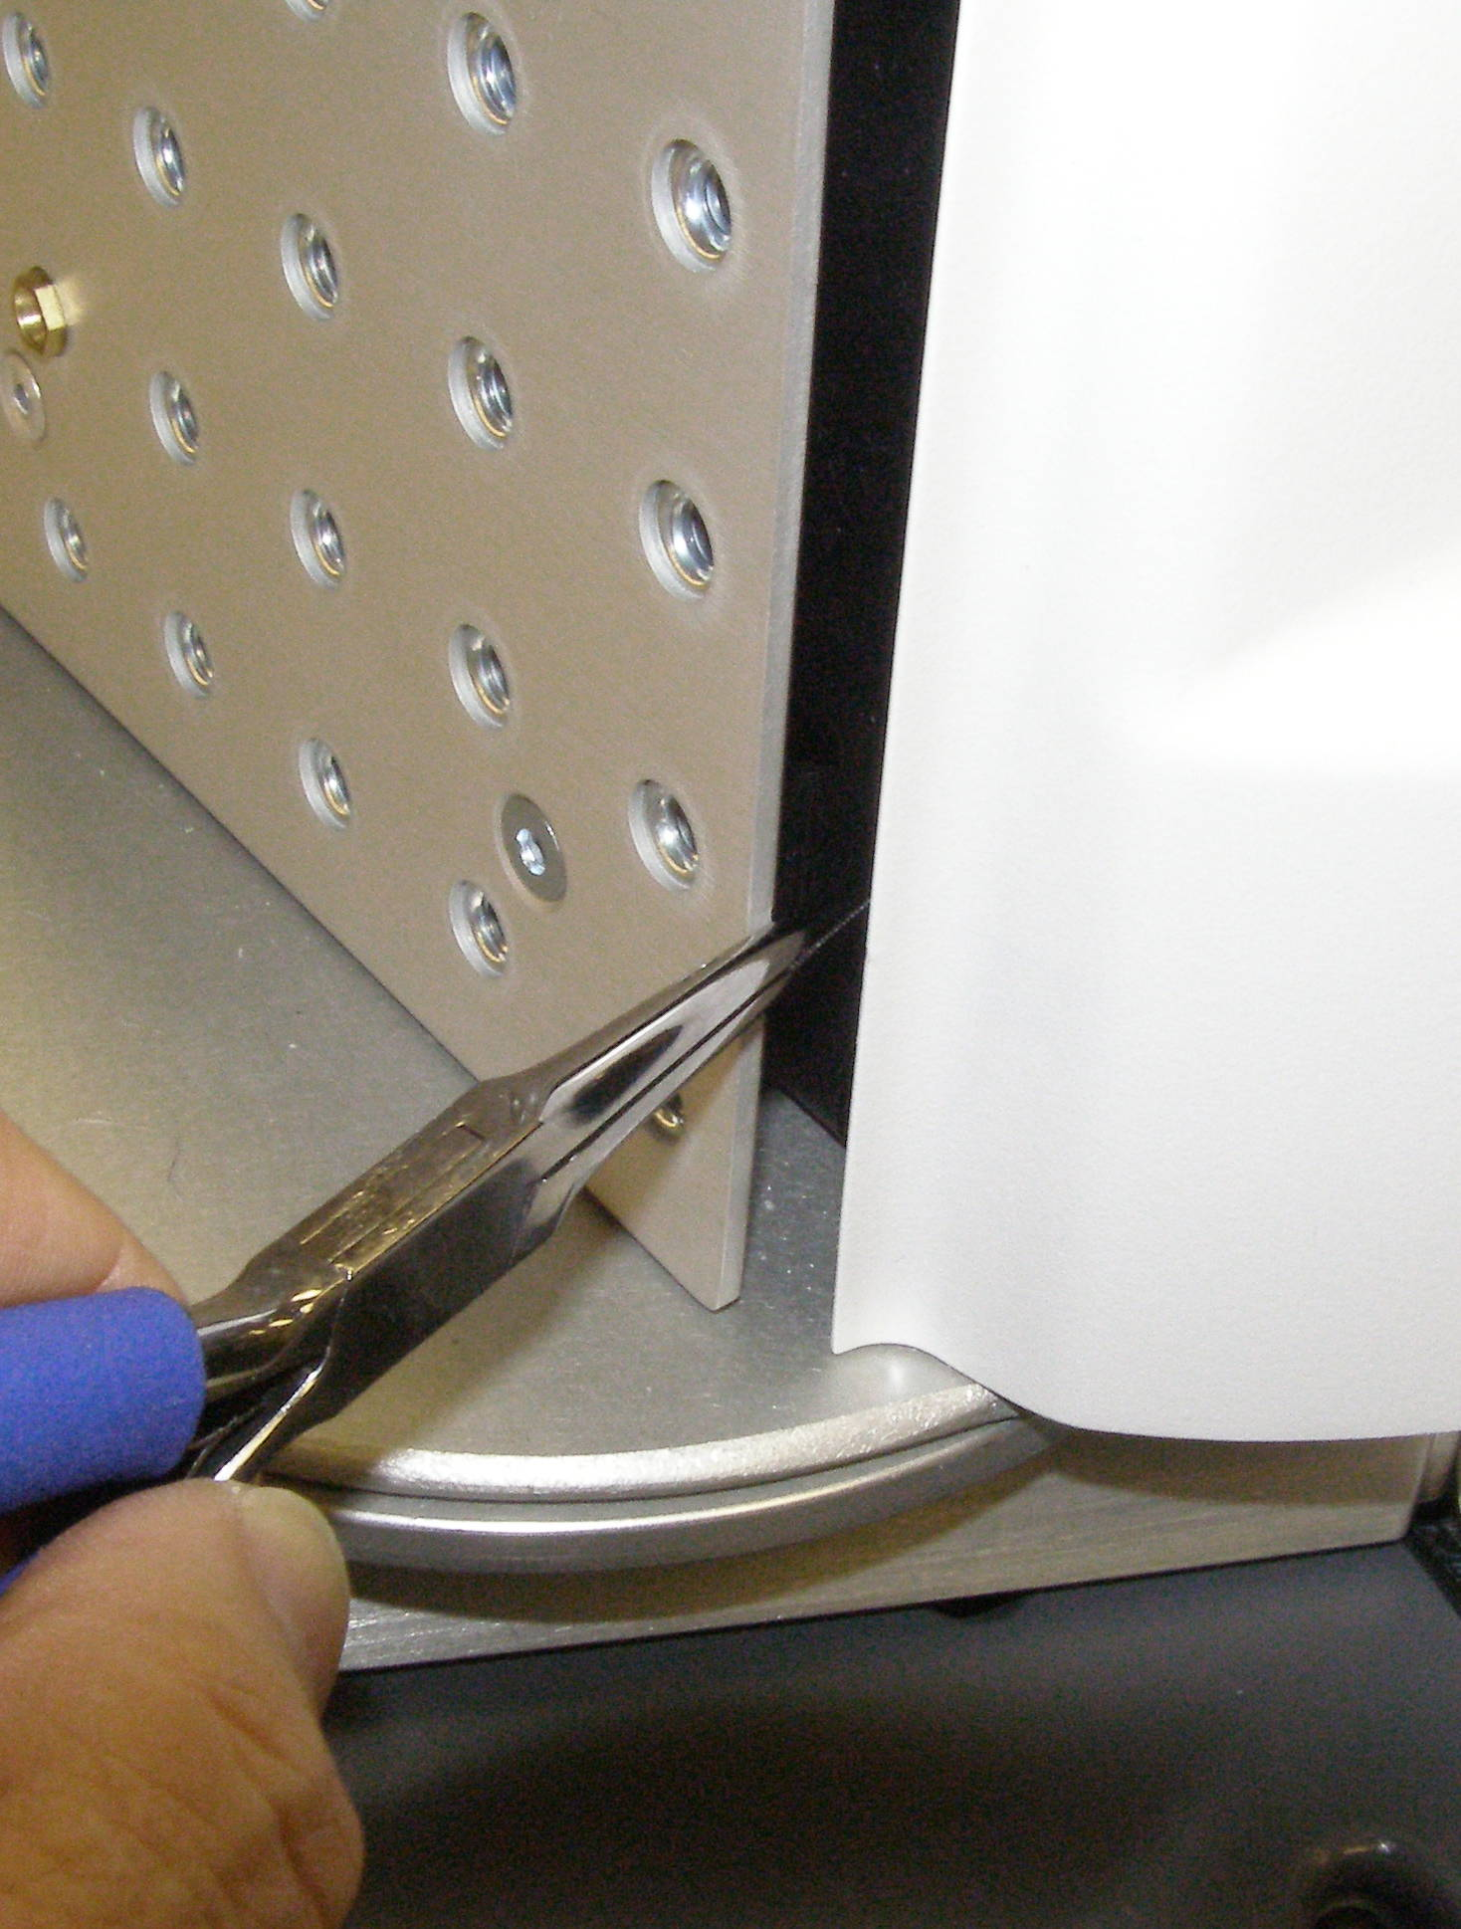
Maintenance – CB Adjust Demo
Observe safety and ESD protocols.
Remove top covers, Doc6
Fig 1
Fig 1
Fig 2
Fig 3
Fig 4

Slide 19




Maintenance – CB Adjust Demo
Observe safety and ESD protocols.
Remove shoulder covers, Doc16
Fig 11
Fig 6
Fig 5
Fig 7

Slide 20
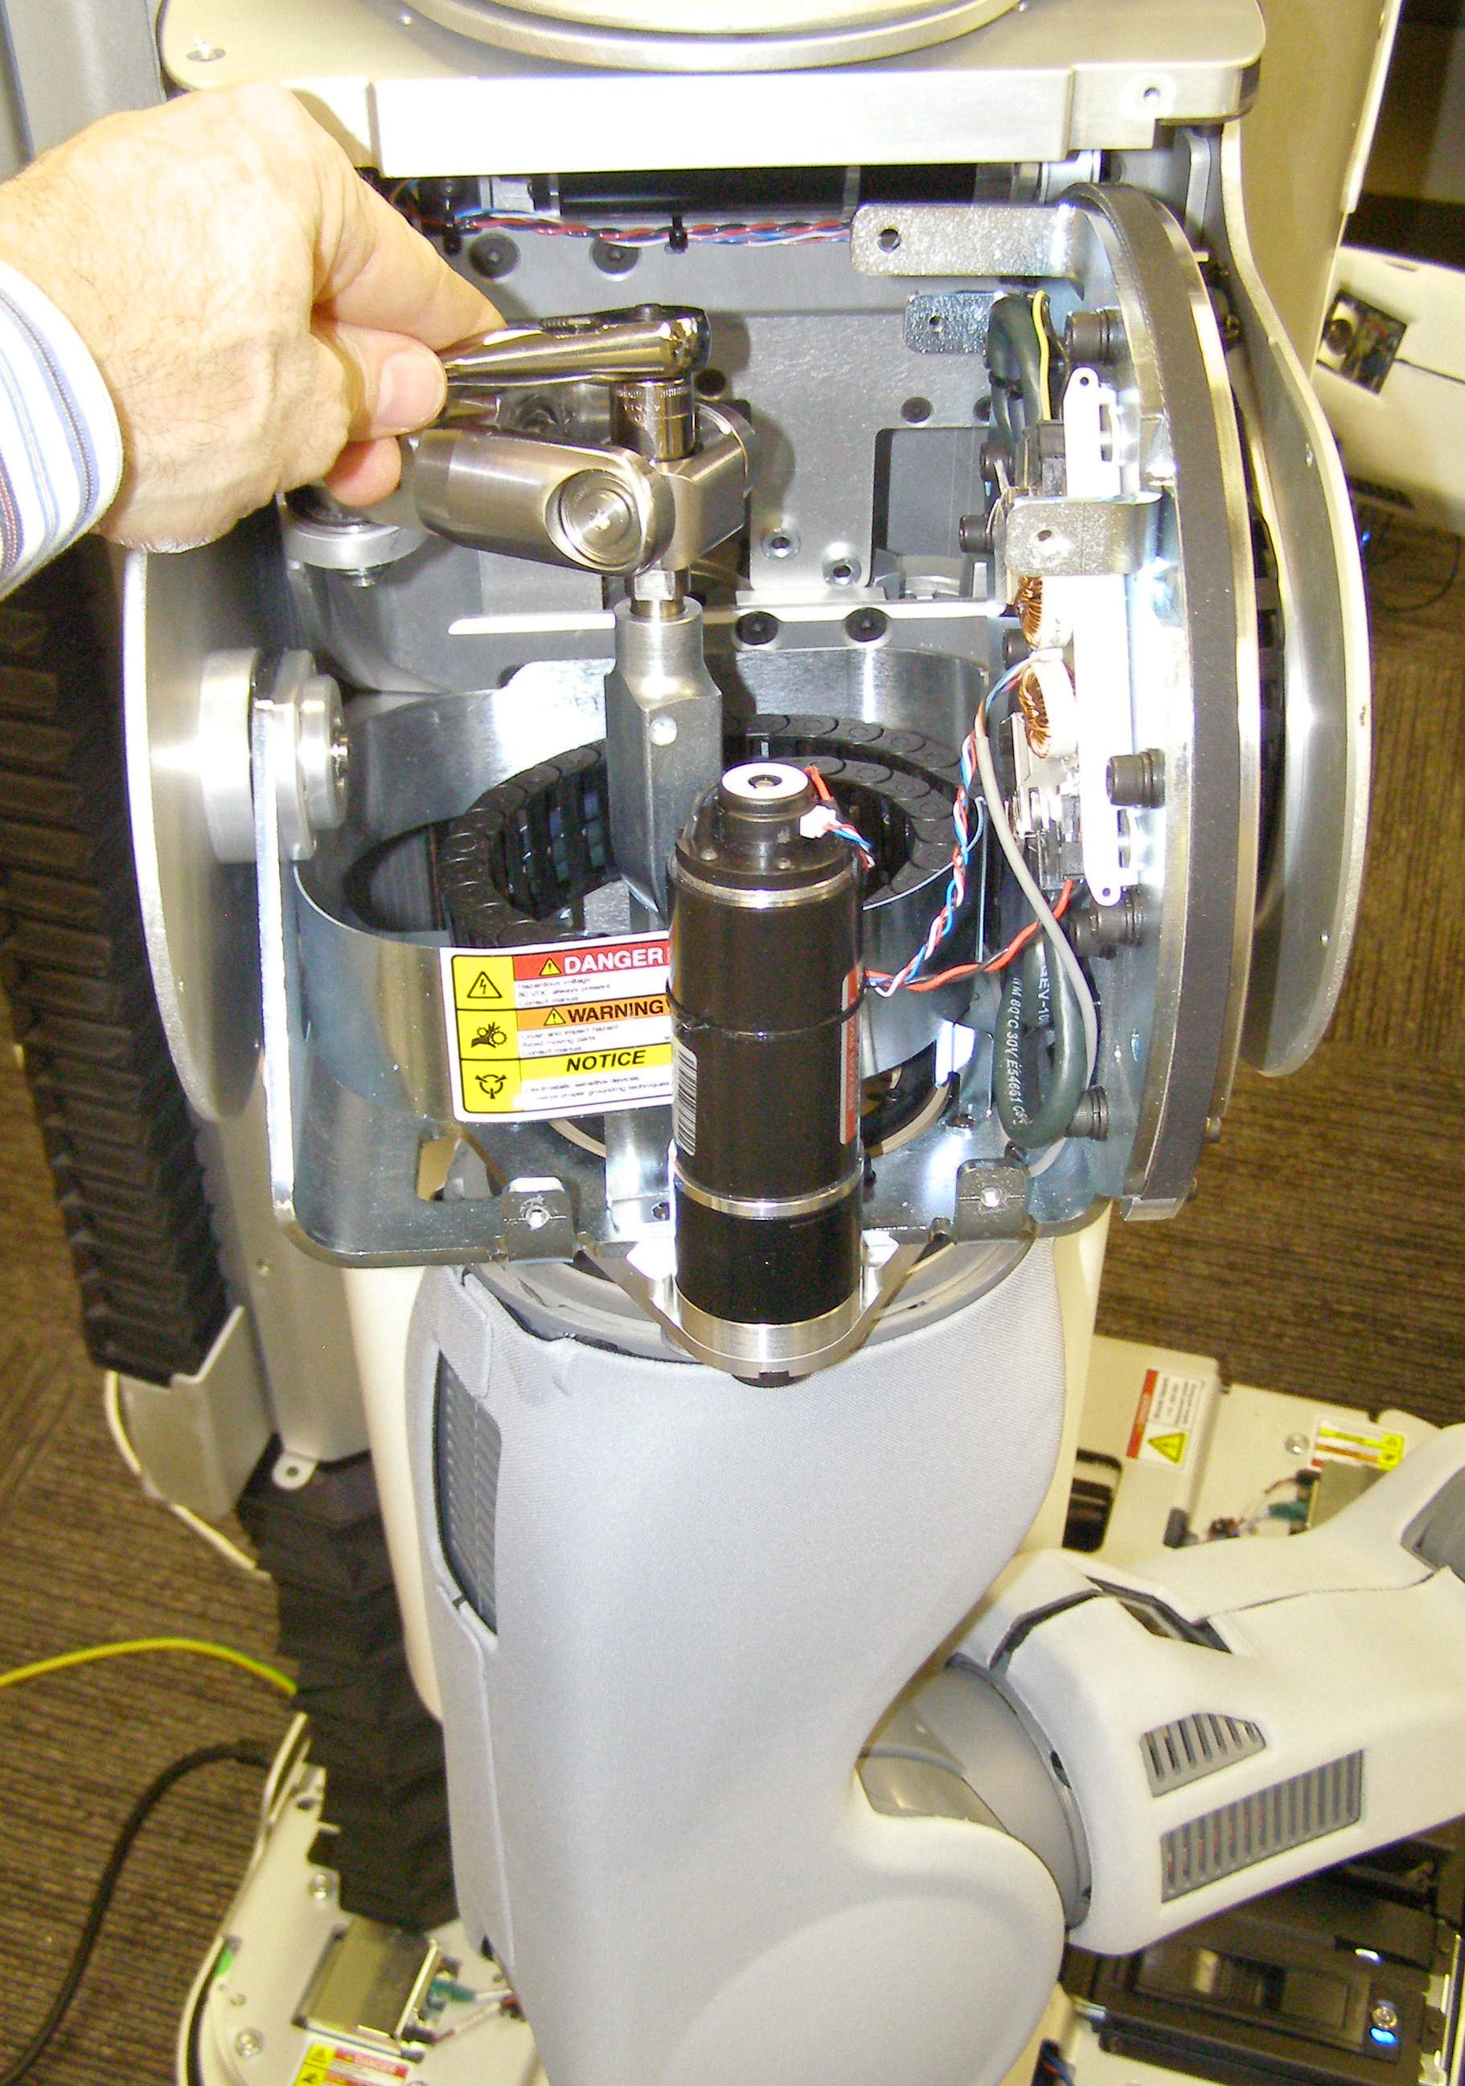

Maintenance – CB Adjust Demo
Adjust counter balance, Doc5
  Re-run the Check program and adjust the CB if needed, Doc5
  Re-install the covers, Doc6
Fig 6
Fig 5
Guide tube

Slide 21
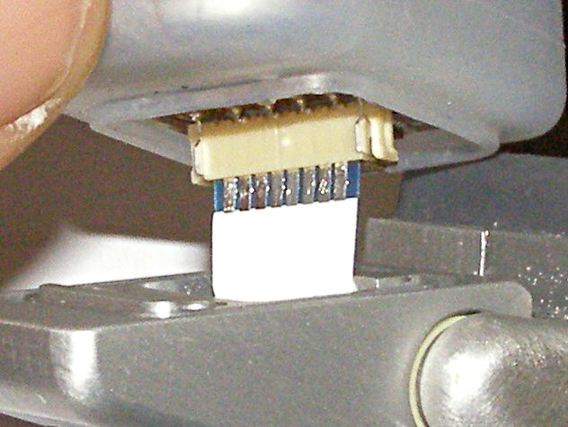
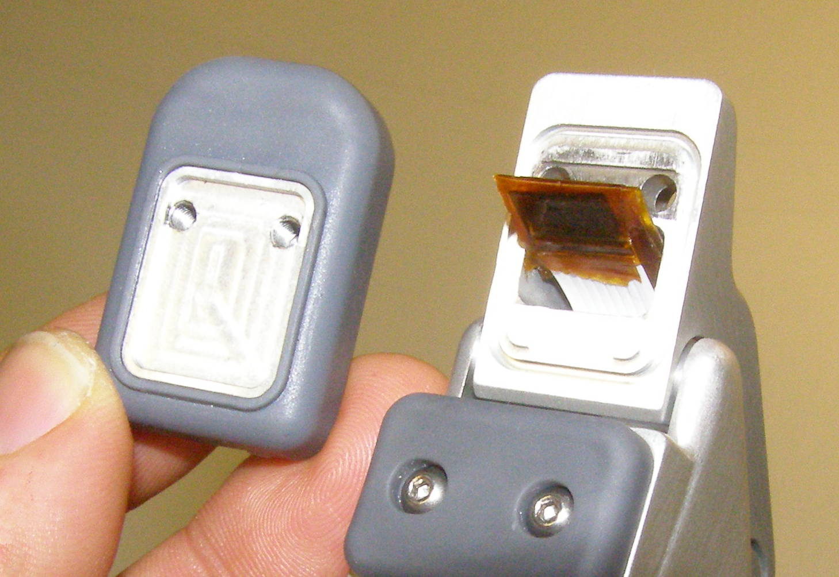
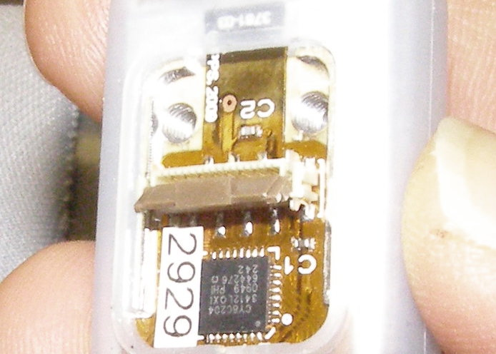
Replacement – Gripper Tips Demo
Video of Gripper Sensor Tip R/R
Safety:
  Turn power off.
  Put on ESD strap.
Gripper Sensor Tip R/R:
  Explain sensorized versus dummy tips.
  Explain Boots:
    must always cover senors.
    relatively easy to damage. Best way to keep sensor tips working is to replace boots as soon as they show any damage.
  R/R tips, Doc3 (skip Pads R/R section)
  WG will not replace sensor tips damaged in use. You can buy them from WG.
  WG will replace boots if you need them.
Fig 6
Fig 7
Fig 10

