Slide 1
PR2 Maintenance
ROS + PR2 Training Workshop

Slide 2
PR2 Maintenance Overview
Robot Overview:
  Review slides of the front, rear, and sides of the robot.
  Show the parts we will be focusing on specifically:
    Filter
    Counter Balance adjustment (CB)
    Gripper tips
Review safety and ESD protocols.
Review power requirements.
Review Accessory and Tool Kits:
  Review items and tools in general
  Show how to use torque tools + why and how to apply Loctite
Hands on demos/videos:
  Filter R/R
  CB adjustment
  Video of Gripper Sensor Tips R/R
  Gripper Sensor tips R/R
See support.willowgarage.com to order replacement parts.

Slide 3
Robot Overview
Robot Overview:
  We'll review “anatomy” slides of the front, rear, and sides of the robot
  Show the parts we will be focusing on specifically:
    Filter
    Gripper Tips
    Top covers and Shoulder for CB adjustment
  Point out:
    Power Switch
    A/C breaker
    Run – Stop button
    Where to plug in the ESD strap on Accessory Mounting plates

Slide 4
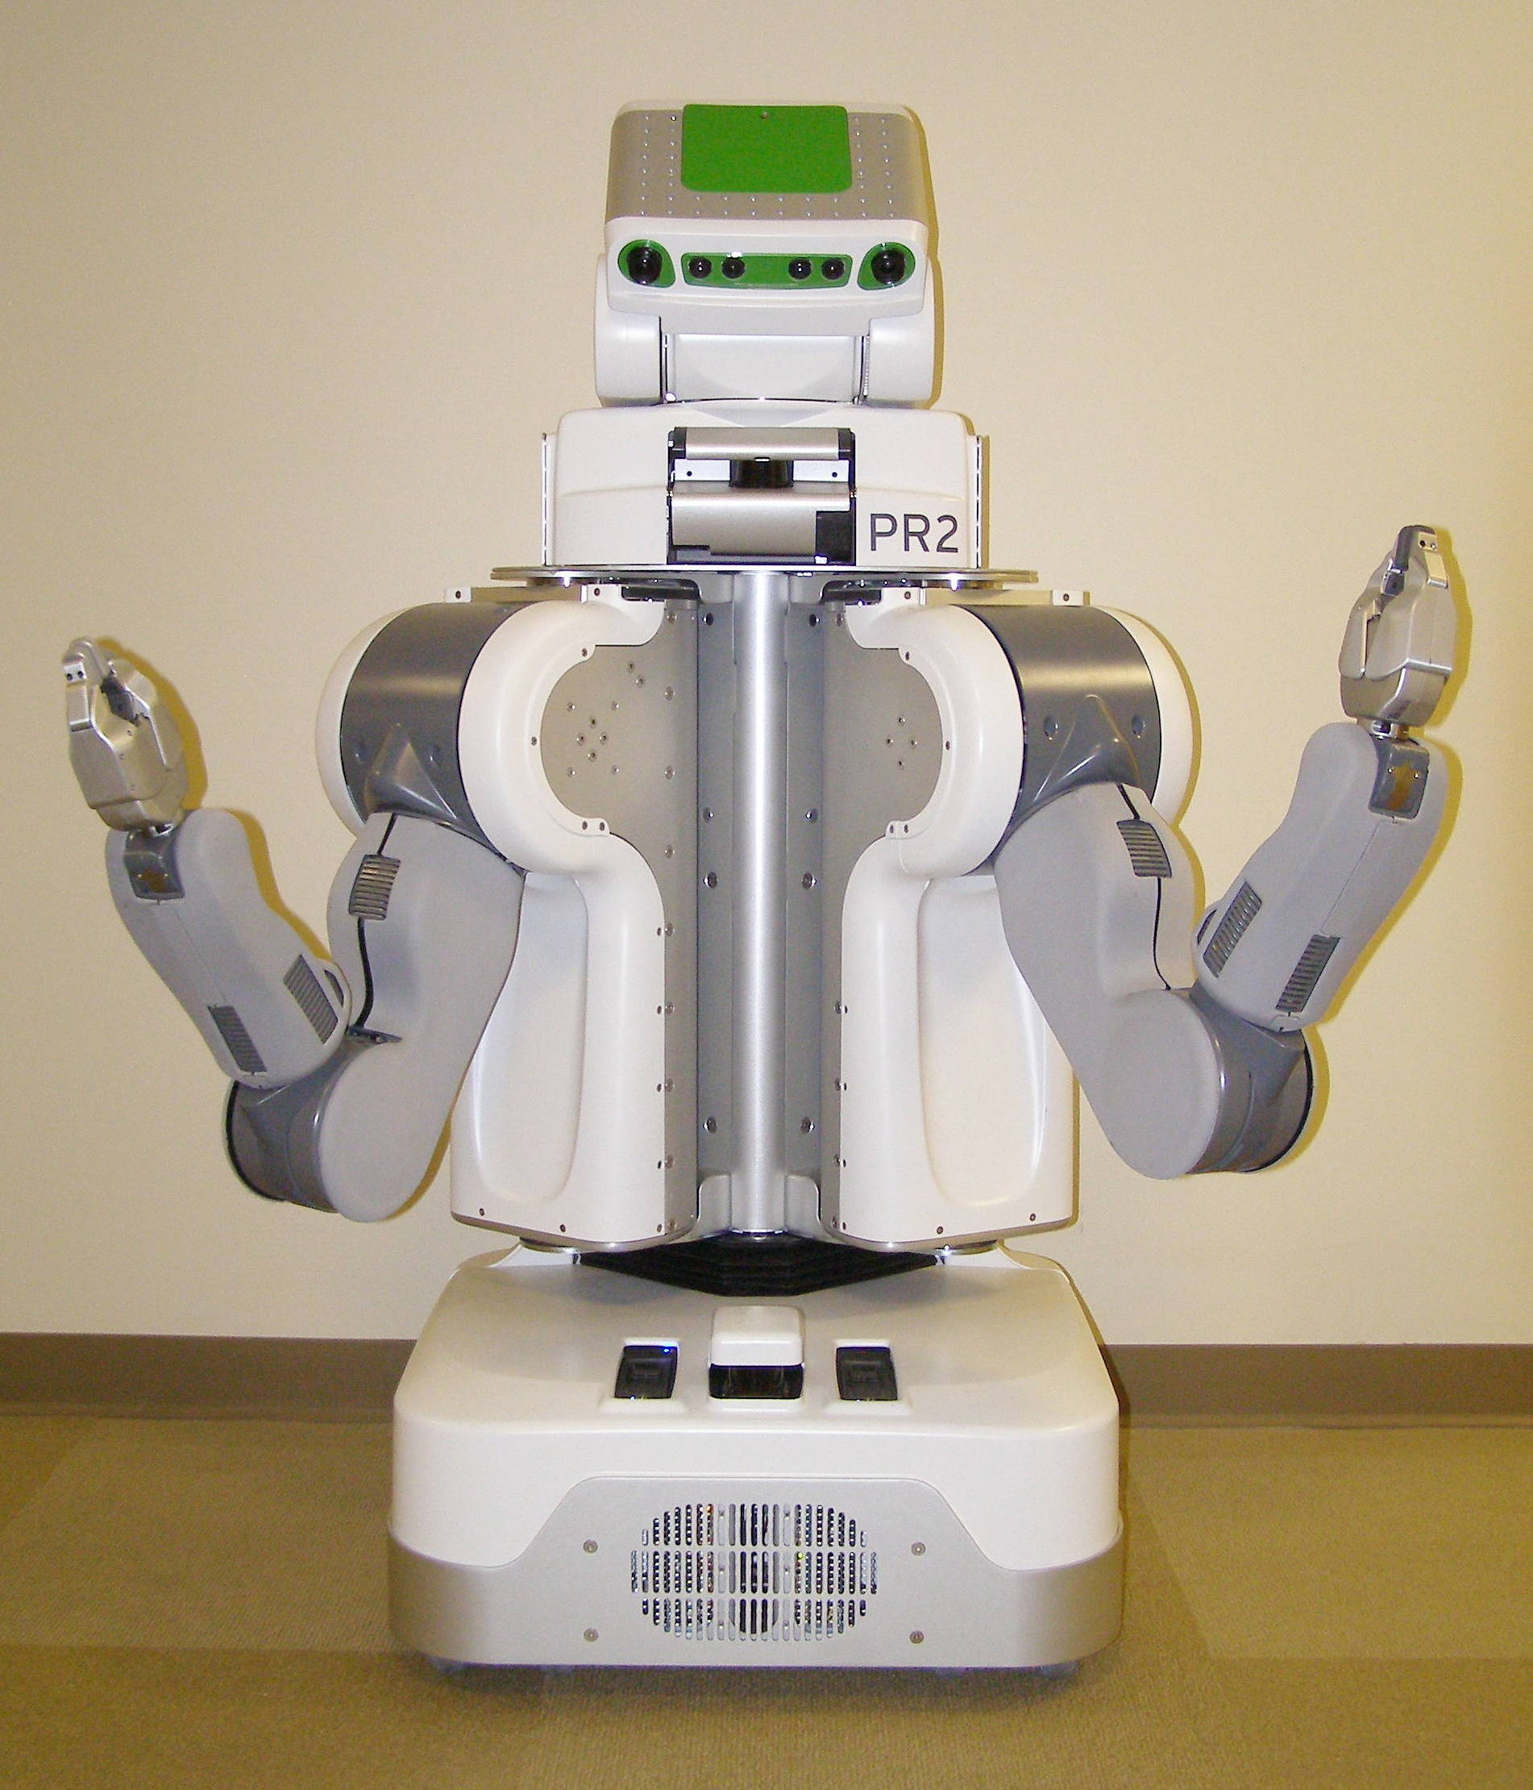
Robot Overview – Front View
Head Tilt Stage Panels
Top Front Panel
Laser Sled
Head Pan Stage Panels
ShoulderCovers
Center Trim
Gripper
Fore Arm
Upper Arm
Front Bellows
Front Bottom Panel
Base Skirt Front

Slide 5
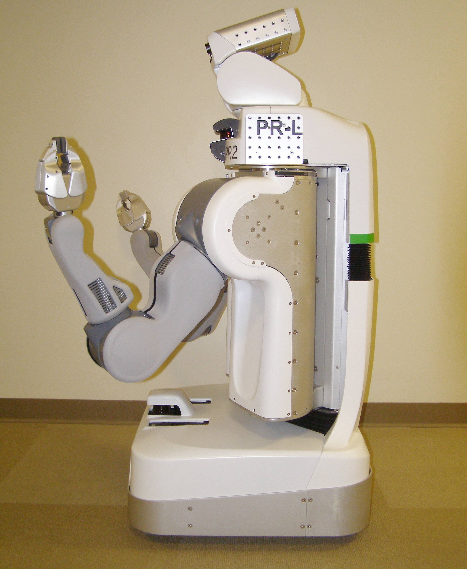
Robot Overview – Side View
Head Tilt Stage Panels
Head Pan Stage Panels
Gripper
Laser Sled
Top Front Panel
Rear Top Panel
Shoulder Covers
Rear Bellows
Rear Bottom Panel
Fore Arm
Left Body Trim
Upper Arm
Hokuyo
Front Bottom Panel
Front Bellows
Base Skirt Front
Base Skirt Rear

Slide 6
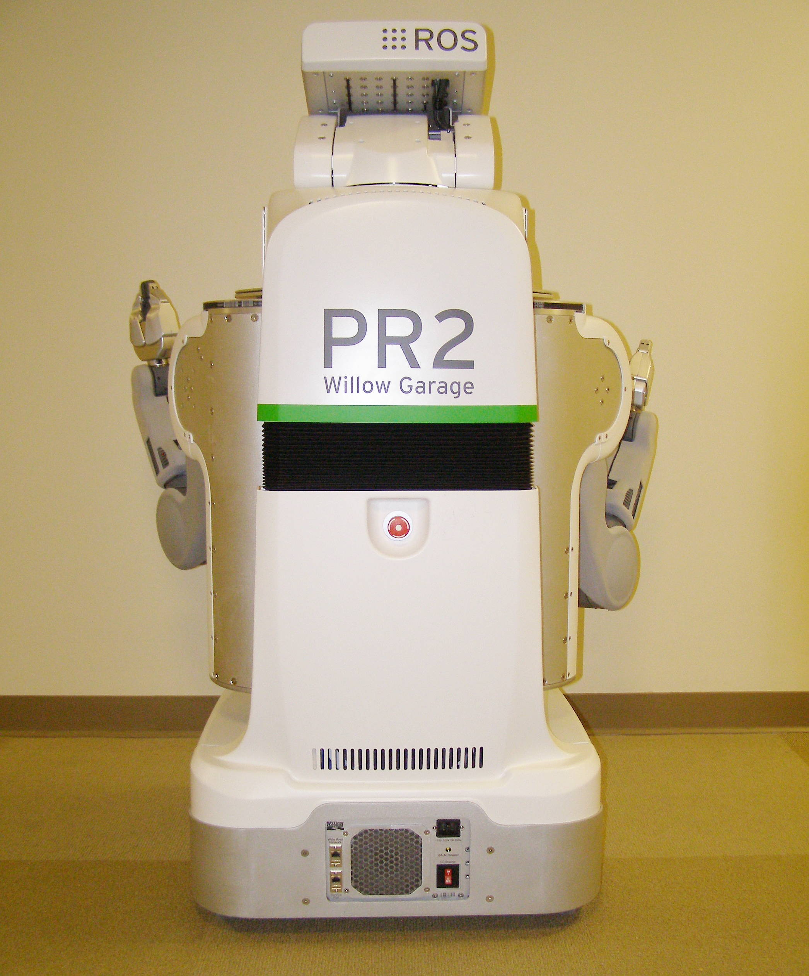
Robot Overview – Rear View
Head Tilt Stage Panel
Head Pan Stage Panel
Rear Top Panel
Rear Bellows
Rear Bottom Panel
Run – Stop
Button
Base Skirt Rear
DC Breaker
Fan Filter

Slide 7
Safety and ESD protocols
PR2 Maintenance General Procedures:
  Disconnect AC power from the wall socket.
  Turn off power, even when just removing covers.
    Exceptions are when running the CB check program after doing CB adjustments and when replacing the Fan Filter.
  Always use an ESD strap, even when just removing covers.
ESD straps:
ESD straps are in the Accessory Kit pouch
The strap should go around the bare wrist
The jack should be plugged into the Accessory Panel

Slide 8
Robot Power requirements
Robot internal power: Precautions & Safety Features:
  Battery power is “live” within the robot even when power is off
  The Power Board controls all power to the Robot systems
    This is accessible and controllable from ROS
  There are as many as 7 levels of protection, but you cannot assume they will prevent damage or injury.
  Always turn off the robot power when servicing
    Except when specifically required to complete a procedure such as the CB adjustment
Wall power
  Plug into a dedicated 15A minimum circuit.
  Only use supplied power cord or self plug-in cord
Runtime
  Runtime is indefinite with wall power.
  Runtime on batteries is 2 hours stationary, less when moving

Slide 9
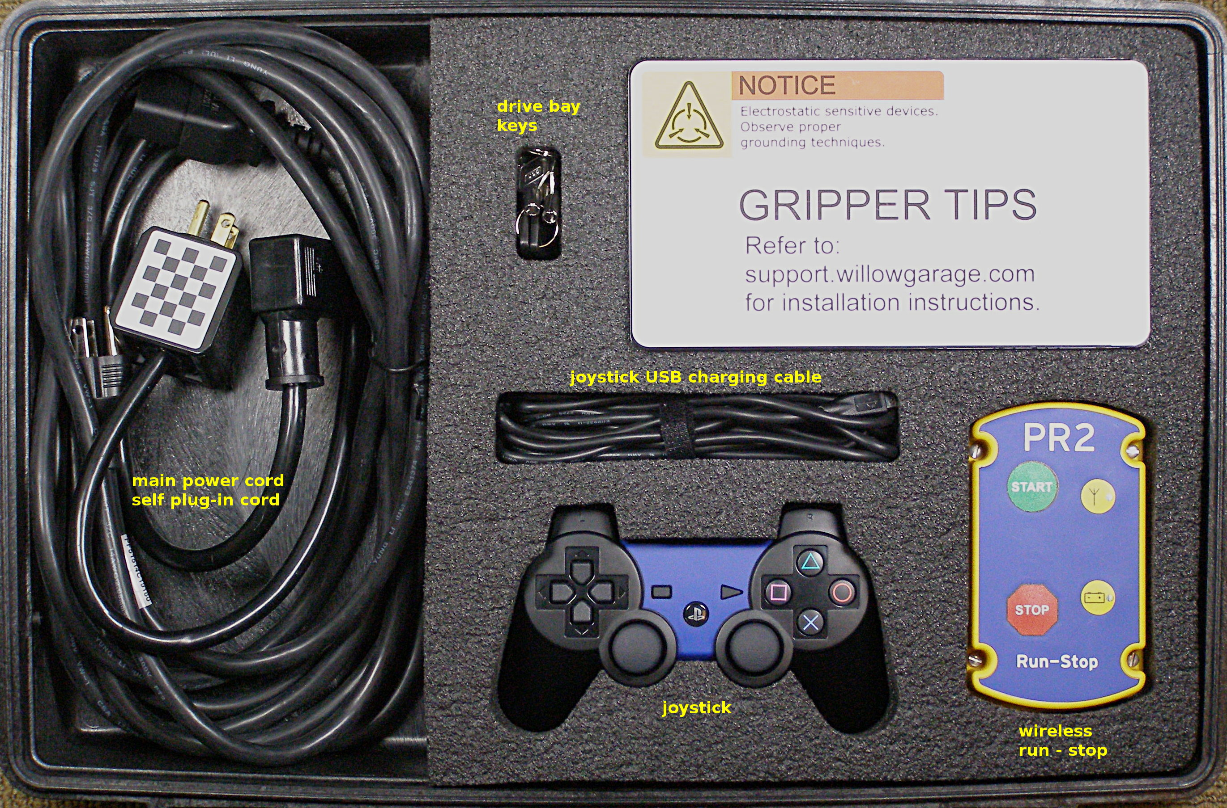
PR2 Accessory Kit
Contents:
  15 FT Power Cord, 68-06167
  (Use only this power cord!)
  Self Plug in Cable, 68-06153
  Joystick, 68-02985
  Hard drive bay keys, 68-03337
  Run-Stop Transmitter, 68-01059
  Joystick charging cable, 68-03533
  User Manual
  Checkerboard (small), 68-03823
  Air Filters (30PPI package of 5), 68-02802
  ESD strap, 68-03024
  Base Station Recovery DVD
  Gripper Box:
    Sensorized fingertips, 68-03840 (x5) (use only with boots!)
    Fingertip boots, 68-03347 (x20)
- See support.willowgarage.com to order replacement parts.
Notes:
- Contents Walk Through

Slide 10
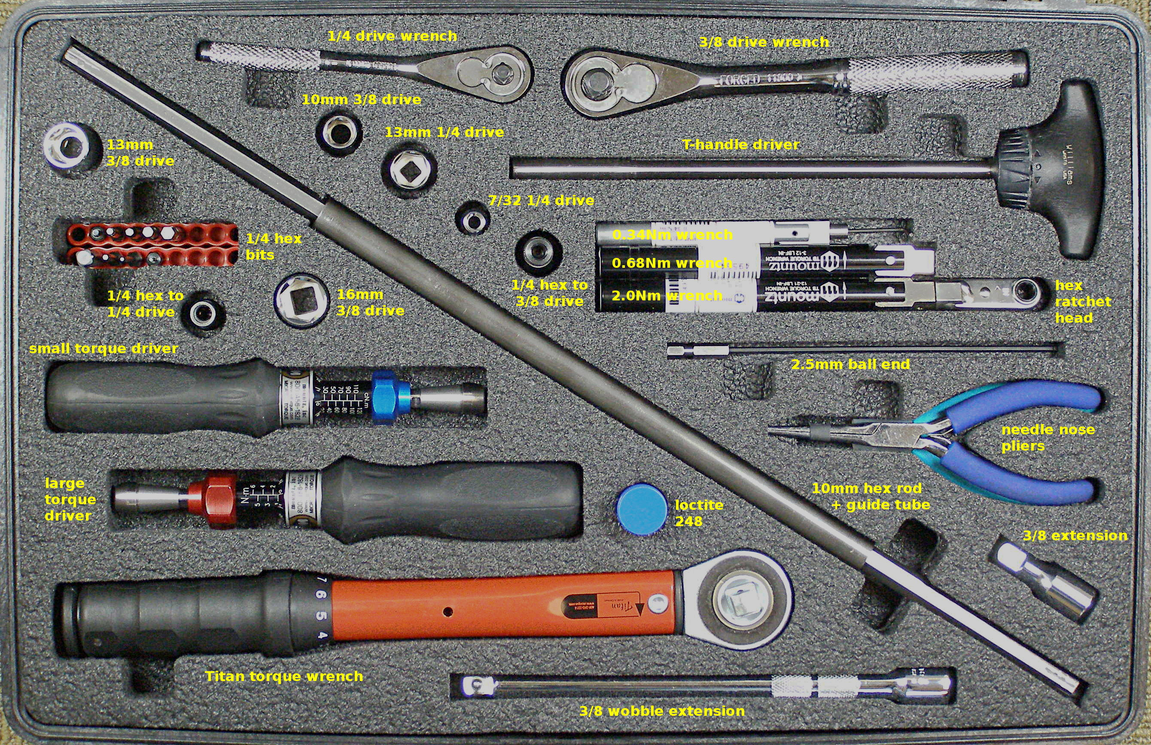
PR2 Tool Kit (1)
Contents:
  Counterbalance adjustment rod - 10mm hex, 68-07034
  Counterbalance adjustment tube, 68-07147
  Ratchet head bits: 1.5mm - 68-07040, 2.5mm – 68-07042
  Driver bits:
    1.5mm, 68-07062
    2mm, 68-07063
    2.5mm, 68-07064
    2.5mm ball end, 68-07059
    3mm, 68-07065
    4mm, 68-07066
    5mm, 68-07067
  1/4 square male to 1/4 hex male adapter, 68-07075
  1/4 square drive to 1/4 hex female adapter, 68-07077
  3/8 square drive to 1/4 hex female adapter, 68-07078
  10mm 3/8 drive socket, 68-07079
  13mm 1/4 drive socket, 68-07085
  13mm 3/8 drive socket, 68-07086
  16mm 3/8 drive socket, 68-07142 (needed for crate)
  7/32 1/4 drive socket, 68-07090
  3/8 drive short extension, 68-07116
  3/8 drive wobble extension, 68-07118
  1/4 drive quick release extension, 68-07140
  1/4 drive flex joint, 68-07141
  1/4 drive ratchet wrench, 68-07138
  3/8 drive ratchet wrench, 68-07139
  Needle Nose pliers, 68-07112
  Diagonal Cutters, 68-07146
  Zip-ties, 68-07150
- See support.willowgarage.com to order replacement parts.
Notes:
- Contents Walk Through
- ESD Strap
- Video: Adjusting Torque Tool
- Video: Loctite Application

Slide 11
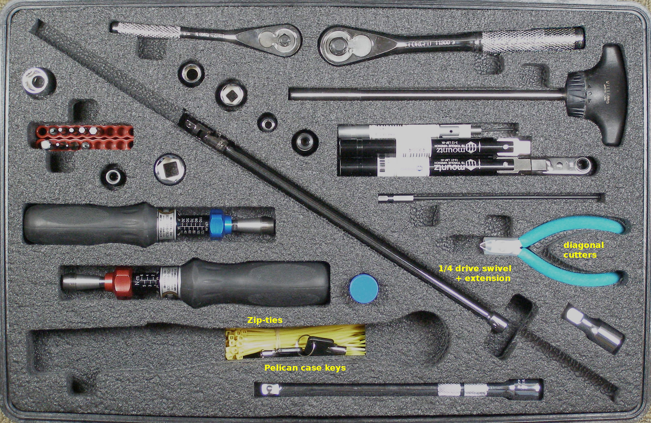
PR2 Tool Kit (2)
Contents:
  Mountz wrench and driver tools:
    Fixed 0.34Nm wrench, with 1.5mm right angle Allen, 68-07025
    Fixed 0.68Nm wrench, 68-07028
    Fixed 2.0Nm wrench, 68-07029
    1/4 hex ratchet head, 68-07033 (for use with 0.68 ans 2.0 Nm wrenches)
    0.20 – 1.20 Nm torque tool, 68-07014 (small)
    1 – 6 Nm Torque tool, 68-07015 (large)
    Titan250I 5.6 – 28 Nm Torque wrench, 68-07020
- See support.willowgarage.com to order replacement parts.
Notes:
- Contents Walk Through
- ESD Strap
- Video: Adjusting Torque Tool
- Video: Loctite Application

Slide 12
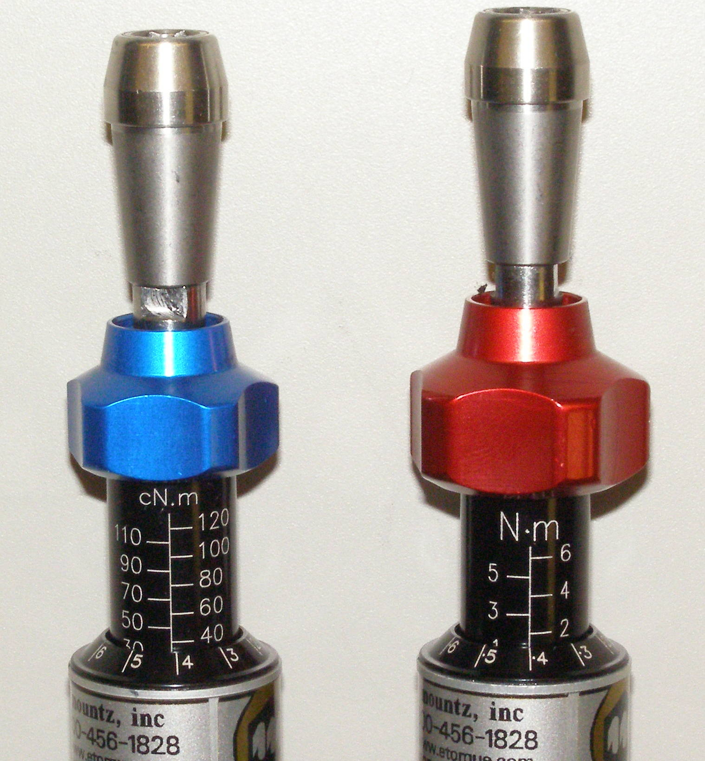
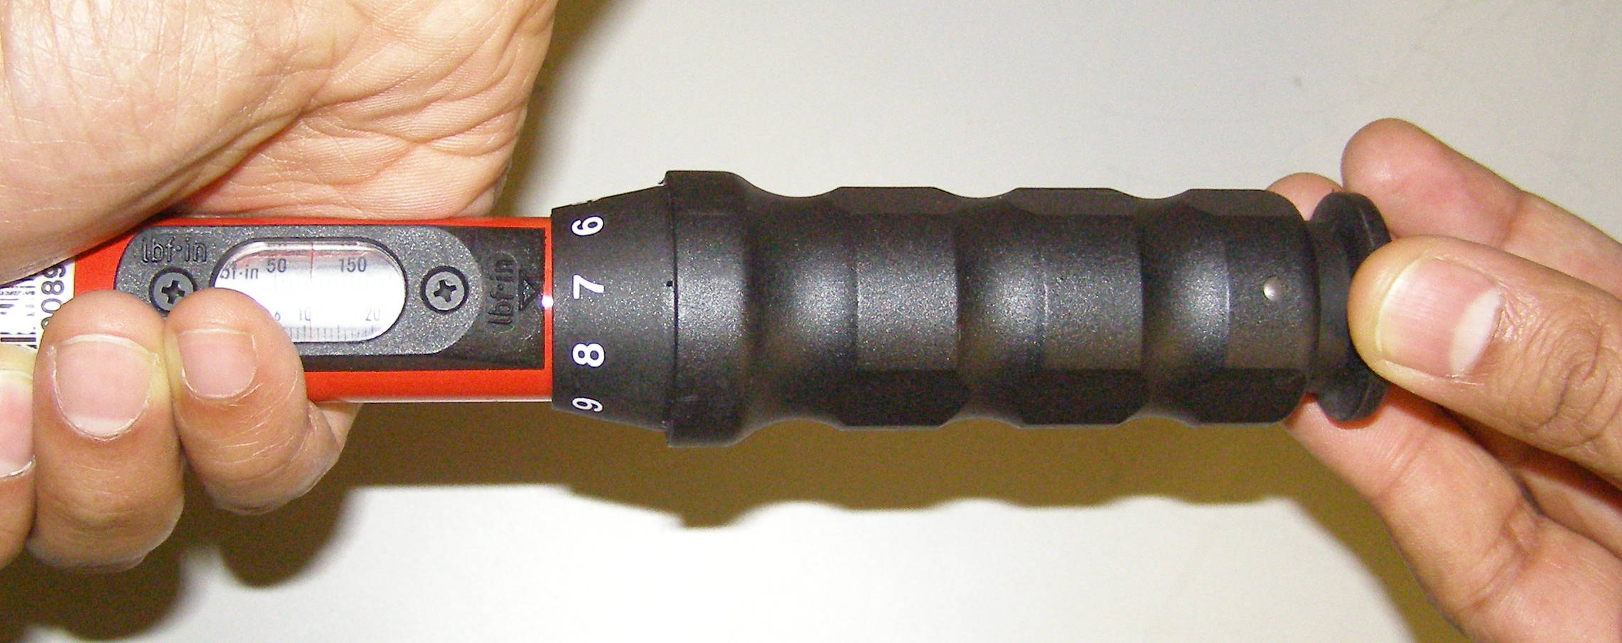
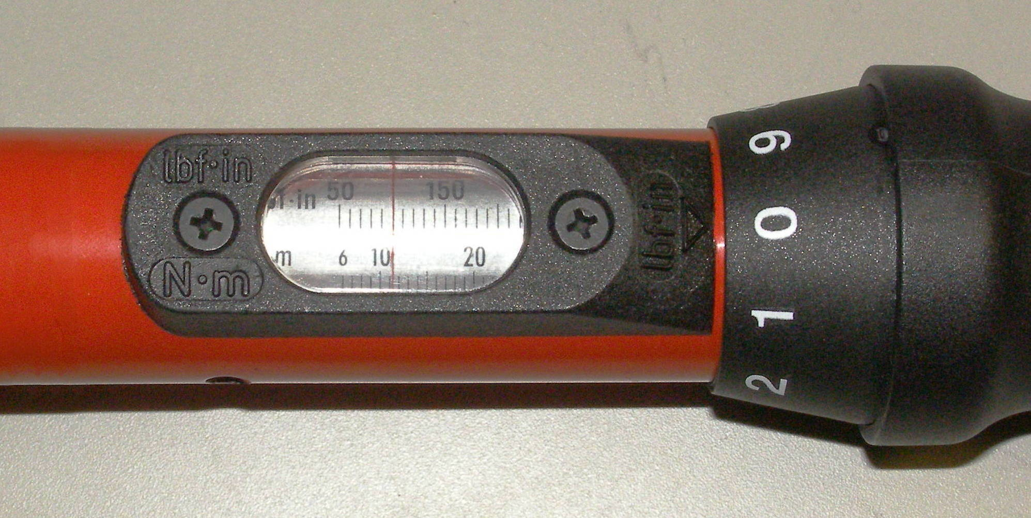
Using the Torque Tools + Loctite
How to use torque tools:
  Small driver
  Large driver
  Titan wrench
  Special stack-ups for clearance (driver+1/4 square+1/4 hex+bit)
Loctite:
  Why we use it?
  How to apply it
  Do we need to clean the old?
Adjustment unlocked
Blue Adjustment Nob – Small Torque Driver
Red Adjustment Nob – Large Torque Driver
To unlock Driver
and enable torque adjustment
Rotate
0.34 Nm
1.36 Nm (1.4)
11.0 Nm
Rotate to adjust torque

Slide 13
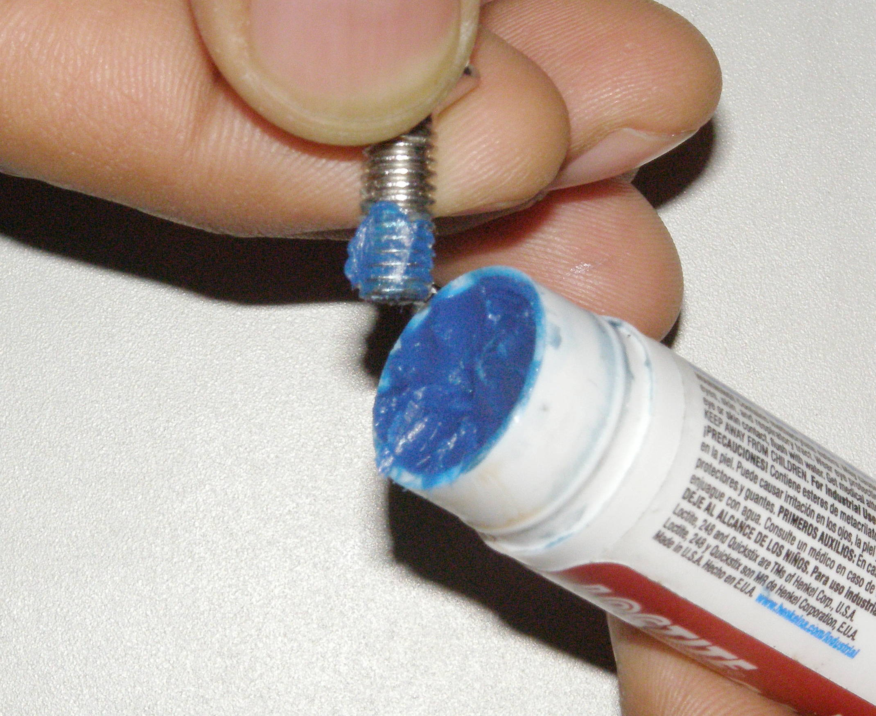
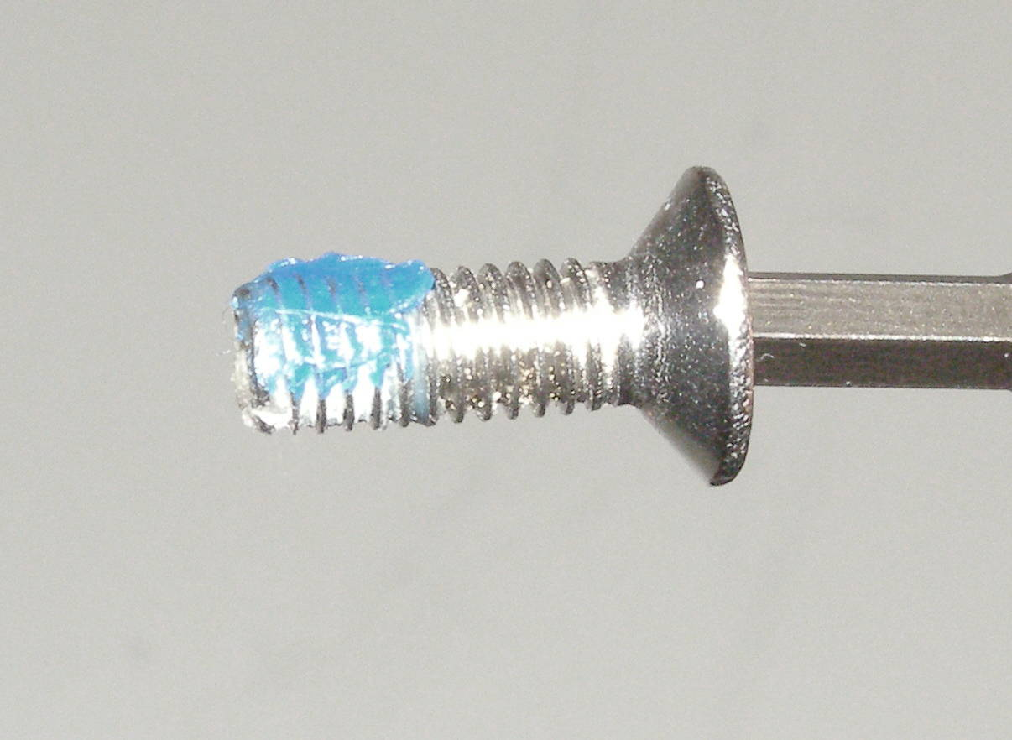
Using the Torque Tools + Loctite
Adjustment unlocked
Only a small “patch” of Loctite is needed.
Rotate
11.0 Nm
Old Loctite.

Slide 14
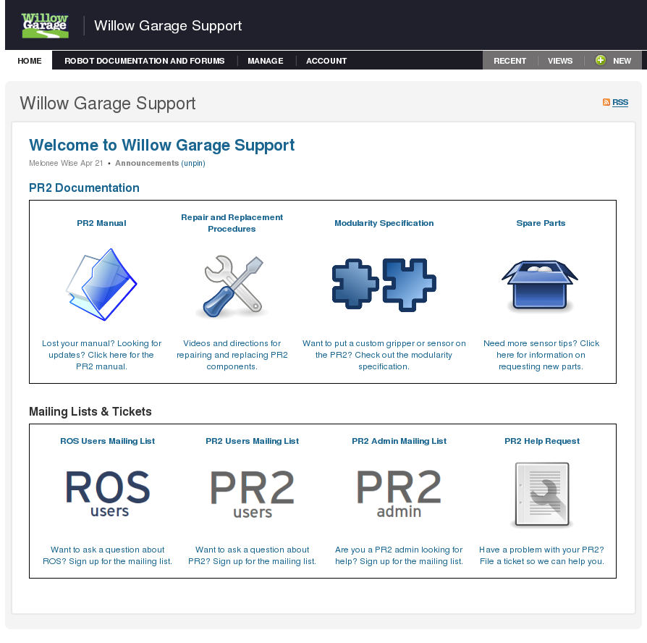
Maintenance and Replacement Demos
For all PR2 maintenance instructions and procedures, see support.willowgarage.com
Today's demos
Video of gripper tip replacement
Live demo of fan filter repair/replacement
Hands-on demo of counterbalance adjustment
<See support.willowgarage.com for maintenance and repair>

Slide 15
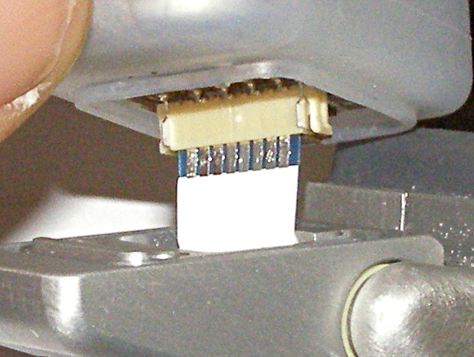
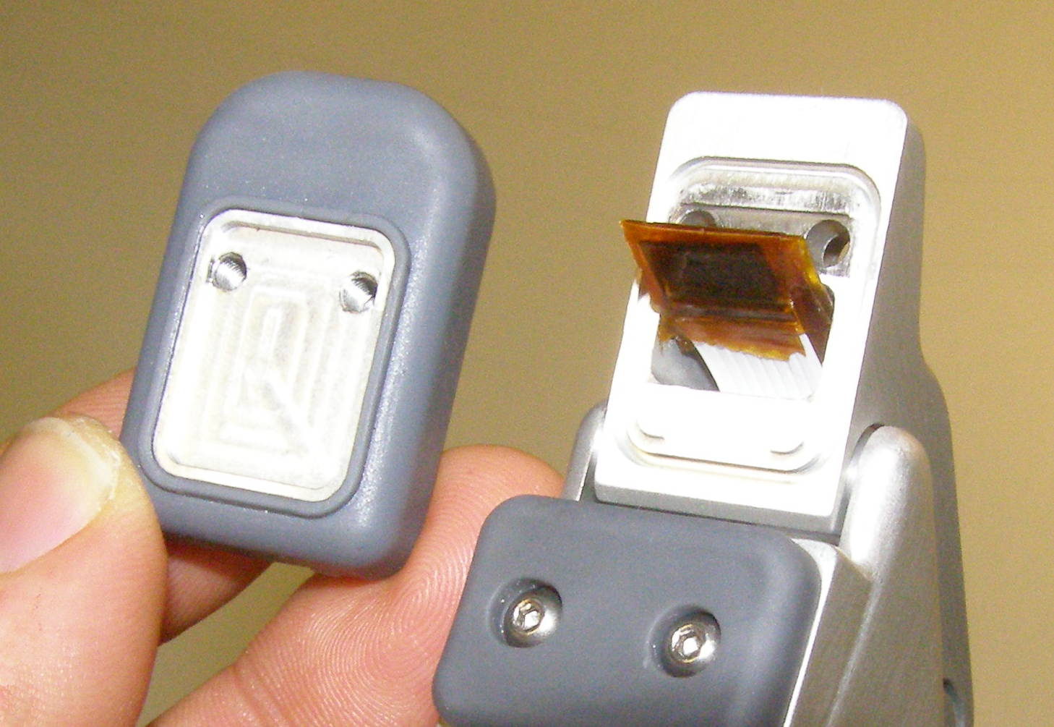
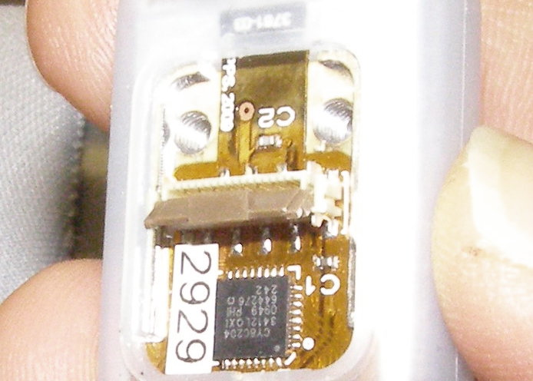
Replacement – Gripper Tips Demo
Video of Gripper Sensor Tip R/R
Safety:
  Turn power off.
  Put on ESD strap.
Gripper Sensor Tip R/R:
  Sensorized versus dummy tips.
  Explain Boots:
    Always cover sensors
    Boots are relatively easy to damage.
    Replace boots as soon as they show any damage
  R/R tips, Doc3 (skip Pads R/R section)
  WG will not replace sensor tips damaged in use. You can buy them from WG.
  WG will replace boots if you need them.
Fig 6
Fig 7
Fig 10

Slide 16
Maintenance – Fan Filter Demo
Fan Filter Cleaning:
  Robot power can remain on.
  Regular cleaning required
    Approximately every 1 to 4 weeks
    As the filter gets clogged, robot fan speed will tend to increase. Can be noisy.
  Vacuuming
    Be careful not to tear filter
    Not recommended
  Washing
    Remove cover plate, Doc15
    Wash and dry filter
    Having the robot fan on helps when placing the filter
    Re-install the cover plate
Replacement filters, order direct from Willow Garage

Slide 17
Maintenance – Counterbalance
Overview: PR2 Counterbalance (CB) holds up the weight of the arms using a spring and pulley system
Goal: The CB should balance the arm so that almost no torque is required to maintain position of the arm
Performance: A well adjusted counterbalance will maximize the performance of the PR2 arm controllers

Slide 18

Maintenance – CB Adjustments
With time, the springs of the CB system can start to sag or give. To maintain performance, you will have to adjust the mechanism.
Adjustments:
  Secondary spring can be stiffened or loosened
    Clockwise (CW) turns increases force on arm
  “Arm gimbal shaft” controls level arm length of CB spring force
    Counterclockwise (CCW) increases force on arm
Both adjustments work together to balance upperarm and forearm of PR2.

Slide 19
Maintenance – CB Adjust Demo
Demo Overview: Demonstrate checking and adjusting the counterbalance on the PR2
  We will demonstrate up front
  You will adjust your own counterbalance with help from Willow Garage engineers and technicians
Notes:
  Safety first
  You need two people to adjust the mechanism
  Observe ESD protocol (wrist strap)
  Watch for pinch points

Slide 20
CB Check Program Overview
We use a counterbalance adjustment/check program to adjust the counterbalance.
  The program moves the arm of the robot and measures the torque on each joint
  It uses training data to recommend adjustments to for a minimum torque setting
    The program is an iterative solver, in some cases more than one iteration is required
You will run the check program and determine your required adjustment.

Slide 21
CB Check Program Install
Counterbalance adjustment program is unreleased.
  You will have to install it from wg-ros-pkg trunk and build it
  Tutorial:
    ros.org/wiki/qualification/Tutorials
  Follow tutorial instructions to install and build
Important: Do not start the CB adjustment program until instructed to do so

Slide 22
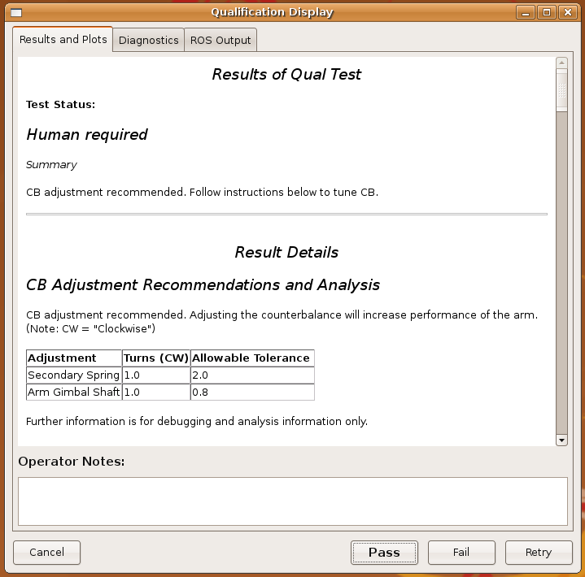
Maintenance – CB Adjust Demo
Check program:
  Run CB Check program, Doc5
  CB check program will tell you if you are within tolerance
Fig 1
Right
Secondary
Arm Gimbal Shaft

Slide 23
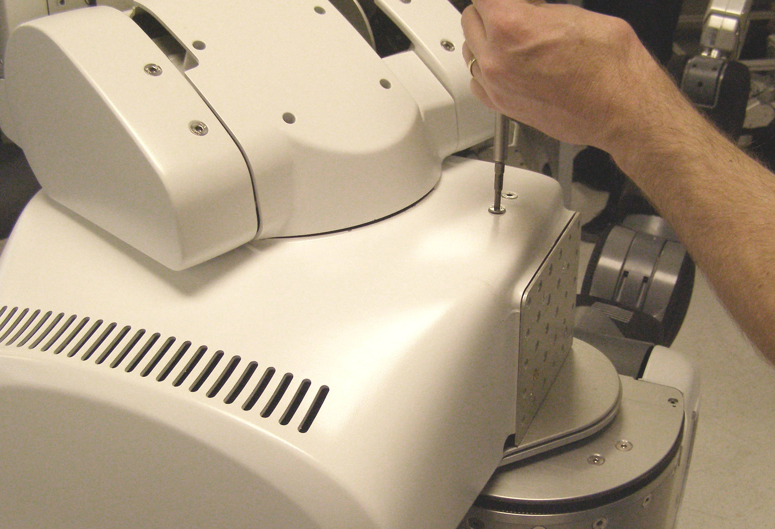
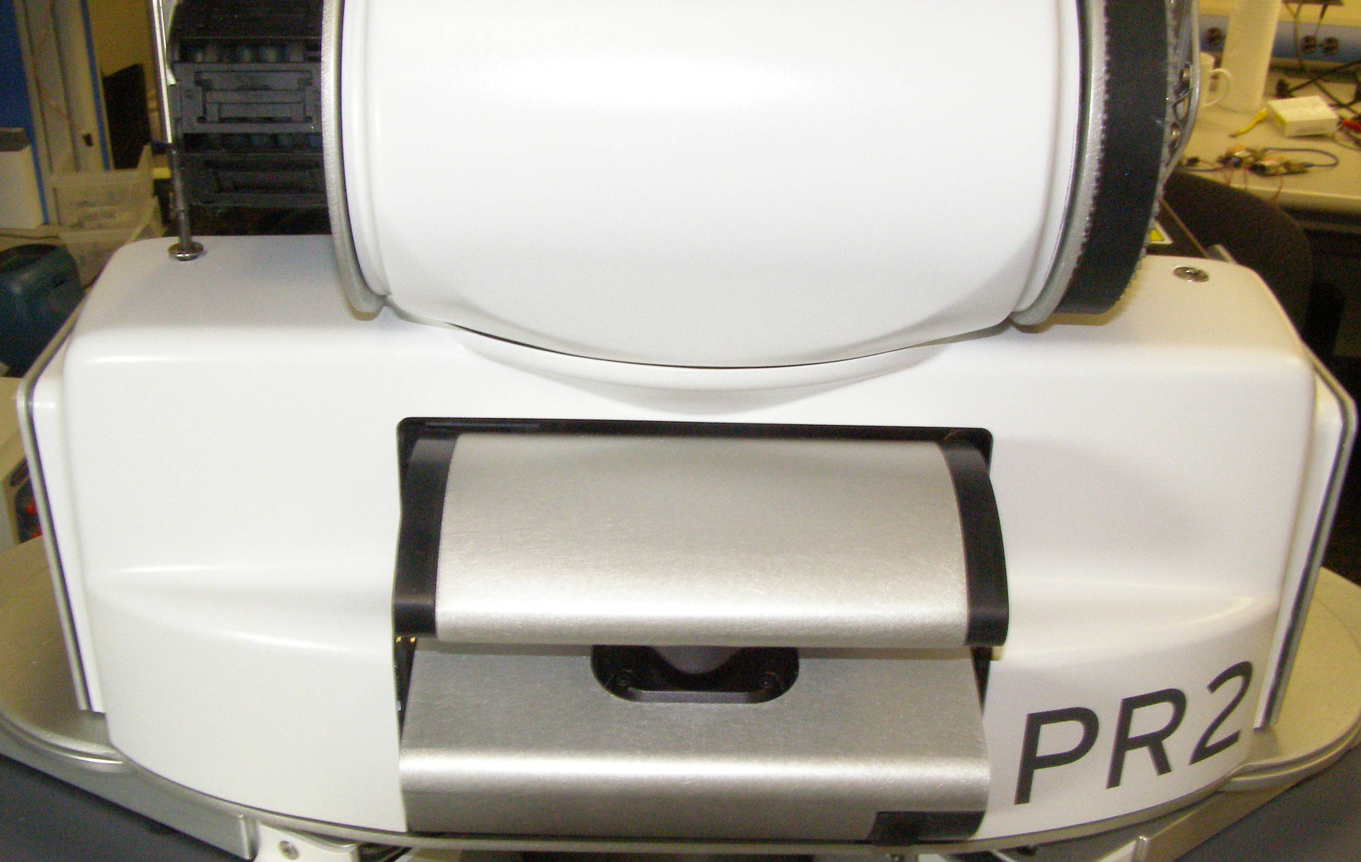
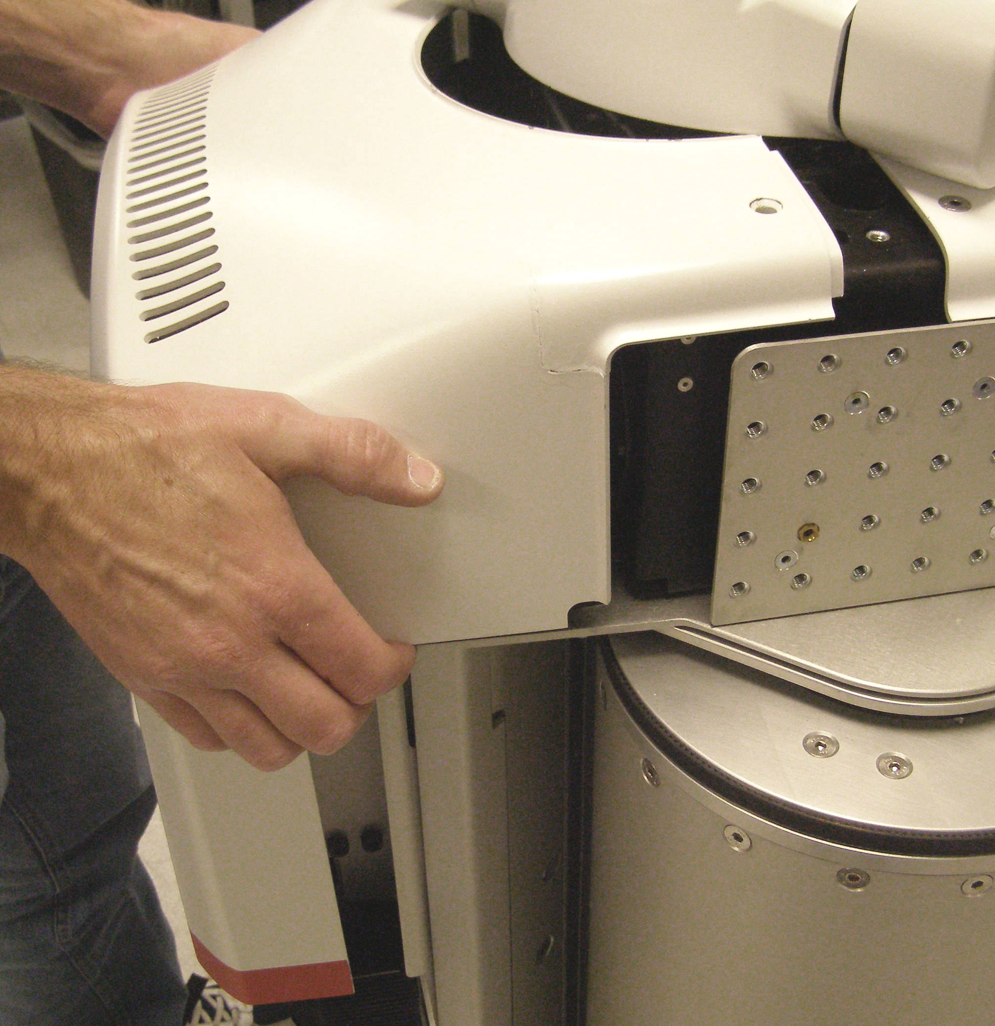
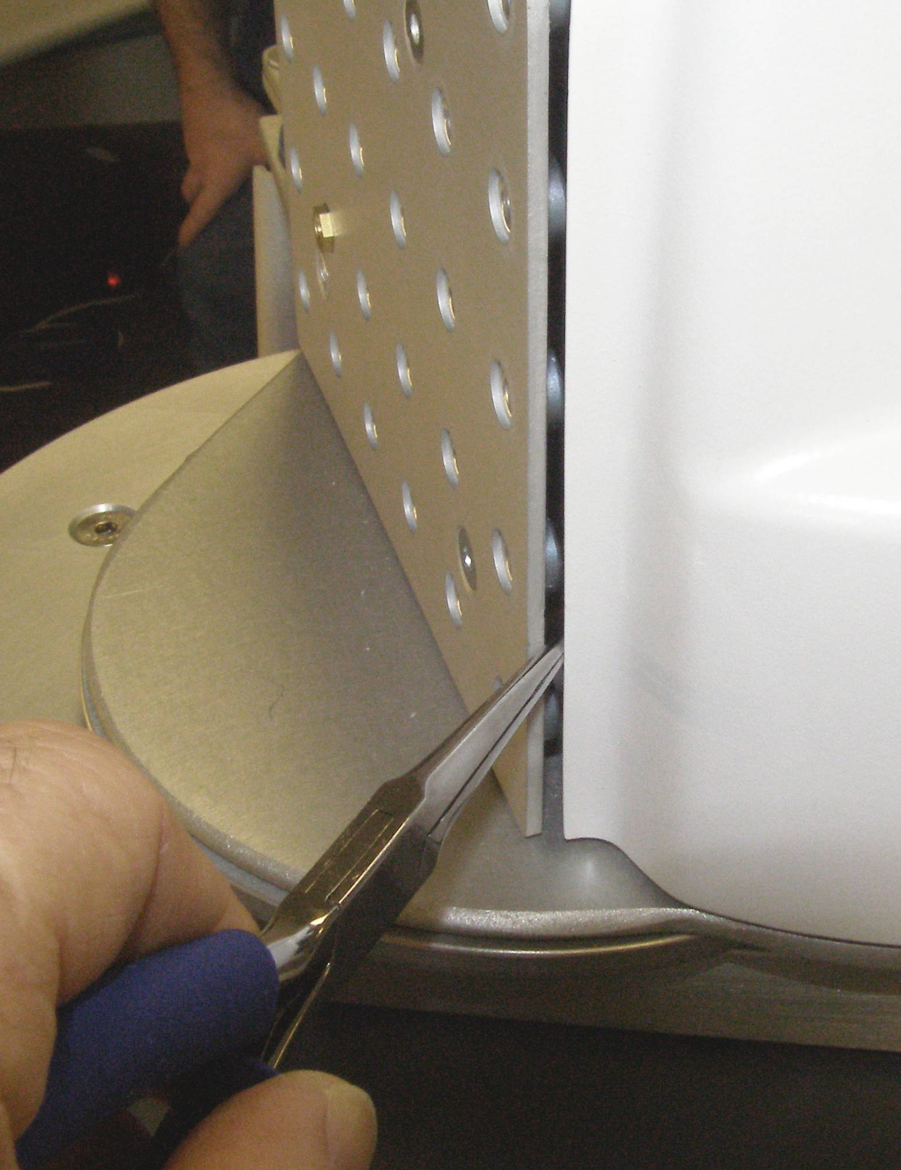
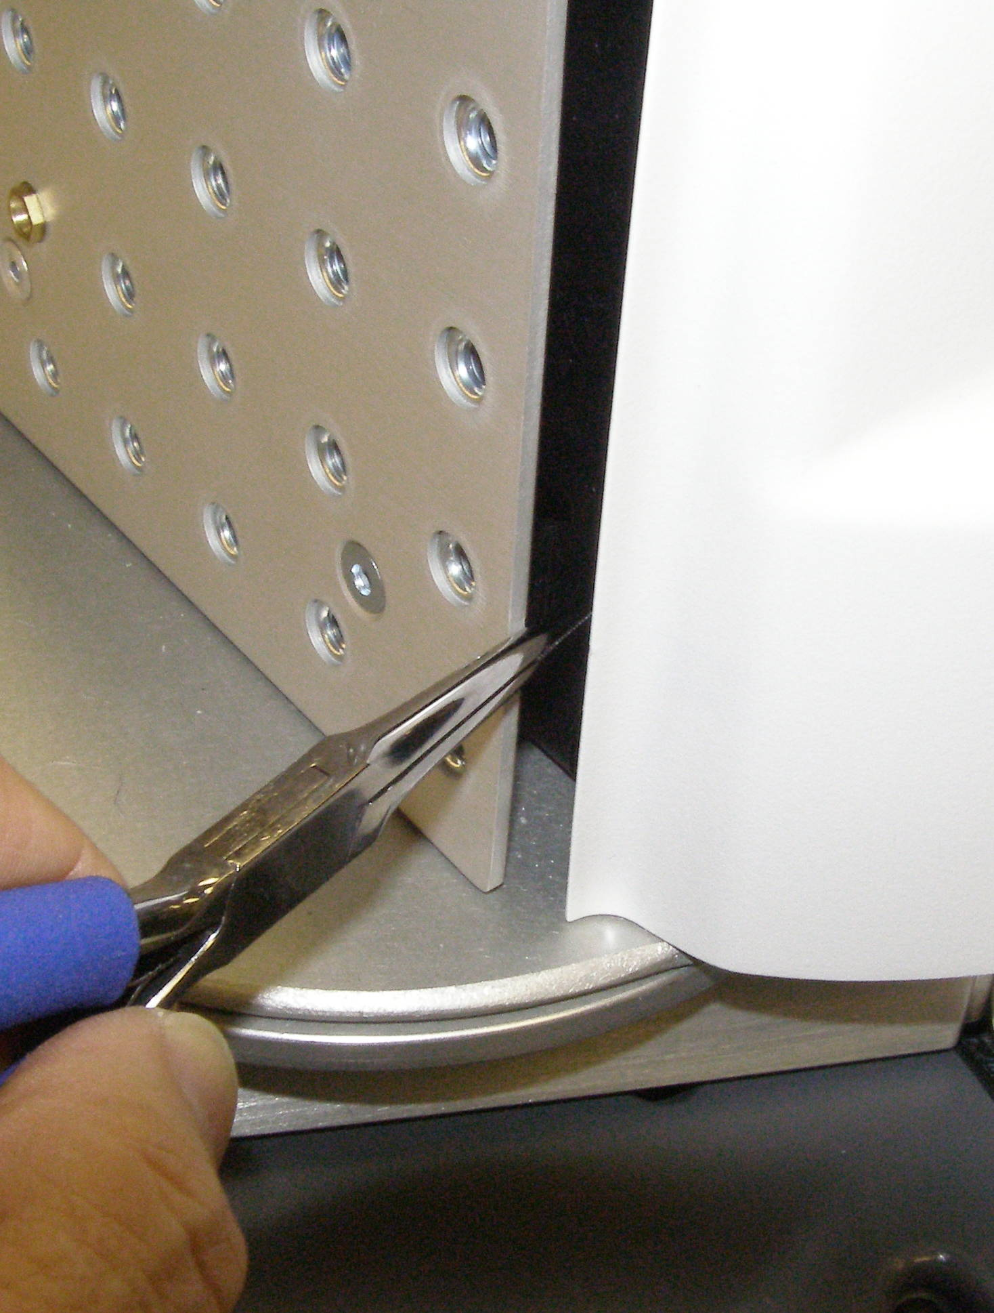
Maintenance – CB Adjust Demo
Observe safety and ESD protocols.
Remove top covers, Doc6
Fig 1
Fig 1
Fig 2
Fig 3
Fig 4

Slide 24




Maintenance – CB Adjust Demo
Observe safety and ESD protocols.
Remove shoulder covers, Doc16
Fig 11
Fig 6
Fig 5
Fig 7

Slide 25
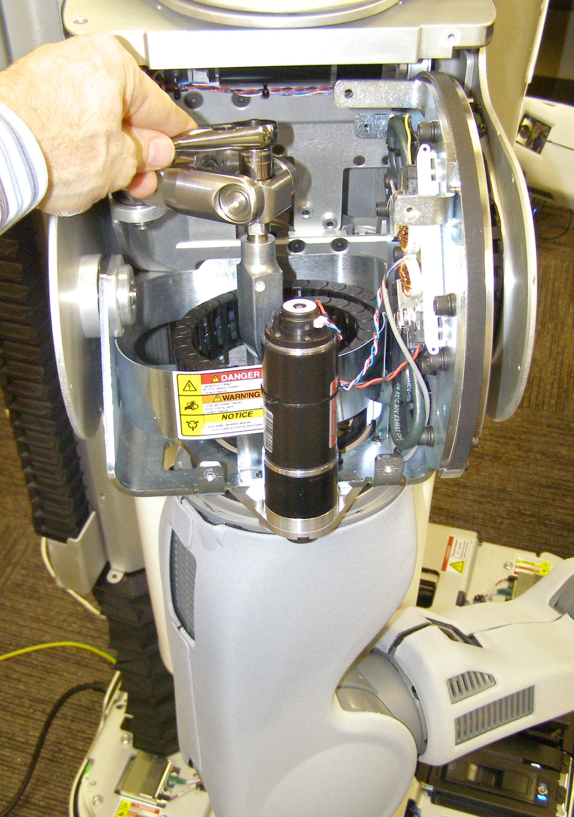

Maintenance – CB Adjust Demo
Adjust counter balance, Doc5
  Re-run the Check program and adjust the CB if needed, Doc5
  Re-install the covers, Doc6
Fig 6
Fig 5
Guide tube

Slide 26
Maintenance – CB Sequence
Check CB with adjustment program
  Clear out 2m space around your robot
Turn robot off (sudo pr2-shutdown)
Remove covers
  Ask your Willow Garage helper for questions
Adjust CB
  Make adjustments check tool recommends
Turn robot on
Check CB with adjustment program
Turn robot off
Reinstall covers

Slide 27
PR2 Maintenance Review
  Safety First
  support.willowgarage.com
  Always wear an ESD wrist strap
Questions?

