Slide 1
Calibrating the PR2
ROS + PR2 Training Workshop

Slide 2
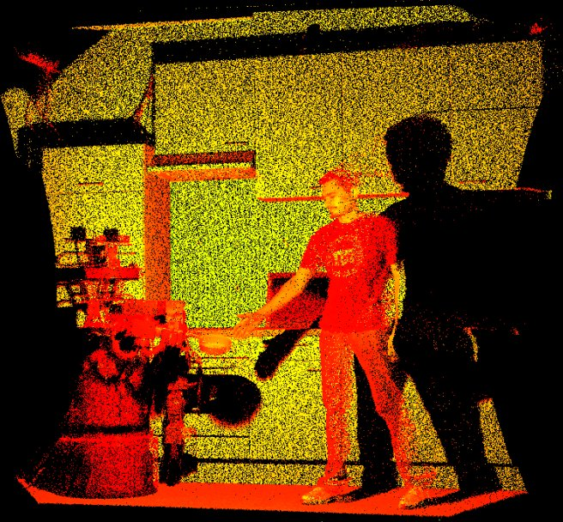
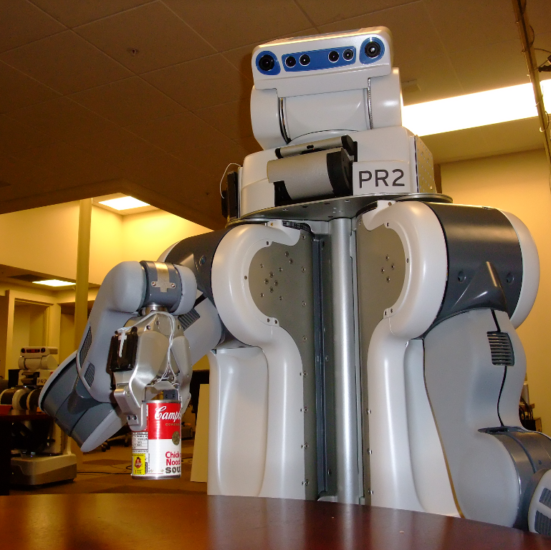
Why is calibration important?
Sensor Fusion
Manipulation

Slide 3
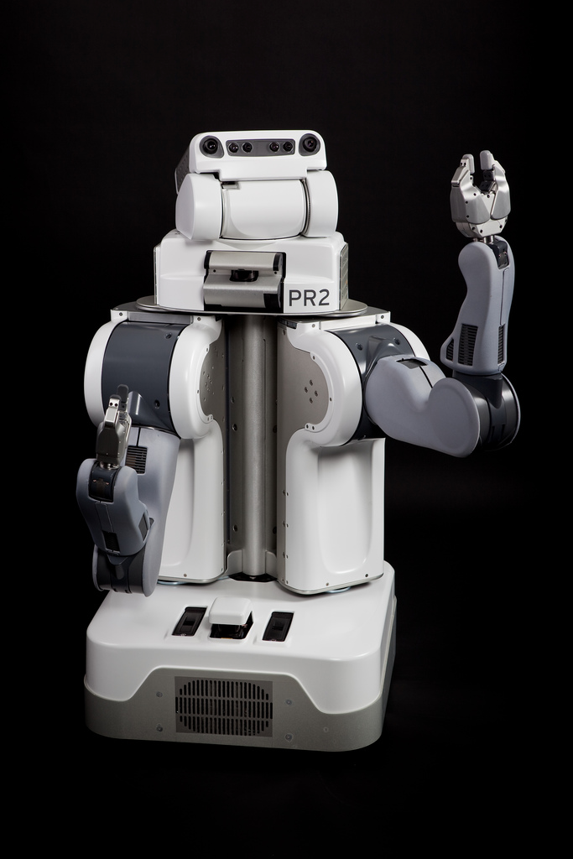
What are we calibrating?
Stereo
Baselines
Camera Positions
Tilting Laser
Position
Joint Angle Offsets
Not Calibrating:
- Camera Distortions
- Camera Projections
- Base Laser Location
- Hi Res Camera Location
- Wheel Odometry
- IMU

Slide 4
Where is it stored?
/etc/ros/urdf/robot.xml
Kinematic Data
Sensor Positions
Lots of other robot info
Camera EEProm
Distortion Parameters
Projection Matrices
Stereo Baselines

Slide 5
Calibration Workflow
Calibrate
Cameras
Update
robot.xml
Capture
Data
Estimate
Params
Calibrated!
Update
Camera
EEProm

Slide 6
Under the Hood:
Data Flow
Capture
Data
Update
EE Prom
cal_measurements.bag
Estimate
Params
system_calibrated.yaml
system.yaml
robot.xml
Write
URDF
robot_calibrated.xml

