Slide 1
Processing Camera Data
ROS + PR2 Training Workshop

Slide 2
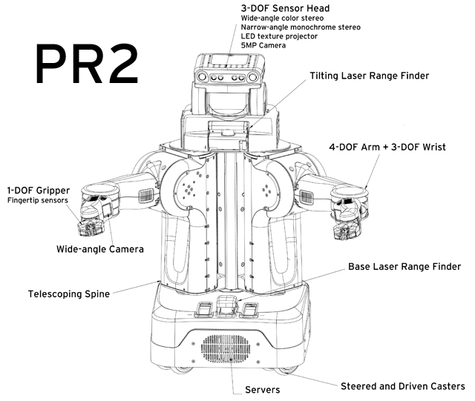
Cameras on the PR2

Slide 3
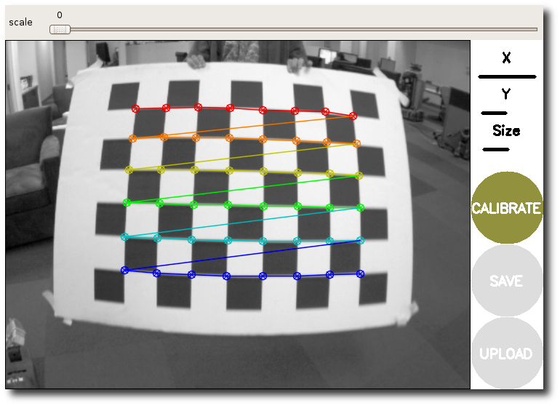
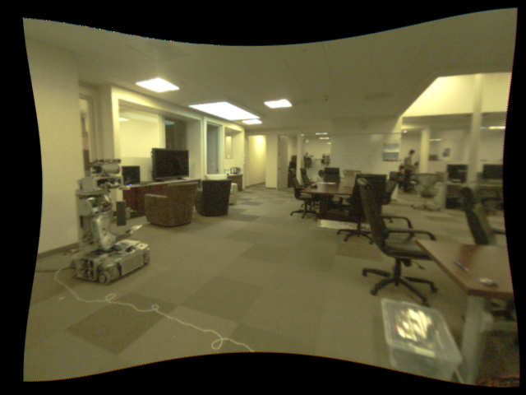
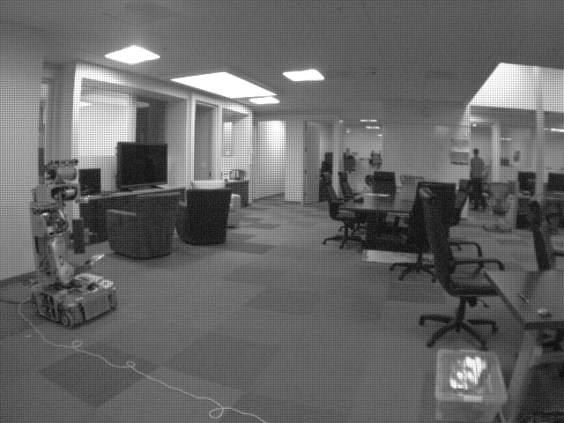
The Image Pipeline
image_view
stereo_view
Camera calibration
image_proc/
stereo_image_proc
Your vision processing nodes!
Camera driver
www.ros.org/wiki/image_pipeline

Slide 4
Camera Calibration
Calibration characterizes:
  Distortion
  How 3D points project to the image plane
  How to rectify stereo pairs
Parameters normally stored by the camera driver
Published in a CameraInfo message with each Image
www.ros.org/wiki/camera_calibration

Slide 5
Camera Calibration
Before
After
Distortion
Stereo rectification
3D geometry
Parameters → camera driver
CameraInfo message published with each Image
www.ros.org/wiki/camera_calibration

Slide 6
Camera Drivers
Stream sensor images and publish them to ROS topics
Configure camera settings (exposure, gain, etc.)
Output topics:
  <camera>/image_raw – the raw image data (often Bayer)
  <camera>/camera_info – camera metadata, including calibration parameters
www.ros.org/wiki/camera_drivers

Slide 7
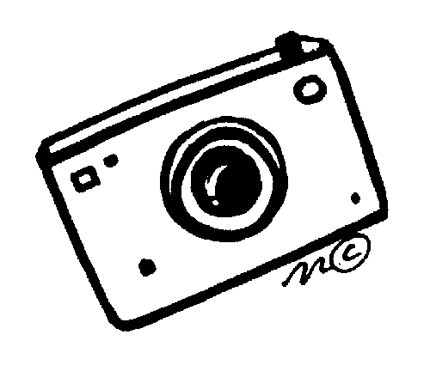
Camera Drivers
Image stream
Camera settings (exposure, gain, etc.)
Camera
Driver
<camera>/image_raw
<camera>/camera_info
www.ros.org/wiki/camera_drivers

Slide 8
Debayering and Rectification
Basic operations performed by
  image_proc (monocular cameras)
  stereo_image_proc (stereo cameras)

Slide 9
Viewing Images (image_view)
$ rosrun image_view image_view image:=r_forearm_cam/image_raw
www.ros.org/wiki/image_view

Slide 10
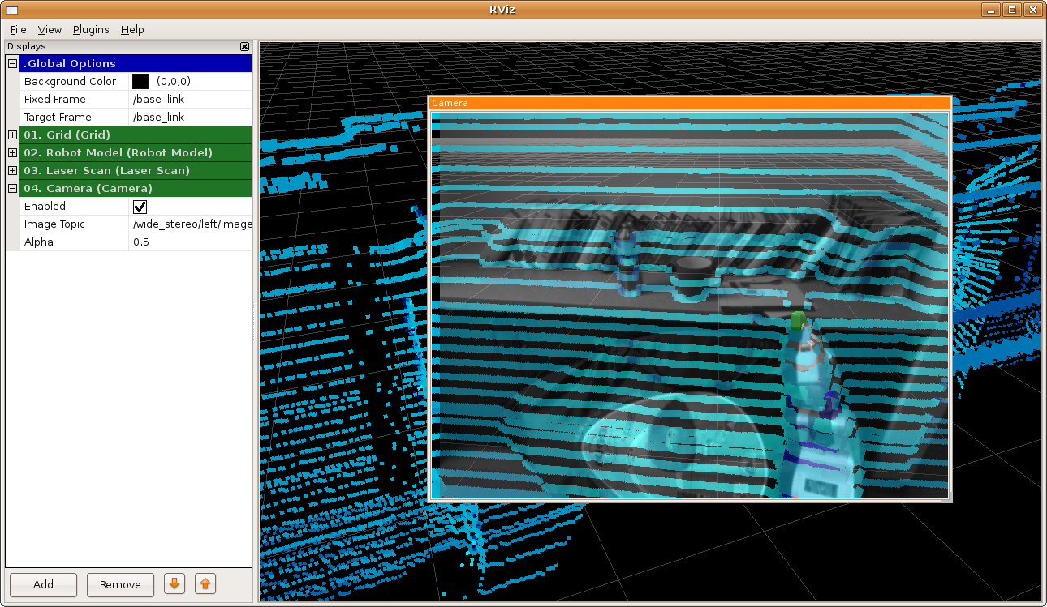
Viewing Images (rviz)
Displays panel → Add → Camera
www.ros.org/wiki/rviz/DisplayTypes/Camera

Slide 11
Stereo Processing
stereo_image_proc produces
  Disparity images
  Point clouds
  On topics:
  <stereo>/disparity
  <stereo>/points
www.ros.org/wiki/stereo_image_proc

Slide 12
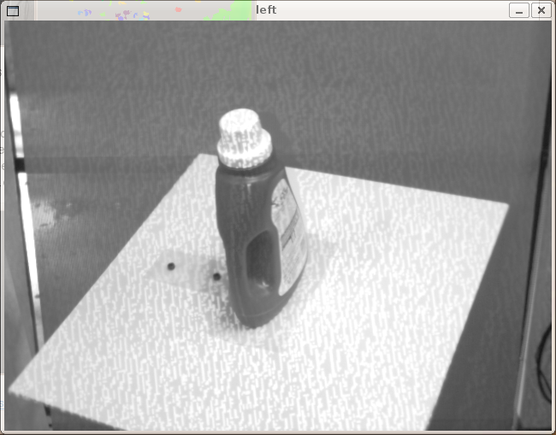
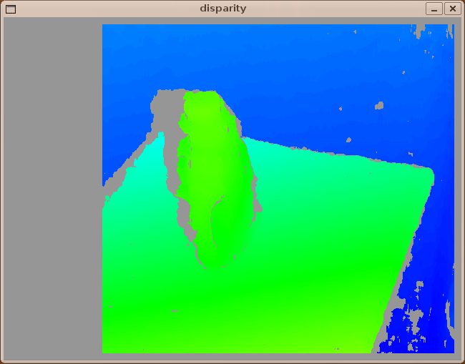
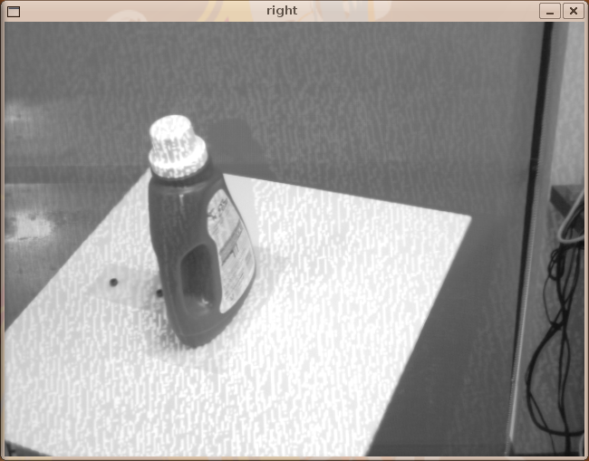
Viewing Disparity Images
$ rosrun image_view stereo_view stereo:=narrow_stereo image:=image_rect

Slide 13
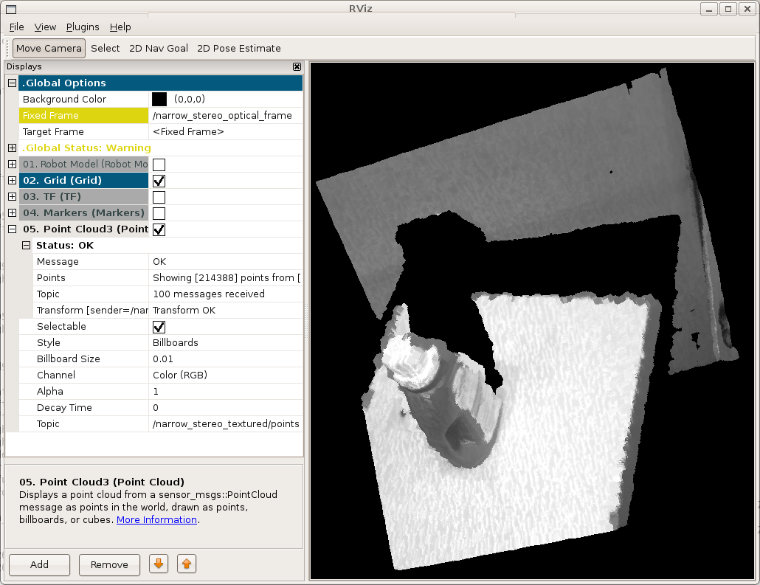
Viewing Point Clouds
Displays panel → Add → Point Cloud
Enter the topic in the red box

Slide 14
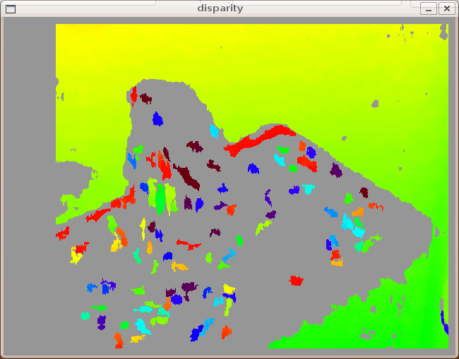
Adjust Stereo Parameters
www.ros.org/wiki/stereo_image_proc/Tutorials/ChoosingGoodStereoParameters

Slide 15
Exercise #1
Calibrate your narrow stereo cameras.
www.ros.org/wiki/camera_calibration/Tutorials/StereoCalibration

Slide 16
Processing Images in ROS
Typical vision node workflow:
  Subscribe to the camera topics
  Image & CameraInfo messages → OpenCV types
  Solve vision!
  Publish poses, output images, etc.

Slide 17
Subscribing to Camera Topics
image_transport
  Compression (JPEG/PNG, Theora)
  Add others as plugins
Subscribe to image AND camera_info topics
  Synchronized time stamps
  CameraSubscriber handles the synchro
www.ros.org/wiki/image_transport

Slide 18
Subscribing to Camera Topics
1 #include <ros/ros.h>
2 #include <image_transport/image_transport.h>
3
4 class MyVisionNode
5 {
6 ros::NodeHandle nh_;
7 image_transport::ImageTransport it_;
8 image_transport::CameraSubscriber sub_;
9
10 public:
11 MyVisionNode()
12 : it_(nh_)
13 {
14 sub_ = it_.subscribeCamera("image_topic", 1, &MyVisionNode::imageCb, this);
15 }
16
17 void imageCb(const sensor_msgs::ImageConstPtr& image_msg,
18 const sensor_msgs::CameraInfoConstPtr& info_msg)
19 {
20 // ...
21 }
22 };

Slide 19
Using ROS messages with OpenCV
cv_bridge
ROS sensor_msgs/Image → OpenCV IplImage
image_geometry
ROS sensor_msgs/CameraInfo → OpenCV calibration matrices
  Many useful functions in the camera model classes
www.ros.org/wiki/cv_bridge/Tutorials
www.ros.org/wiki/image_geometry

Slide 20
ROS Image -> OpenCV
1 #include <cv_bridge/CvBridge.h>
2
3 class MyVisionNode
4 {
5 sensor_msgs::CvBridge bridge_;
6
7 public:
8 void imageCb(const sensor_msgs::ImageConstPtr& image_msg,
9 const sensor_msgs::CameraInfoConstPtr& info_msg)
10 {
11 IplImage *cv_image = NULL;
12 try {
13 cv_image = bridge_.imgMsgToCv(image_msg, "bgr8");
14 }
15 catch (sensor_msgs::CvBridgeException& error) {
16 ROS_ERROR("Couldn't convert image with encoding %s",
17 image_msg->encoding.c_str());
18 return;
19 }
20 }
21 };

Slide 21
ROS CameraInfo -> OpenCV
1 #include <image_geometry/pinhole_camera_model.h>
2
3 class MyVisionNode
4 {
5 image_geometry::PinholeCameraModel cam_model_;
6
7 public:
8 void imageCb(const sensor_msgs::ImageConstPtr& image_msg,
9 const sensor_msgs::CameraInfoConstPtr& info_msg)
10 {
11 cam_model_.fromCameraInfo(info_msg);
12 }
13 };

Slide 22
Publishing Image Topics
1 class MyVisionNode
2 {
3 ros::NodeHandle nh_;
4 image_transport::ImageTransport it_;
5 image_transport::Publisher pub_;
6
7 public:
8 MyVisionNode()
9 : it_(nh_)
10 {
11 pub_ = it_.advertise("image_out", 1);
12 }
13
14 void imageCb(const sensor_msgs::ImageConstPtr& image_msg,
15 const sensor_msgs::CameraInfoConstPtr& info_msg)
16 {
17 // ...
18 pub_.publish(bridge_.cvToImgMsg(image, "bgr8"));
19 }
20 };

Slide 23
Exercise #2
Draw the location of the robot gripper (according to tf) on an image stream.
http://www.ros.org/wiki/image_geometry/Tutorials/ProjectTfFrameToImage

Slide 24
Logging Sensor Data
Recording data:
  $ rosbag record r_forearm_cam/image_raw r_forearm_cam/camera_info tf
Play back data:
  $ rosbag play XXX.bag
What's in a bag file:
  $ rosbag info mystery_data.bag
www.ros.org/wiki/rosbag/Tutorials/Recording and playing back data

Slide 25
Questions?
http://www.ros.org/
http://opencv.willowgarage.com/
ros-users@code.ros.org

