Slide 1

Installing NetFT on PR2
June 29, 2011

Slide 2
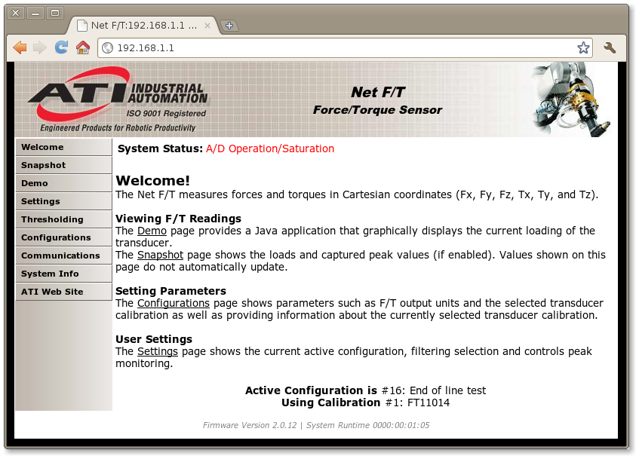
NetFT Configuration
Before putting NetFT on PR2, get it working first with wall power supply and desktop computer.
By default NetFT tries to get a IP address using DHCP after first powering up. However, when its gets an address from DHCP the question of what IP address it got assigned arises. If NetFT does not get a DHCP address after about 10 seconds, it will fall-back to using a static IP address of 192.168.1.1. On my computer, I have an extra NIC (eth1). I connect NetFT directly to NIC and assign it a static address on same subnet as NetFT:
sudo ifconfig eth1 192.168.1.100
The NetFT has a web browser, so it should be possible to view NetFT status information with browser by using http://192.168.1.1 (Fig2)
You can also the ROS netft_node to read and publish force/torque data from the sensor. The is a tutorial for the node available here : “http://www.ros.org/wiki/netft_rdt_driver/Tutorials/RunningNetFTNode
Fig 1

Slide 3
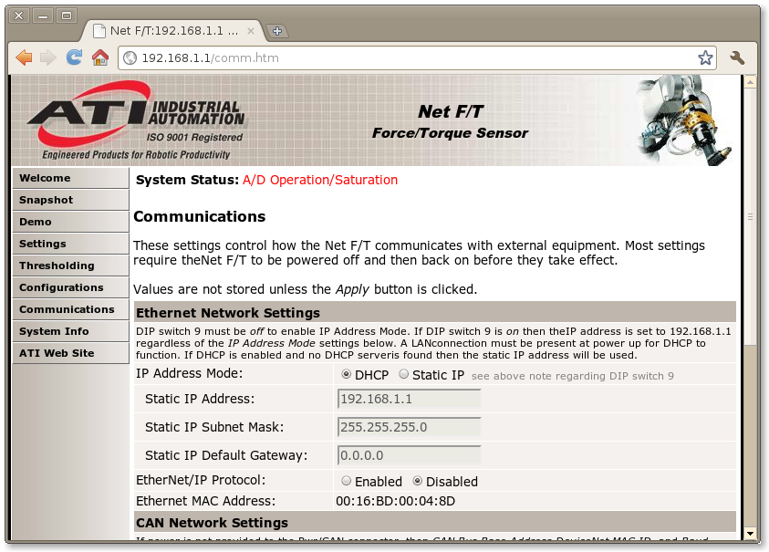
NetFT Configuration
When using NetFT on PR2 we assign it a static IP address of 10.68.0.60 . Before putting NetFT on PR2 it might be useful to assign a static IP of 10.68.0.60 using NetFT 'Communications' webpage (Fig1)
Fig 1

Slide 4
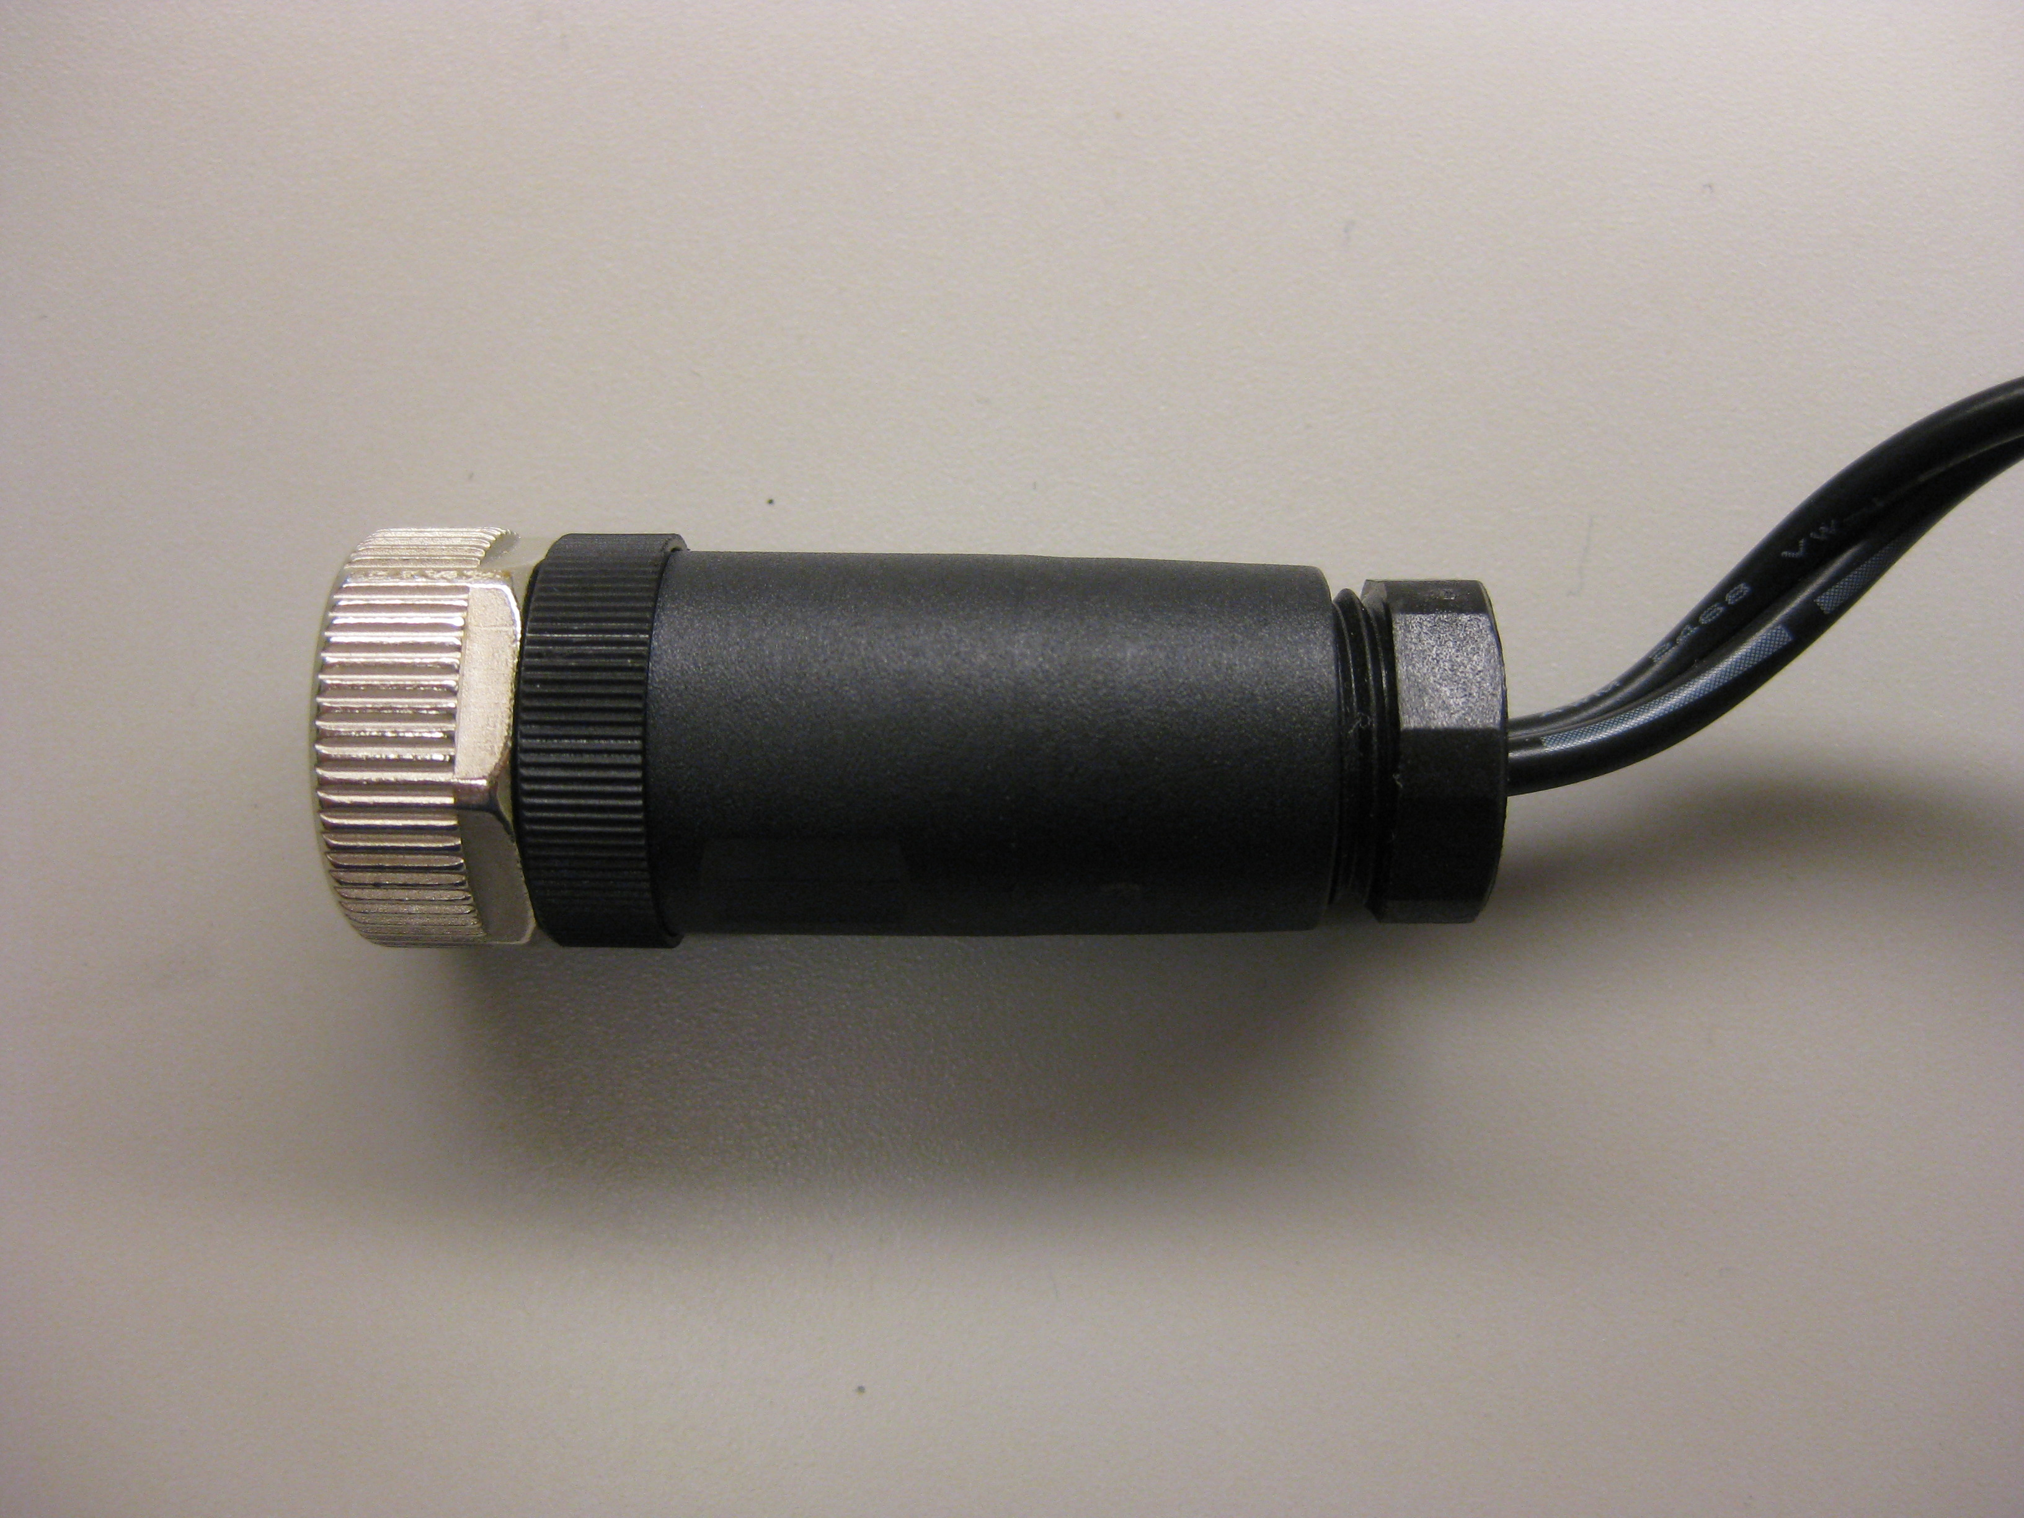
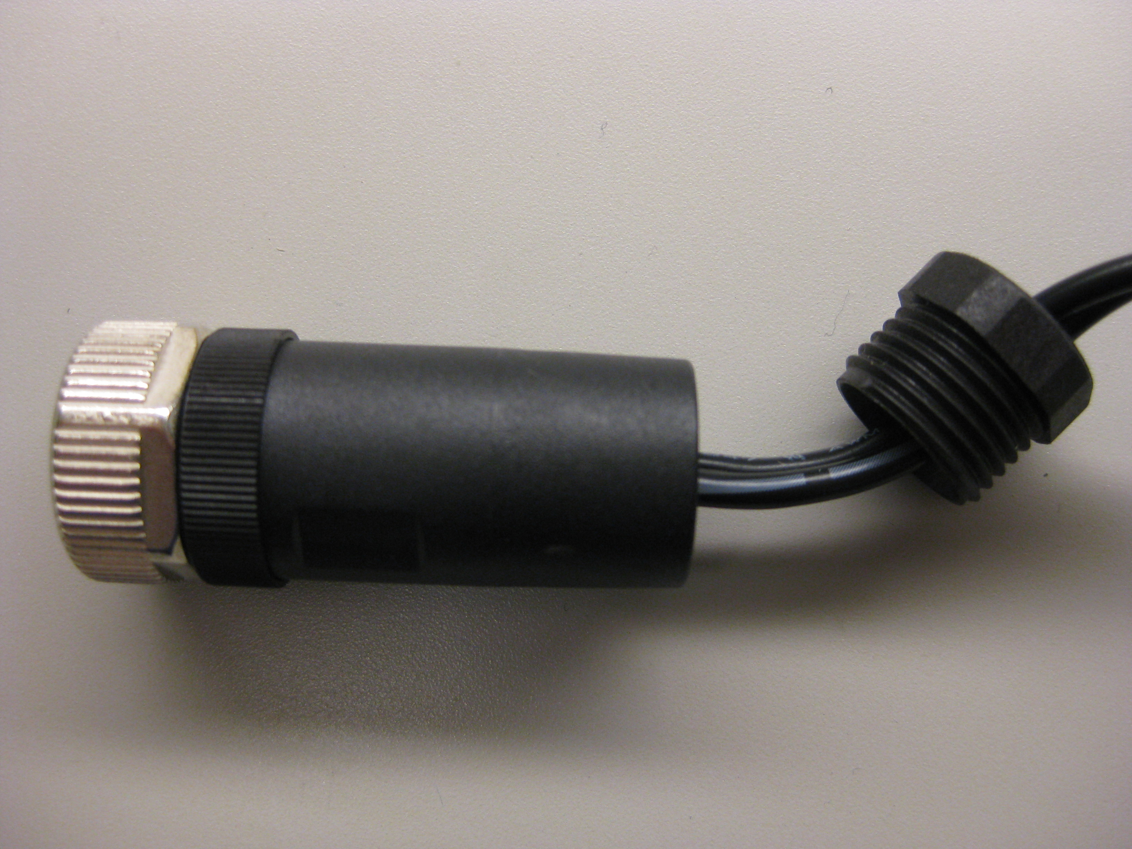
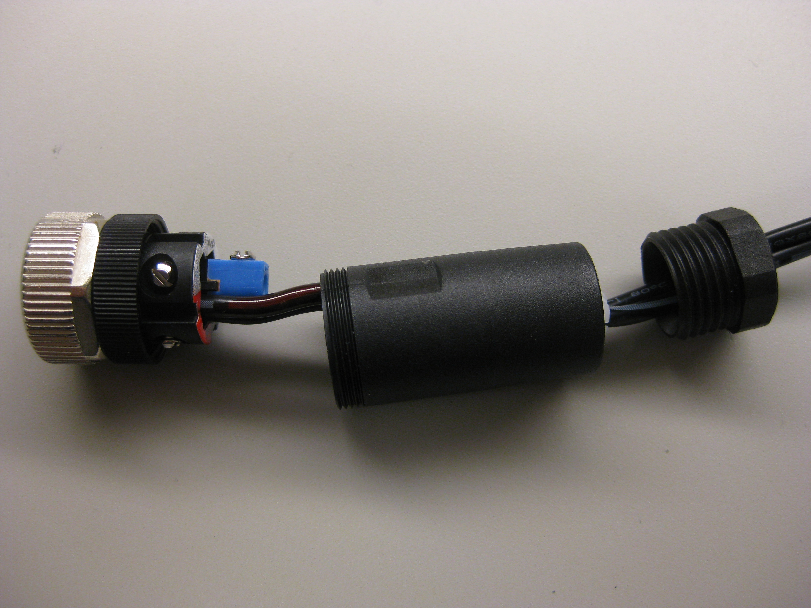
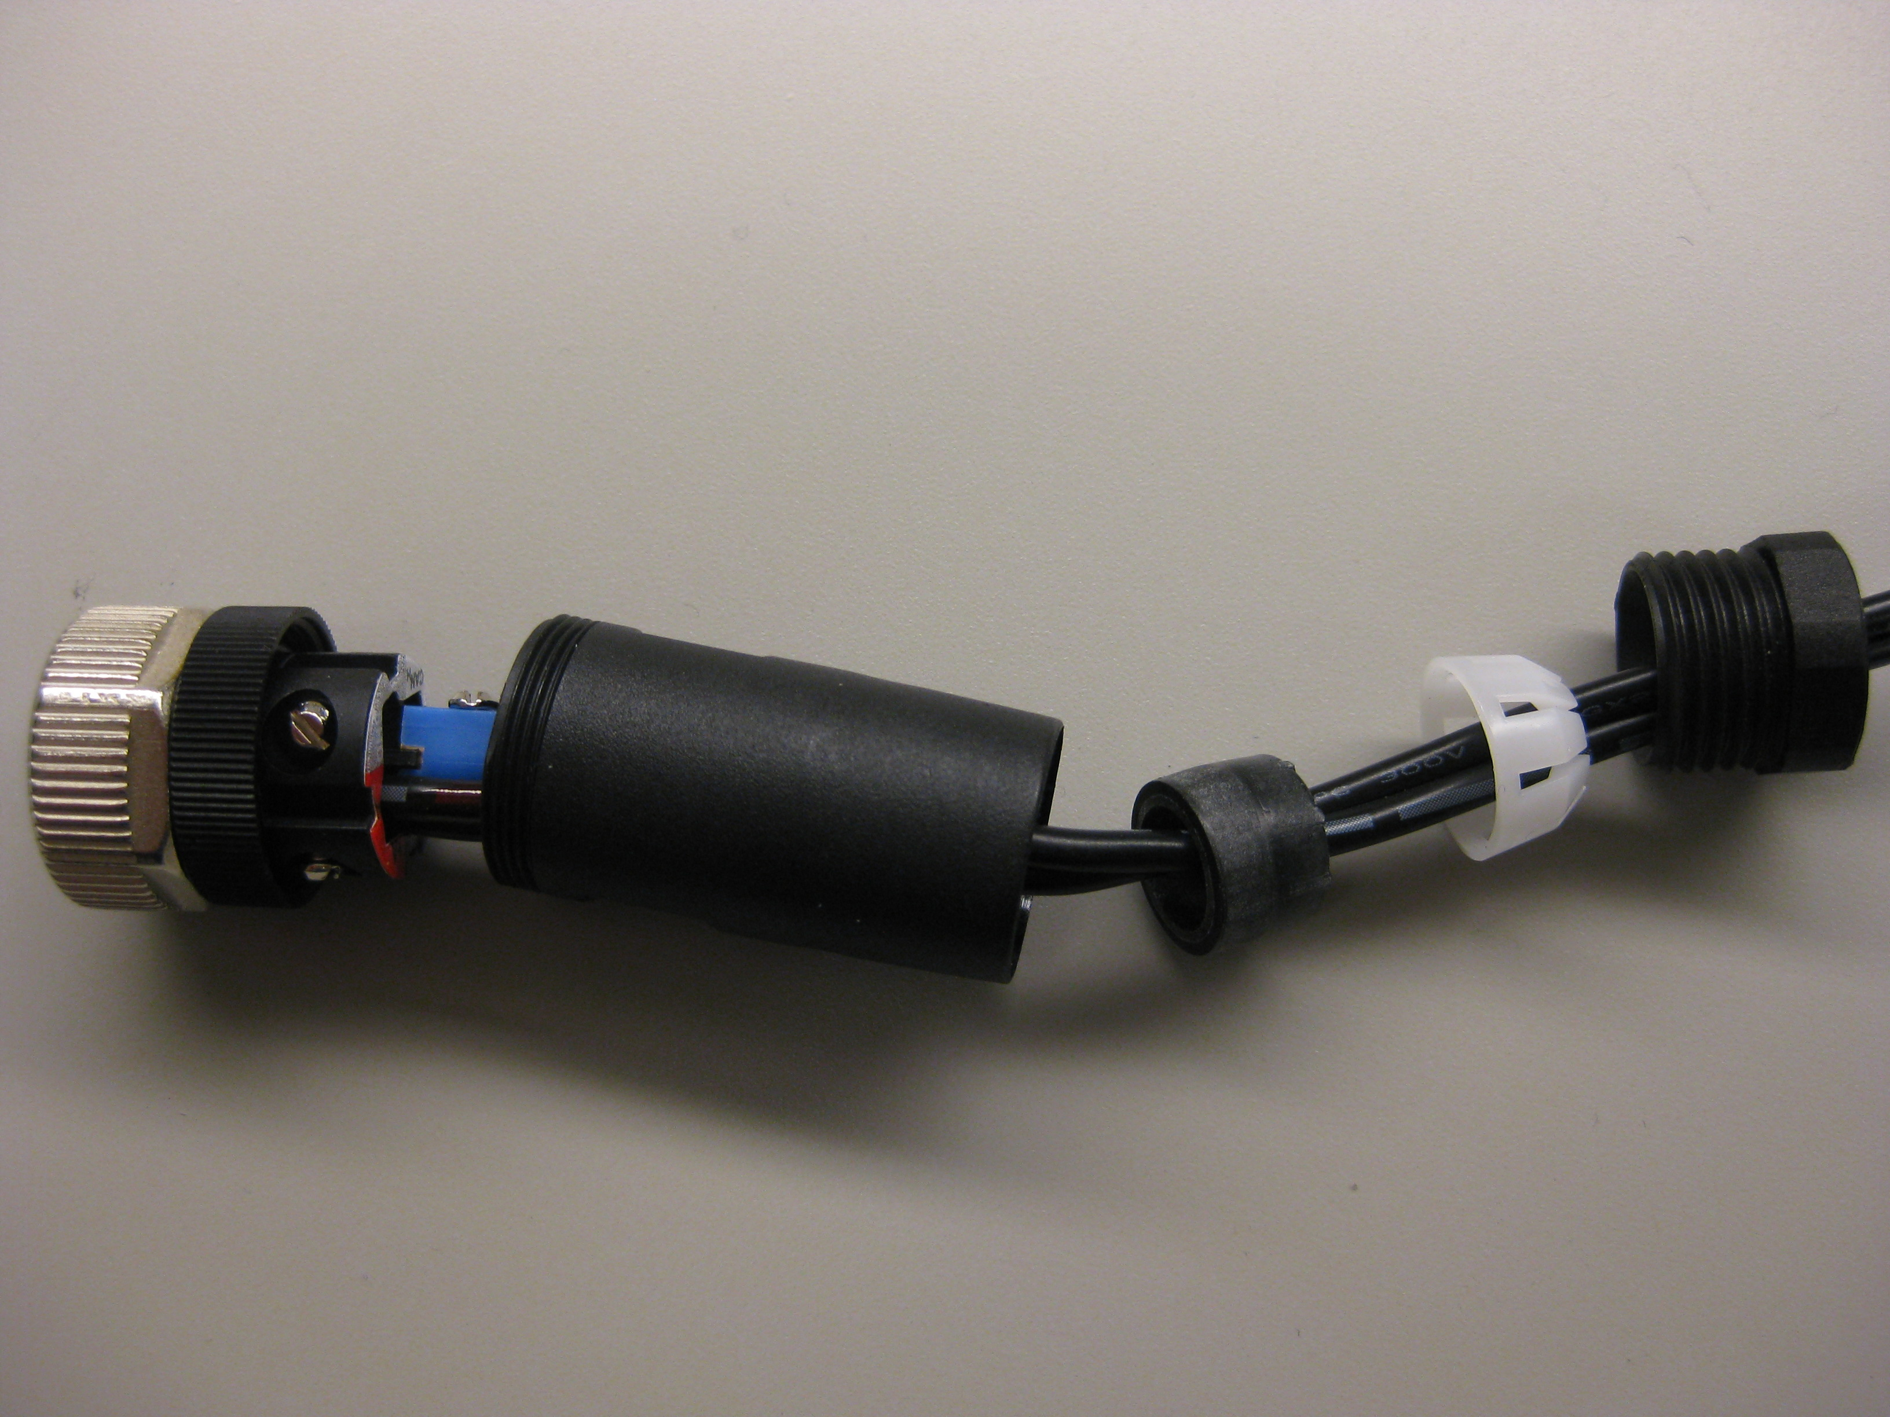
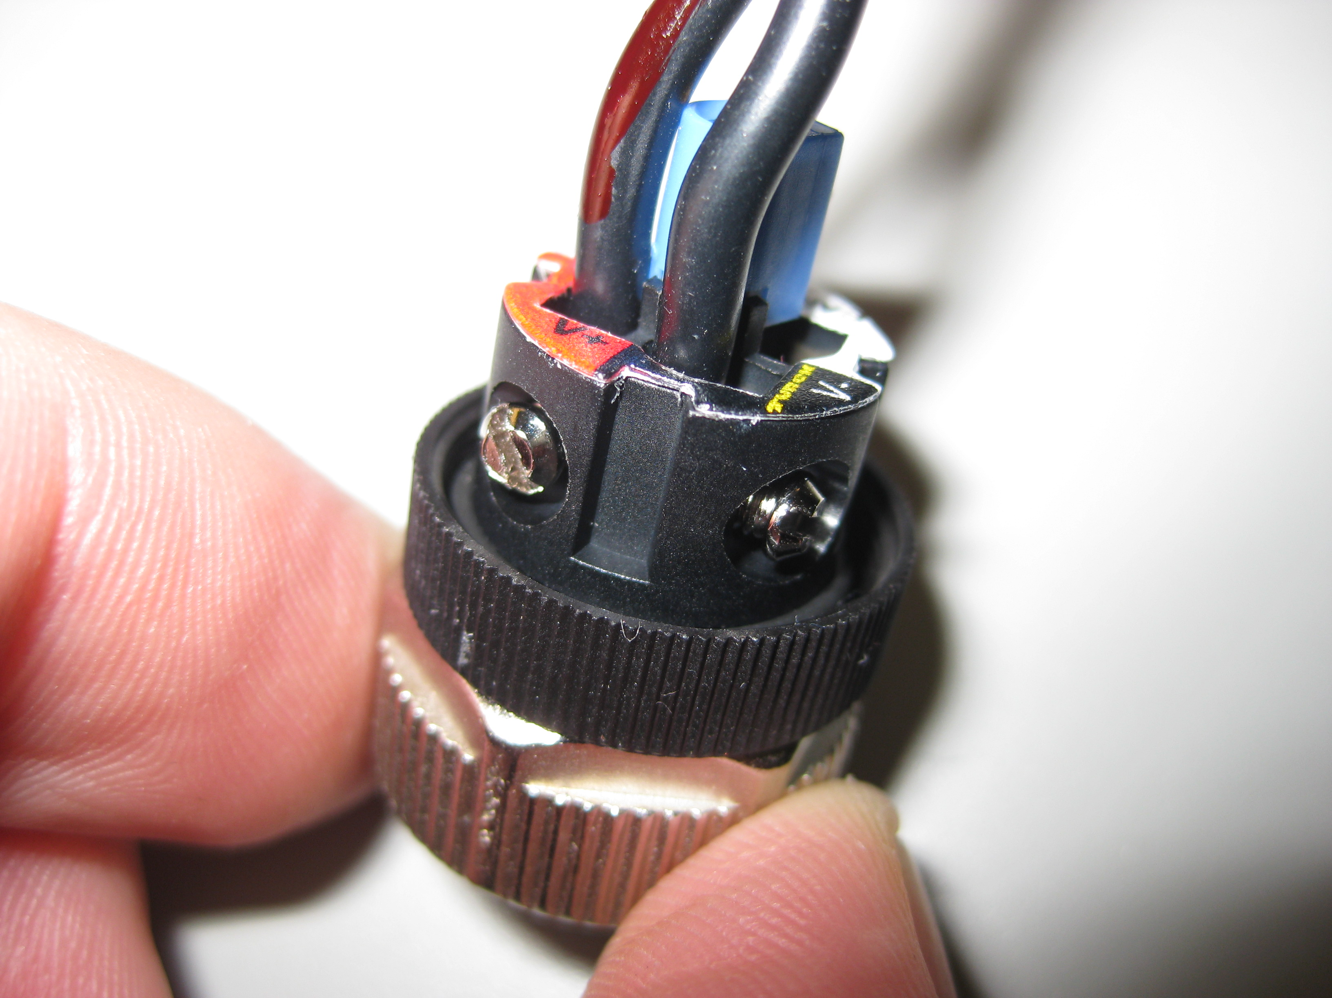
NetFT Power Cable Teardown
Before modifying power cable for PR2 (Fig 1), get NetFT to working when plugged into wall outlet.
After proper NetFT operation has been verified, unplug power converter and wait for a few minutes for capacitors to discharge.
Unscrew rear part of plug (Fig 2)
Unscrew center part of plug (Fig 3)
There a couple of parts hidden inside center part of plug (Fig 4)
Use red marker to mark positive wire (Fig 5.1)
Use screw driver to loosen terminal screw and remove power wires (Fig 5.2)
Fig 1
NetFT Power Plug
Fig 2
Fig 3
Fig 5
1
Fig 4
2
2

Slide 5
NetFT Power Cable Teardown
Before modifying power cable for PR2 (Fig 1), get NetFT to working when plugged into wall outlet.
After proper NetFT operation has been verified, unplug power converter and wait for a few minutes for capacitors to discharge.
Unscrew rear part of plug (Fig 2)
Unscrew center part of plug (Fig 3)
There a couple of parts hidden inside center part of plug (Fig 4)
Use red marker to mark positive wire (Fig 5.1)
Use screw driver to loosen terminal screw and remove power wires (Fig 5.2)
Fig 1
NetFT Power Plug
Fig 2
Fig 3
Fig 5
1
Fig 4
2
2

Slide 6
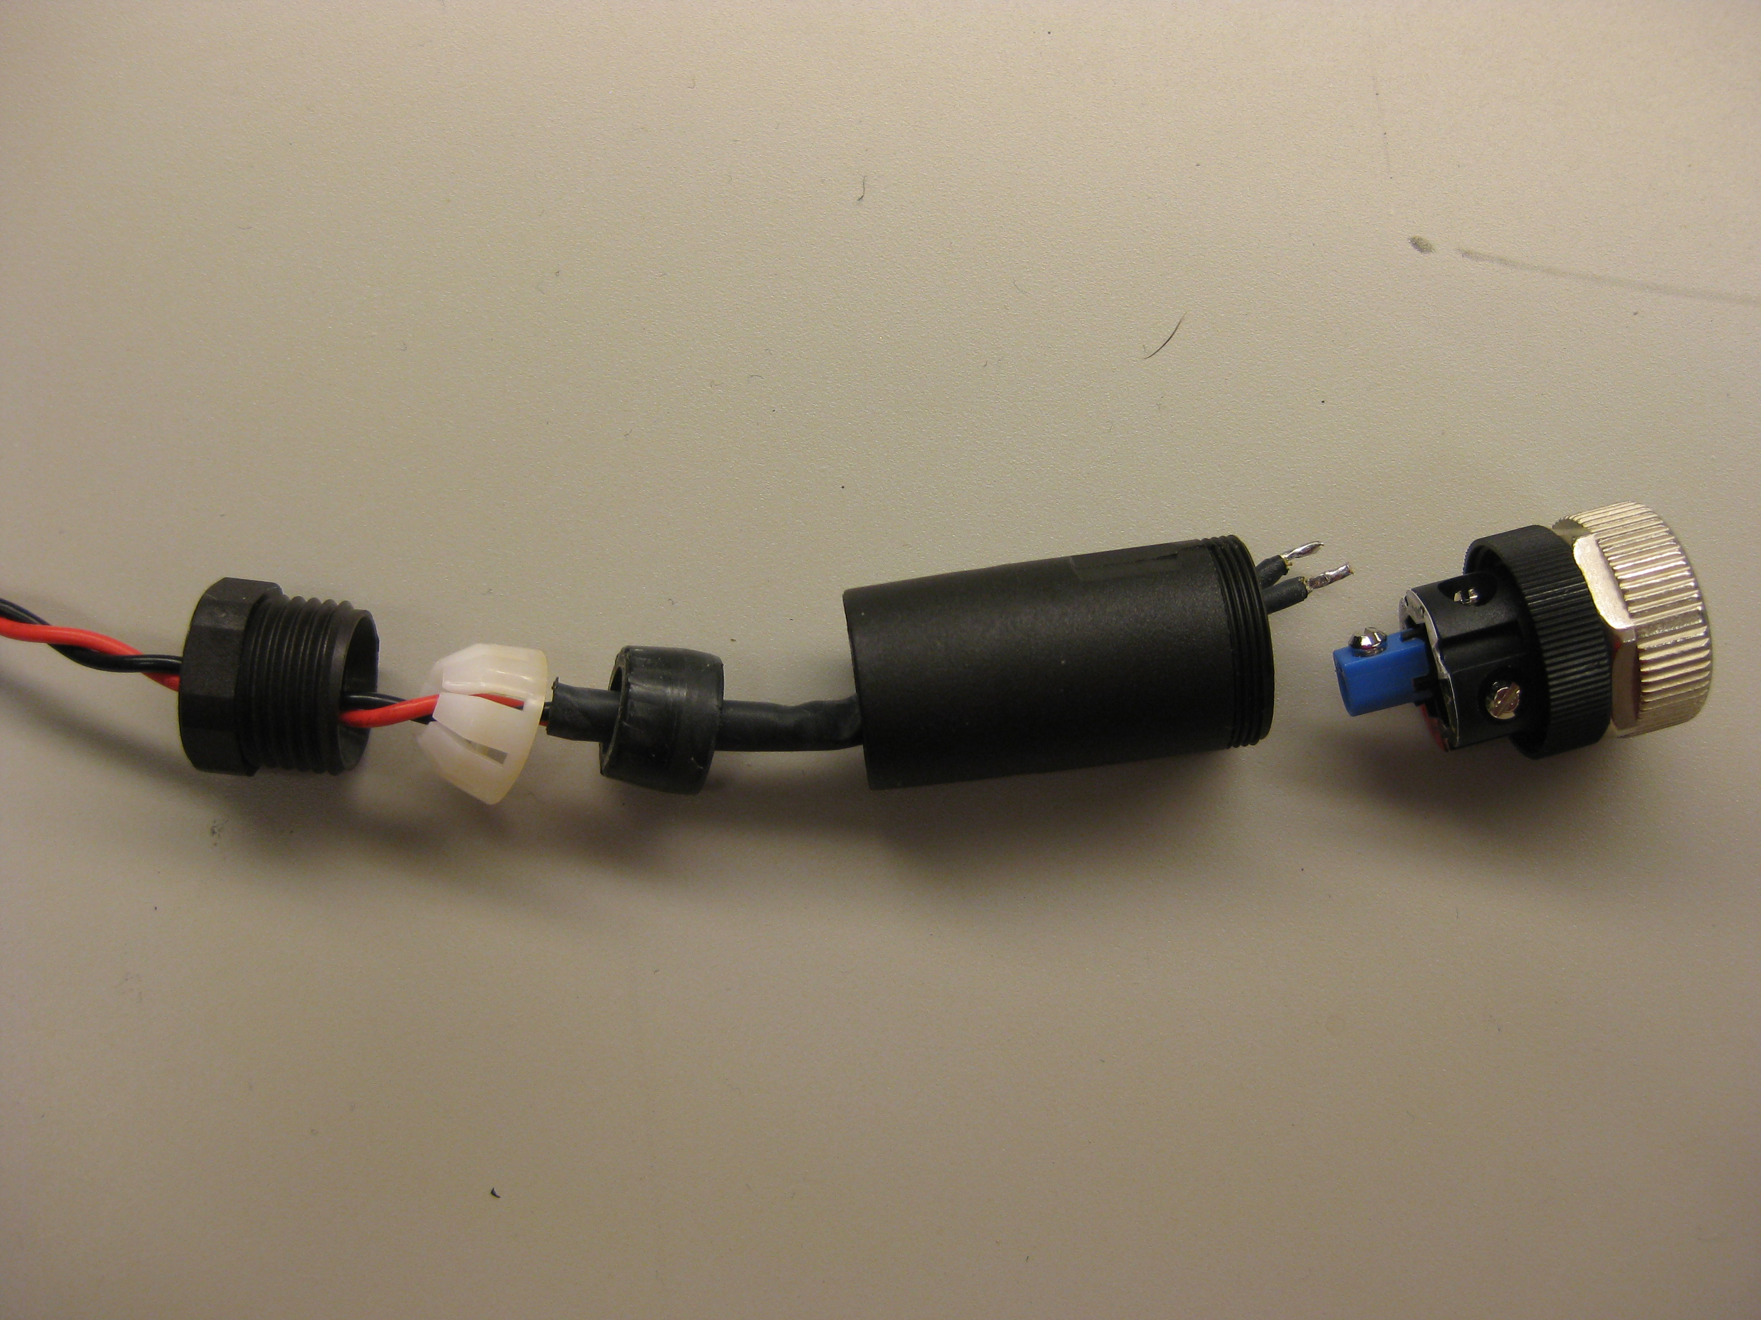
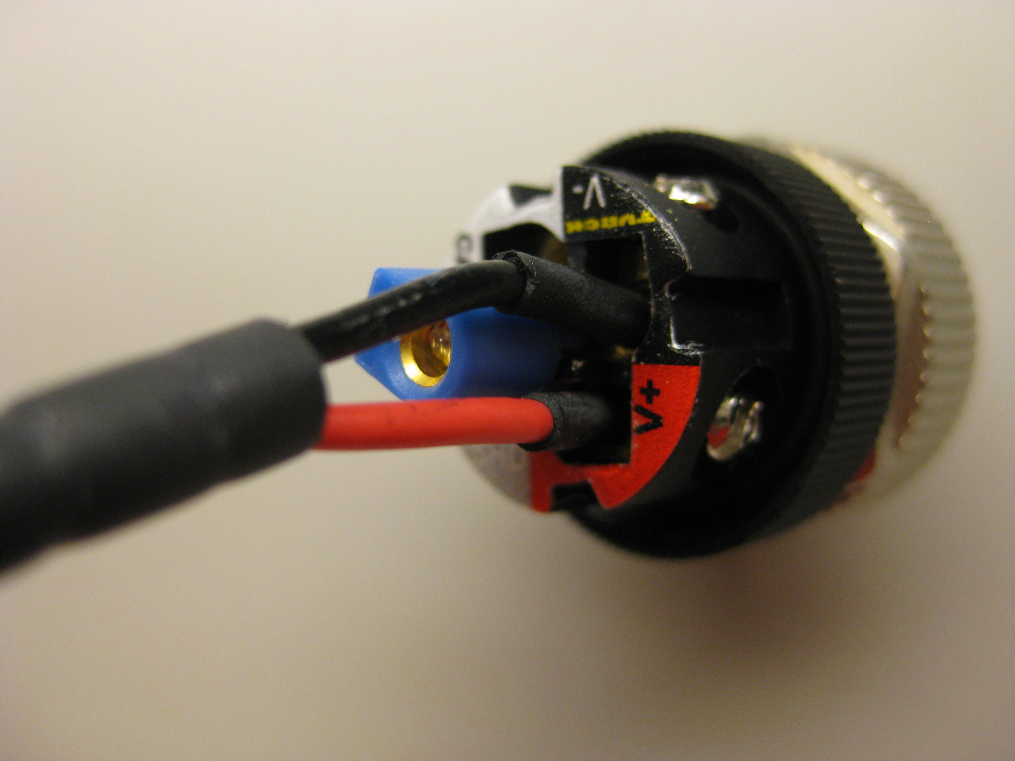
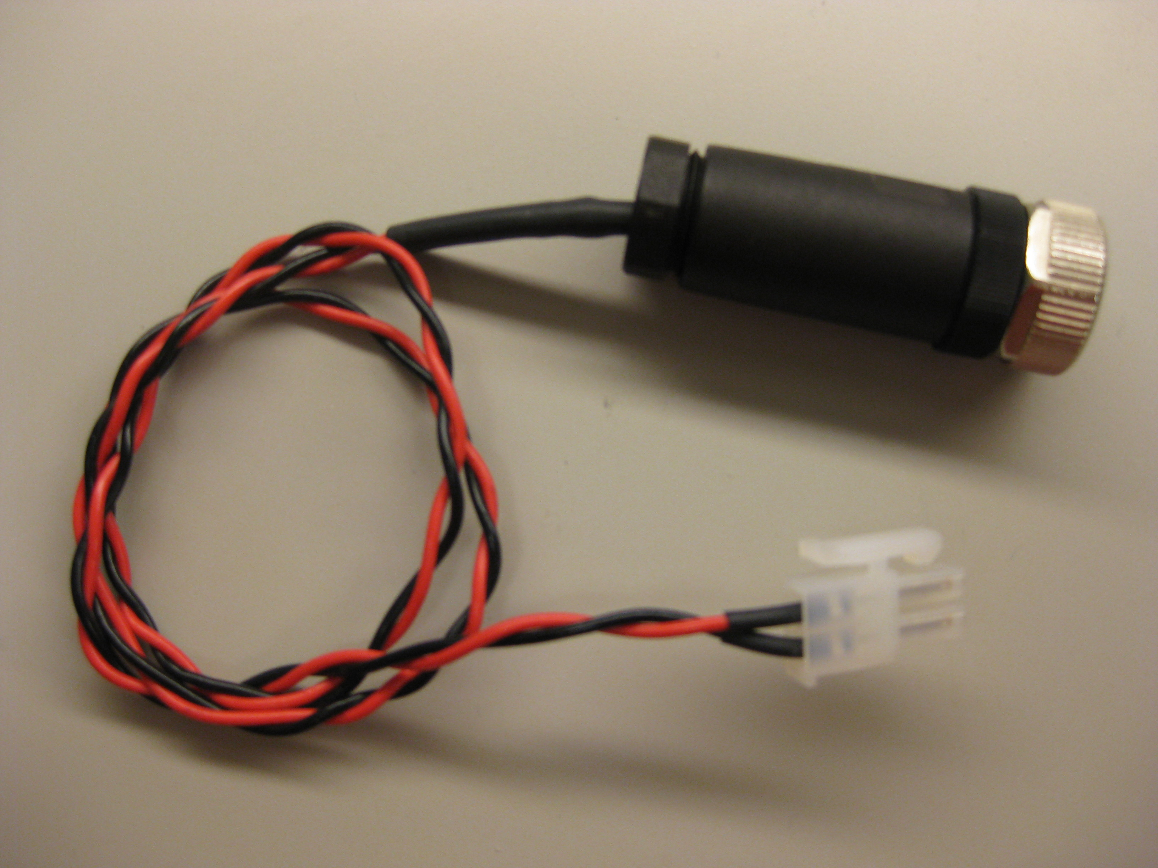
NetFT Power Cable Assembly
Put NetFT power connector components on to cable for PR2. (Fig 1)
Use terminal screws to secure wires in terminal. Black wire goes to black V- hole (Fig 2.1). Red wire goes to red V+ hole (Fig 2.2).
Screw connector pieces back together. You final cable should look something like (Fig 3)
Fig 1
Fig 2
1
2
Fig 3

Slide 7
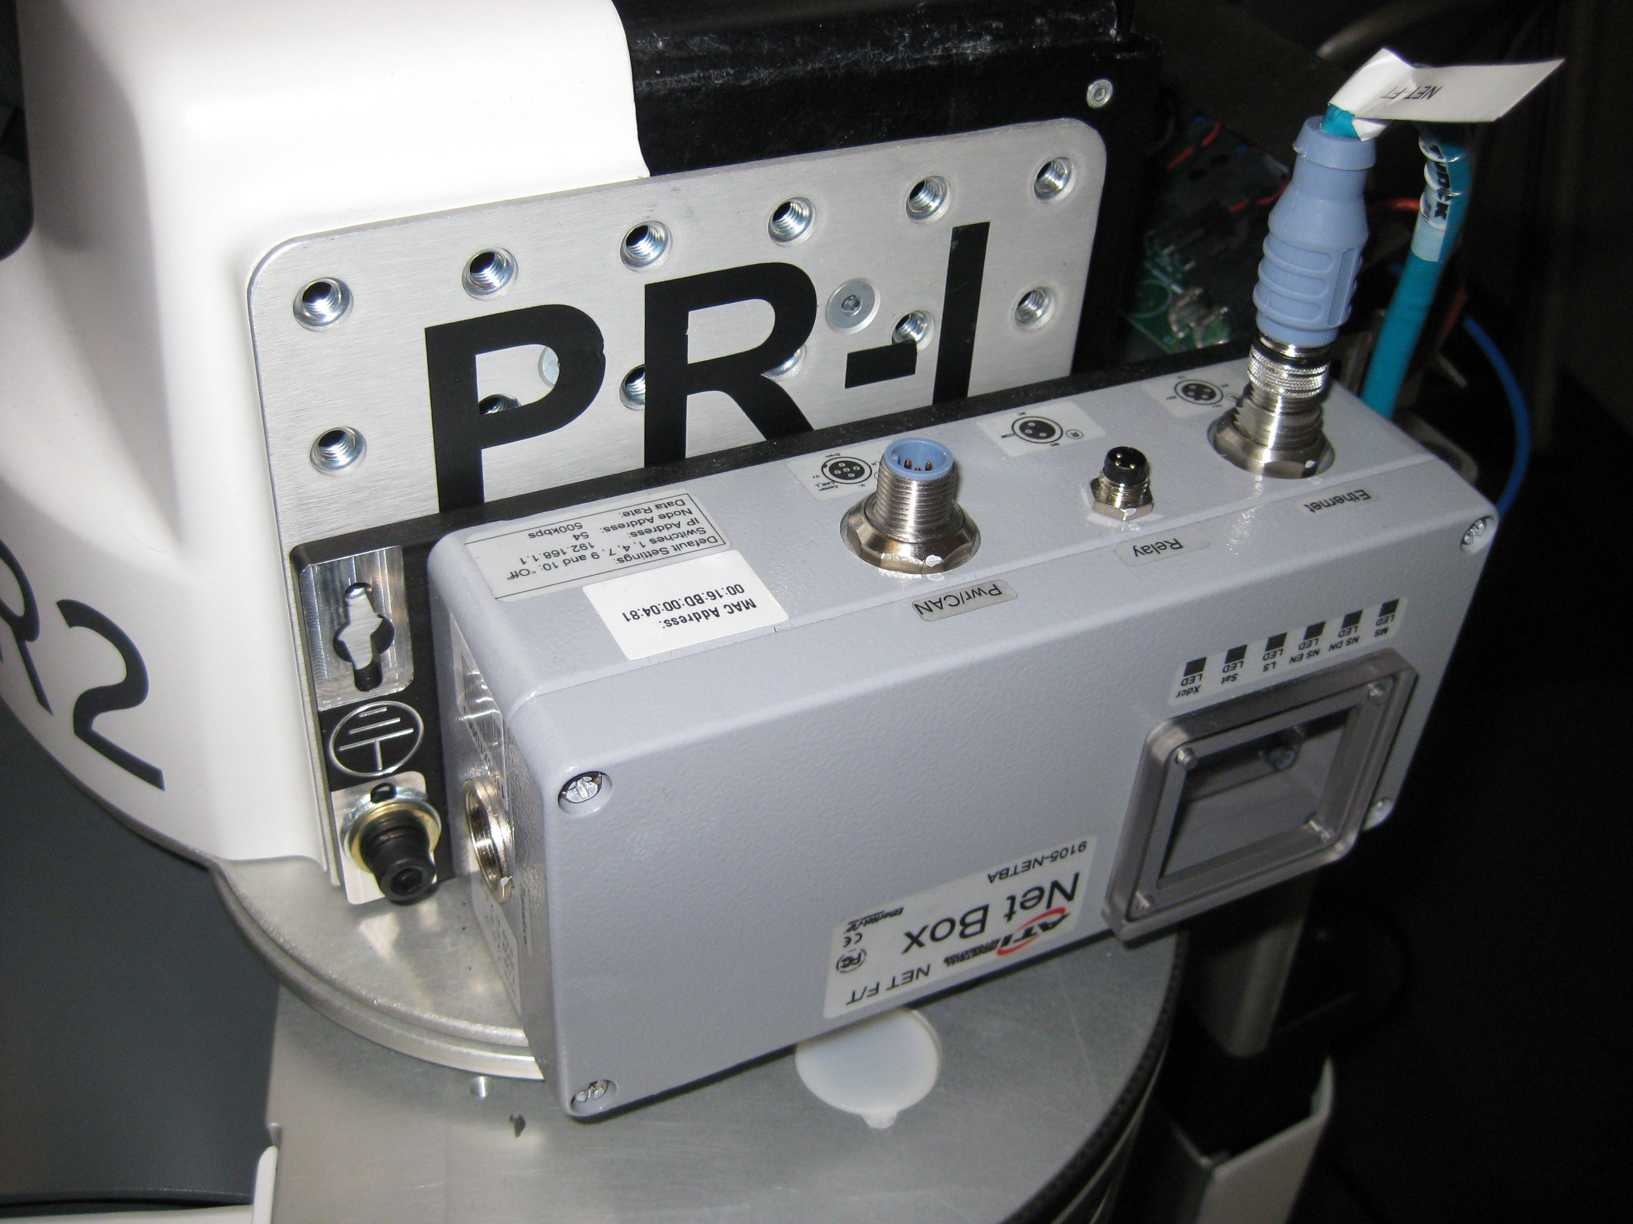
NetFT PR2 Mount
We used a single bolt to mount the NetFT to the side mounting plates of the PR2.

Slide 8
Take off PR2 Rear Top Panel
Use the 'Rear Top Panel R/R' instructions here:
http://www.scribd.com/doc/34939615/PR2-Top-and-Rear-Spine-Cover-Removal-and-Replacement

Slide 9
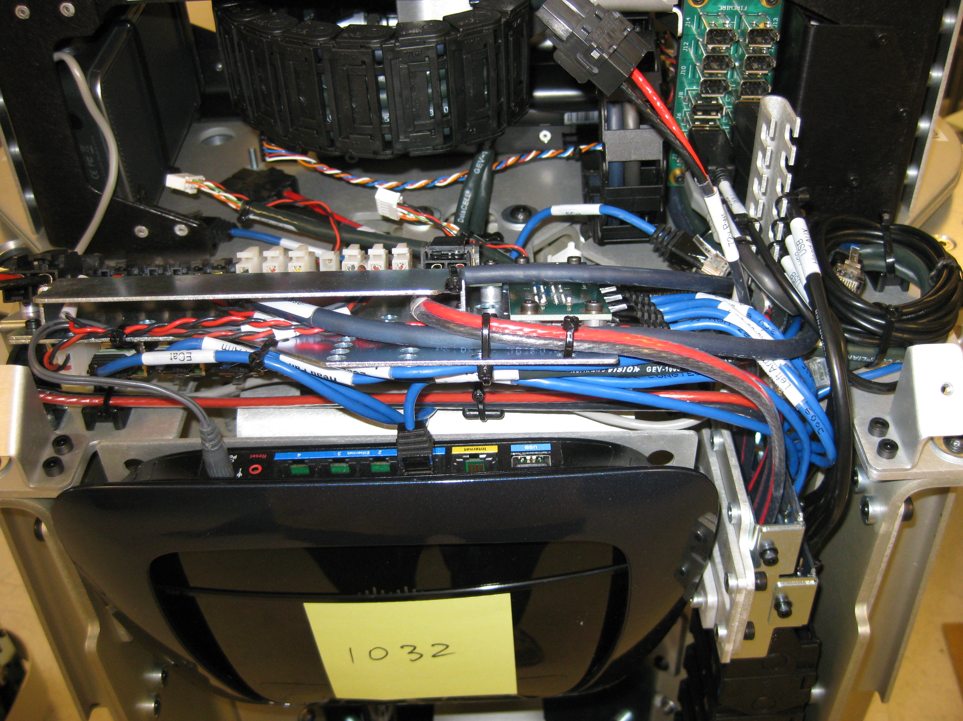
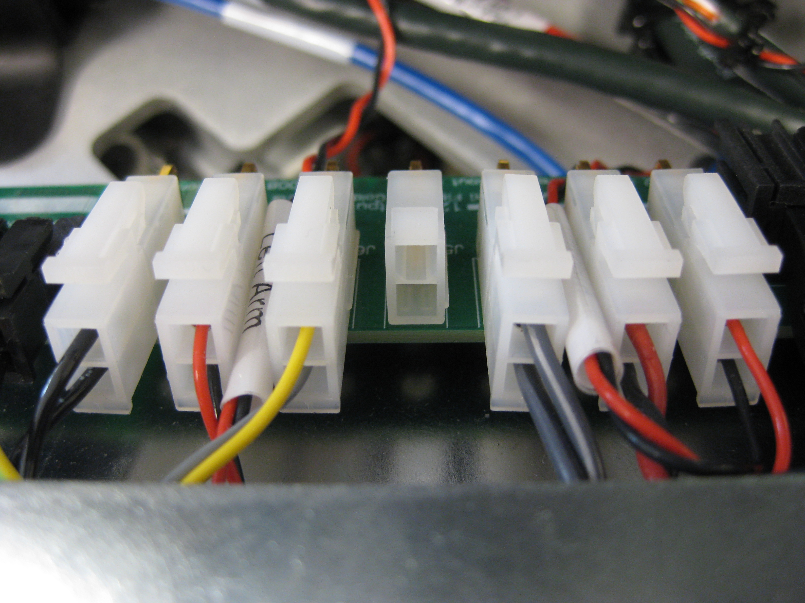
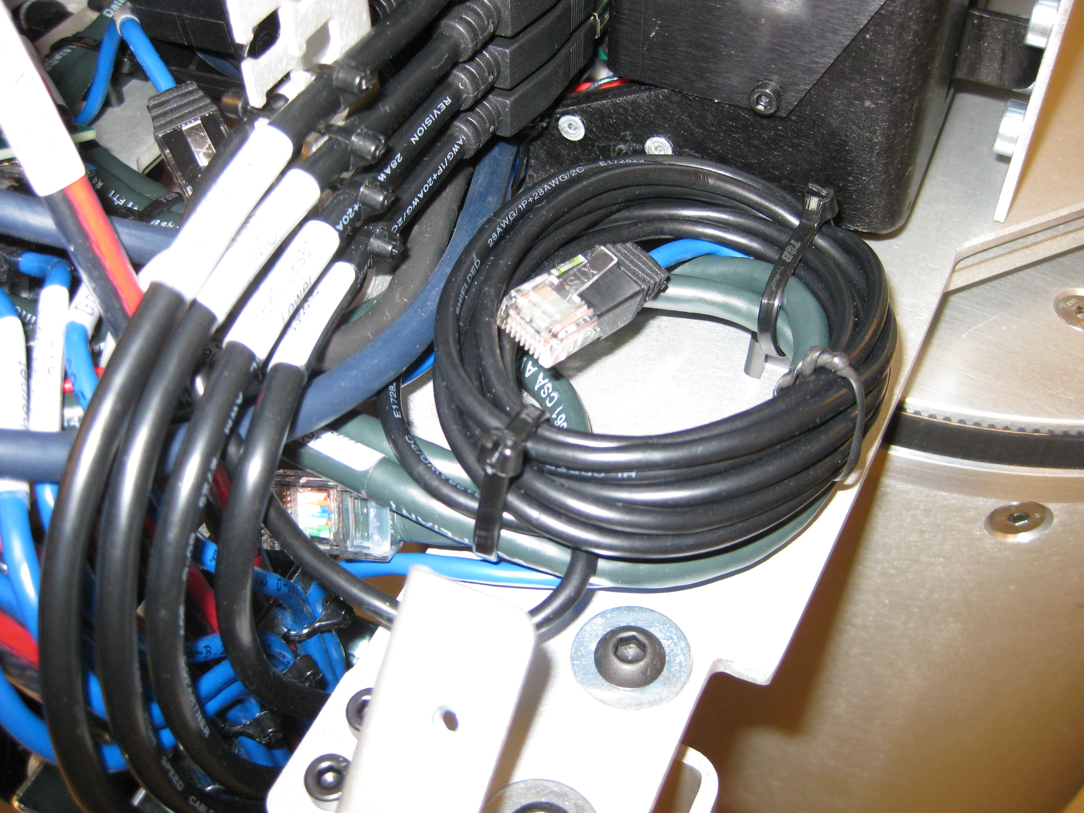
Connect NetFT
Once the cover is removed locate the power breakout board (1), and 'Ethernet Head Aux Lower' cable (2).
Plug NetFT power connector into empty 12V power port on power breakout board (1).
Use Ethernet coupler and extra Ethernet cable to connect “Ethernet Head Aux Lower” cable to NetFT (2).
1
2

