Slide 1
PR2 Simulation
ROS + PR2 Training Workshop

Slide 2
Motivations applications and goals
Interactive research development.
Regression testing.
Design, optimization.
Predictive control, planning.
Monte Carlo simulation / perturbation analysis.
Visualization.

Slide 3
Software Platforms
PR2 Simulator is based on the Open Source project Gazebo of the Player/Stage/Gazebo project. It uses Open Dynamics Engine for physics and Ogre for rendering.

Slide 4
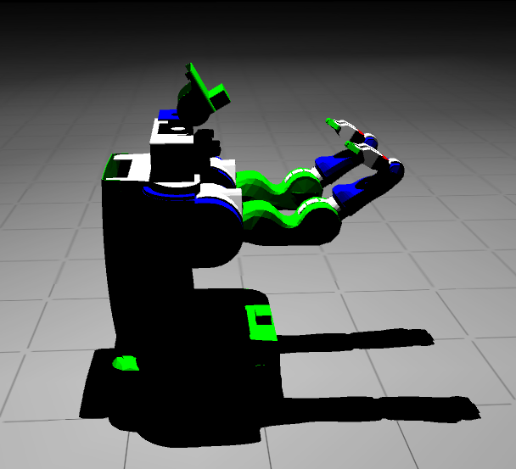
Simulation Fidelity
Physics fidelity / how the PR2 is simulated
Constrained rigid body dynamics. Velocity based complementarity formulation.
Contacts are modeled by inelastic collisions with simplified friction pyramid.
Fixed time stepping (1kHz).
Constant coefficient viscous
friction joint damping.
See wiki for more information.

Slide 5
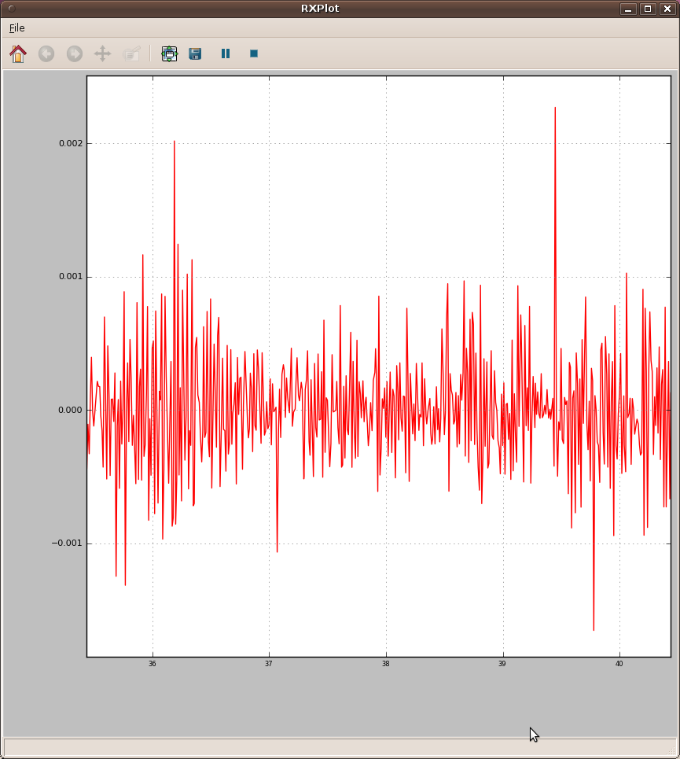
Simulation Fidelity
Physics fidelity / numerical errors
Joint velocity “jitters” vs. slow simulation. Numerical errors vs. simulation efficiency.
Joints with high reduction ratios (torso_lift and gripper joints) are numerically stiff without proper modeling of low joint efficiency and high viscous damping. Currently an artificial stabilizer is applied to improve simulation efficiency.

Slide 6
Simulation Fidelity
Real world vs. simulation
ROS parameter use_sim_time and /clock topic.
Self collision checks are disabled by default.
Anti-gravity arms.
Laser scan duration.
Robot start up race conditions.
pr2.machine and sim.machin.

Slide 7
Simulation Fidelity
PR2 simulation fidelity
Manipulation - Mechanism Controllers
  Simulated real-time PR2 etherCAT node communicates actuator states (motor effort and position encoder values) through ROS.
Perception - Sensors
  Simulated sensor nodes for cameras, lasers, imu streams data / offers services through ROS.

Slide 8
Applications
PR2 Simulation Examples
Opening Doors
Plugging In

