Slide 1
PR2 Simulation
ROS + PR2 Training Workshop

Slide 2
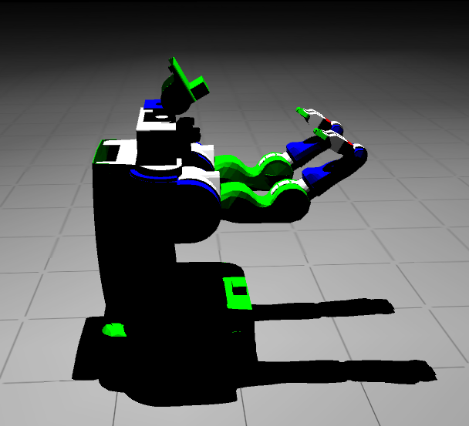
Workshop Outline
Simulator Overview
Modeling the World
Modeling the Robot
Simulation Physics
Simulation Interface
Robot Interface
Misc.
Working with PR

Slide 3
Simulator Overview
Main Software Components
Gazebo
  ODE / Bullet
  plugins
Ogre
ROS

Slide 4
Simulator Overview
Simulation Dynamics Overview
Constrained Dynamics
  Prismatic, revolute with explicit damping. Fixed joints.
  Contact modeling
    Allows interpenetration with restorative forces.
    Decoupled x-y dry friction pyramid.
Integrator
  LCP formulation.
  First order semi-implicit integrators.

Slide 5
Simulator Overview
PR2 Dynamics Overview
Δt = 1ms (matches real-time pr2_etherCAT)
Force controlled joints
Gravity compensation → turn gravity off
All I/O through ROS

Slide 6
Modeling the World
Gazebo World File Breakdown
<world>
<physics:ode/>
<rendering:gui/>
<rendering:ogre/>
<model:physical/>
...
<model:physical/>
...
</world>
Integrator
Time step size
Dissipation, stabilization parameters
GUI window Properties
Ambient lighting
Sky description
Ground grid
GUI rendering update rate
Shadow technique
Physical Models
Lights, etc.

Slide 7
Modeling the World
Gazebo Physics Integration Parameters
<physics:ode>
<stepTime>0.001</stepTime>
<gravity>0 0 -9.8</gravity>
<cfm>0.0000000001</cfm>
<erp>0.2</erp>
<quickStep>true</quickStep>
<quickStepIters>10</quickStepIters>
<quickStepW>1.3</quickStepW>
<contactMaxCorrectingVel>100.0</...>
<contactSurfaceLayer>0.001</...>
</physics:ode>

Slide 8
Modeling the World
Gazebo Physics Model
<model:physical name=”model1” [xmlns:...]>
<body:box name="box1">
<mass>1</mass>
<ixx>1</ixx> [ixy,iyy,iyz,izz]
<geom:box name="geom1">
<visual>
<size>1 1 1</size>
<material>Gazebo/Blue</material>
<mesh>unit_box</mesh>
</visual>
</geom:box>
</body:box>
</model:physical>
**ROS provides URDF parser

Slide 9
Simulation Physics
Outline
Assumptions and Simplifications.
Solver Tuning and Limitations.

Slide 10
Simulation Physics
Assumptions and Simplifications
3D rigid body dynamics in the inertial frame
  f=Ma
Simple joint constraints
  J₁v₁+J₂v₂=c
Simple contact constraints
  Constraint forces based on velocity constraints (J_{c}v ≥ c).
  Contact joints are created and destroyed at every time step.

Slide 11
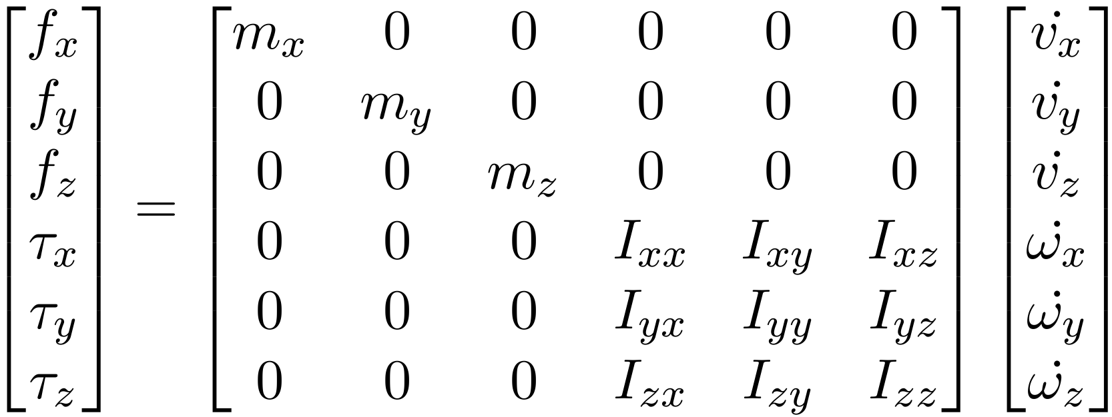
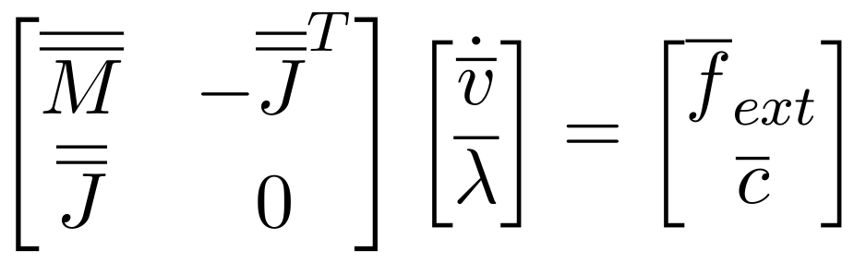
Simulation Physics
Assumptions and Simplifications
Governing Equations

Slide 12
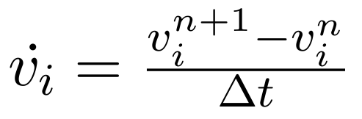
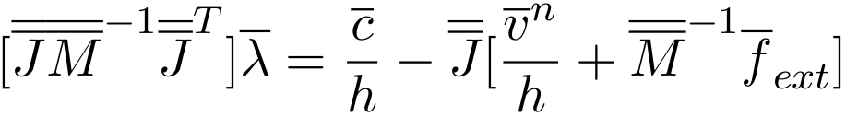

Simulation Physics
Integrator Overview
Discretized Governing Equations

Slide 13
Simulation Physics
Assumptions and Simplifications
Contact Modeling
  Gazebo friction example
  Future work
    Friction direction alignment
    Implicit surfaces

Slide 14
Simulation Physics
Solver Tuning and Limitations
General numerical properties
  Solution existence and uniqueness
  Stability, consistency and convergence
  Accuracy O(dt)
Choosing a solver
  Pivot – currently less stable, but provides “exact” solution
  Iterative – more stable, not exact but convergence is good in practice

Slide 15
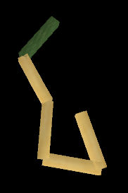
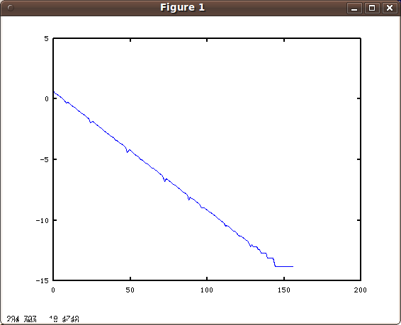
Simulation Physics
Solver Tuning and Limitations
Example inner iteration convergence (rms of Δλ vs. iteration #) for 5 link pendulum.

Slide 16
Simulation Physics
Solver Tuning and Limitations
Setting up physics simulation
  Model Stability
    Physically unstable models?
  Constraint Solver
    Time step size
    Iterations per time step
    Relaxation parameter (w)
    Constraint “stiffness”, condition numbers, CFM, ERP (K_{p},K_{d}) – adding to numerical stability by artificially modifying the system of equations

Slide 17
Simulation Physics
Examples
Single Pendulum Example
  Time Step Size vs. Numerical Error
  Inner Iterations vs. Numerical Error
  Inner Iteration Convergence
  Effects of CFM and ERP
Double pendulum Example
  Simulation vs. analytical solution

Slide 18
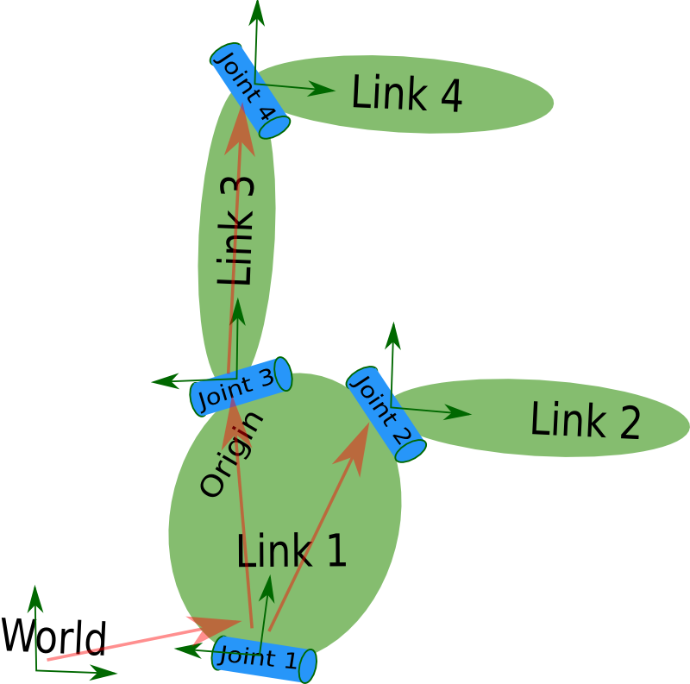
Modeling the Robot
Universal Robot Description Format (URDF)
Description of the robot as a set of rigid linkages and joints.
Must be a tree (single parent).

Slide 19
Modeling the Robot
Universal Robot Description Format (URDF)
Links
  Inertial element – provides M in f=Ma.
  Visual element – for visualization and camera sensors.
  Collision element – enables collision detection for contact joint creation and range sensor simulation.

Slide 20
Modeling the Robot
Universal Robot Description Format (URDF)
Joints
  Prismatic, revolute, ball (position only), etc..
  Specify joint axis for prismatic and revolute joints.
  Dynamics – damping force is proportional to velocity. (stability condition for the damping term).
  Transmissions
    Maps joint state ↔ actuator(motor) states
    pr2_mechanism_model: SimpleTransmission, Pr2GripperTransmission, WristTransmission.

Slide 21
Simulation Interface
Simulating and Controlling PR2
Controlling PR2 in simulation
https://docs.google.com/a/willowgarage.com/Doc?docid=0AXzTiNaRWL7fZGc4ZDd0N3hfMjFjZ3puZHdkYw&hl=en

Slide 22
Simulation Interface
Spawning, Manipulating Objects
Simulating a single controlled joint
(gazebo_benchmark + google doc for work flow to be completed)

Slide 23
Simulation Interface
Spawning, Manipulating Objects
Spawn simple objects
http://www.ros.org/wiki/simulator_gazebo/Tutorials/AddingObjectsToTheWorld

Slide 24
Simulation Interface
Spawning, Manipulating Objects
Manipulate simple objects
(To be created, using set_pose.py)

Slide 25
Simulation Interface
Simulation Plugins
Creating simulator plugins
  Example: gazebo_plugins/src/gazebo_ros_template.cpp
    GZREGISTER_DYNAMIC_CONTROLLER()
    LoadChild()
    InitChild()
    UpdateChild()
    FiniChild()

Slide 26
Robot Interface
PR2 ROS Interface
Starting the PR2 simulatorhttp://www.ros.org/wiki/pr2_simulator/Tutorials/StartingPR2Simulation
Browse rostopics, parameters and services

Slide 27
Robot Interface
PR2 ROS Interface
Mechanism control through ROS
  controller_manager plugin
  /joint_states

Slide 28
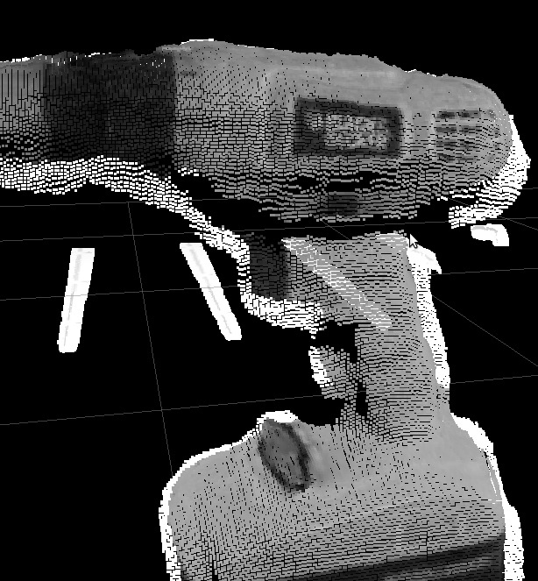
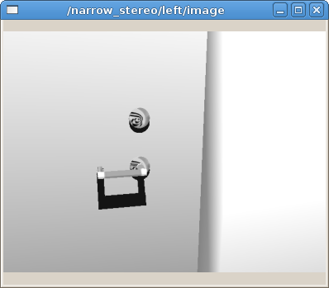
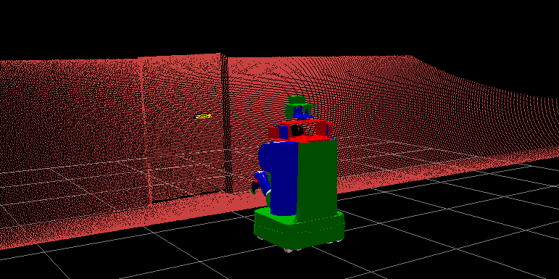
Robot Interface
PR2 ROS Interface
Sensor plugins ROS topics
  /base_scan
  /tilt_scan
  /narrow_stereo/*
  /wide_stereo/*
  /l_forearm_cam/*
  /r_forearm_cam/*

Slide 29
Robot Interface
PR2 ROS Interface
Power state (power_monitor) simulation
  power_state
  plugged_in
IMU simulation
  torso_lift_imu/data

Slide 30
Robot Interface
Example: Mechanism Controllers
Single actuator controlled joint (gazebo_benchmark)
Loading and unloading example controllers

Slide 31
Miscellaneous
Debugging with Gazebo
Running Gazebo with GDB

Slide 32
Working with PR2 in Simulation
PR2 joystick teleop
PR2 arm manipulation by sending simple commands to r_arm_controller
  Run the same routine on PR2 by changing ROS_MASTER_URI

