Slide 1
Adding a Sensor to the PR2
Kevin Watts
Hardware Testing
Willow Garage
watts@willowgarage.com

Slide 2
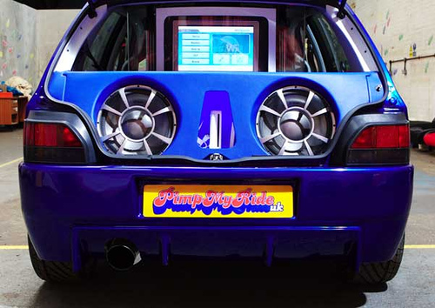
Modifying the PR2
You may want to modify the PR2 for research
  Add sensor or device
  Add functionality
  Change color
Today, we'll add a Hokuyo laser scanner to the side platform

Slide 3
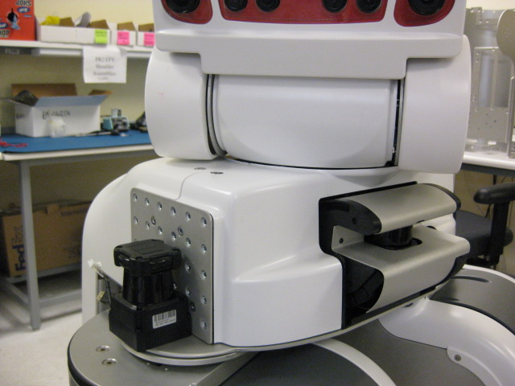
What We're Doing Today
Add Hokuyo laser scanner on the side panel
We'll be able to scan sideways!
It's easy to demonstrate
  Near side USB port
  Have a ROS driver

Slide 4
Modification Procedure
Today's goal - show you how to modify PR2
  How to contact Willow Garage
  What to watch out for
  Simple hardware modifications
  Software configuration
  Where to go for help
We're following tutorial on wiki
  http://www.ros.org/wiki/pr2_robot/Tutorials/Adding a Hokuyo to the PR2

Slide 5
PR2 Modifications
Safety first
  PR2 design is carefully validated at Willow Garage
  Changes to some HW or SW may be dangerous
  Can damage the PR2
Willow Garage support
  We might be able to offer tips for adding sensors
  We can't help with everything
  Some changes make it hard for us to help you

Slide 6
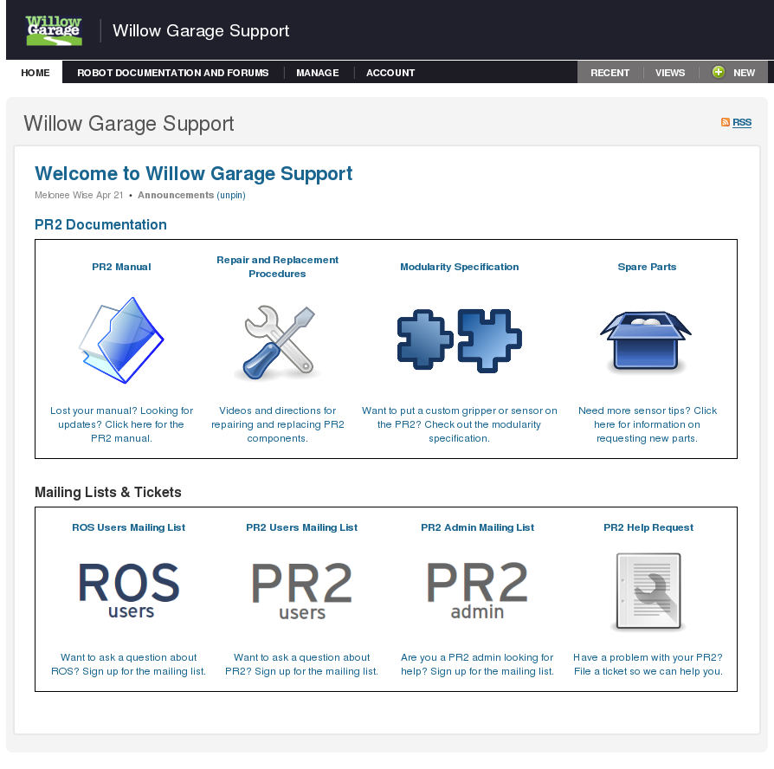
Before You Modify...
Pre-modification checklist:
  Ask you lab supervisor and safety rep
  Check Willow Garage Support
    If specification not listed,
    make sure to ask us
Note: Under the Beta Program Agreement, permanent modifications to the PR2 must be approved by Willow Garage.

Slide 7


Adding Sensor Pre-check
I'm supervising myself today
Checked Willow Garage Support
  Checked power requirements of the laser
  PR2's power system is OK
Remove and Replacement Procedures
  Shows me how to remove covers
  Computer configuration, AUX USB port

Slide 8
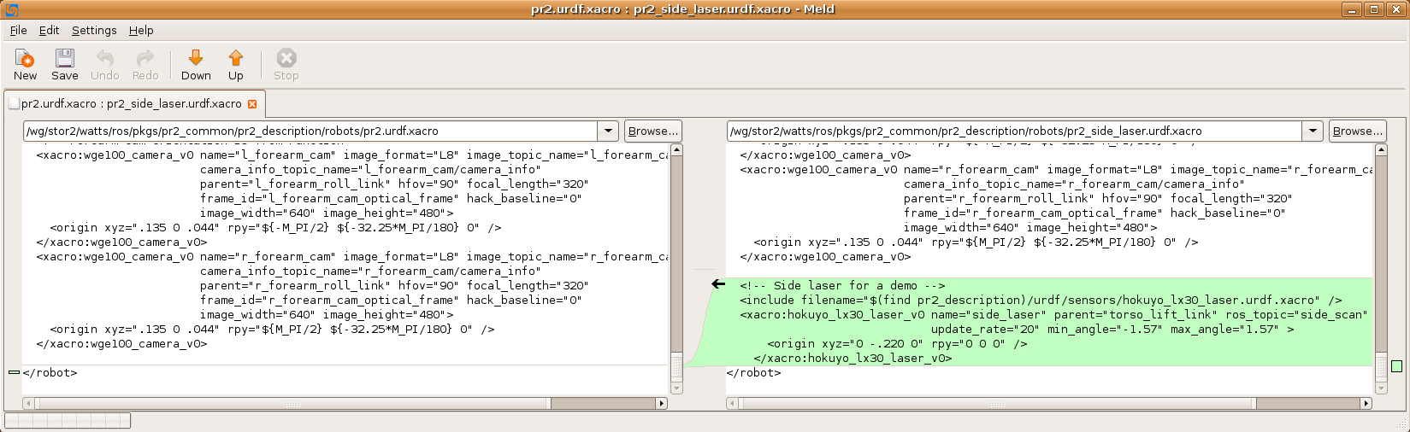
Software Configuration
Add new Hokuyo scanner in URDF
  URDF mods: http://www.ros.org/wiki/urdf/Tutorials/AddingSensorsToPR2
  Need to measure location of sensor relative to PR2 coordinate center
  Coordinates: http://pr.willowgarage.com/wiki/PR2/CoordinateSystems

Slide 9
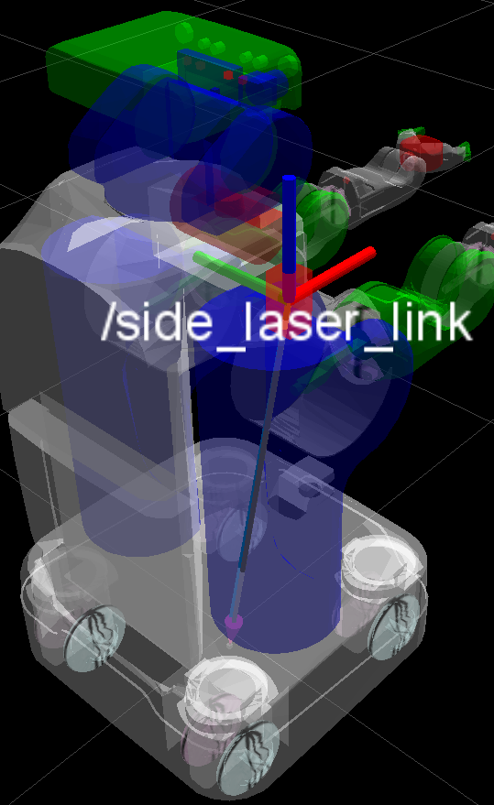
Software Configuration
Add driver to “/etc/ros/robot.launch” on PR2
Add diagnostic Analyzer for Hokuyo data
  http://www.ros.org/wiki/pr2_robot/Tutorials
Test in gazebo

Slide 10

Before Opening PR2
PR2 is designed to operate with covers ON
When taking covers off, use extreme caution
  Power is OFF
  Wearing wrist strap for ESD
  Use proper tools (toolkit)
Inform your local safety rep
Contact Willow Garage first
Risk of damage to your PR2 and harm to yourself

Slide 11

Modification PR2 Procedures
Modifications like this aren't that hard...
  But the downside of a mistake is huge

Slide 12
Opening PR2
Always shut down robot before removing covers
  sudo pr2-shutdown
  When red lights on server go out, safe to turn off
Remove covers using correct hex key, T-handle wrench
  Remove and replace instructions at Willow Garage Support

Slide 13
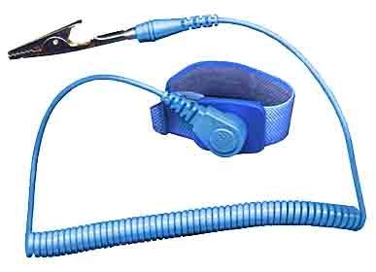
Mounting Sensor
We need to secure the sensor and bracket to the robot
  Sensors are expensive, mount securely
Cables must be secured to robot before we continue
Wear a wrist strap at all times

Slide 14
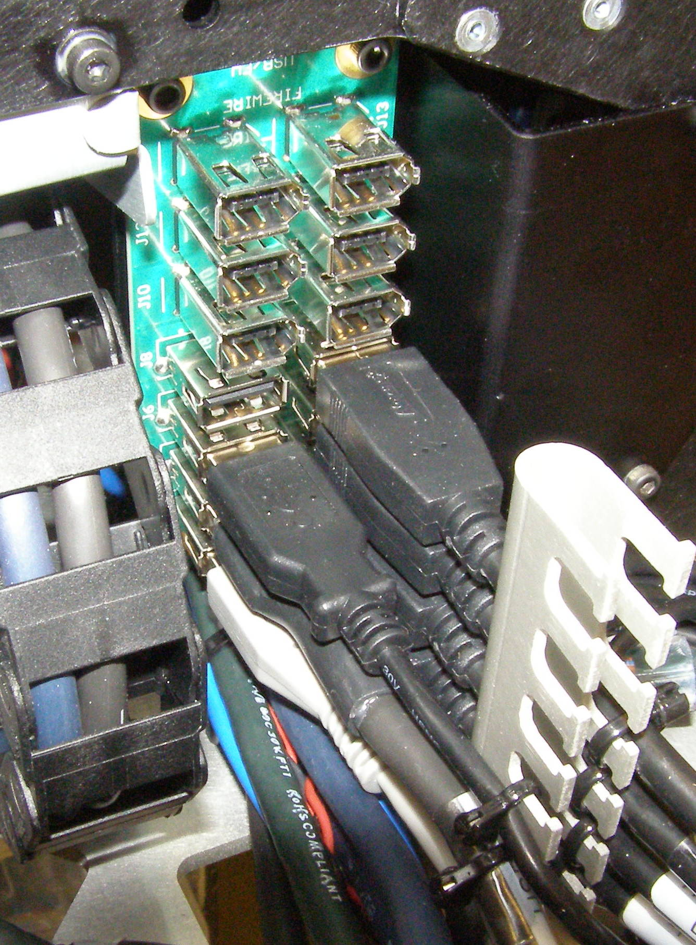

Plugging in Sensor
Plug in to AUX USB port, near head
  Port connects to c1 on PR2
  AUX USB port has USB, firewire passthroughs
Plug in 12V power cable to Hokuyo sensor
Reinstall cover

Slide 15
Computer/Sensor Configuration
Turn on robot, flip main breaker
Look for “/dev/ttyACM0” on “c1”
  http://www.ros.org/wiki/hokuyo_node/Tutorials/UsingTheHokuyoNode
  Note that existing Hokuyo scanners are on “c2”
Make sure you have correct permissions
  sudo chmod a+rw /dev/ttyACM0
You can get check the HK firmware or other device info using tools in hokuyo_node

Slide 16
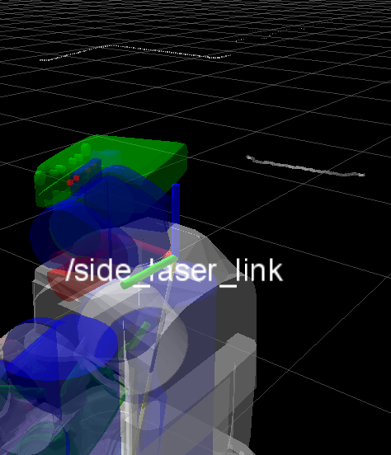
Getting Sensor Data
Launch robot
  sudo robot start
Use rviz to view sensor data
You can drive in circles and build a point cloud!

Slide 17
PR2 Modification Summary
Safety First
Contact Willow Garage Support
Ask other PR2 users
Test your code ahead of time

Slide 18

Questions?

