Slide 1

Installing a Gripper with
a Mini45
68-08014-RC
January 8, 2013

Slide 2
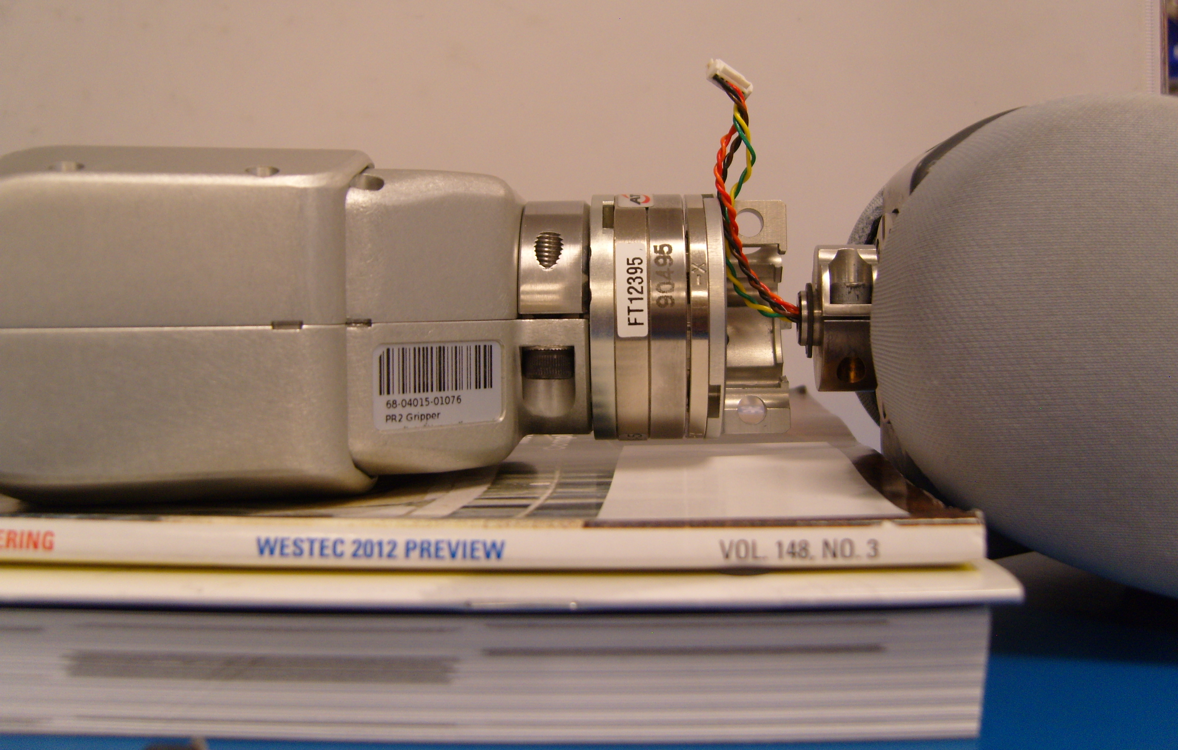
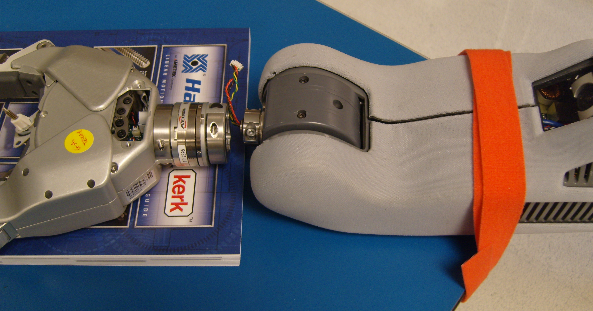
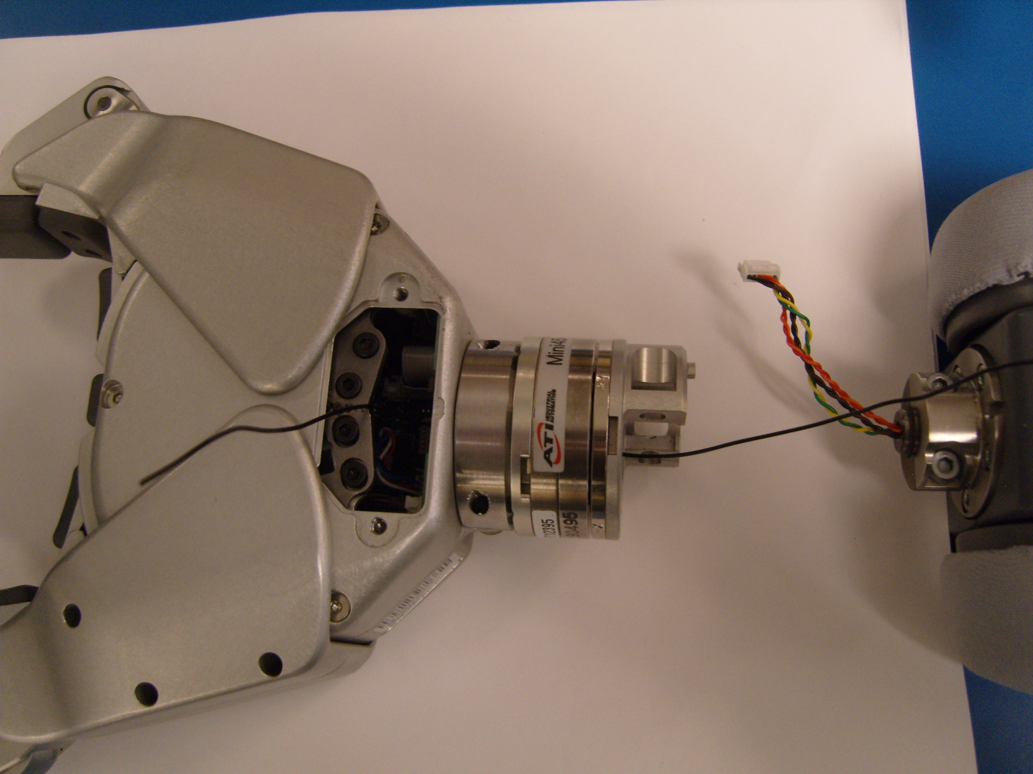
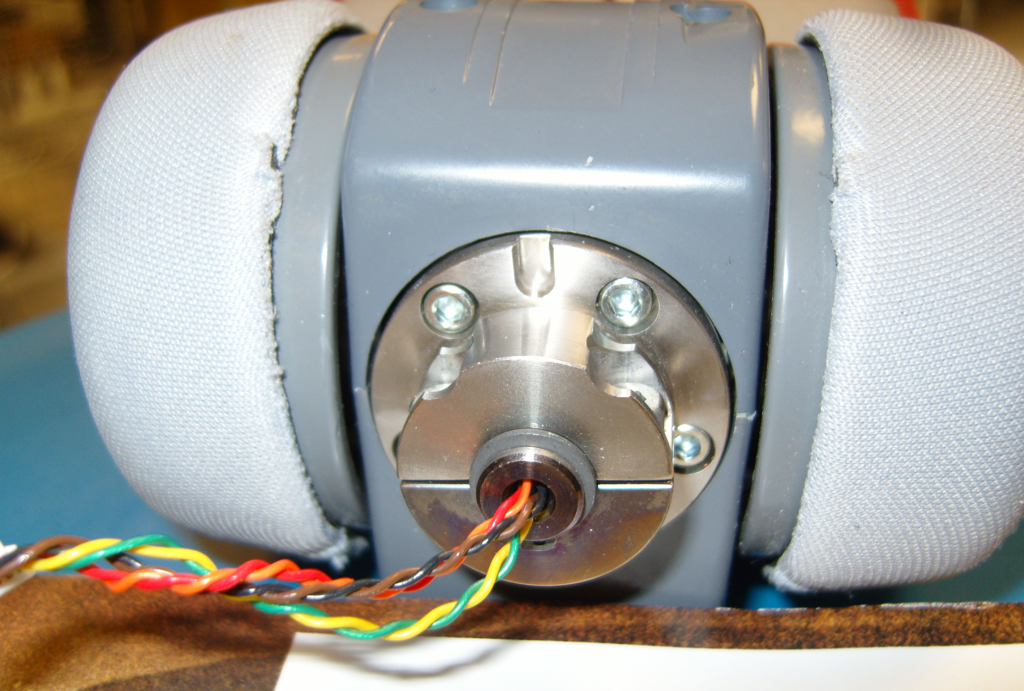
Gripper Installation
Refer to the PR2 Overview document for additional information.
*** Make sure the PR2 is powered off. Use ESD Precautions
Elevate the gripper on the table ~22mm. (Fig. 3)
Remove the gripper from the PR2 following instructions in toolkit Doc3
Position the PR2 at a corner of a table with an overhang and strap the forearm down with the camera facing up so the arm is not free to move (Fig. 1)
22mm
Fig. 3
Thread a short piece of solid wire (eg 26 AWG) through the gripper and F/T bodies and use it as a pull wire. (Fig. 4)
Fig. 1
Position the wrist rotation joint, so that the key-way is facing upwards (Fig. 2)
Fig. 4
Fig. 2

Slide 3
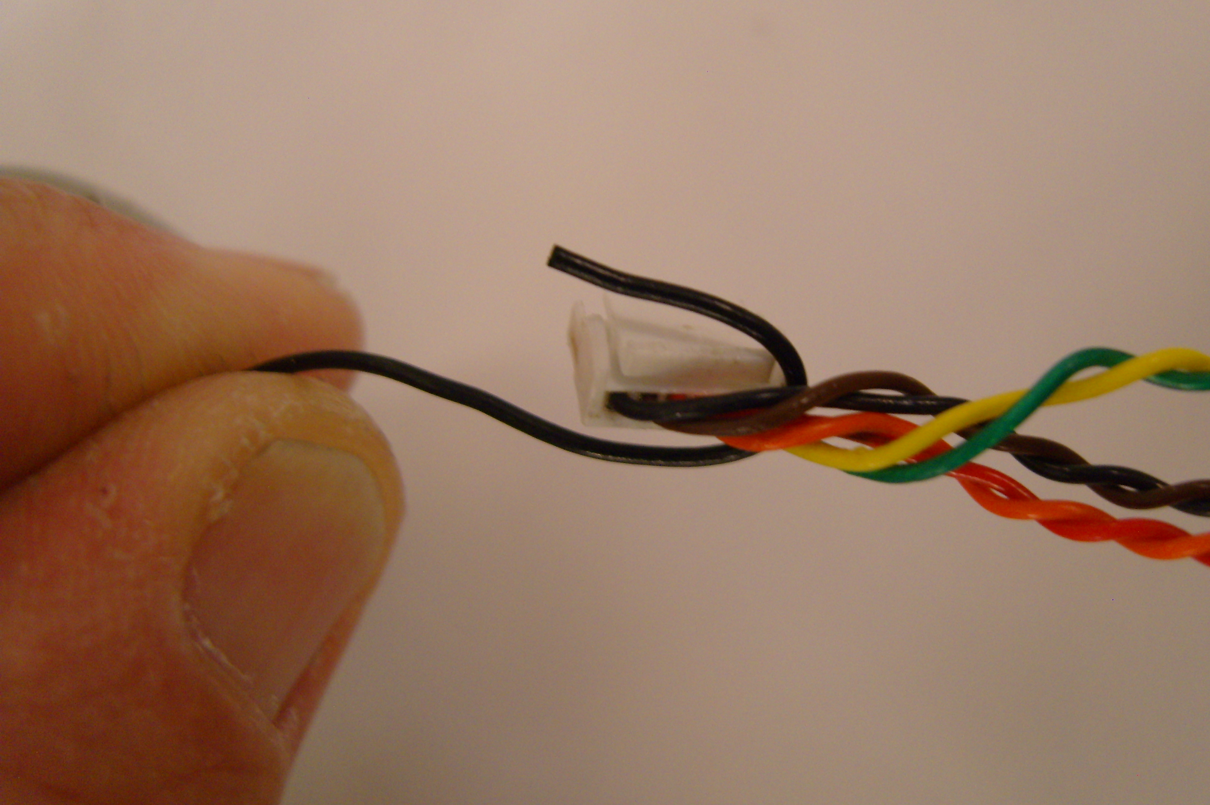
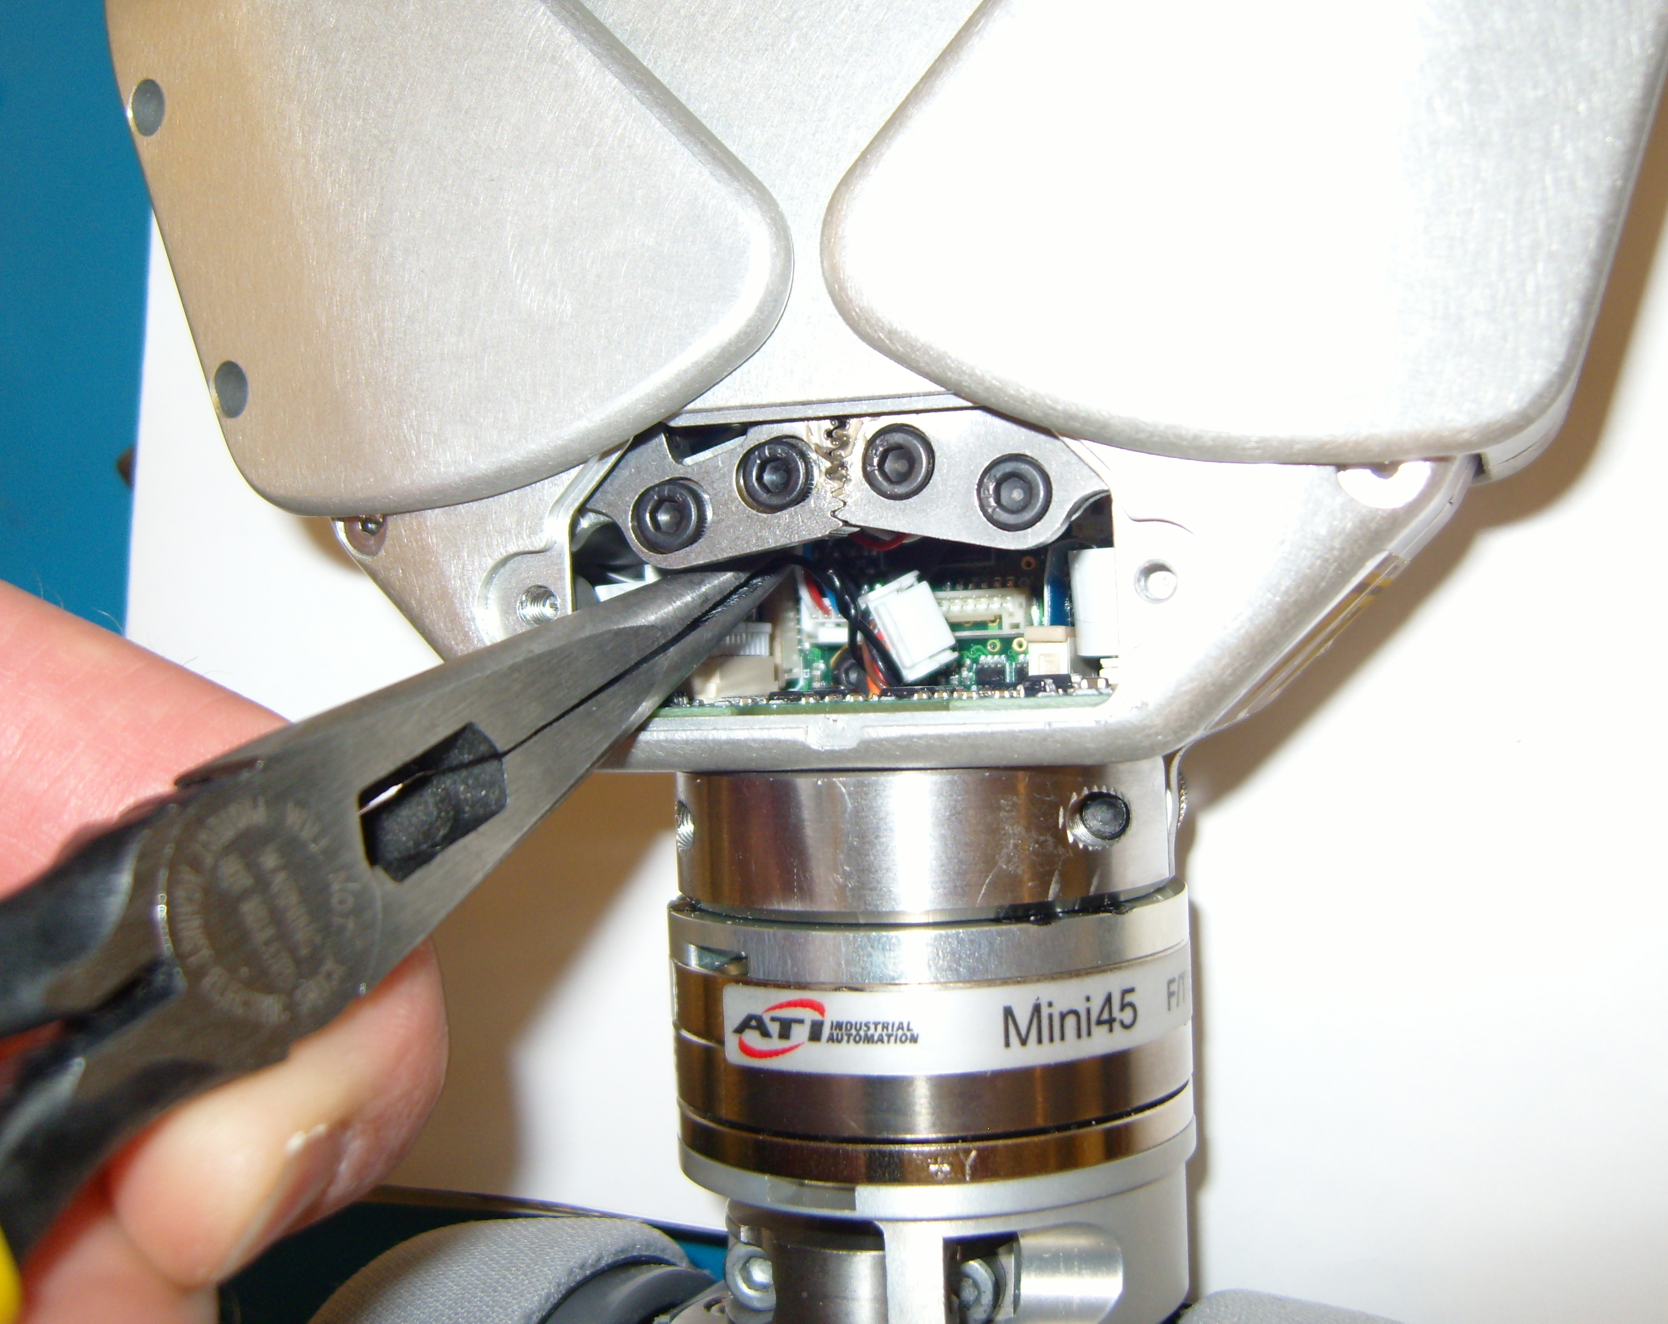
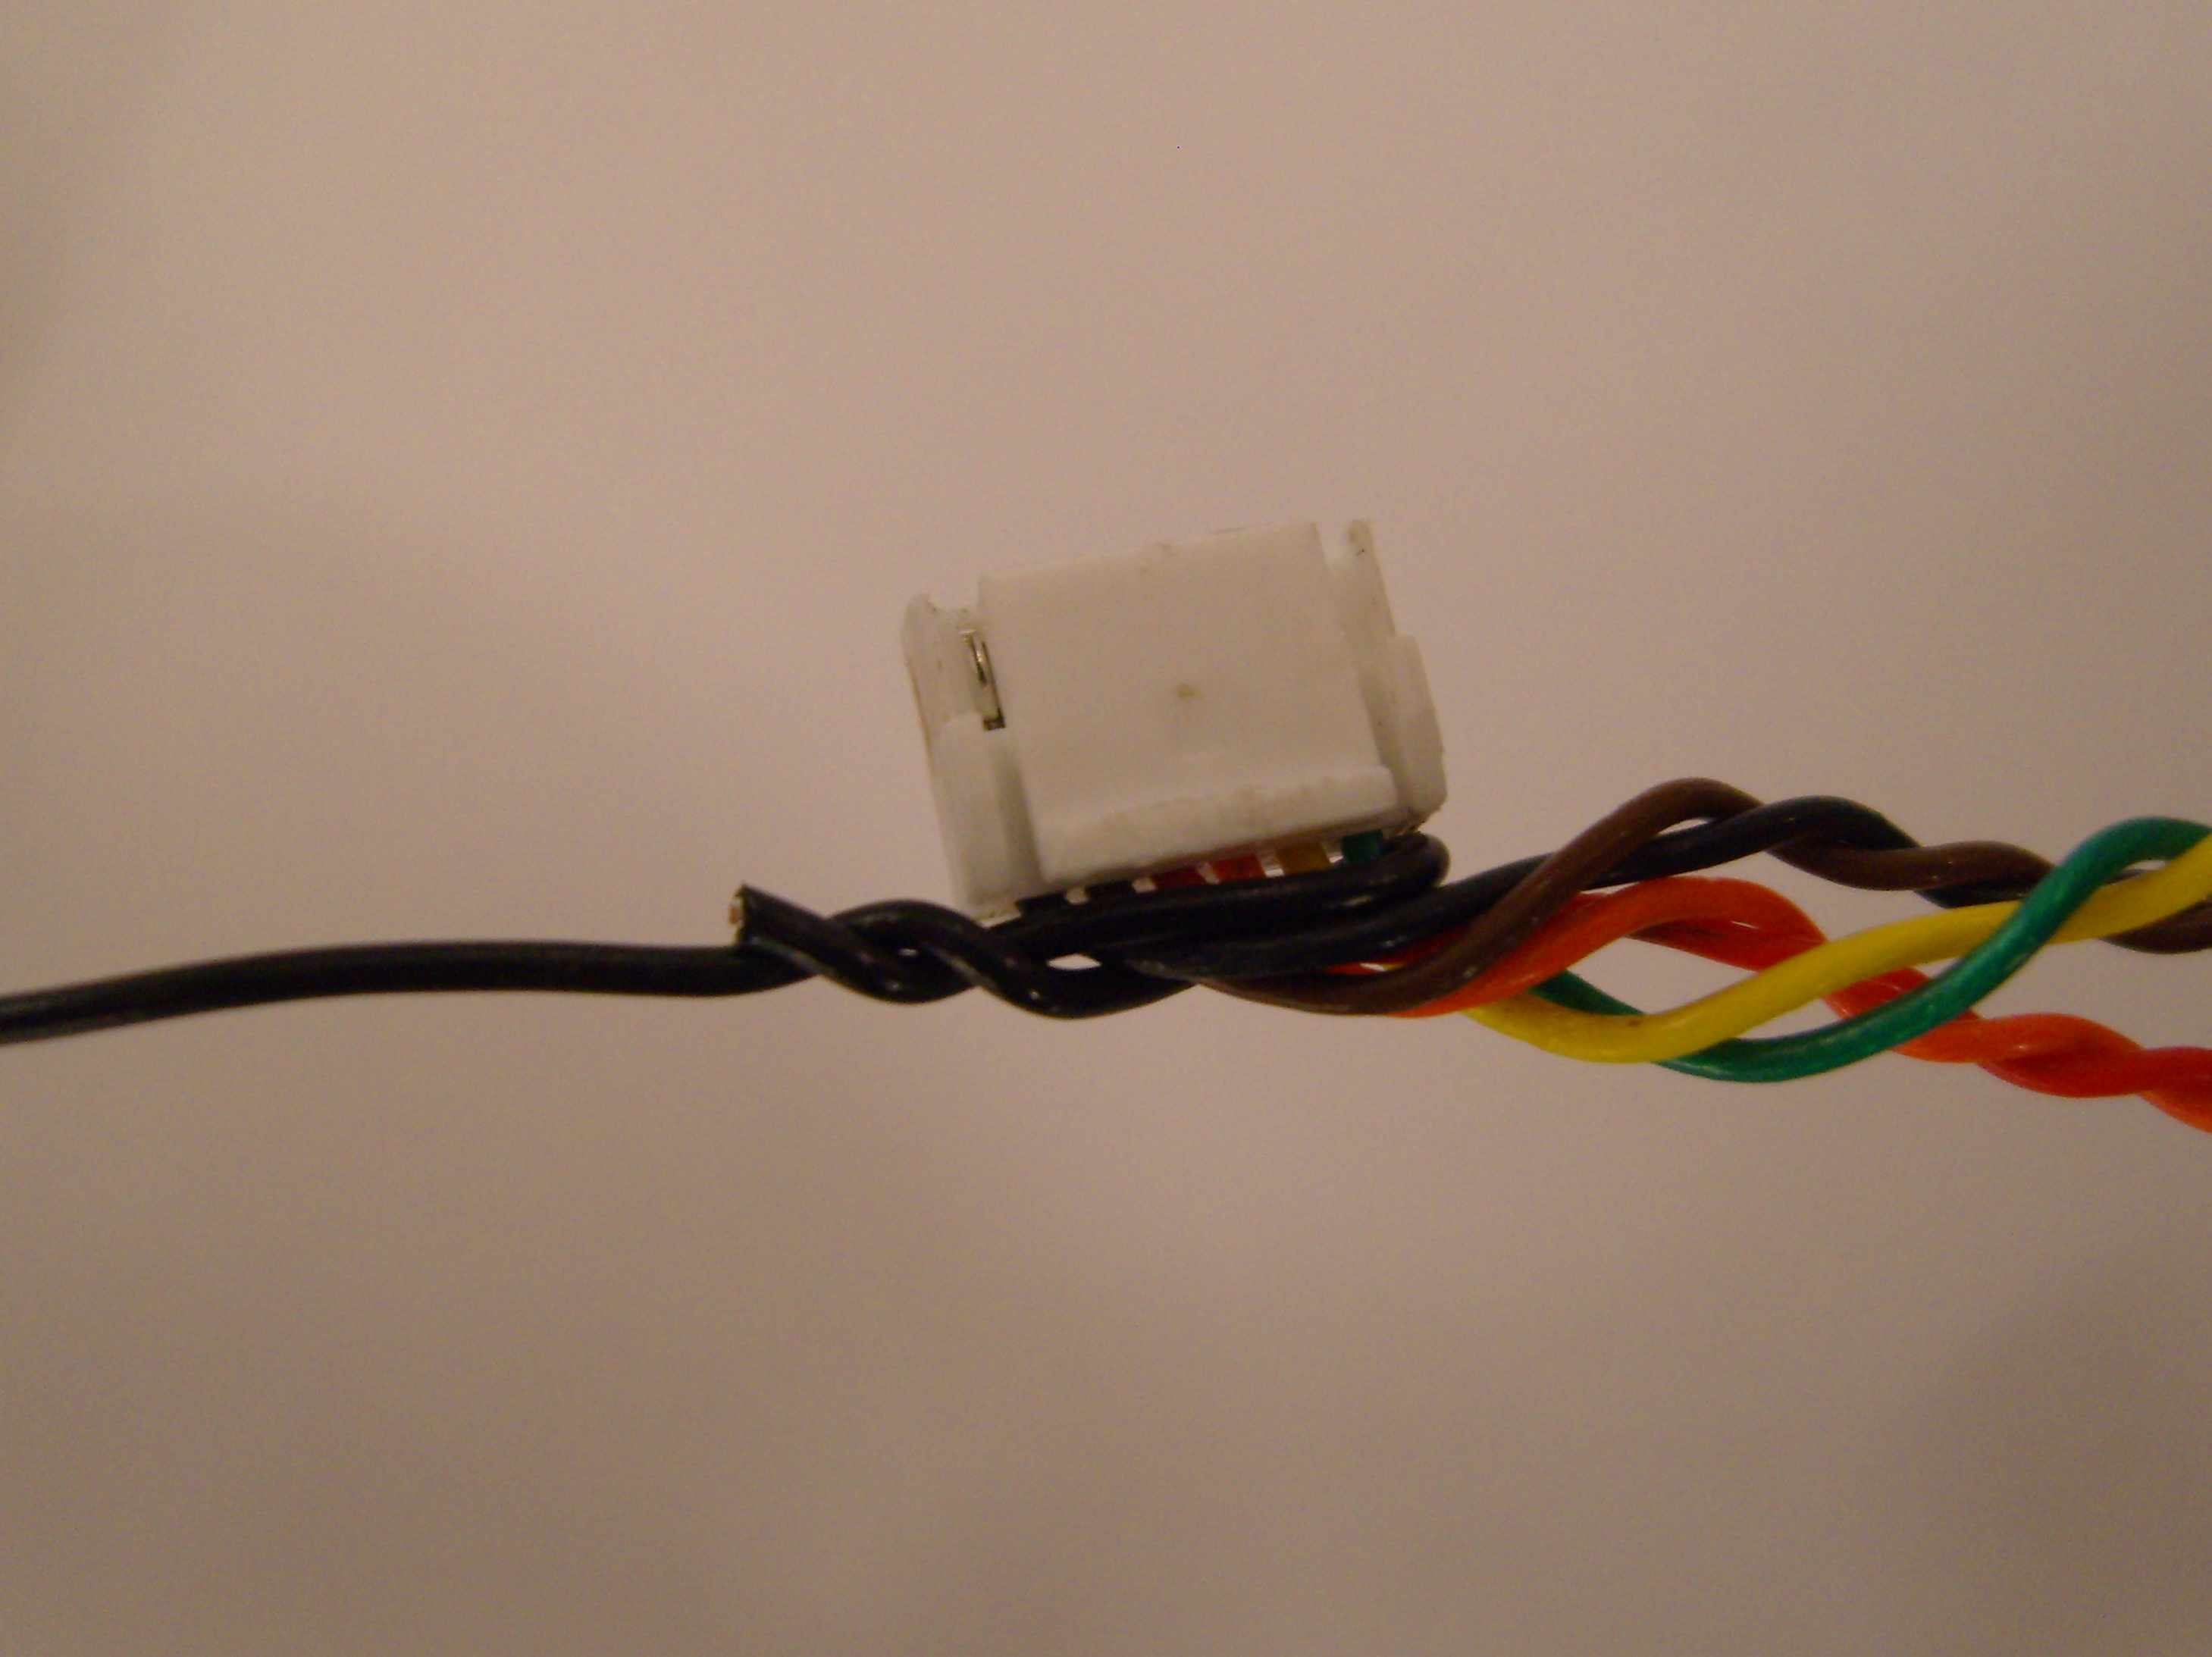
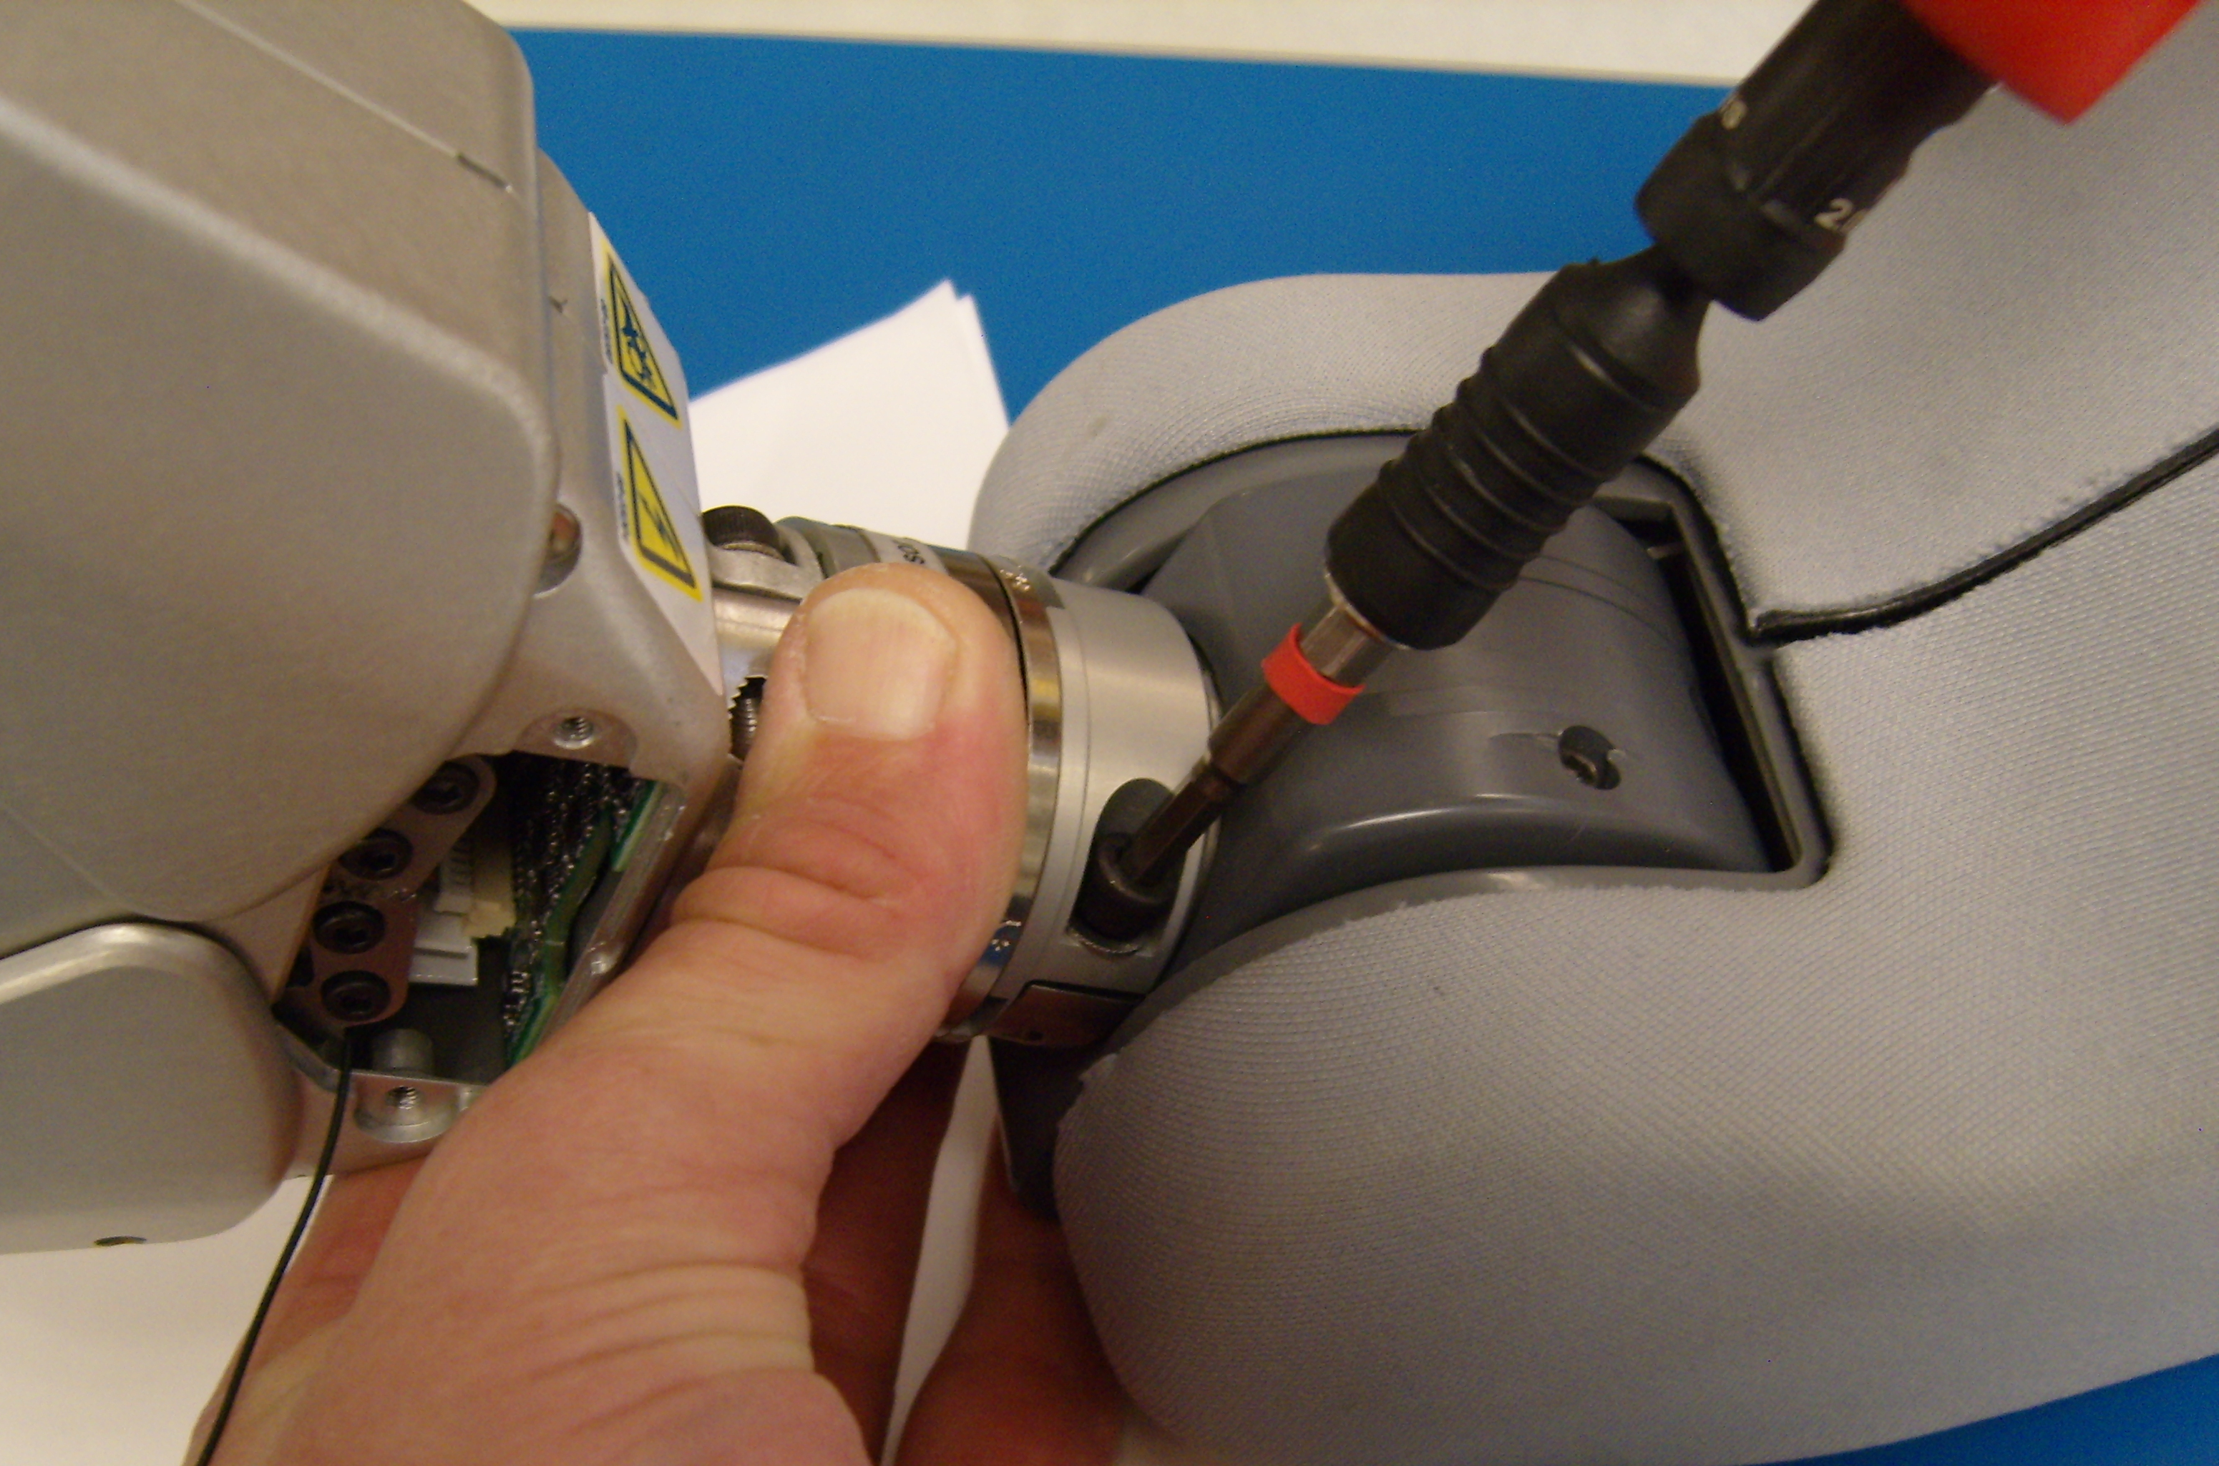
Gripper Installation Continued
Shape the gripper wire with a bend just outside the connector and make a hook with the black pull wire. (Fig. 5)
Gently pull the wire through as you move the gripper closer to the forearm. (Fig. 7)
***Be careful of delicate electronics, wires, and mechanics
Fig. 5
Twist the pull wire together a couple turns (neatly), and then trim it flush so that no part of the wire is hanging out. (Fig. 6)
Fig. 7
Pivot the wrist up slightly while picking up and rotating the gripper to align the key to mount it to the wrist.
Make sure that the gripper is fully seated onto the forearm.
Add the clamp with its washers and screws. Use Loctite 248 and a torque of 1.36N-M.
***Make sure to tighten the two screws equally
Fig. 6
Fig. 8

Slide 4
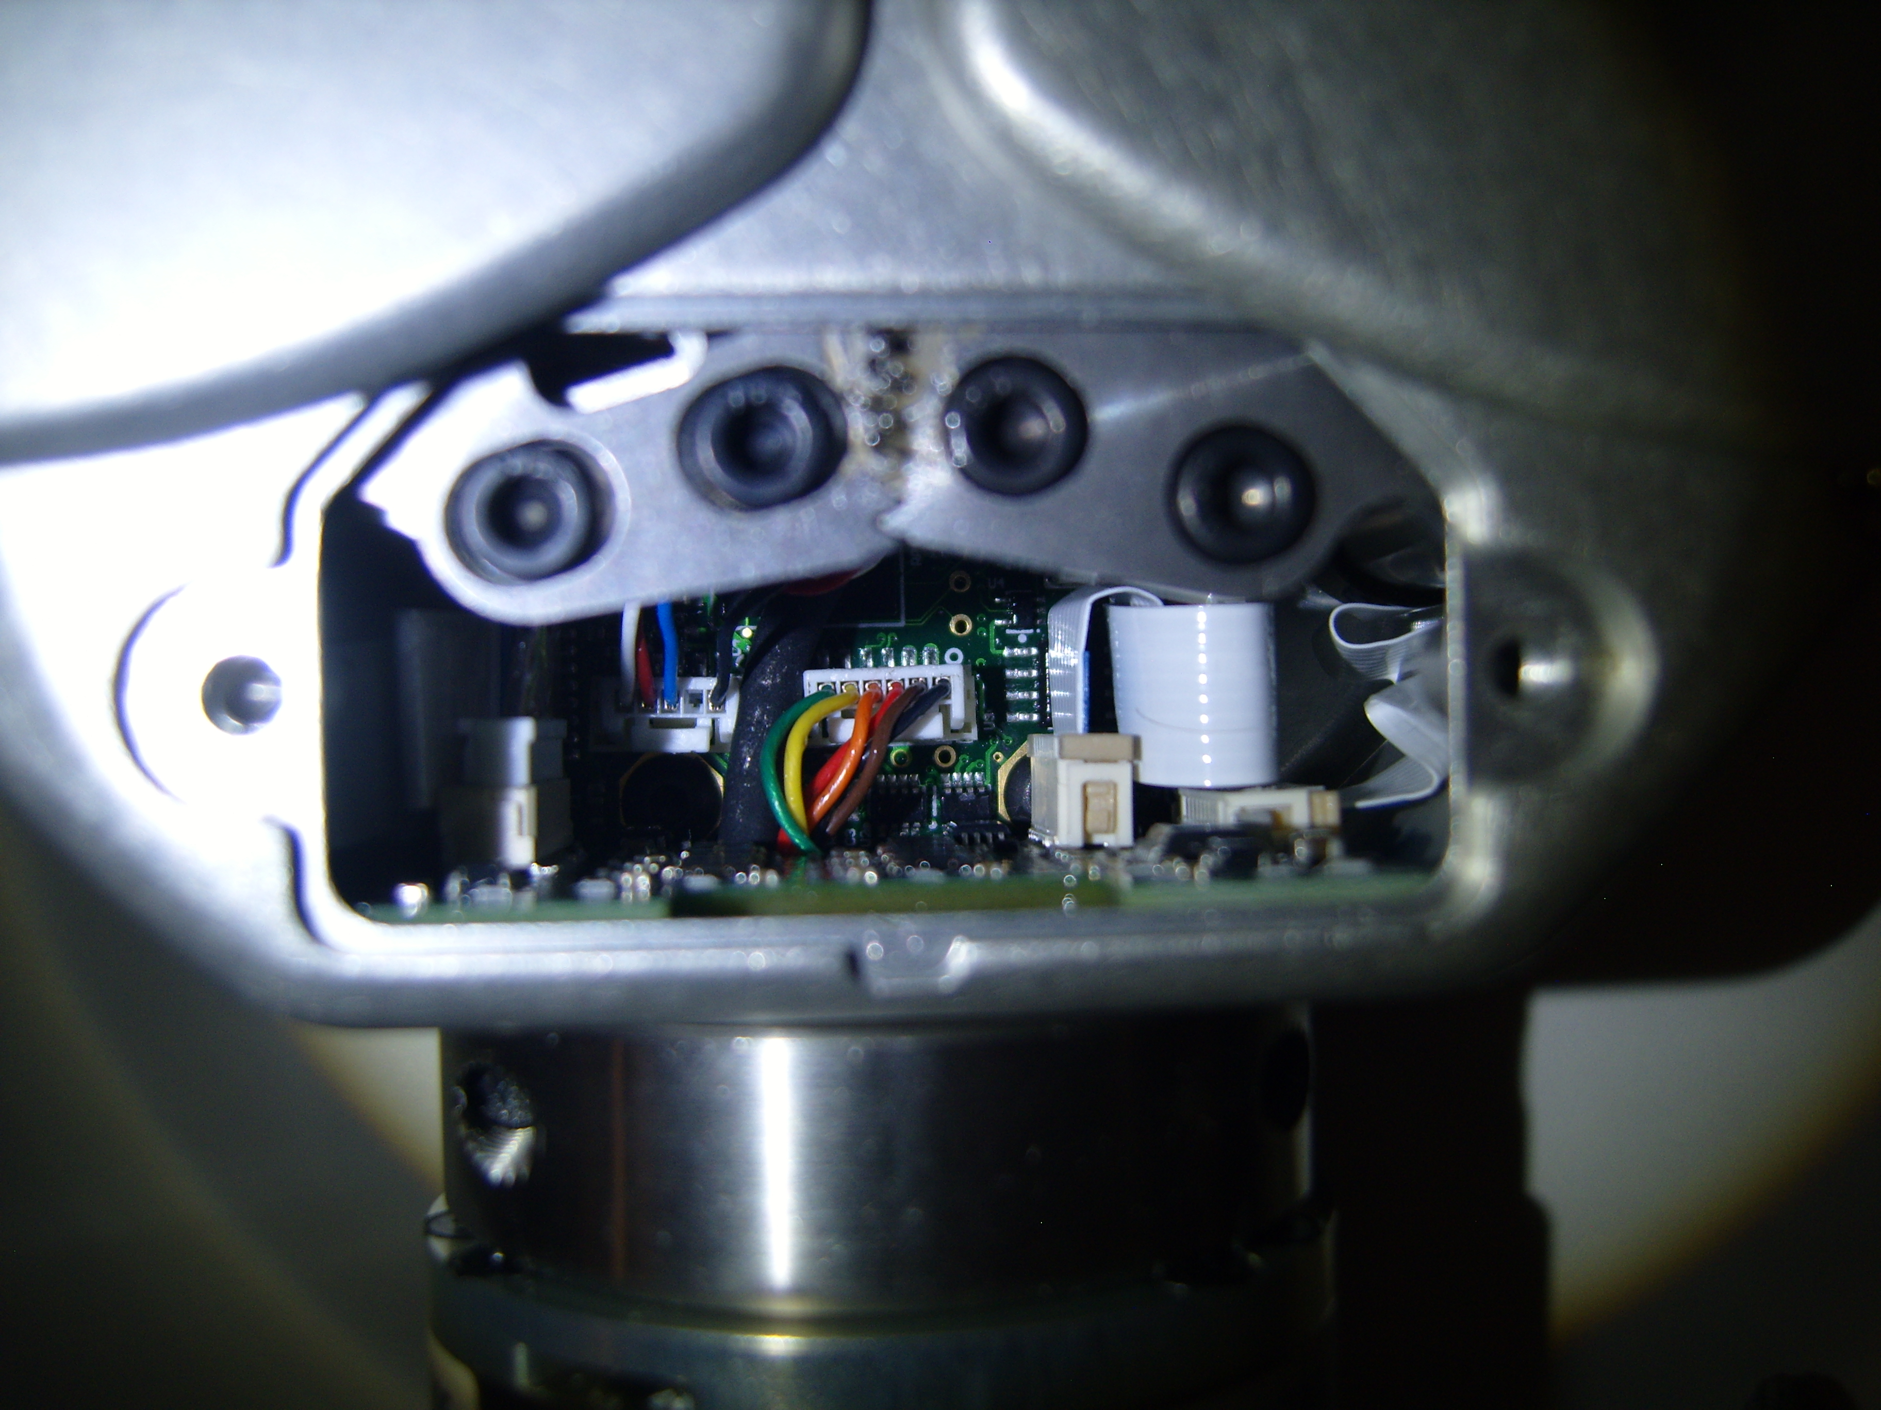
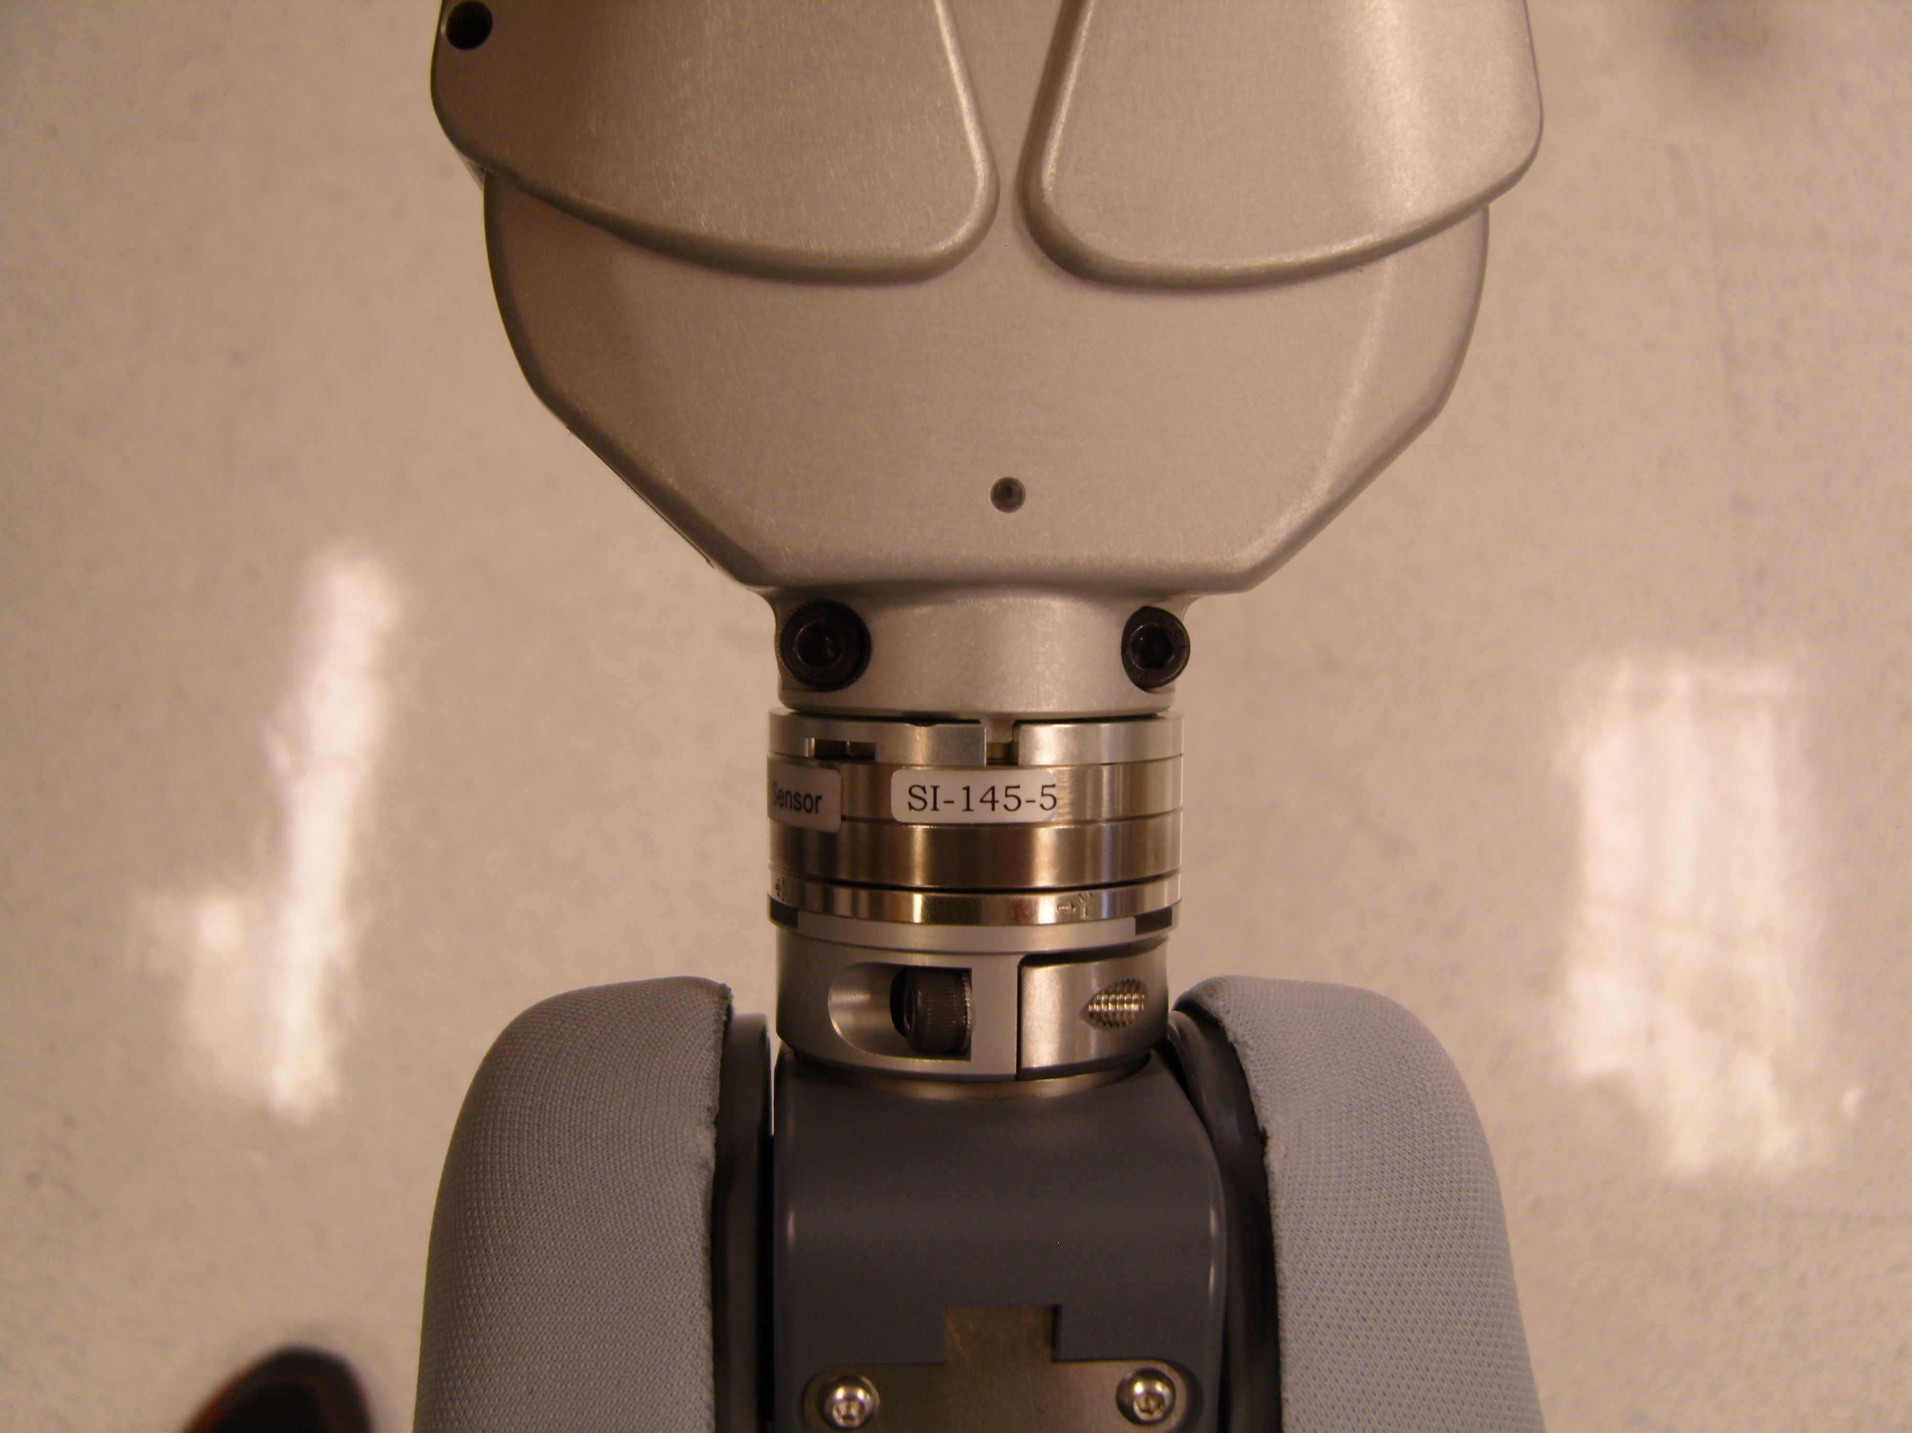
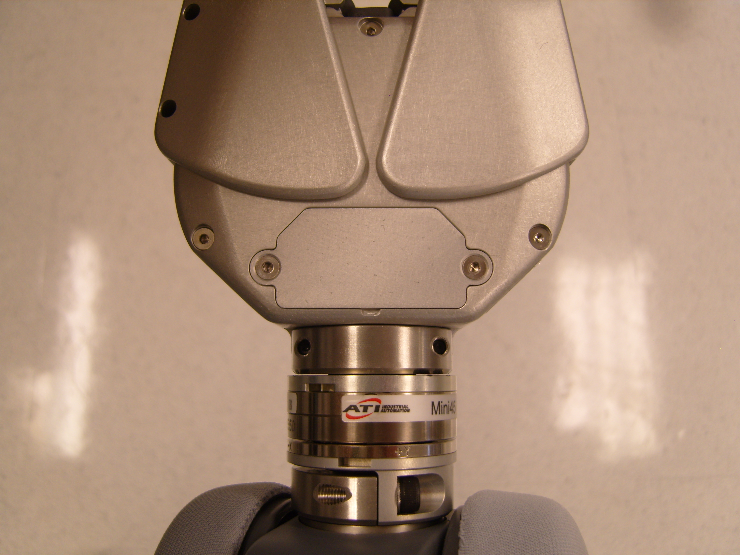
Gripper Installation Continued
Remove the pull wire and insert the connector as shown in (Fig. 9)
***Be careful of electronics, wires, and mechanics
***DO NOT disturb the two screws that mount the gripper to the Mini45 Sensor (shown below). If touched or altered, damage may occur.
Fig. 9
Mount the cover plate with the two 68-03061-05 (M3x0.50x5) screws, using a small amount of Loctite 248, and a torque value of 0.34N-M. (Fig. 10)
Fig. 10
Fig. 8

