Slide 1
tf: On the PR2
ROS + PR2 Training Workshop

Slide 2
What is tf?
A coordinate frame tracking system
  Standard Protocol for publishing transform data to a distributed system
  Helper classes and methods for:
    Publishing coordinate frame data - TransformPublisher
    Collecting transform data and using it to manipulate data - Transformer, TransformListener, tf::MessageFilter

Slide 3
tf is Distributed!
There are two types of tf nodes:
  Publishers
  Listeners
Listeners – listen to /tf and cache all data heard up to cache limit
Publishers – publish transforms between coordinate frames on /tf
There is no central source of tf information, or history before a node was started.

Slide 4
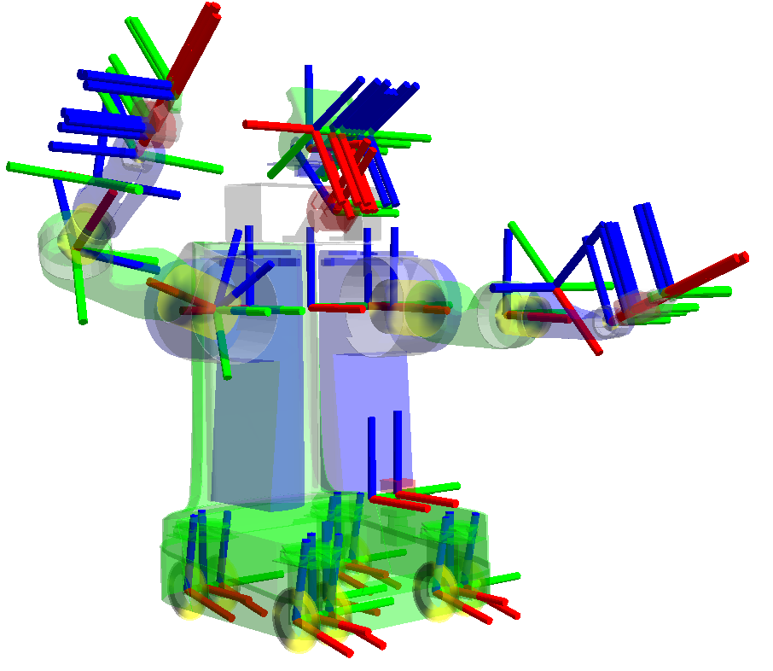
Coordinate Frames in the PR2
Every Link has a frame_id the same as in the URDF
Each sensor has a frame_id in which it takes measurements
Data is broadcast in the frame in which it was observed.

Slide 5
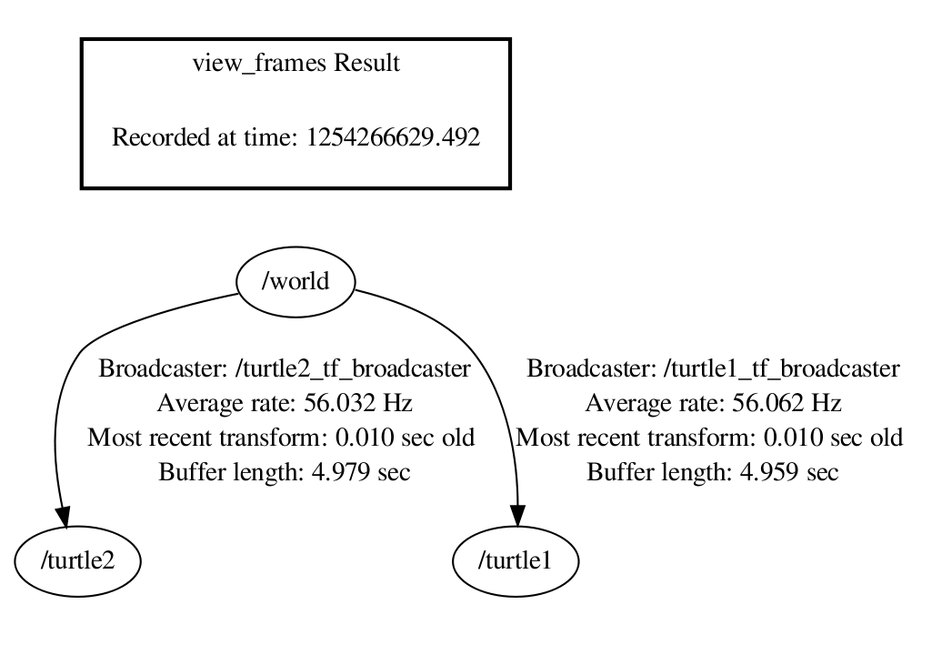
Transform Tree
Each link in the tree is cached
10 seconds is default cache time
It will work with multiple disconnected trees
Only for transforms within the same tree

Slide 6
Values of tf
No data loss when transforming multiple times
No computational cost of intermediate data transformations between coordinate frames
The user does not need to worry about which frame their data started
Information about past locations is also stored and accessible, but not before recording locally was started

Slide 7
Advanced API
Object 1 observed in the camera at Time = 0.25 while driving past
Object 2 observed in the camera at Time = 0.5 while driving past
The robot is planning it's path at Time = 1 where are all objects?
Time = 0
Time = 1
Tme

Slide 8
Advanced API
?
Object 2 observed in the camera at Time = 0.5 while driving past
The robot is planning it's path at Time = 1 where are all objects?
Object 1 observed in the camera at Time = 0.25 while driving past
Time = 0
Time = 1
Tme

Slide 9
Advanced API examples
Compute the position of an observed ball in the target frame at the target time assuming it was stationary in the fixed frame
  lookupTransform(ball_frame, ball_time, target_frame, target_time, fixed_frame, result_transform)
Compute how far the robot moved between t =1 and t = 2 in the map frame
  lookupTransform(robot_frame, t = 1,robot_frame, t =2, map_frame, result_transform)

Slide 10
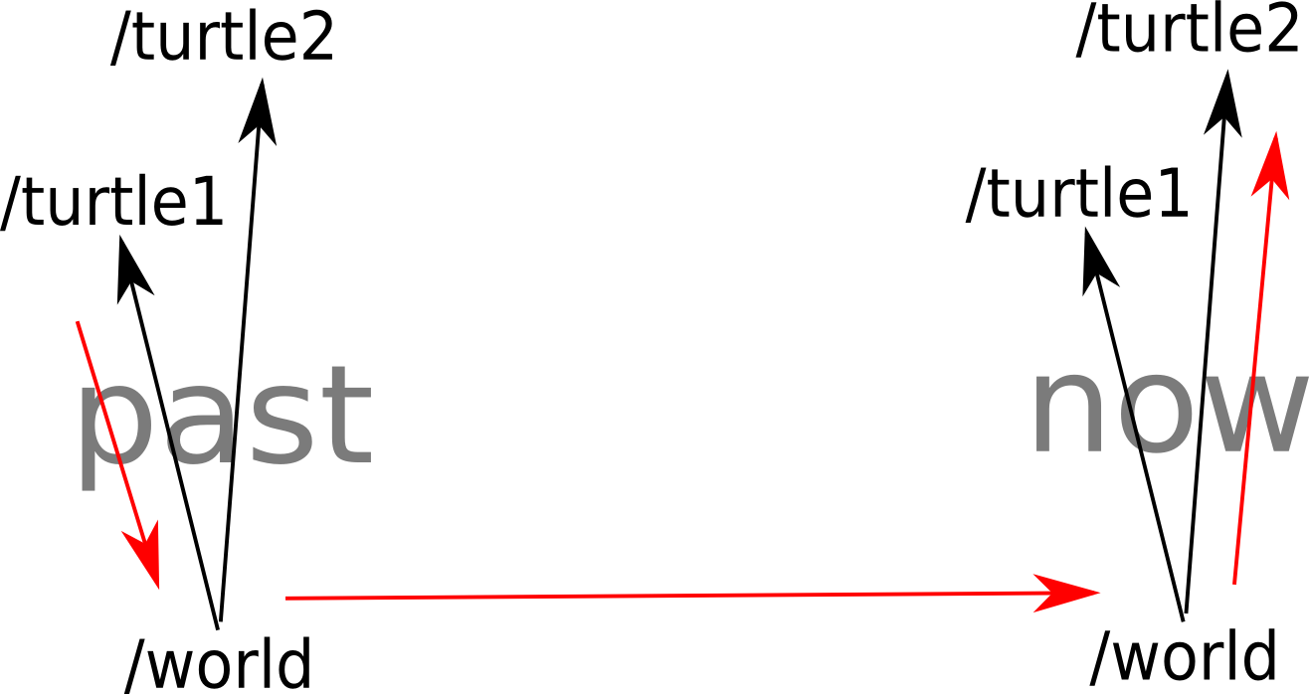
Avanced API Walk Through
5) Object available for manipulation in Target Frame at Target Time
1) Object Observed
2) Object Transformed into Fixed Frame at Observation Time
4) Object Transformed into Target Frame At Target Time
3) Object Assumed Static in Fixed Frame

Slide 11
Advanced API
Construct transform from first frame to fixed frame at data timestamp
Jump to query time in the fixed frame
Compute the transform from fixed frame to query frame at query time
Return the product of these transforms

Slide 12
PR2 Transform Debugging Tools
Command Line Tools http://www.ros.org/wiki/tf#Command-line_Tools
tf_echo – Print a specific transform to the screen
tf_monitor – Display statistics about transforms
roswtf (tf_plugin) Debug common tf configuration errors

Slide 13
tf Design Patterns
tf::MessageFilter
Transformer::waitForTransform

Slide 14
tf::MessageFilter
Purpose
Provide a non blocking way to queue data pending transform data availability
Usage
Register a target frame and an incoming topic
Receive a callback when transforms are available
Notes:
Why
Non blocking
Non polling

Slide 15
Transformer::waitForTransform
Dangers
No data coming in if in single thread
Blocks all progress, can make all processing late
Protection in Transformer class usingSeperateThread method
Using this method can delay the whole system unnecessarily
But it's very convenient for scripting/sequencing

Slide 16
tf Challenge
Install unreleased:
  . /opt/ros/latest/setup.sh
  ~/rosinstall -o ~/latest_wg_devel http://ros.org/rosinstalls/wg_latest_devel.rosinstall
roslaunch tf_workshop_demo system.launch
Write a node to draw a visulization_msgs/Marker in rviz on the ground below a detected checkerboard

Slide 17
tf Challenge Hints
There is a service /get_checkerboard_pose provided
There is a topic /board_pose provided
There are

Slide 18
tf Python
See Docs at: http://www.ros.org/doc/api/tf/html/python
Provides implementation of C++ API

Slide 19
PR2 Navigation frame_ids
map – The coordinate frame fixed to the map
odom_combined – The self consistent coordinate frame using the odometry measurements only(This will not change on localization updates)
base_footprint – The base of the robot at zero height above the ground
base_link – The base link of the robot

Slide 20
PR2 Sensor Frames
/r(l)_forearm_cam
/wide(narrow)_stereo_r(l)_stereo_camera_frame
/wide(narrow)_stereo_link
/wide(narrow)_stereo_optical_frame
/imu_link
/sensor_mount_link
/high_def_frame
/high_def_optical_frame
/laser_tilt_link
/base_laser_link

Slide 21
PR2 Manipulation Frames
/r(l)_elbow_flex_link
/r(l)_forearm_cam_frame
/r(l)_forearm_cam_optical_frame
/r(l)_forearm_link
/r(l)_forearm_roll_link
/r(l)_gripper_l_finger_link
/r(l)_gripper_l_finger_tip_link
/r(l)_gripper_motor_accelerometer_link
/r(l)_gripper_palm_link
/r(l)_gripper_r_finger_link
/r(l)_gripper_r_finger_tip_link
/r(l)_gripper_tool_frame
/r(l)_shoulder_lift_link
/r(l)_shoulder_pan_link
/r(l)_upper_arm_link
/r(l)_upper_arm_roll_link
/r(l)_wrist_flex_link
/r(l)_wrist_roll_link
/torso_lift_link
/base_footprint
/base_laser_link
/base_link
/bl_caster_l_wheel_link
/bl_caster_r_wheel_link
/bl_caster_rotation_link
/br_caster_l_wheel_link
/br_caster_r_wheel_link
/br_caster_rotation_link
/double_stereo_link
/fl_caster_l_wheel_link
/fl_caster_r_wheel_link
/fl_caster_rotation_link
/fr_caster_l_wheel_link
/fr_caster_r_wheel_link
/fr_caster_rotation_link
/head_pan_link
/head_plate_frame
/head_tilt_link

Slide 22
The End

Slide 23
Example Using Message Filter

Slide 24
Ball Tracking Single Robot
A case study of tossing a ball and catching it.
The camera runs at 30Hz, the ball tracker induces a 50ms delay, and the arms update at 100Hz with 10ms lag. The ball is very light and flies for 3 seconds.
Assume the robot is stationary

Slide 25
Ball Tracking Single Robot
Approach
Throw the ball upward.
Track the ball with the head.
Compute the trajectory and predict where it will pass through the plane at a good catching height.
Move the gripper in front of it in time to catch it.

Slide 26
Diagram
Robot Throwing Ball
Ball trajectory
Stereo Camera Tracking
t=0
t=n

Slide 27
Ball Tracking Single Robot
Inputs: ball in camera frame, joint states,
PositionBall_Shoulder = Transform(Head Pan, Head Tilt) * PositionBall_Camera
Track the ball and predict where to catch it output: PositionBallFuture_Torso
Command hand to go to PositionBallFuture_Torso
Notes:
Can you see any problems??

Slide 28
Ball Tracking Single Robot
Problems
Need to cache all this information in time to build trajectory.
All the data is not available at once.
Assume that the hand is fast enough and can get there in time.

Slide 29
Ball Tracking Single Robot
Receive Joint States
Store in time accessible data structure
Receive ball tracking data
Make sure joint states are available(wait if not)
Record trajectory and estimate landing position.
Move arm there.

Slide 30
Ball Tracking Single Robot
Use a tf::MessageFilter to subscribe to ball tracking info when available in the torso frame.
Record trajectory and estimate landing position.
Move arm there.

Slide 31
Moving Robot
Robot Throwing Ball
Ball trajectory
Stereo Camera Tracking
t=0
t=n

Slide 32
Ball Tracking Moving Robot
Receive Joint States and store in time indexed data structure (long enough to overcome network lag)
Receive ball tracking data
Make sure joint states are available(wait if not)
Receive localization information
Store it in a time indexed history.
Polling for when available, compute the net transform for each observation of the ball into world frame.
Record trajectory and estimate landing position.
Transform landing position into torso frame
Move arm there.

Slide 33
Ball Tracking Single Robot
Use a tf::MessageFilter to subscribe to ball tracking info when available in the world frame and in arm frame.
Record trajectory and estimate landing position.
Transform landing position into torso frame
Move arm there.

Slide 34
Ball Tracking Single Robot
Two robots, each can see the ball for half the flight.
The camera runs at 30Hz, the ball tracker induces a 50ms delay.
The arms update at 100Hz with 10ms lag.
The robots are localized at 10Hz.
The ball is very light and travels for 3 seconds.

Slide 35
Example: Ball Tracking Pseudo Code
Inputs: ball in camera frame, joint states,
PositionBall_Torso = Transfrom(Head Pan, Head Tilt) * PositionBall_Camera
PositionBall_Base1 = Transform(Torso Lift) * PositionBall_Torso
PositionBall_Map = Transform(Robot1 Position)*Positionball_Base1
PositionBall_Base2 = Transform(Robot2 Position)*Positionball_Map
PositionBall_Torso2 = Transform(Spine Lift 2) * PositionBall_Base2

