Slide 1

GPU Install
August 1, 2011

Slide 2
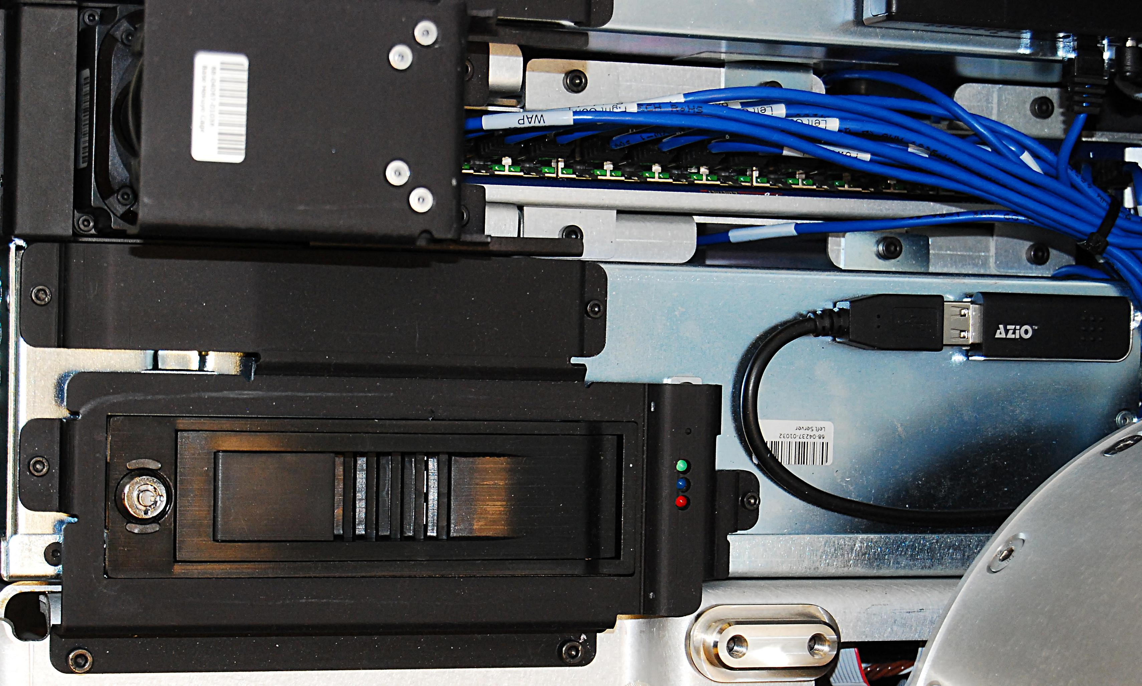
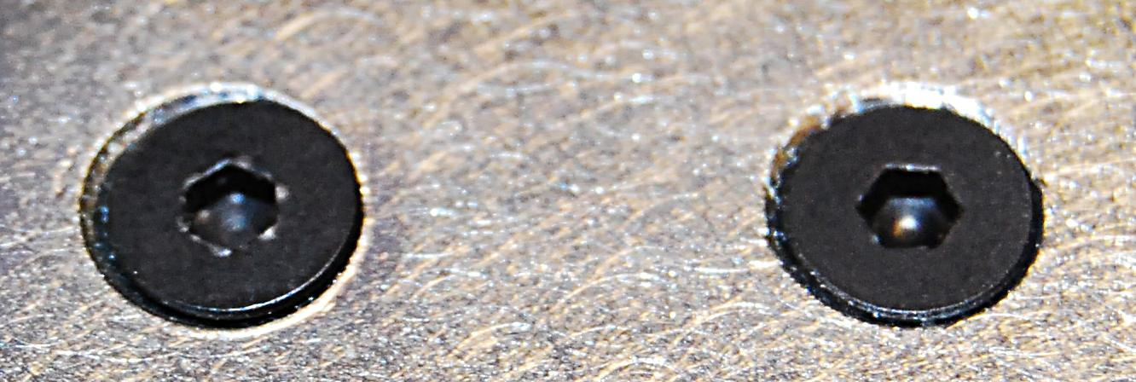
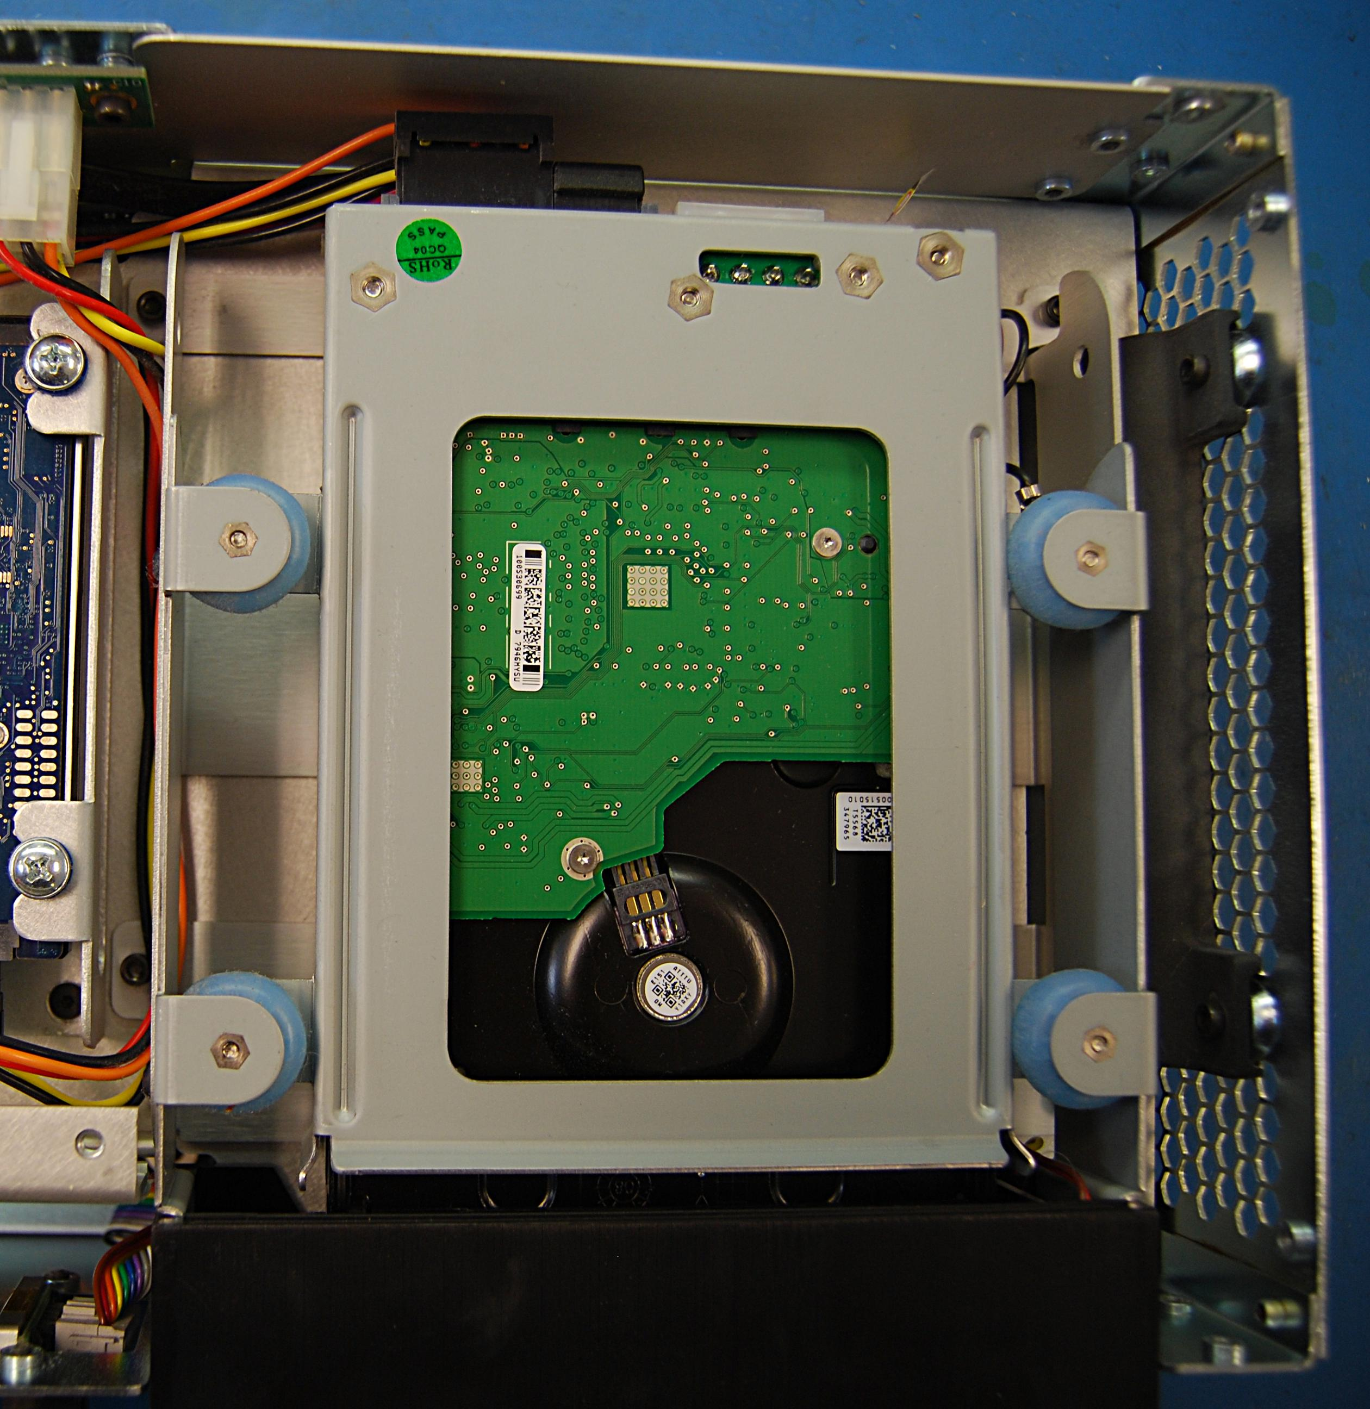
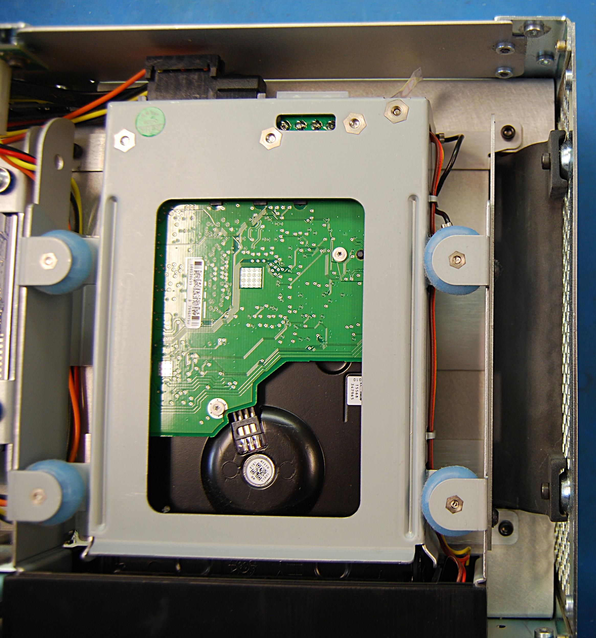
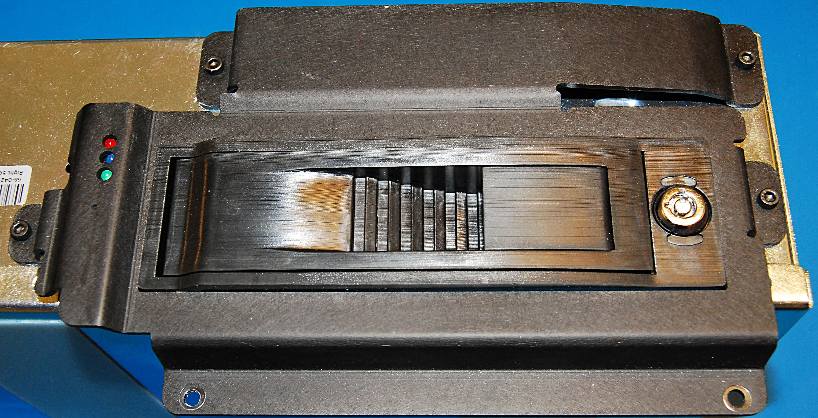
GPU Installation
Refer to the PR2 Overview document for additional information.
Move the spine of the robot all the way up, turn the robot off, and remove the front bottom panel and front bellows
Refer to Doc2 for instructions on how to remove the front bottom panel
Refer to Doc9 for instructions on how to remove the front bellows
Remove the 3 screws that secure the server to the base using a 3mm bit with the T-handle driver (Fig. 1)
Remove the 14 screws that secure the lid onto the server chassis using a 2mm bit with the T-handle driver. (Fig. 3)
***When removing the 14 screws make sure to be perpendicular to them and use a lot of down-pressure as these small socket head screws tend to strip
Fig. 3
Remove the hard drive bay by removing the 4 screws holding it down (Fig. 4) before you install the GPU.
Fig. 1
Slowly and carefully lift the server up out of the base and disconnect all cables from the back of the server
Remove the 4 screws from the hard drive bay cover using a 2.5mm bit with the T-handle driver (Fig. 2)
Fig. 2
Fig. 4

Slide 3
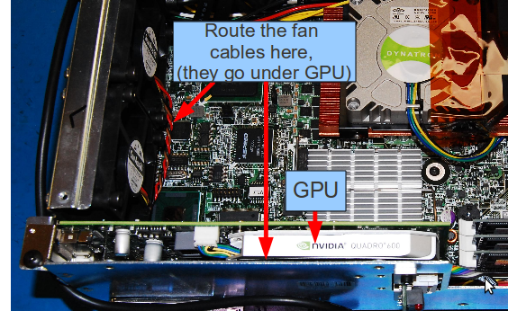
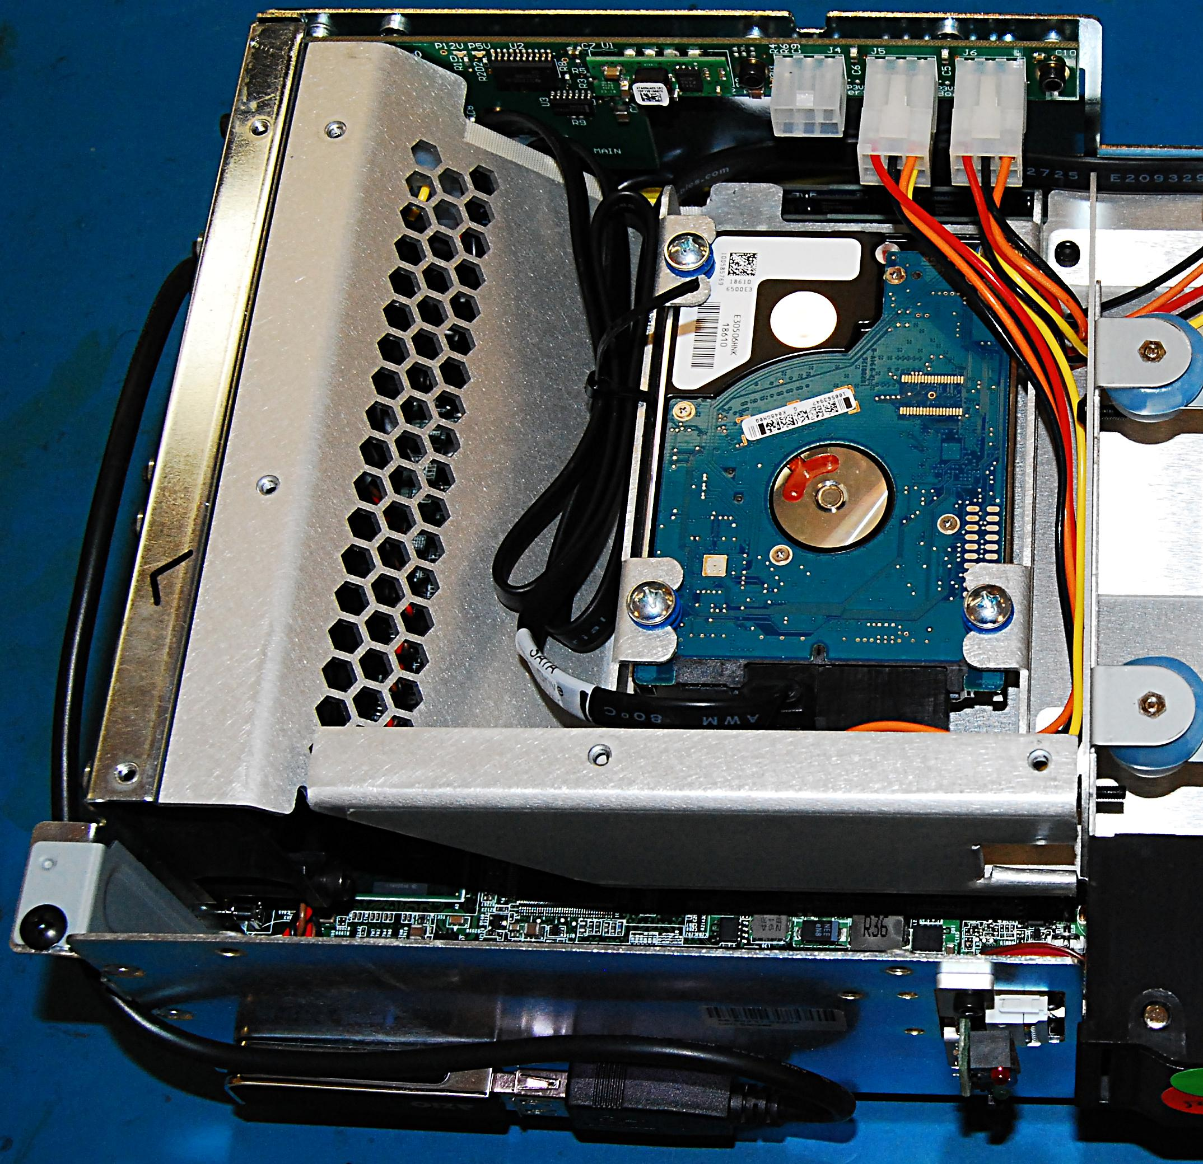
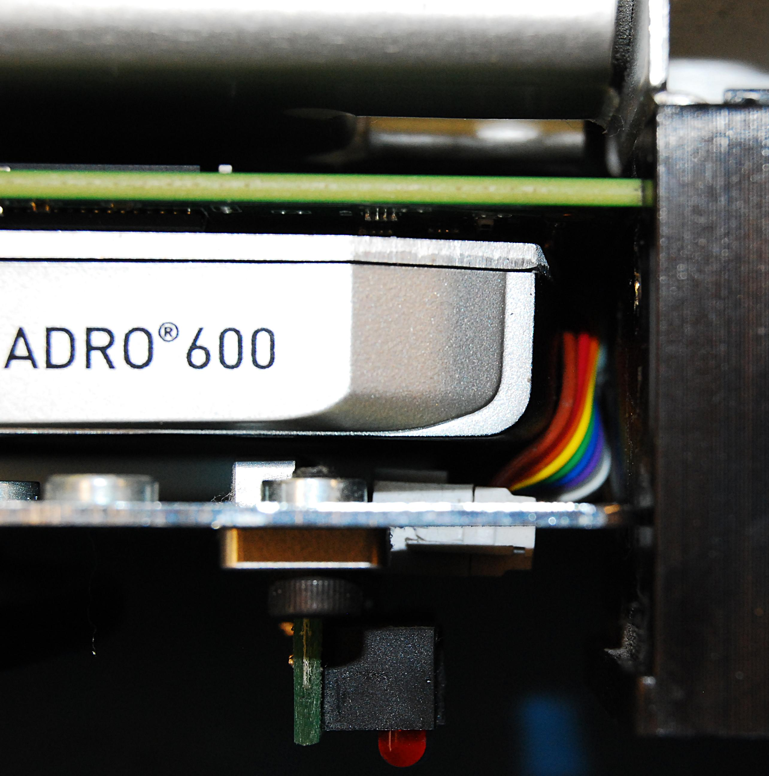
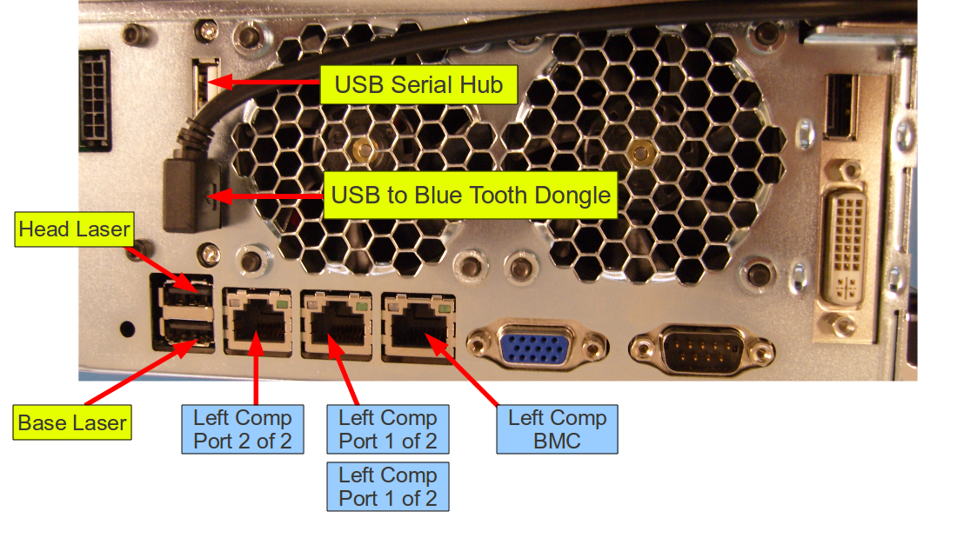
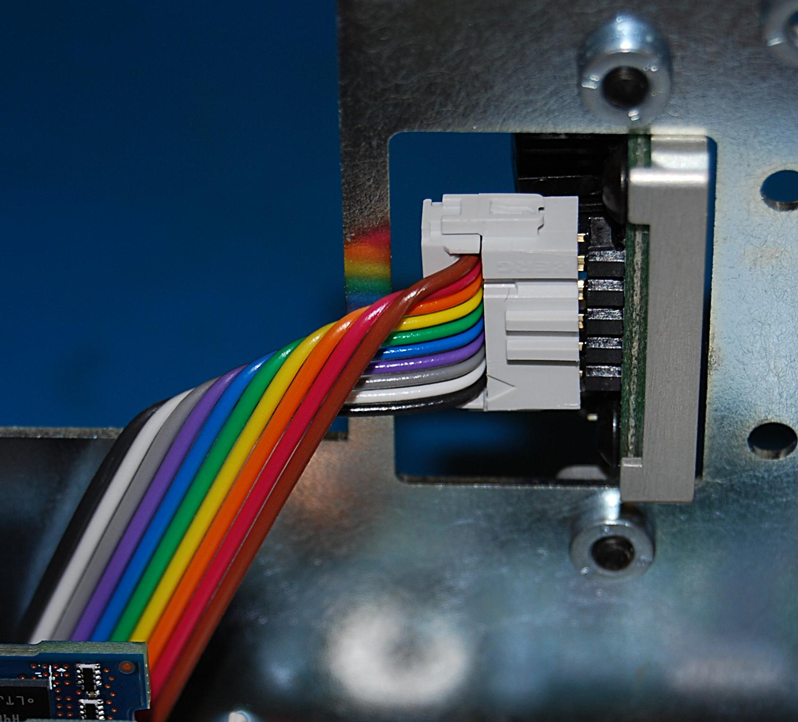
GPU Installation
Remove the card slot blank cover and install the GPU (Fig. 5,6)
  Very important to make sure that the ribbon cable from the front leds do not interfere with the gpu fan (Fig. 7,8)
Fig. 6
Reinstall the lid onto the chassis using NEW screws and loctite 248 with a torque of .68 N-M
Reinstall the hard drive bay cover using NEW screws and loctite 248 with a torque of 1.36 N-M
Fig. 5
Reconnect all cables to the server. Look at the labels on the cables and (Fig. 9) below
Fig. 7
Fig. 9
Fig. 8
Reinstall the server into the base of the robot using loctite 248 and a torque of 3.17 N-M
Reinstall the front bellow (refer back to Doc9) and reinstall the bottom panel onto the robot (refer back to Doc2)

