Slide 1

Shoulder pan MCB remove/replace
Aug 31, 2011

Slide 2
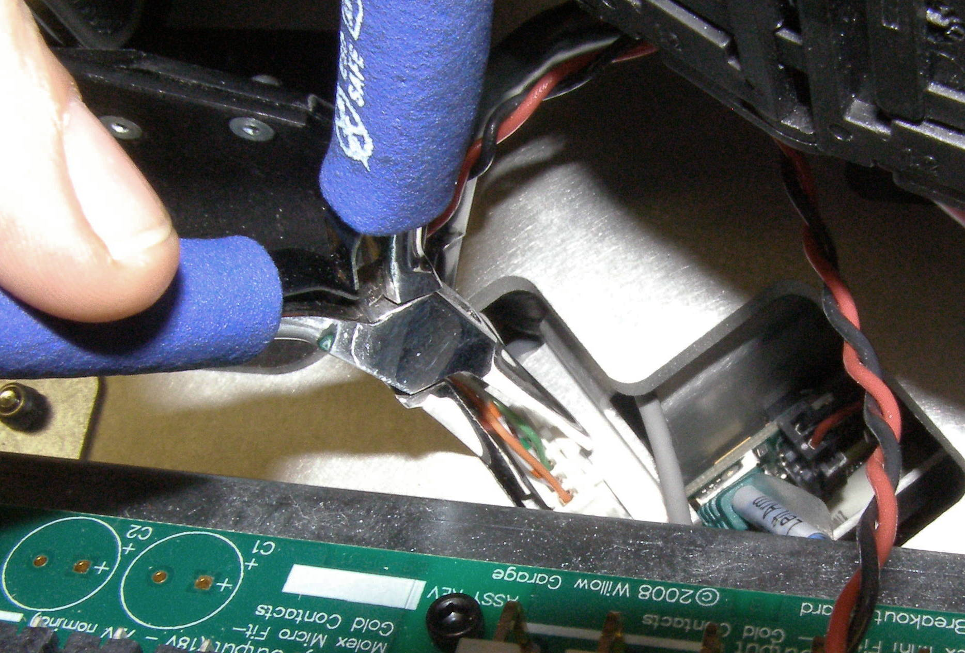
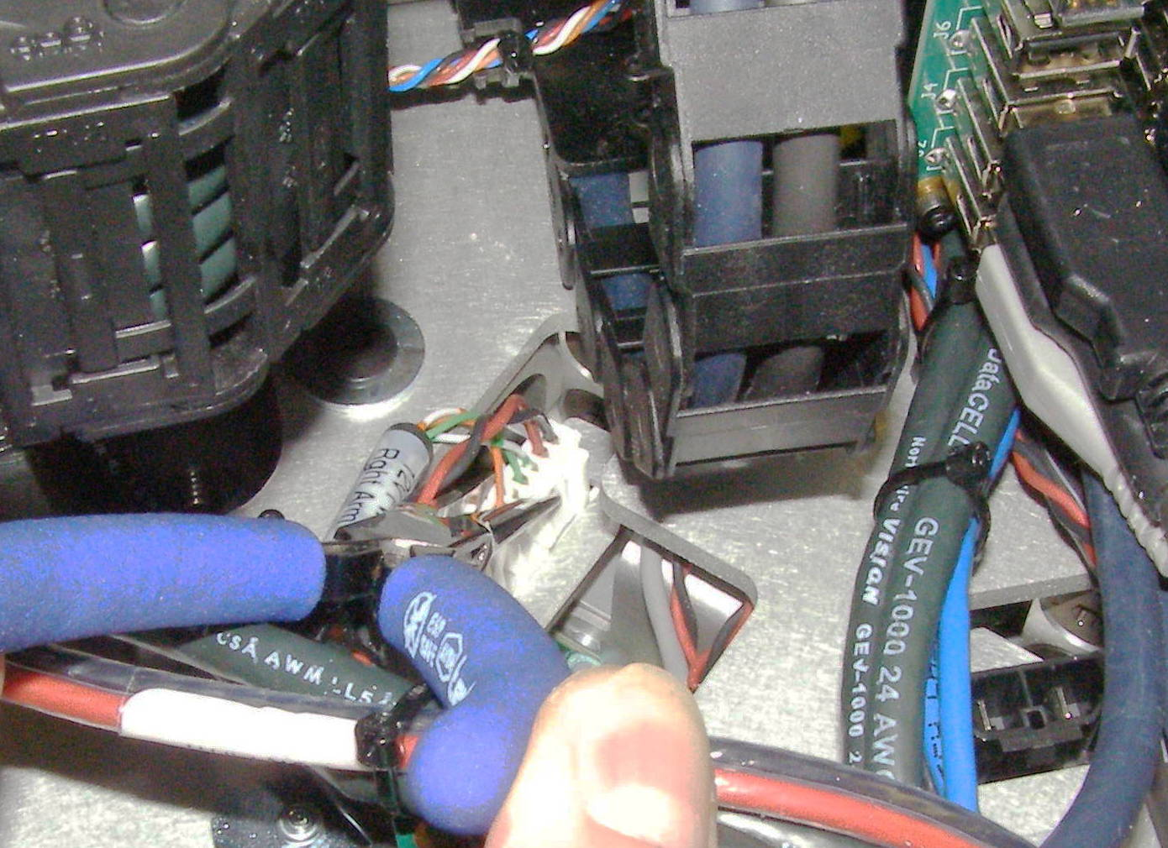
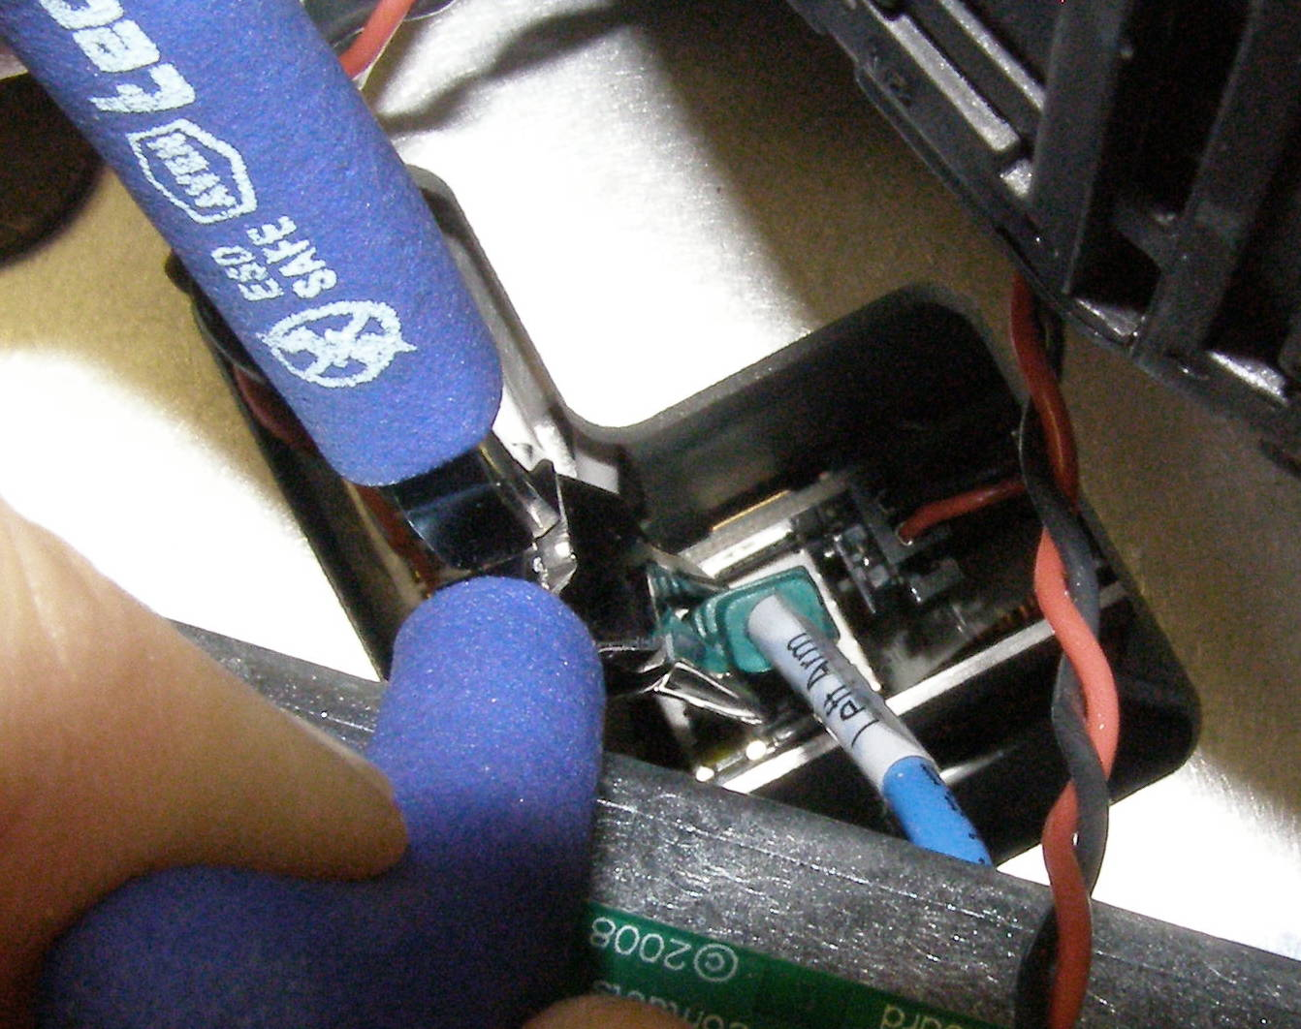
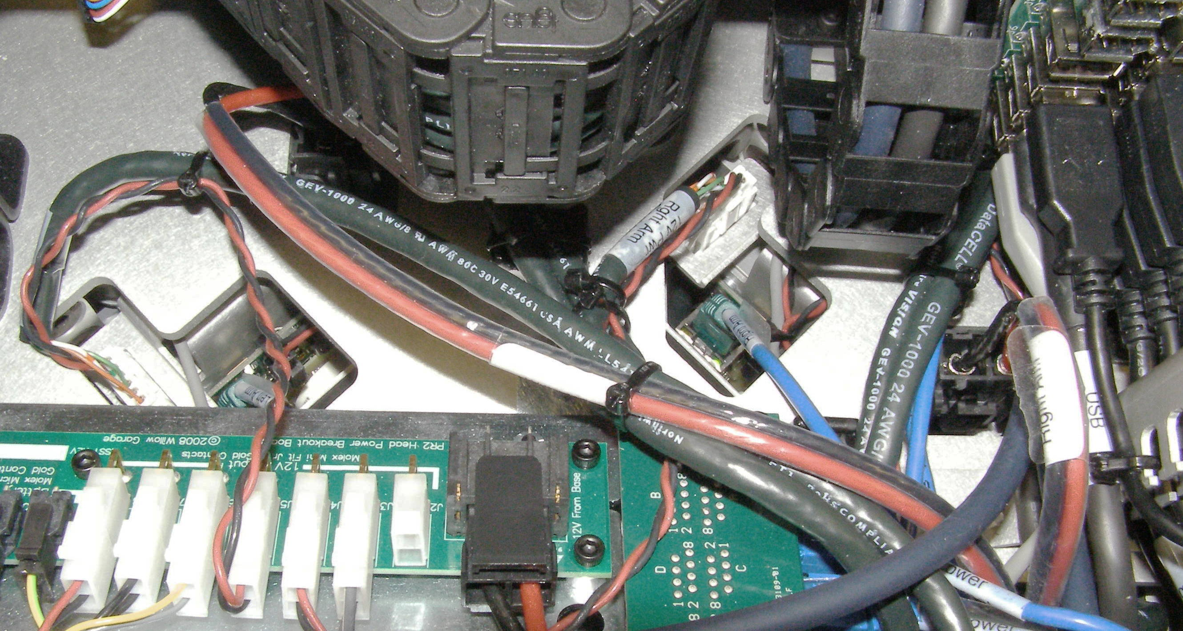
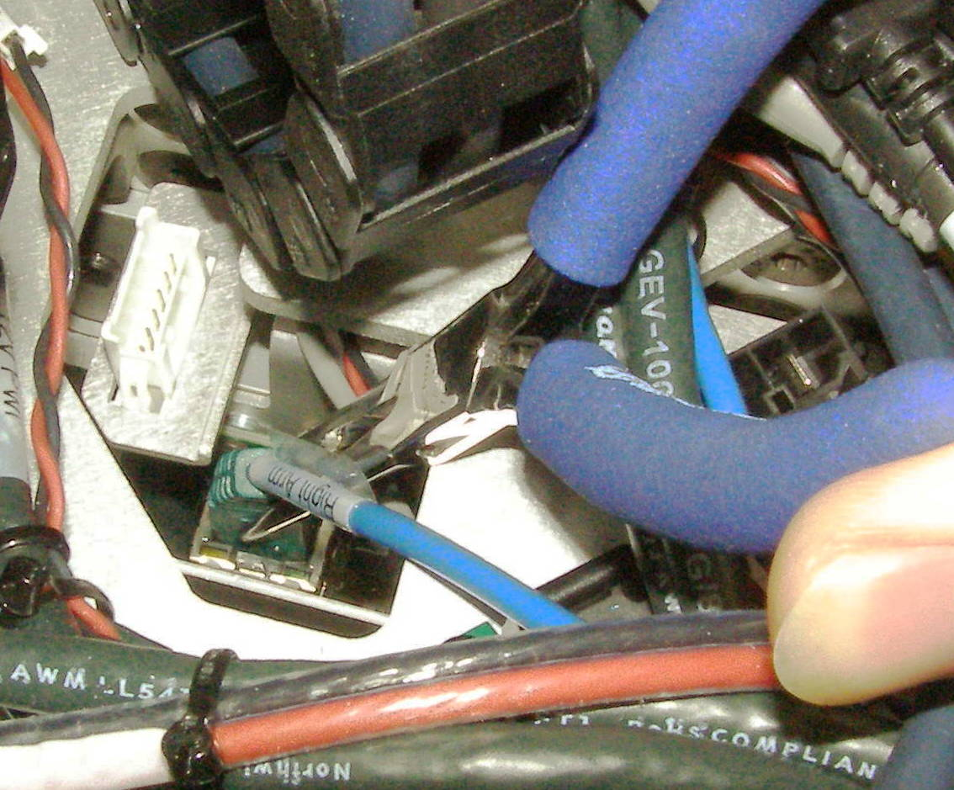
Shoulder Removal (1)
For this procedure, you will remove the entire PR2 arm at once. The arm is heavy, so put the torso at a height that makes it easy to reach the bottom of the turret without bending over too much. We recommend raising spine up about 20cm.
Shutdown PR2.
Turn of red breaker switch in back of robot.
Unplug PR2 from wall power.
Remove turret cover. Use instructions in “Shoulder Covers Removal and Replacement” on PR2Support website under “Service Information”
Remove spine rear top panel. Use instructions in “Top and Rear Spine Cover Removal” on PR2Support website under “Service Information”
Remove trim pieces. Use instructions in “Trim Panels Removal and Replacement” on PR2Support website under “Service Information”
Disconnect 3 cables per Shoulder. You will need to use the Needle Nose pliers to release the latches for the connectors. The Right Shoulder connectors are on the Right side and the Left on the Left side. Both of the Power connectors (Red/Black wire) are hidden under cables or an energy chain. (Fig 2-7)
Fig 3
Fig 4
Fig 5
Secondary
Fig 7
Fig 2
Fig 6

Slide 3
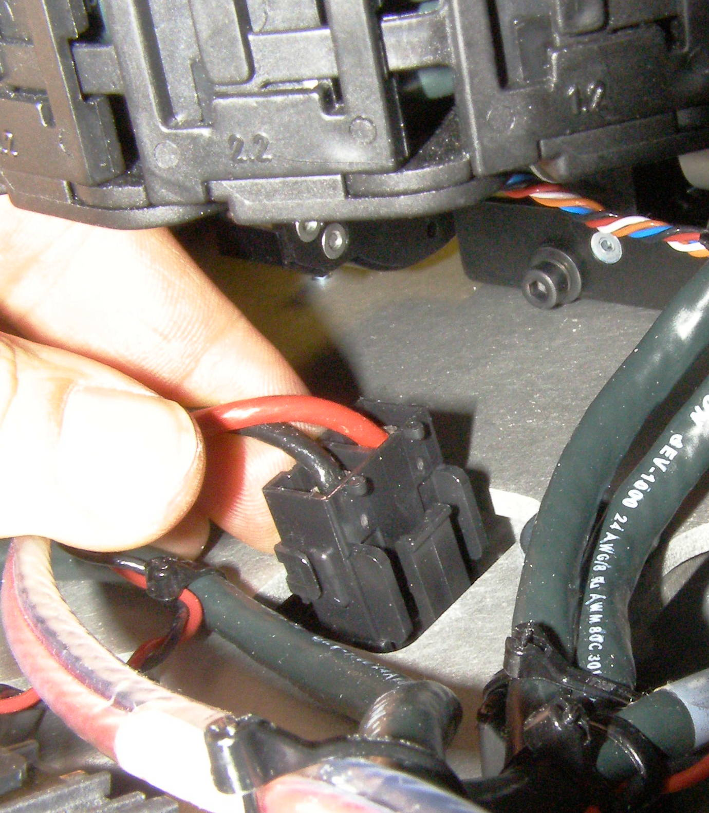
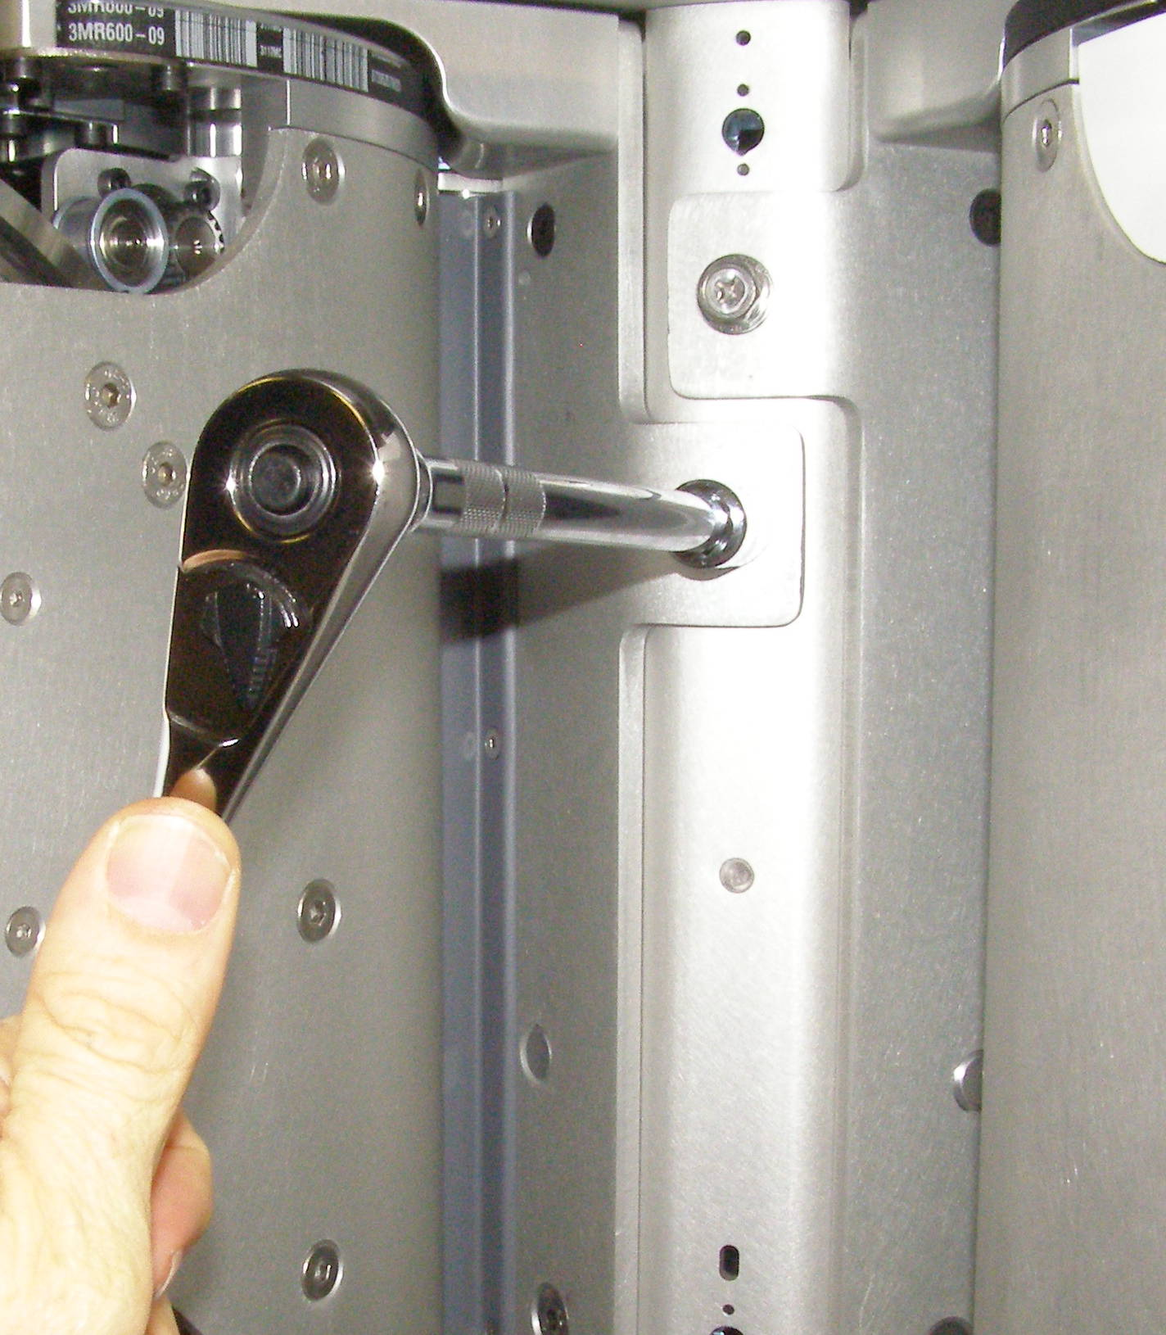
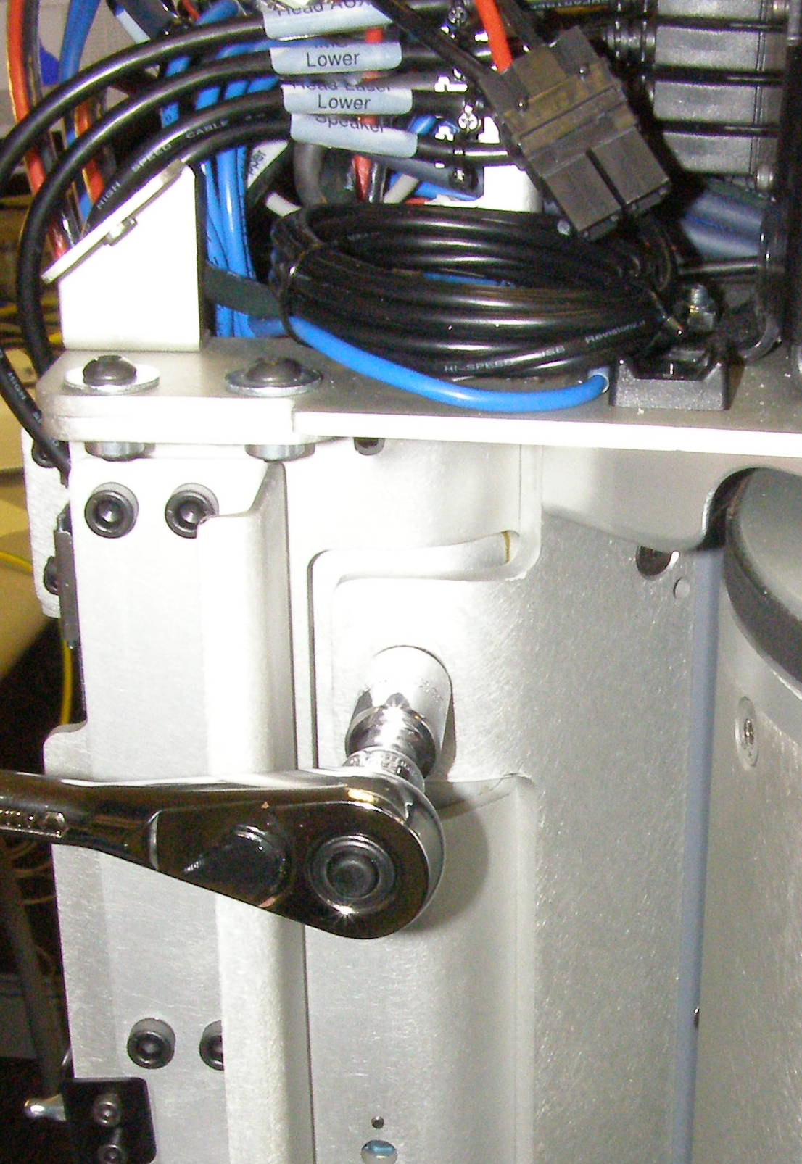
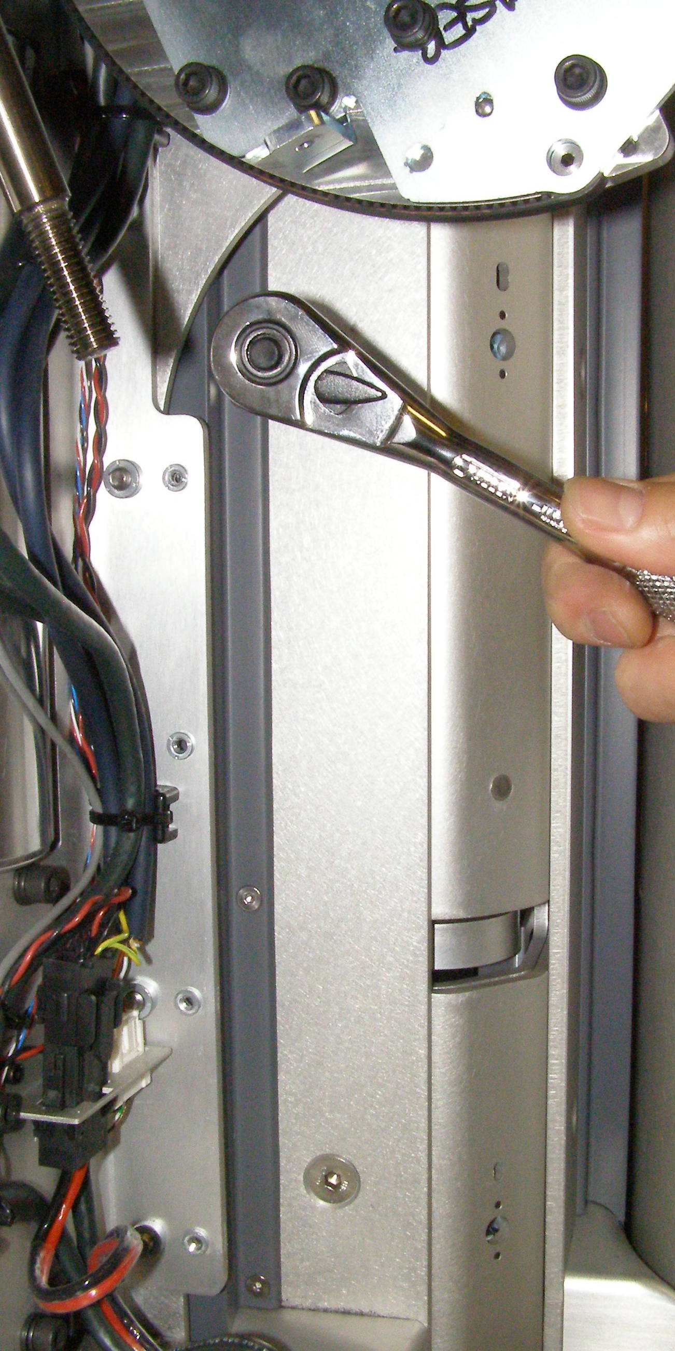
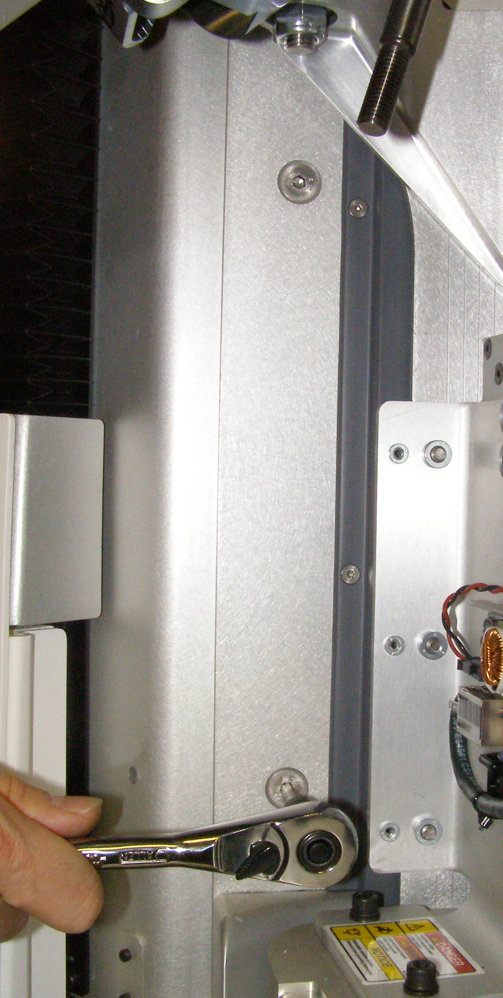
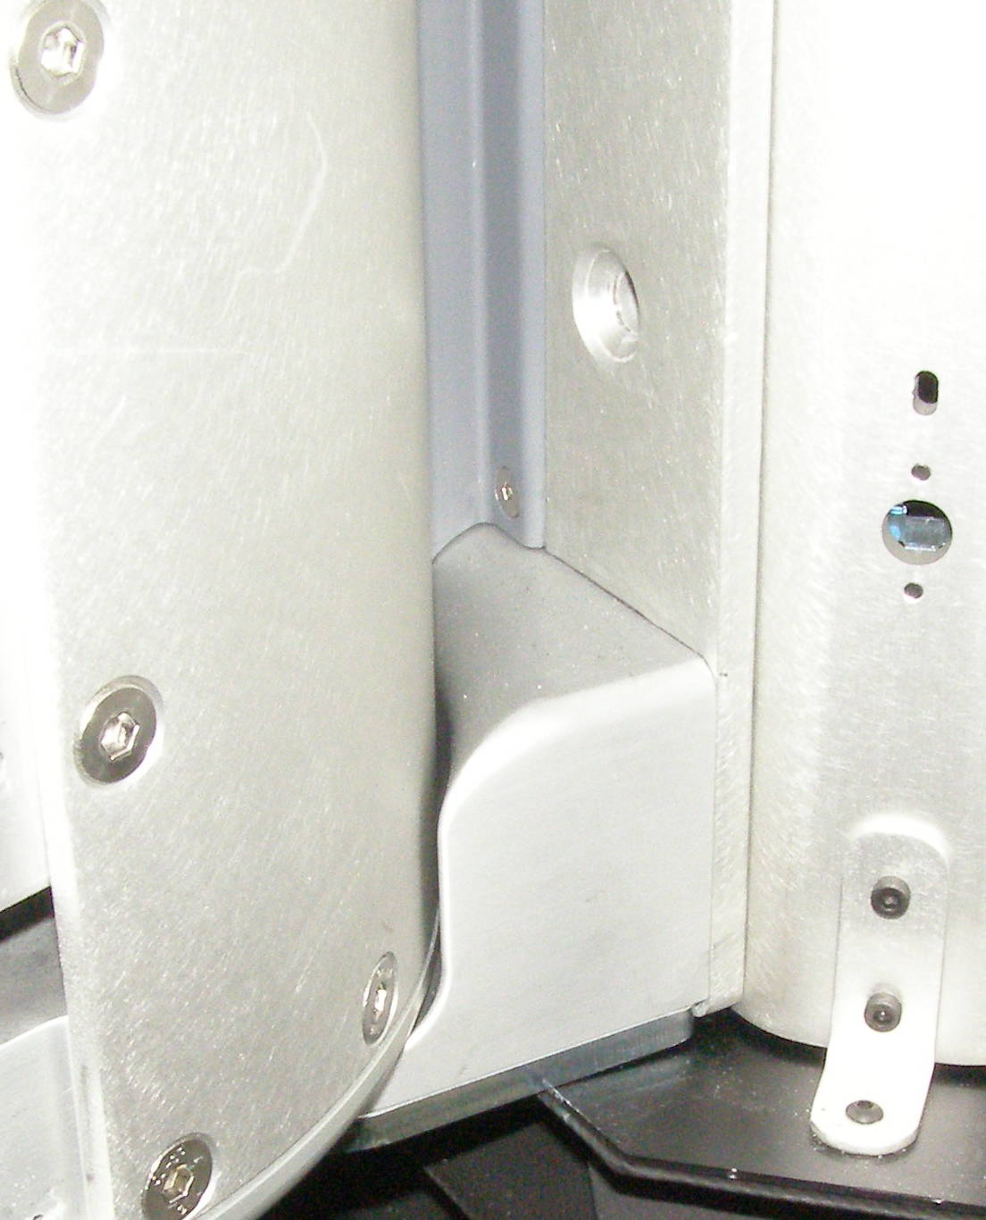
Shoulder Removal (2)
  Have one person support the Shoulder so it will not fall of when the bolts are released. Using the 13mm socket with the 8 inch extension and the 3/8 drive ratchet wrench, remove 1 bolt on each side of the Shoulder. 2092-25 (Fig 10,11)
  Using two people, carefully extract the Shoulder sideways not letting it fall on the lower Bellows. (Fig 12)
Fig 7
Fig 10
  Rotate the Shoulder to gain access to the mounting screws, using the 5mm bit with the hex to 3/8 drive adapter and the 3/8 drive ratchet wrench, remove 2 Flathead screws on each side of the Shoulder (4 screws total). 3067-20 (Fig 8,9)
Fig 8
Fig 9
Fig 11
Fig 12

Slide 4
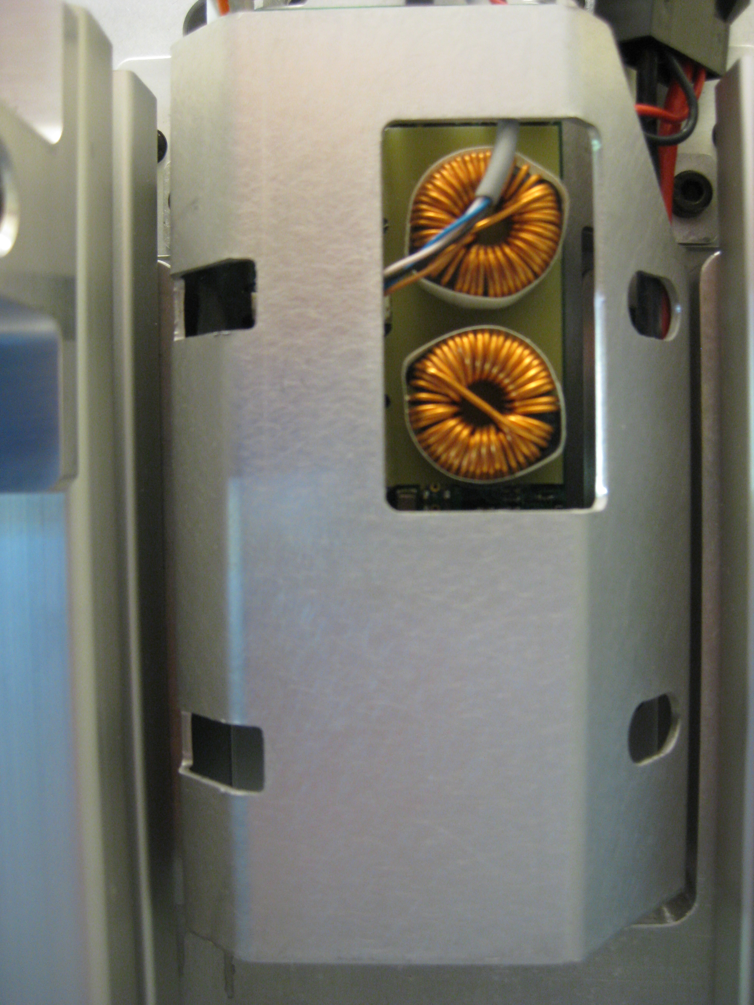
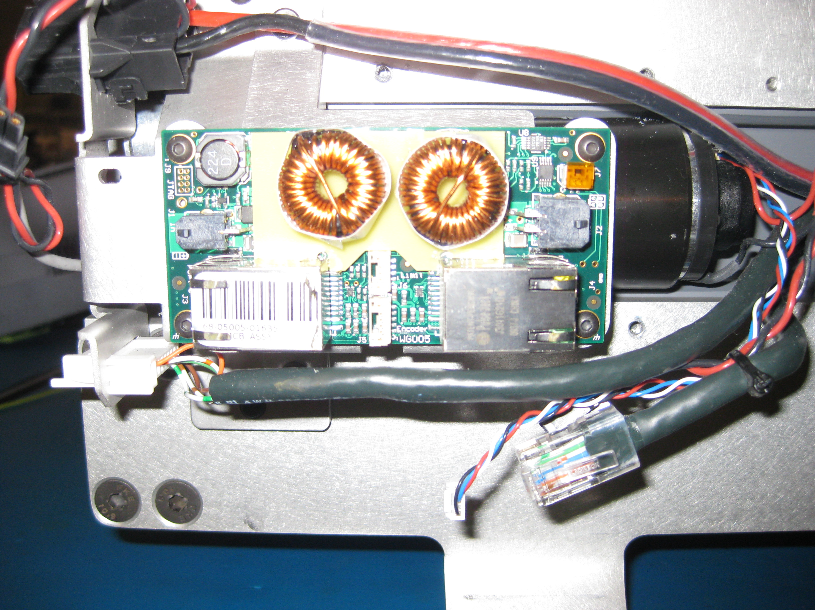
MCB Removal
  Remove 4 screws from cover over shoulder pan MCB using 3mm bit. (Fig 13)
  Unplug 5 cables from MCB. All cables
    Supply power (Fig 14-1)
    Limit switch (Fig 14-2)
    Encoder (Fig 14-3)
    Port 1 EtherCAT (Fig 14-4)
    Motor power (Fig 14-5)
  Use 2mm bit to remove 4 screws holding MCB to back plate. (Fig 14-6,7,8,9)
Fig 13
9
8
1
2
5
4
6
7
3
Fig 14

Slide 5
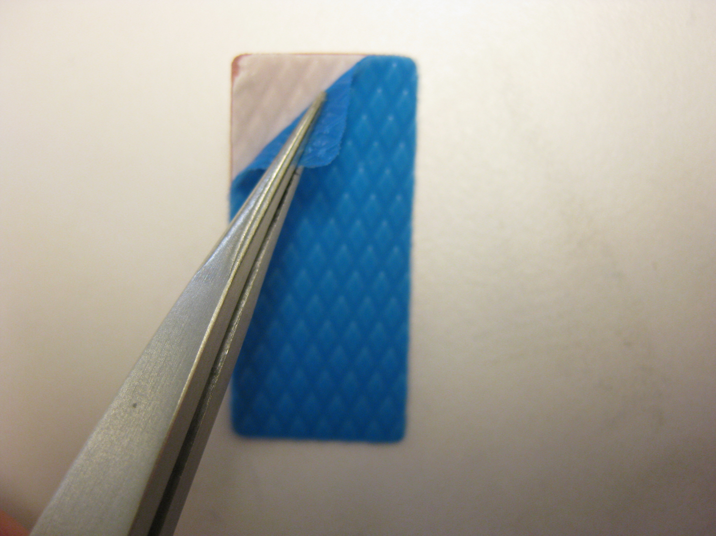
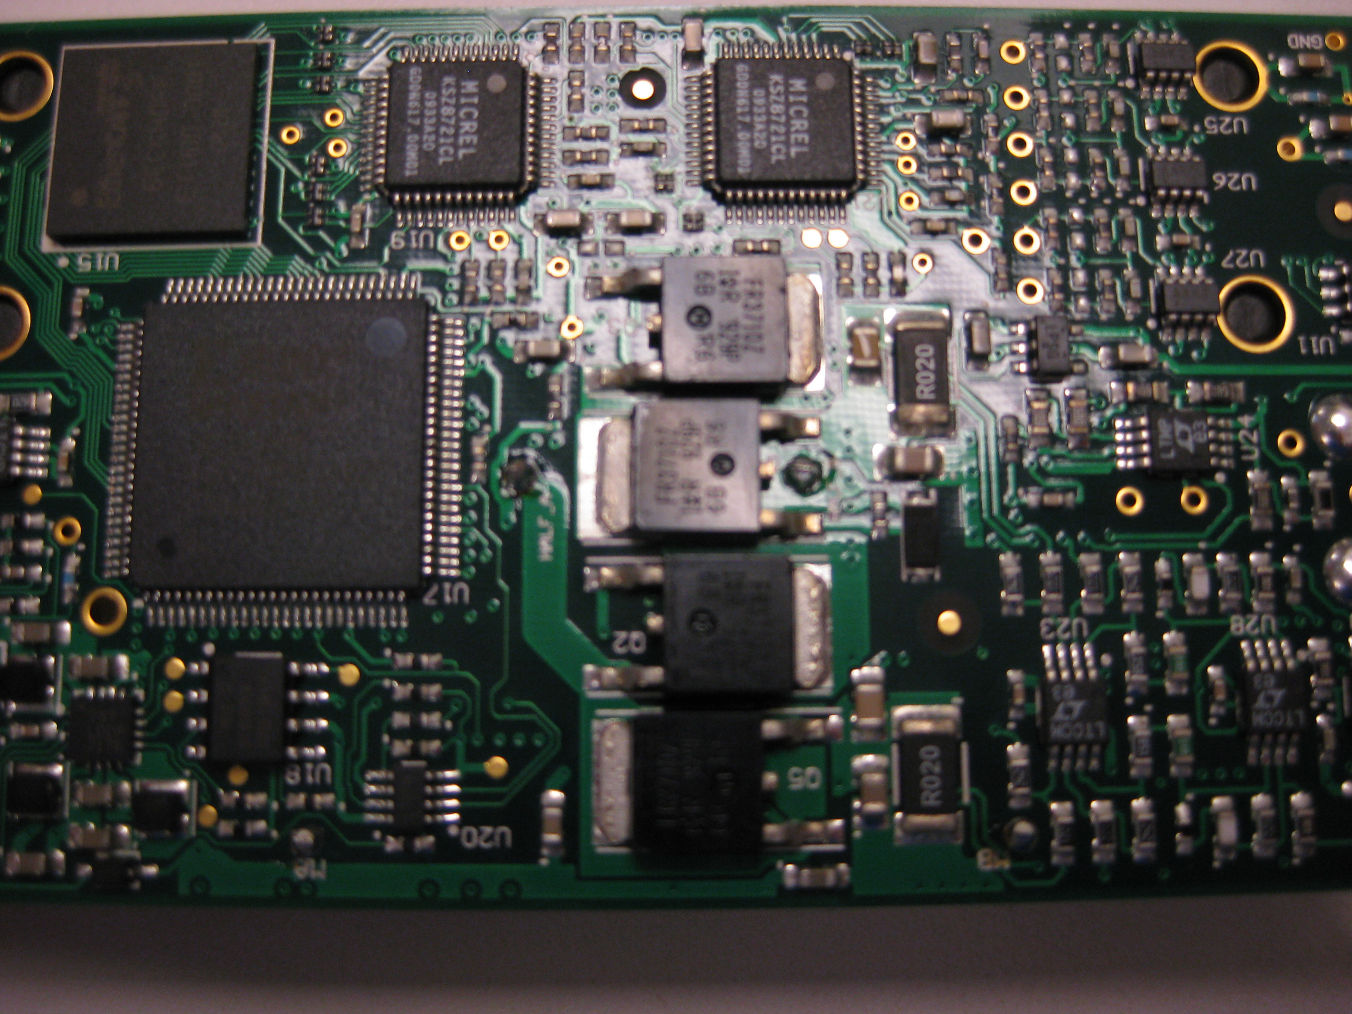
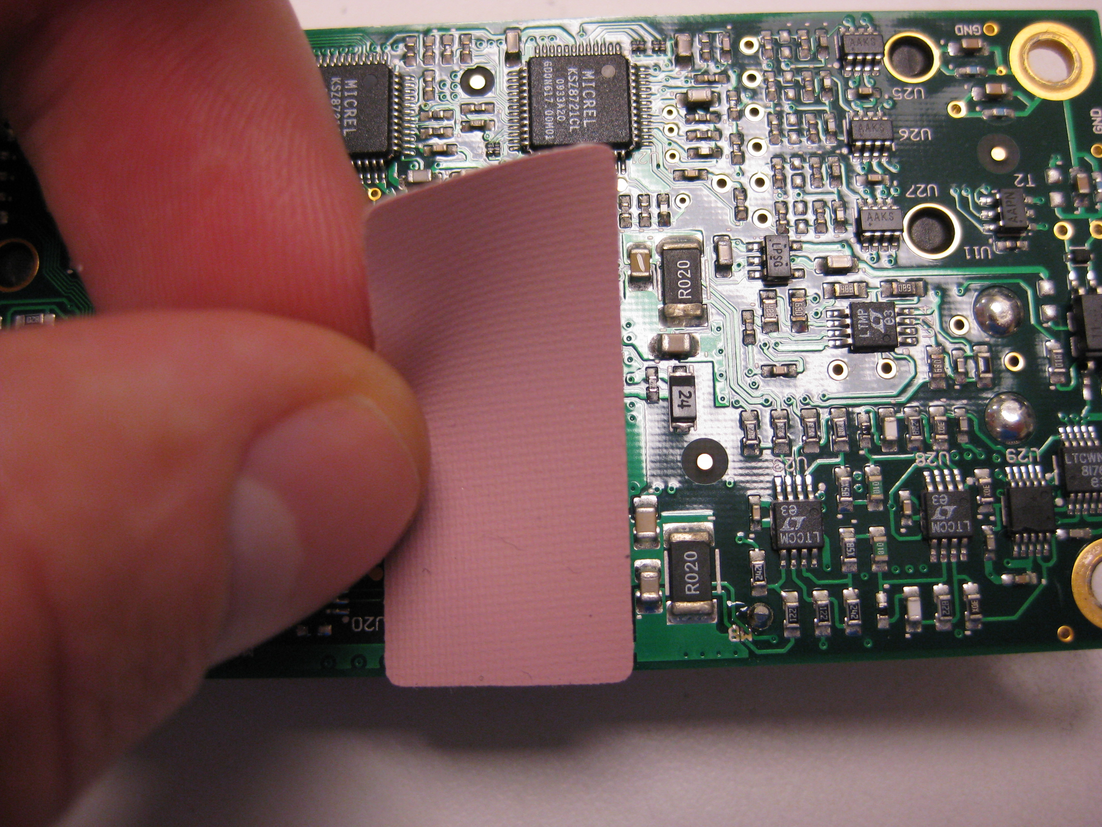
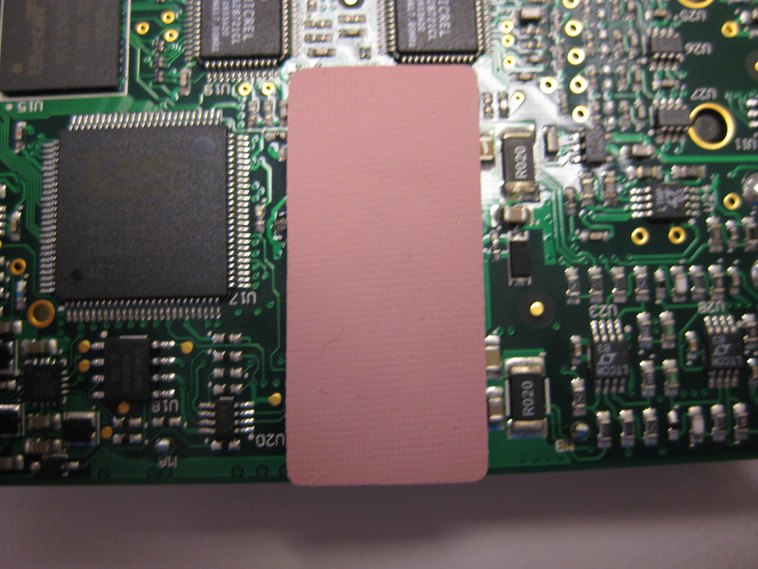
MCB Replacement
  Remove blue tape from back of MCB thermal pad (68-05023). (Fig 16)
  Stick white side of thermal pad on top of MOSFETs on replacement MCB. (Fig 17, 18,19)
  Use 2mm bit to attach new MCB to shoulder. Use Loctite 248 and torque of 0.68 Nm. Do not reuse old screws, instead use provided replacement screws (68-02055-06).
  Plug in 5 cables to new MCB.
Fig 16
Fig 17
Fig 18
Fig 19

Slide 6
Arm testing
  Because of the difficulty of replacing the arm, we will first test the shoulder on the bench. To do this we will connect the MCB power and EtherCAT chain from the PR2 to the arm.
  Use power extension cable and EtherCAT cable to plug the arm to the PR2
  Turn on the PR2. Use pr2-systemcheck to verify all the devices are present.
  Turn off the PR2.
  Next, install the cover over the MCB. Be careful not a catch any wires under the cover. Use Loctite 248 and on 4 bolts (68-02039-06) with a torque of 3.17Nm
  Turn on the PR2. Use pr2-systemcheck to verify all the devices are still present
  Shoulder is now working and ready to install on PR2. Turn off PR2. Then remove extension cables (Power and EtherCAT)

Slide 7
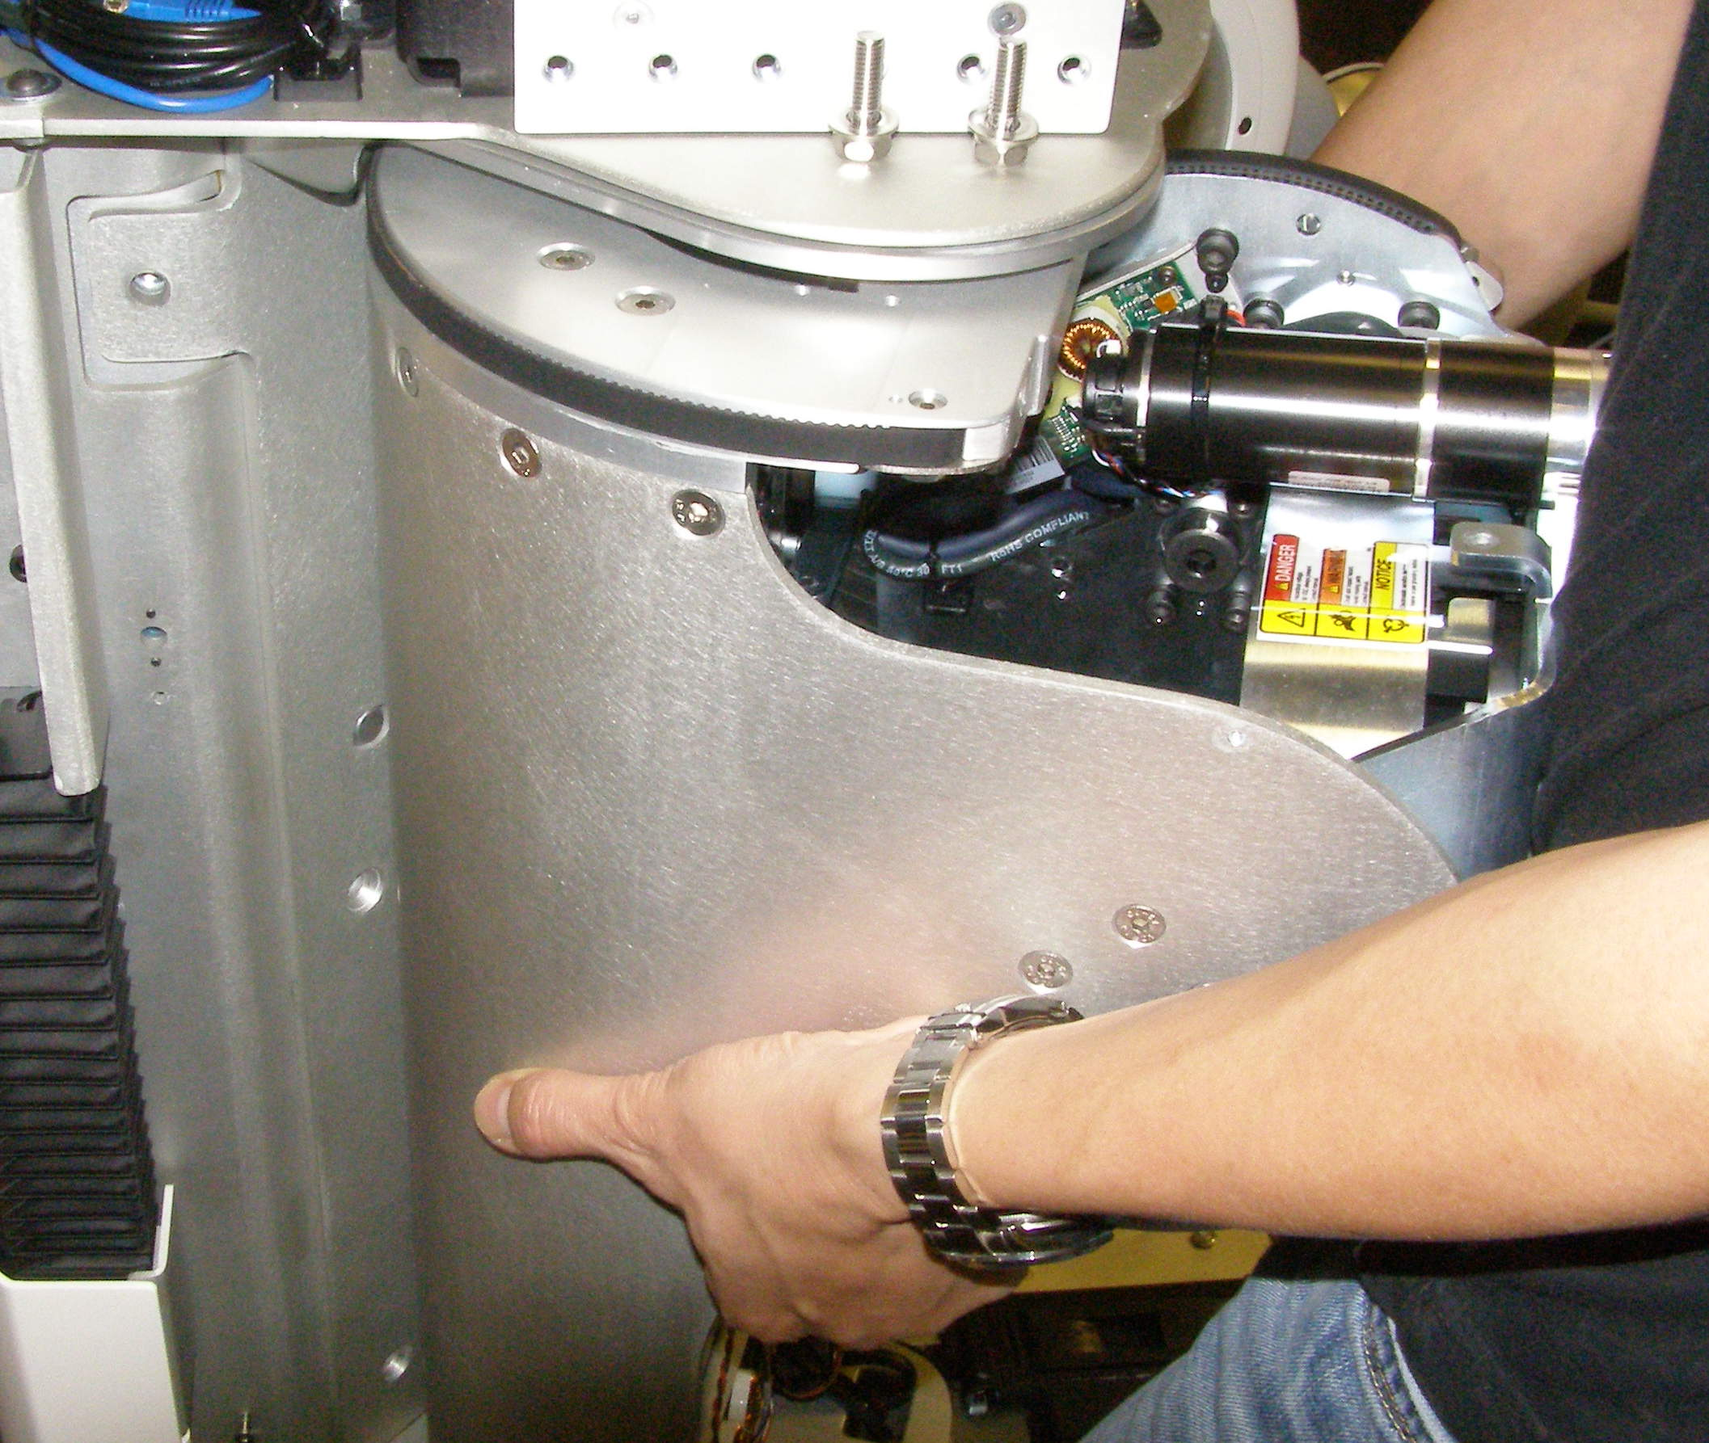
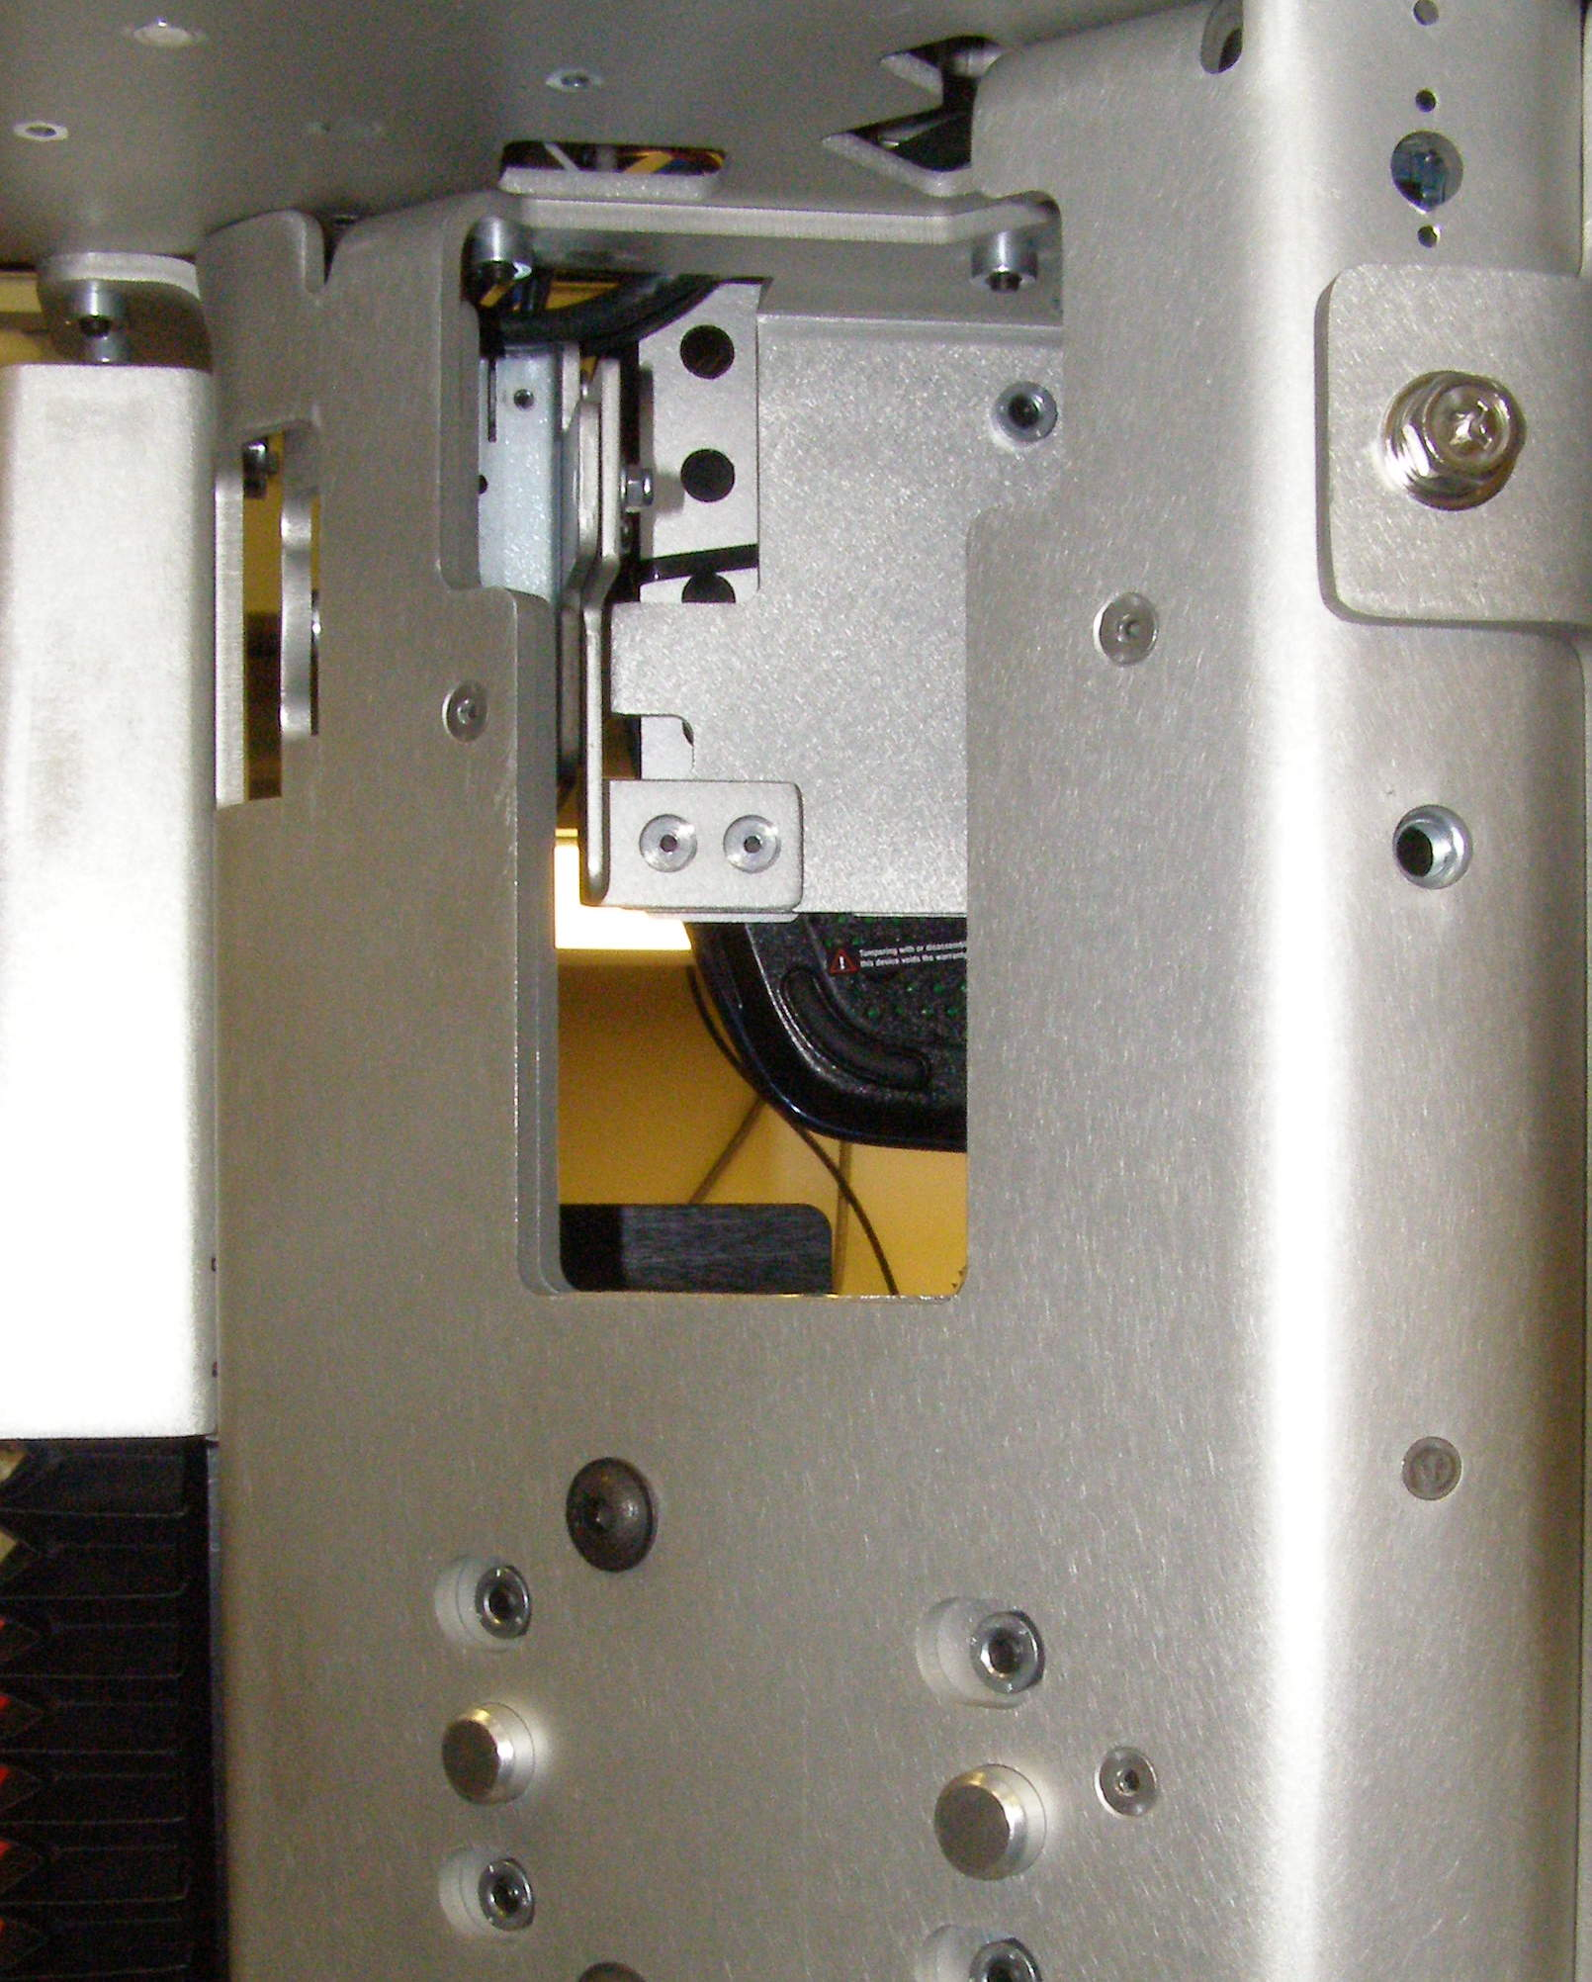
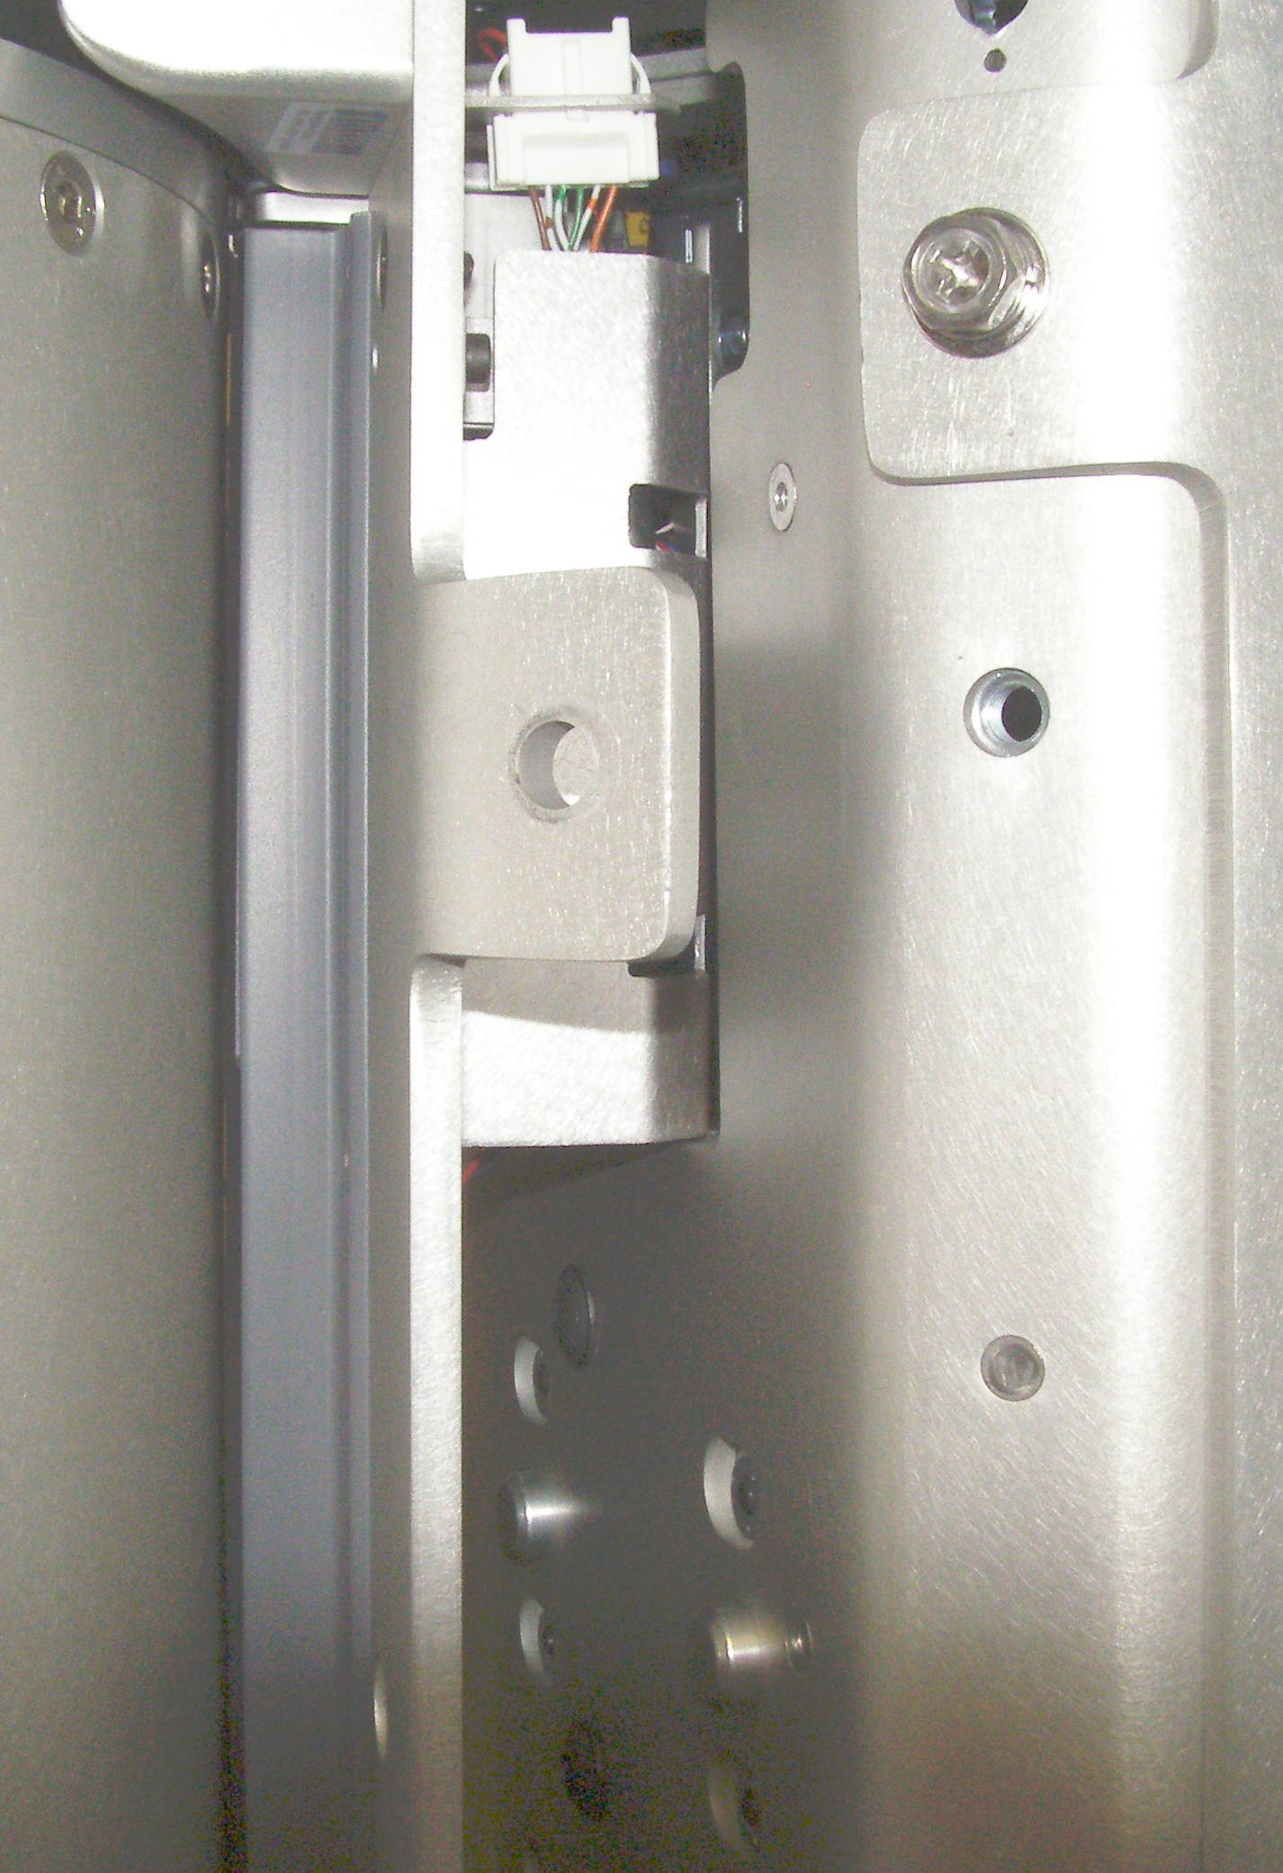
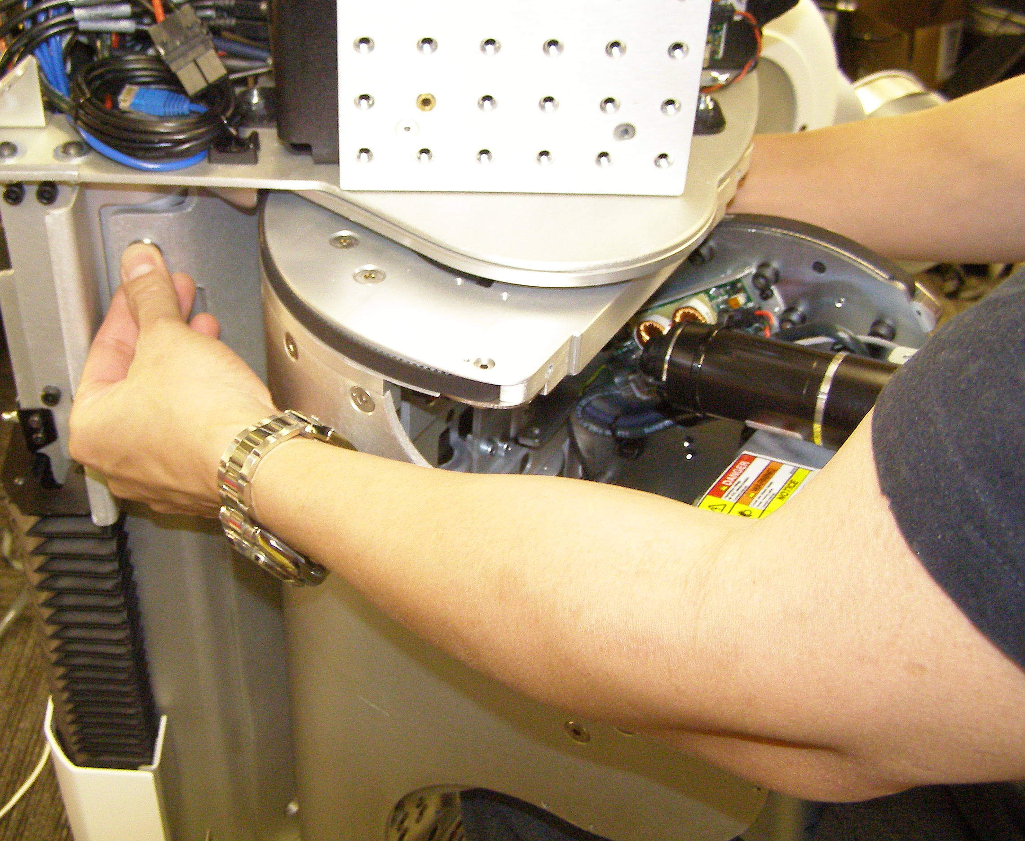
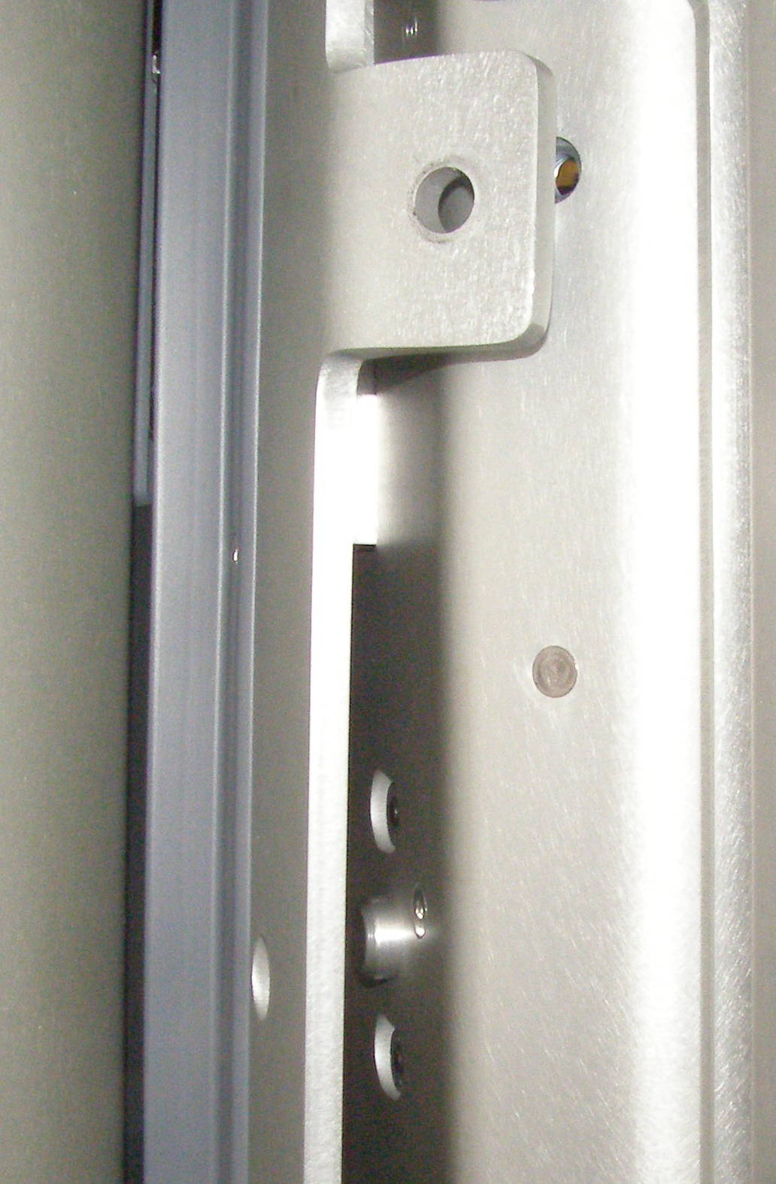
Shoulder Install
Shoulder, Install (requires 2 people)
  With 2 people lifting, offer the Shoulder up to the Robot being careful to keep the top of the Shoulder just under the Head shelf. The MCB assembly and it's shield must fit into the space at the top, and the Shoulder must fit on the 2 alignment studs as shown. Be careful that the Shoulder clears the bottom Bellows, you may have to push the Bellows down slightly. (Fig 1-4)
  With one person holding the Shoulder in place, using Locktite 248, install the 2 upper bolts as far as possible by hand so as to keep the Shoulder from falling off. With these 2 bolts in place the Shoulder will be supported by the 2 alignment studs.
  (Fig 5,6)
Alignment Stud
Fig 1
Fig 5
Alignment Stud
MCB Assembly
Fig 2
Fig 4
Fig 6
  Using Loctite 248, combine the 5mm bit with the the hex to 3/8 drive adapter, and the Titan torque wrench, install the lower 4 mounting screws and torque to 28Nm.
  Using the 13mm socket with the 8 inch extension and the Titan torque wrench, torque the bolts to 28Nm.
  Plug the the 3 cables into place using the Needle Nose pliers.
Fig 3

