Slide 1

Toolkit DocXX Prosilica Focusing
June 27, 2011

Slide 2
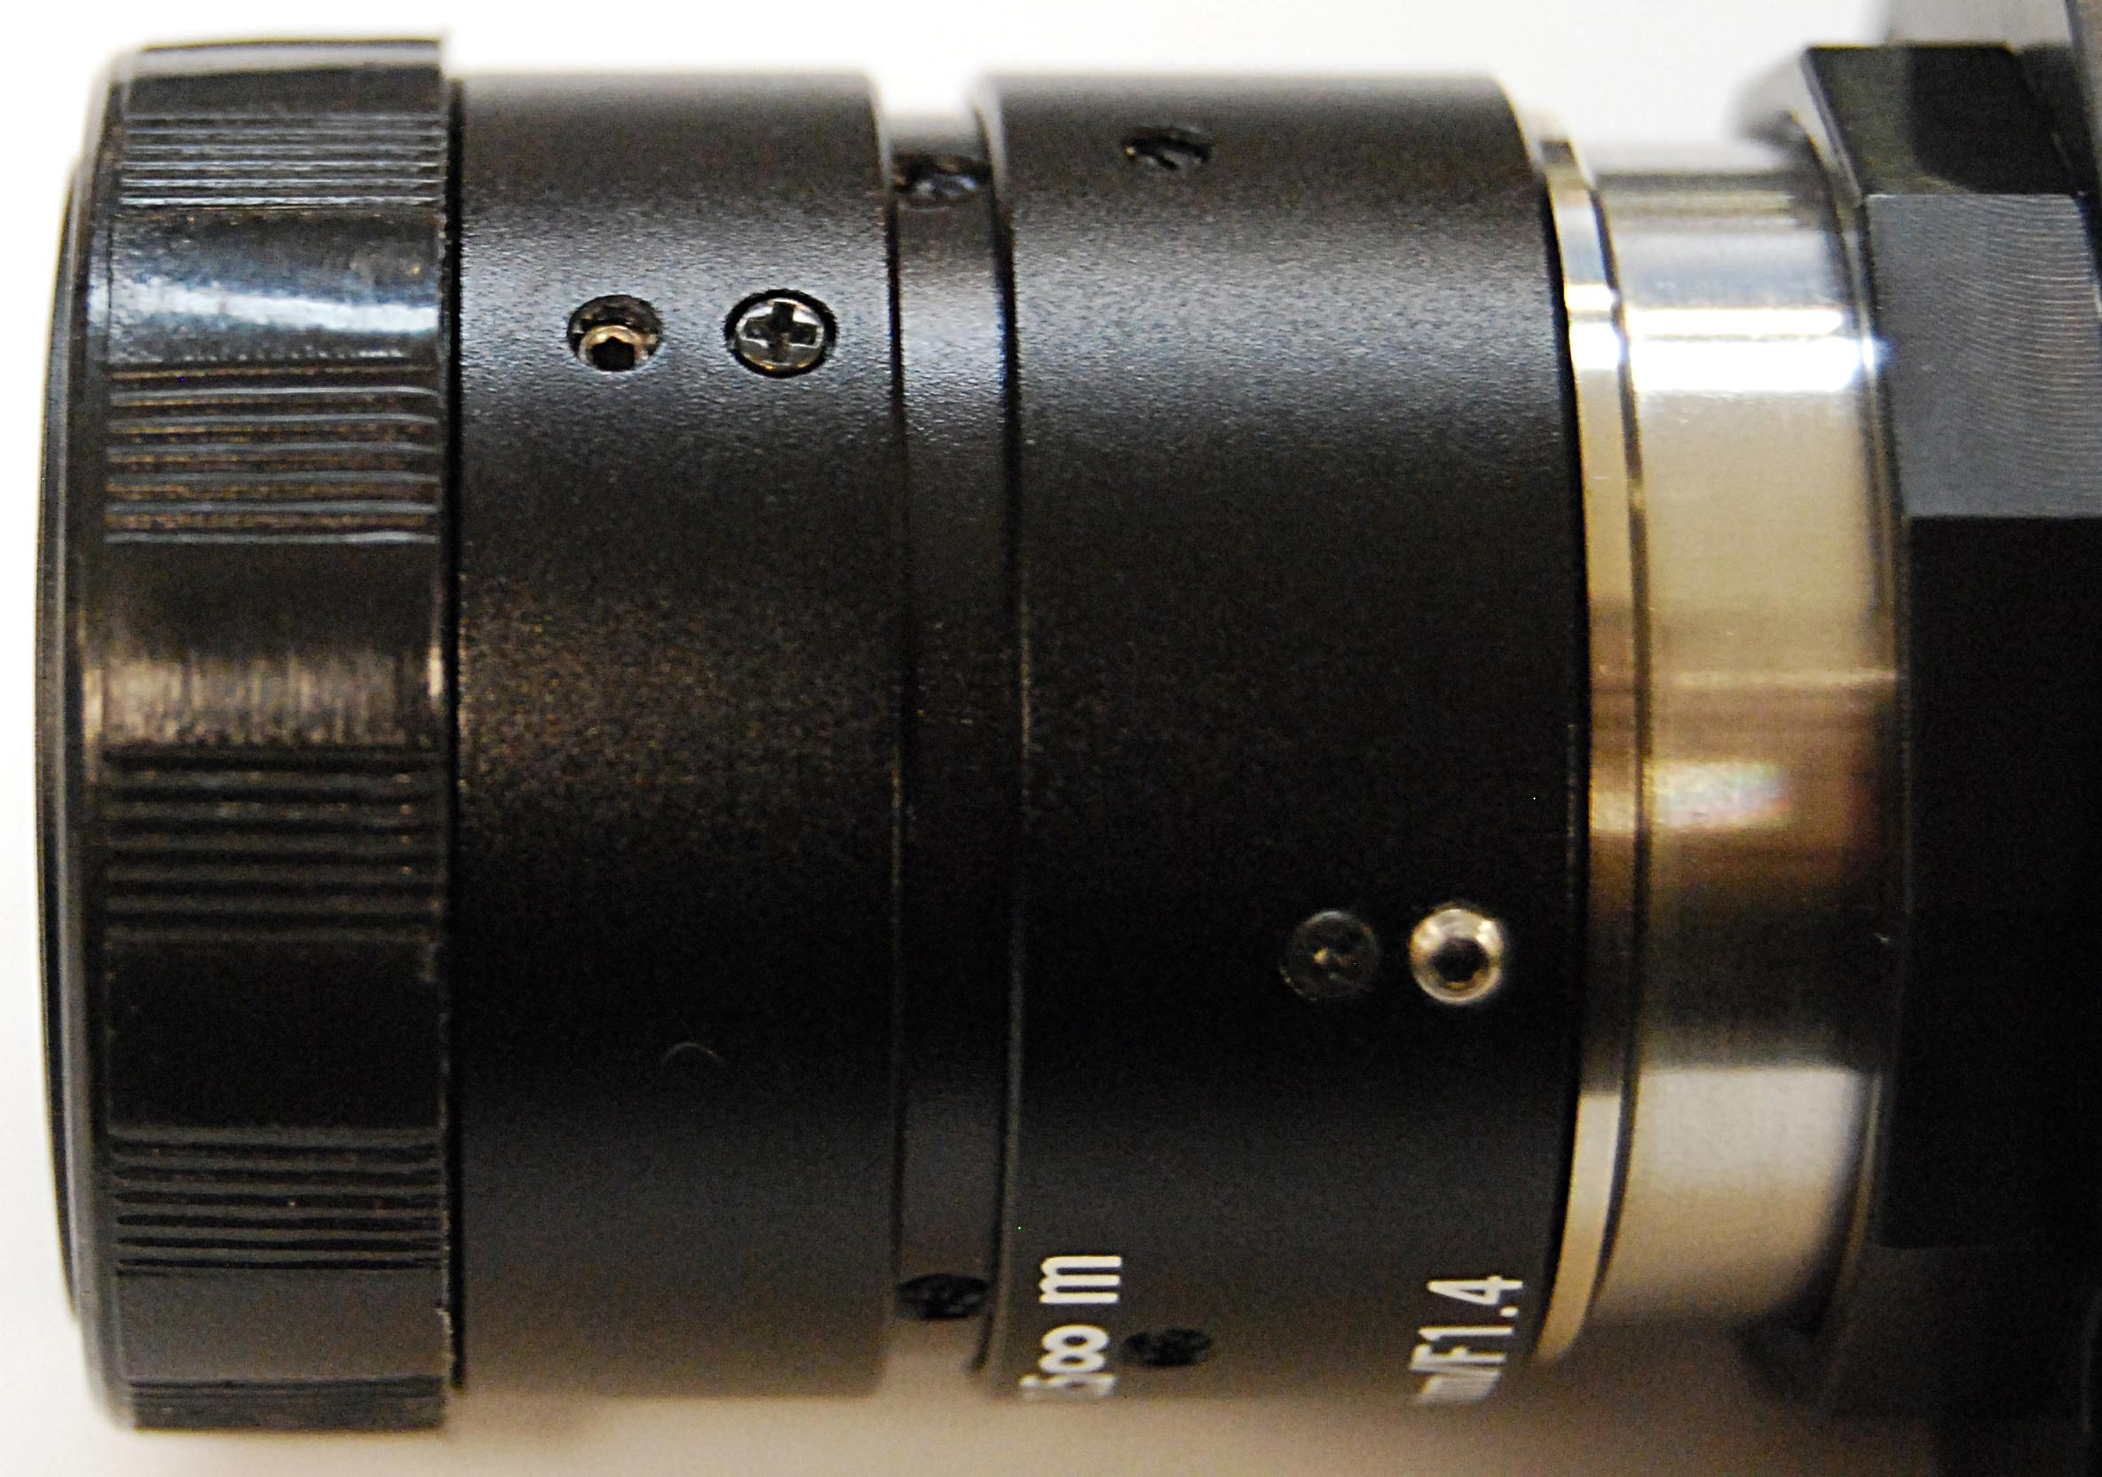
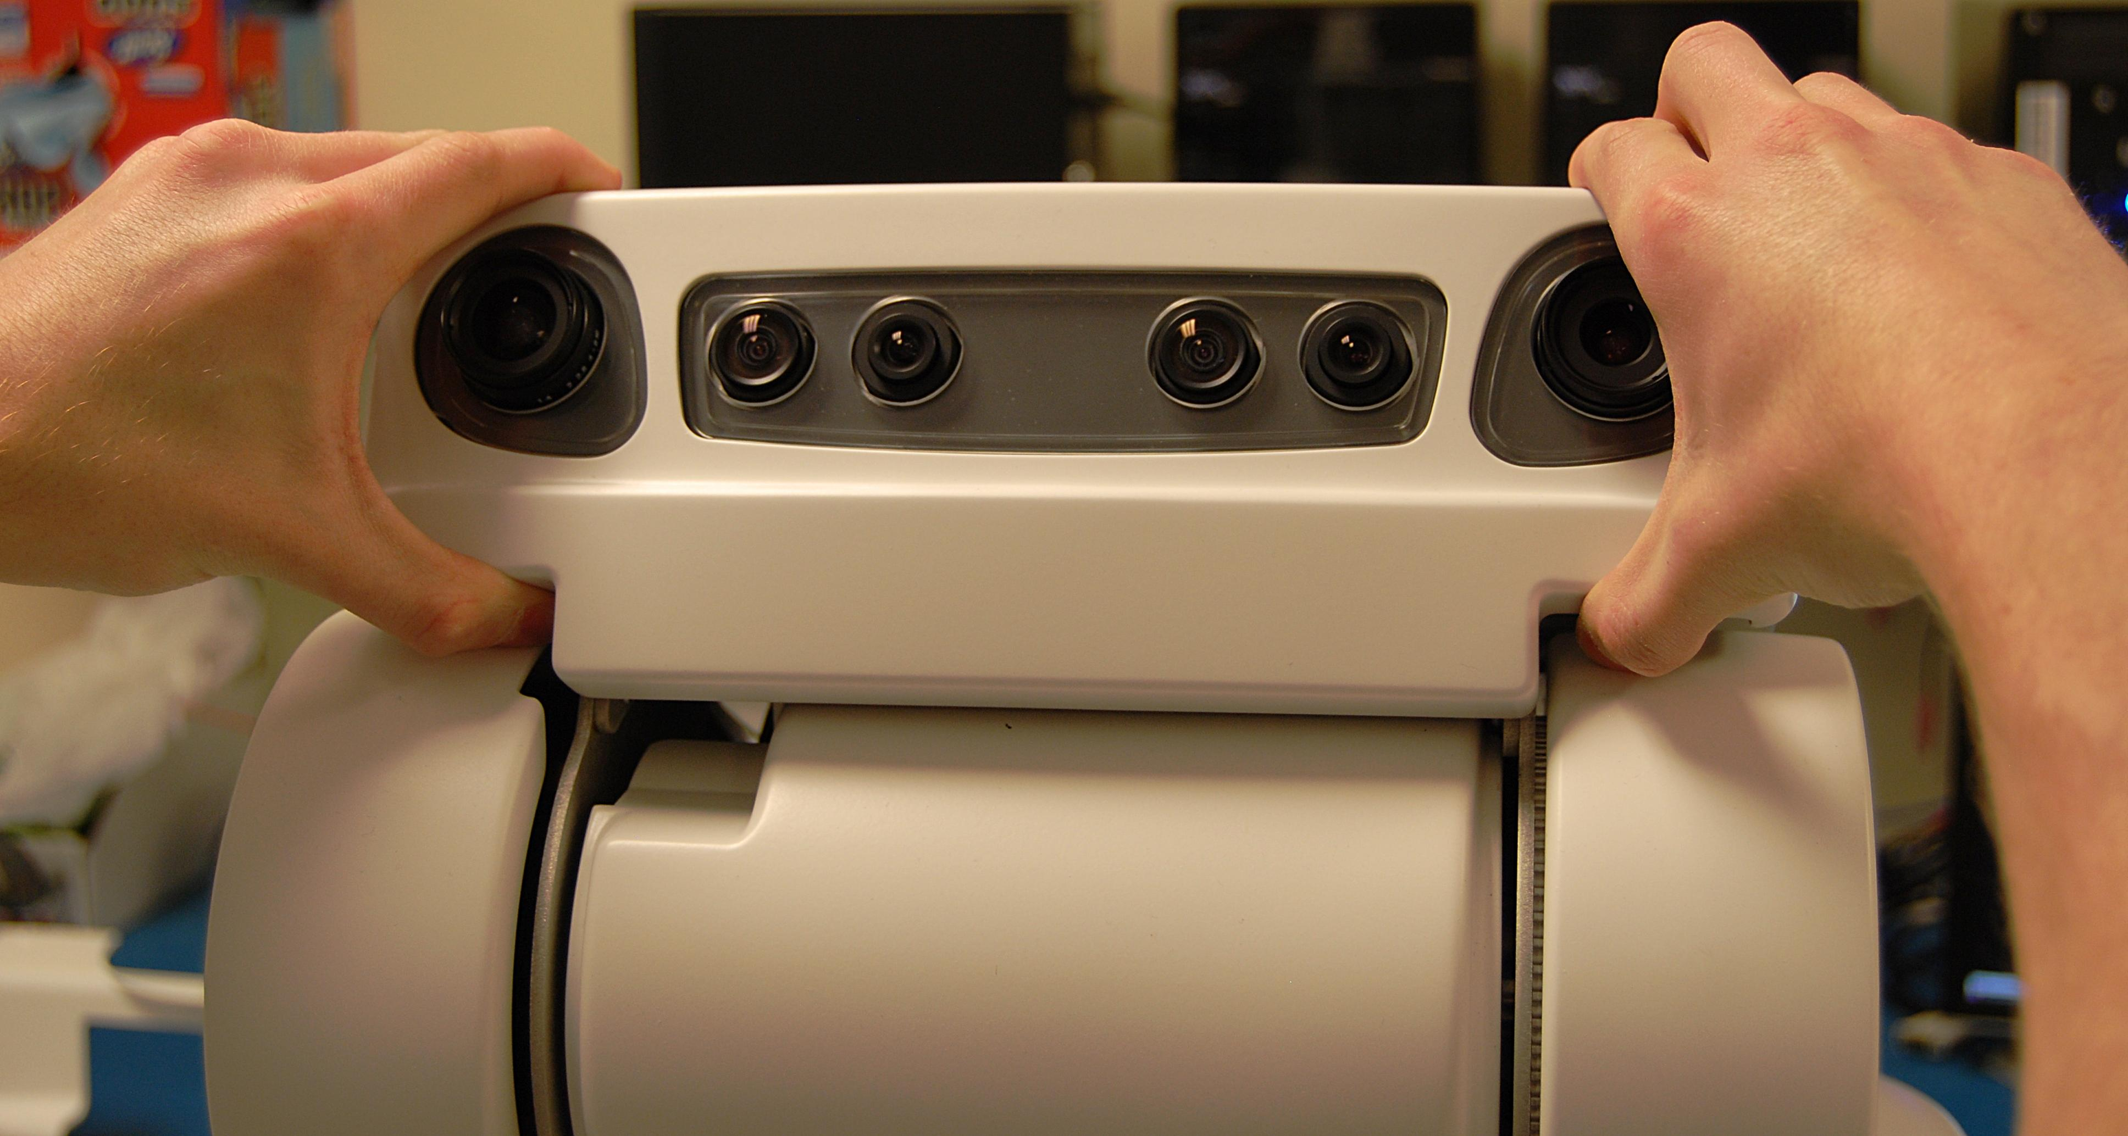
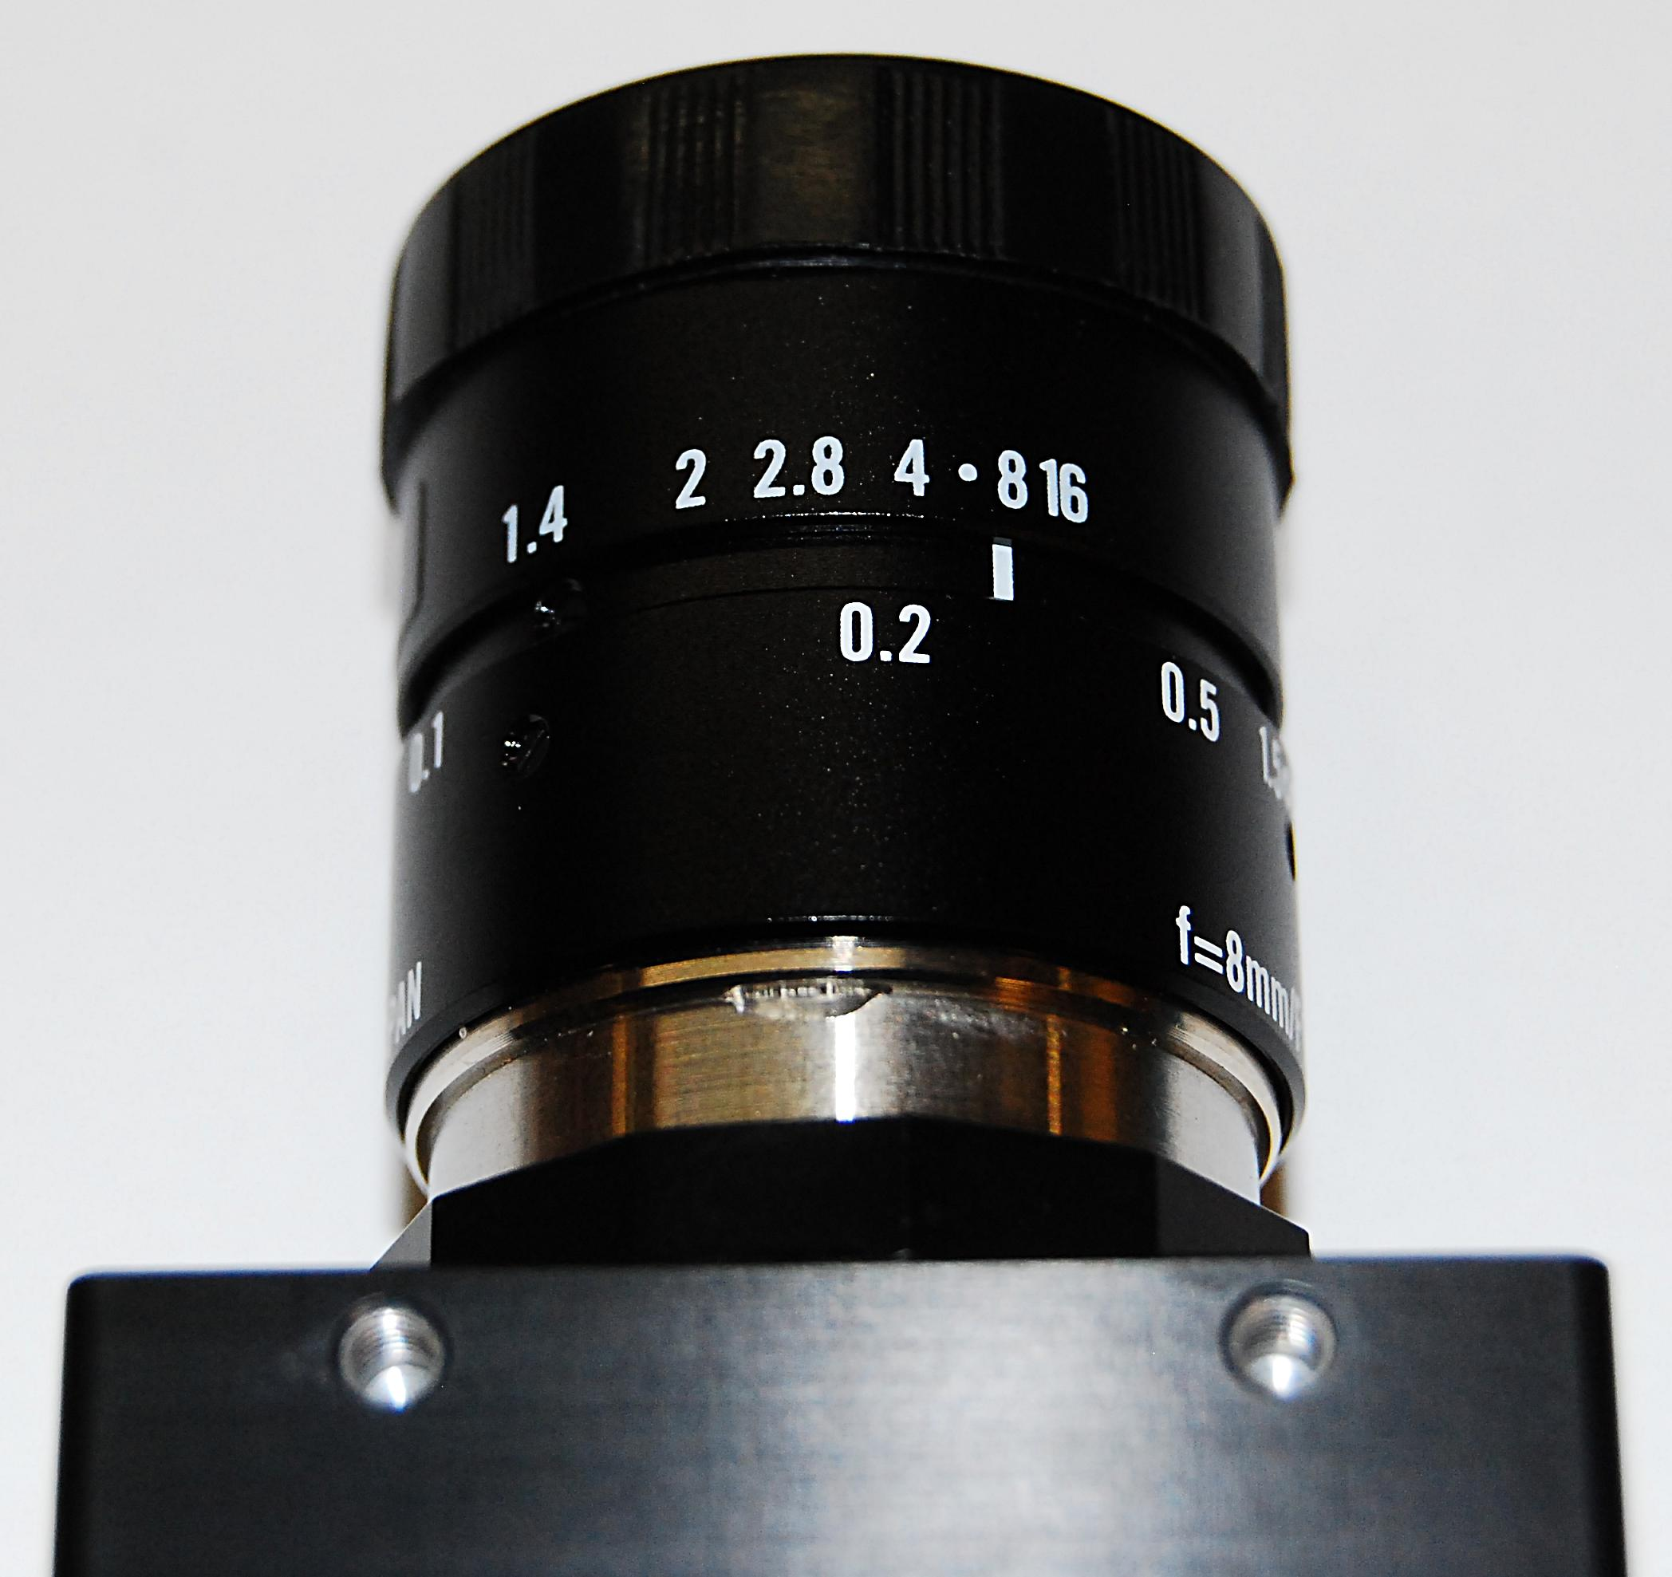
Prosilica Camera Focusing
Parts Needed: 0.9mm allen wrench required (Available from McMaster-Carr P/N 7289A32)
Refer to the PR2 Overview document for additional information.
With two hands give the front head bezel a gentle tug (Fig. 1). If the bezel comes off proceed to the next step. If not remove the Head Bezel Front (see Head Bezel R/R - pg5)
Bringup the Prosilica camera image
  Power up your robot
  SSH -X into your robot
  Type 'screen'
  'Ctrl A' then 'Ctrl C' a couple times to open multiple screens
  'Ctrl A' + 0,1,2... will open the corresponding screen
  In screen 0 type 'roscore'
  In screen 1 type 'roslaunch /etc/ros/robot.launch'
  In screen 3 copy paste both lines of code below for bringing up the prosilica camera image:
    'rosrun dynamic_reconfigure dynparam set /prosilica_driver trigger_mode streaming'
    'rosrun image_view image_view image:=/prosilica/image_raw'
Fig. 1
Locate the iris (Red arrow) and focus ring (Yellow arrow) on the prosilica camera (robot right)
Loosen the set screws on the iris (0.9mm hex)
Set the iris to be wide open (look into the lens and see how open the iris is)
Tighten the iris screw
Loosen the focus set screw (0.9mm hex)

Slide 3
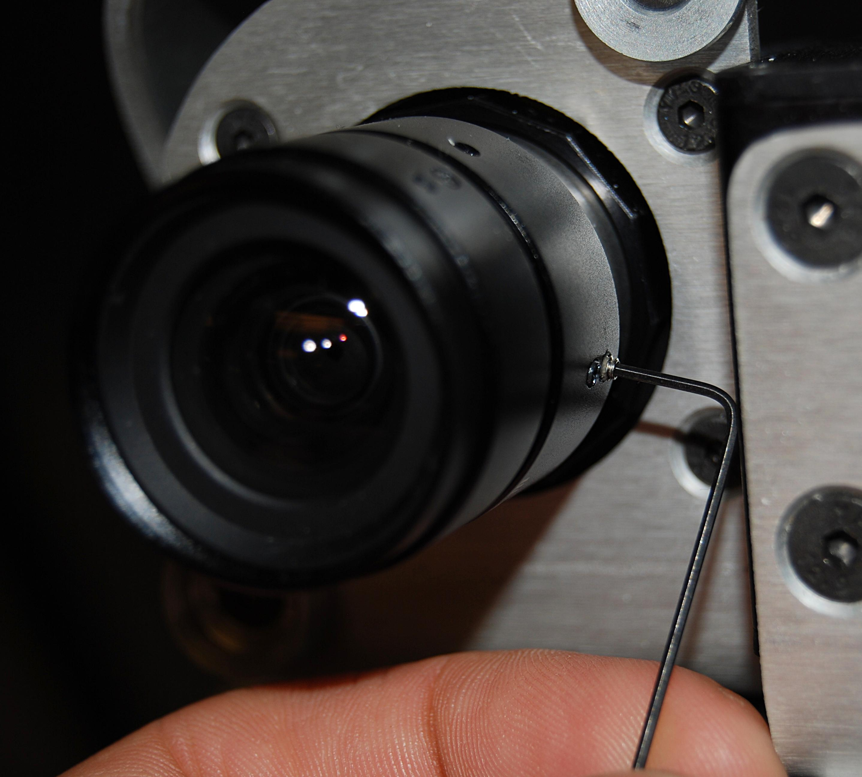
Prosilica Camera Focusing
Focus the prosilica camera to your liking
Tighten the focus set screw without changing the focus (torque to 0.17Nm) NO Loctite.
Type 'rosrun dynamic_reconfigure dynparam set /prosilica_driver trigger_mode polled' to set the camera back to polling mode
If the focus changes while you are tightening the set screw, return to step #6
Loosen the iris set screw
Set the iris to the 8 marking
Tighten the iris screw being careful no to over tighten. Excessive torque can strip the setscrew. NO Loctite.
Reinstall the front head bezel

