Slide 1
PR2 Maintenance
ROS + PR2 Training Workshop

Slide 2
Accessory and Tool Kit
Contents:
- Accessory Kit contains everything needed to run the robot. It also contains the Gripper tips and ESD strap.
- Tool Kit contains all of the tools needed to maintain the robot.
- See support.willowgarage.com to order replacement parts.

Slide 3
Accessory Kit
Acc Kit Photo
Contents:
  15 FT Power Cord, 68-06167
  (Use only this power cord!)
  Self Plug in Cable, 68-06153
  Joystick, 68-02985
  Hard drive bay keys, 68-03337
  Run-Stop Transmitter, 68-01059
  USB Joystick charging cable, 68-03533
  User Manual
  Checkerboard (small), 68-03823
  Air Filters (30PPI pakage of 5), 68-02802
  ESD strap, 68-03024
  Base Station Recovery DVD
  Gripper Box:
    Sensored fingertips, 68-03840 (x5) (use only with boots!)
    Fingertip boots, 68-03347 (x20)
- See support.willowgarage.com to order replacement parts.
Notes:
- Contents Walk Through

Slide 4
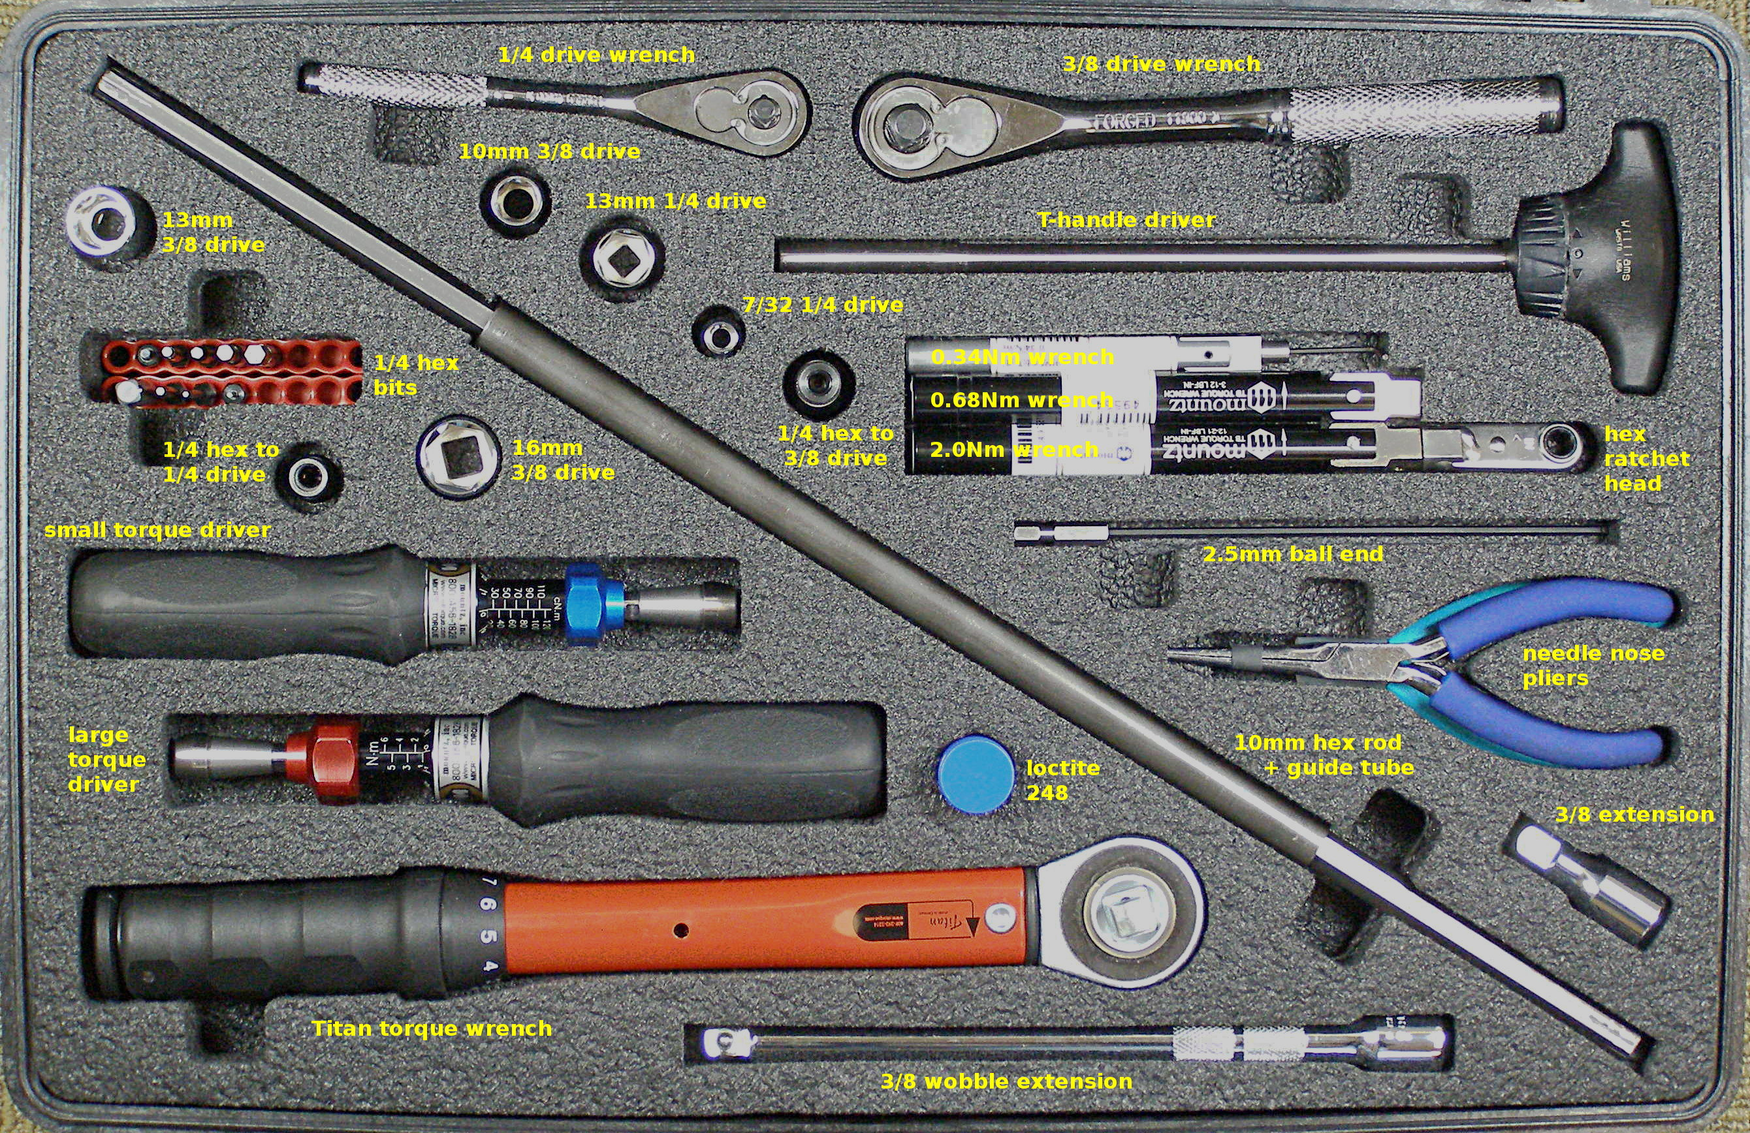
Tool Kit (1)
Contents:
  Counterbalance adjustment rod, 68-07034
  Counterbalance adjustment tube, 68-07147
  Ratchet head bits: 1.5mm - 68-07040, 2.5mm – 68-07042
  Driver bits:
    1.5mm
    2mm
    2.5mm
    2.5mm ball end
    3mm
    4mm
    5mm
  ¼ square male to ¼ hex male adapter, 68-07075
  ¼ square drive to ¼ hex female dapter, 68-07077
  3/8 square drive to ¼ hex female adapter, 68-07078
  8mm ¼ drive socket
  10mm 3/8 drive socket
  13mm ¼ drive socket
  13mm 3/8 drive socket
  16mm 3/8 drive socket (needed for crate)
  7/32 ¼ drive socket
  3/8 drive short extension
  3/8 drive wobble extension
  ¼ drive quick release extension
  ¼ drive flex joint
  ¼ drive ratchet wrench
  3/8 drive ratchet wrench
  Needle Nose pliers
  Diagonal Cutters
  zip-ties
- See support.willowgarage.com to order replacement parts.
Notes:
- Contents Walk Through
- ESD Strap
- Video: Adjusting Torque Tool
- Video: Loctite Application

Slide 5
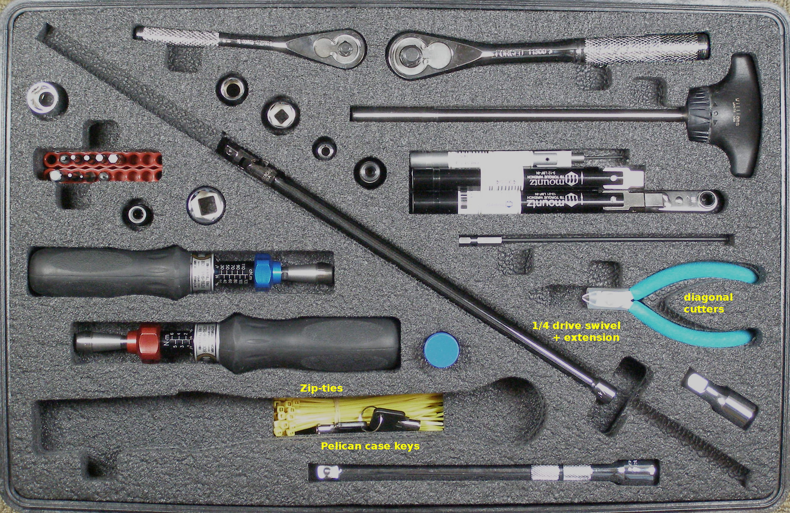
Tool Kit (2)
Contents:
  Mountz wrench and driver tools:
    Fixed 0.34Nm wrench, with 1.5mm right angle Allen
    Fixed 0.68Nm wrench
    Fixed 2.0Nm wrench
    ¼ hex ratchet head (for use with 0.68 ans 2.0 Nm wrenches)
    0.20 – 1.20 Nm torque tool (small)
    1 – 6 Nm Torque tool (large)
    Titan250I 5.6 – 28 Nm Torque wrench
- See support.willowgarage.com to order replacement parts.
Notes:
- Contents Walk Through
- ESD Strap
- Video: Adjusting Torque Tool
- Video: Loctite Application

Slide 6
PR2 Power Requirments
- Plug into a dedicated 20A minimum circuit
- Only use supplied power cord

Slide 7
Maintenance
Fan Filter Cleaning:
  Vacuuming
  Washing
  Replacing
Counter Balance Adjustment:
  Remove covers
  Run check program
  Adjust counter balance

Slide 8
Repair & Replacement
<Link to PR2 repair/replacement instructions>
Hands-On Demos:
  Safety:
    - turn power off
    – show ESD strap usage (plugin, wrist)
    - Robot internal power, precautions, safety features
  Overview of – Accessory kit:
  Overview of – Tool kit:
    - Demo torque tools
    - Demo Loctite 248
  Begin Gripper tips + Fore Arm hands on:
Video – demos: Gripper Replacement

Slide 9
Gripper Tips
- Use ESD precautions
- Explain sensorized versus dummy tips
- Explain Boots:
  - must always cover senors
  - relatively easy to damage
- R/R tips (use procedure)

Slide 10
Fore Arm
- Forearm R/R (use procedure)

