Slide 1
PR2 Maintenance
ROS + PR2 Training Workshop

Slide 2
PR2 Maintenance Overview
PR2 overview
Review electrical and ESD safety
Review PR2 power system
PR2 accessory kit
PR2 tool kit
Hands on demos
See support.willowgarage.com to order replacement parts

Slide 3
PR2 Overview
PR2 “anatomy”
Hands-on demos
  Filter maintenance
  Gripper tip replacement
  Counter balance adjustment
Points of interest
  Power switch
  A/C breaker
  Run-Stop button
  Plug for the ESD strap

Slide 4
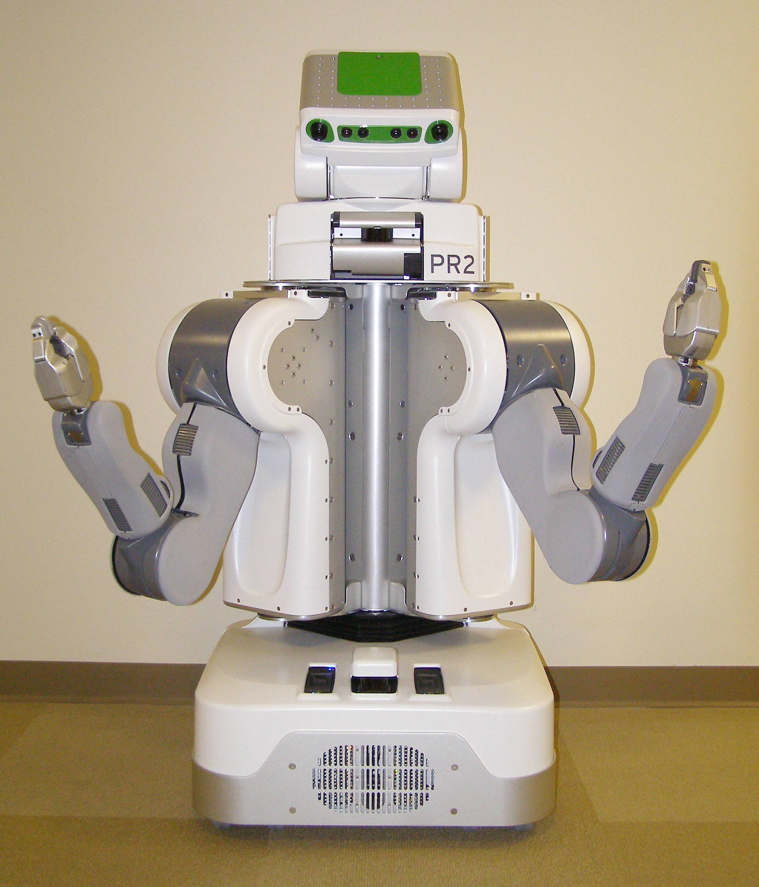
PR2 Front View
Head Tilt Stage Panels
Top Front Panel
Laser Sled
Head Pan Stage Panels
ShoulderCovers
Center Trim
Gripper
Fore Arm
Upper Arm
Front Bellows
Front Bottom Panel
Base Skirt Front

Slide 5
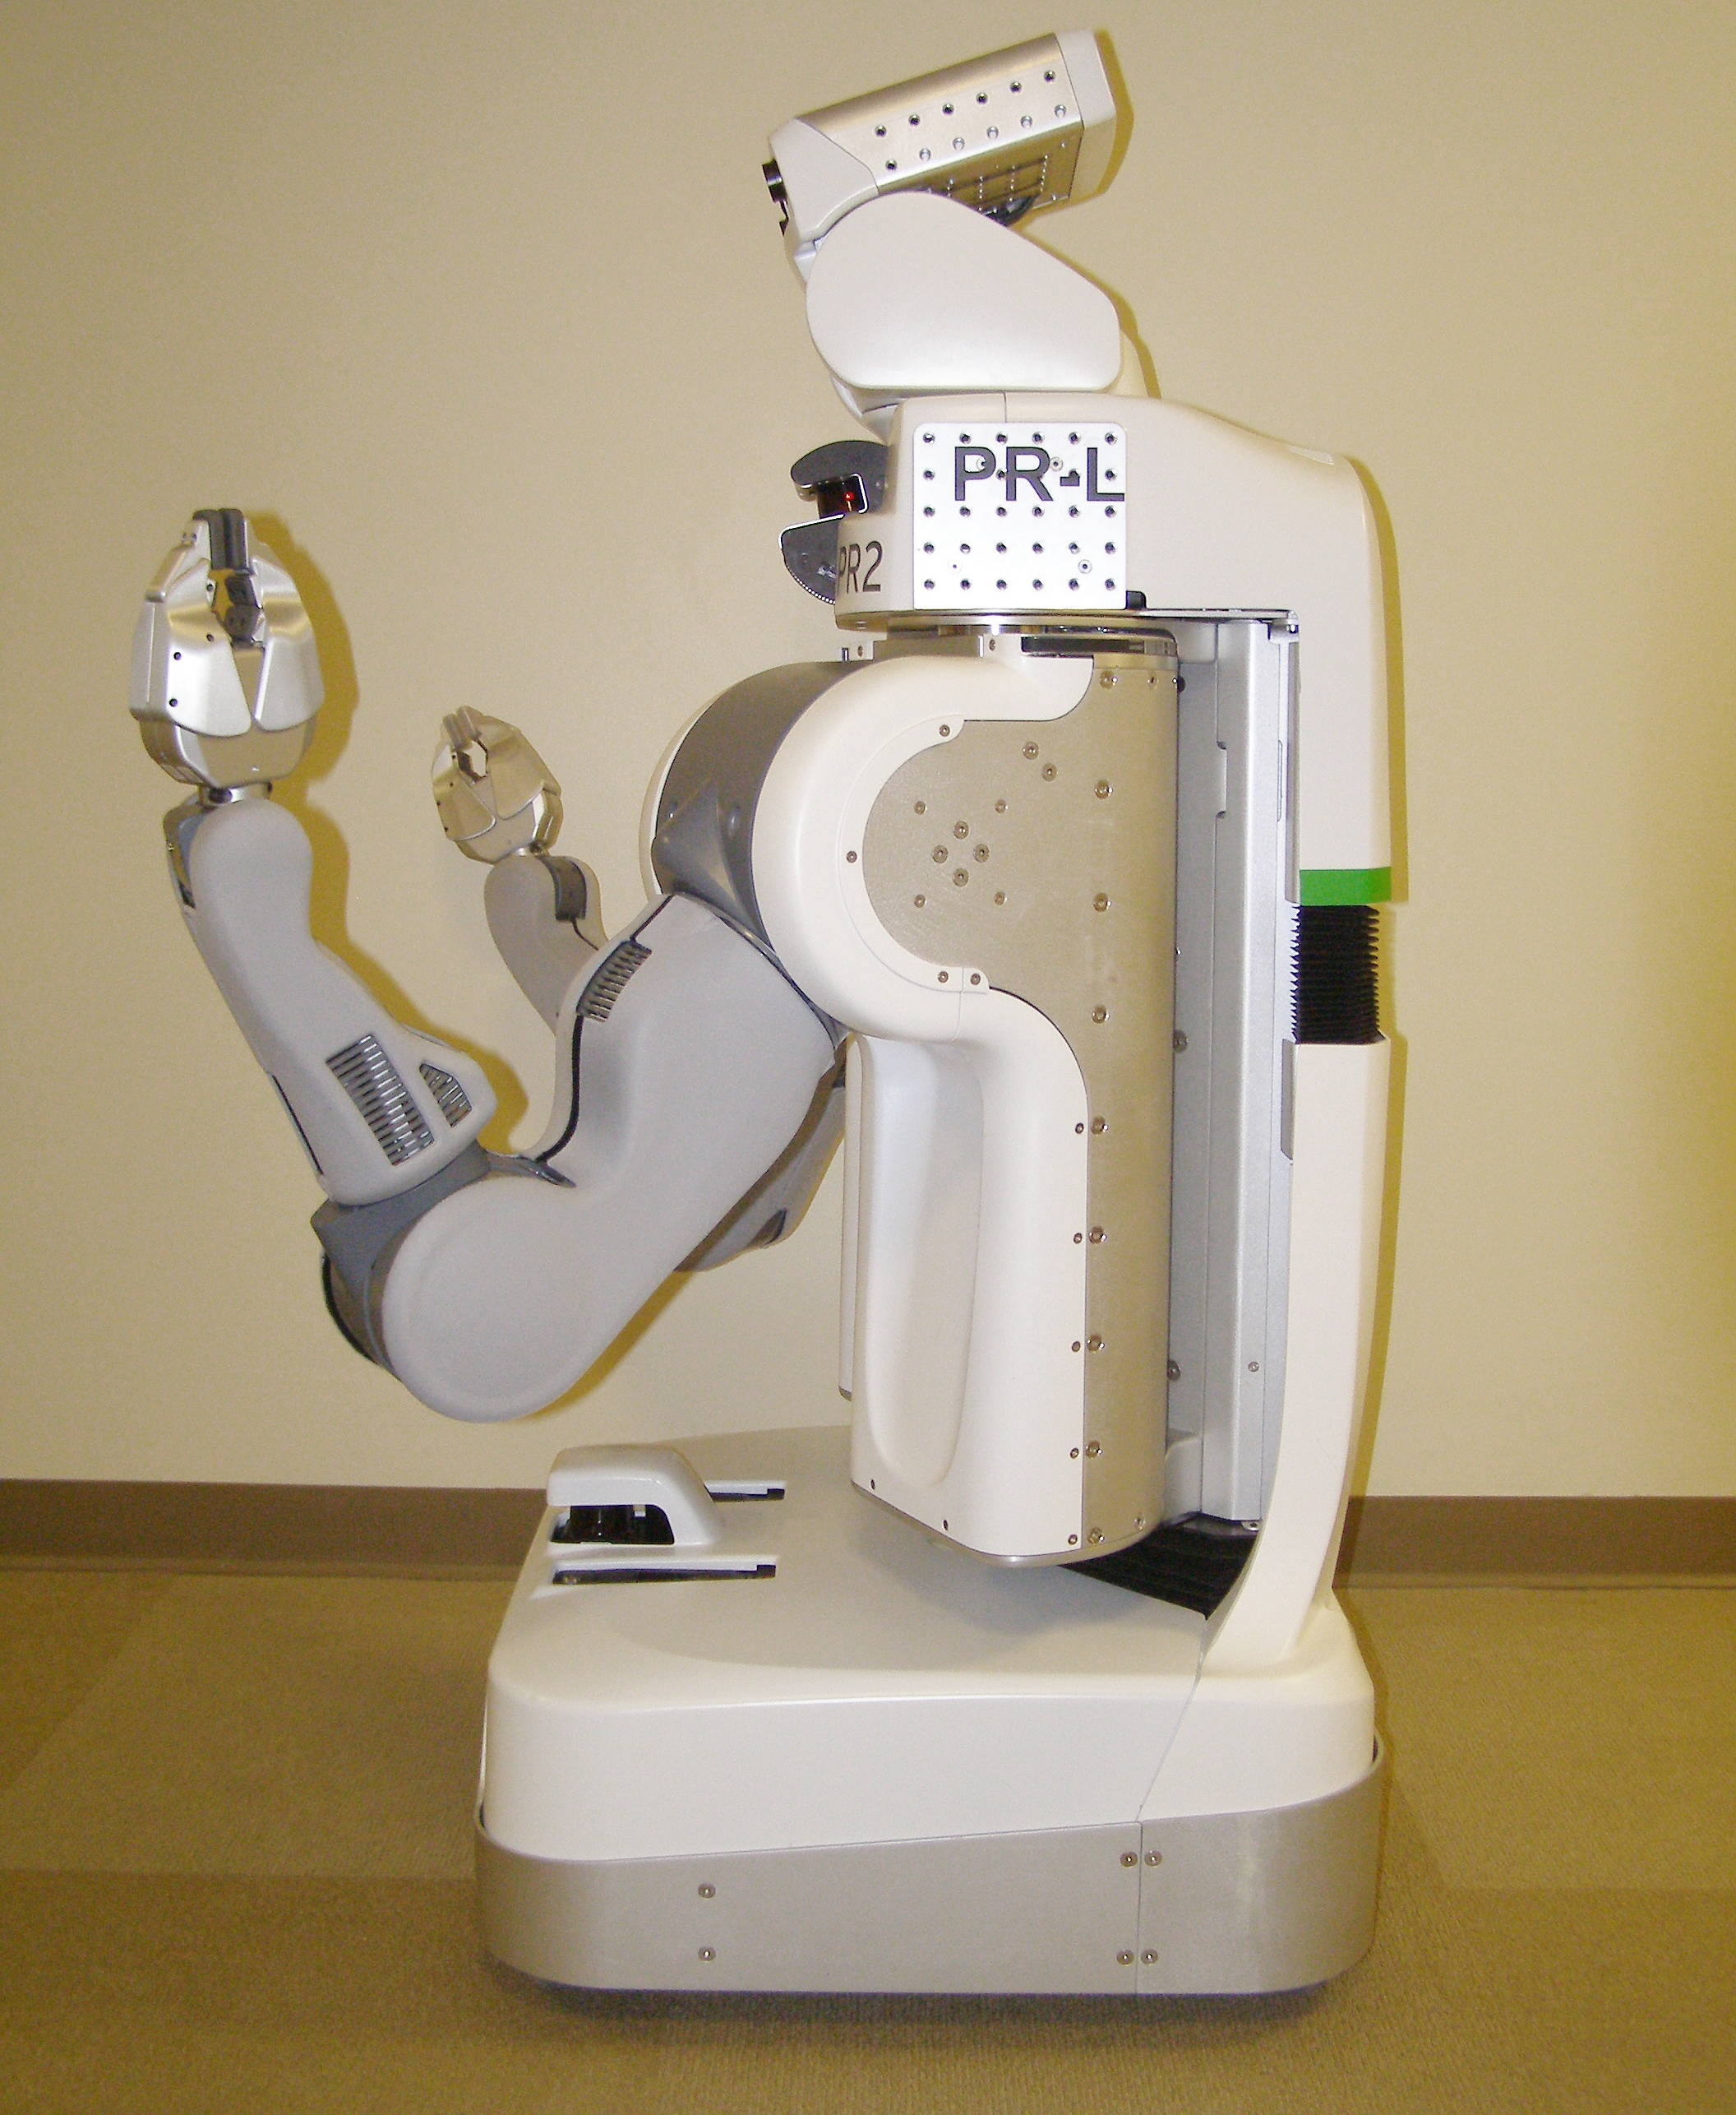
PR2 Side View
Head Tilt Stage Panels
Head Pan Stage Panels
Gripper
Laser Sled
Top Front Panel
Rear Top Panel
Shoulder Covers
Rear Bellows
Rear Bottom Panel
Fore Arm
Left Body Trim
Upper Arm
Hokuyo
Front Bottom Panel
Front Bellows
Base Skirt Front
Base Skirt Rear

Slide 6
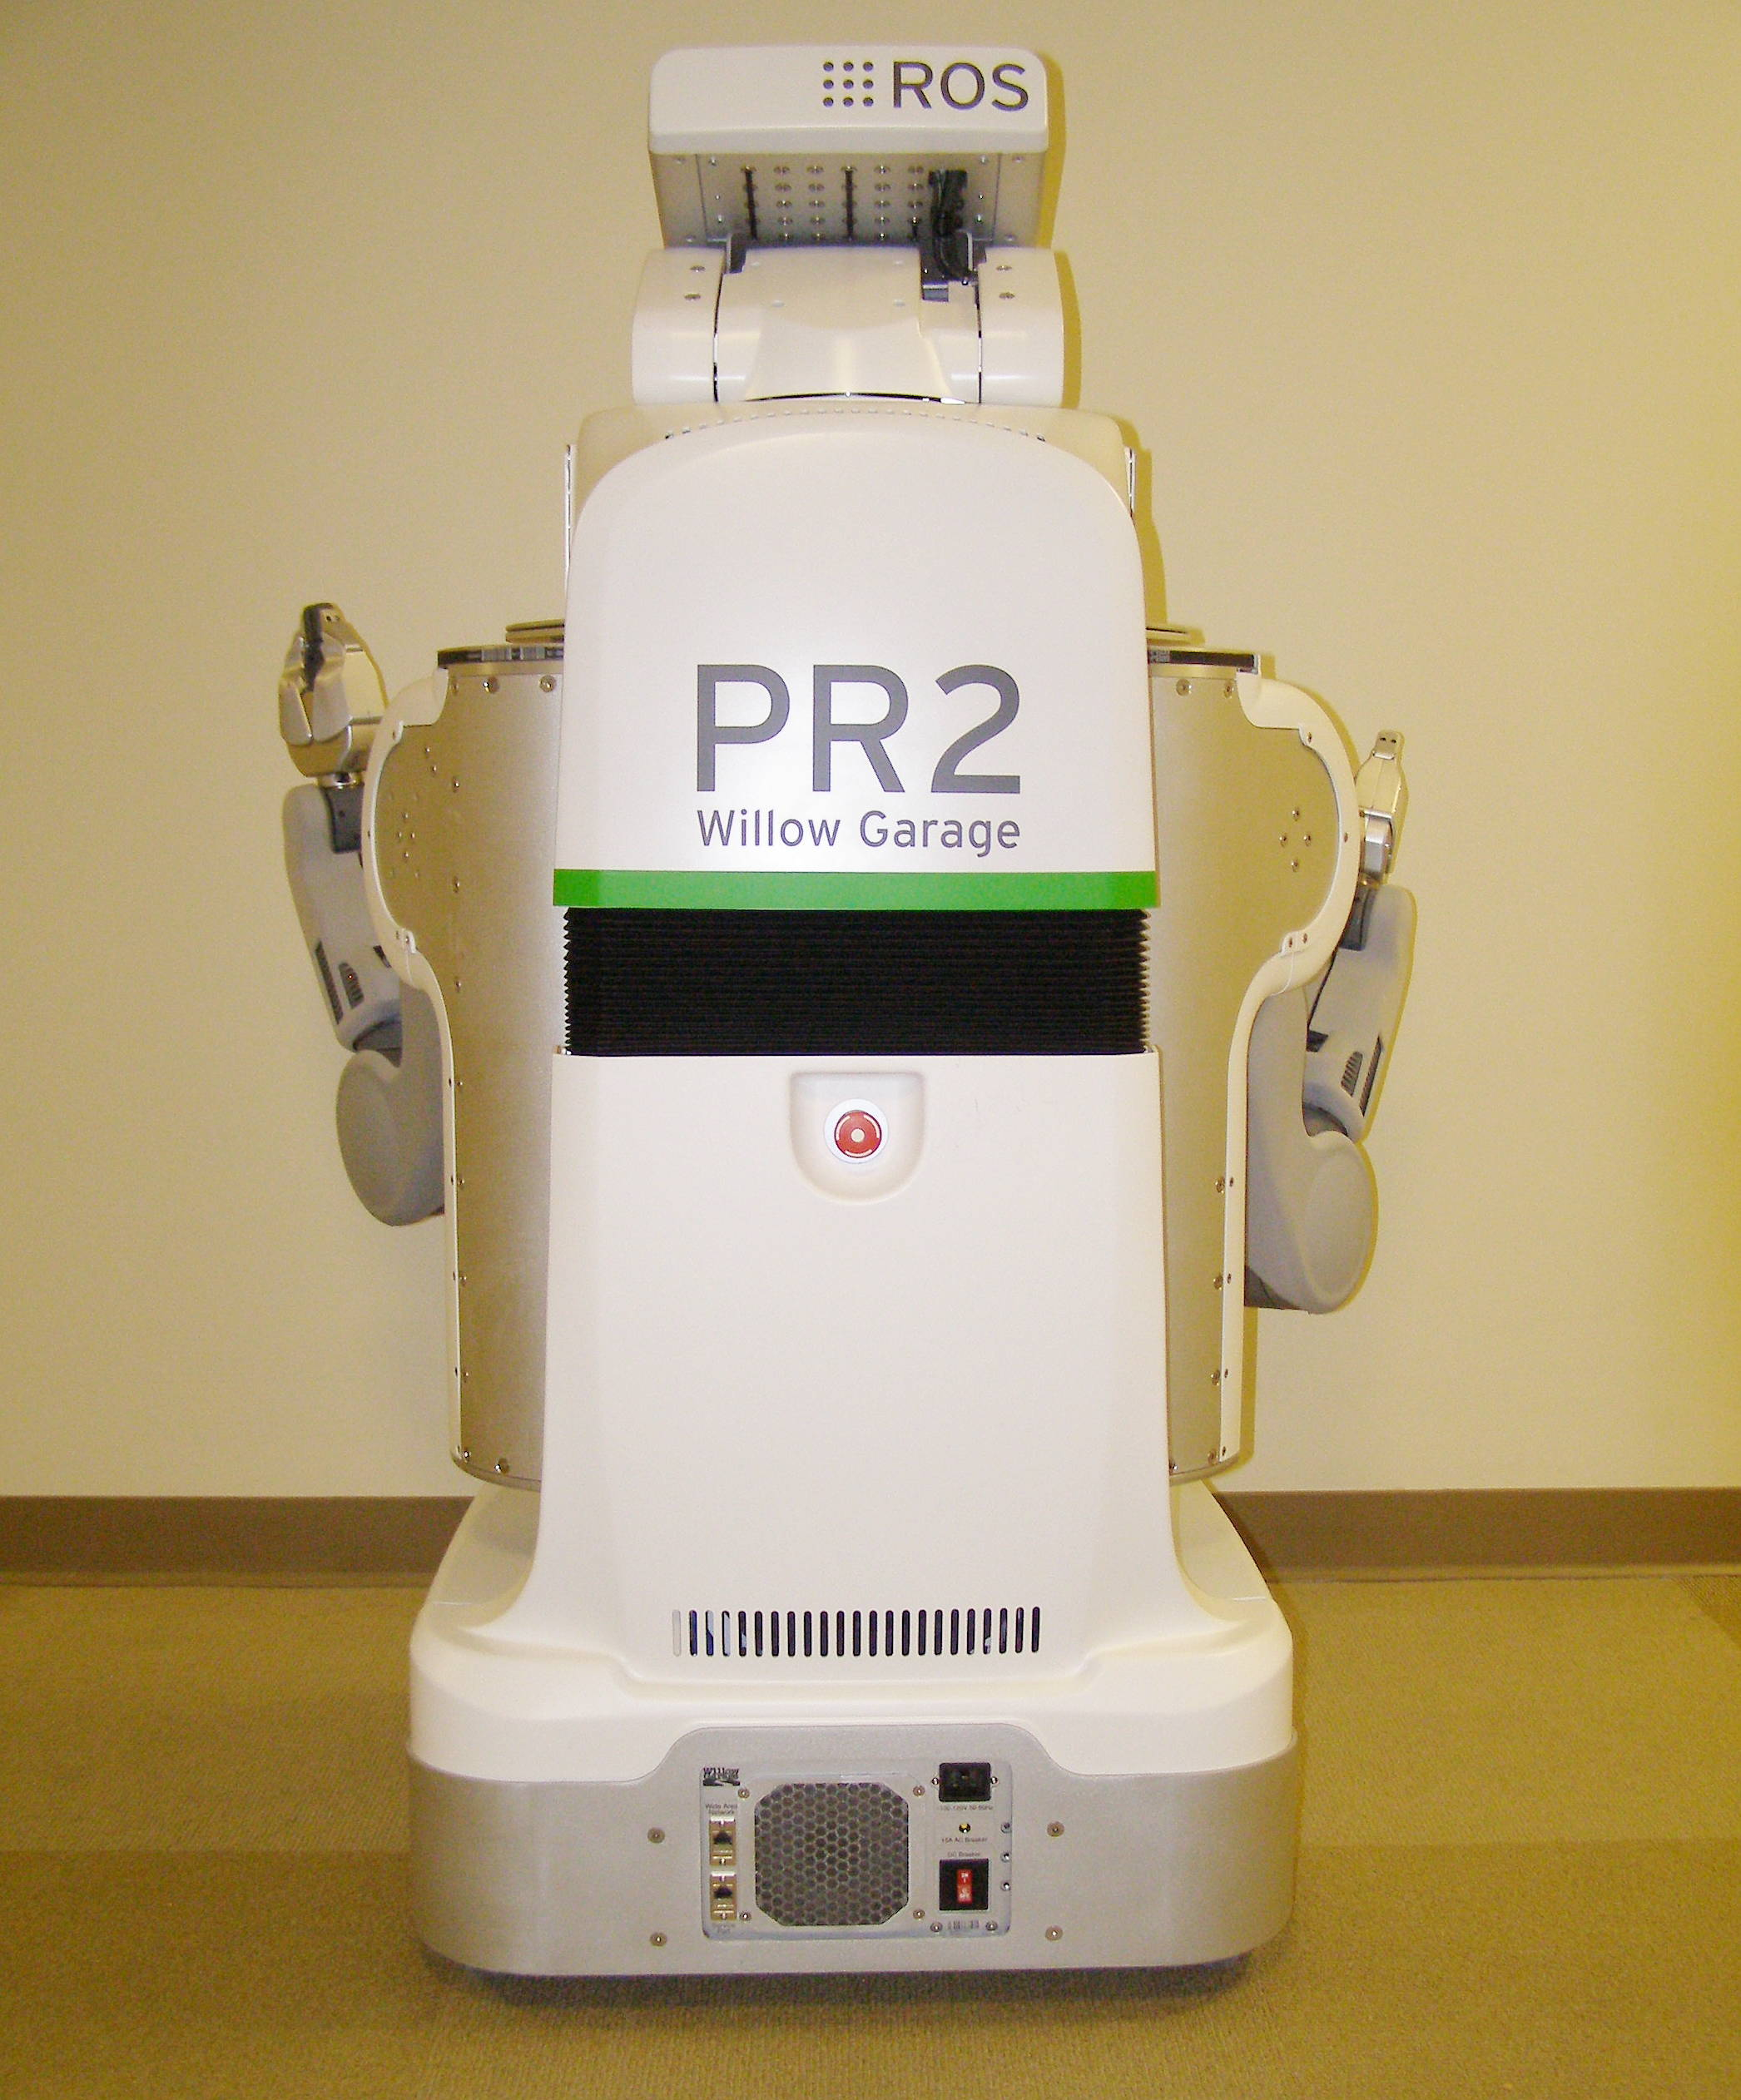
PR2 Rear View
Head Tilt Stage Panel
Head Pan Stage Panel
Rear Top Panel
Rear Bellows
Rear Bottom Panel
Run – Stop
Button
Base Skirt Rear
DC Breaker
Fan Filter

Slide 7
Electrical and ESD safety
When performing maintenance:
  Turn off power even when removing covers
    The only exceptions are when performing counter balance adjustments and replacing the fan filter
  Disconnect AC power to the PR2
  Always use an ESD strap
ESD straps are provided in the accessory kit:
  Place strap around bare wrist
  Plug jack into accessory panel

Slide 8
PR2 Power System
PR2 internal power precautions and safety features:
  Battery power is “live” within the robot, even when the power is off
  The power board controls all the power to the PR2 systems and is accessible/controllable via the ROS pr2_power_node
  There are as many as 7 levels of protection but you cannot assume they will prevent damage or injury
  Always turn off the PR2 power when performing maintenance except when specifically required to complete a procedure such as the counter balance adjustment

Slide 9
PR2 Power Requirements
Wall power:
  The PR2 can only be plugged into a dedicated 15A minimum circuit
  Only use the supplied power cord
  Only use the supplied self plug-in cord
  See support.willowgarage.com for ordering replacement cords
Battery runtime
  Approximately 2 hours stationary, less when moving

Slide 10
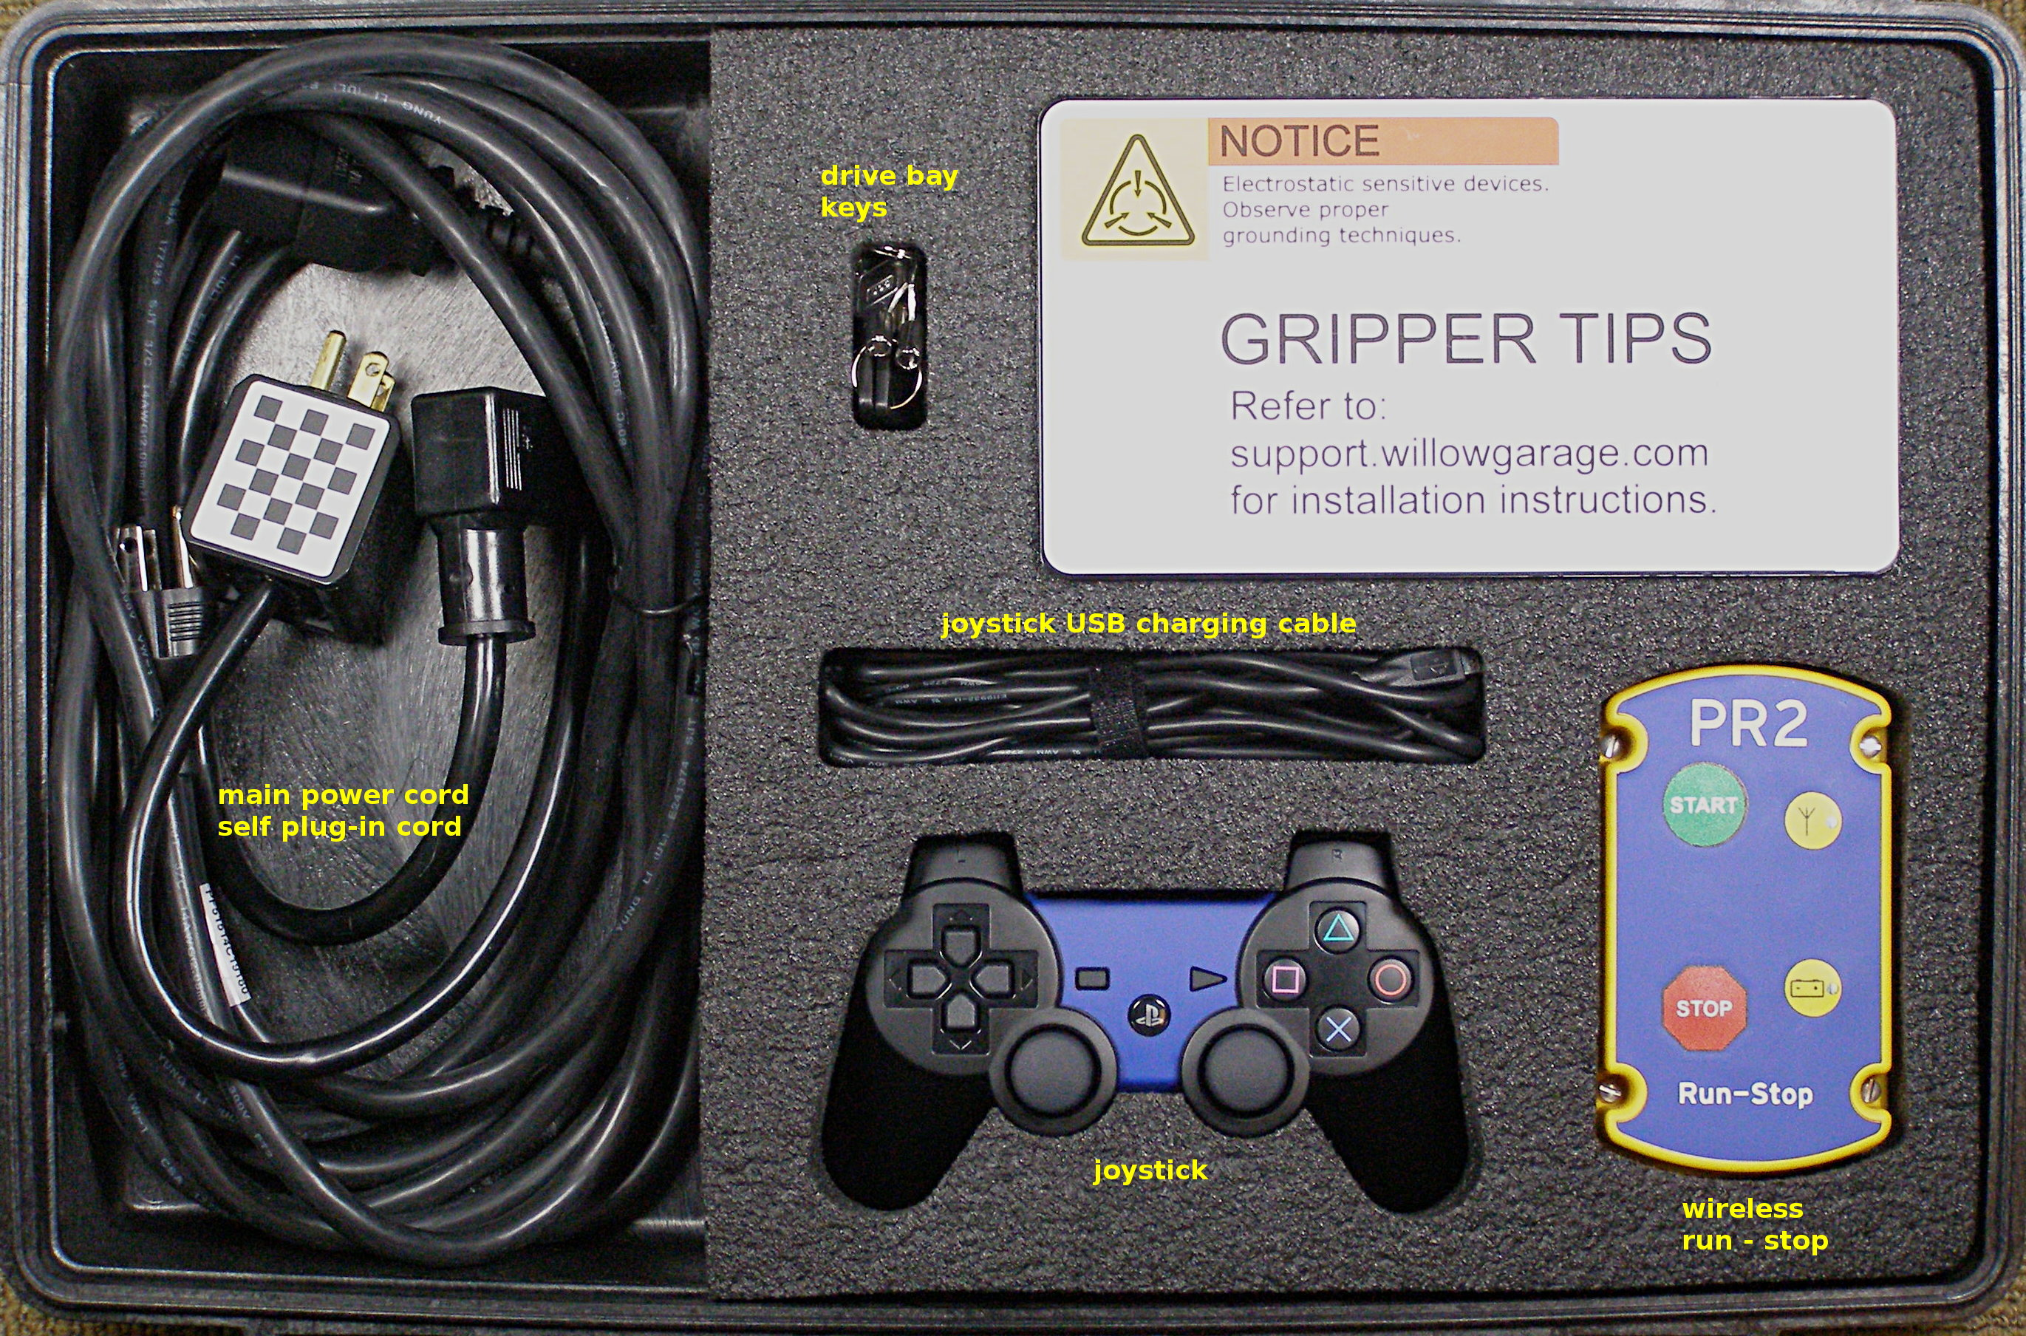
PR2 Accessory Kit
15 FT power cord 68-06167
Self plug-in cord 68-06153
Joystick 68-02985
Hard drive bay keys 68-03337
Wireless run-stop 68-01059
USB joystick cable 68-03533
Small Checkerboard 68-03823
Fan filters 68-02802 (x5)
ESD strap 68-03024
Base station recovery DVD
User manual
Gripper tips box:
  Sensor fingertips 68-03840 (x5) (use only with boots!)
  Fingertip boots 68-03347 (x20)

Slide 11
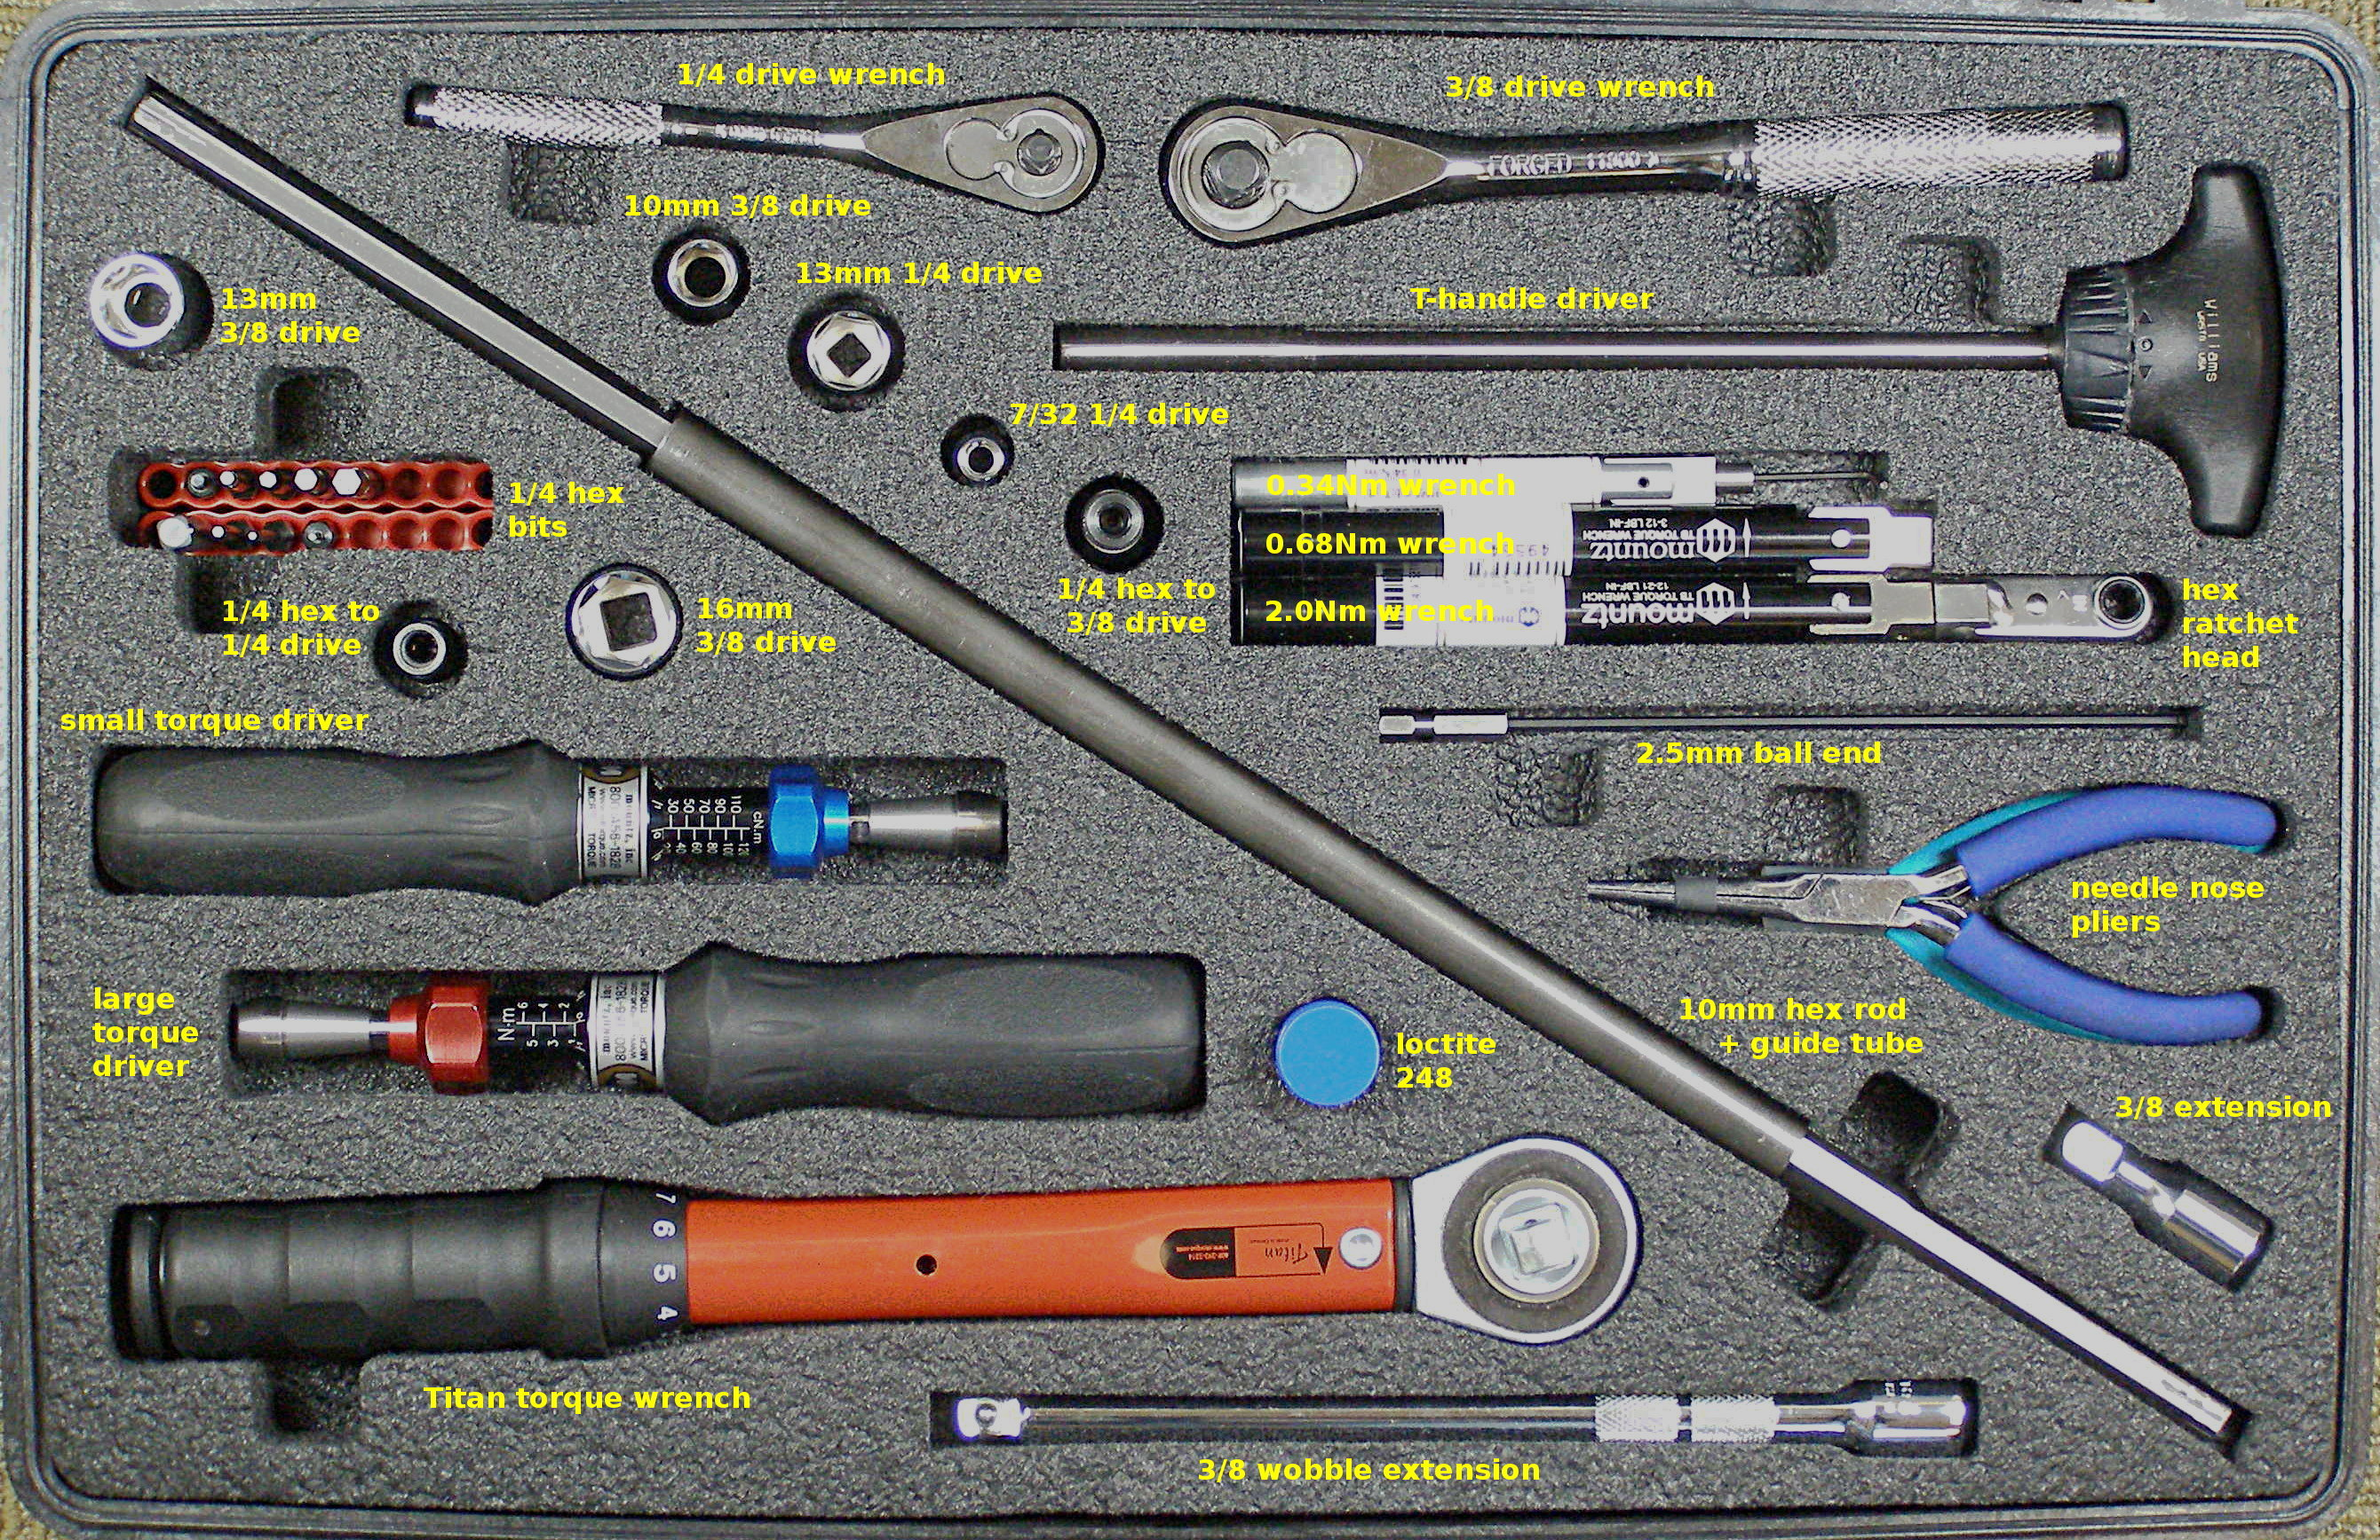
PR2 Tool Kit (1)
Counter balance adjustment rod - 10mm hex 68-07034
Counter balance adjustment tube 68-07147
Ratchet head bits:
1.5mm 68-07040
2.5mm 68-07042
Driver bits:
1.5mm 68-07062
2.0mm 68-07063
2.5mm 68-07064
2.5mm ball end 68-07059
3.0mm 68-07065
4.0mm 68-07066
5.0mm 68-07067
Needle nose pliers 68-07112
Diagonal Cutter 68-07146
Zip-ties 68-07150
1/4 sq. male to 1/4 hex male 68-07075
1/4 sq. drive to 1/4 hex female 68-07077
3/8 sq. drive to 1/4 hex female 68-07078
10mm 3/8 drive socket 68-07079
13mm 1/4 drive socket 68-07085
13mm 3/8 drive socket 68-07086
16mm 3/8 drive socket 68-07142

Slide 12
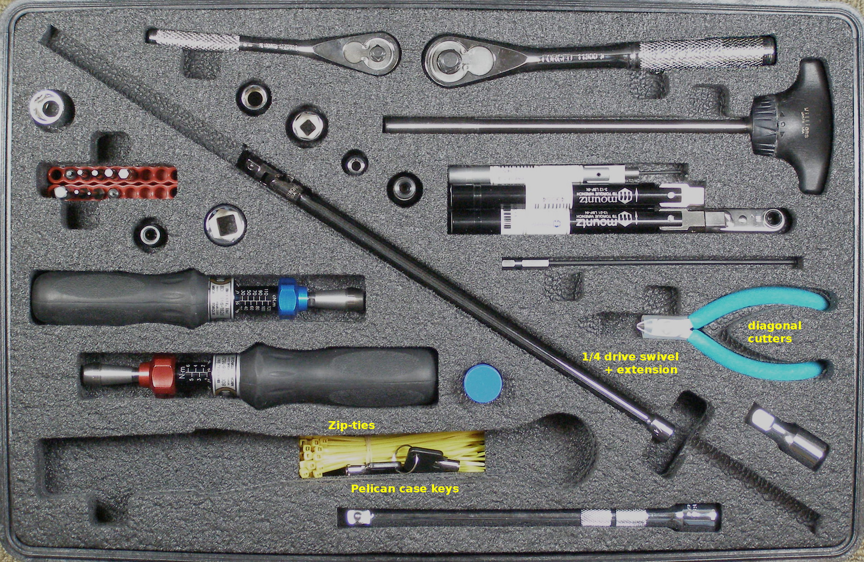
PR2 Tool Kit (2)
7/32 1/4 drive socket 68-07090
3/8 drive short extension, 68-07116
3/8 drive wobble extension, 68-07118
1/4 drive quick release extension, 68-07140
1/4 drive flex joint, 68-07141
1/4 drive ratchet wrench, 68-07138
3/8 drive ratchet wrench, 68-07139
Needle Nose pliers, 68-07112
Mountz wrench and driver tools:
  Fixed 0.34Nm wrench, with 1.5mm right angle Allen, 68-07025
  Fixed 0.68Nm wrench, 68-07028
  Fixed 2.0Nm wrench, 68-07029
  1/4 hex ratchet head, 68-07033 (for use with 0.68 ans 2.0 Nm wrenches)
  0.20 – 1.20 Nm torque tool, 68-07014 (small)
  1 – 6 Nm Torque tool, 68-07015 (large)
  Titan250I 5.6 – 28 Nm Torque wrench, 68-07020

Slide 13
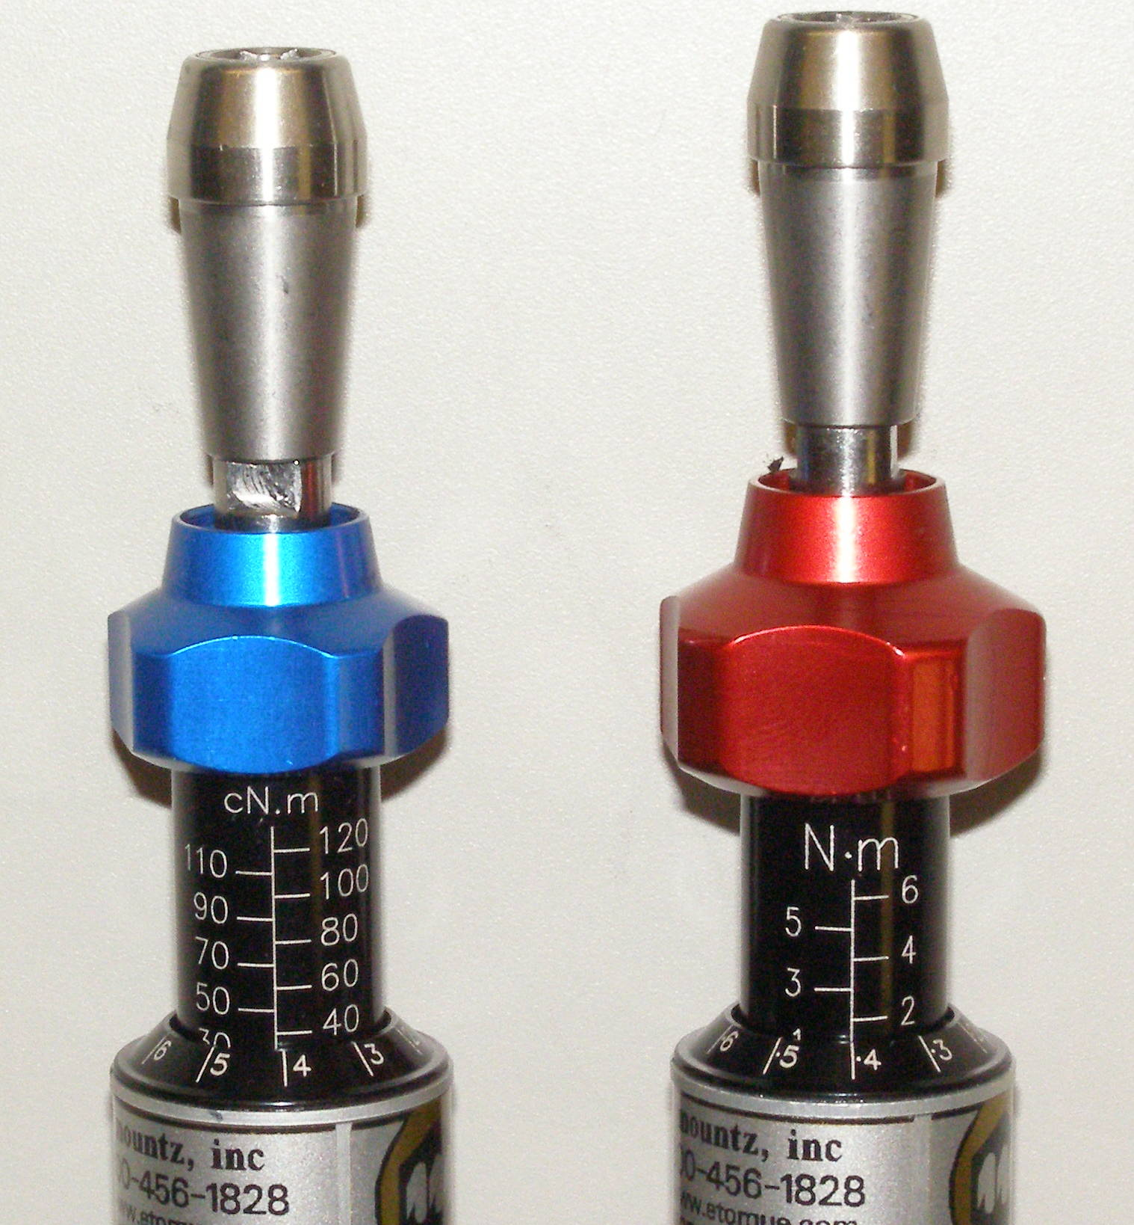
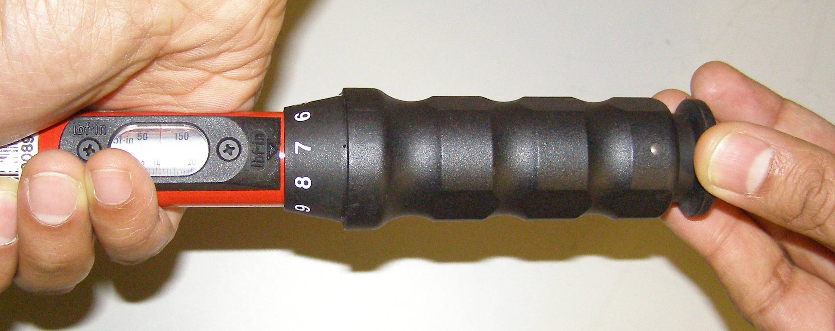
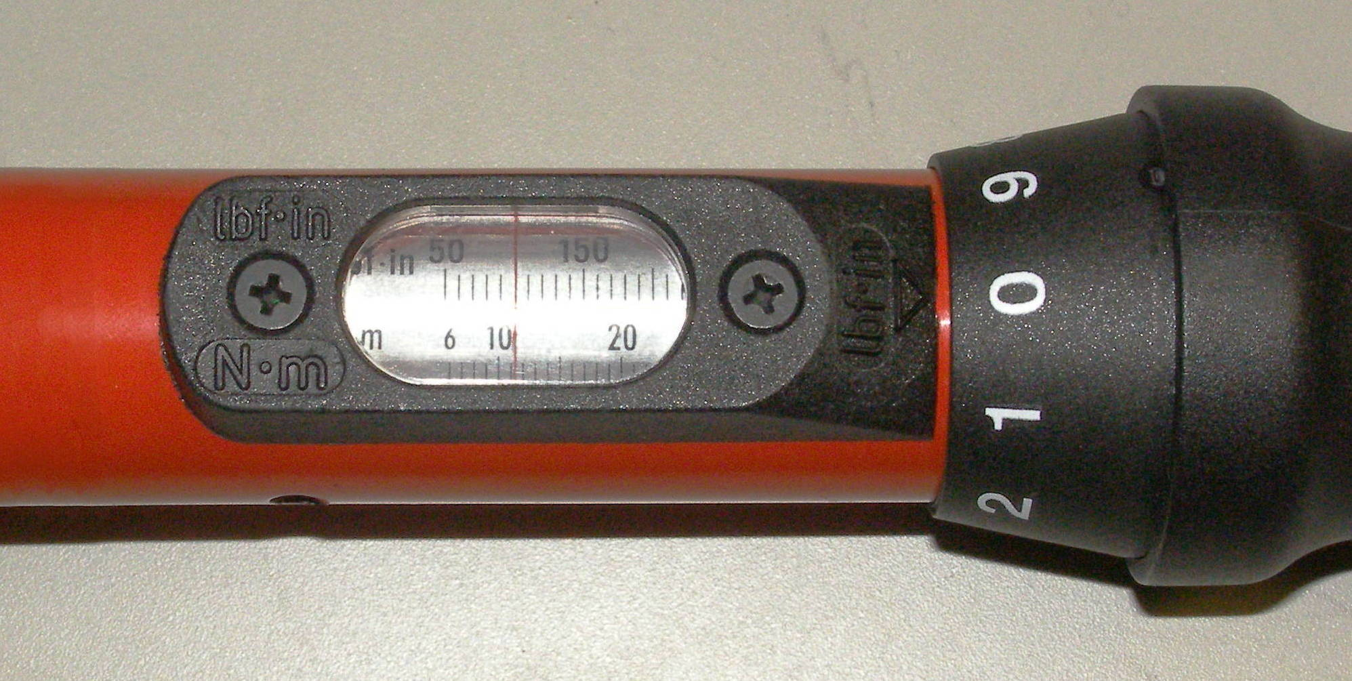
Using Torque Tools
Small and large driver
Special stack-ups
See support.willowgarage.com:
  PR2 Toolkit: Setting Torque Driver
Adjustment unlocked
Blue Adjustment Nob – Small Torque Driver
Red Adjustment Nob – Large Torque Driver
Rotate
0.34 Nm
1.36 Nm (1.4)
Rotate to adjust torque
11.0 Nm

Slide 14
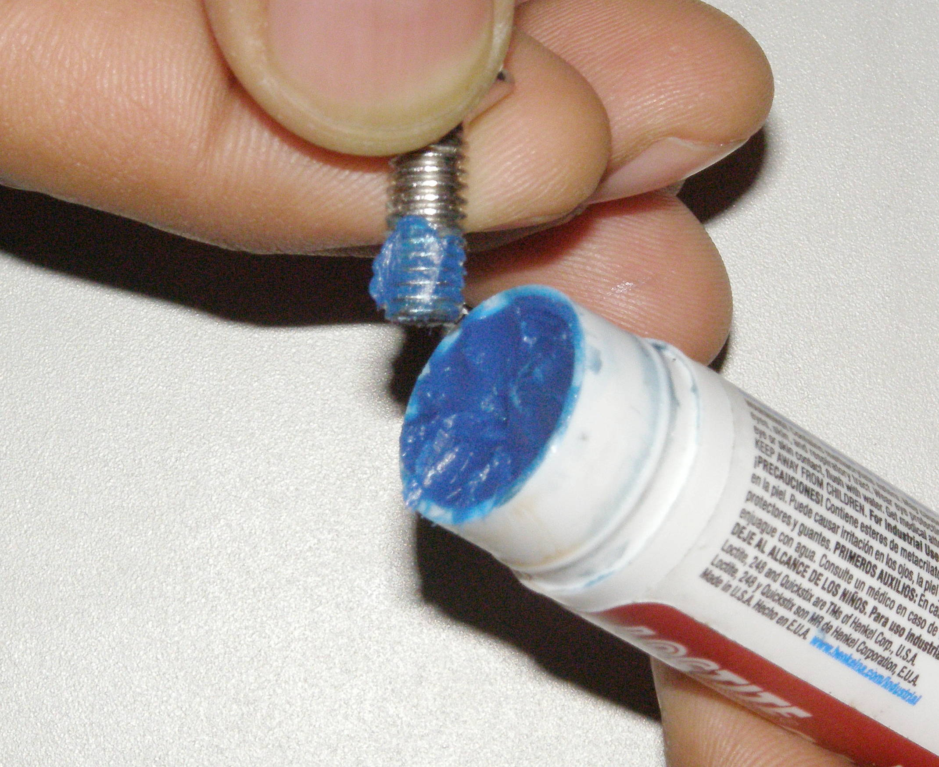
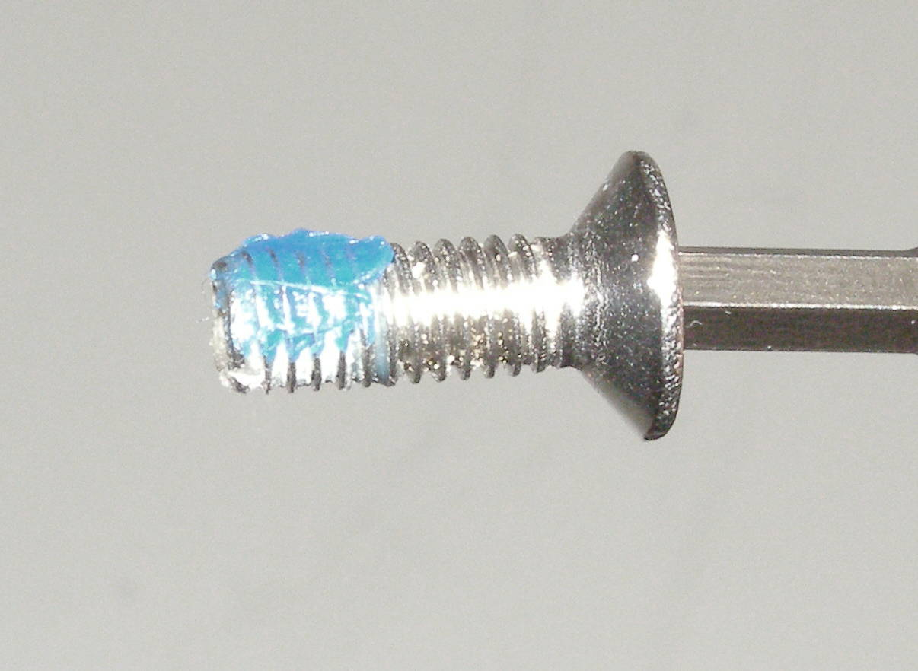
Using Loctite
Use Loctite to retain fasteners and keep them from vibrating loose
There is no need to clean the old Loctite
The fresh Loctite will integrate with the old
Only a small “patch” of Loctite is needed.
Old Loctite.

Slide 15

Today's Demos
Video of gripper tip replacement
Live demo of fan filter repair/replacement
Hands-on demo of counterbalance adjustment
See support.willowgarage.com for all maintenance procedures

Slide 16
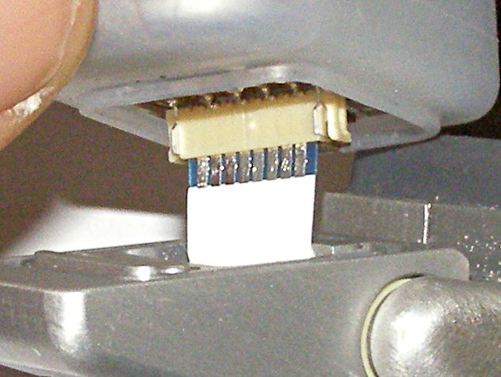
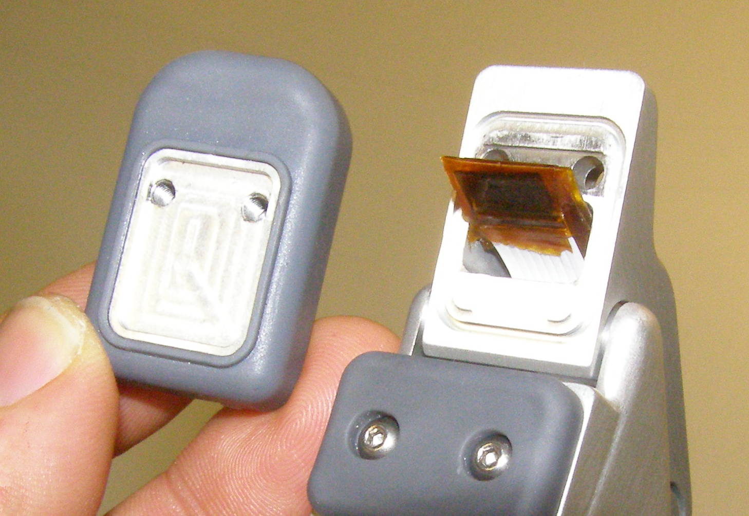
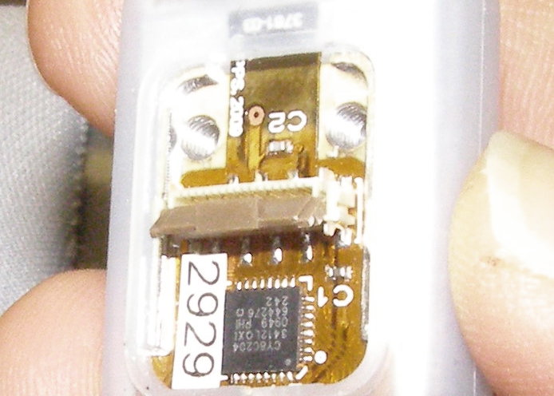
Gripper Tip R/R Video
Turn off power
Wear ESD strap
Always cover sensors with boots
Replace boots as soon as they show signs of damage
Willow Garage will not replace damaged sensor tips
  See support.willowgarage.com for replacements
Fig 6
Fig 7
Fig 10

Slide 17
Fan Filter Demo
Clean regularly every 1-4 weeks
Clogged filter will cause fan speed to increase (noisy robot)
Vacuuming filter is not recommended since this may tear the filter
Maintenance:
  Remove the filter cover plate
  Wash and dry filter
  Having the fan on helps when placing the filter
  Re-install the cover plate

Slide 18
Counter Balance Review
Overview: PR2 counter balance (CB) holds up the weight of the arms using a spring and pulley system
Goal: The CB should balance the arm so that almost no torque is required to maintain position of the arm
Performance: A well adjusted counter balance will maximize the performance of the PR2 arm controllers

Slide 19

CB Adjustment Overview
With time, the springs of the CB system can start to sag or give. To maintain performance, you will have to adjust the mechanism.
Fig 1
Right
  Secondary spring can be stiffened or loosened
      Clockwise (CW) turns increases force on arm
  “Arm gimbal shaft” controls level arm length of CB spring force
      Counterclockwise (CCW) increases force on arm
Secondary Spring
Arm Gimbal Shaft

Slide 20
CB Adjustment Demo
Demonstrate checking and adjusting the counterbalance on the PR2
  We will demonstrate up front
  You will adjust your own counterbalance with help from Willow Garage engineers and technicians
Notes:
  Safety first
  You need two people to adjust the mechanism
  Observe ESD protocol (wrist strap)
  Watch for pinch points

Slide 21
CB Check Program
We use a counterbalance adjustment/check program to adjust the counterbalance.
  The program moves the arm of the robot and measures the torque on each joint
  It uses training data to recommend adjustments to for a minimum torque setting
    The program is an iterative solver, in some cases more than one iteration is required
You will run the check program and determine your required adjustment.

Slide 22
CB Check Program Install
Counterbalance adjustment program is unreleased.
  You will have to install it from wg-ros-pkg trunk and build it
  Tutorial:
    ros.org/wiki/qualification/Tutorials
  Follow tutorial instructions to install and build
Important: Do not start the CB adjustment program until instructed to do so

Slide 23
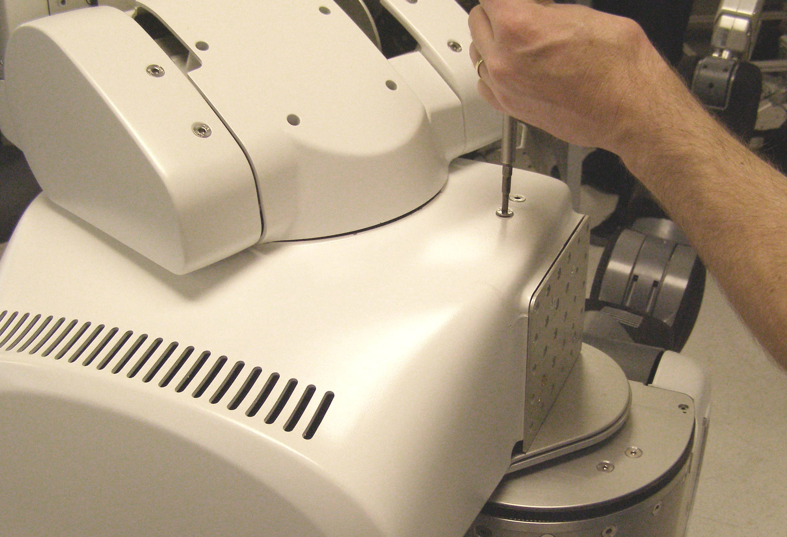
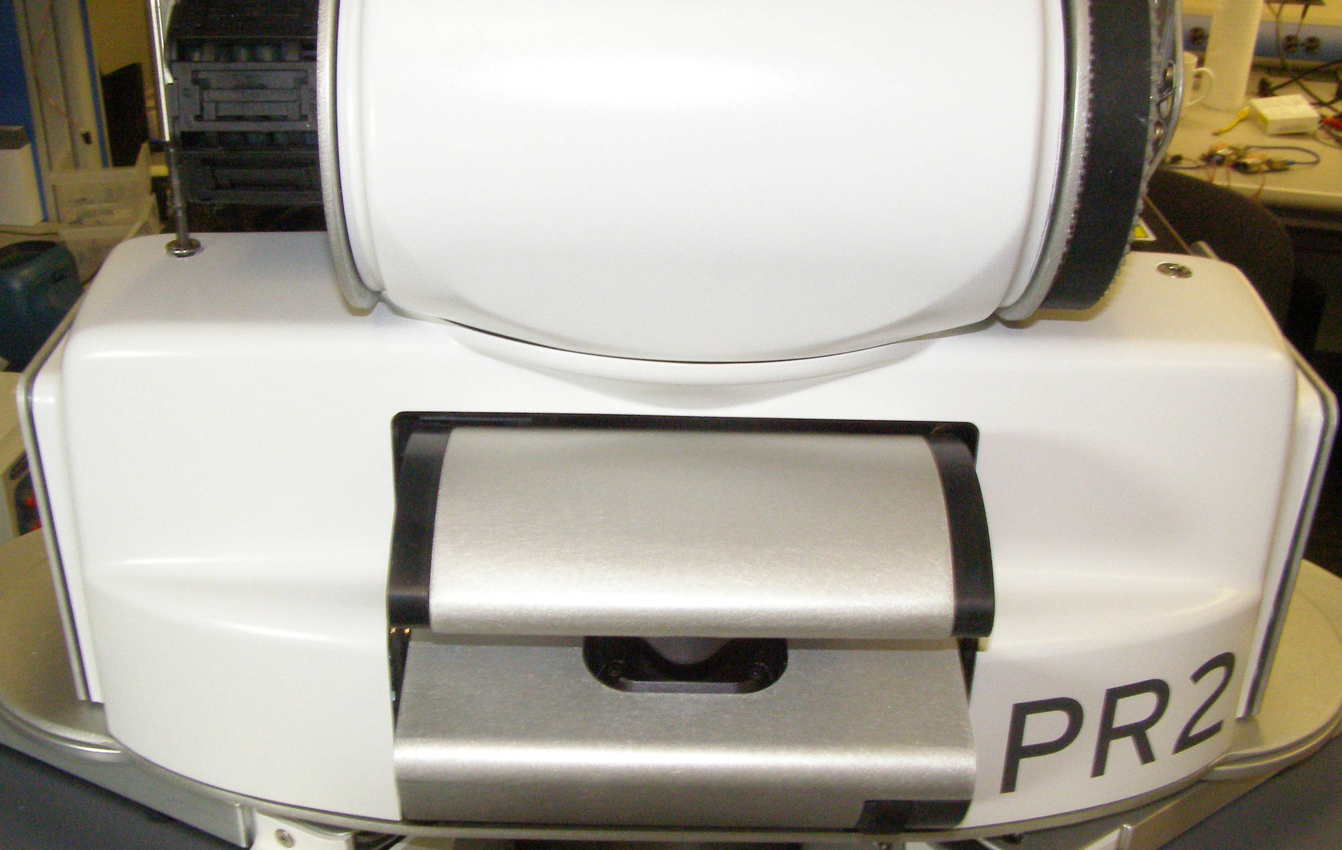
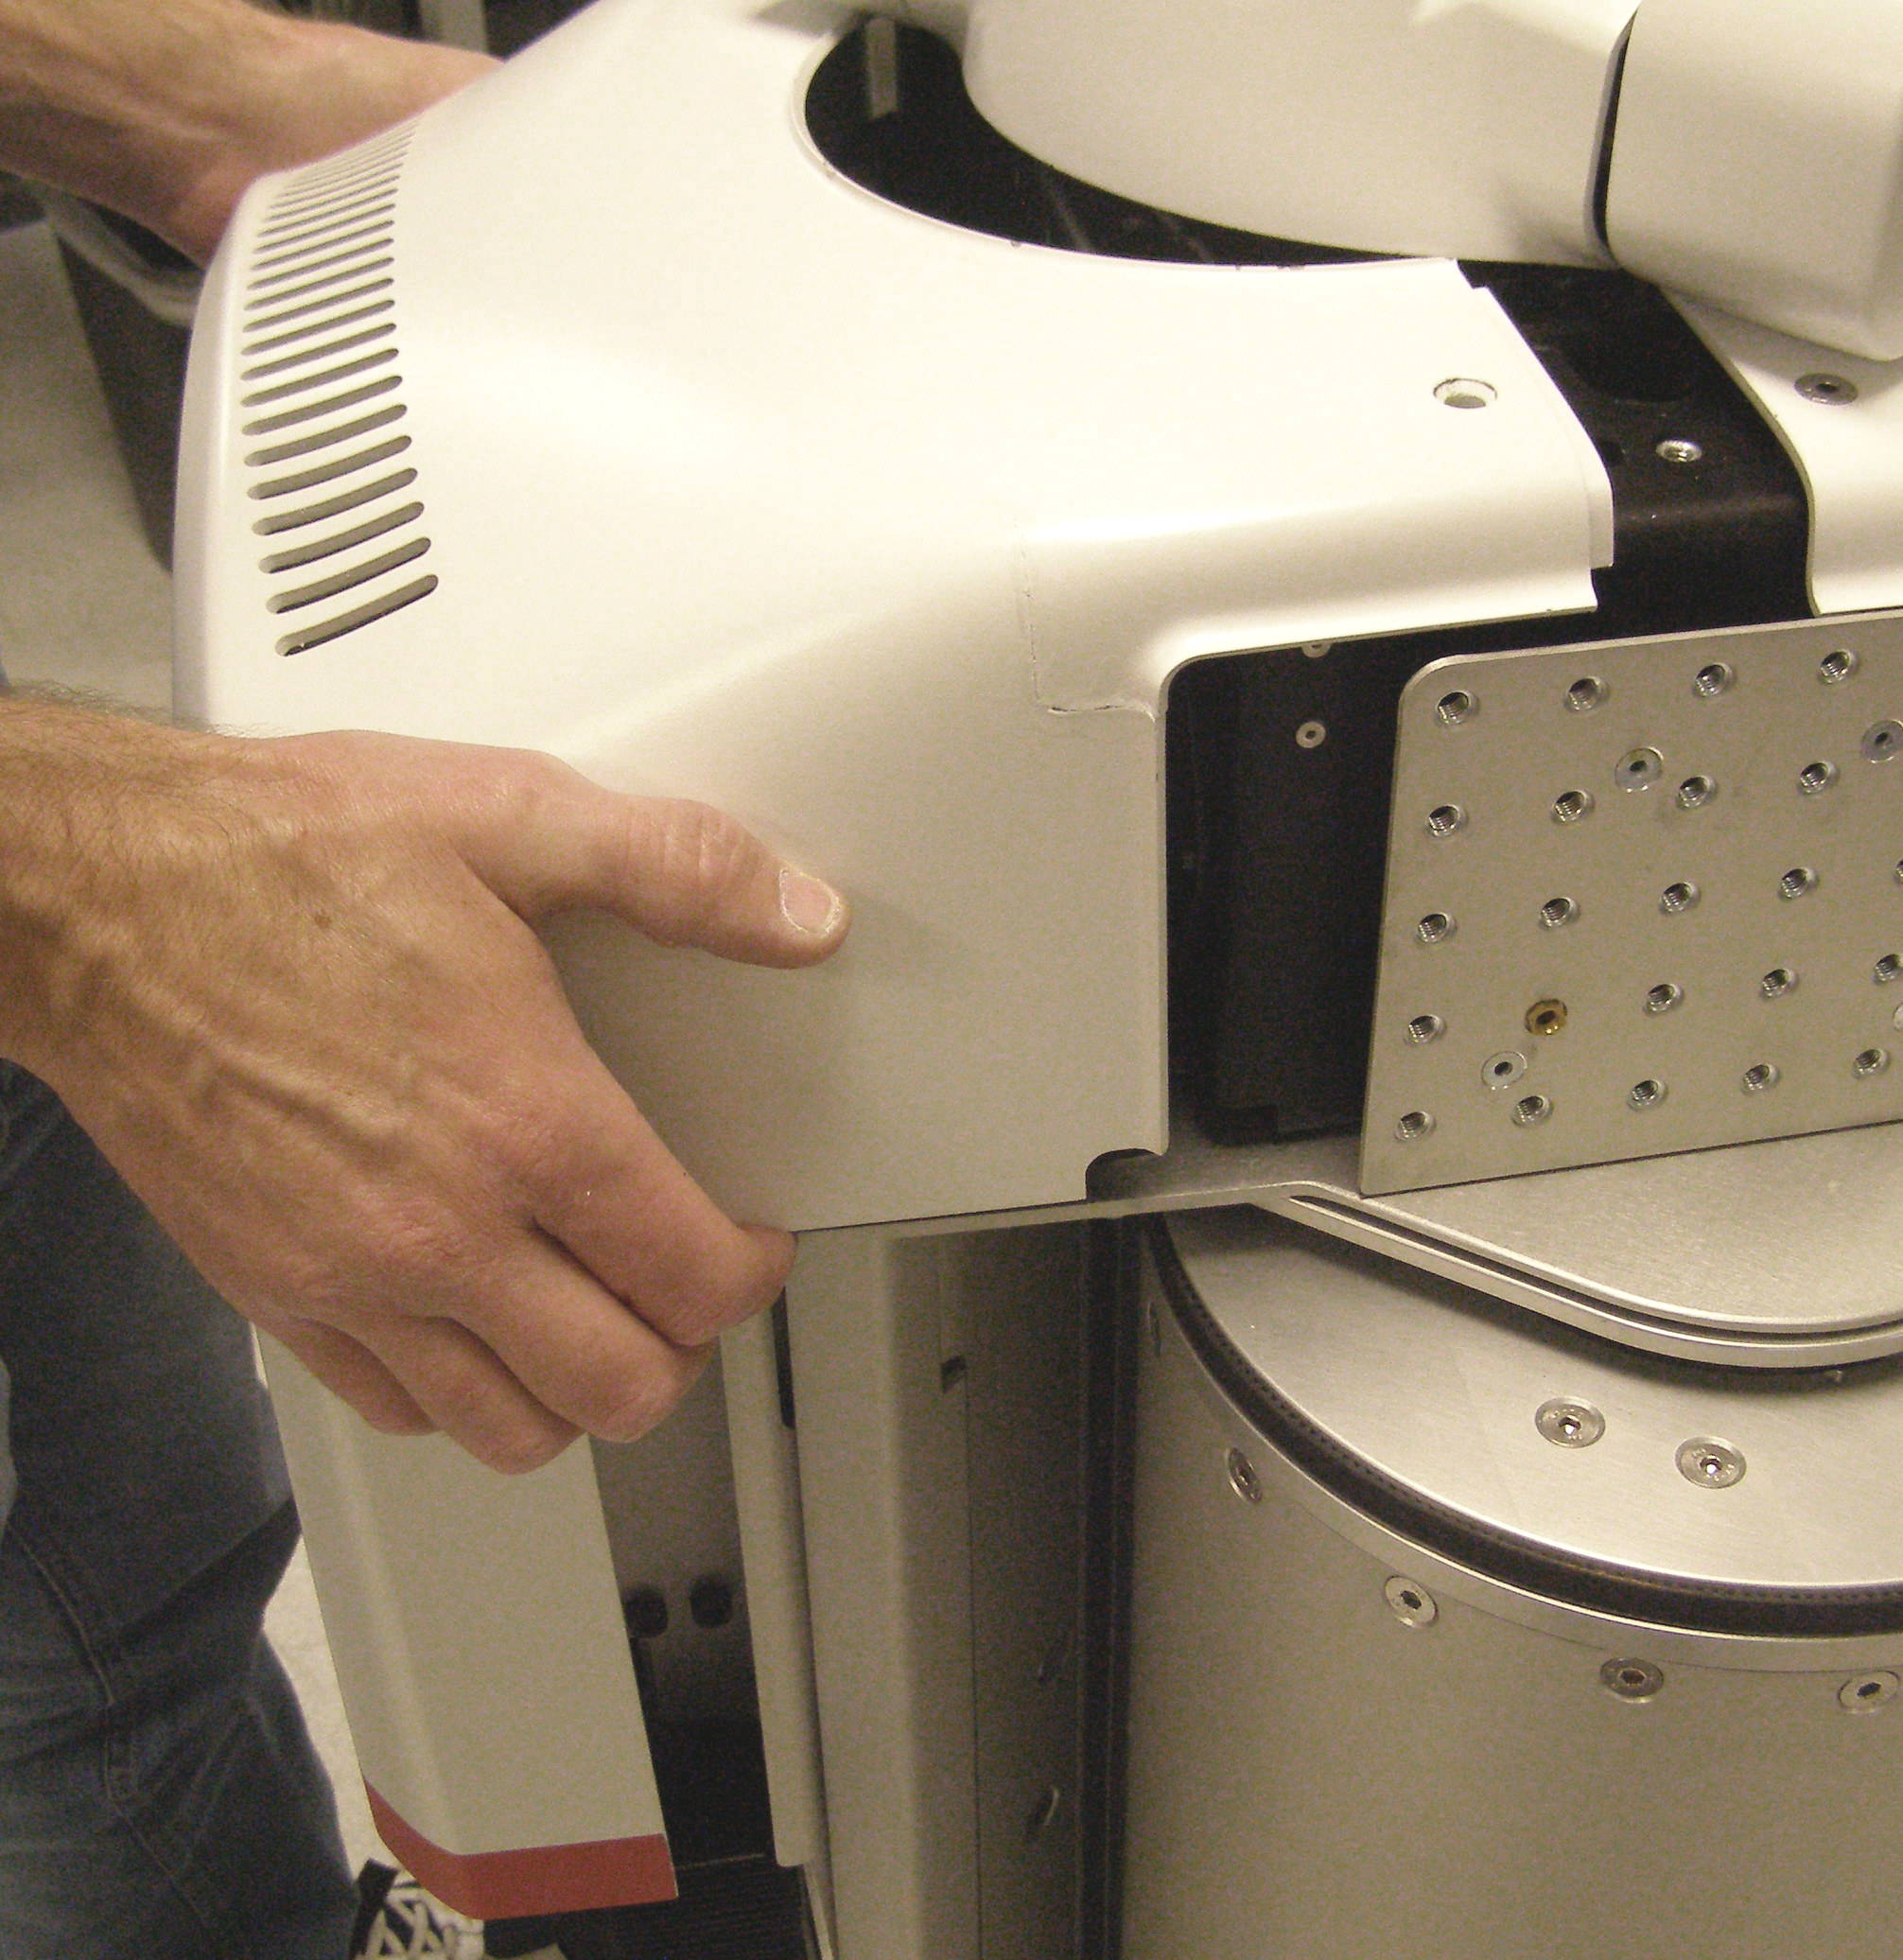
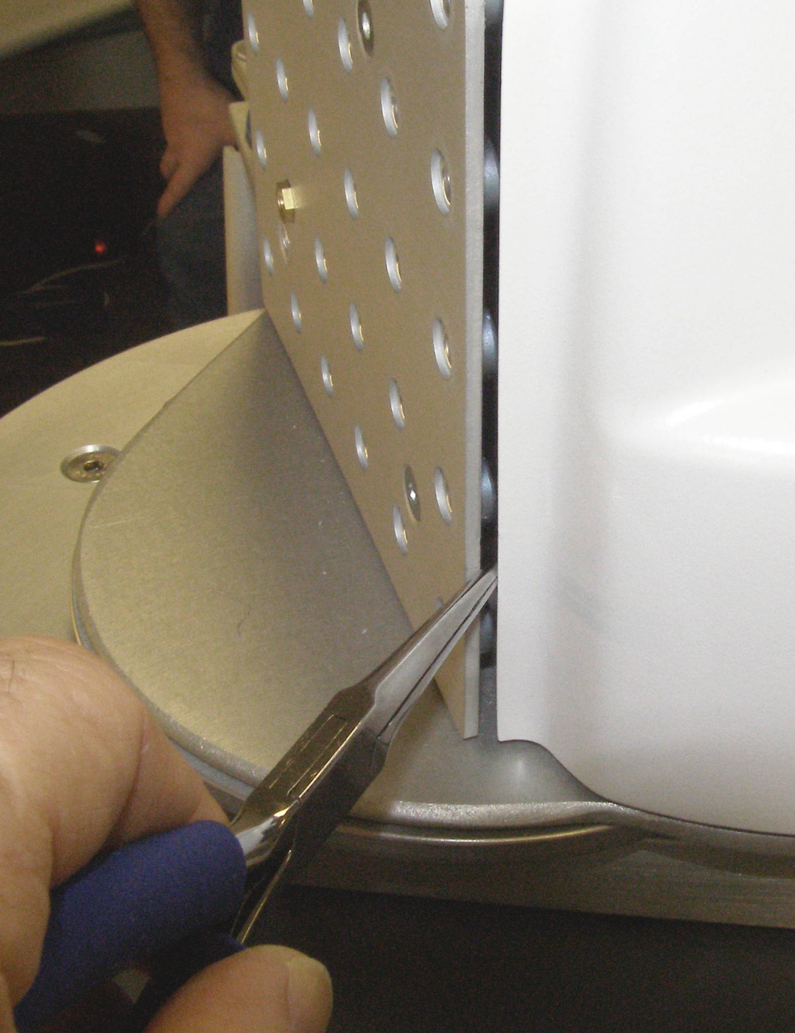
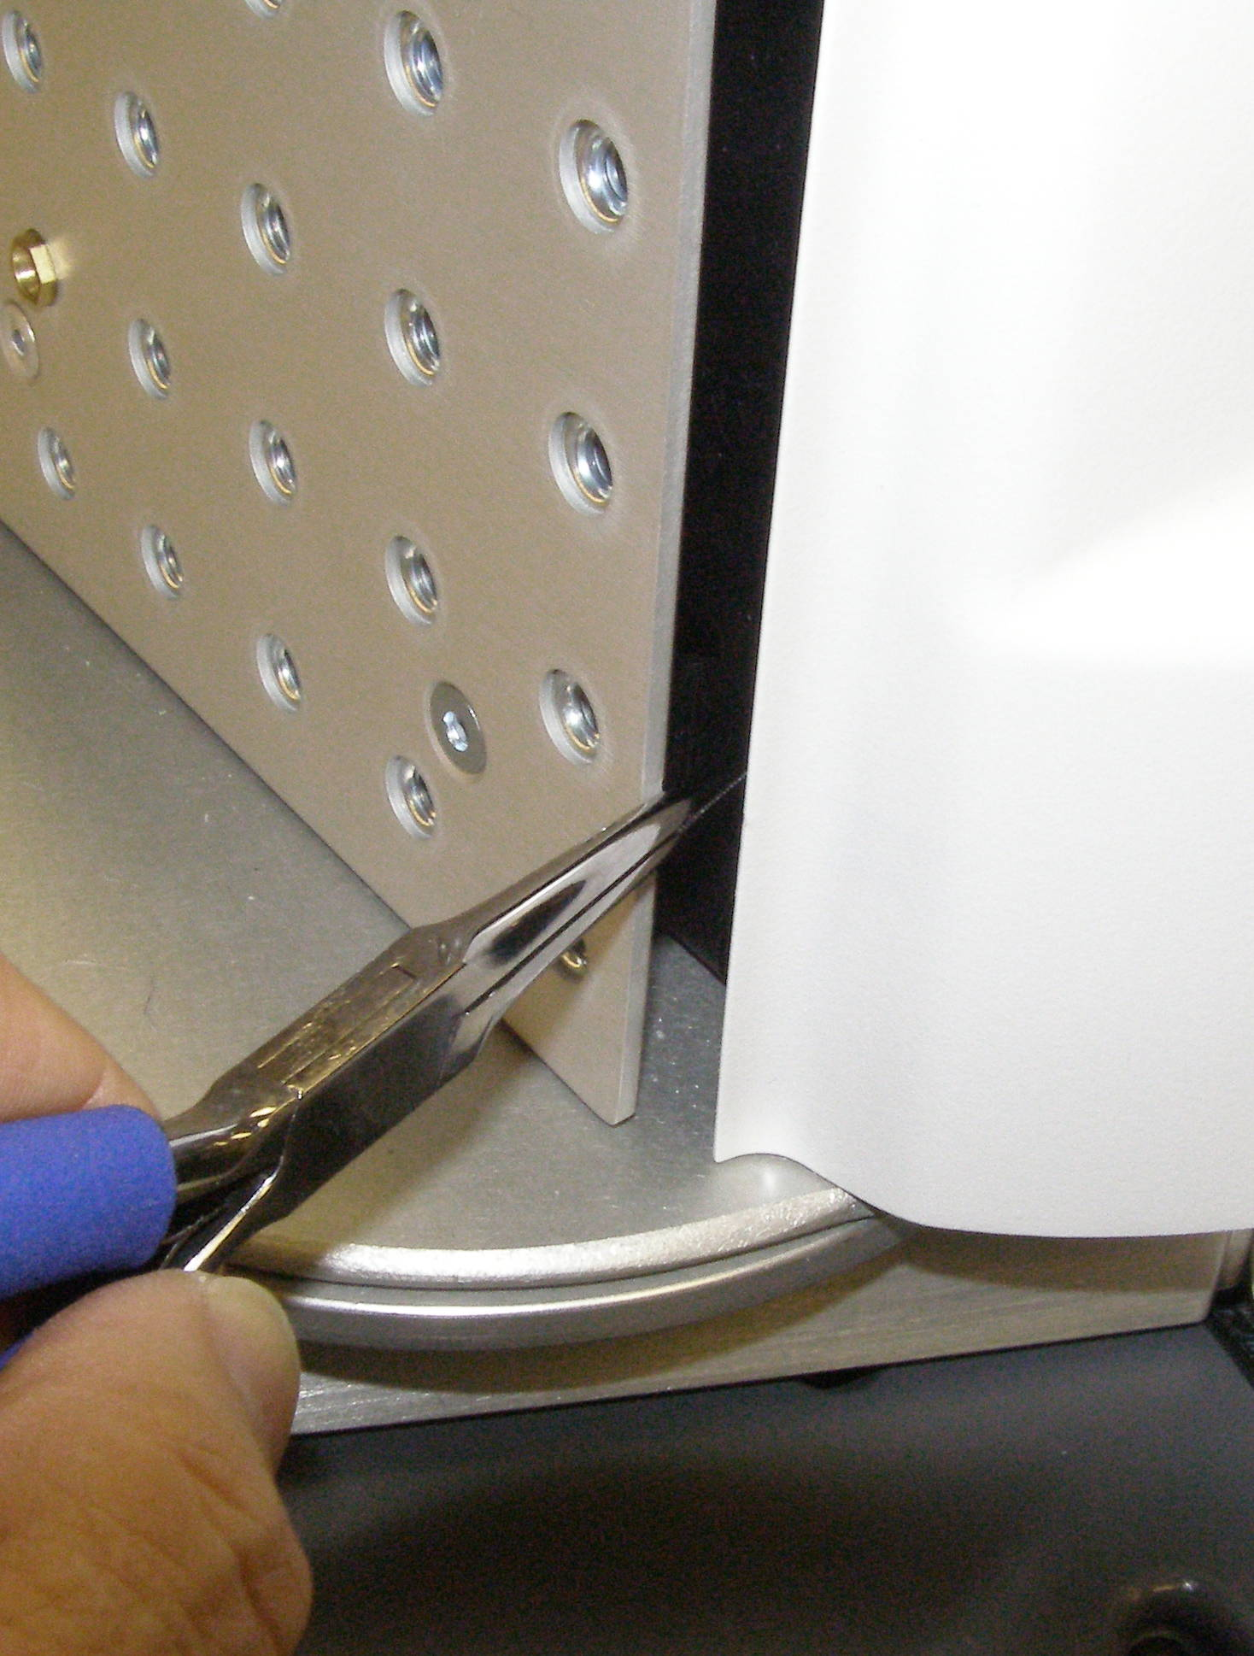
CB Adjustment Demo
Observe safety and ESD protocols.
Remove top covers, Doc6
Fig 1
Fig 1
Fig 2
Fig 3
Fig 4

Slide 24




CB Adjustment Demo
Observe safety and ESD protocols.
Remove shoulder covers, Doc16
Fig 6
Fig 5
Fig 7
Fig 11

Slide 25
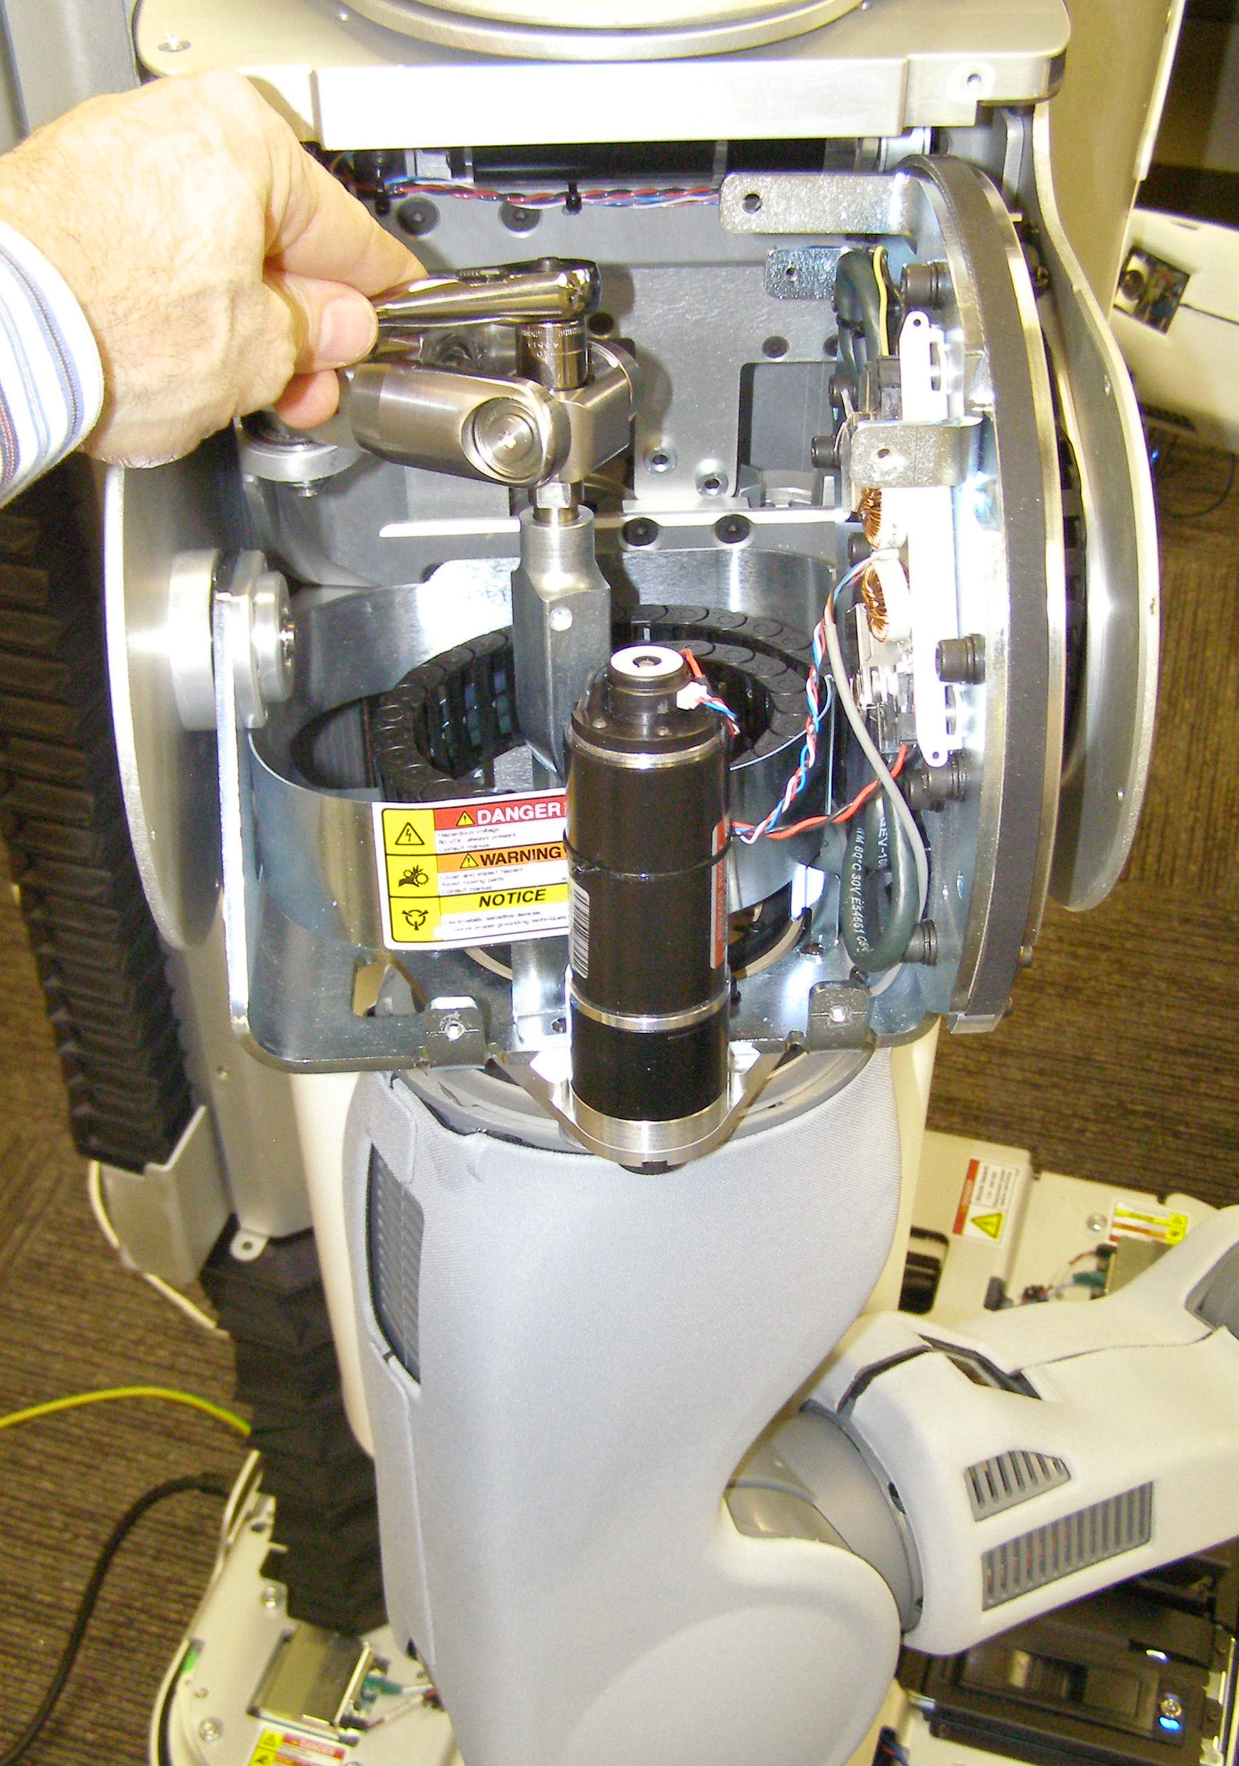

CB Adjustment Demo
Adjust counter balance, Doc5
  Re-run the Check program and adjust the CB if needed, Doc5
  Re-install the covers, Doc6
Fig 6
Fig 5
Guide tube

Slide 26
CB Adjustment Procedure
Check CB with adjustment program
  Clear out 2m space around your robot
Turn robot off (sudo pr2-shutdown)
Remove covers
  Ask your Willow Garage helper for questions
Adjust CB
  Make adjustments check tool recommends
Turn robot on
Check CB with adjustment program
Turn robot off
Reinstall covers

Slide 27
Remember!
Safety First
support.willowgarage.com
Always wear an ESD wrist strap
Don't be afraid to ask questions

Slide 28
Questions?????

