Slide 1

Forearm Roll EtherCAT Cable
Remove and Replace
Jun 28, 2011

Slide 2
General Safety Instructions
Always wear an ESD wrist strap when reaching into the robot.
Shutdown Computers and power off robot (red switch in back) before working on robot.
If you have any questions about using this document, contact Willow Garage Support before proceeding.
Pre-Start Checklist
Unplug robot from wall electrical power.
Power down robot and turn off DC breaker (red rocker switch on rear panel)
Required Tools and Materials:
ESD strap

Slide 3
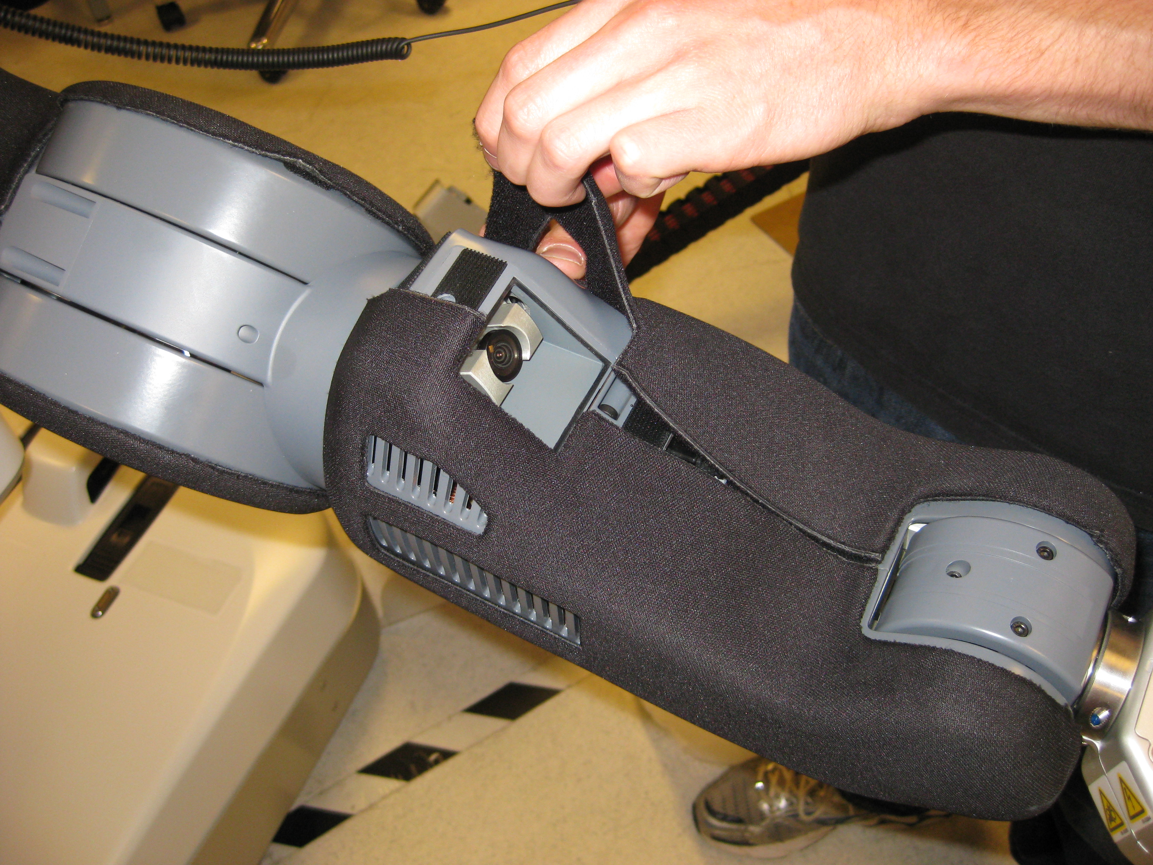
Forearm Cover Removal : Part 1
Forearm is strongly retained with Velcro. Peel the Cover off starting from the back edge on a single side.

Slide 4
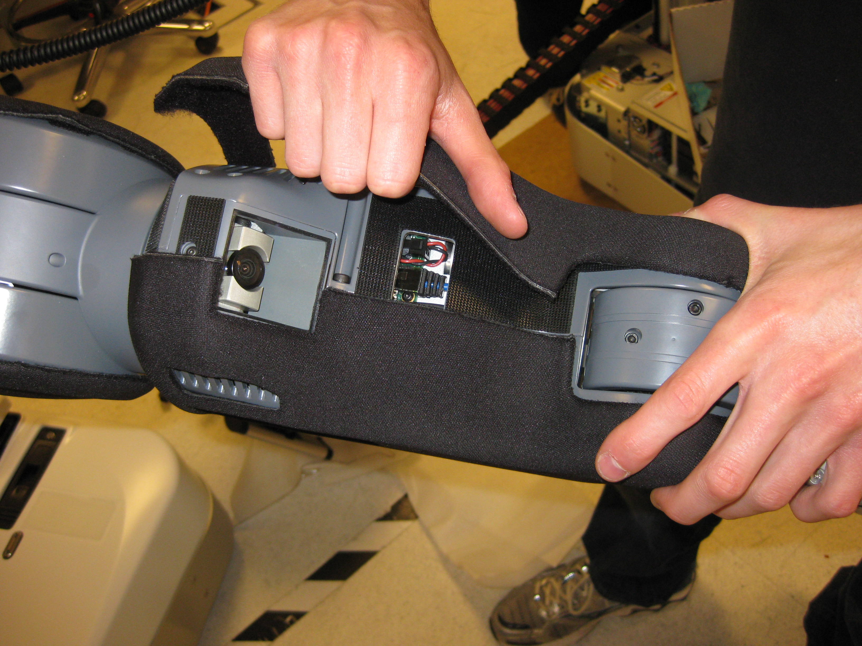
Forearm Cover Removal : Part 2
Next pull off front part of same side (Fig 2).
Fig 2
Finally unwrap and pull cover from remaining side.

Slide 5
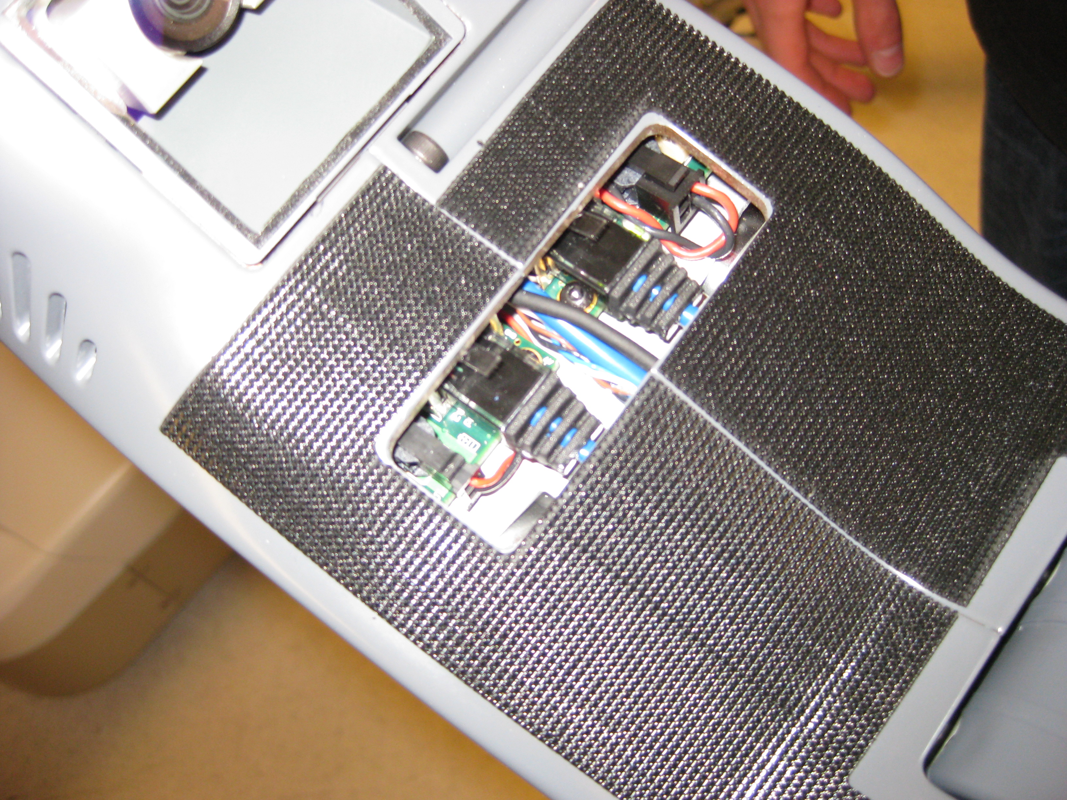
Forearm EtherCAT Plug Closeup
  The plugs for both forearm_r_motor and forearm_l_motor are visible in Fig 3.
Fig 3
Fig 4
EtherCAT
Port1
Encoder
Calibration Sensor
EtherCAT
Port0
Motor
Power
Fig 5
Supply
Power

Slide 6
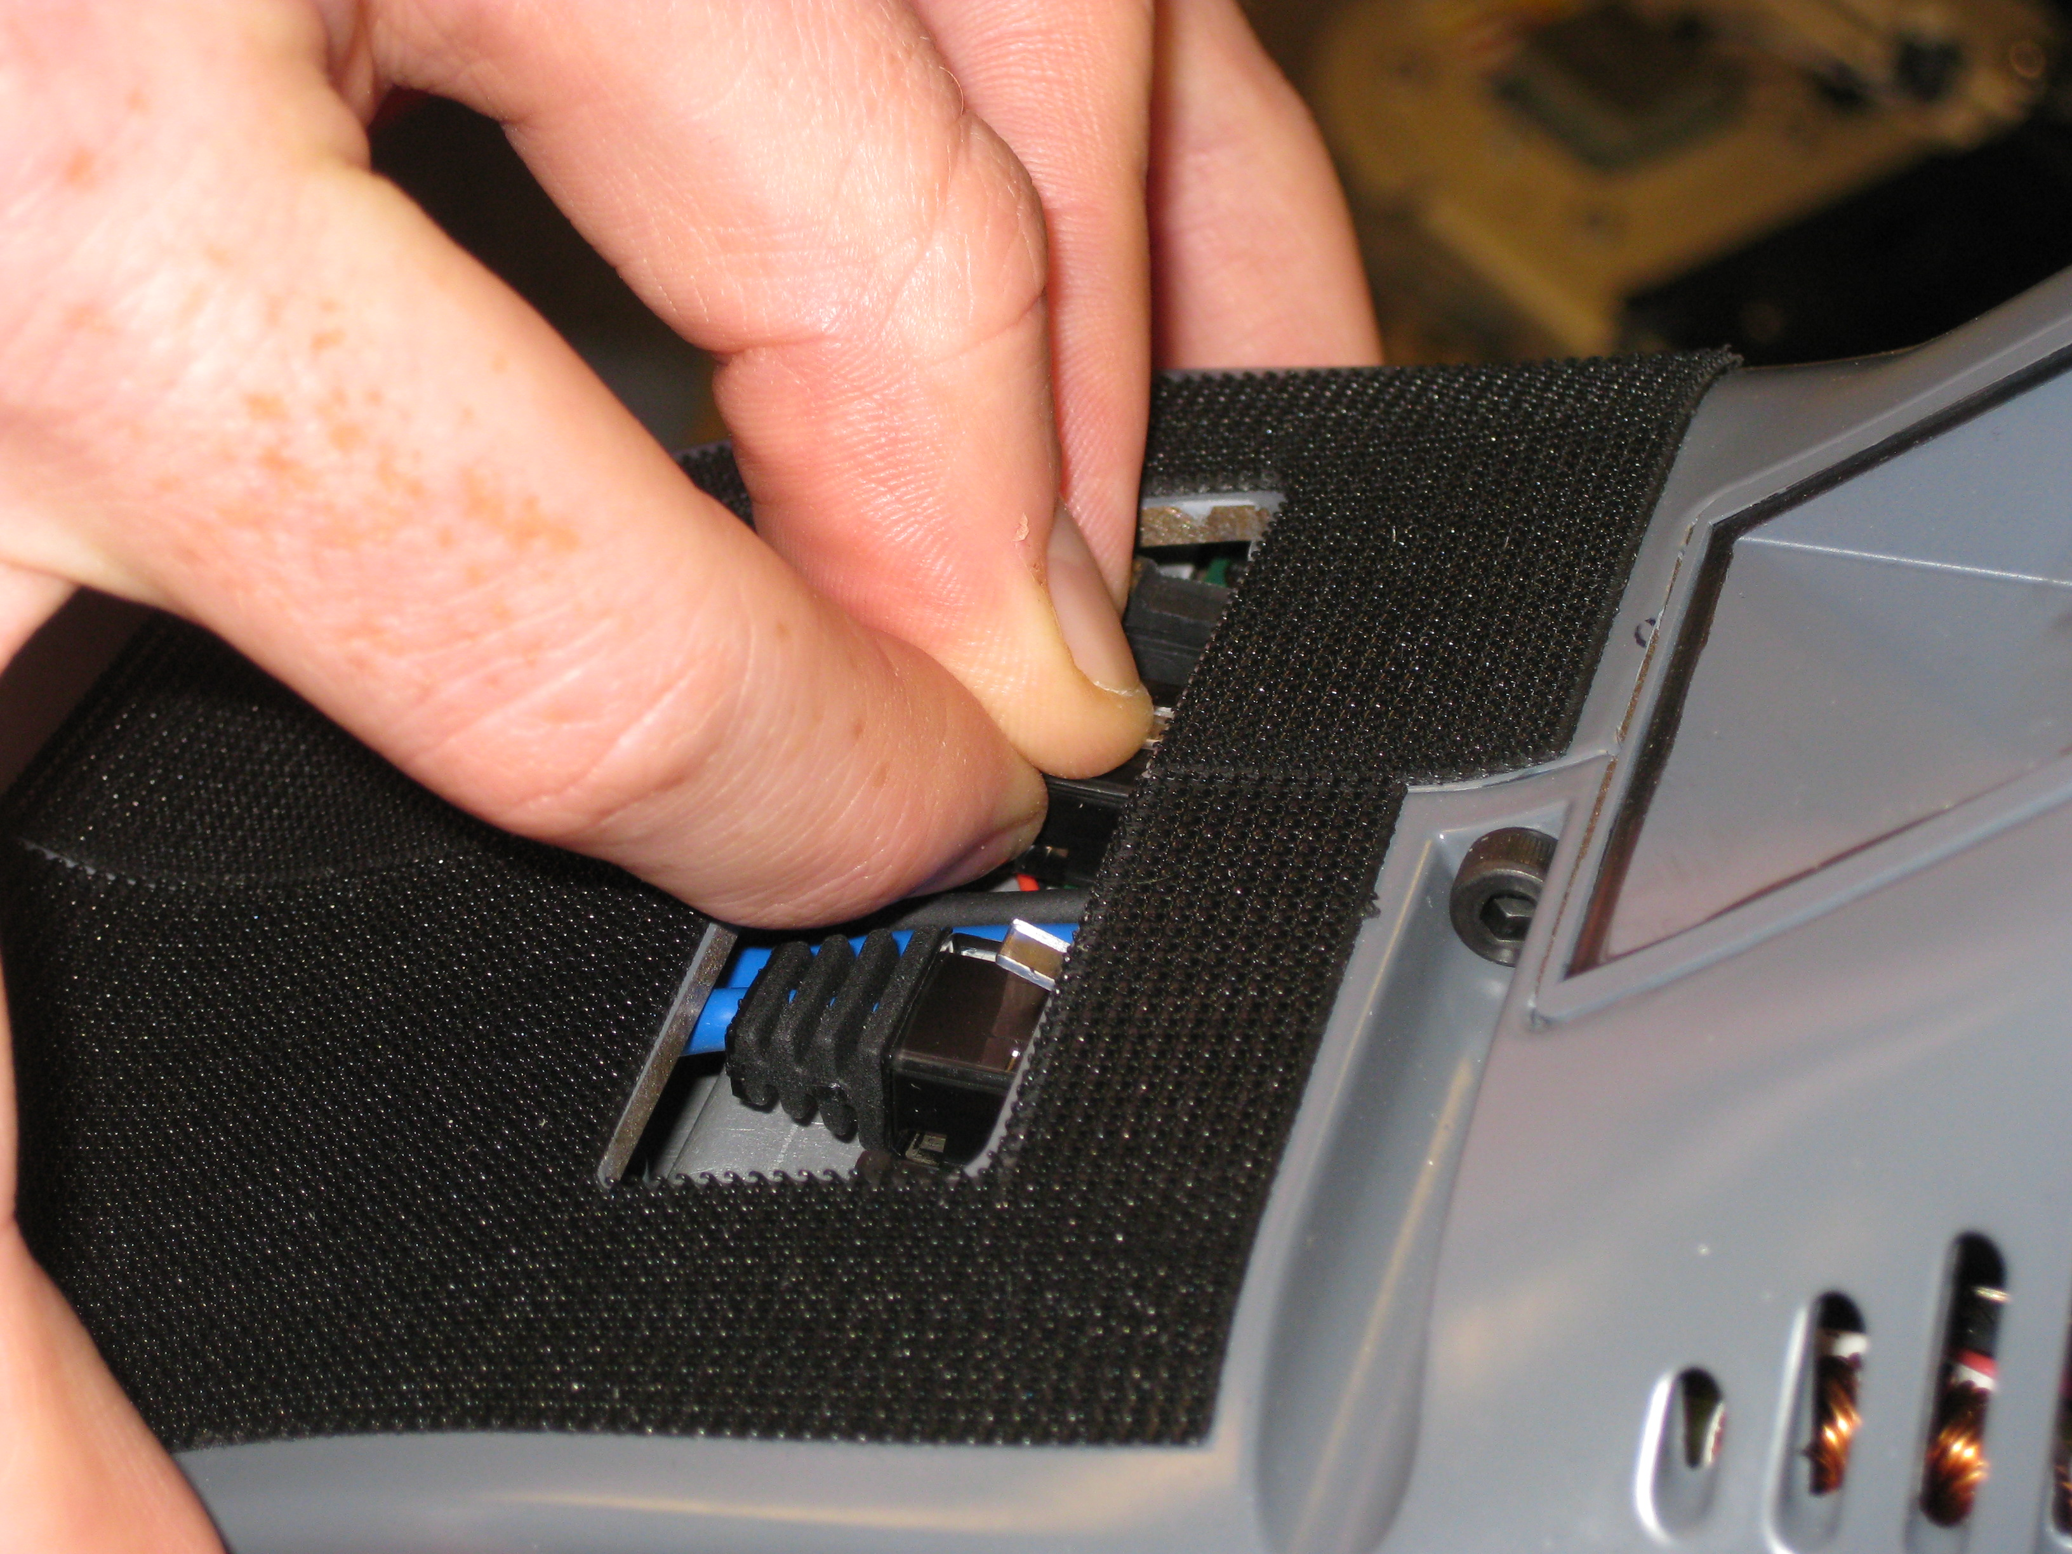
EtherCAT Plug Removal : Part 1
The plug is constrained and is difficult to remove. The trick to removing the plug is to push down on latch and pull the plug back just enough so that the latch will not pop back up.
Do NOT use pliers to do this. It takes finesse to remove plug not brute force.

Slide 7
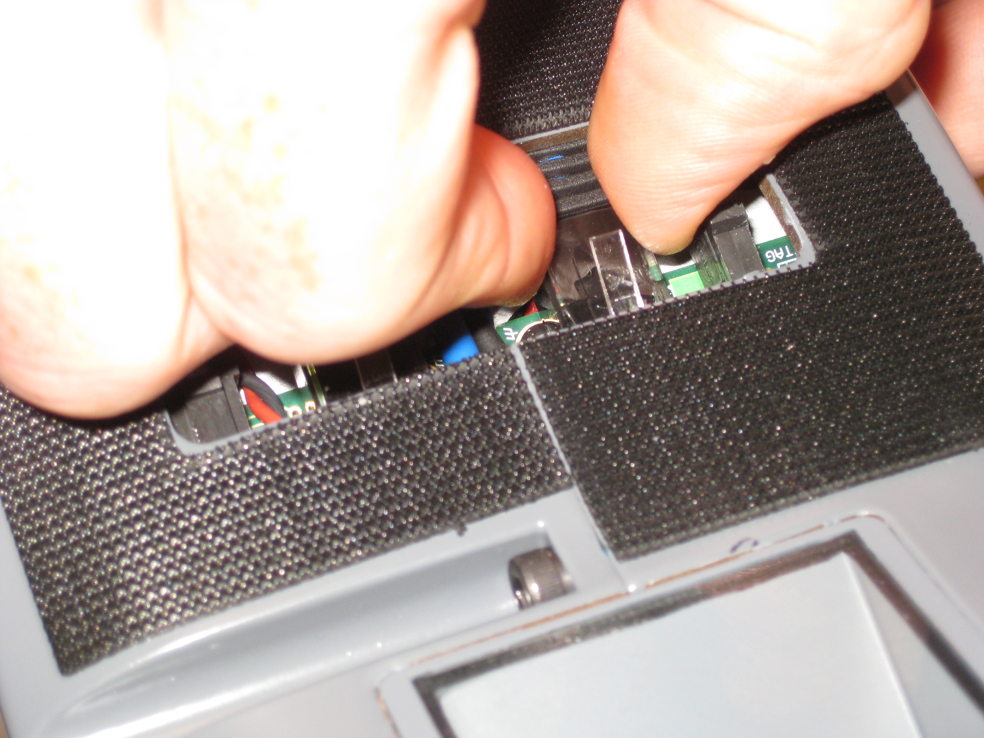
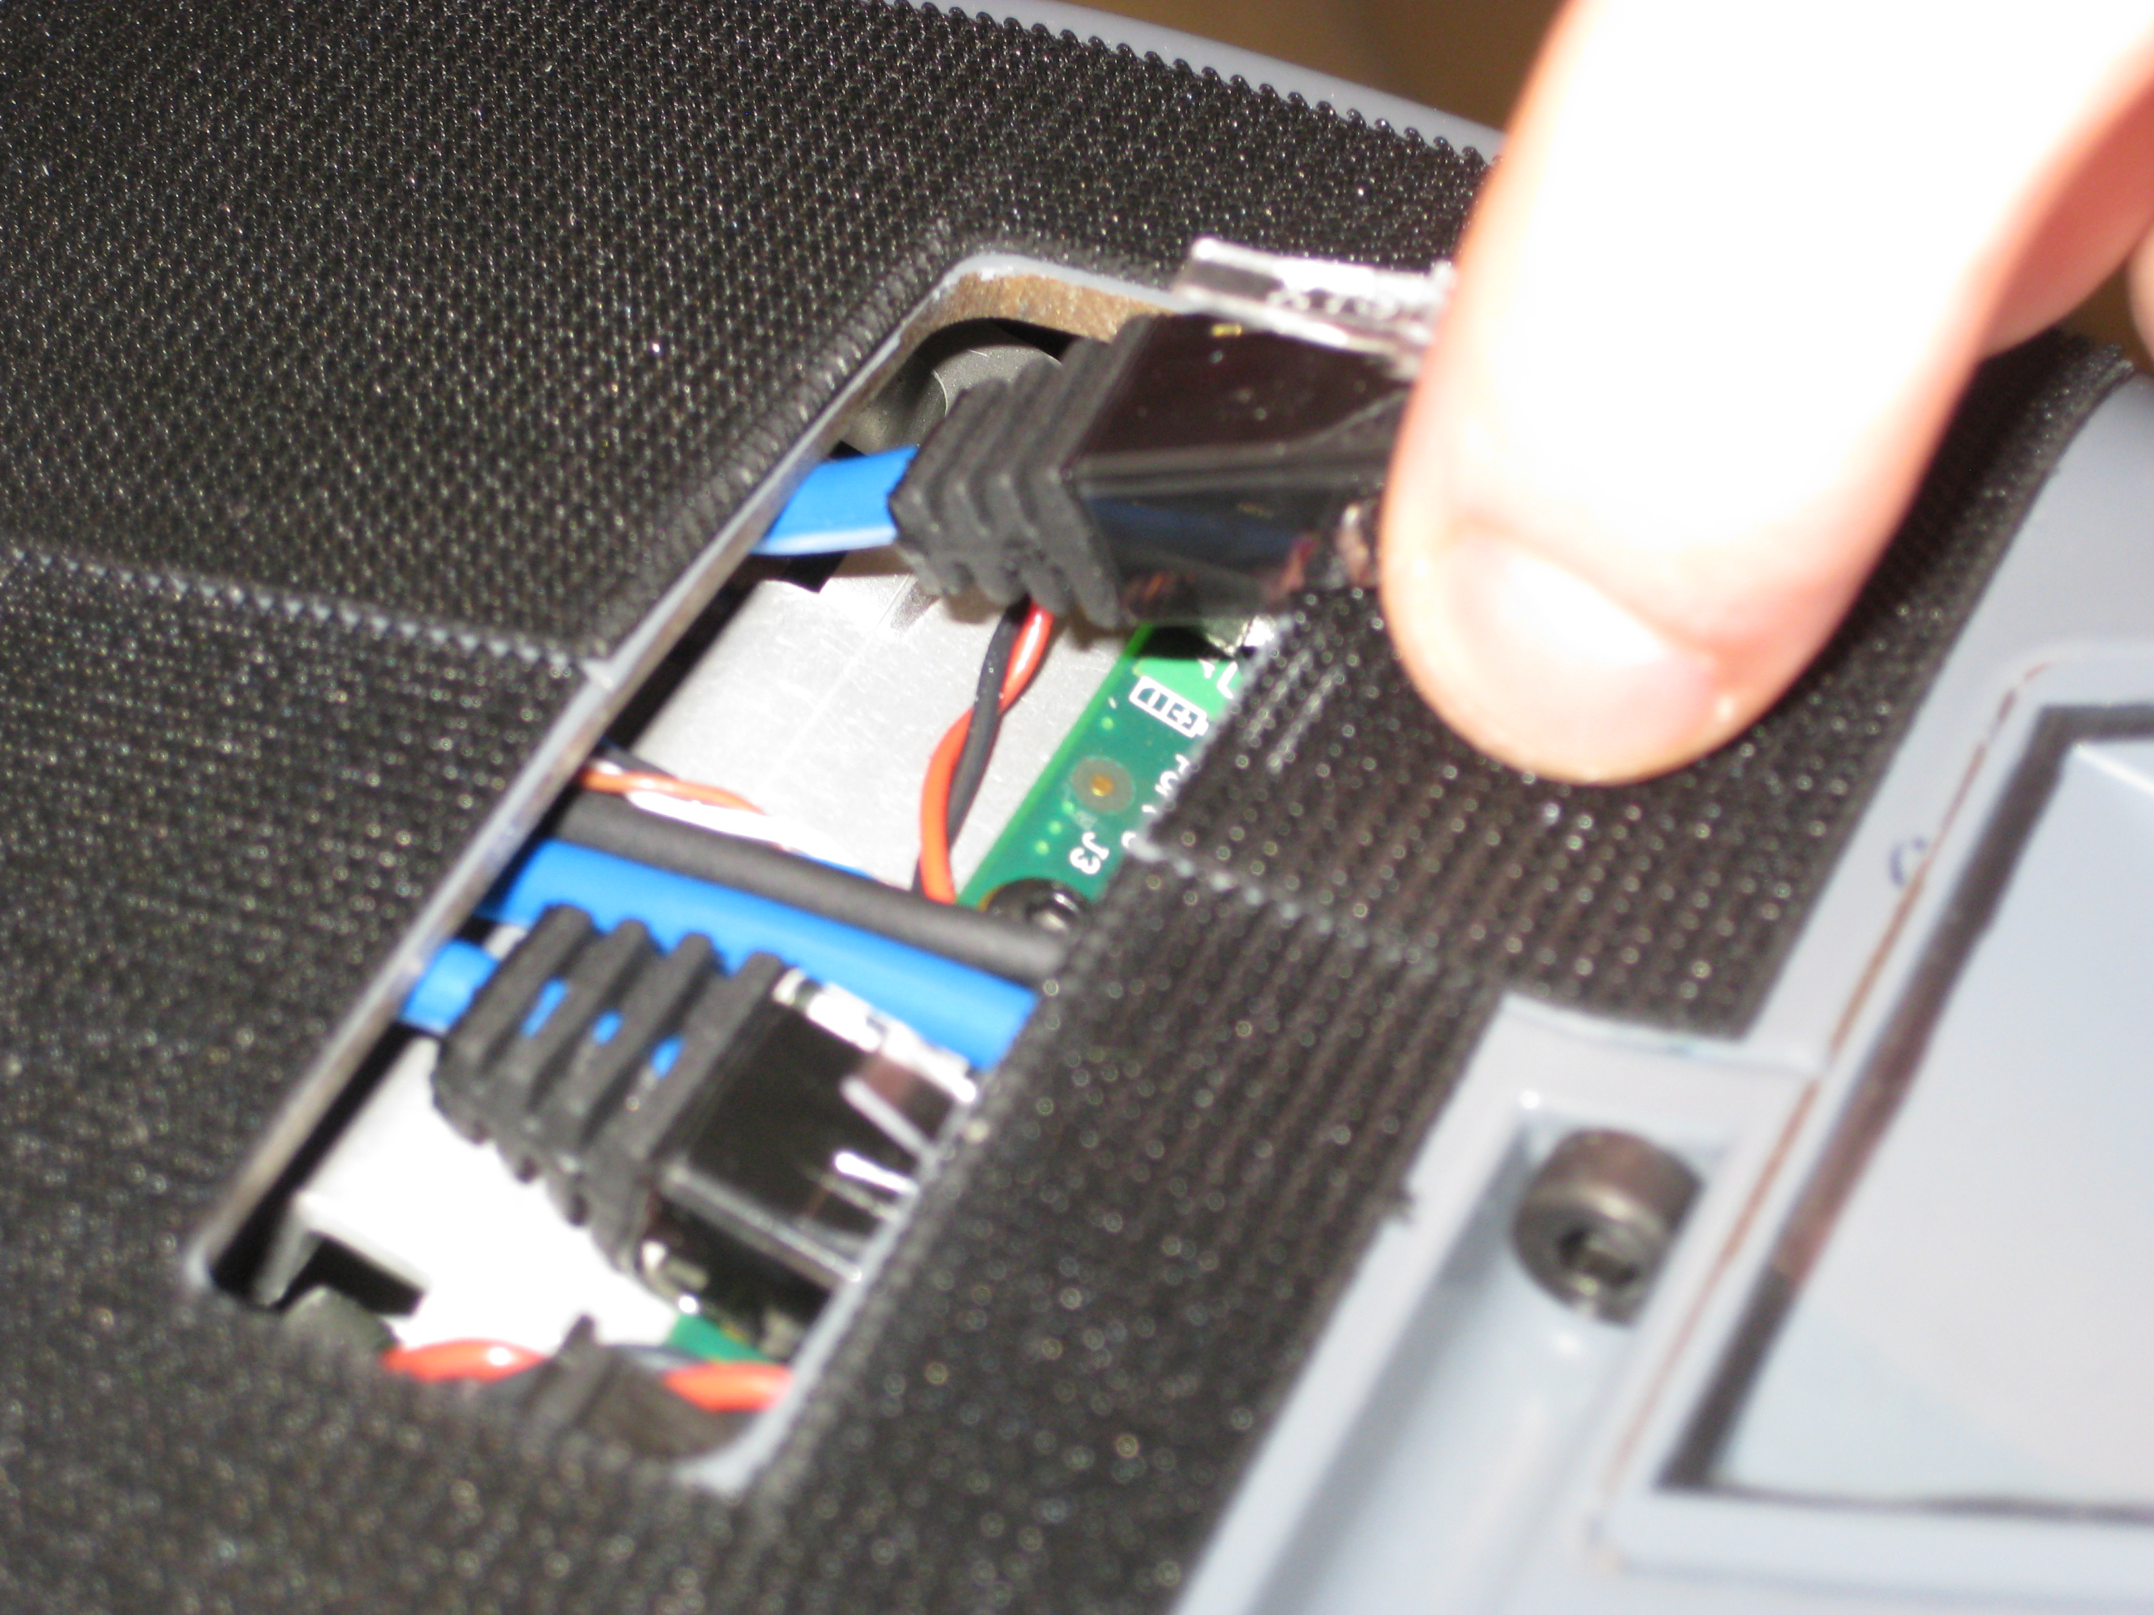
EtherCAT Plug Removal : Part 2
Once the latch is released, it is easier to pull the plug farther back and then move it out.

Slide 8
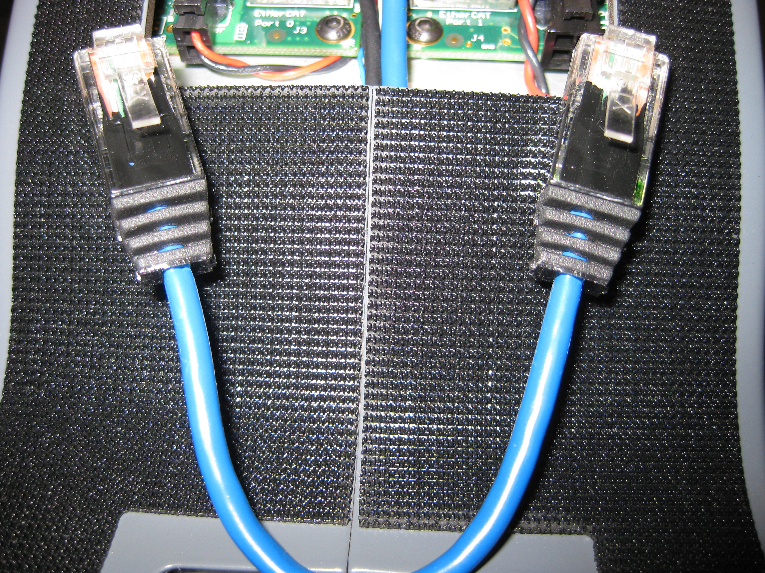
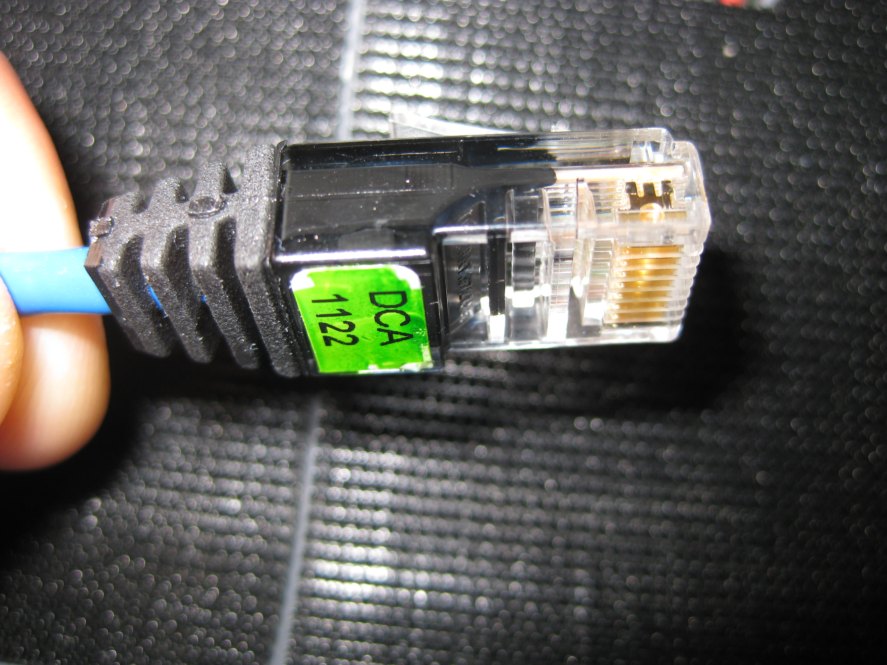
EtherCAT Cable Inspection
Once the cable has been removed, take a look at the cable and plug for any damage or cracking.

Slide 9
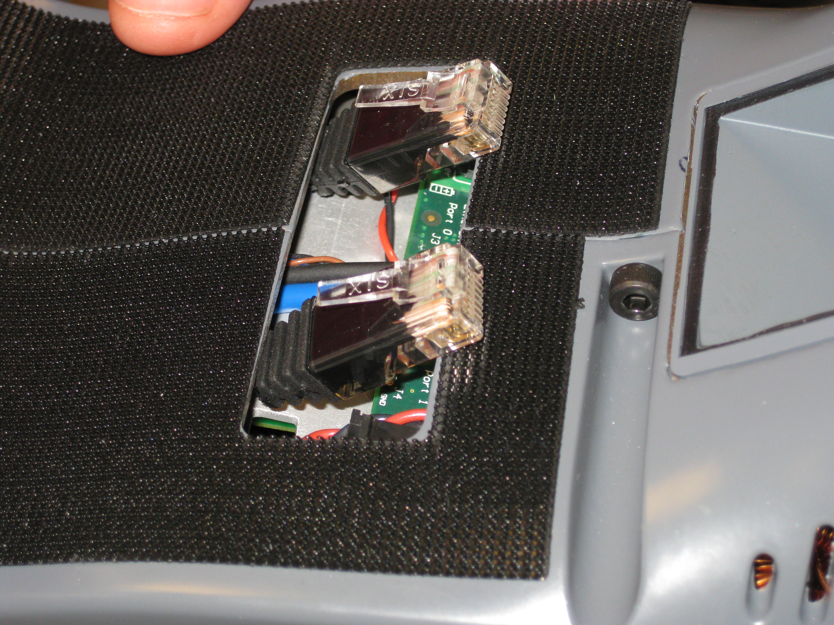
EtherCAT Plug Replace
Push the EtherCAT cable back into the forearm opening.
Then push each plug back into to connector. When plug latches, it should make a 'click'. The 'click' is made by latch engaging in the jack. If you don't hear the 'click' the plug is most likely not latched and may fall out over time. If you don't hear a 'click', pull the plug out and try reinserting it.

Slide 10
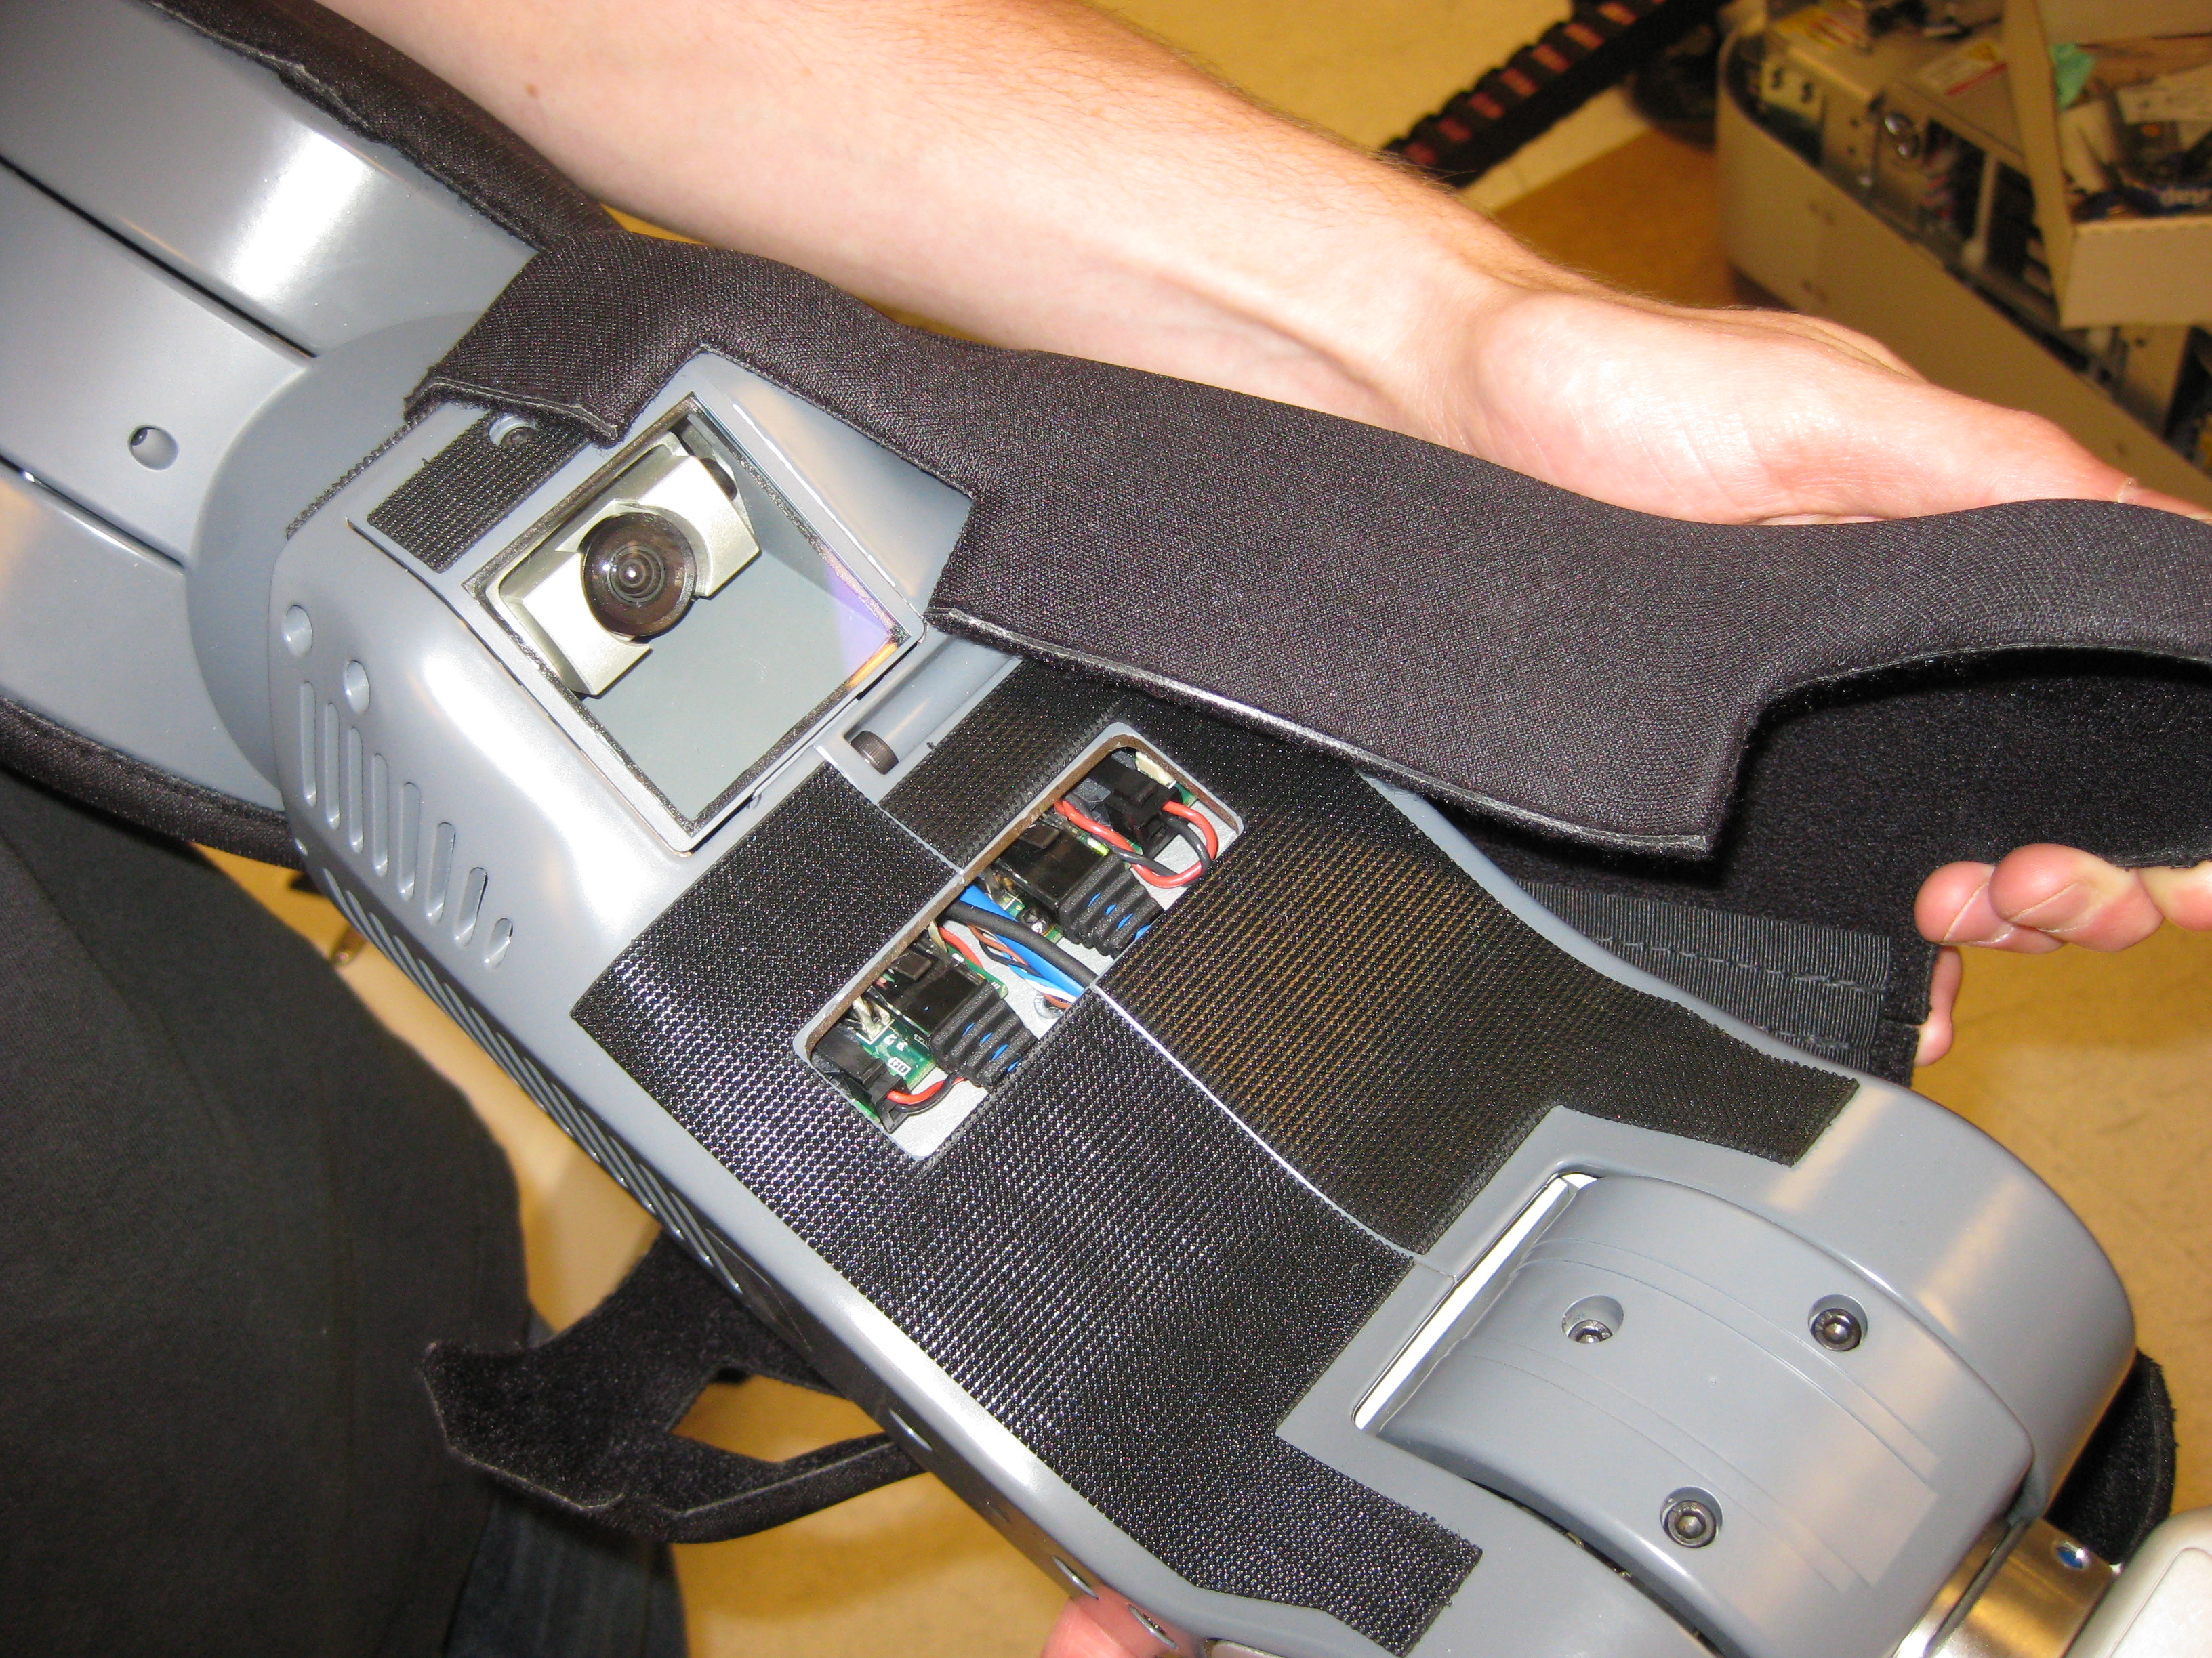
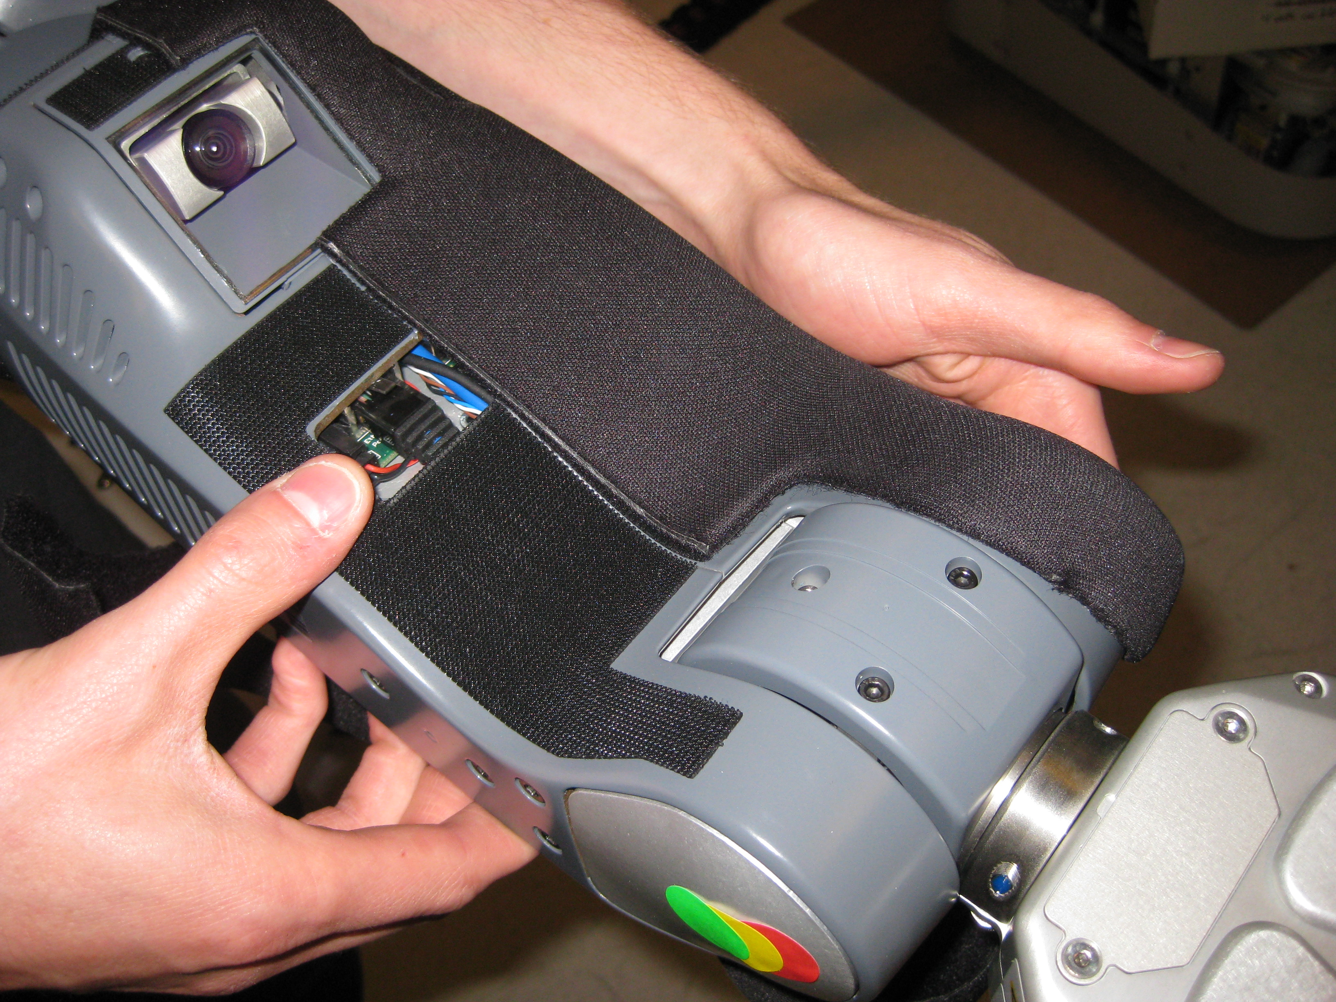
Forearm Cover Replace : Part 1
Replace the forearm cover starting from the back on one side. Then move toward gripper.

Slide 11
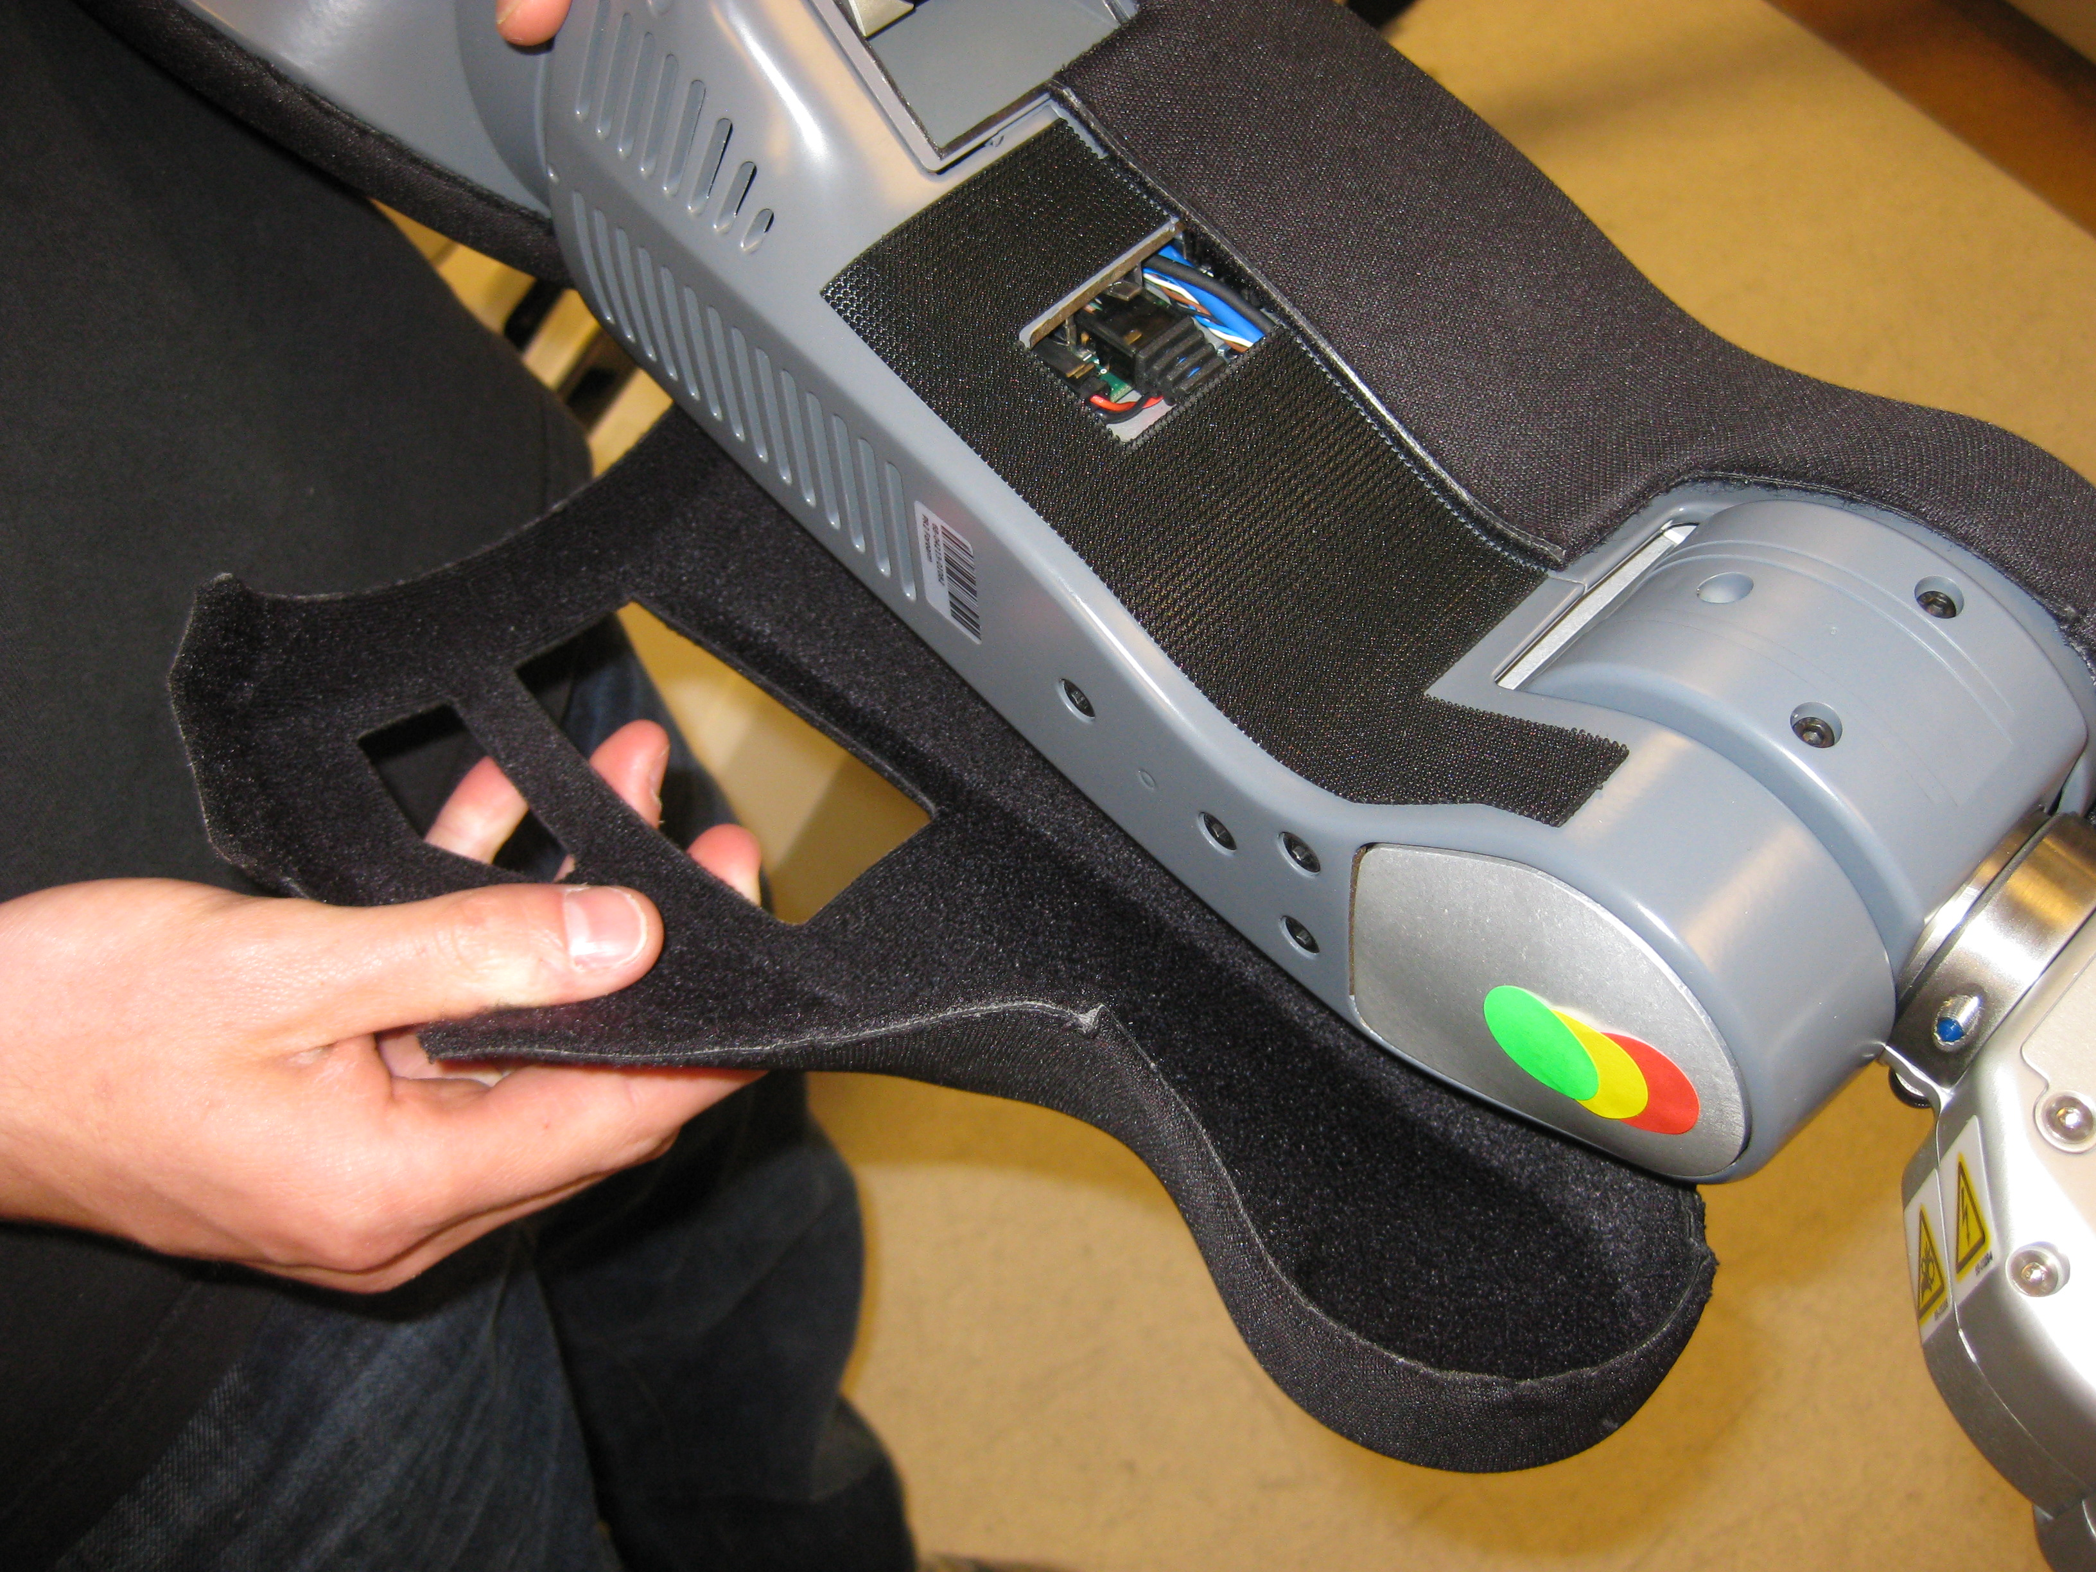
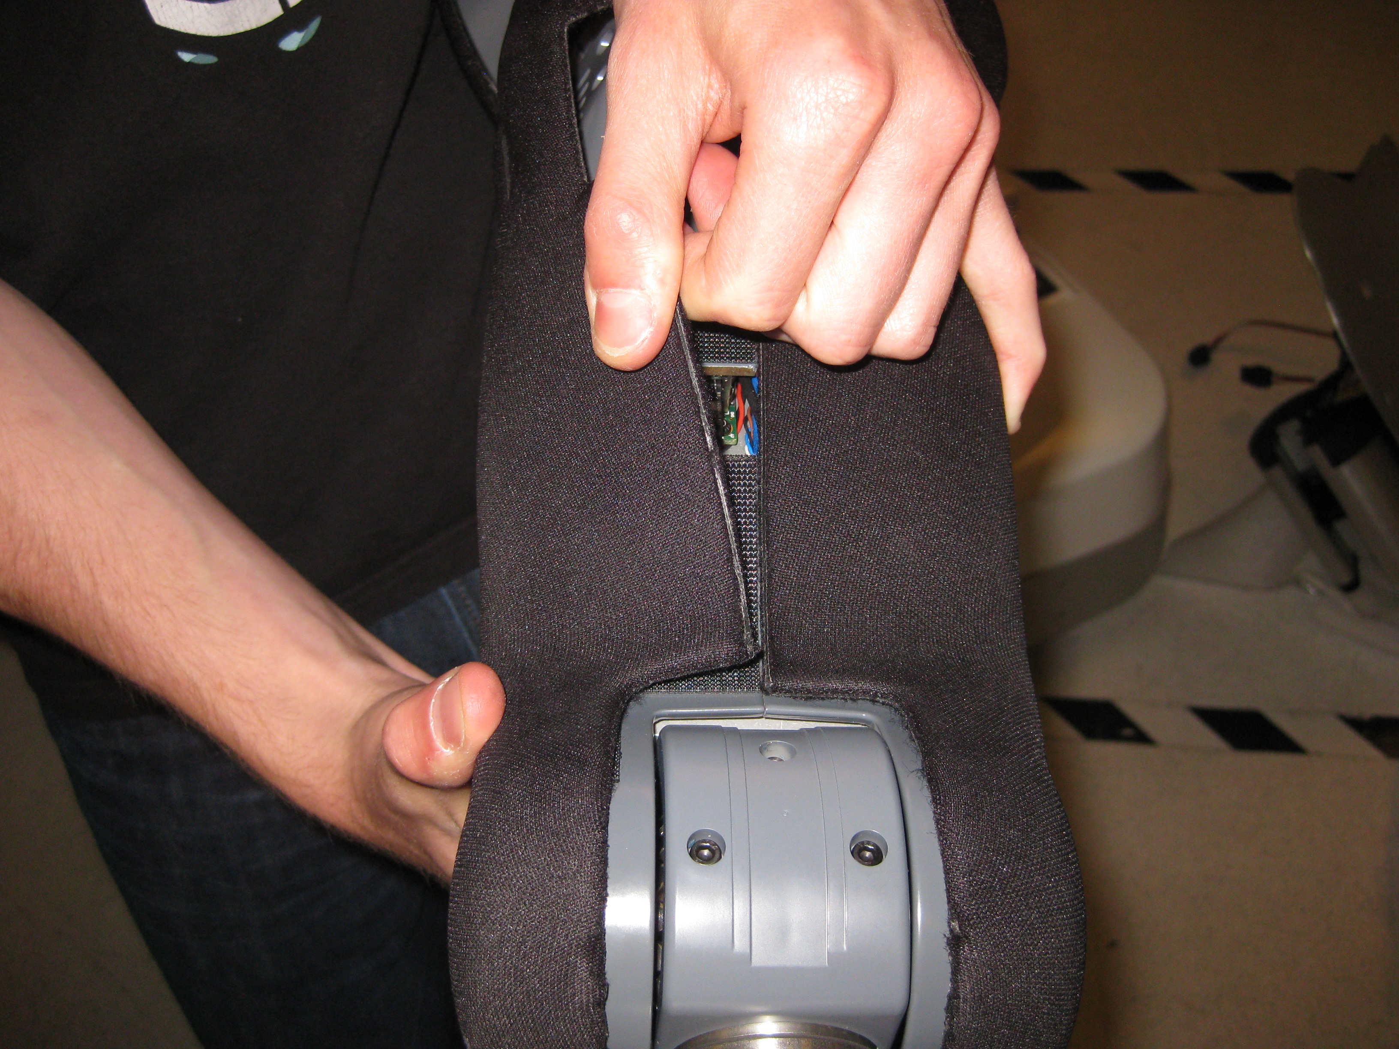
Forearm Cover Replace : Part 2
Then pull cover tight around back side of forearm and attach to Velcro on other side of forearm.

Slide 12
Post Install verification
After replacing cable. Power on the PR2 and then run:
  sudo pr2-systemcheck
If the “check_ethercat.sh” script displays an error, then you may not have properly connected the EtherCAT ports.

