Slide 1

Navigation Tutorial
Eitan Marder-Eppstein
May 25, 2010

Slide 2
Outline
Brief overview of navigation
Run navigation with SLAM to build a map
Send goals to the navigation stack through code
Learn how to save a map and use it for navigation later

Slide 3
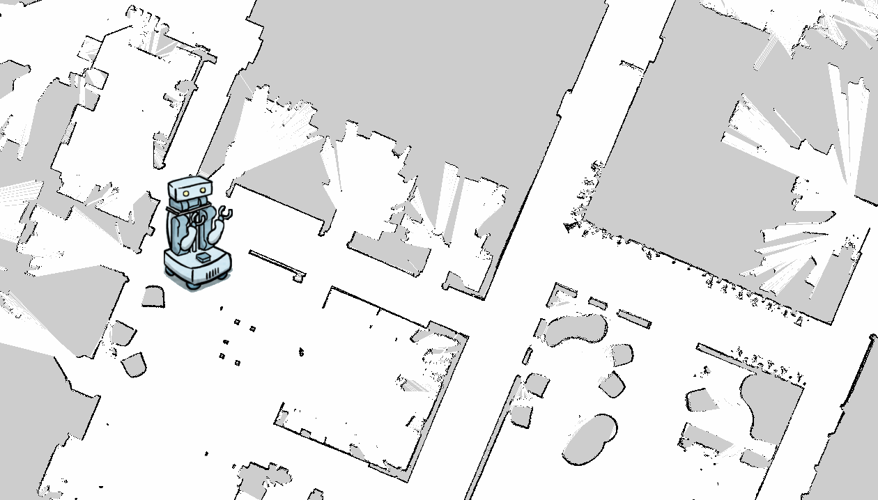
Overview
A
B

Slide 4
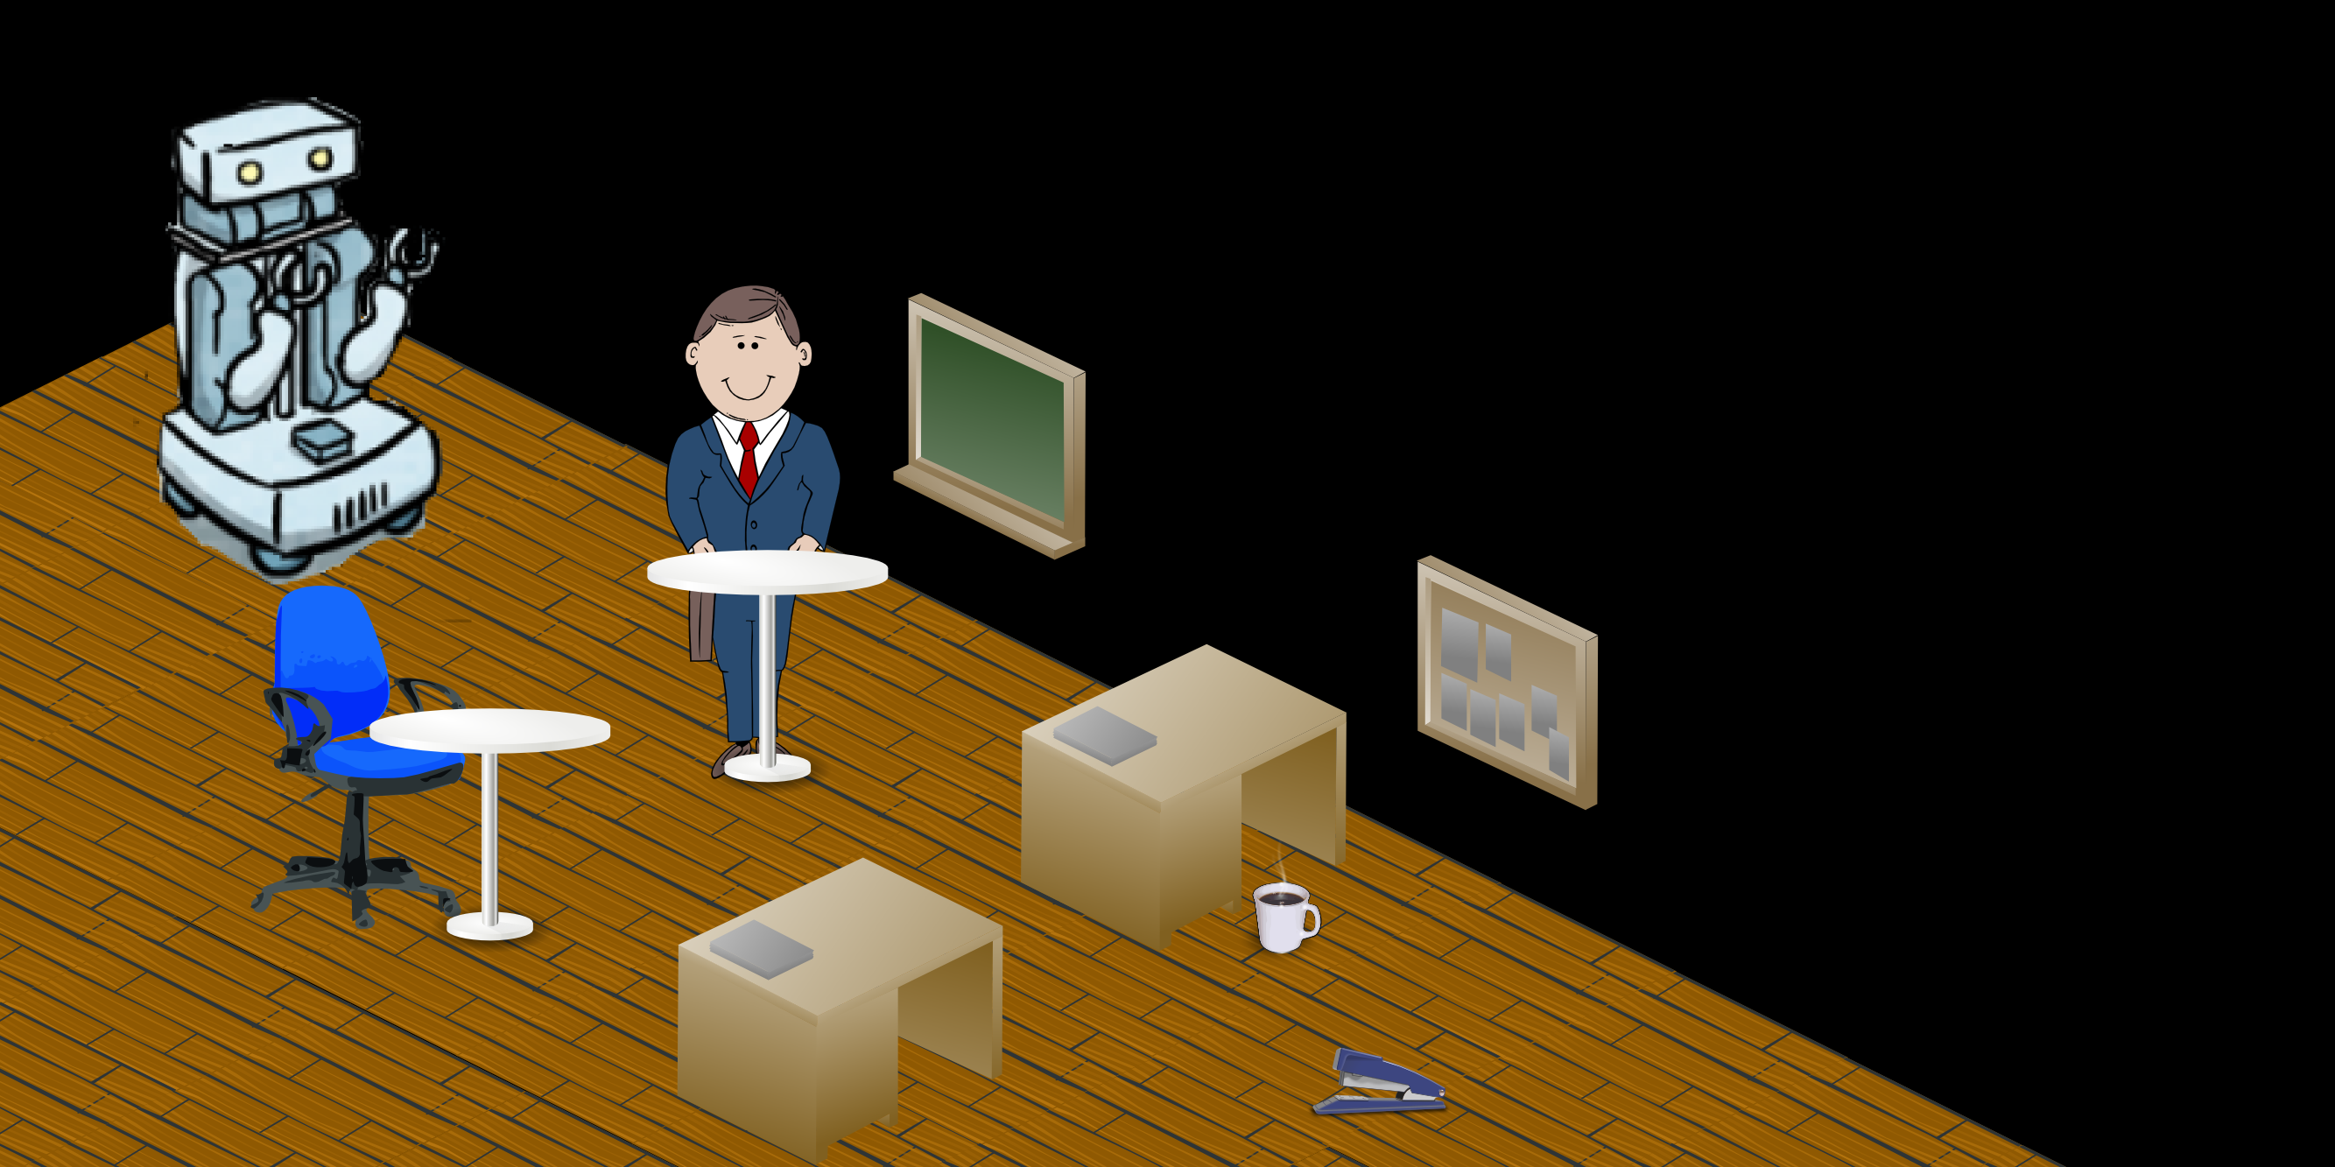
A Typical Office Environment

Slide 5

The PR2 Robot
Holonomic base.
Planar Hokuyo laser on base
Actuated Hokuyo laser just below head - takes 2 seconds to produce a full 3D scan of the environment

Slide 6
Obstacle Avoidance
Use a 3D Voxel Grid to store information about known free, known occupied, and unknown space

Slide 7
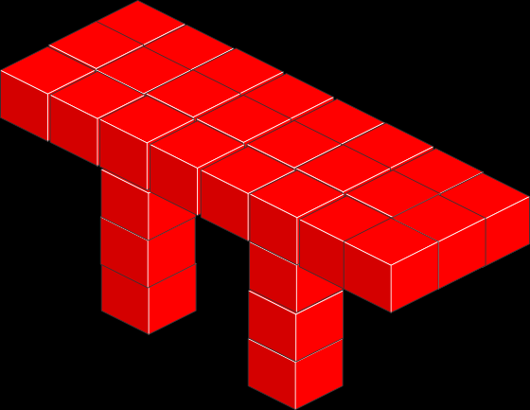
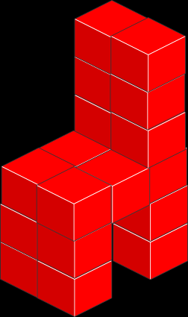
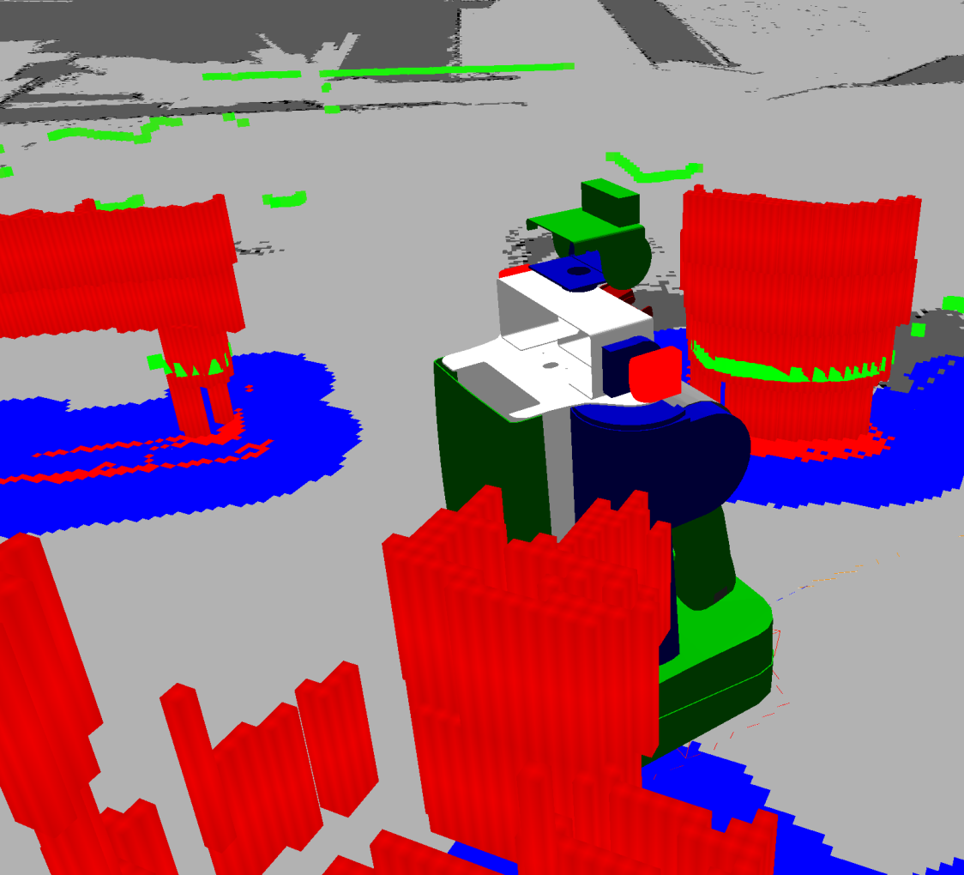
Voxel Grid

Slide 8
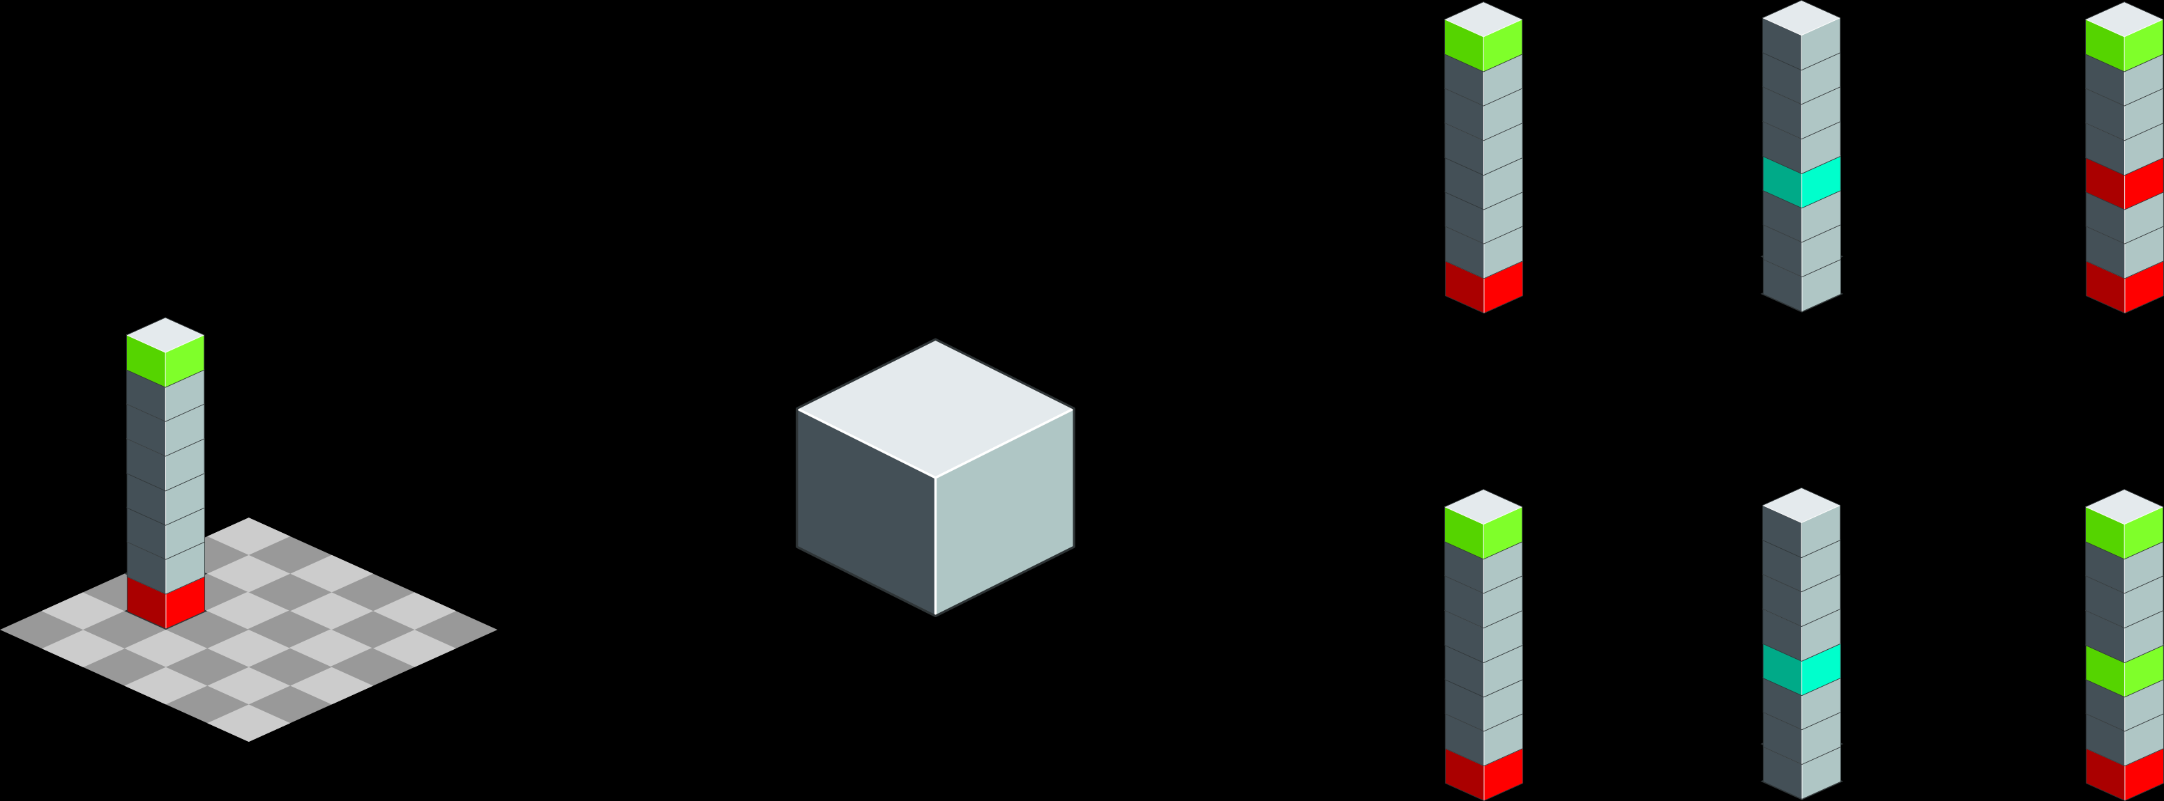
Voxel Grid Implementation
3D raytracing at 2D speed
Allows for tracking of unknown space
Marking in Column
|
=
2D Grid of
32-bit Integers
Clearing in Column
&~
=
Every 2-bits of each integer represents a cell at a different height
Notes:
Known Occupied: 11
Unknown: 01
Known Free: 00
z_mask = 1<<z<<16 | 1 << z

Slide 9
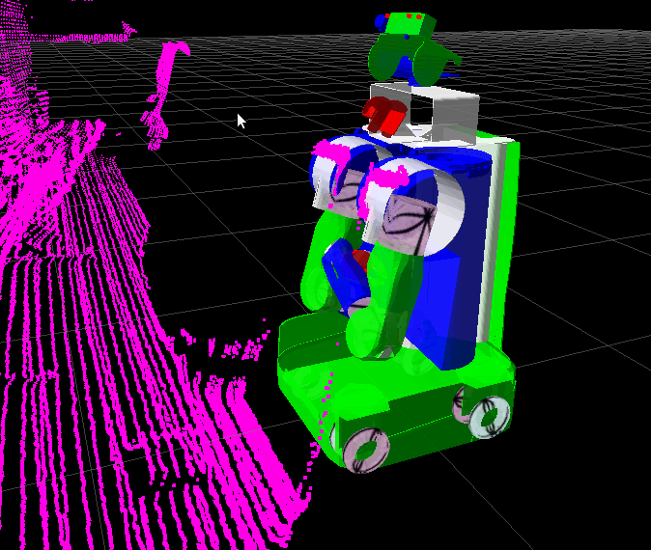
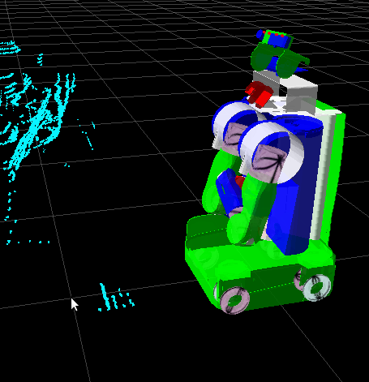
Sensor Processing Pipeline
Raw Sensor Data
Processed Sensor Data

Slide 10
Global Planner
Fast, grid based planner that uses an A* heuristic.
Optimistic, uses the inscribed circle of the robot for planning.

Slide 11
Local Planner
Forward simulates a number of possible velocity commands using the Dynamic Window Approach.
Checks for collisions using the footprint of the robot.

Slide 12
Frames Matter
localization jump
resulting obstacle
t = 1
t = 2
map
odom

Slide 13
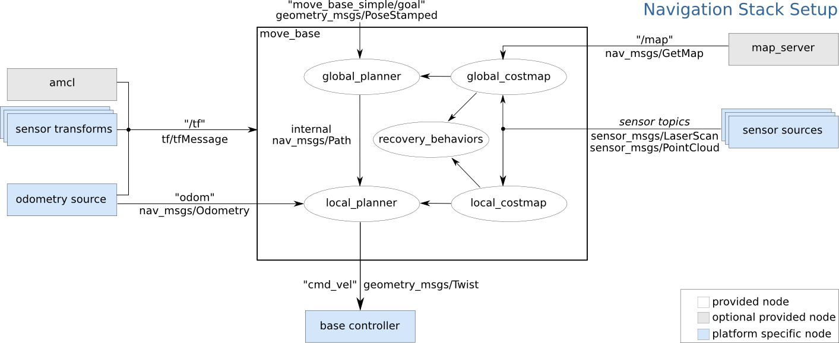
The Navigation Stack
http://www.ros.org/wiki/navigation

Slide 14
PR2 Navigation Flavors
pr2_2dnav_local: Navigation in the odometric frame. Does not use any localization or a user-provided map.
pr2_2dnav_slam: Navigation with SLAM, builds a map as you go.
pr2_2dnav: Navigation with a user-provided map. Requires that the user initialize localization in that map using rviz.

Slide 15
Task 1: Make a Map
Get things up and running on the robot:
  http://www.ros.org/wiki/pr2_2dnav_slam
  The joystick will be active, so you can drive the robot around
  You can also send goals to the navigation stack using the “2D Nav Goal” button in rviz
If you have extra time
  Play around with rviz, give the robot a goal and jump in front of it, put an object in the robot's path and see if it can avoid it, etc.

Slide 16
Task 2: Goals With Code
Complete the following tutorial
  http://www.ros.org/wiki/navigation/Tutorials/SimpleNavigationGoals
If you have extra time
  Try to send a goal to the navigation stack in the “map” frame instead of the “base_link” frame
  Try to send a goal to the navigation stack in python instead of C++ (http://www.ros.org/wiki/actionlib)

Slide 17
Task 3: Save and Use a Map
Follow instructions on using the “map_saver” tool
  http://www.ros.org/wiki/map_server
Bring down pr2_2dnav_slam
Follow instructions on using the “map_server” tool
  http://www.ros.org/wiki/map_server
Run pr2_2dnav
  http://www.ros.org/wiki/pr2_2dnav
  Send a goal using rviz or your code
If you have extra time
  Ask any questions you might have. Try to come up with something on your own. Take a break.

Slide 18
#wait for the action server to be available
move_base_client = actionlib.SimpleActionClient('move_base_local', MoveBaseAction)
move_base_client.wait_for_server()
#construct a simple goal in the base_link frame
goal = MoveBaseGoal()
goal.target_pose.header.frame_id = 'base_link'
goal.target_pose.pose.position.x = 1.0
goal.target_pose.pose.orientation.w = 1.0
#send the goal and wait for the base to get there
move_base_client.send_goal_and_wait(goal)

Slide 19
#Get the pose of the 3x4 checkerboard
get_checkerboard_pose = rospy.ServiceProxy('wide_get_checkerboard_pose', GetCheckerboardPose)
board_pose = get_checkerboard_pose(3, 4, .108, .108).board_pose

Slide 20
#given the pose of the checkerboard, get a good pose to approach it from
get_approach_pose = rospy.ServiceProxy('get_approach_pose', GetApproachPose)
nav_pose = get_approach_pose(board_pose).nav_pose

Slide 21
#OK... our nav_pose is now ready to be sent to the navigation stack as a goal
move_base_client = actionlib.SimpleActionClient('move_base_local', MoveBaseAction)
move_base_client.wait_for_server()
goal = MoveBaseGoal()
goal.target_pose = nav_pose
#send the goal and wait for the base to get there
move_base_client.send_goal_and_wait(goal)

