Slide 1
Processing Laser Data
ROS + PR2 Training Workshop

Slide 2
Outline
Lasers and 3D sensing
Visualizing Laser Scans
From LaserScan to PointCloud
What are Point Clouds?
Data representation
Visualizing PointCloud messages
Preview :: ROS C-Turtle (latest)
Notes:
Overview of the PR2 cameras, viewing camera data and the image pipeline.
Start with the cameras, what each one is good for, and how to view the image streams.

Slide 3
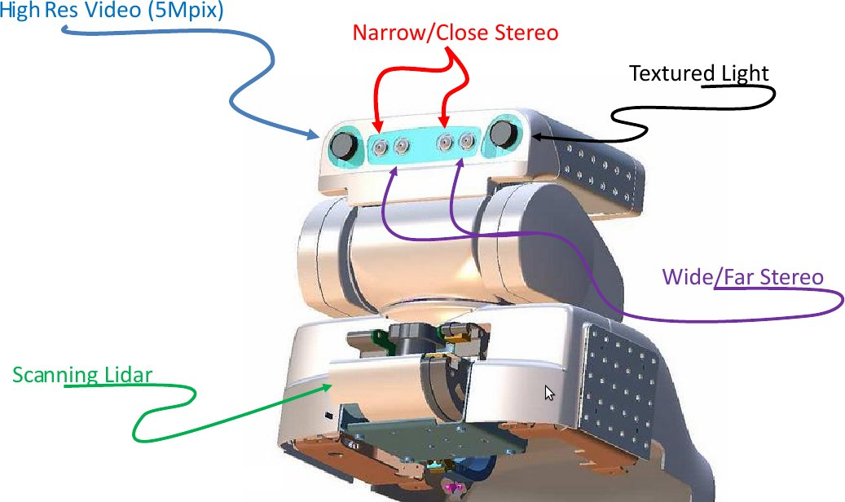
Lasers and 3D sensing
Stereo cameras in the head
Tilting laser range finder
Base laser range finder

Slide 4
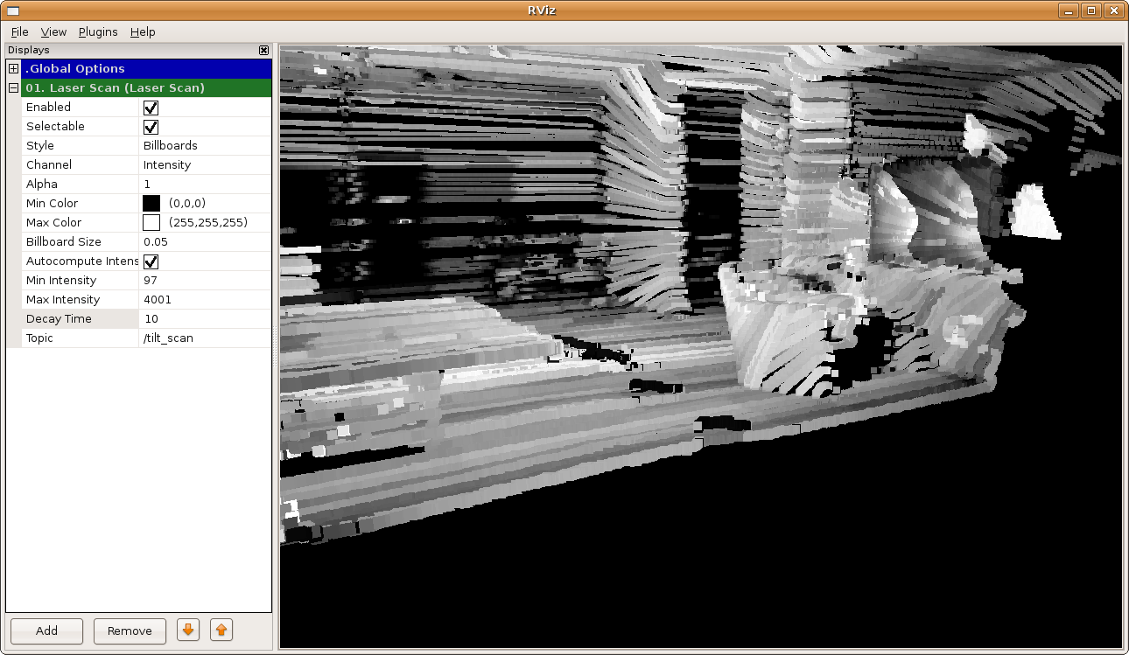
Visualizing Laser Scans
rviz (http://www.ros.org/wiki/rviz/DisplayTypes/LaserScan)
  $ rosrun rviz rviz
  Add a Laser Scan display
  Set the topic and the TF frames (Fixed/Target)

Slide 5
Outline
Lasers and 3D sensing
Visualizing Laser Scans
From LaserScan to PointCloud
What are Point Clouds?
Data representation
Visualizing PointCloud messages
Preview :: ROS C-Turtle (latest)
Notes:
Overview of the PR2 cameras, viewing camera data and the image pipeline.
Start with the cameras, what each one is good for, and how to view the image streams.

Slide 6
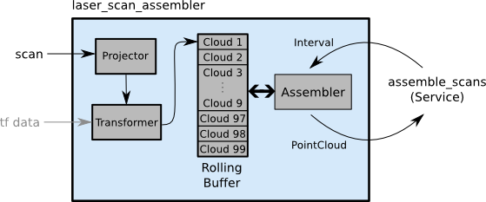
From LaserScan to PointCloud
Check if the tilt laser is being actuated
(http://www.ros.org/wiki/pr2_mechanism_controllers/LaserScannerTrajController)
laser_assembler (http://www.ros.org/wiki/laser_assembler)
  create PointCloud from LaserScan messages

Slide 7
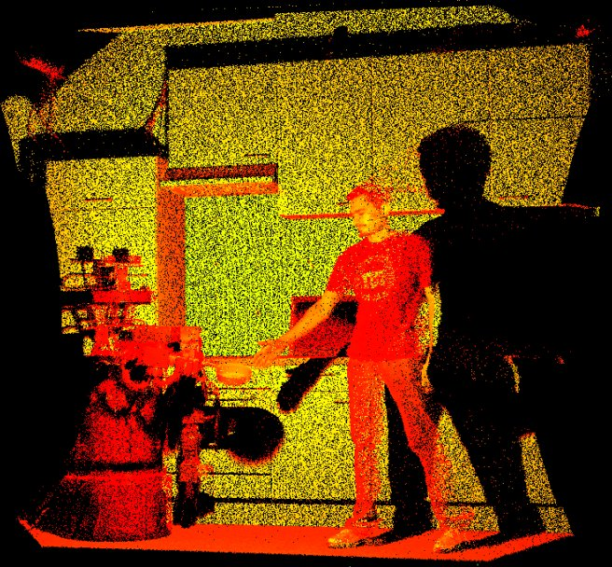
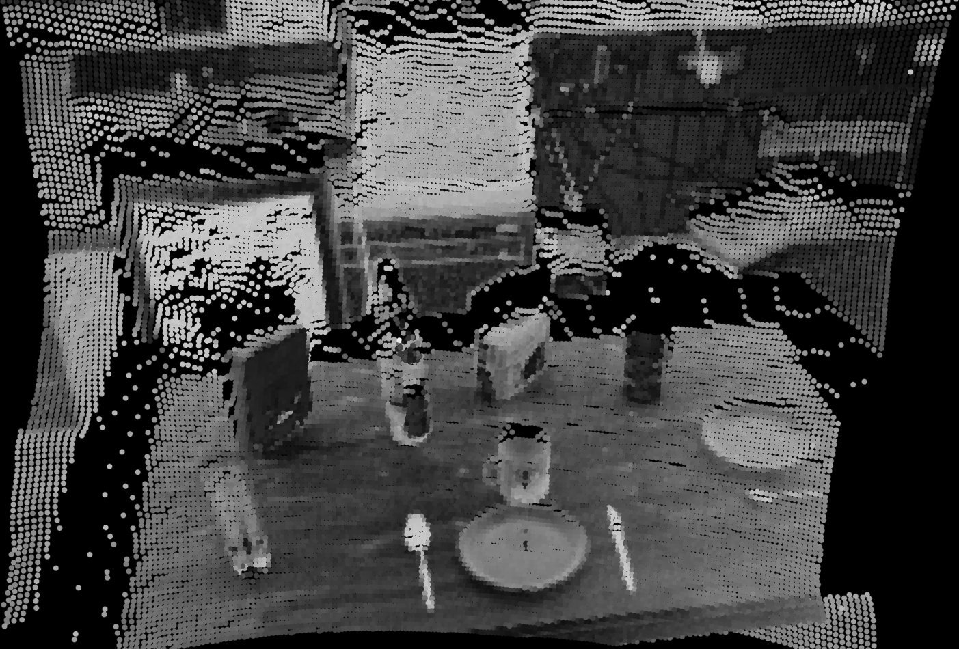
What are Point Clouds?
Point Cloud = a “cloud” (i.e., collection) of nD points (usually n = 3)
p = {x, y, z} → P = {p1, p2,..., pn}
represent 3D information about the world

Slide 8
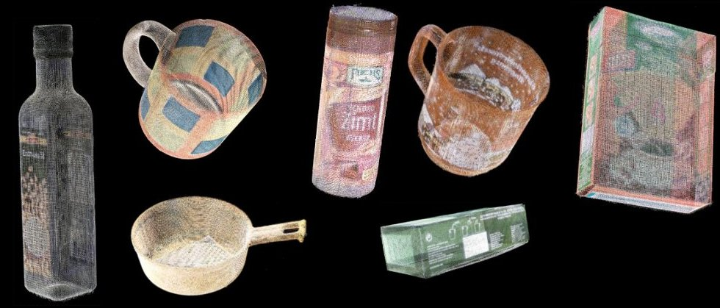
What are Point Clouds?
besides XYZ data, each point p can hold additional information
examples include: RGB colors, intensity values, distances, segmentation results, etc

Slide 9
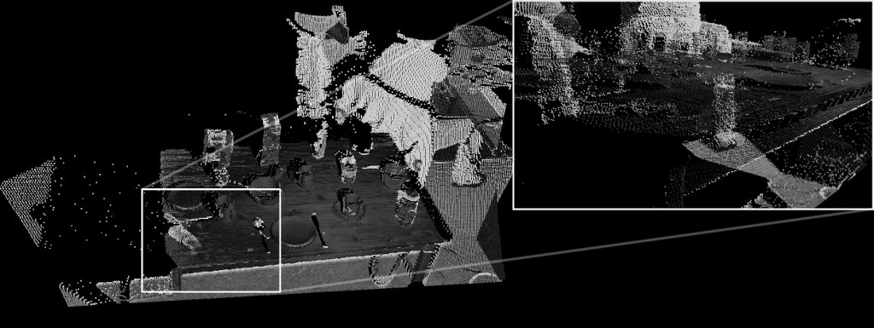
What are Point Clouds?
intensity data

Slide 10
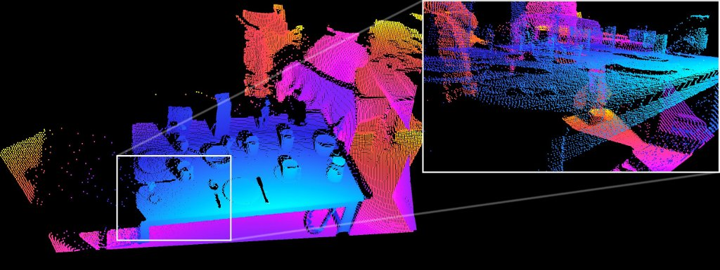
What are Point Clouds?
distance data

Slide 11
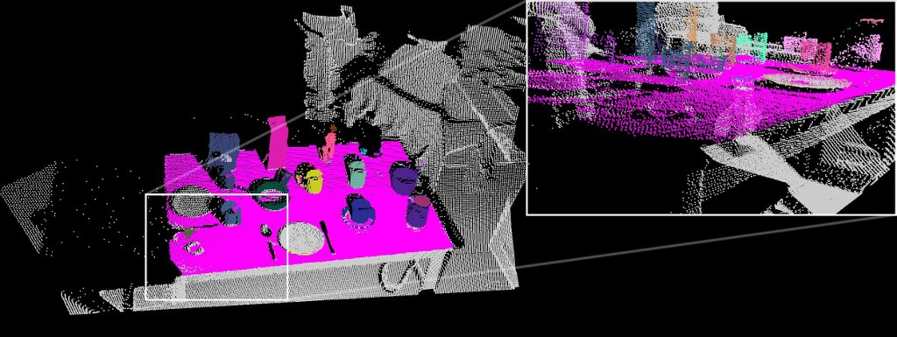
What are Point Clouds?
segmentation data

Slide 12
Data representation
a point p is a n-tuple, e.g.
pi ={xi,yi,zi,ri,gi,bi,...}
a Point Cloud P is represented as a collection of points p_{i}, e.g. P={p1, p2,..., pn}
in terms of data structures, an XYZ point can be represented as: float32 x, float32 y, float32 z
an n-dimensional point is then: float32[] point
therefore a Point Cloud P is Point[] points

Slide 13
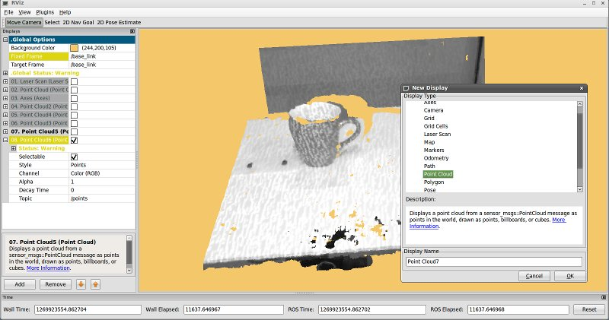
Visualizing Point Clouds
rviz (http://www.ros.org/wiki/rviz/DisplayTypes/PointCloud)
  $ rosrun rviz rviz
  Add a Point Cloud display
  Set the topic and the TF frames (Fixed/Target)

Slide 14
Outline
Lasers and 3D sensing
Visualizing Laser Scans
From LaserScan to PointCloud
What are Point Clouds?
Data representation
Visualizing PointCloud messages
Preview :: ROS C-Turtle (latest)
Notes:
Overview of the PR2 cameras, viewing camera data and the image pipeline.
Start with the cameras, what each one is good for, and how to view the image streams.

Slide 15
Preview :: ROS C-Turtle (latest)
Preview
PointCloud2 message types: compact, aligned, efficient representations for point clouds
PCL (Point Cloud Library): a full package for 3D processing

Slide 16
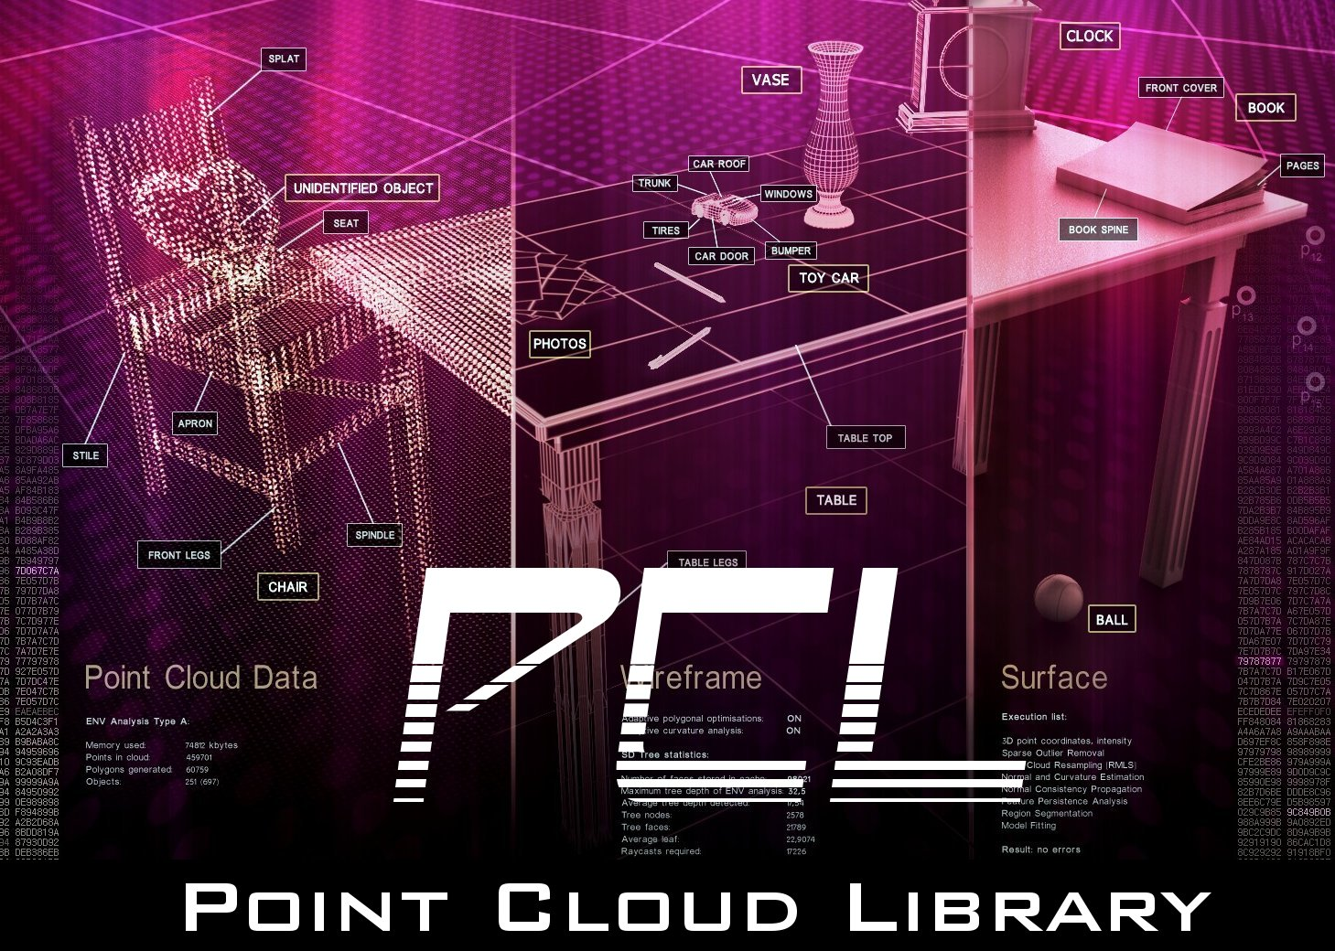
Point Cloud Library (PCL)

Slide 17
PCL Tutorials
http://www.ros.org/wiki/pcl/Tutorials
Downsampling data (VoxelGrid)
Planar model segmentation (SACSegmentation)
Exercise: build a node that segments a table in front of the robot
PROBLEM: Not all tools support PointCloud2 (!!!)
SOLUTION:
  $ rosrun point_cloud_converter point_cloud_converter points2_in:=MYTOPIC

Slide 18
PCL VoxelGrid - downsampling
1 #include <pcl/filters/voxel_grid.h>
2 #include <pcl/point_types.h>
3 int main (int argc, char **argv) {
4 ros::init (argc, argv, "pcl_demo");
5 ros::NodeHandle nh;
6 point_cloud::Publisher<pcl::PointXYZ> pub_downsampled;
7 pub_downsampled.advertise (nh, "downsampled", 1);
8
9 pcl::PointCloud<pcl::PointXYZ> cloud, cloud_downsampled;
10 pcl::VoxelGrid<pcl::PointXYZ> grid;
11 grid.setFilterFieldName ("z");
12 grid.setLeafSize (0.01, 0.01, 0.01);
13 grid.setFilterLimits (0.4, 1.6);
14 while (nh.ok ()) {
15 sensor_msgs::PointCloud2ConstPtr cloud2_blob_ptr = ros::topic::waitForMessage<sensor_msgs::PointCloud2>("/narrow_stereo_textured/points2");
16 point_cloud::fromMsg (*cloud2_blob_ptr, cloud);
17 grid.setInputCloud (boost::make_shared<pcl::PointCloud<pcl::PointXYZ> > (cloud));
18 grid.filter (cloud_downsampled);
19 pub_downsampled.publish (cloud_downsampled);
20 }
21 }

Slide 19
PCL Segmentation - planar
#include <pcl/filters/project_inliers.h>
#include <pcl/segmentation/sac_segmentation.h>
#include <pcl/PointIndices.h>
#include <pcl/ModelCoefficients.h>
…
point_cloud::Publisher<pcl::PointXYZ> pub_plane;
pub_plane.advertise (nh, "plane", 1);
…
pcl::PointIndices plane_inliers;
pcl::ModelCoefficients plane_coefficients;
…
pcl::SACSegmentation<pcl::PointXYZ> seg;
seg.setDistanceThreshold (0.05);
seg.setMaxIterations (1000);
seg.setModelType (pcl::SACMODEL_PLANE);
seg.setMethodType (pcl::SAC_RANSAC);
pcl::ProjectInliers<pcl::PointXYZ> proj;
proj.setModelType (pcl::SACMODEL_PLANE);
…
seg.setInputCloud (boost::make_shared<pcl::PointCloud<pcl::PointXYZ> > (cloud_downsampled));
seg.segment (plane_inliers, plane_coefficients);
proj.setInputCloud (boost::make_shared<pcl::PointCloud<pcl::PointXYZ> > (cloud_downsampled));
proj.setIndices (boost::make_shared<pcl::PointIndices> (plane_inliers));
proj.setModelCoefficients (boost::make_shared<pcl::ModelCoefficients> (plane_coefficients));
…
pub_plane.publish (cloud_plane);

Slide 20
Questions?
http://www.ros.org/
http://www.ros.org/wiki/pcl
ros-users@code.ros.org

