Slide 1

Toolkit Doc 24
PR2 Battery R&R
December 20, 2012

Slide 2
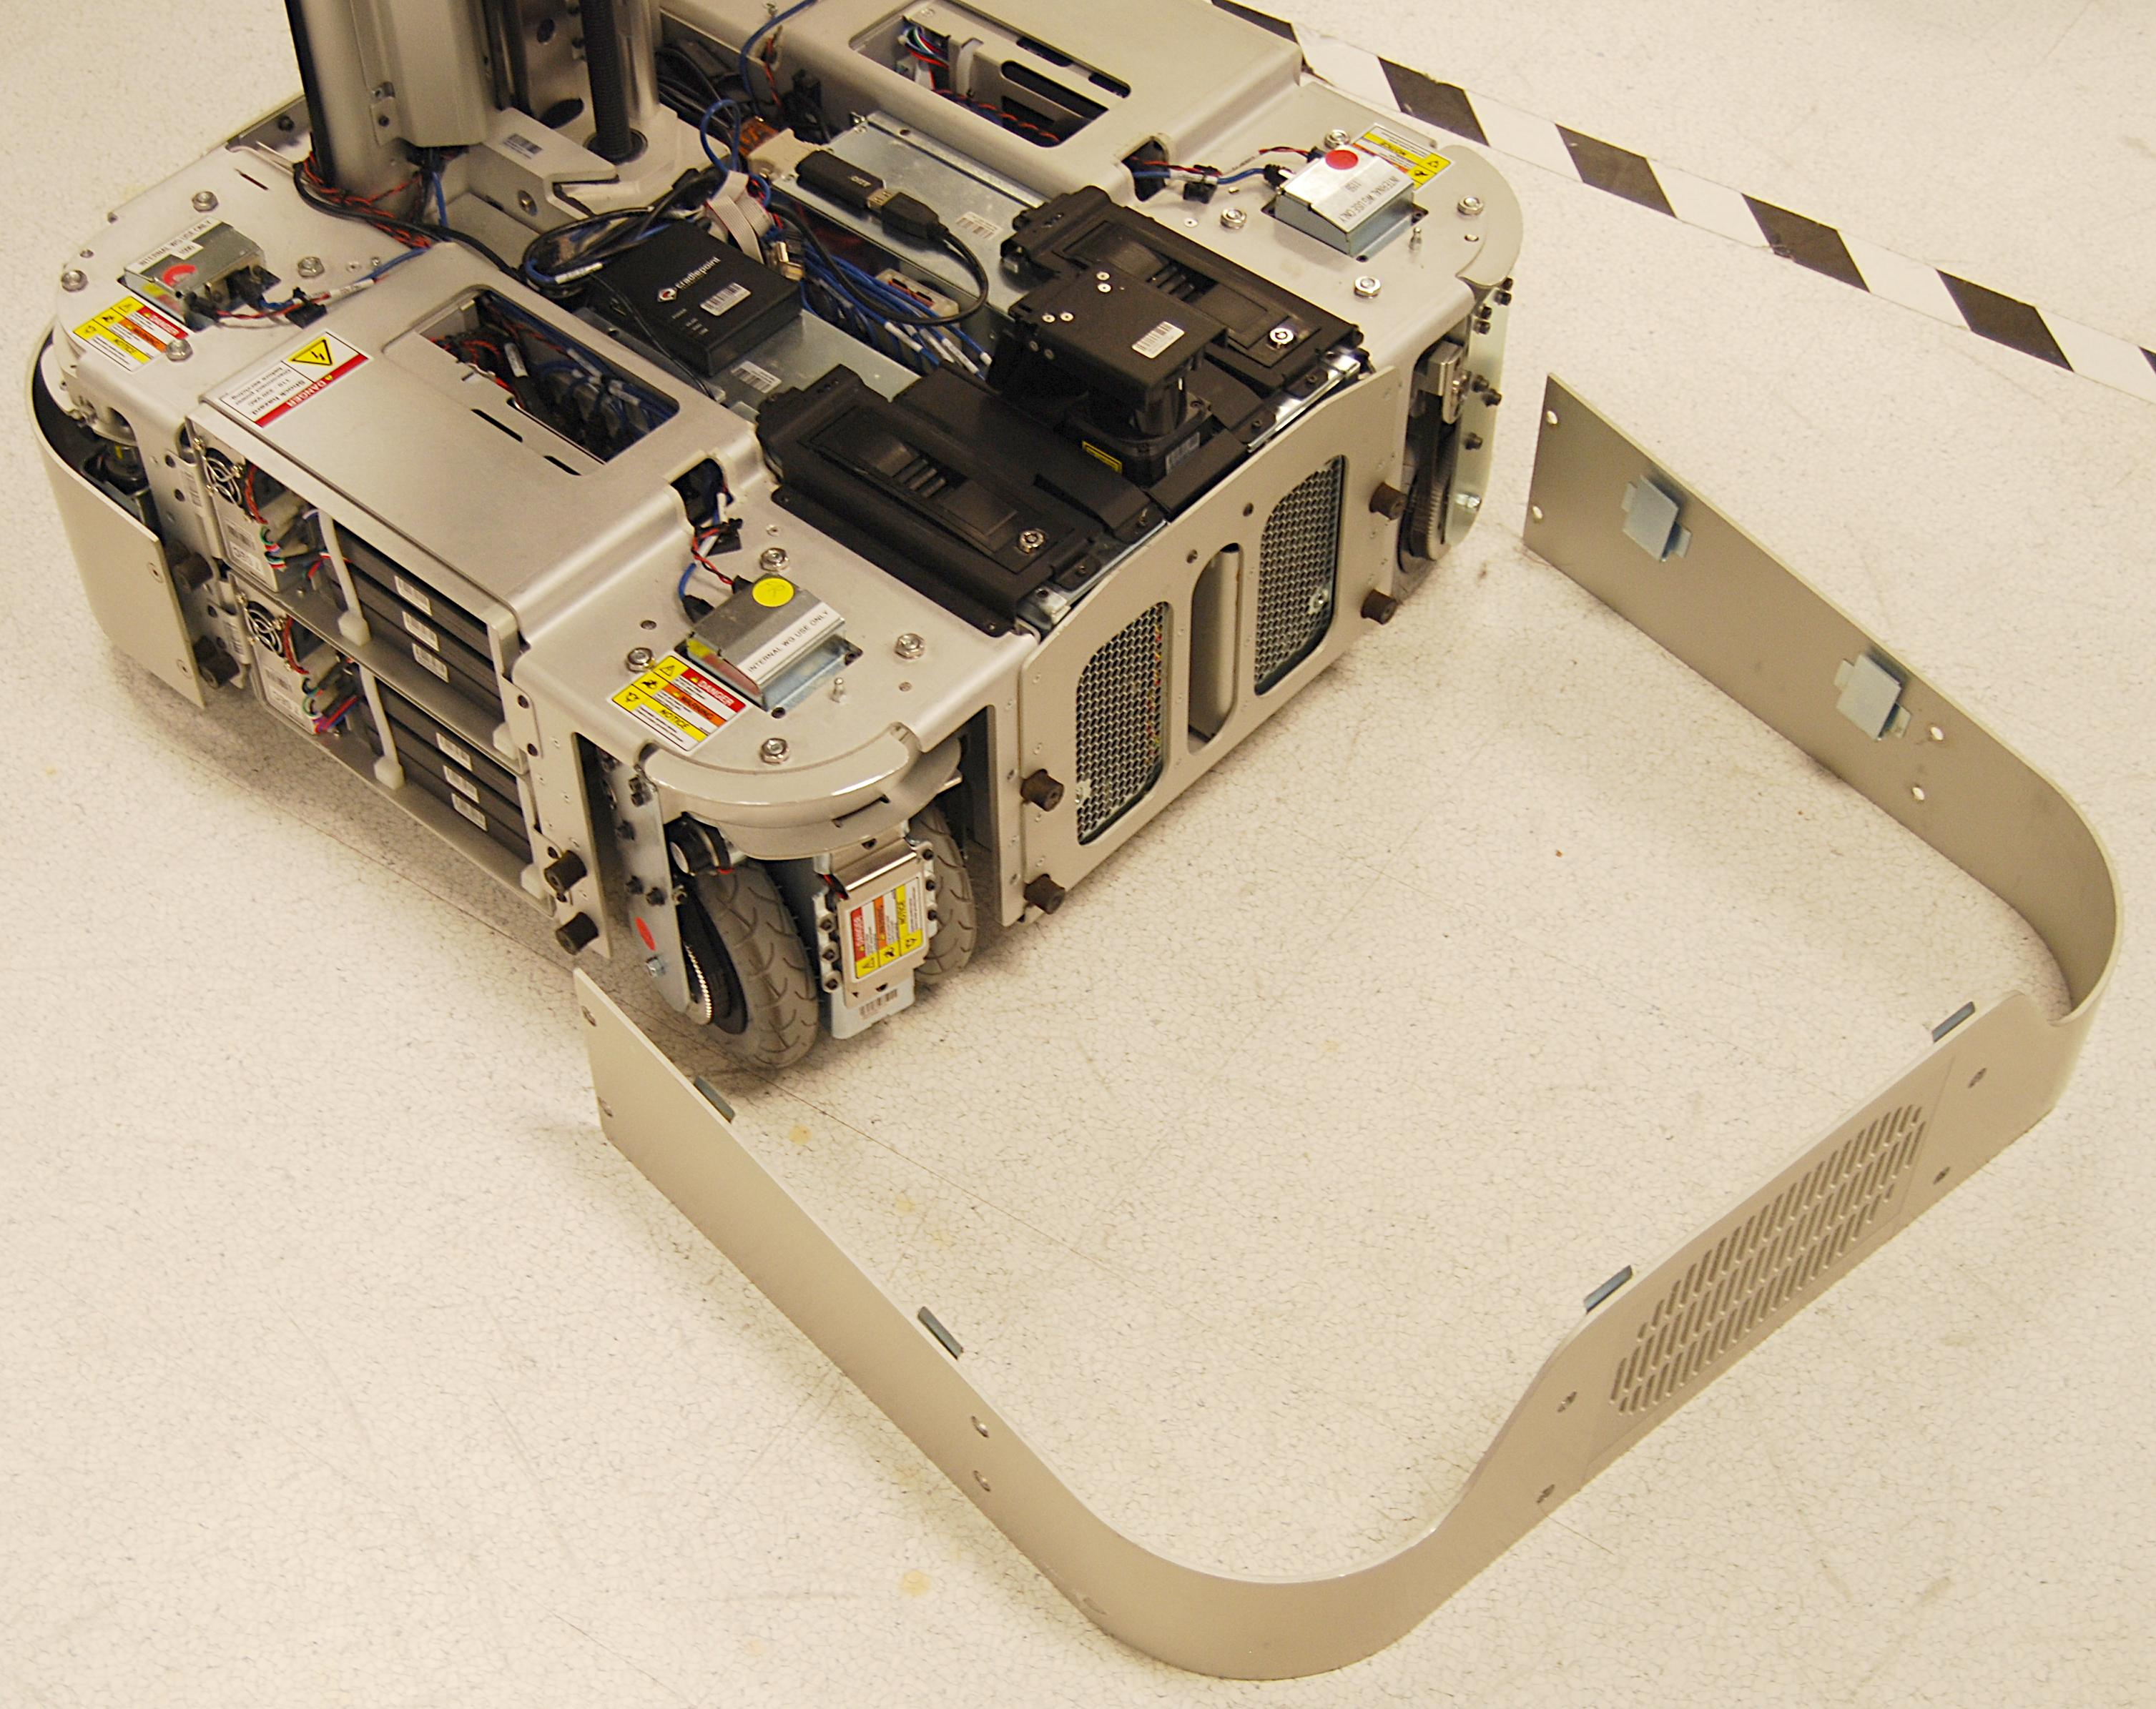
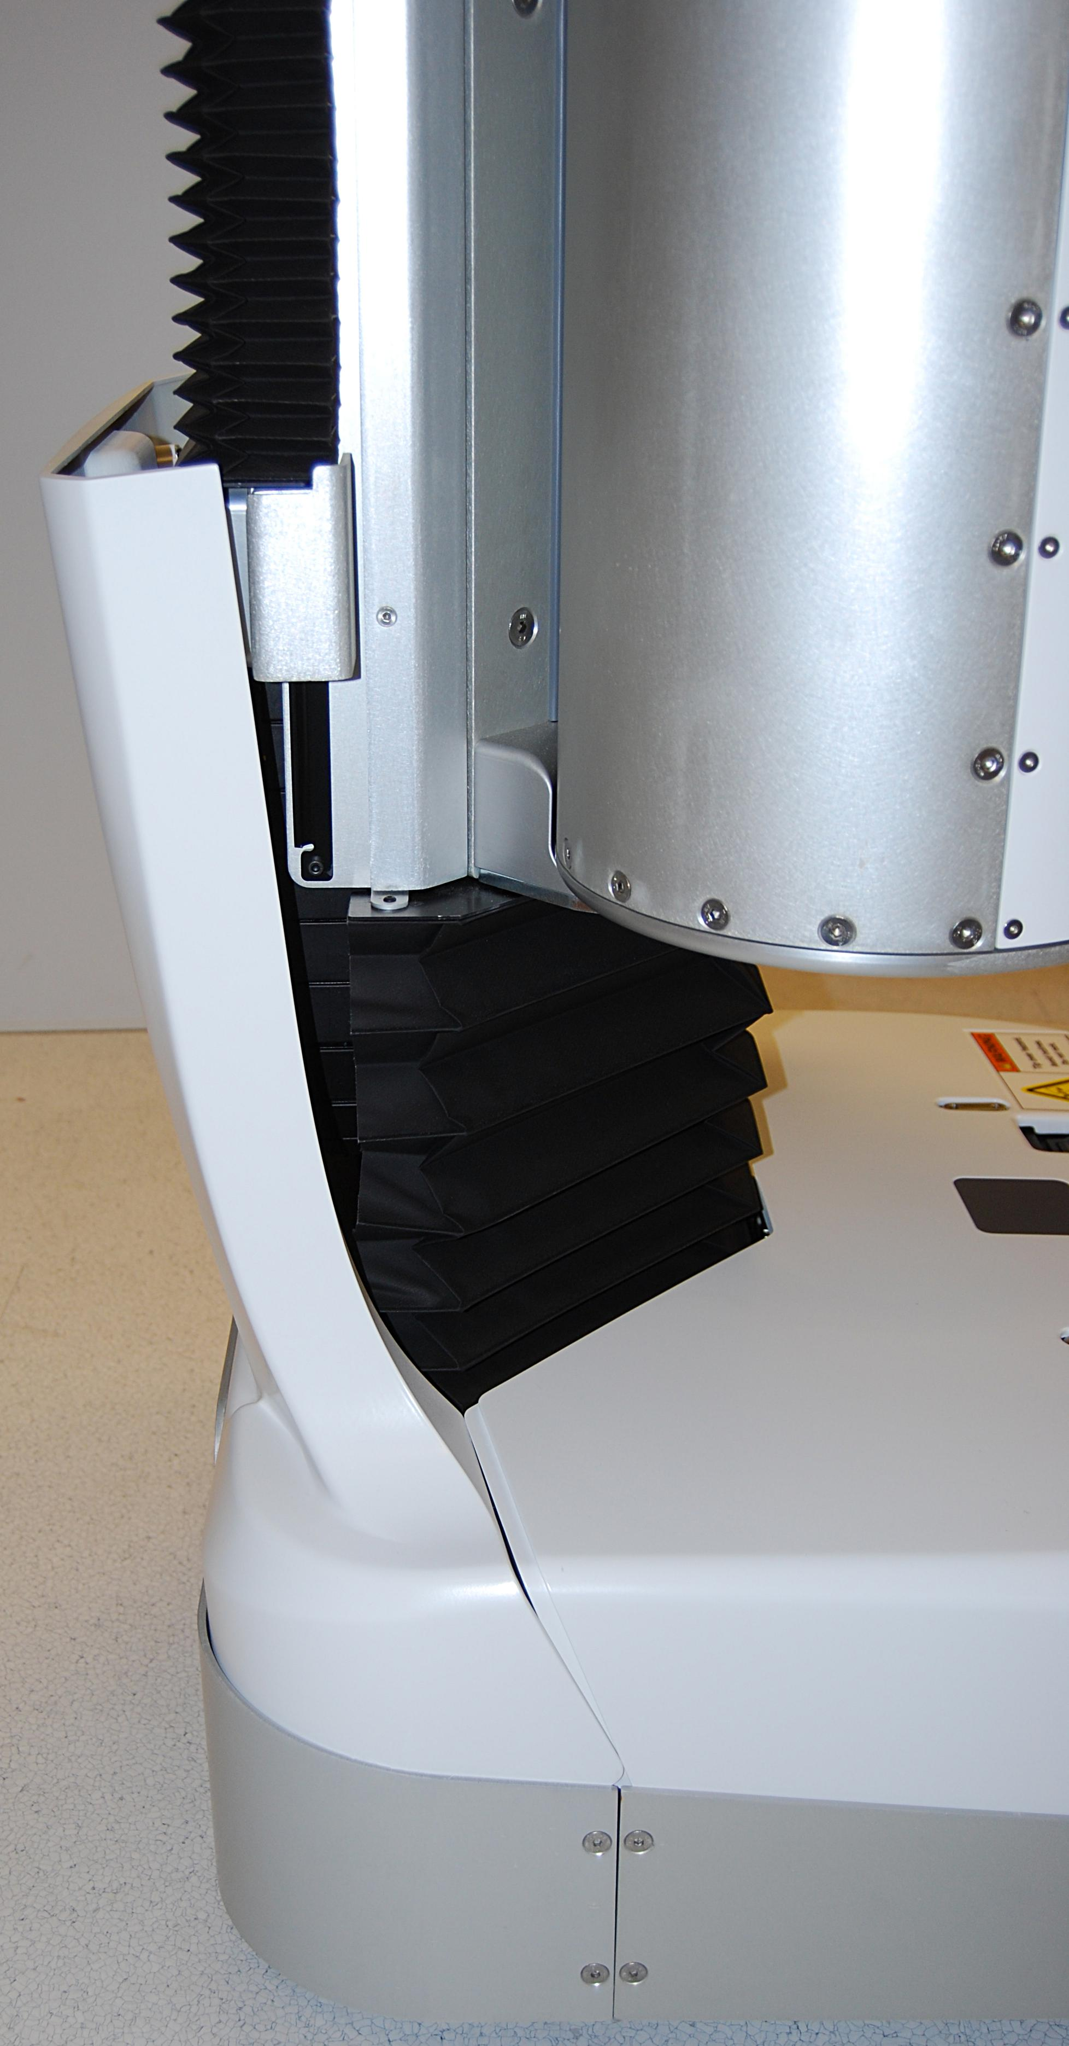
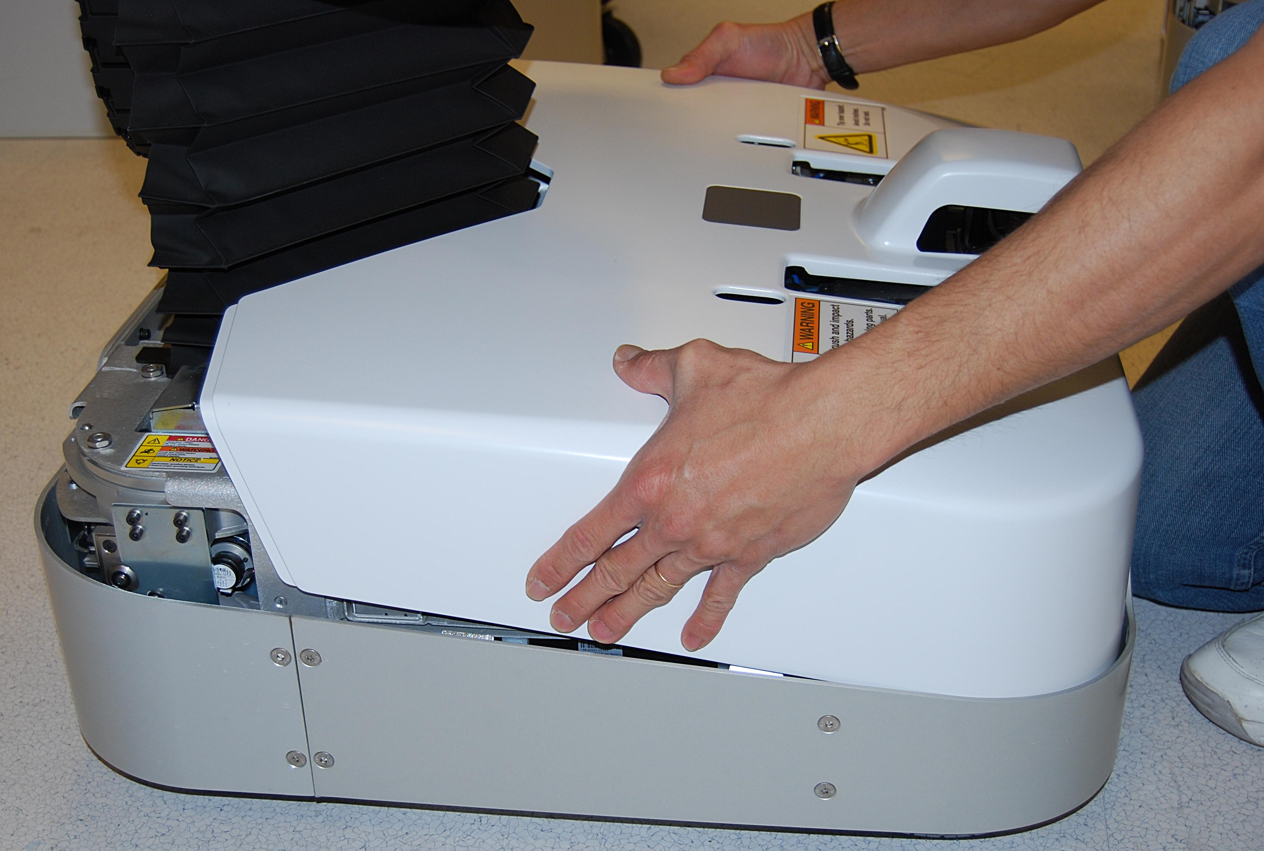
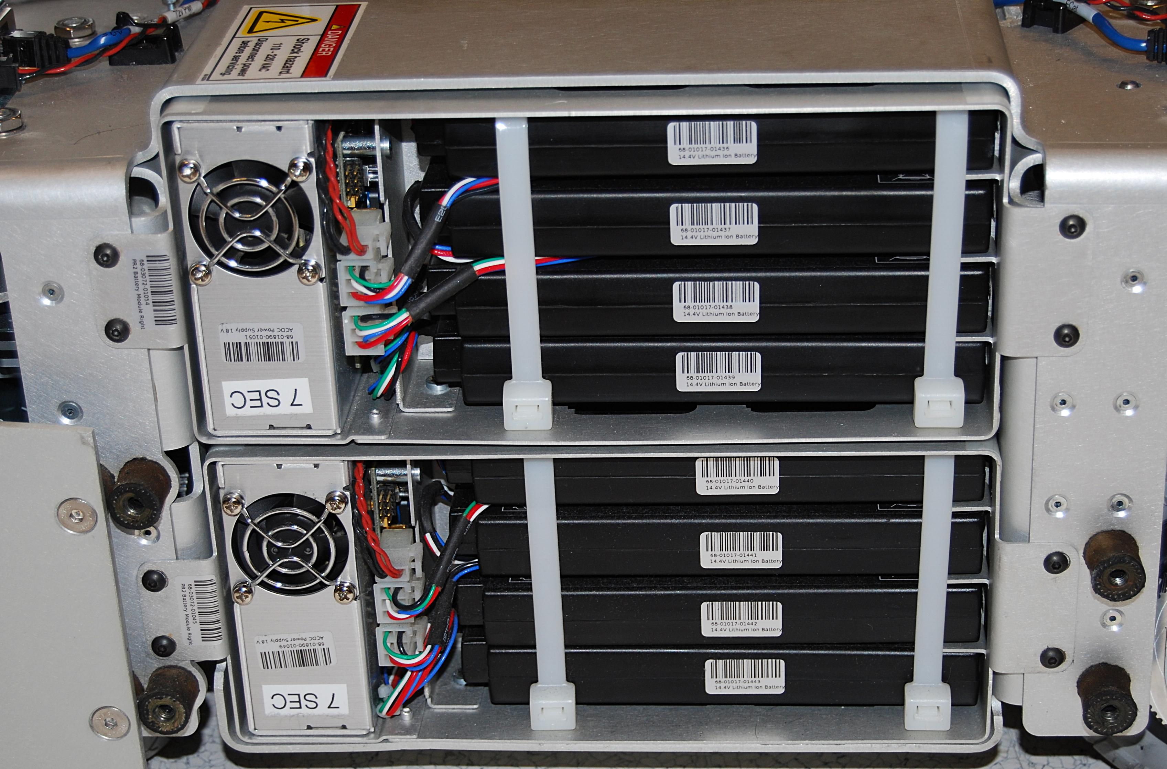
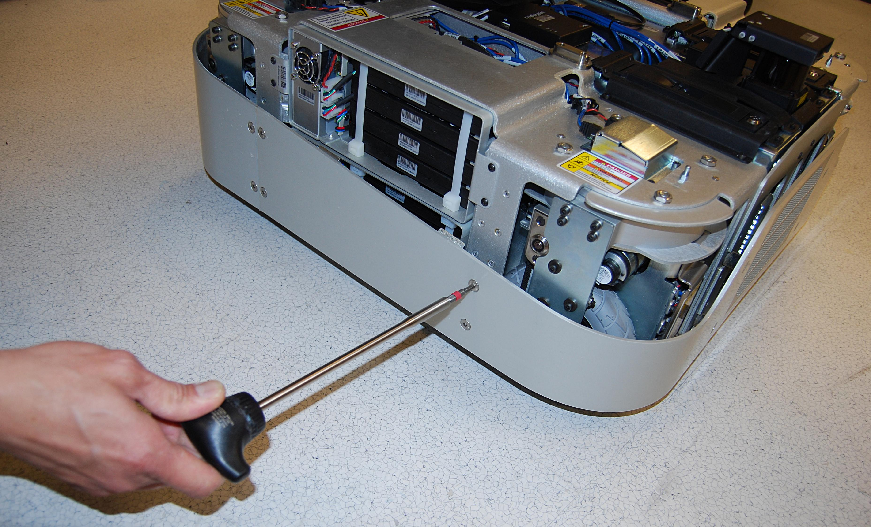
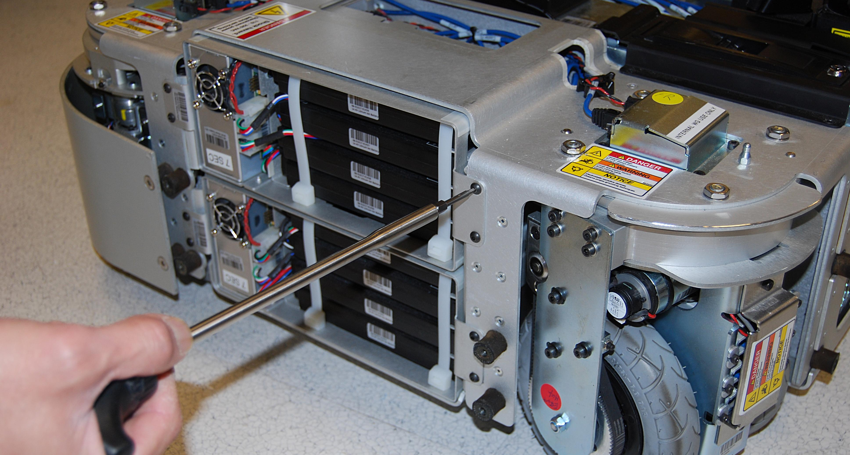
PR2 Battery Remove & Replace
Refer to the PR2 Overview document for additional information.
Move the spine of the robot all the way up, turn the robot off
***Once all covers are removed, double check to make sure that the robot is NOT PLUGGED IN and completely powered off. You will be servicing areas that have AC power. Use ESD precautions
Remove the lower back cover, and the base cover (Doc 2, Fig. 1,2)
Fig. 4
Using a 2.5mm hex bit with the T-handle driver remove the screws that are securing the battery module you want to replace(Fig. 5,6)
  If you want to remove a bottom module you have to remove the top as well
  If you are trying to remove a robot right battery module you need to remove the screws on the left side batteries as well
Fig. 2
Fig. 1
Remove the front skirt of the robot using the 4mm hex bit with the T-handle driver. There are 12 countersunk screws (68-03063-08) to remove (Fig. 3,4)
Fig. 5
Fig. 3
Fig. 6

Slide 3
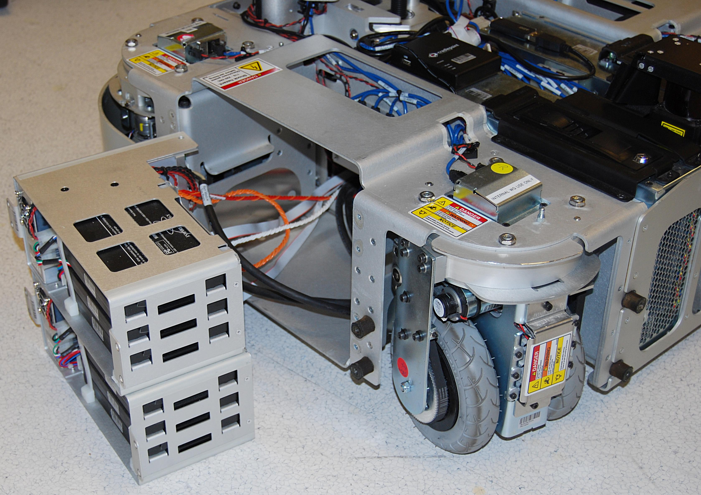
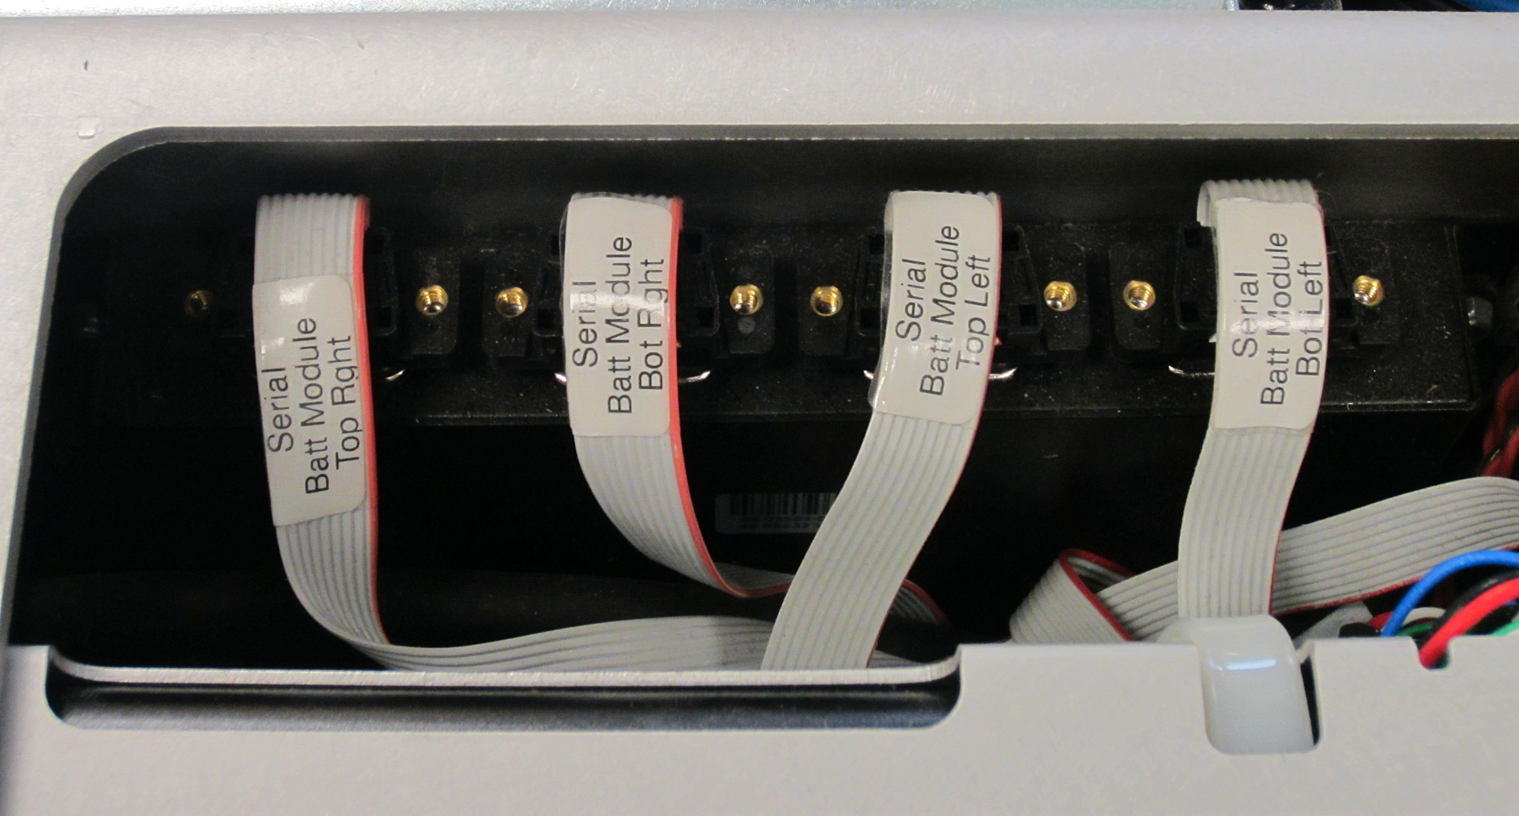
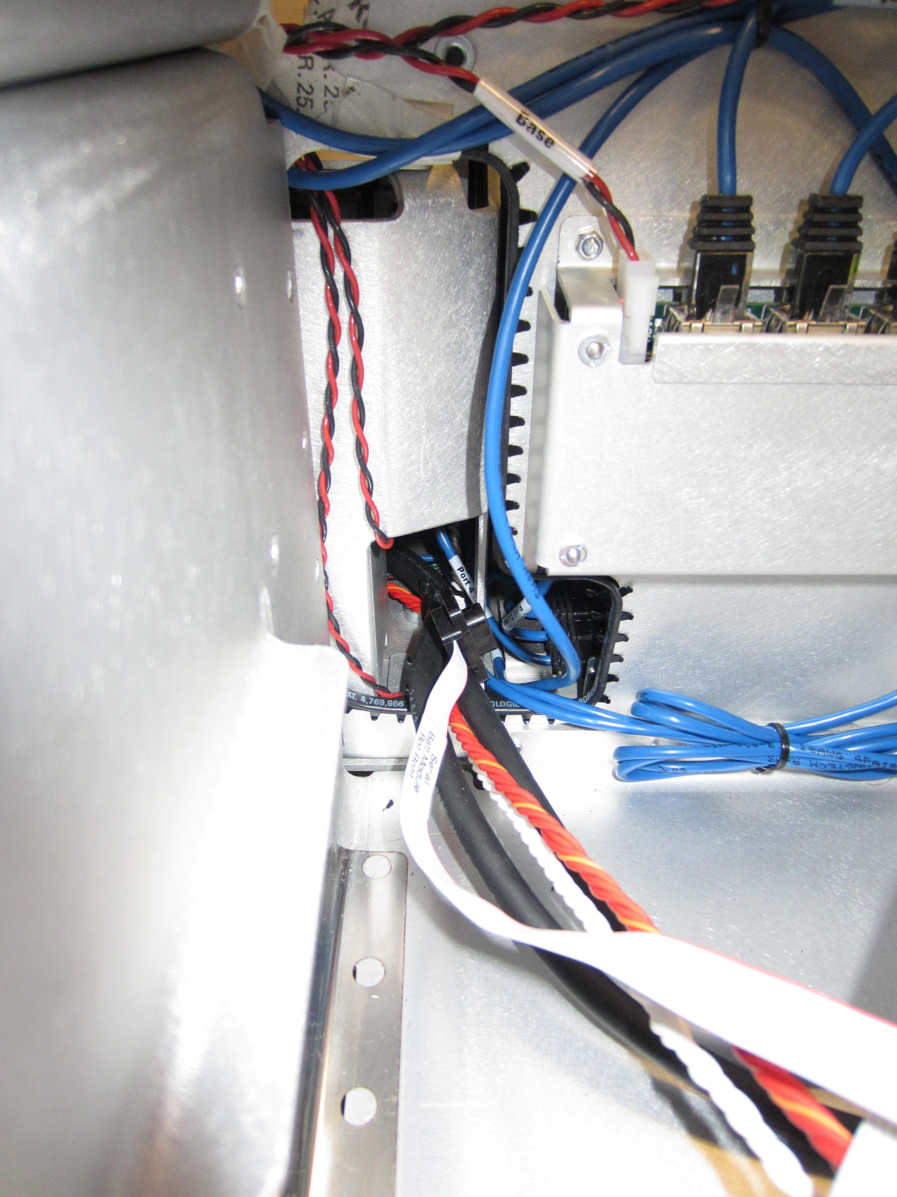
PR2 Battery Remove & Replace
Remove the modules slowly and lay them next to the robot (cables may not have lots of slack) (Fig. 7)
Consult Willow Garage if you are having a problem with removing the right battery serial cable.
Re-Installing the Battery Modules
When you are ready to re-install the battery modules first begin by plugging in the “AC Main” cable and the “battery module stackup cable”.
For Left Battery Modules:
  Plug the serial cable back into the serial hub and then slide the modules back into the base of the robot (Make sure to not pinch or damage any cabling)
  Secure the battery modules to the base of the robot using Loctite 248, the provided 68-03063-08 screws, and a torque value of 3.17Nm
Fig. 7
Unplug the serial cable that corresponds to the battery module that you are trying to remove. (Fig. 8)
For Right Battery Modules:
  Fish BOTH serial cables through the base of the robot as shown in the following series of photos below.
Fig. 8
Unplug the other two cables that are leading to the battery module that you are trying to remove.
  If you are removing a left battery it will now be free to take away.
  If you are removing a right battery module, wiggle the serial cable (from battery side) and try to remove it from the robot. (this step might be tricky)
1

Slide 4
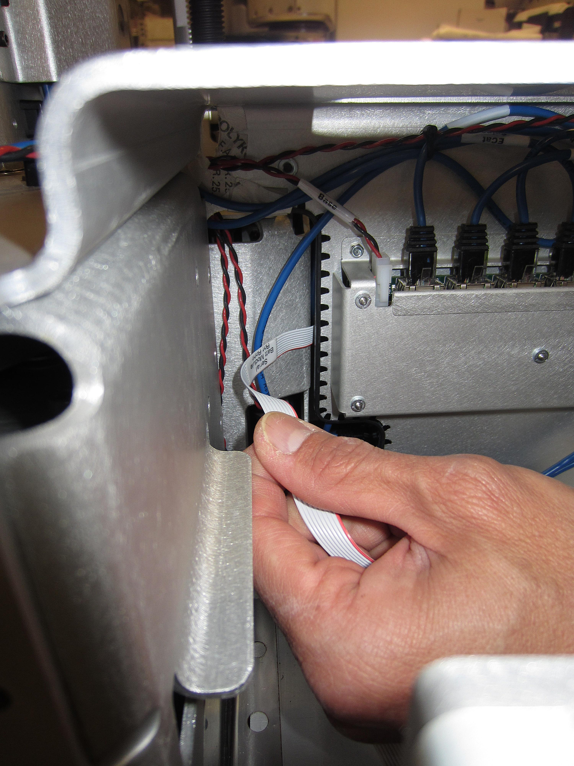
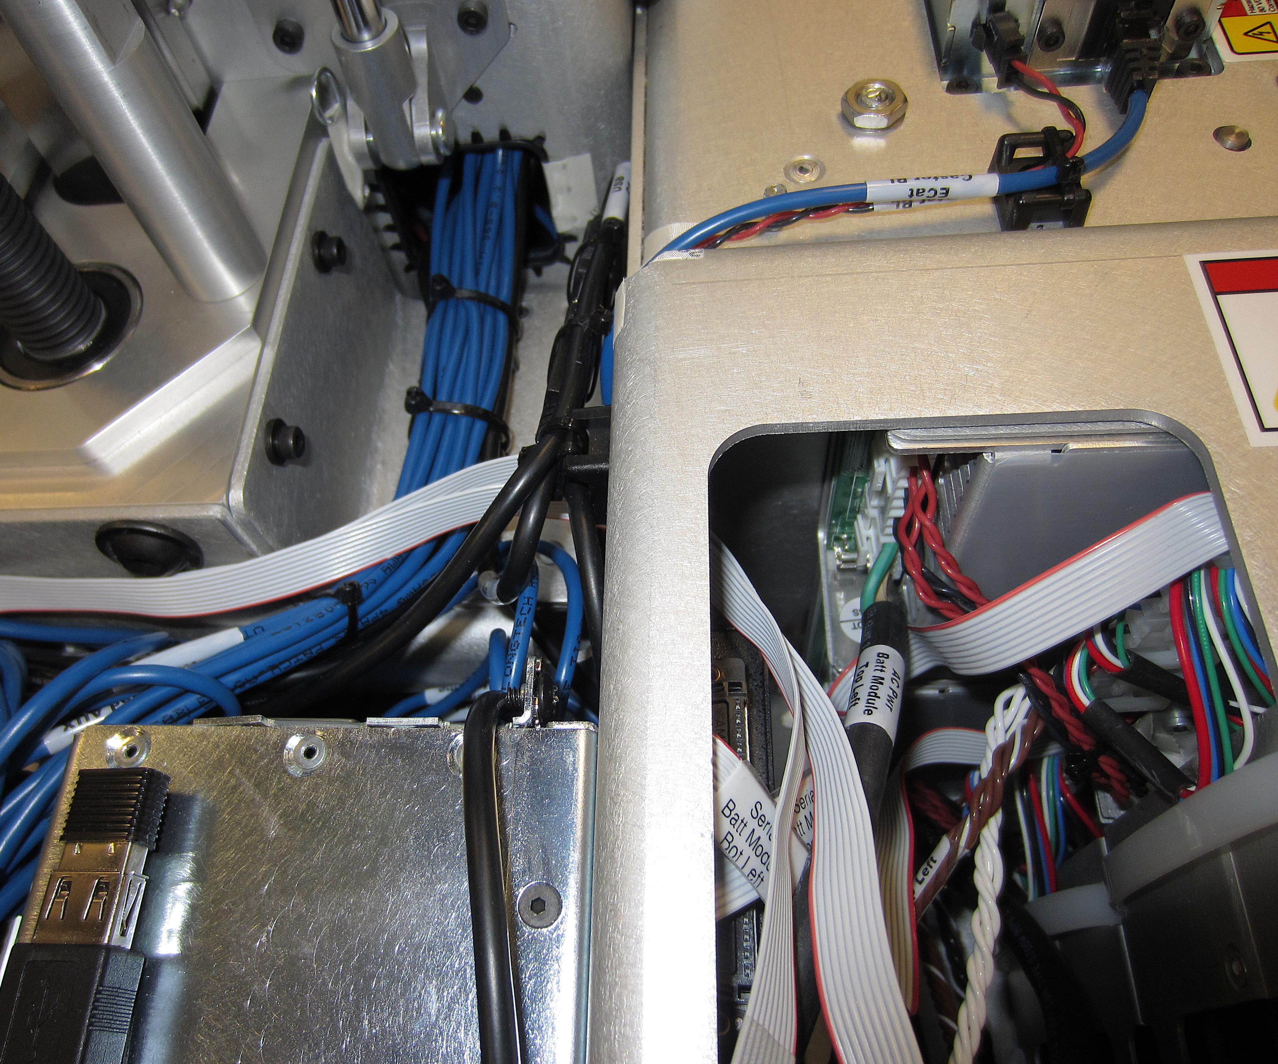
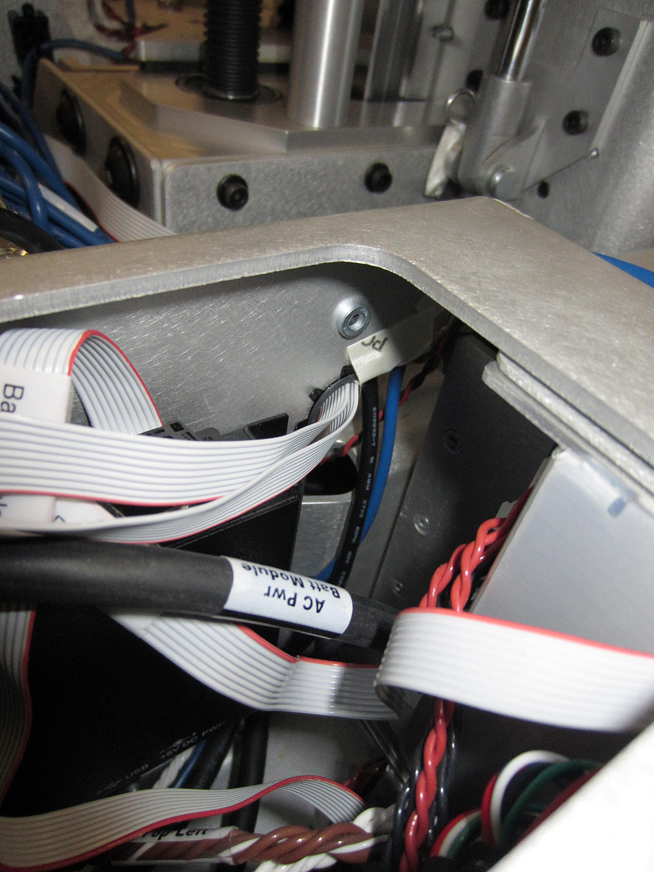
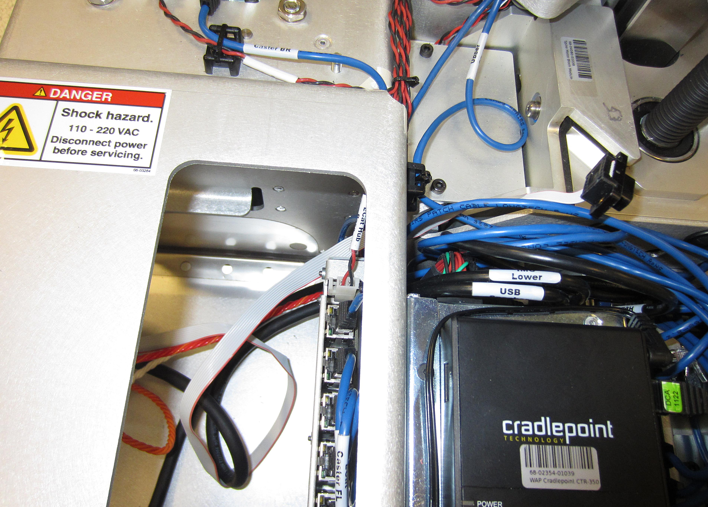
PR2 Battery Remove & Replace
Slide cables between
sheet metal here
2
4
3
5

Slide 5
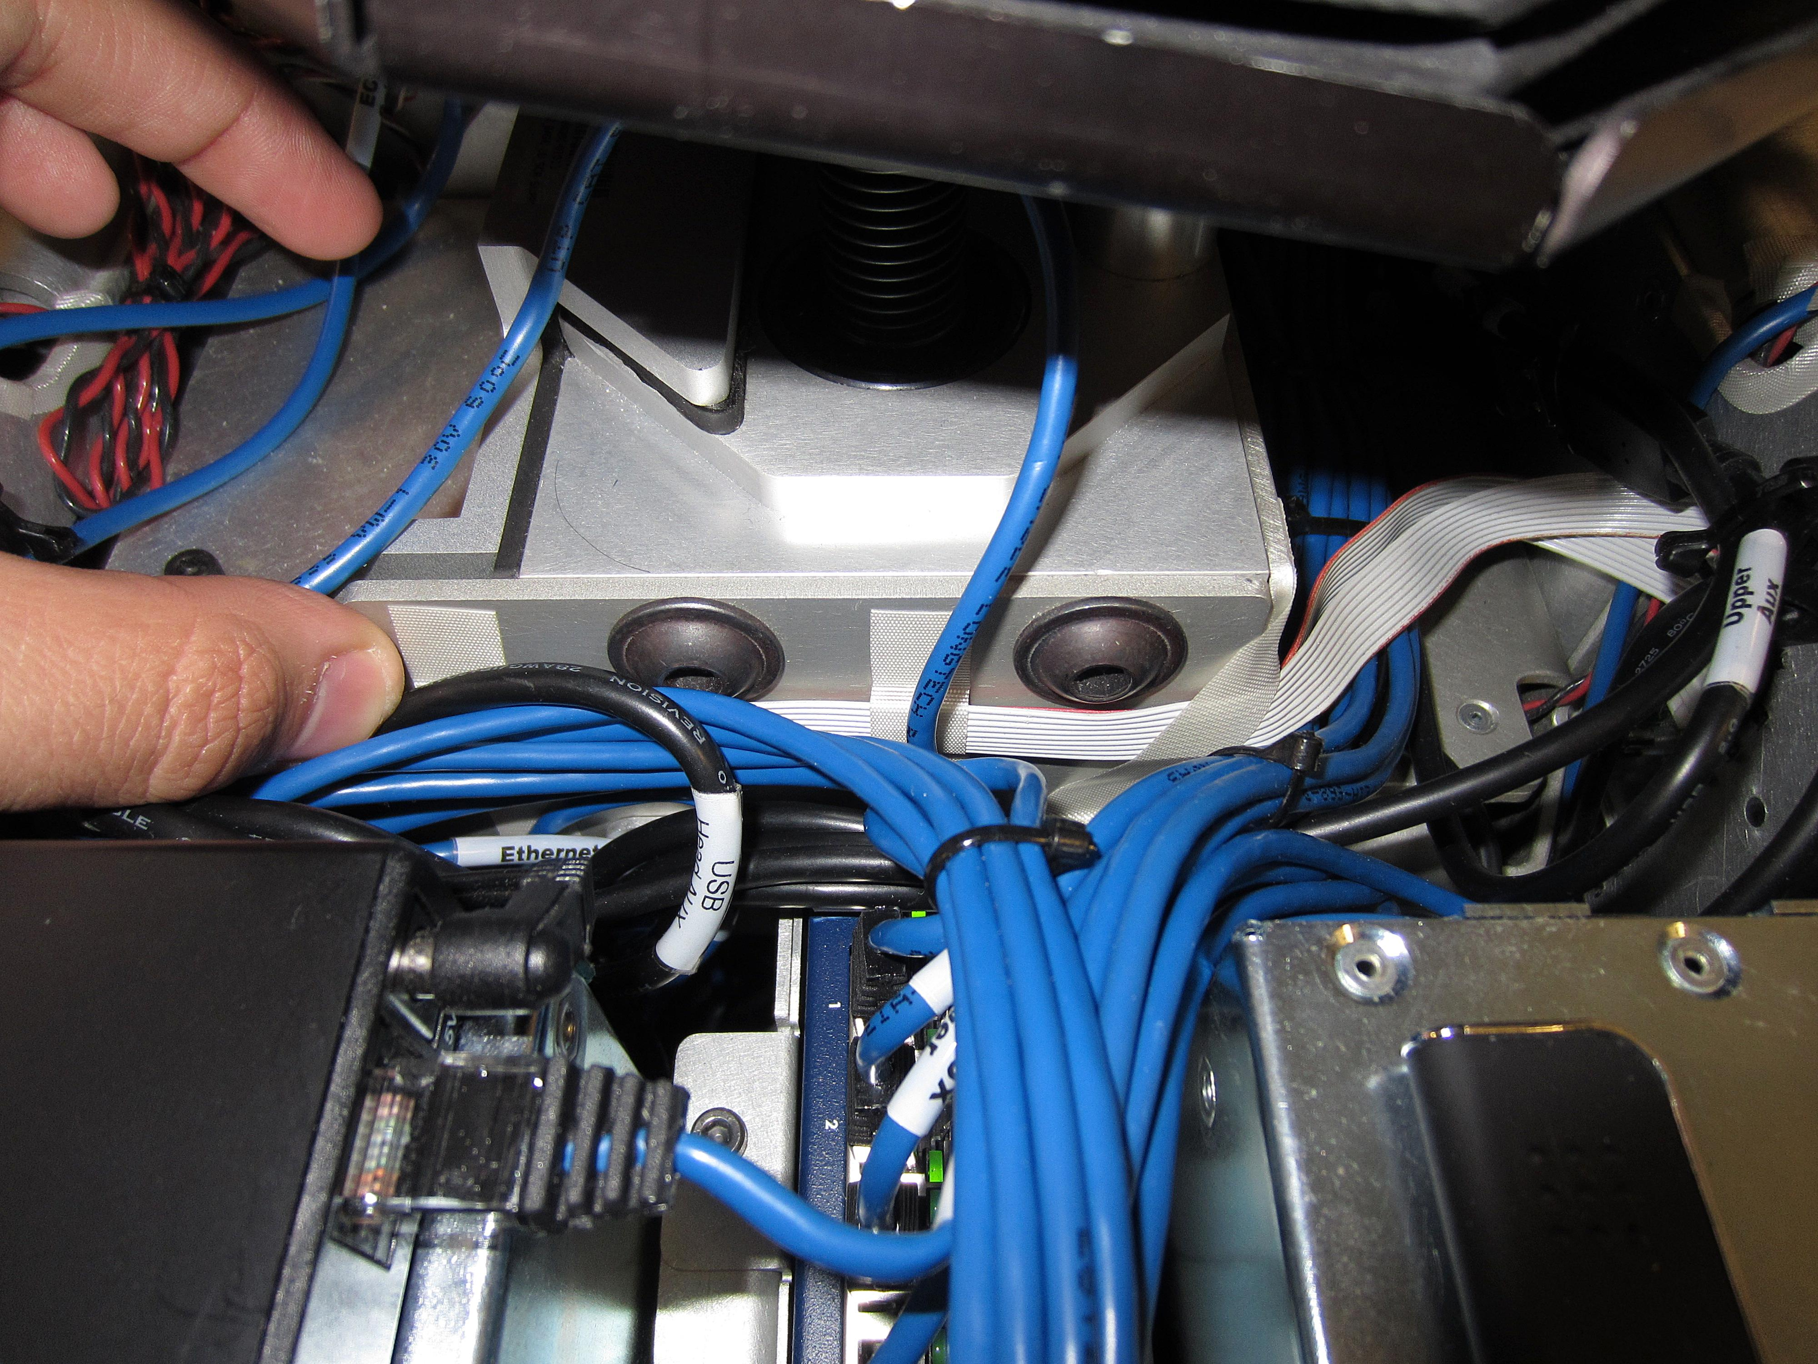
PR2 Battery Remove & Replace
Tape the cables in
These 3 places
6
Now that the right battery module serial cables are fished through the base of the robot you may:
Plug the serial cable back into the serial hub and then slide the modules back into the base of the robot (Make sure to not pinch or damage any cabling)
Secure the battery modules to the base of the robot using Loctite 248, the provided 68-03063-08 screws, and a torque value of 3.17Nm
After the Battery modules are secure re-install the front skirt on the PR2 using twelve 68-03063-08 screws, Loctite 248, and a torque value of 3.17Nm
Re-install the lower back cover and the base cover onto the PR2

Slide 6
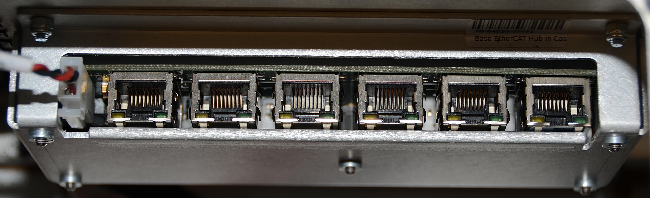
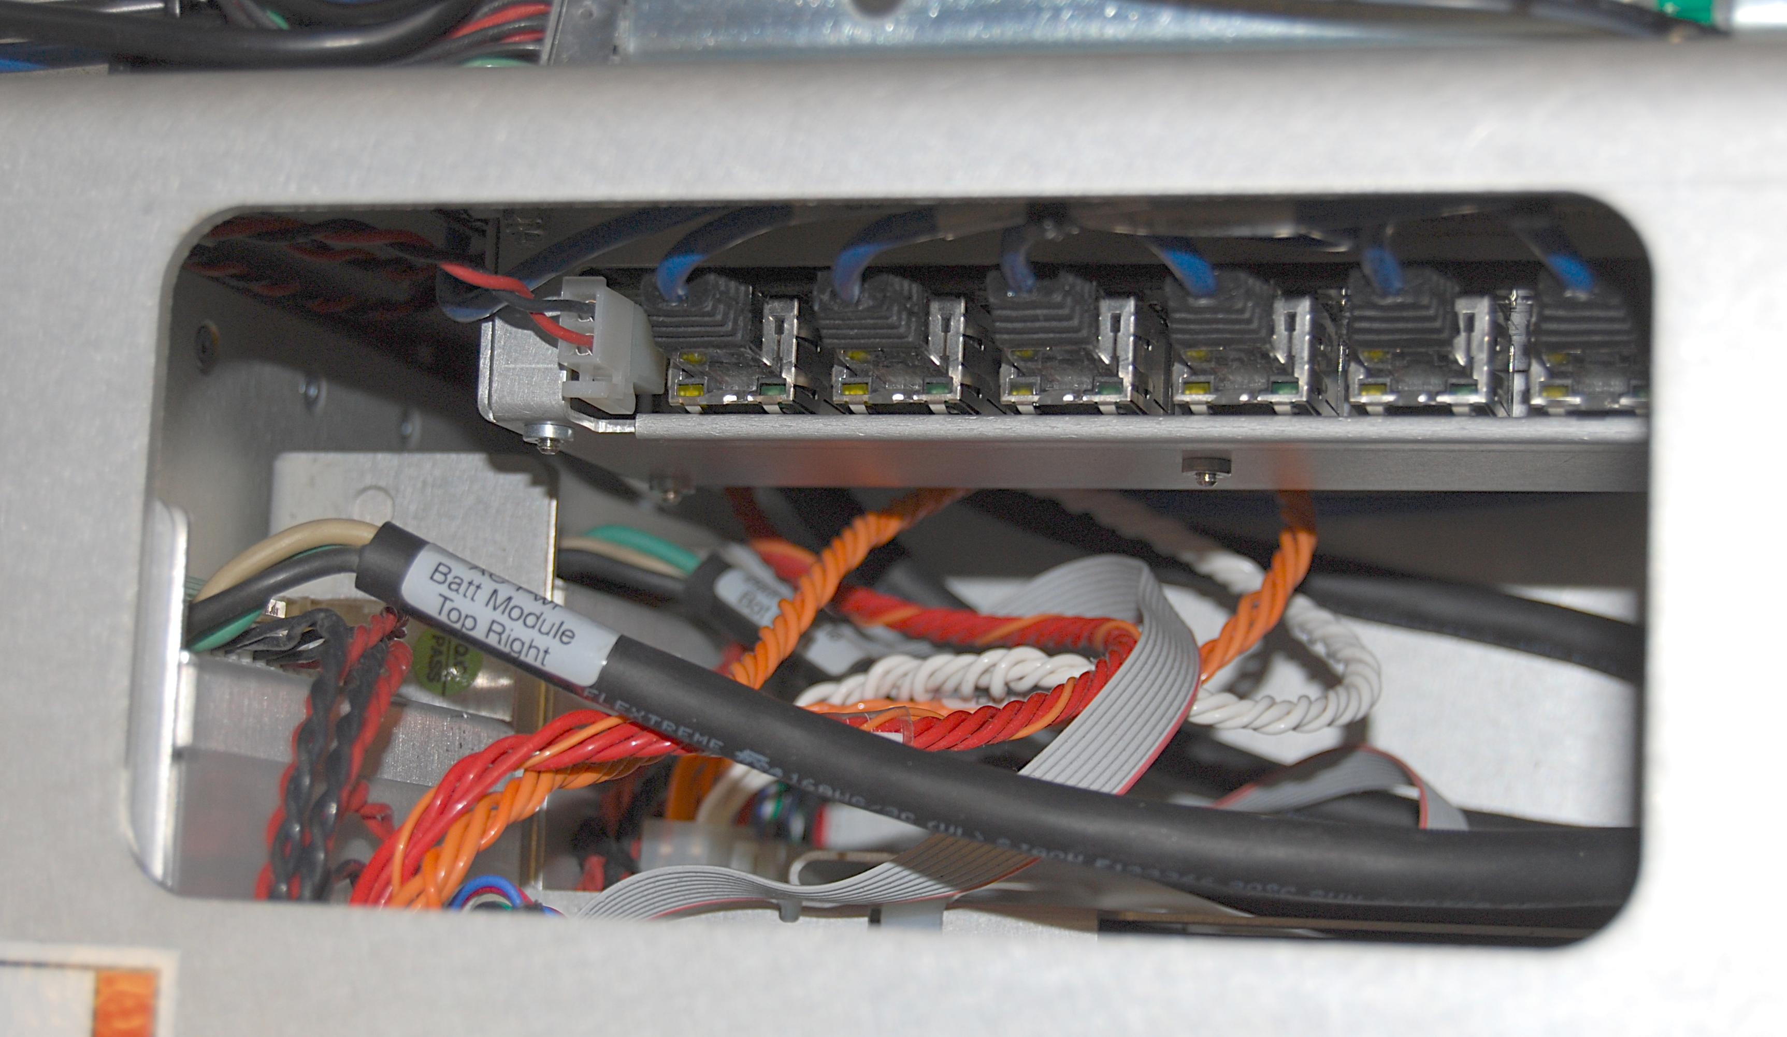
E-Cat Hub Replacement
Plug in all cables into the hub (Fig. 10)
Reinsert the battery modules into the base of the robot being careful to not pinch any of the wires (Fig. 11, 12)
Fig. 10
12v E-cat Hub Base
E-Cat Caster BL
E-Cat Spine
Lower
E-Cat Base Hub
E-Cat Caster BR
E-Cat Caster FL
E-Cat Caster FR
Secure the two battery modules into the base of the robot using Loctite 248 on the eight 2085-06 screws. Use a 2.5mm hex bit and a torque of 1.36Nm
Reinstall the front skirt of the robot using Loctite 248 on the twelve 3063-08 screws. Use a 4mm hex bit and a torque of 3.17Nm
Reinstall the base cover and then the back cover to complete
Fig. 11
Fig. 12

