Slide 1

Project Review
Hostel Management System
A Web-Based Application for Streamlined Hostel Administration
Presented by:
25b21AI052 - V. BHUVAN BHUPATI - AIML
25B21AI037 – K.RAMA SURYA CHARAN – AIML
25B21AI039 – G.LAKSHMI PRASAD - AIML
25B21AI059 – G.SAI PRABODH - AIML
BATCH NUMBER: 12
Department of Computer Science & Engineering

Slide 2
Outline
1. Abstract
2. Introduction
3. Problem Statement
4. Scope of the Project
5. Modules
6. Database Design
7. Output Screenshots
8. Conclusion
9. References
10. Thank You

Slide 3
Abstract
The Hostel Management System is a comprehensive web-based application developed using PHP and MySQL to automate and streamline the administrative functions of a student hostel.
Key highlights:
Replaces traditional paper-based processes with a centralized digital platform
Supports student registration, room allocation, and course management
Provides a secure admin login module restricting unauthorized access
Admin dashboard with real-time statistics using Chart.js
Responsive front-end using Bootstrap 3 and jQuery
MySQL database with 8 core tables; total size ~146.8 KiB
Keywords: Hostel Management System · PHP · MySQL · Bootstrap · jQuery · Admin Dashboard · Session Authentication

Slide 4
Introduction
The Hostel Management System is a web-based application designed to automate the day-to-day administrative tasks of managing a student hostel.
Why this system is needed:
Increasing number of students residing in hostels at educational institutions
Manual record-keeping has become inefficient, error-prone and time-consuming
No centralized system to manage room allocations and registrations
What this system provides:
A secure, centralized platform accessible to both admin and students
Admin can manage rooms, students, courses and view live statistics
Students can self-register, login and view room and profile details

Slide 5
Problem Statement
Traditional hostel management relies heavily on paper-based records and manual processes.
Challenges with the existing manual system:
Difficulty in tracking room availability in real time
Duplication of student records across registers
Delays and errors in fee management and record retrieval
Absence of a centralized platform makes reporting cumbersome
No mechanism for student self-service or digital access
"How to efficiently handle student registrations, room allocations and course information while providing administrators with real-time statistical data?"

Slide 6
Scope of the Project
Admin Side
Student Side
Admin login with session management and access log
Room creation, editing and availability checking
Student registration with full personal, guardian and address details
Course management – add and edit academic programmes
Statistical dashboard: total students, rooms and courses
Manage student records and view user access logs
Self-registration via the User Registration form
Student login using email and password credentials
View personal profile and room details
Change password via student portal
Book hostel and view room details post-login
Login activity tracked in user_log table

Slide 7
Modules
01. Home / Landing Page
02. Admin Authentication
Public entry point – system title, feature diagram, Register / User Login / Admin Login buttons
Login validated against admin table; PHP session initiated; IP & timestamp logged in admin_log
03. User Authentication
04. Dashboard Modules
Student self-registration and login; activity tracked in user_log table
Admin: total students, rooms, courses (Chart.js charts). Student: My Profile & My Room panels
05. Room Management
06. Student Registration
Create rooms (seater 1–5, room no., fees); edit rooms; check availability before registration
Admin-side multi-section form: room assignment, personal details, guardian info, address, academics
07. Profile & Password Module
08. Course Management
Admin and student can update profile info and change password (old password required)
Add / edit academic programmes (B.Tech, BCA, MBA, MCA, etc.) for student categorisation

Slide 8
Technologies Used
Technology | Purpose | Version
PHP | Server-side scripting | 5.5.28
MySQL | Database management | 5.6.26
Bootstrap | Responsive UI framework | 3.x
jQuery | Client-side scripting | 1.11.3
Chart.js | Dashboard charts | Latest
DataTables | Interactive sortable tables | Latest
Font Awesome | Icon library | 4.x
Apache/XAMPP | Local web server | 3.x

Slide 9
Database Design
Database: 'hostel' · MySQL 5.6 · phpMyAdmin · 8 Tables · ~146.8 KiB · InnoDB / MyISAM
Table Name | Rows | Description
admin | 1 | Administrator credentials, email, password and registration date
admin_log | 0 | Tracks every admin login — IP address and timestamp
rooms | 5 | Room number, seater capacity (1–5) and monthly fee (INR)
registration | 4 | Full student record: room assignment, personal, guardian & address info
courses | 7 | Academic programme catalogue: B.Tech, BCA, BComm, BSc, MCA, MBA, BE
states | 36 | State reference list used in address dropdowns
user_log | 26 | Tracks every student login — IP address and timestamp
userregistration | 3 | Student self-registration credentials for the student portal

Slide 10
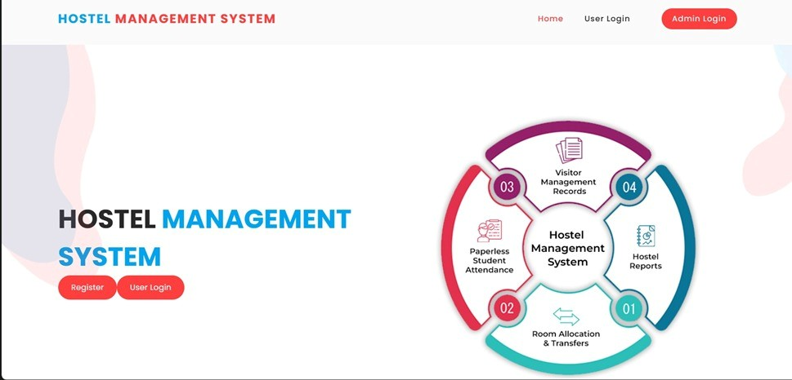
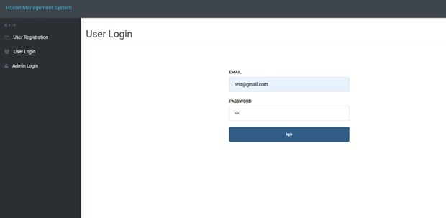
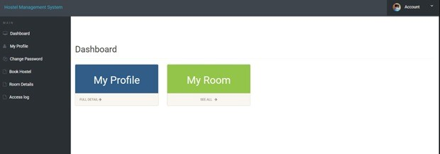
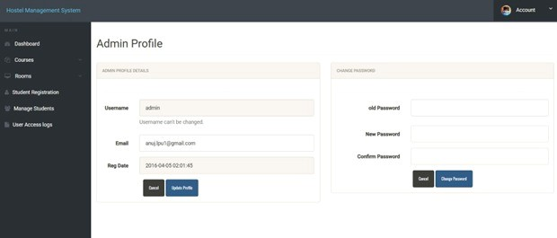

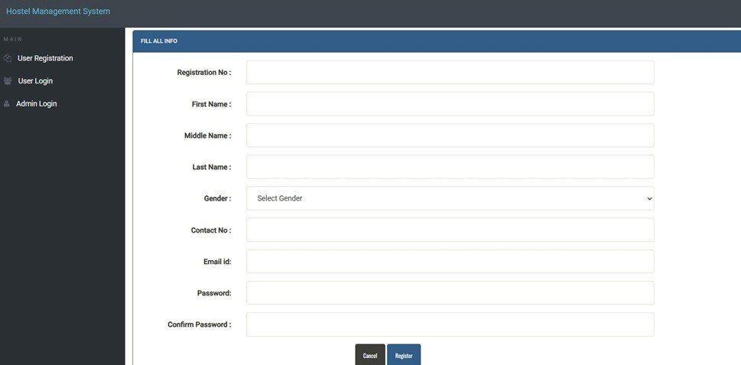
Output Screenshots
[ Home / Landing Page ]
[ Admin Login Screen ]
[ Admin Dashboard ]
System title · Feature diagram (Room Allocation, Hostel Reports, Visitor Mgmt, Attendance) · Register / Login nav buttons
Styled overlay form · Validates credentials · Initiates PHP session · Redirects to Admin Dashboard
Live stats: total students, rooms, courses · Line chart, Pie chart and Doughnut chart via Chart.js
[ Admin Profile Screen ]
[ User Login Screen ]
[ User Registration ]
Two panels side-by-side: Profile Details (read-only username) + Change Password panel
Student-facing auth form (email + password) · Separate from Admin portal · Role-based separation
Form: Reg. No., First/Middle/Last Name, Gender, Contact, Email, Password, Confirm Password

Slide 11
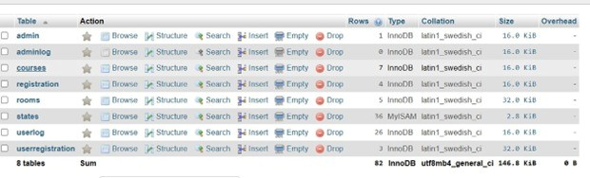
Output Screenshots (Cont.)
[ Student Dashboard ]
[ Room Management ]
[ phpMyAdmin – DB View ]
Two panels: My Profile (blue) & My Room (green). Sidebar: Dashboard, My Profile, Change Password, Book Hostel, Room Details, Access Log
Create room: select seater (1–5), enter room no. & monthly fee. Duplicate check via SELECT query before INSERT
All 8 tables listed: admin(1), courses(7), rooms(5), registration(4), states(36), user_log(26), userregistration(3). Total: 146.8 KiB
Security: Session-based auth (checklogin.php) · MySQLi prepared statements · htmlentities() input sanitization · Role-based access control

Slide 12
Conclusion
The Hostel Management System successfully achieves all objectives set at the beginning of the project.
Key outcomes:
Automates critical hostel tasks: student registration, room management and course cataloguing
Student-facing portal adds self-service functionality – register, login, view profile and room
Replaces paper-based processes with a fast, centralized digital platform
PHP prepared statements and session management ensure strong data security
Bootstrap provides a fully responsive, cross-device user interface
Admin dashboard with live Chart.js statistics gives powerful operational overview
Future Enhancements:
Online fee payment (Razorpay / PayU) · Email & SMS notifications · Visitor management
Paperless attendance via QR codes / biometrics · Multi-hostel multi-admin support · Grievance module

Slide 13
References
[1] PHP Documentation, The PHP Group. Available: https://www.php.net/docs.php
[2] MySQL Reference Manual, Oracle Corporation. Available: https://dev.mysql.com/doc/
[3] Bootstrap Documentation (Version 3.4), Bootstrap Team. Available: https://getbootstrap.com/docs/3.4/
[4] jQuery API Documentation, jQuery Foundation. Available: https://api.jquery.com/
[5] Chart.js Documentation, Chart.js Contributors. Available: https://www.chartjs.org/docs/
[6] Font Awesome Icons (Version 4), Fonticons, Inc. Available: https://fontawesome.com/v4/icons/
[7] DataTables Documentation, SpryMedia Ltd. Available: https://datatables.net/
[8] XAMPP Documentation, Apache Friends. Available: https://www.apachefriends.org/

Slide 14
THANK
YOU
Hostel Management System
Department of Computer Science & Engineering · Aditya University, Surampalem

