Slide 1



TRAFFIC MONITORING USING UAV AERIAL IMAGES
22CSP72 – PROJECT WORK II PHASE II
First Review
Team Members:
PRADAKSHINA B (23CSR159)
PRAHADHEESH S(23CSR160)
RAGAVI R(23CSR170)
Date:20.07.2026
MENTOR : Ms S MOHANAPRIYA
Assisstant Professor [SRG] / CSE

Slide 2
Problem Statement
UAVs capture images from high altitude.
Objects occupy very few pixels.
Existing detectors miss tiny objects.
Complex backgrounds increase false detections.
Real-time detection is required for traffic monitoring.

Slide 3
Objectives
Improve small-object detection accuracy.
Preserve fine object features.
Capture local and global context.
Reduce false detections.
Achieve real-time traffic monitoring.

Slide 4
Literature Survey
S.No | Title of Paper | Author / Journal / Year | Proposed Work | Limitations / Future Work
1 | UAVDet: A CNN–Mamba Hybrid Network for Efficient Small Object Detection in UAV Imagery | Yiming Yang, Feng Guo, Pei Niu Computer Vision and Image Understanding (Elsevier), 2026 | • Hybrid CNN + Vision Mamba architecture. • Introduced CSPMB for global feature learning. • Proposed TFPN with tiny-object detection head. • Improved small-object detection while maintaining real-time performance. | • Still challenging in extremely dense scenes. • Does not include image enhancement. • Can be improved using advanced attention or feature fusion mechanisms.
2 | YOLO11s-UAV: An Advanced Algorithm for Small Object Detection in UAV Aerial Imagery | Qi Mi et al. Journal of Imaging (MDPI), 2026 | • Proposed CARIFPN for efficient feature fusion. • Introduced S2DResConv for better downsampling. • Added FlexSimAM attention module. • Lightweight model suitable for UAV deployment. | • Slight reduction in inference speed due to additional modules. • Performance can be further improved in highly cluttered backgrounds. • Scope for stronger feature extraction techniques.
3 | SAMYOLO: Integrating Super-Resolution and Vision Mamba for Enhanced Small Object Detection | Wanjun Wang et al. IEEE JSTARS, 2026 | • Combined Super-Resolution with Vision Mamba. • Dual-branch RGB + SR input. • Feature Mapping module for cross-modal fusion. • Improved detection of tiny objects. | • Increased computational complexity. • Higher training cost due to SR module. • Future work includes developing a lightweight version for real-time UAV applications.

Slide 5
Literature Survey
S.No | Title of Paper | Author / Journal / Year | Proposed Work | Limitations / Future Work
4 | MFFSODNet: Multiscale Feature Fusion Small Object Detection Network for UAV Aerial Images | Lingjie Jiang et al. IEEE Transactions on Instrumentation and Measurement, 2024 | • Proposed MSFEM for multi-scale feature extraction. • Introduced BDFPN for dense feature fusion. • Added tiny-object prediction head. • Improved feature representation of small objects. | • CNN-based architecture has limited global context modeling. • Performance can be enhanced using Transformer/Mamba-based feature learning. • Computational complexity can be further reduced.
5 | SRTSOD-YOLO: Stronger Real-Time Small Object Detection Algorithm Based on Improved YOLO11 for UAV Imageries | Zechao Xu et al. Remote Sensing (MDPI), 2025 | • Proposed MFCAM attention module. • Designed GAC-FPN for multi-scale feature fusion. • Used Adaptive Threshold Focal Loss. • Improved accuracy while maintaining real-time performance. | • Model complexity increases with additional modules. • Requires further optimization for edge-device deployment. • Future work focuses on lightweight implementation.

Slide 6
Research Gap
Existing methods
Lose tiny object features
Struggle in dense traffic
Detect many false positives
Have high computational cost
Need
Accurate + lightweight + real-time detector

Slide 7
Architecture Diagram
Input UAV Image
↓
Image Preprocessing
↓
YOLOv11 Backbone
↓
Feature Extraction
↓
Neck (Feature Fusion)
↓
Detection Head
↓
Detected Traffic Objects

Slide 8
Proposed Work with Planned Innovation
Current YOLOv11 Implementation
↓
Implement Faster R-CNN
↓
Analyze Performance
↓
Identify Weaknesses
↓
Add Novel Improvement
↓
Final Enhanced Model

Slide 9
Modules of the Project
Module | Description
Dataset Collection | Collect and prepare the VisDrone dataset.
Image Preprocessing | Resize, normalize, and augment UAV images.
Baseline Model | Train and test the YOLOv11 object detection model.
Traffic Object Detection | Detect vehicles, pedestrians, and other traffic objects.
Performance Evaluation | Measure mAP, Precision, Recall, and FPS.
Future Enhancement | Implement Faster R-CNN and introduce the proposed innovation.

Slide 10
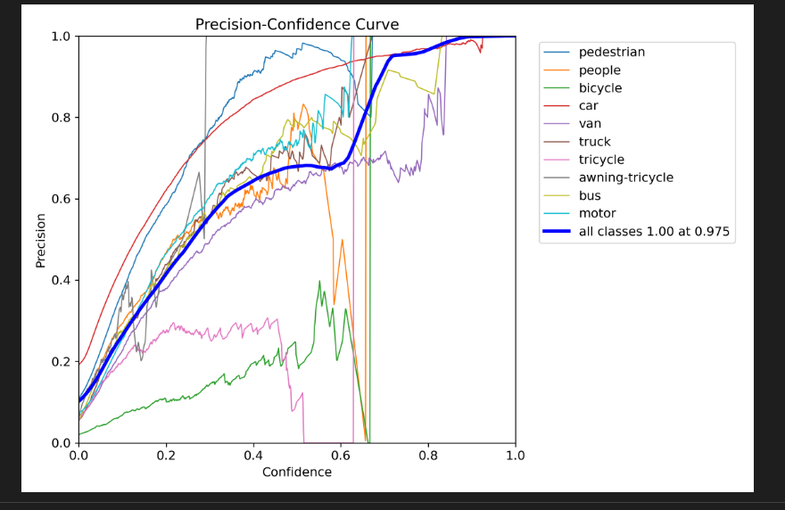
Implementation with intermediate result

Slide 11
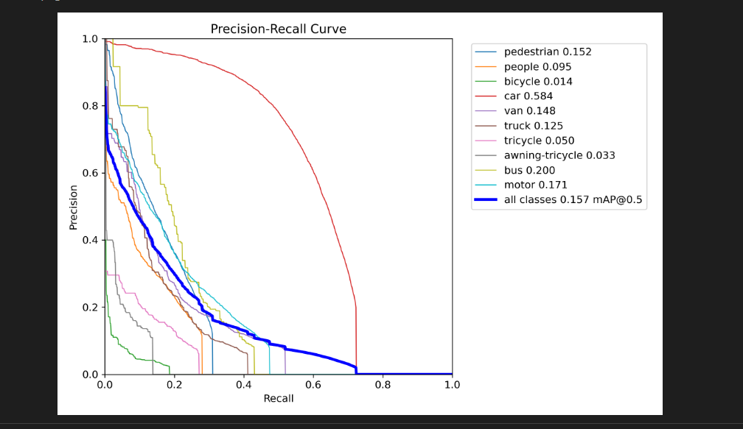

Slide 12
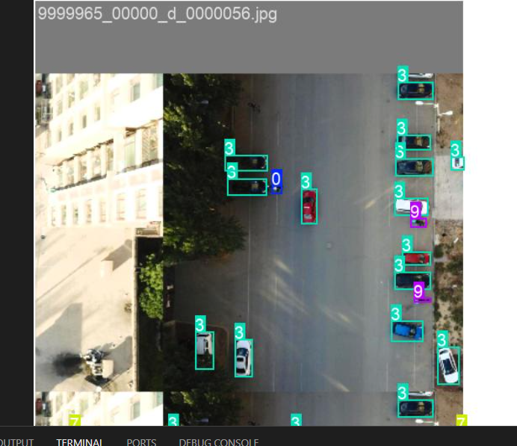

Slide 13
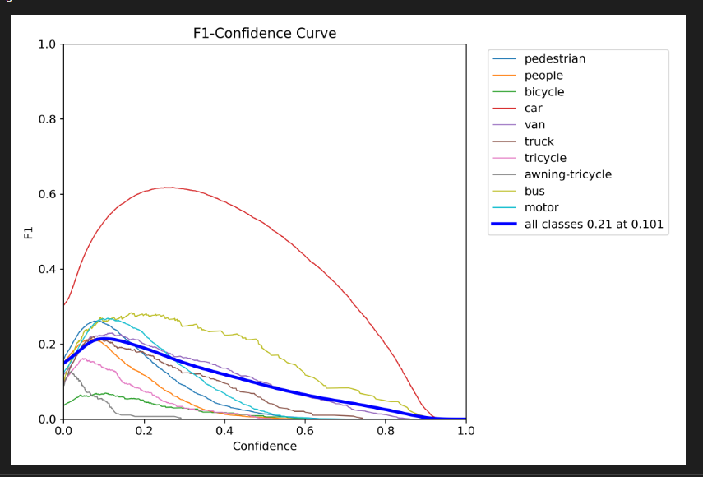

Slide 14
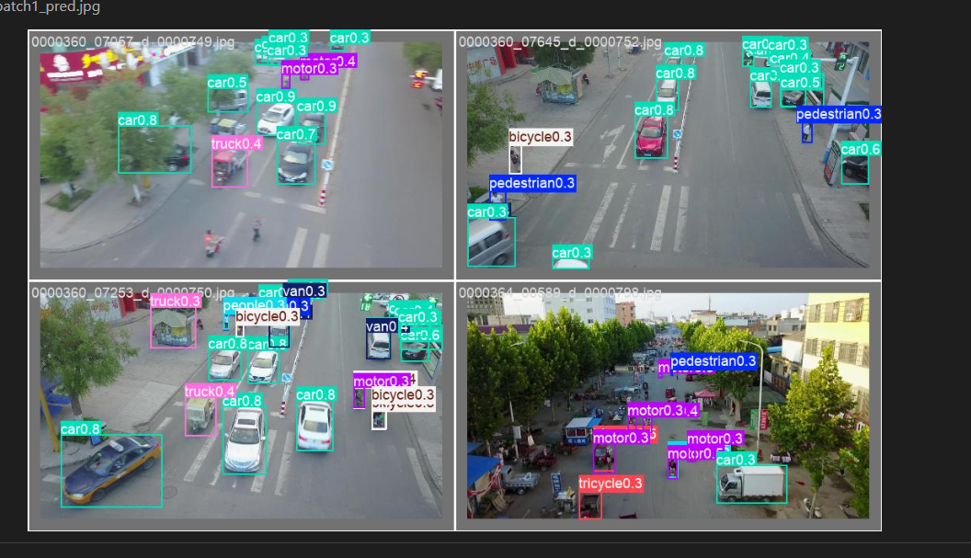

Slide 15
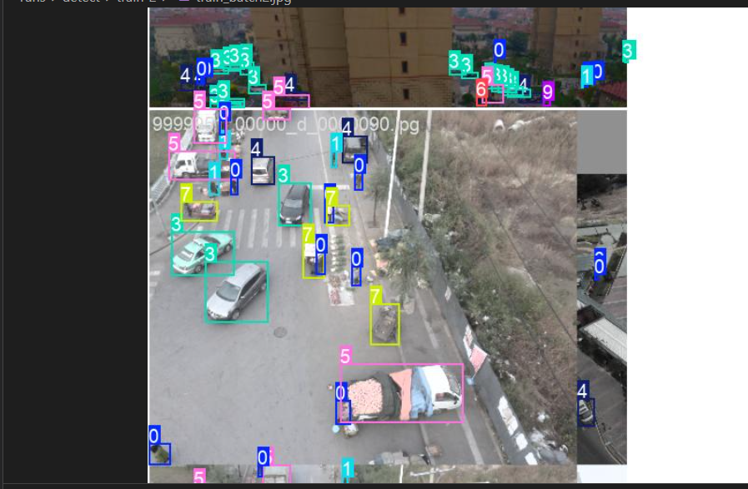

Slide 16
THANK YOU

