Slide 1
CSE7000 - INTERNSHIP
A Presentation on
AI Centre of Excellence (Accelerated by NVIDIA)
Student Details
Name | PRADEEP KUMAR S
Roll No | 20241CSE1059
Section | 5CSE07
Under the Supervision of,
Dr. Arivarasan Selvam , Assistant Professor and Ms. Rahna C M , Assistant Professor
Presidency School of Computer Science and Engineering
Presidency University
Name of the Program: B. Tech (CSE)
Name of the HoD: Dr. Nagaraja S R
Name of the Program Internship Coordinator: Dr. Balakrishnan R
Name of the School Internship Coordinators: Dr. Bhuvaneshwari Patil

Slide 2
Content
About Company or Organization
Working Domain or the Technology
Objectives of the Work
Methodology Used: Architecture & Pipeline
Methodology Used: Secure Docker Sandbox
Results & Application Demo
Conclusion

Slide 3
About Company or Organization
AI Centre of Excellence (Accelerated by NVIDIA)
Industry-oriented training initiative focused on Artificial Intelligence and modern computing.
Provides hands-on learning in AI, Machine Learning, Deep Learning,
Generative AI, and Full-Stack Web Development.
Offers practical exposure through labs, projects, and real-world applications.
Aims to equip students with industry-ready technical and problem-solving skills.

Slide 4
Working domain or the technology
Working Domain:
Generative AI & Large Language Models (LLMs)
Autonomous Agents
Containerized Security
Technologies and Tools:
Python & PyTorch
Hugging Face smolagents & Qwen 2.5 Coder
Docker (Sandbox Environments)

Slide 5
Objectives of the work
Secure Code Execution: Prevent host system vulnerabilities by executing AI-
generated code within a restricted Docker sandbox.
Autonomous Task Completion: Use a Code Agent paradigm to dynamically
write and execute Python scripts, avoiding the limitations of rigid JSON tool-
calling.
Edge AI Deployment: Implement 4-bit LoRA quantization to enable running
the 3B parameter Qwen model efficiently on local consumer GPUs.

Slide 6
Methodology Used: Architecture & Pipeline
Agent Orchestration: Utilized the Hugging Face smolagents framework to process natural language prompts and iteratively generate Python solutions.
Execution Pipeline:
Prompt Reception
Agent Planning & Code Generation
Docker Sandbox Injection
Feedback Loop (Self-correction via Traceback analysis)

Slide 7
Methodology Used: Secure Docker Sandbox
Isolation: Deployed a lightweight python:3.11-slim Docker container using the Docker Python SDK.
Constraints: Enforced CPU and memory limits (512MB) to prevent resource exhaustion from faulty agent code or infinite loops.
Controlled Access: Mounted only explicitly authorized host directories (e.g., the user's Desktop) to allow necessary file manipulation without jeopardizing the overarching system integrity.

Slide 8
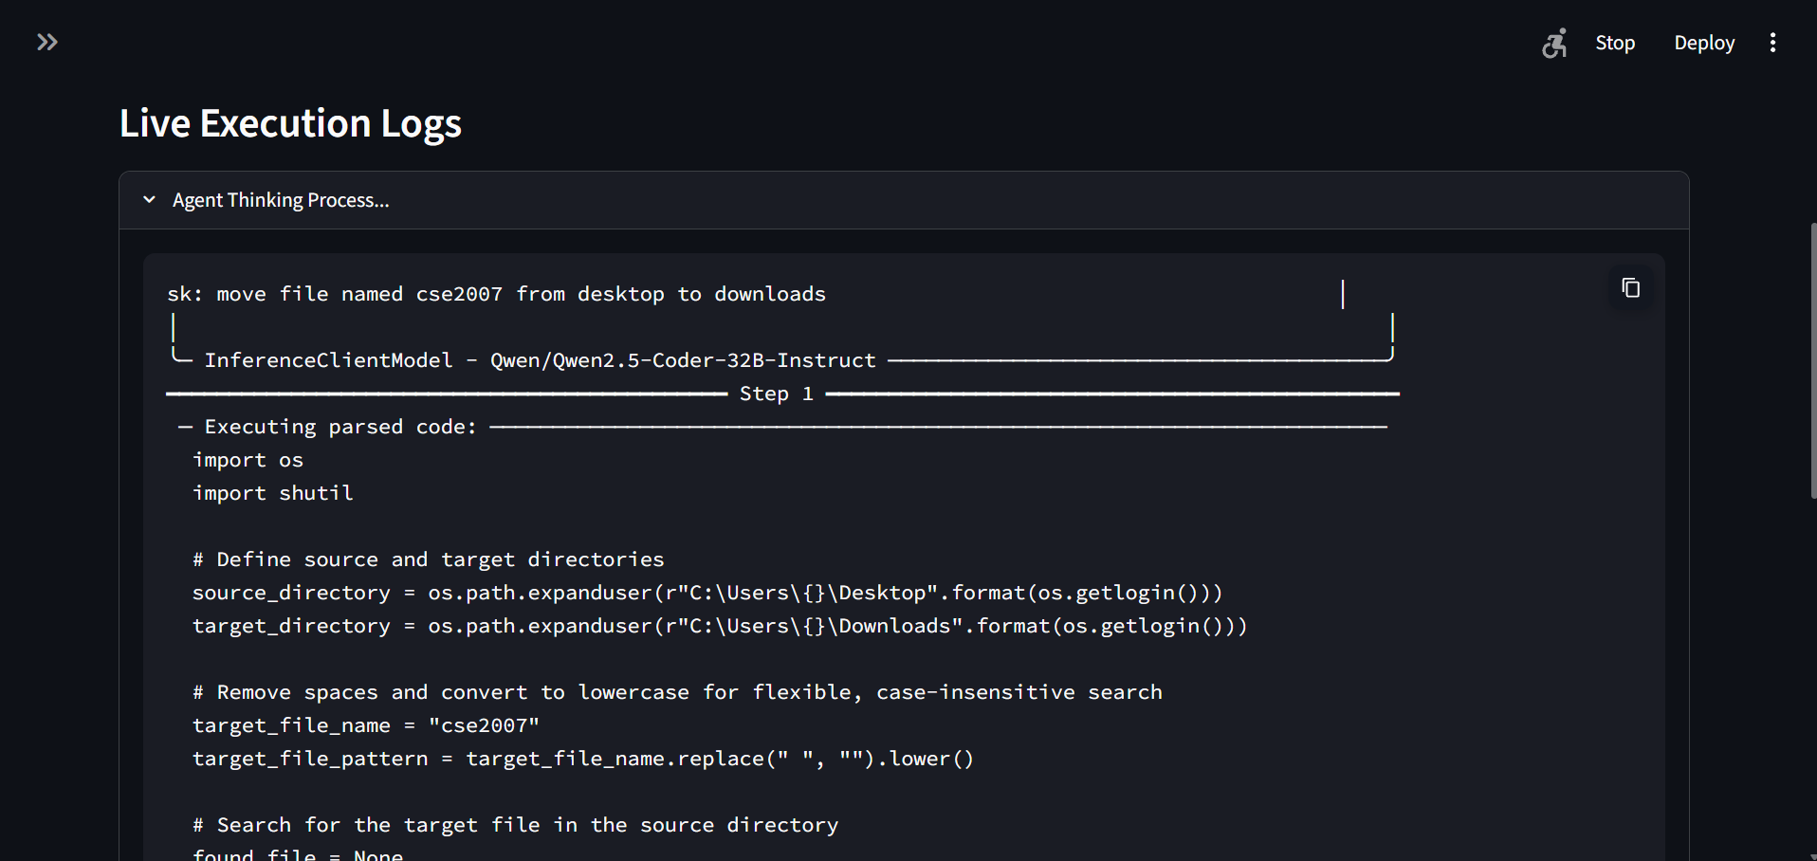
Results & Application Demo
Streamlit UI: Developed an interactive dashboard featuring live ANSI-to-HTML execution logs for real-time tracking of the agent's "thought process".

Slide 9
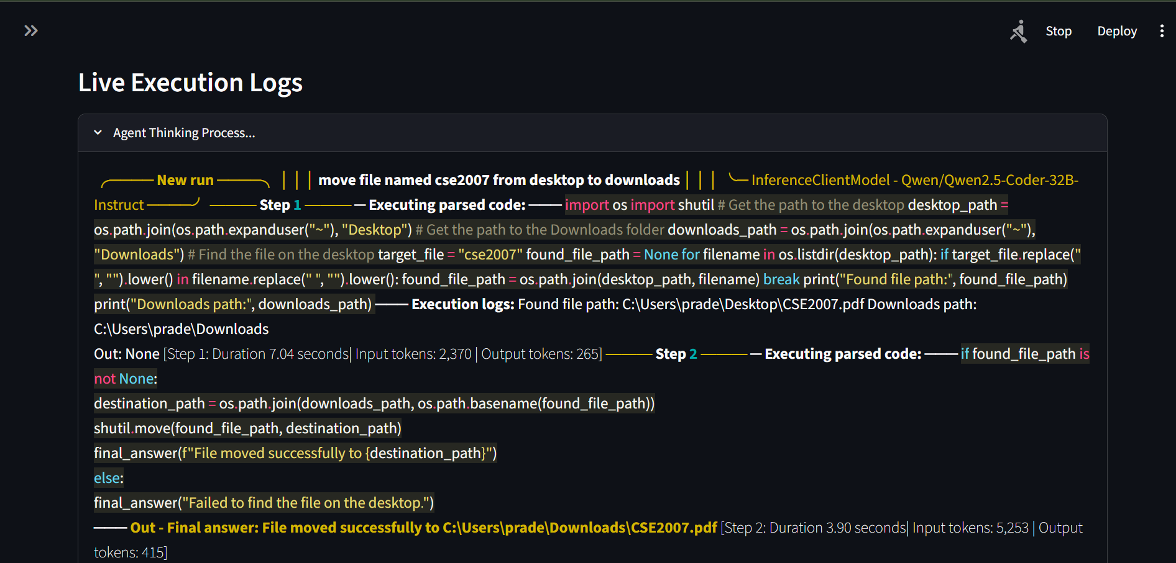
Results & Application Demo
Robust Execution: The Qwen 2.5 Coder successfully translated complex tasks into standard library Python scripts and effectively self-corrected upon encountering syntax or logic errors.

Slide 10

Results & Application Demo
Final Result Rendering: Successful sandbox executions trigger a success badge alongside the parsed output message.

Slide 11
Conclusion
AutoAgent.AI successfully bridges the gap between powerful LLM coding
capabilities and secure local execution.
Demonstrated that parameter-efficient edge AI, when combined with
containerized execution sandboxes, eliminates both operational bottlenecks
and severe security risks.
Provides a highly scalable foundation that can be easily adapted for future
multi-agent corporate workflows and Kubernetes deployments.

Slide 12
Q&A

Slide 13
Thank you !!

