Slide 1



EXPLORING INDIAN ROAD ACCIDENT DATA TO IMPROVE SAFETY
KONGU ENGINEERING COLLEGE
PERUNDURAI ERODE-638060
DEPARTMENT OF AI
PROJECT GUIDE
Dr.C.S.Kanimozhi selvi
PROJECT MEMBER
Pradeepa S-22ALR065
Roshini G-22ALR082
Yoganath M-22ALR116

Slide 2
PROBLEM STATEMENT
India faces a significant number of road accidents annually.
A considerable number of these accidents occur near schools, hospitals, and heavily trafficked areas.
The underlying causes of these accidents are not fully understood.
Young drivers and pedestrians are particularly vulnerable to these incidents.
Weather conditions also play a role in influencing accident rates.
Policymakers find it challenging to develop effective safety measures.
There is a pressing need for enhanced data analysis to improve road safety and reduce the incidence of accidents.

Slide 3
OBJECTIVE
To conduct a comprehensive analysis of trends and patterns in road accidents across India.
To identify and evaluate high-risk zones for accidents, particularly in proximity to schools, hospitals, and heavily trafficked areas.
To assess the influence of driver demographics, with a specific focus on young drivers and pedestrians, on accident rates.
To examine the relationship between weather conditions and road accident occurrences.
To provide data-driven insights and strategic recommendations for policymakers to enhance road safety measures.
To employ advanced data analysis techniques to deepen the understanding of road safety challenges.
To contribute to the formulation of effective strategies aimed at mitigating road accidents in India.

Slide 4
DATASET DESCRIPTION
It Contains 6 CSV File:
Accidents by Location (2014 & 2016): Data on road accidents near schools, hospitals, and busy areas, including casualties.
Driver Education Accidents (2009-2016): Accidents involving drivers with over 10 years of education across various states.
Driver Education (9-10 Standard, 2009-2016): Accidents involving drivers with up to 10 years of education.
Weather Impact on Accidents (2006-2015): Data on accidents influenced by weather conditions, including annual statistics and casualties.
Driver Age Accidents (2014-2016): Details on accidents categorized by the ages of drivers.
City Accident Profiles (2011-2015): Road accident statistics in select cities, highlighting fatalities and total incidents.

Slide 5
DATA PREPROCESSING
Data Preprocessing for Power BI:
Clean Data: Handle missing values and correct data types.
Merge Datasets: Combine related datasets for comprehensive analysis.
Transform Data: Create calculated columns and normalize data.
Format Dates: Ensure date columns are in the proper format.

Slide 6
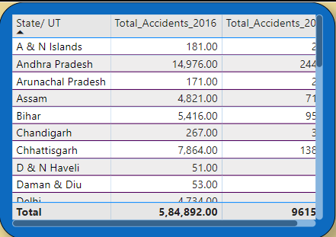
KEY ANALYSIS QUESTIONS
Using the road accident data from 2014 and 2016, analyze the trends in accident frequency across different states and Union Territories (UTs)?
INFERENCE
The total number of accidents across all states in 2016 was 584,892, while in 2014, the total was 961,554.

Slide 7
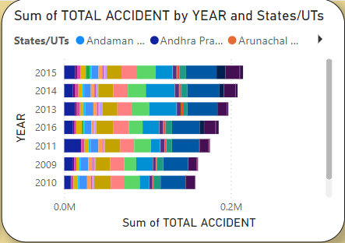
2. Analyze the road accident trends from 2009 to 2016?
INFERENCE
The highest accidents occurred in 2015, and the lowest in 2010, with Andhra Pradesh recording the most accidents overall.

Slide 8
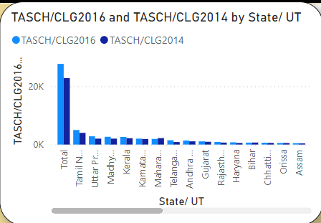
3. Compare the number of road accidents near schools and colleges in 2014 and 2016?
INFERENCE
Tamil Nadu recorded the highest TASCH/CLG values in both 2016 and 2014.
• Uttar Pradesh, Madhya Pradesh, and Kerala also show relatively high TASCH/CLG figures.
• States such as Assam, Orissa, and Chhattisgarh have comparatively low TASCH/CLG values

Slide 9
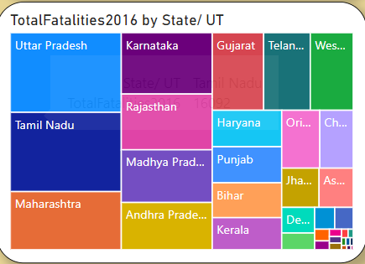
4. Using the data on road accident fatalities from 2016, identify the state with the highest number of fatalities?
INFERENCE
Uttar Pradesh had the highest number of road accident fatalities in 2016, followed closely by another state.

Slide 10
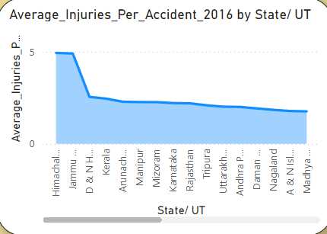
5. Calculate the average number of injuries per accident for each state in 2016?
INFERENCE
Himachal Pradesh had the highest average injuries per accident, with a declining trend observed in other states.

Slide 11
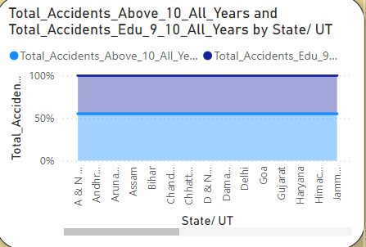
6. Examine the correlation between the education qualification of drivers and the number of accidents?
INFERENCE
Andhra Pradesh led in accidents linked to drivers' education levels, highlighting the impact of education on accident trends.

Slide 12
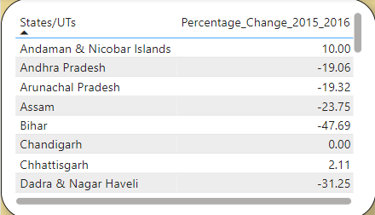
7. Evaluate the percentage change in the number of road accidents from 2015 to 2016 across different states?
INFERENCE
Andaman & Nicobar Islands saw a 10% increase, while Bihar had the largest reduction, decreasing by 47.69%.

Slide 13
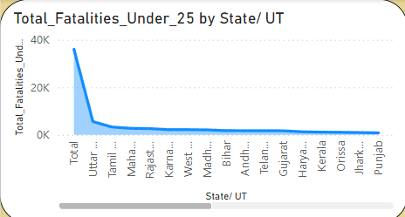
8. Design a DAX measure to analyze the average severity of accidents by city?
INFERENCE
Dhanbad recorded the highest severity, with other cities showing gradually decreasing severity levels.

Slide 14
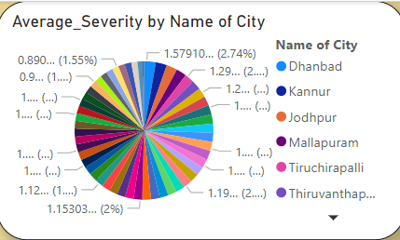
9. Write a DAX measure to calculate the total number of fatalities per state, considering only accidents involving drivers under the age of 25?
INFERENCE
Uttar Pradesh had the most fatalities involving young drivers, while Punjab recorded the least.

Slide 15
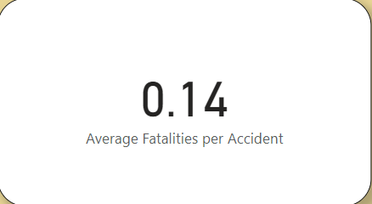
10. Design a DAX measure to calculate the average number of fatalities per accident
INFERENCE
The calculated average fatalities per accident in 2016 was 0.14.

Slide 16
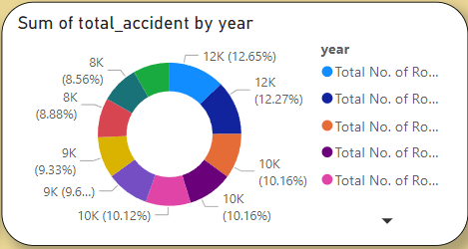
11. Analyze the yearly distribution of accidents caused by weather conditions from 2006 to 2015?
INFERENCE
Accidents peaked in 2015, with the lowest fatalities recorded in 2016 due to weather-related conditions.

Slide 17
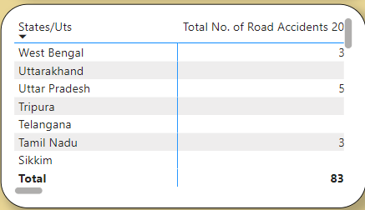
12. Create a Pivot Table showing the total number of accidents by state and year?
INFERENCE
Uttar Pradesh consistently reported the highest number of accidents, peaking at 831 in 2010, while states like Tripura and Telangana reported zero accidents, indicating missing data or no incidents.

Slide 18
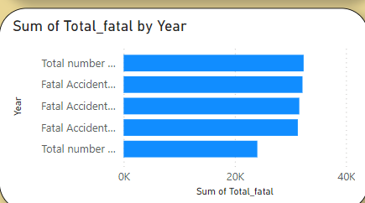
13. Calculate the total number of fatalities per accident by year?
INFERENCE
The total fatalities remained consistent across years, peaking near 40,000, with minimal annual variation.

Slide 19
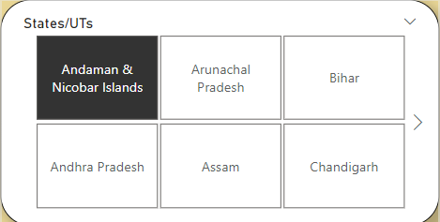
14. Design a process to filter data by specific states for customized reports?
INFERENCE
A slicer allows filtering by specific states; selecting Arunachal Pradesh customizes the report to its data.

Slide 20

15. Identify the age group that has experienced the highest number of accidents?
INFERENCE
The group above and below 18 years experienced the highest number of accidents.

Slide 21
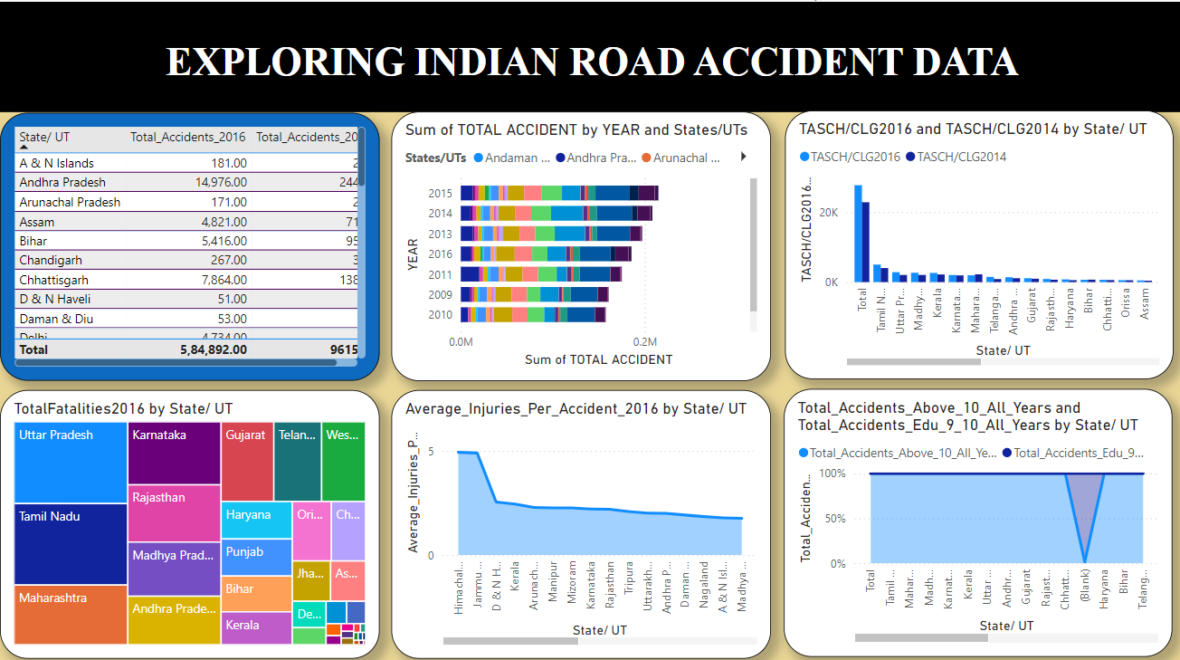
DASHBOARD
Page:1

Slide 22
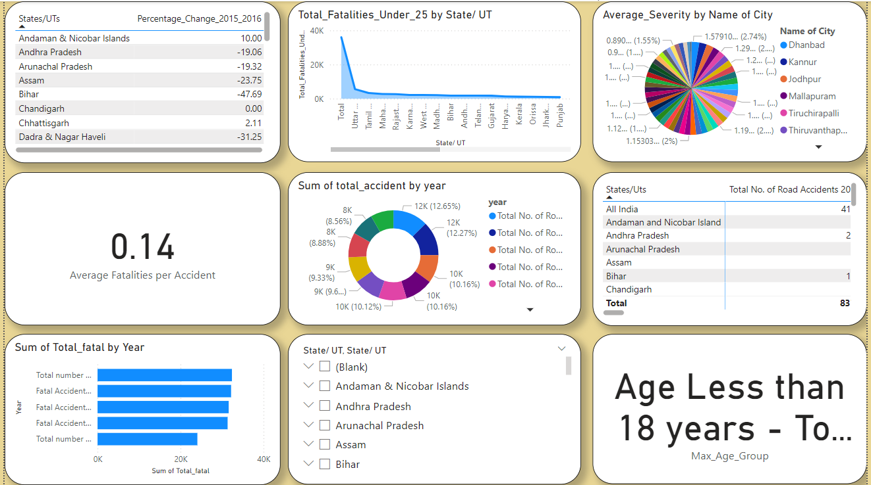
Page:2

Slide 23
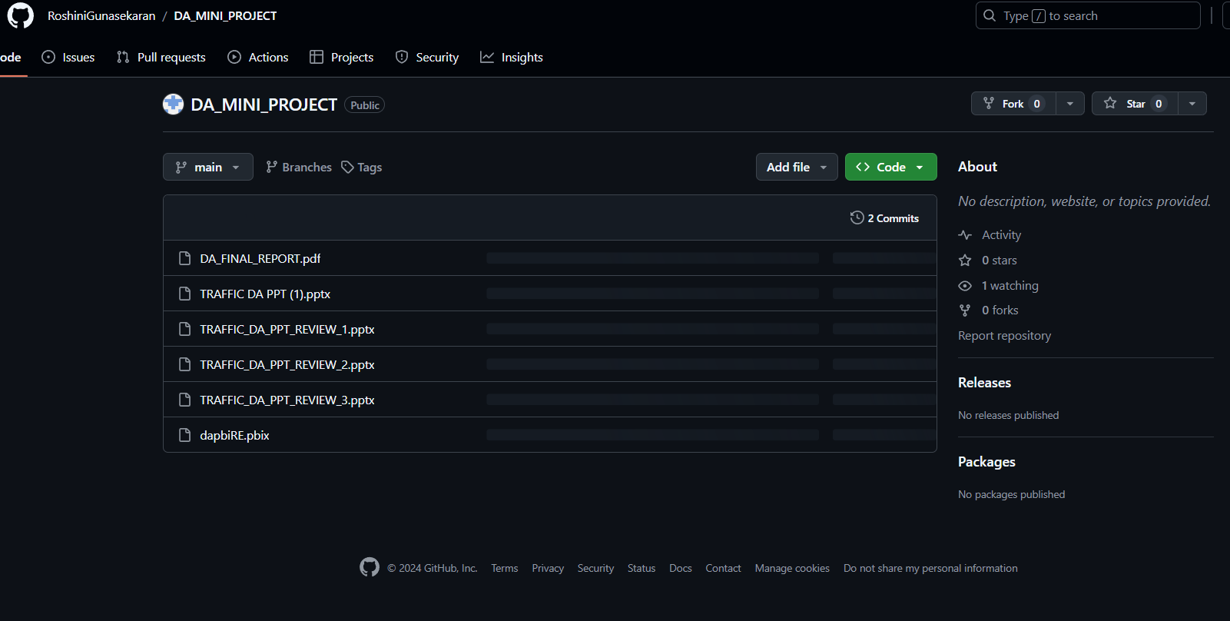
GIT HUB LINK:
https://github.com/RoshiniGunasekaran/DA_MINI_PROJECT.git

Slide 24
REFERENCE
1. Sonal, Shristi, and Saumya Suman. "A framework for analysis of road accidents." 2018 International Conference on Emerging Trends and Innovations In Engineering And Technological Research (ICETIETR). IEEE, 2018.
2. Ruikar, Manisha. "National statistics of road traffic accidents in India." Journal of Orthopaedics, Traumatology and Rehabilitation 6.1 (2013): 1-6.
3. Krishnan, Vijay. "Research data analysis with power bi." (2017).
4. Becker, Louis T., and Elyssa M. Gould. "Microsoft power BI: extending excel to manipulate, analyze, and visualize diverse data." Serials Review 45.3 (2019): 184-188.
5. Ferrari, Alberto, and Marco Russo. Analyzing data with power BI and power pivot for excel. microsoft press, 2017.

Slide 25
CONCLUSION
The analysis of Indian road accident data from 2009 to 2016 using Power BI reveals key trends, including state-wise accident variations, the impact of driver education, and weather-related accidents. The data highlights vulnerable areas like schools and hospitals, along with significant fatalities in specific states. Yearly trends and state-specific reports offer valuable insights for developing targeted interventions, helping policymakers create more effective strategies to reduce accidents and enhance road safety across India.

Slide 26
THANK YOU

