Slide 1
7,043
customers analysed
ChurnIQ
Predicting telecom customer churn with machine learning written from scratch
26.5%
churn rate
6
algorithms from scratch
ML Lab Project · NumPy · Streamlit
Notes:
ChurnIQ predicts which telecom customers are likely to leave. Every model and metric is implemented from scratch with NumPy, and a Streamlit app lets you change parameters and predict live.

Slide 2



Why customer churn matters
Problem
Customers leave, and each loss is lost recurring revenue. Only about 1 in 4 customers churns, so finding them is hard.
7,043
19
customers
features + 1 target
Goal
Estimate each customer's churn probability, find what drives it, and group customers into segments.
26.5%
11
Approach
Binary classification with four models and K-means, all written in NumPy with no scikit-learn.
churned (imbalanced)
blank TotalCharges, all tenure 0
Notes:
A model that always says 'stays' is 73.5% accurate but useless, so we judge models with precision, recall and AUC rather than accuracy.

Slide 3






One simple pipeline, six steps
Load
EDA
Features
Model
Evaluate
Predict
clean CSV, Yes/No to 1/0
distributions, churn by group
engineer, split, encode, scale
train 4 models from scratch
AUC, recall, threshold
live in Streamlit
pipeline.py
plots.py
pipeline.py
models.py
metrics.py
app.py
Split first, then fit all preprocessing on training rows only, so no test information leaks in.
Notes:
The whole project is five flat Python files. Each file maps to one stage of the pipeline.

Slide 4
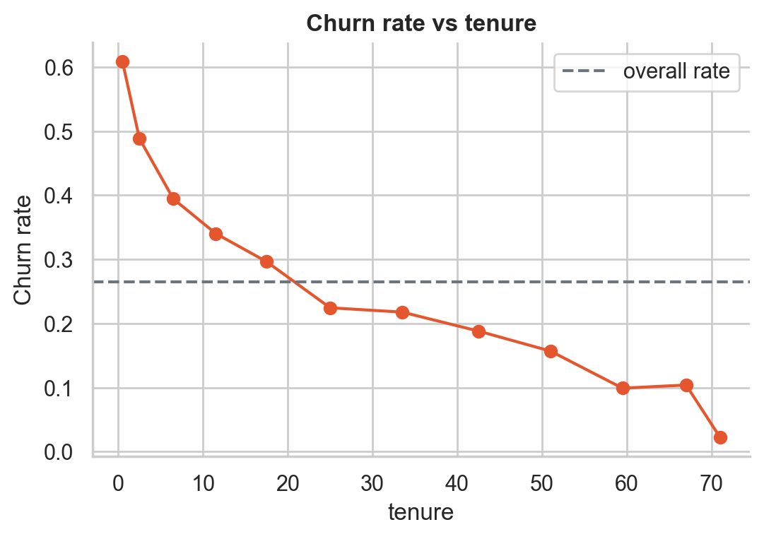
Who churns: new, month-to-month customers
41.9% fibre-optic churn vs 19.0% for DSL
45.3% electronic-check churn vs about 15-19% for other payments
Notes:
Month-to-month contracts churn at 43% versus under 3% for two-year contracts. Churn drops steadily with tenure. These are associations, not proven causes.

Slide 5



19 columns become 48 model inputs
Stratified split 70 / 15 / 15
Train fits, validation tunes, test is used once. Each part keeps the 26.5% churn share.
3 engineered features
NumServices
count of subscribed services
AvgMonthlySpend
TotalCharges / tenure
ChargePerService
MonthlyCharges / (NumServices + 1)
Impute and standardise
Median fills blanks. z = (x - mean) / std puts every number on one ruler.
One-hot encode
Each category gets its own 0/1 column, so no fake ordering.
ChargePerService is the 2nd most important feature in the tree.
Notes:
All statistics (median, mean, std, categories) are learned on the training rows only and reused unchanged for validation, test and new customers.

Slide 6
Four classifiers, all written in NumPy
1
Logistic Regression
2
K-Nearest Neighbors
p = sigmoid(w·x + b)
p = mean label of k nearest
Linear log-odds, trained by gradient descent on cross-entropy.
Ask the 31 most similar customers what they did.
3
Gaussian Naive Bayes
4
Decision Tree (CART)
P(y|x) ∝ P(y) · Π N(xⱼ)
split to maximise Gini gain
Bayes' rule with independent Gaussian features, in log space.
Ask the yes/no question that makes groups purest, then repeat.
Plus K-means (k-means++) and PCA for customer segments.
Notes:
Full derivations are in MATH_INTUITION.md. Every model exposes fit and predict_proba so the app can swap them freely.

Slide 7
Inside logistic regression
Score
z = w·x + b
1
Probability
p = 1 / (1 + e^-z)
2
Loss
L = -mean[ y·log p + (1-y)·log(1-p) ]
3
Gradient
dL/dw = Xᵀ(p - y) / m
4
Update
w ← w - η · dL/dw
Longer tenure and long contracts lower risk. Month-to-month raises it. The loss is convex, so gradient descent finds the global minimum.
5
Notes:
The gradient is simply features times prediction error. L2 regularisation adds lambda/m times w to shrink weights and reduce overfitting.

Slide 8
Logistic regression ranks customers best
Model | AUC | Recall | Precision | F1 | Accuracy
Logistic Regression | 0.849 | 0.789 | 0.534 | 0.637 | 0.761
K-Nearest Neighbors | 0.839 | 0.804 | 0.516 | 0.628 | 0.748
Gaussian Naive Bayes | 0.824 | 0.811 | 0.488 | 0.609 | 0.724
Decision Tree | 0.811 | 0.768 | 0.495 | 0.602 | 0.731
Recall about 0.79 means roughly 4 in 5 churners are caught. Precision about 0.53 means about half of the flagged customers really would leave.
Test set: 1,056 customers. Thresholds chosen on validation by best F1. Gaps between models are small, about 0.01 AUC.
Notes:
Logistic regression also wins on F1 and is the easiest to interpret, so it is the default model in the app. Differences of about 0.01 AUC are within noise on about 1,000 test rows.

Slide 9
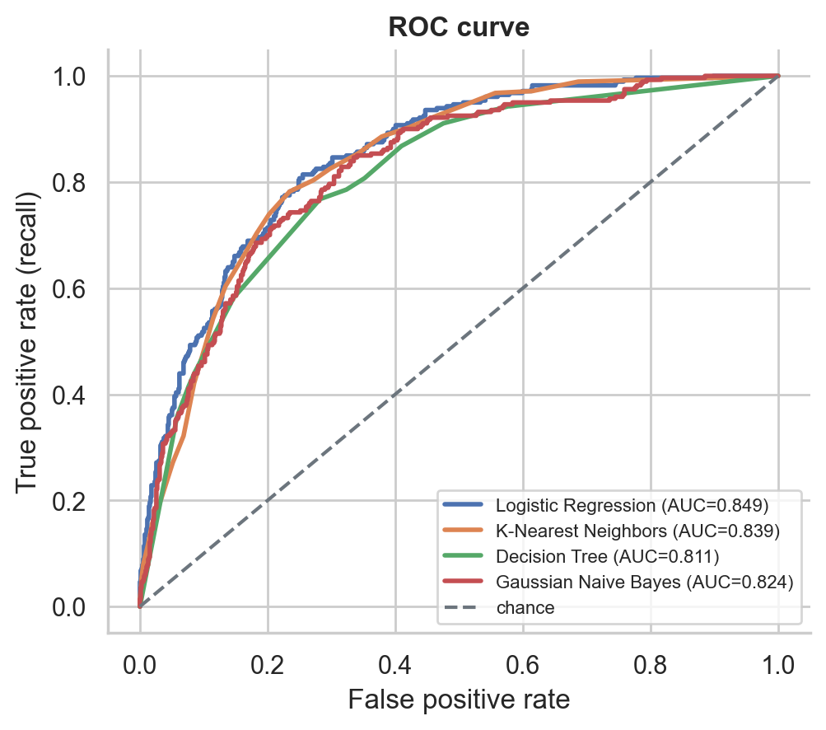
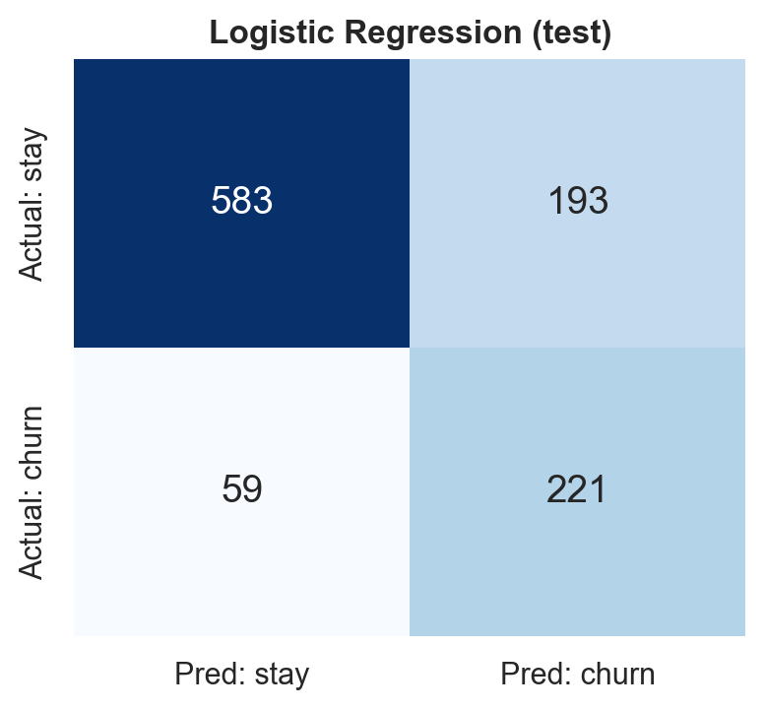
ROC curves and the confusion matrix
Logistic regression on test: 221 churners caught, 59 missed, 193 false alarms.
AUC = chance a random churner is scored above a random loyal customer.
Notes:
The ROC curve sweeps the decision threshold. The area under it, computed with the trapezoid rule, is the AUC.

Slide 10
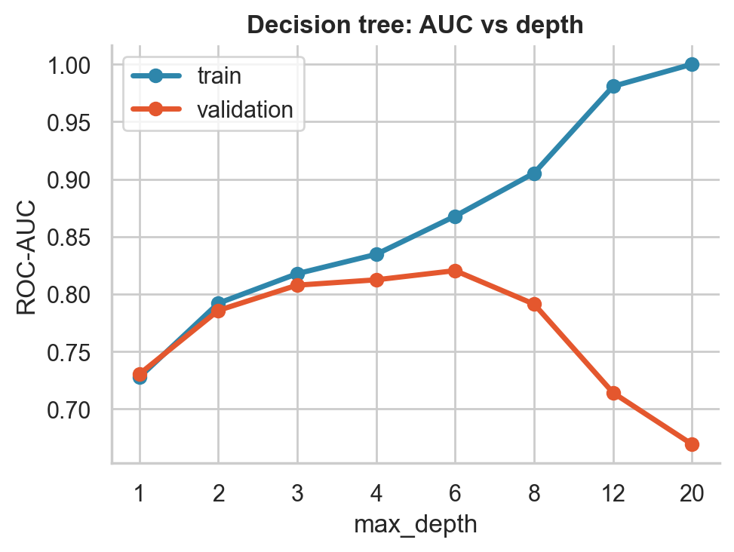
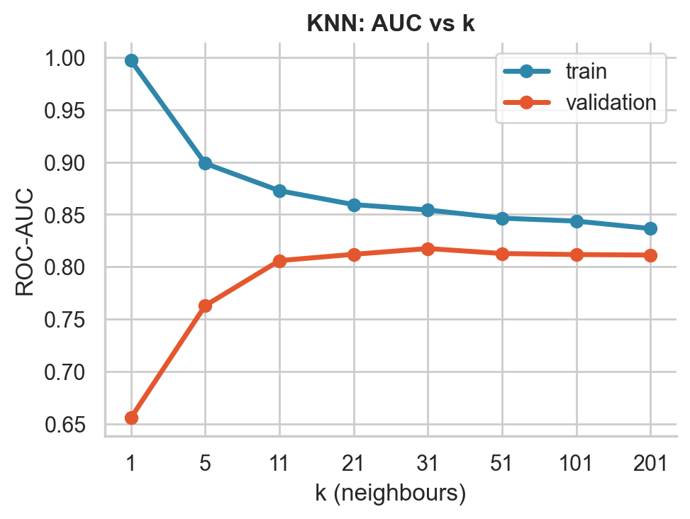
Too simple underfits, too complex overfits
Overfit: depth 20
train AUC 1.00, validation 0.67
Overfit: KNN k = 1
train 0.997, validation 0.656
Good: depth 4, k = 31
train and validation close, validation AUC peaks
Notes:
A big gap between training and validation AUC means high variance, i.e. overfitting. Choose the setting where validation AUC peaks.

Slide 11
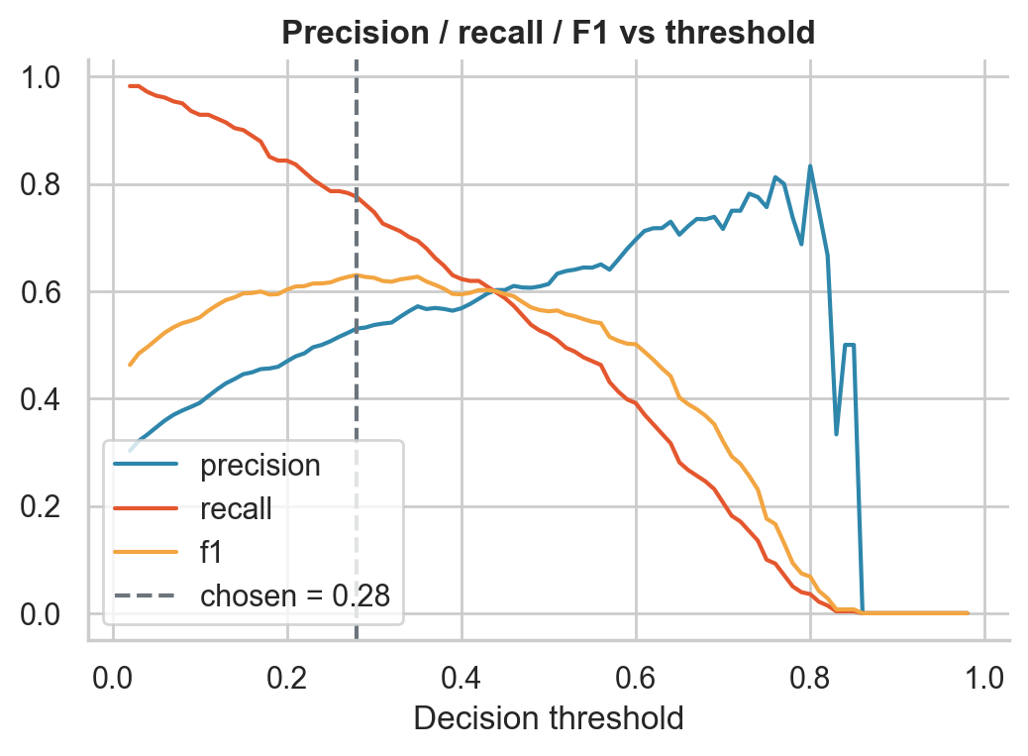



From probability to action: the threshold
Best F1
Highest F1 on validation. Logistic regression: 0.28.
Minimum recall
Catch at least X% of churners. At 80%, the threshold is 0.23 (flag anyone at 23% risk or more).
Manual
Drag the slider and watch precision, recall and F1 move.
Lower threshold: more recall, more false alarms. Higher: the reverse.
Notes:
The threshold is always chosen on validation data, never on the test set. The recall constraint turns a business requirement into the cheapest cut-off that satisfies it.

Slide 12
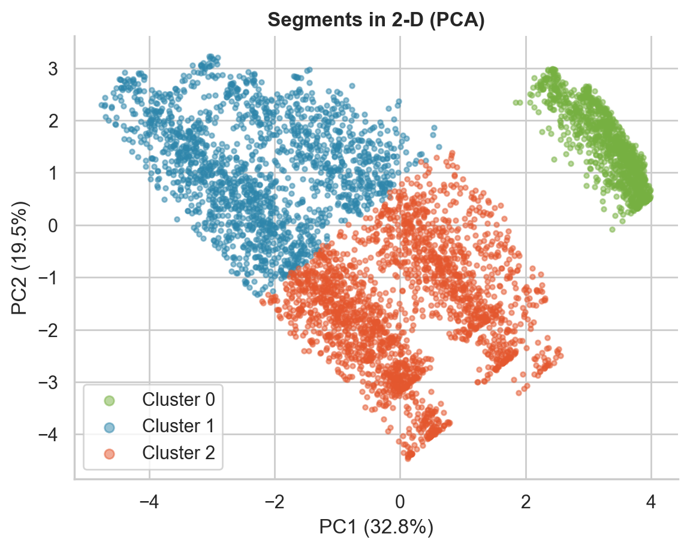
Three customer segments with K-means
Low-bill customers
1085 customers · 31 months · $21/mo
Churn 7.1%
C0
Loyal, high spenders
1712 customers · 54 months · $89/mo
Churn 17.1%
C1
Newer, mid-bill
2133 customers · 16 months · $67/mo
Churn 44.0%
C2
Notes:
K-means never sees the churn label. Churn rate is computed afterwards to describe each segment. The newer mid-bill group churns at 44%, so it is the retention priority.

Slide 13


The Streamlit app: tune, constrain, predict
Data and EDA 9 exploratory plots
Sidebar controls
Model and its parameters
Engineered features on or off
Random seed
Threshold rule: best F1, minimum recall, manual
Inputs limited to the training range; impossible service combinations blocked
Feature engineering split, encoding, new features
Model and results metrics, ROC, sweeps, comparison
Predict a customer probability, risk band, drivers
Segments K-means, PCA, elbow
Notes:
The app retrains instantly when parameters change, and results are cached. Run it with: streamlit run app.py

Slide 14
Takeaways and next steps
AUC 0.85
Contract type
44% segment
Logistic regression is the strongest and most interpretable model.
Short tenure and month-to-month contracts drive churn.
Newer mid-bill customers are the retention priority.
Limits One dataset; probabilities are not calibrated; effects are associations, not causes.
Next A/B test retention offers, monitor drift, calibrate probabilities, try ensembles.
Notes:
Keep a human in the loop for any consequential action based on a score.

