Slide 1

IBM University Engagement Project Submission
“Exploring the Power of Agentic AI with IBM Granite and IBM Bob”

Slide 2

Project Tile – AI Agent for Smart Farming Advice
Domain of Project – Agriculture
Student Name | Recent Passport Photo | Email ID | Mobile number [WhatsApp]
PRAJWAL.B.R |  | prajugowda8050@gmail.com | 8867414268

Slide 3
Problem Statement - AI Agent for Smart Farming Advice
Problem Statement : AI Agent for Smart Farming Advice
The Challenge
Farmers often struggle with low crop yield, unpredictable weather, pest infestations, and limited access to timely expert advice. Traditional farming advisory services are fragmented, slow, and not personalized to the farmer’s specific land, crop, or climate conditions. With the rise of climate change, data-driven smart farming solutions are needed to empower farmers with actionable insights.
The Objective
The Objective Develop an AI-powered Smart Farming Agent that provides personalized, real-time, and sustainable agricultural advice. The solution should:
  Agricultural Knowledge Retrieval (RAG) – Use Retrieval-Augmented Generation to fetch best practices, crop-specific guidelines, and government advisory updates.
  Weather & Soil Insights – Integrate real-time weather forecasts, soil health data, and irrigation needs to optimize farm planning.
  Pest & Disease Detection – Enable multimodal support where farmers upload crop images for early pest/disease identification and get instant recommendations.
  Personalized Advisory Agent – Suggest seeds, fertilizers, irrigation schedules, and harvesting timelines based on farmer profile and land conditions.
  Market & Cost Optimization – Forecast demand, suggest market prices, and recommend cost-efficient practices for better income.
  Multi-Agent Collaboration – o Crop Advisory Agent o Weather & Irrigation Agent o Pest/Disease Detection Agent o Market Insights Agent

Slide 4
Proposed Solution -
Proposed Solution – AgroMind AI: An Intelligent Smart Farming Advisory Agent
Now audit the AgroMind AI project you just built. Do not redesign everything or replace working code without a reason.
Inspect the actual files and compare the implementation against the original problem statement, including agricultural RAG, weather and soil insights, pest and disease detection, personalized crop advice, market optimization, and multi-agent collaboration.
Run the backend and frontend using the available environment.
Execute the tests and frontend production build. Identify and fix actual errors.
Verify that IBM Granite is called through the configured IBM watsonx.ai service and that LangFlow or the selected mandatory IBM-compatible agentic approach is genuinely integrated.
Verify that RAG retrieves relevant agricultural documents with real source metadata and traceable citations, including crop guidelines and government advisories where available.
Verify that the four specialized agents—Crop Advisory, Weather & Irrigation, Pest & Disease Detection, and Market Insights—have separate responsibilities and work correctly through the agent orchestrator.
Test crop image uploads, input validation, pest and disease analysis, farmer profile persistence, soil and weather data handling, and personalized recommendations. Clearly distinguish actual image-model inference from demo-mode or unavailable vision functionality.
Verify market price information, weather forecasts, irrigation recommendations, fertilizer and seed suggestions, and harvesting guidance. Use real data sources where configured and label sample data and estimates honestly.
Check API communication, error handling, loading states, demo-mode labeling, and all major frontend buttons and forms.
Check for hardcoded fake live data, invented citations, unsupported agricultural claims, exposed credentials, and nonfunctional integrations.
Confirm which features work without API keys and which require IBM watsonx.ai credentials, LangFlow configuration, weather or market data APIs, or a compatible vision model.
Update the README with exact installation, environment configuration, startup, testing, and deployment commands suitable for a beginner.
Fix the issues you can resolve directly in the workspace without unnecessarily replacing existing working code.
Give me a concise final audit report covering implemented features, actual test and build results, verified integrations, unresolved issues, and the remaining work required to meet the original problem statement.

Slide 5
Technology Used
• IBM Bob Platform – For designing and orchestrating multi-agent workflows visually.
• IBM Granite Model – For example, ibm-granite-3.2-8b – For natural language understanding, reasoning, and personalized agricultural recommendations.
• IBM Cloud – It provides the infrastructure to build, deploy, and scale the Smart Farming Agent efficiently. IBM Cloud enables a reliable, secure, and scalable environment for deploying the Smart Farming Agent.
• RAG (Retrieval-Augmented Generation) – To fetch real agricultural data first, then generate intelligent answers, making the Smart Farming Agent more trustworthy and effective by using crop-specific guidelines, best practices, and government advisories.
• IBM watsonx.ai – For model deployment, embeddings, and AI governance.
• Vector Database (FAISS/Chroma) – For RAG-based agricultural data retrieval, including crop guidelines, soil information, pest and disease management, and farming best practices.

Slide 6
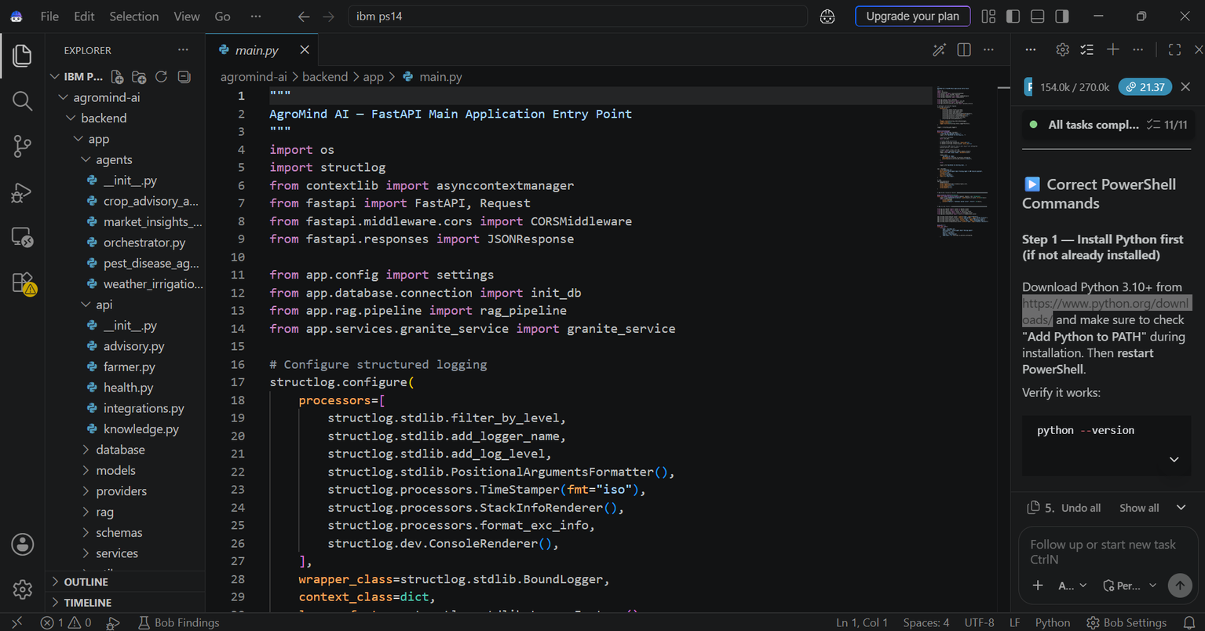
Some required Files created using IBM bob -
  App.py
  Requirements.txt
  .env
  Index.html

Slide 7
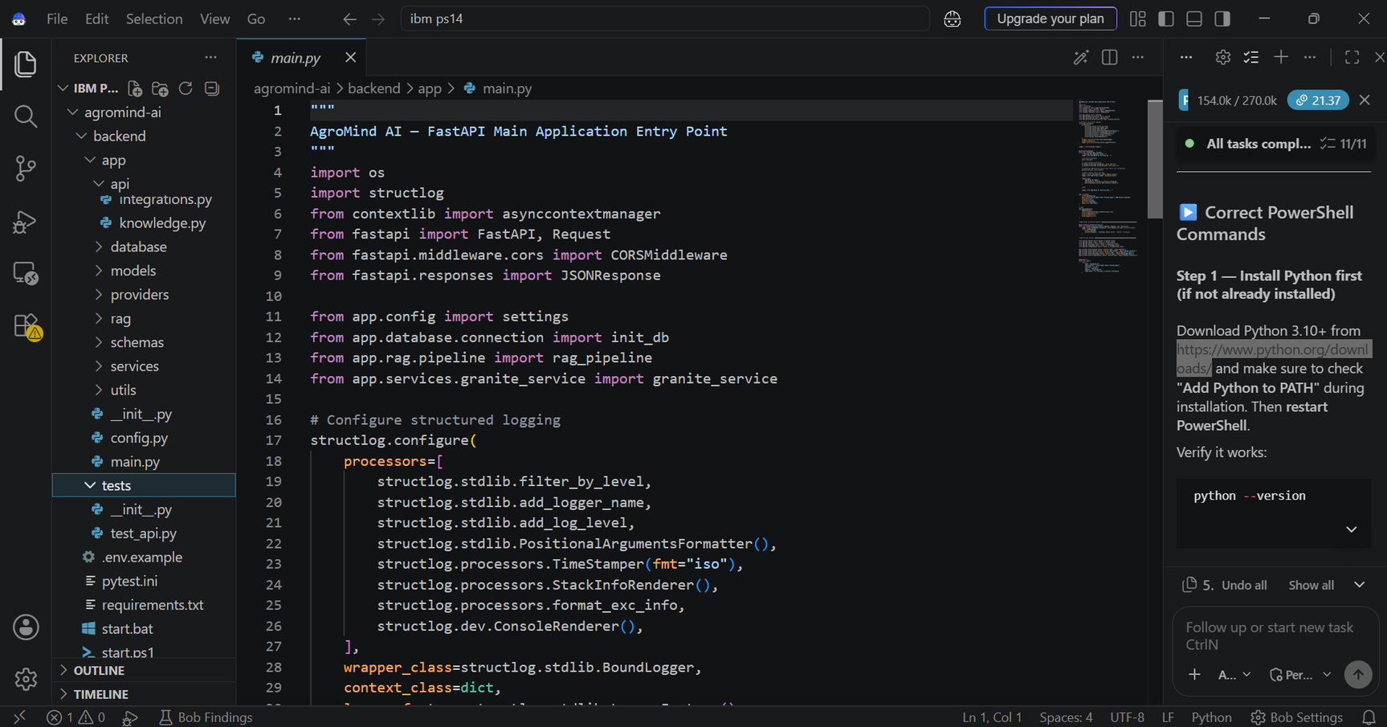
IBM Bob Screenshots:

Slide 8
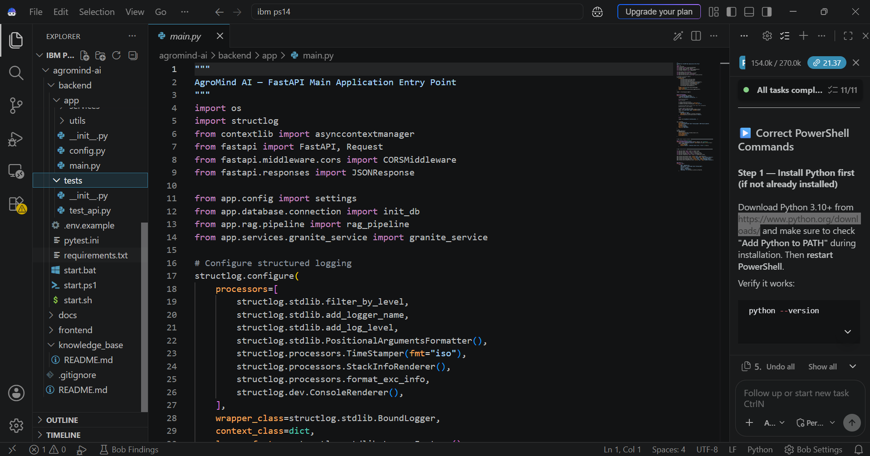
IBM Bob Screenshots:

Slide 9
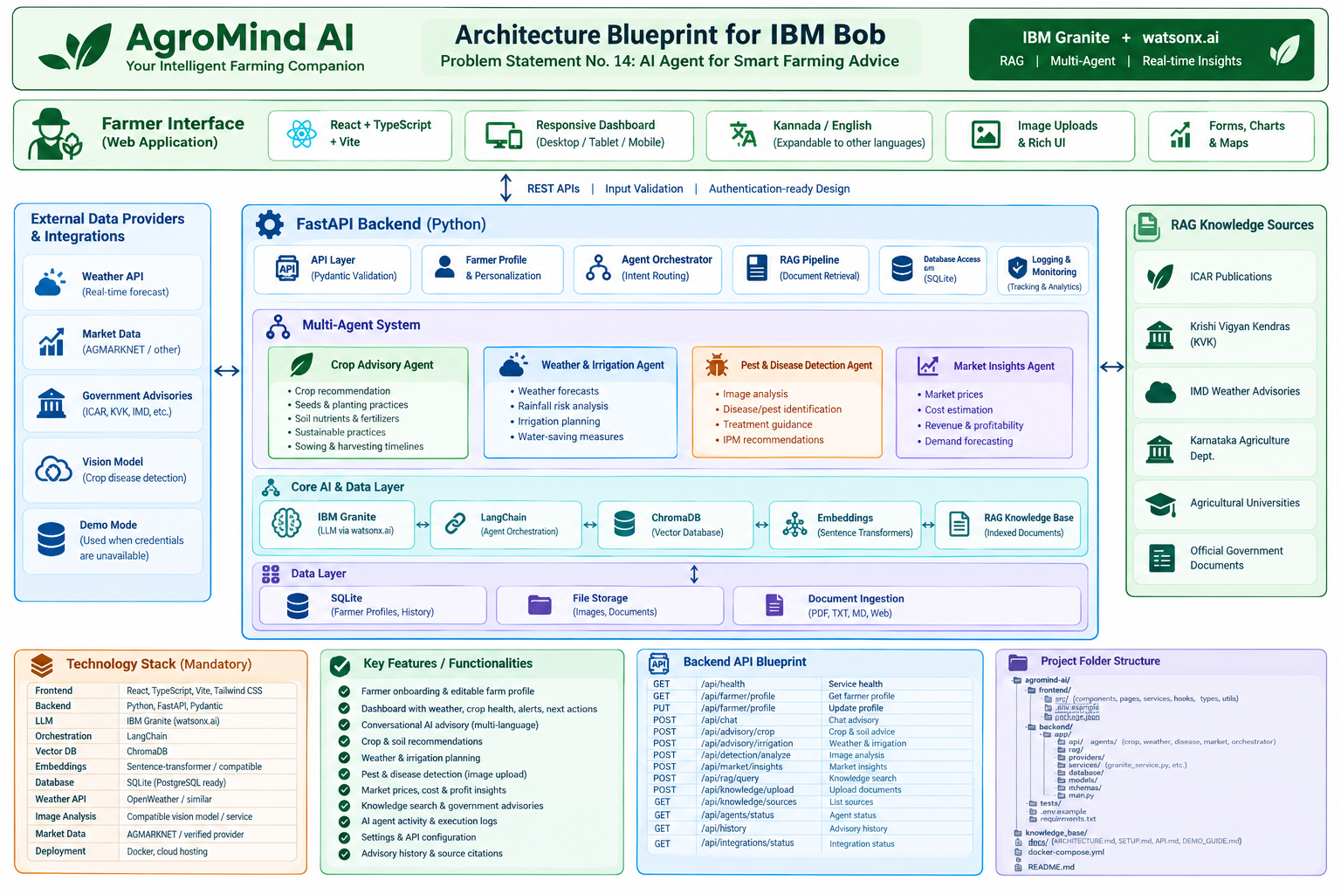
Architecture blueprint for IBM bob:

Slide 10

Role of Agentic AI in the solution
Role of Agentic AI in the Solution
• Crop Advisory Agent – Analyzes crop type, soil conditions, and farmer profile to recommend suitable seeds, fertilizers, crop management practices, and harvesting timelines.
• Weather & Irrigation Agent – Monitors weather forecasts and soil moisture data to recommend irrigation schedules, rainfall preparedness, and water-saving strategies.
• Pest & Disease Detection Agent – Analyzes uploaded crop images to identify potential pests and diseases and provides early warnings and suitable treatment recommendations.
• Market Insights Agent – Analyzes market demand, mandi prices, and cultivation costs to suggest profitable crops and cost-efficient farming practices.
• RAG Knowledge Agent – Retrieves relevant agricultural guidelines, government advisories, and verified farming information to provide reliable, context-specific recommendations.
• Multi-Agent Collaboration – The IBM Bob platform coordinates the specialized agents, enabling them to share relevant insights, combine their findings, and generate personalized, actionable, and sustainable farming advice.
• Intelligent Decision-Making – Agentic AI evaluates information from multiple sources, adapts recommendations to changing farm conditions, and helps farmers make informed decisions to improve crop yield and profitability.

Slide 11
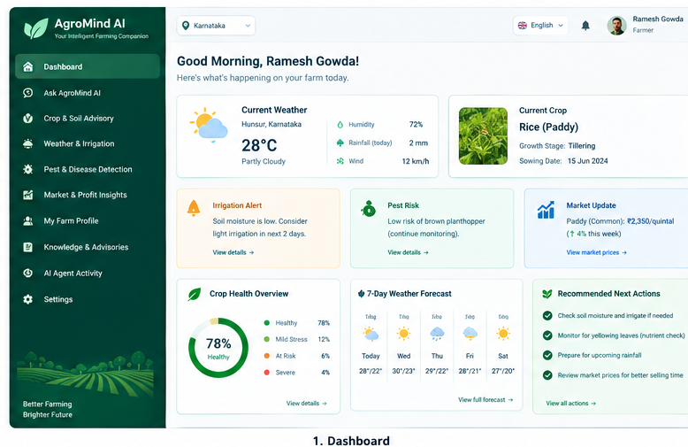
Project Output Screenshot
Please put IBM Bob output screenshots with 2-3 prompts.
You can take 2-3 more slides for each screenshot
·
·
·

Slide 12
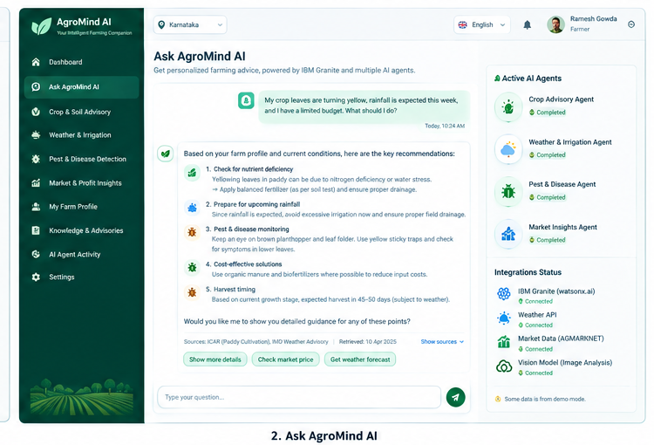
Project Output Screenshot
Please put IBM Bob output screenshots with 2-3 prompts.
You can take 2-3 more slides for each screenshot
·
·
·

Slide 13
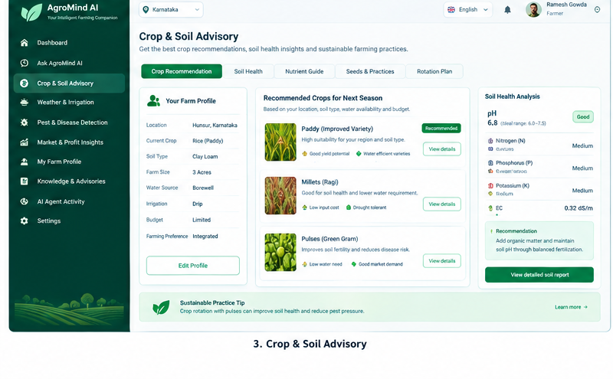
Project Output Screenshot
Please put IBM Bob output screenshots with 2-3 prompts.
You can take 2-3 more slides for each screenshot
·
·
·

Slide 14
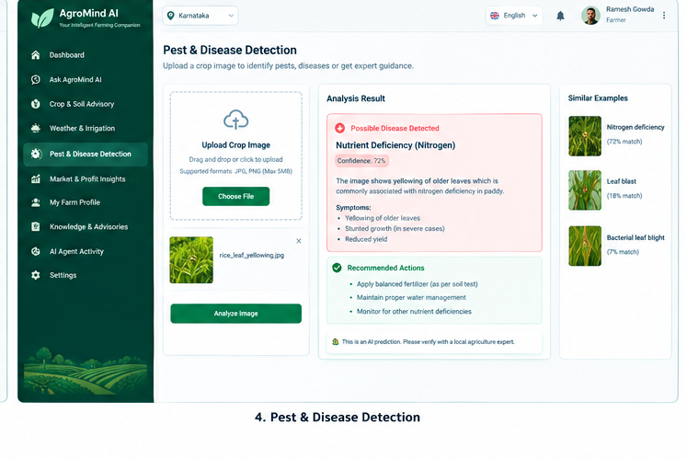
Project Output Screenshot
Please put IBM Bob output screenshots with 2-3 prompts.
You can take 2-3 more slides for each screenshot
·
·
·

Slide 15
Novelty and Uniqueness
Novelty and Uniqueness
• Multi-Agent Collaboration – Combines Crop Advisory, Weather & Irrigation, Pest & Disease Detection, and Market Insights agents to deliver comprehensive farming solutions through a coordinated AI system.
• Personalized Farming Recommendations – Provides crop-specific advice based on the farmer’s profile, land conditions, soil health, local climate, and budget.
• RAG-Based Verified Knowledge – Retrieves relevant agricultural best practices, crop guidelines, and government advisories before generating recommendations, improving the relevance and reliability of responses.
• Multimodal Pest & Disease Detection – Enables farmers to upload crop images for early identification of potential pest infestations and diseases, along with appropriate preventive and treatment guidance.
• Real-Time Weather and Smart Irrigation – Integrates weather forecasts and available soil moisture data to recommend irrigation schedules, reduce water wastage, and support climate-resilient farming.
• Market-Driven Profit Optimization – Combines market price information, demand trends, and cultivation costs to help farmers make informed crop-selection and selling decisions.
• Sustainable and Cost-Effective Agriculture – Encourages efficient use of water, fertilizers, and other agricultural resources while promoting environmentally responsible farming practices.
• Agentic AI with IBM Technology – Uses the IBM Bob platform to orchestrate specialized AI agents, with IBM Granite models and RAG-based knowledge retrieval, to transform fragmented agricultural information into coordinated, actionable recommendations.

Slide 16
Git Hub Link
https://github.com/PRAJUGOWDRU/AgroMind-AI-Smart-Farming
·
·
·

Slide 17
Future Scope
Future Scope
• IoT-Based Smart Farming – Integrate sensors to monitor soil moisture, temperature, and nutrient levels in real time.
• Drone & Satellite Integration – Monitor crop health, identify affected areas, and assess large agricultural fields.
• Regional Language & Voice Support – Provide multilingual and voice-based assistance for better accessibility.
• Predictive Crop Yield Analysis – Forecast crop yields and identify potential agricultural risks using AI.
• Advanced Pest & Disease Prediction – Detect potential outbreaks early using crop images, weather data, and historical information.
• Automated Irrigation Management – Optimize water usage through smart irrigation and soil moisture monitoring.
• Market & Financial Integration – Provide updated market prices, cost analysis, and relevant government scheme information.
• Scalable Multi-Agent System – Expand with specialized agents for soil health, crop insurance, and climate-risk assessment.
·
·
·

Slide 18
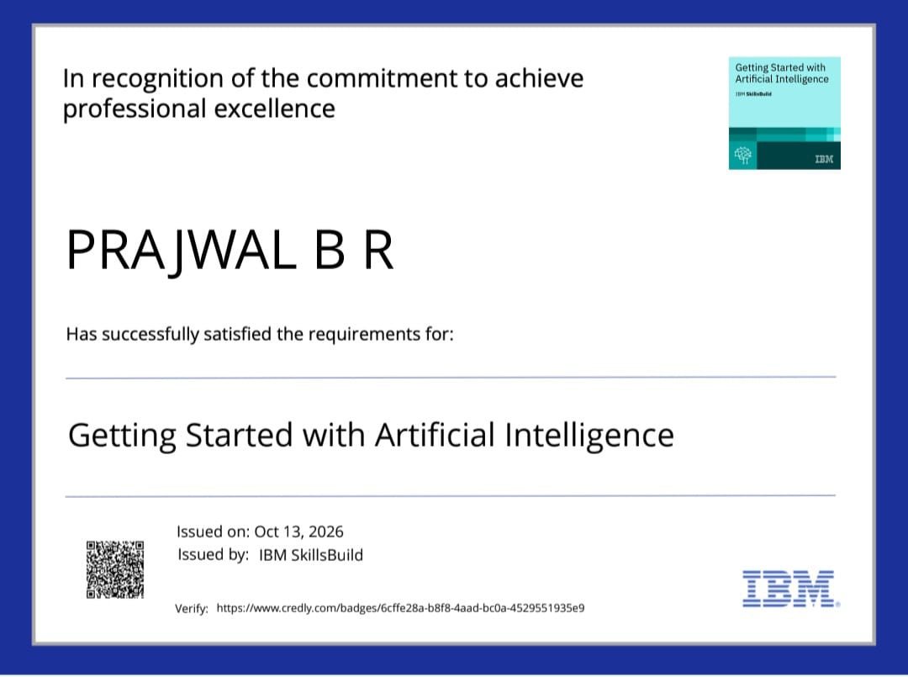
Certificates Earned:

Slide 19
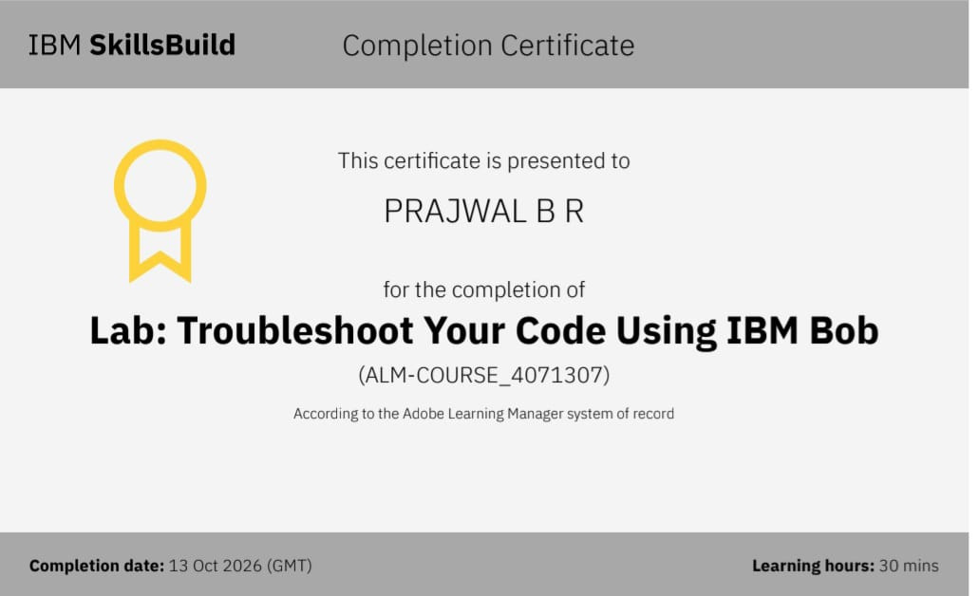
Certificates Earned:​

Slide 20


