Slide 1

PRESENTATION FOR BANK LOAN OF CUSTOMERS

Slide 2
DOMAIN : Finance
PROJECT : Bank loan of customers
DATA SET PROVIDED : Finance_1 & Finance_2
DATASET TYPE : Excel

Slide 3
Main objective of project
This is Bank loan of Customers project where we were provided with 2 datasets with .csv extension files having 39k rows each and the objective was to analyze the growth that bank got within given years in loans.
We used MS-Excel for analyzing, cleaning and removing duplicates from dataset and prepared dashboard using Tableau and Power BI tools where we did calculations, merging and prepared interactive dashboards.

Slide 4




MS Excel
Tableau
Project Management Tools
Power BI
My SQL

Slide 5
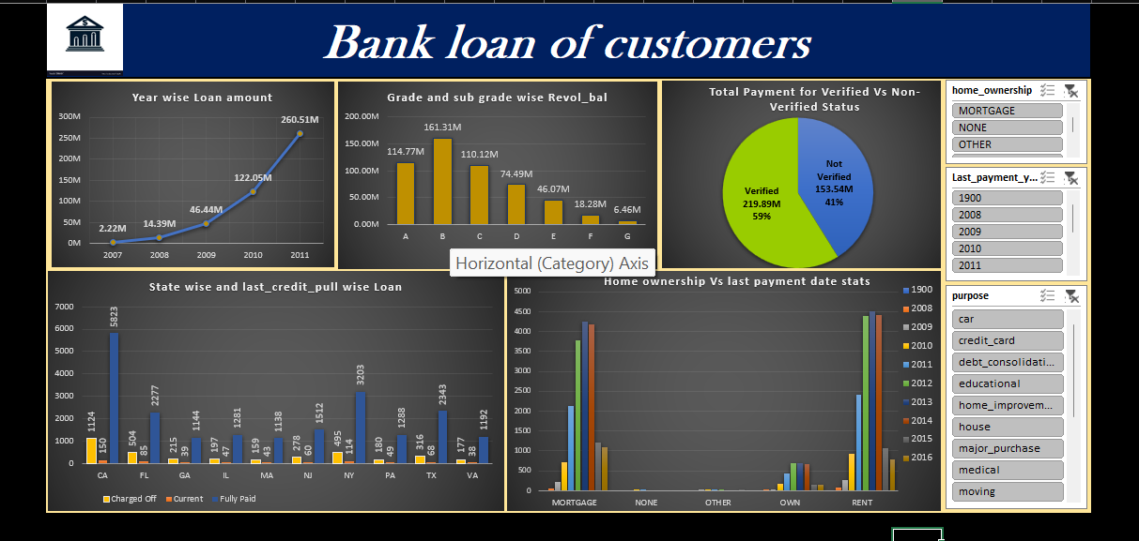
Excel dashboard

Slide 6
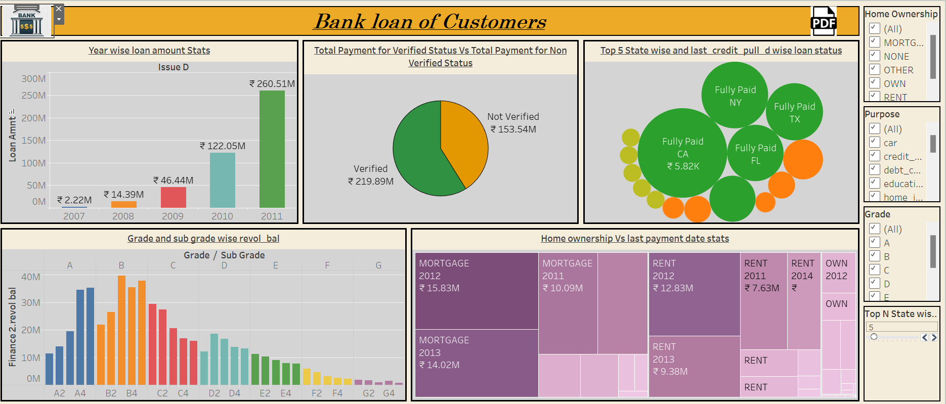
TABLEAU DASHBOARD

Slide 7
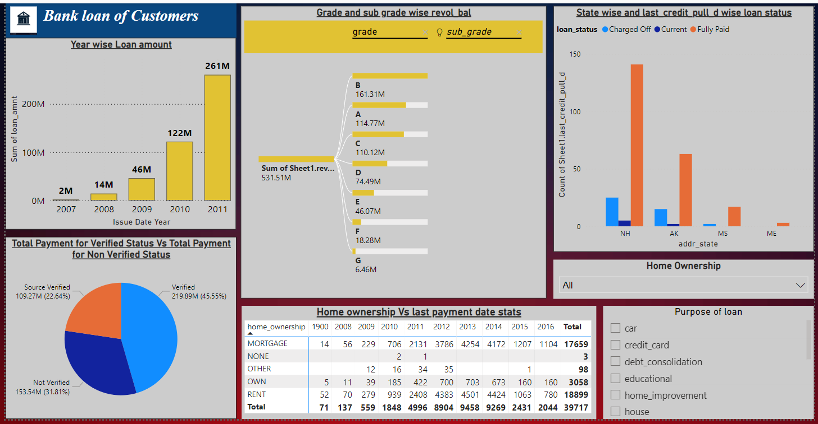
POWER BI DASHBOARD

Slide 8
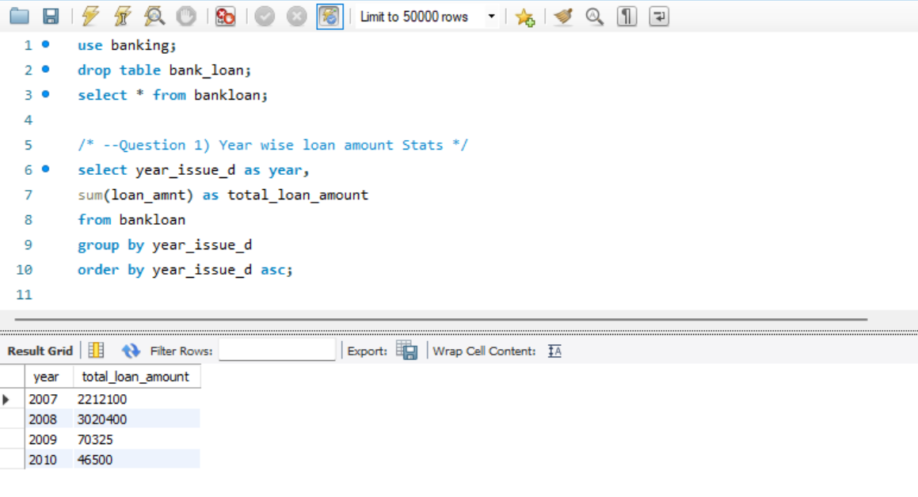
SQL SCRIPTS
STEP 1 – Created the database named “Banking”.
STEP 2 – Imported the csv file by “table data import wizard”.
STEP 3 – Table now ready to fetch the data for different scenarios.
QUESTION 1) Year wise Loan amount stats.

Slide 9
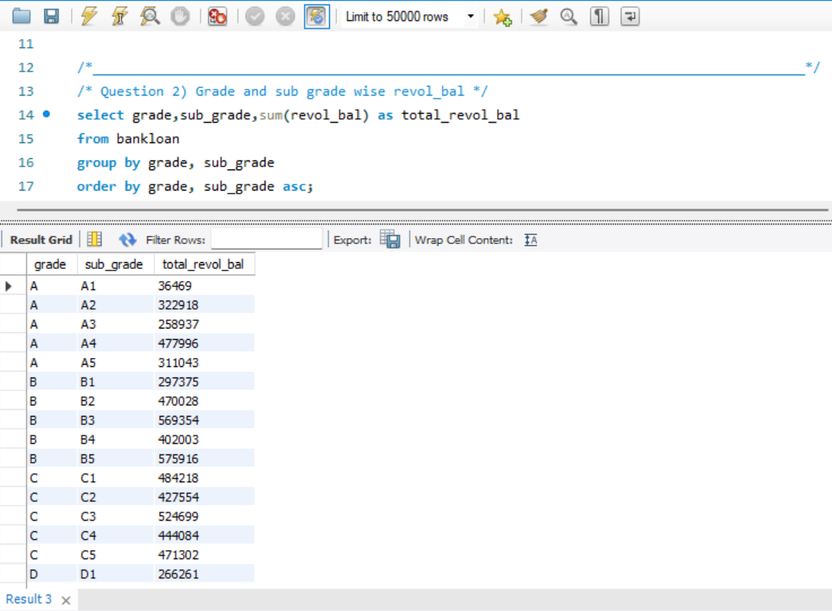
QUESTION 2) Grade & Sub-grade wise Revol balance

Slide 10
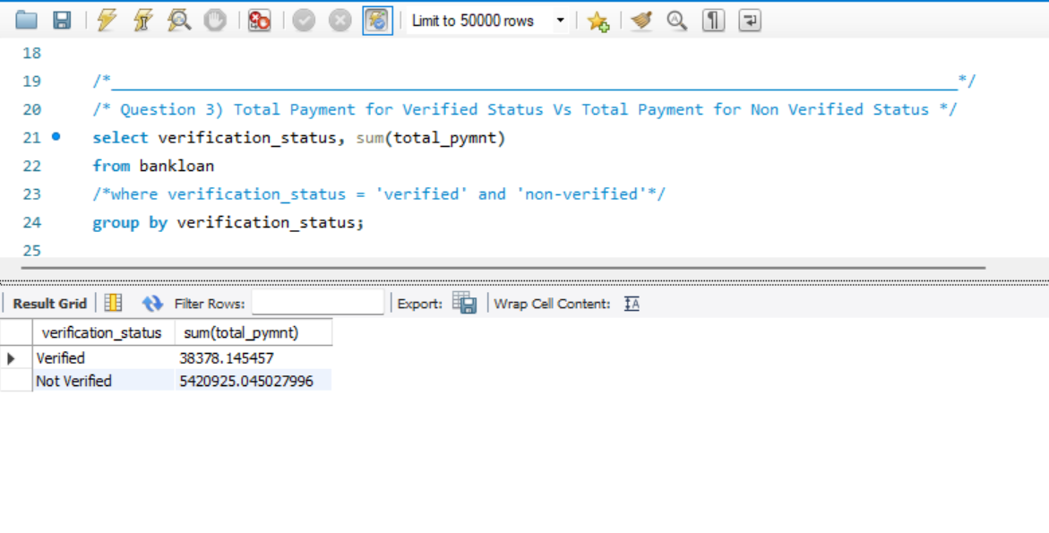
QUESTION 3) Total payment for Verified and Non-verified status

Slide 11
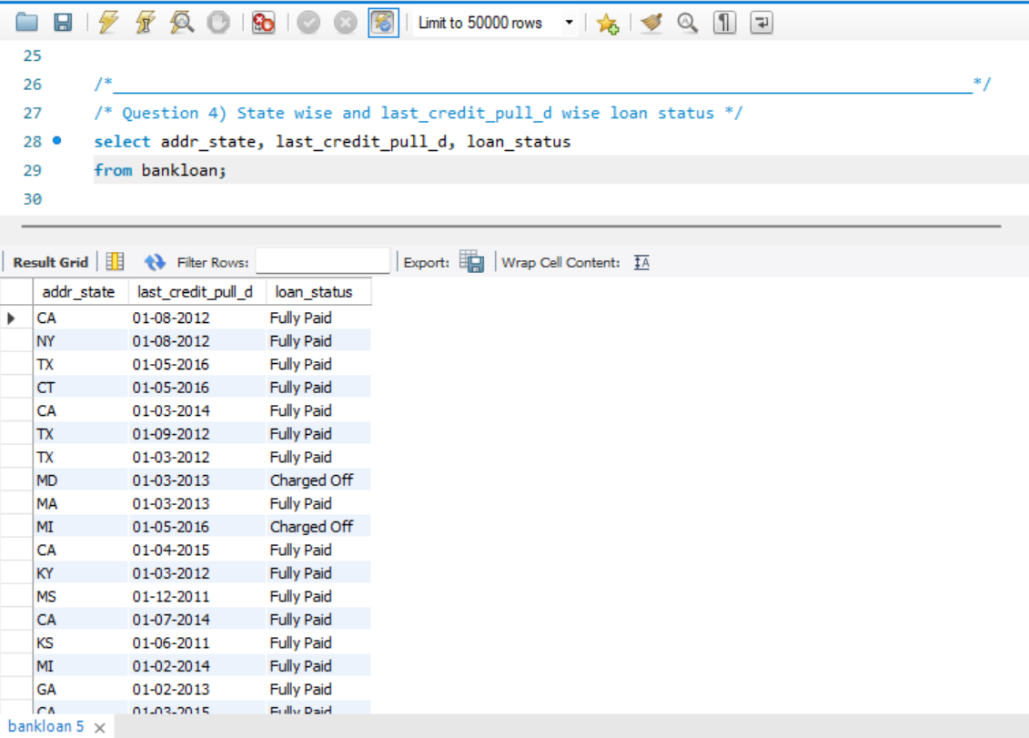
QUESTION 4) State wise and Last credit pull wise loan status

Slide 12
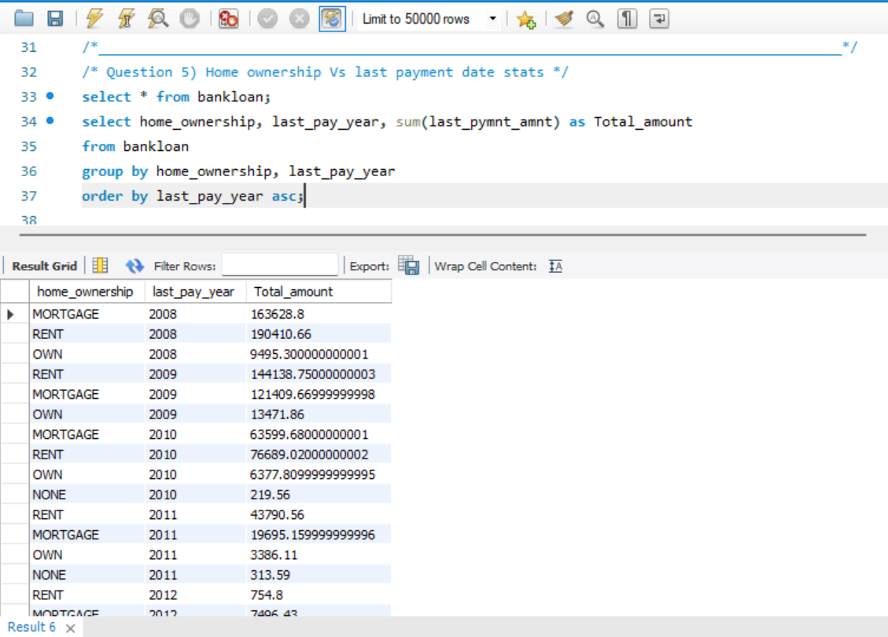
QUESTION 5) Home ownership vs last payment date stats

Slide 13
Key Insights :
The Loan amount Was increased Year by year. The increase in loan amounts signifies a growing credit demand.
Growing loan amounts indicate borrowers' increased willingness to seek financing for various needs.
This data underscores the importance of verification in facilitating higher payment volumes and potentially enhancing trust and security in financial transactions.
Analyzing the last payment date aids in assessing payment timeliness and potential repayment patterns within each home ownership category.

Slide 14
THANK YOU

