Slide 1
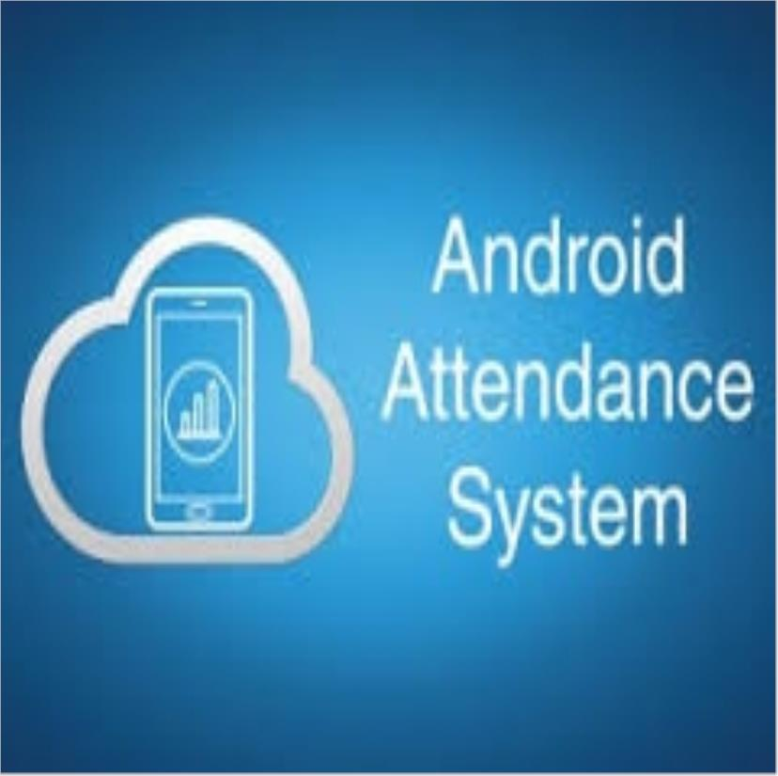

Slide 2
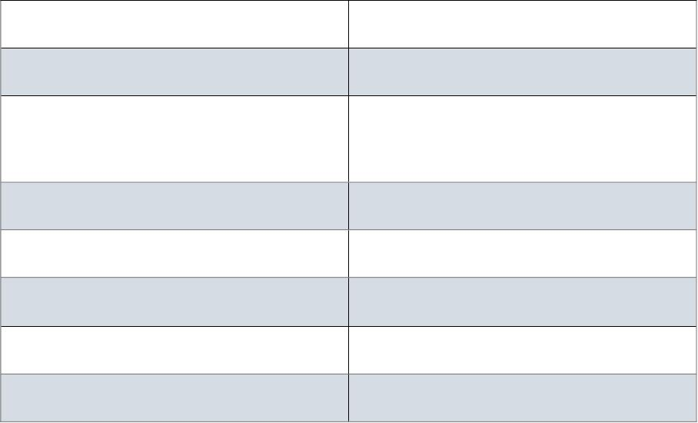
INDEX
Sr.no
Topic
1
2
Introduction
System Requirements
3
4
5
6
7
Diagrams
Input Design
Future Scope
Conclusion
References

Slide 3
Introduction
Attendance Management System is a software developed for
daily student attendance in schools, collages and institutes.
If facilitates to access the attendance information of a
particular student in a particular class.
The information is sorted by the operators, which will be
provided by the teacher for a particular class.
This system will also help in evaluating attendance eligibility
criteria of a student.
Attendance is a vital part of daily routine in educational
institutes, offices and many other organizations.
The mobile attendance system has been built to eliminate the
time and effort wasted in taking attendances in school and collages.
It also greatly reduces the amount of paper resources needed
in attendance data management. This is an android mobile app.
1.1 Existing System
In existing system when teacher write the all information in
on paper means designing the theoretically .
then it write the information on student spellings are mistake in
the data that’s why it is very difficult to handle this system.
• Time consuming
• Difficult to report generating.
• Difficult to handle the all student data.

Slide 4
1.2 Proposed System
In proposed system the attendance are design in practical
format.
Teacher can collect information in this system. Then
overcome this problem in existing system this attendance system
are developing.
• This system saves the time.
• Easily install.
• Easy to transfer from mobile to computer.
• It gives the overall performance of class in attendance.
Over the years the manual attendance management
report in java has been carried across most of educational
institutions. To overcome the problems of manual
attendance, I have developed “web based attendance
Management System”.
Attendance Management System is based on web
server, which can be implemented on any computer. In This
application, java is server side language, MySQL/SQLITE
and java is used as back-end design and HTML, CSS and
JavaScript are used as front-end tools.

Slide 5
System Requirements:
• Hardware Requirements:
Processor :- Intel I 5
RAM :-512 MB
Hard disk :-512 MB
• Software Requirements:
Platform:- Windows, Android Operating System
Language:- Java, XML
External Source:- Android Studio
• Backend: SQLITE.
• Frontend: JAVA.

Slide 6
• Entity relationship diagram (ERD)

Slide 7
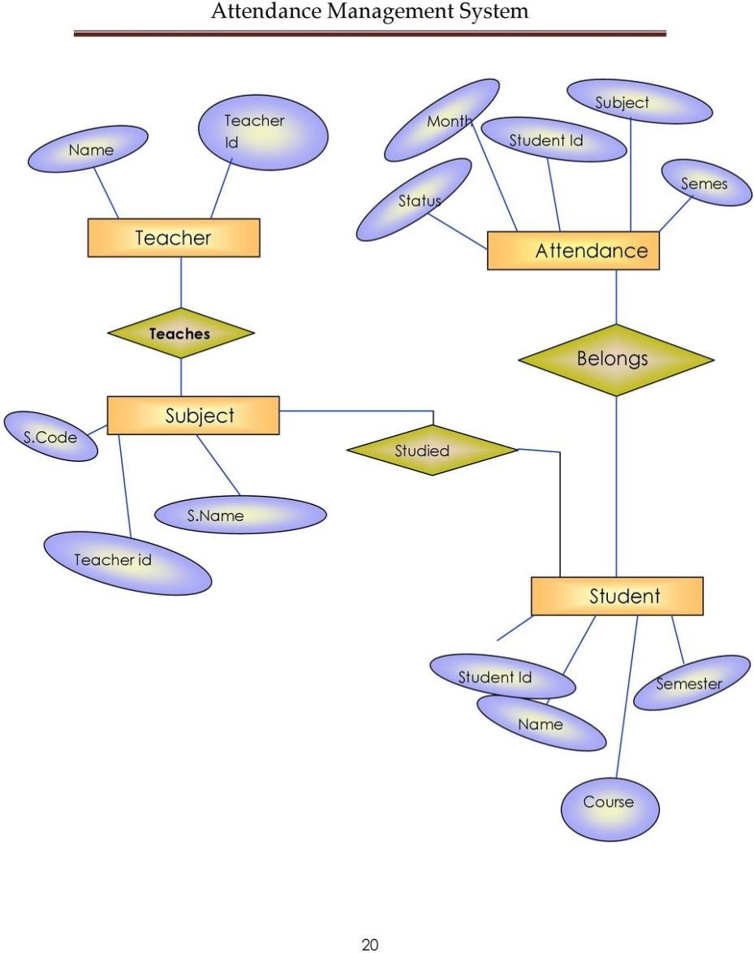
• Data Flow Diagram (DFD)
• 0 Level DFD

Slide 8
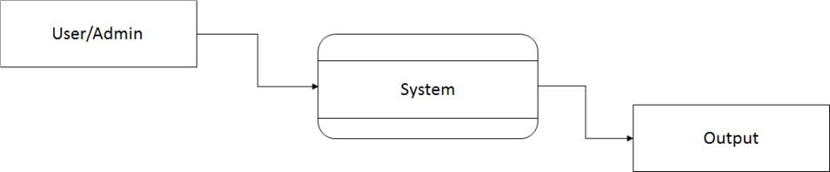
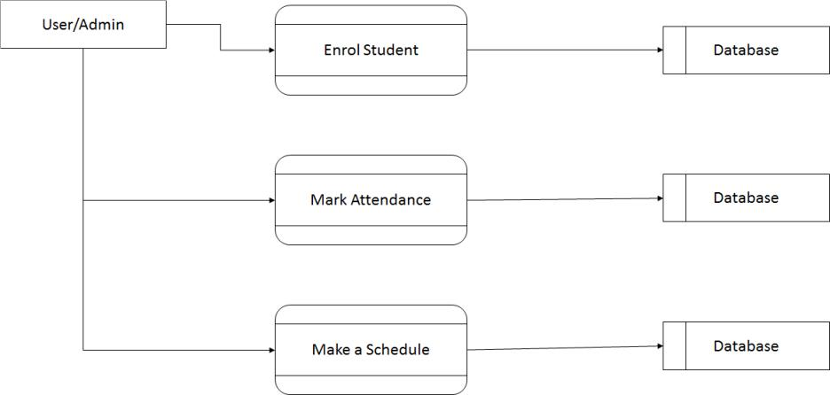
• Fig: 0 level DFD
1 Level DFD

Slide 9

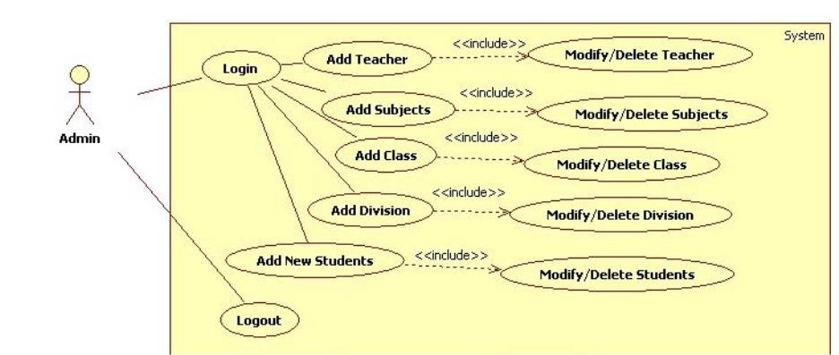
• Fig: 1 Level DFD
Use Case
Input Design

Slide 10

Home Page

Slide 11
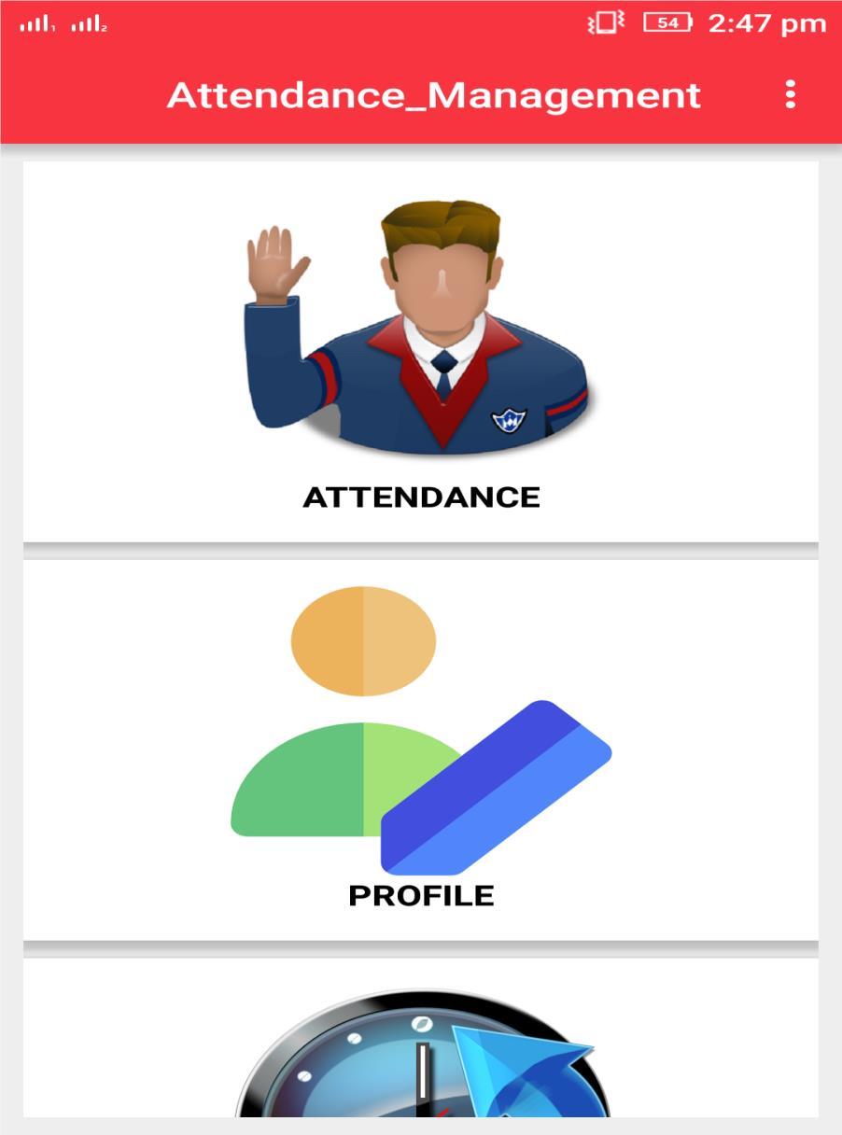

Slide 12
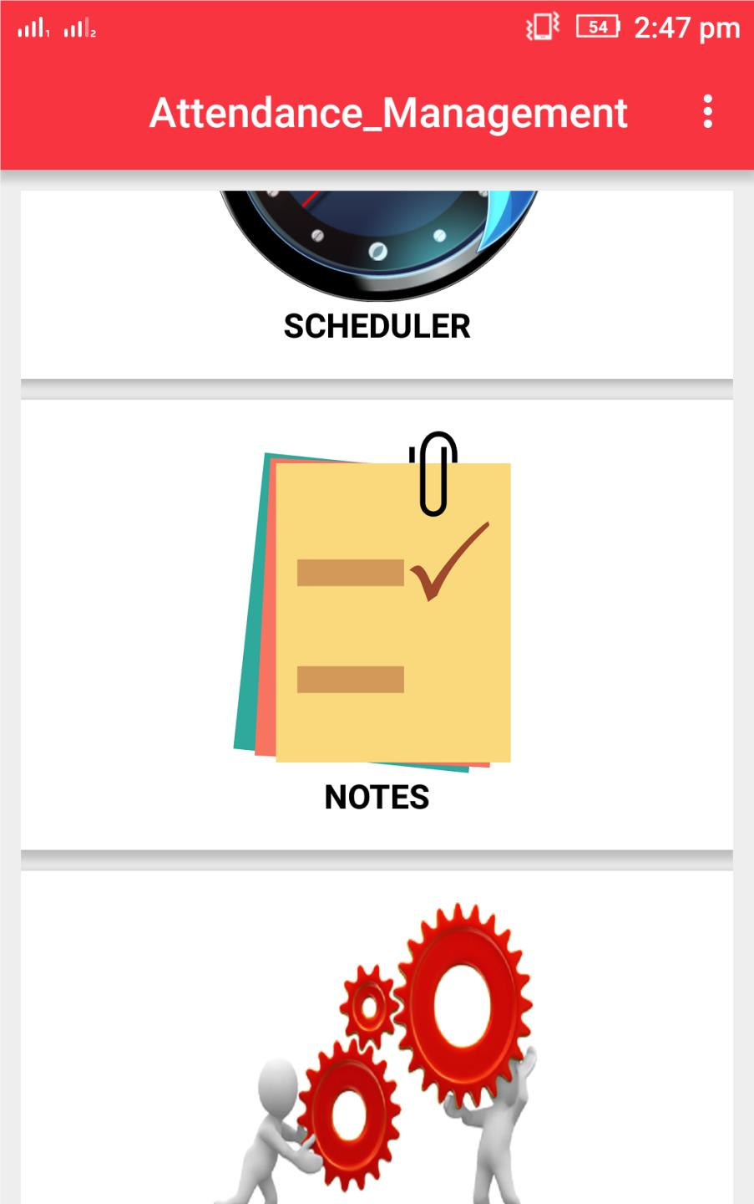

Slide 13
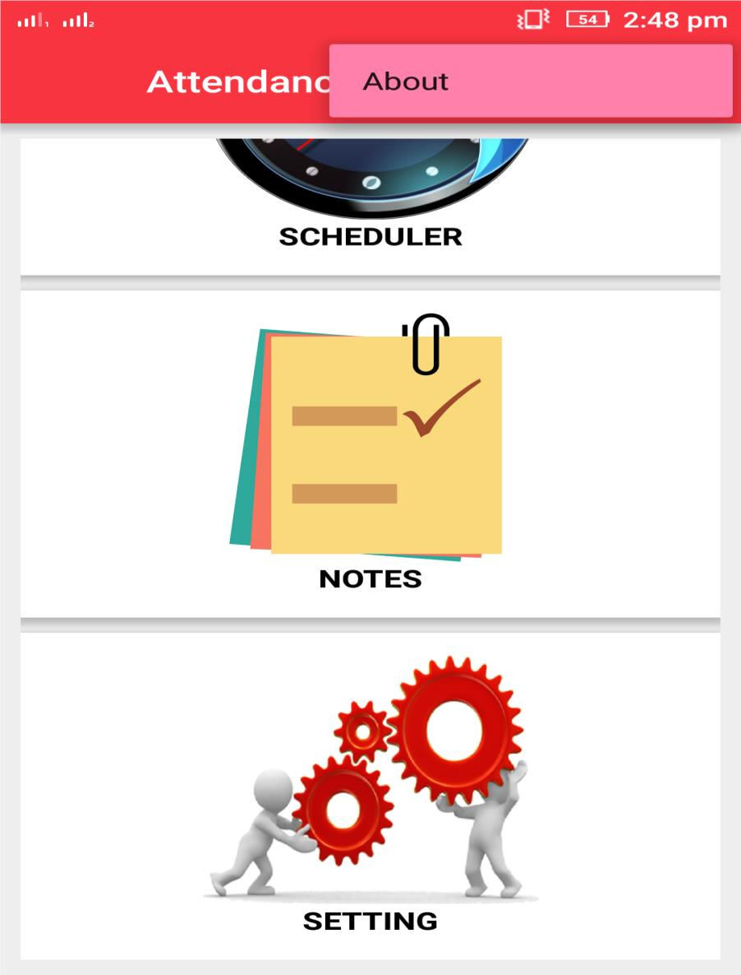

Slide 14
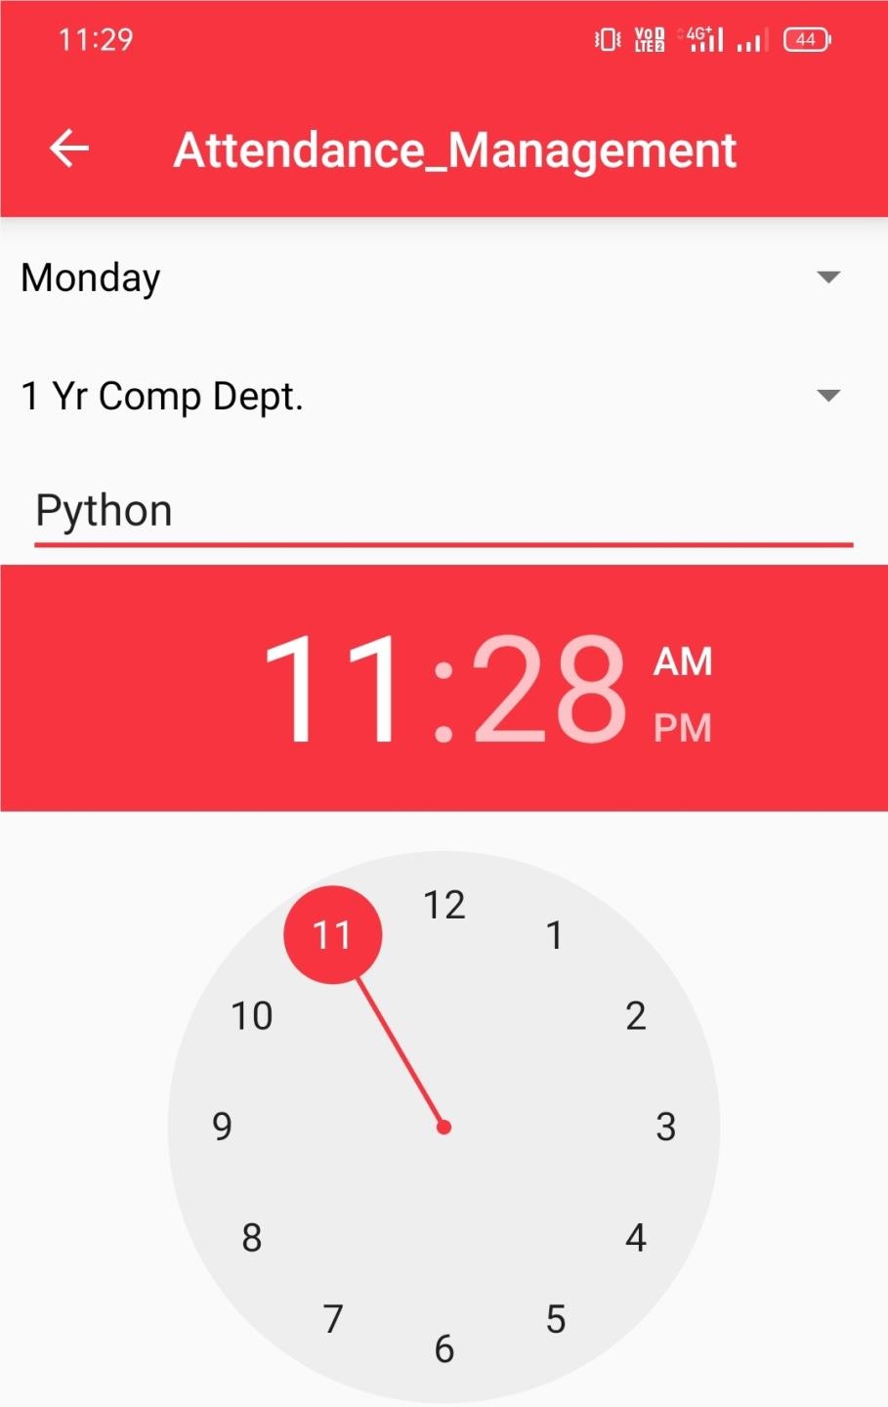

Slide 15
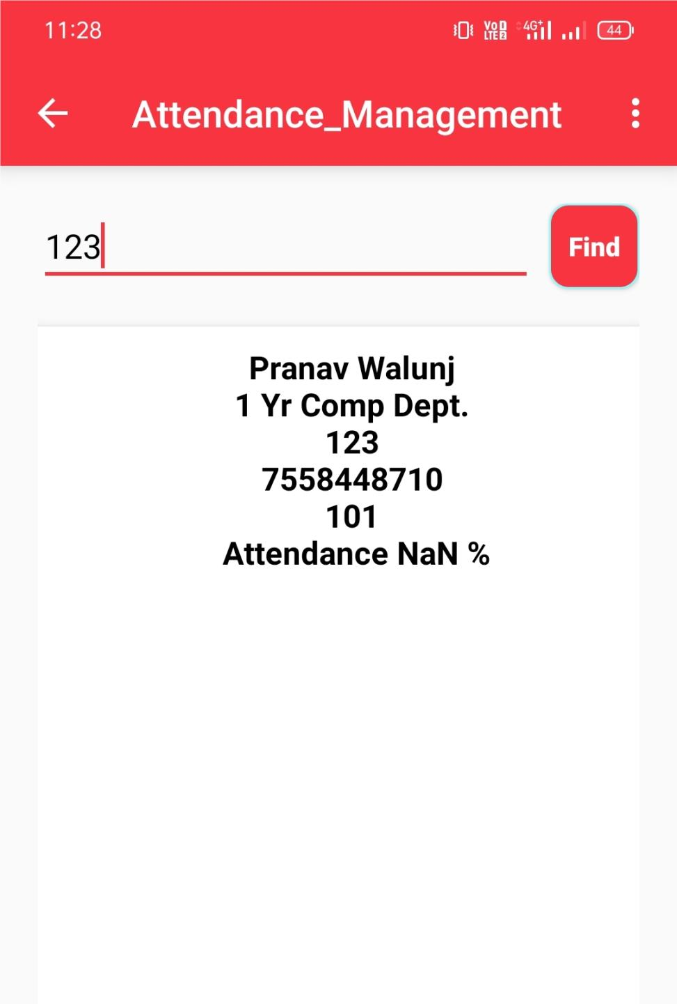

Slide 16
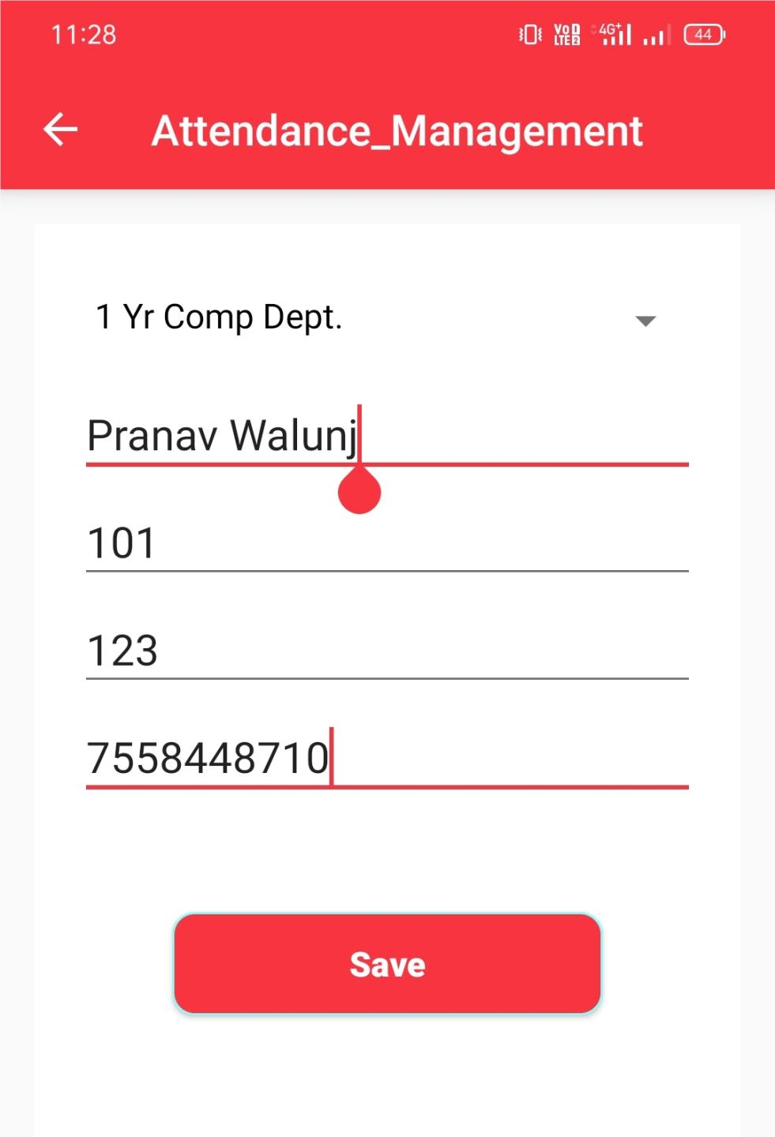

Slide 17
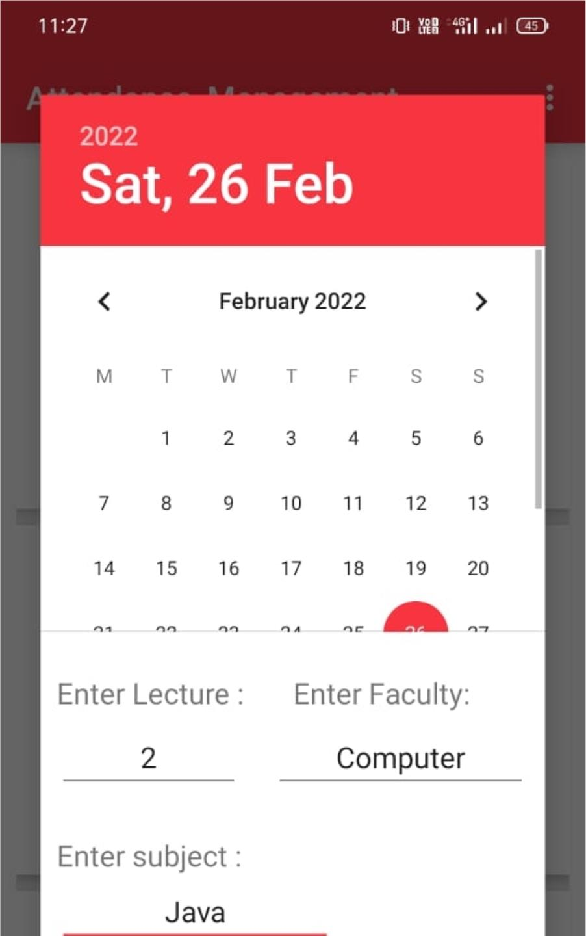

Slide 18
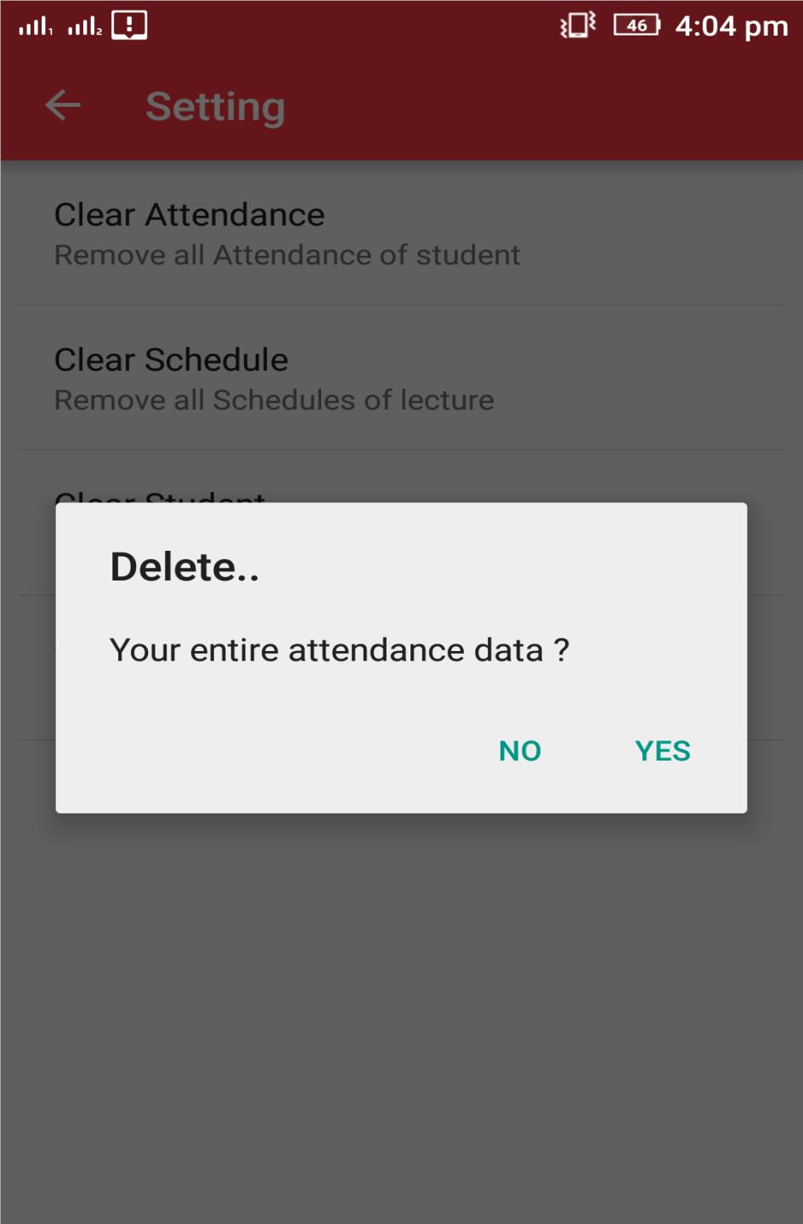

Slide 19

Future Enhancement

Slide 20
Future Enhancement
Introduction of messaging and emailing can be added, which may
send the attendance details to the students, or more probably their
parents.
This feature may help in maintaining a good attendance of any
institute.
It is not possible to develop a system that makes all the
requirement of the user. User requirements keep changing as the system
is being used. Some of the future enhancements that can be done to this
system are :
1. As the technology emerges, it is possible to upgrade the system
and can be adaptable to desired environment.
2. Based on the future security issues, security can be improved
using emerging technologies.

Slide 21
Conclusion:
The Attendance Management System is developed using Java and
Android fully meets the objectives of the system which it has been
developed.
The system has reached a steady state where all bugs have been
eliminated.
The system is operated at a high level of efficiency and all the
teachers and user associated with the system understands its advantage.
The system solves the problem. It was intended to solve as requirement
specification

Slide 22
References:
www.wikipedia.org
www.issuu.com
www.scribd.com
http://www.dropbox.com
http://www.slideshare.com

