Slide 1

GRAPHIC ERA DEEMED TO BE UNIVERSITY, DEHRADUN
Department of Computer Science & Engineering · B.Tech CSE Core
PHASE-1 MAJOR PROJECT SYNOPSIS
Care Pathway
Guideline-grounded health assistant with specialist tools and fail-closed answering.
Student
Guide
Team ID
Pranav Maheshwari · GE-232023518
Dr. Narayan Chaturvedi · Associate Professor
MP2026CSE344
No diagnostic claim. No trained “health GPT”. Future tense only.
Evaluators · September 2026 · 10 slides
Graphic Era Deemed to be University · B.Tech CSE Core · Phase-1 Synopsis · September 2026

Slide 2
01 · PROBLEM
02 / 10
People already ask language models for health advice.
The failure is not missing Indian guidelines. It is ungrounded answering: invented drugs, skipped official pages, and talk when evidence is missing.
01
02
03
Invention
Over-talking
Wrong architecture
A drug, dose, or referral that does not appear in any retrieved official span.
The model answers an out-of-scope item because prompts were built only from answered neighbours.
Chatting “specialist agents” that order tests in a loop are not evaluable and are not a doctor.
Graphic Era Deemed to be University · B.Tech CSE Core · Phase-1 Synopsis · September 2026
Notes:
Open: India already has STWs, NLEM, CDSCO. The student gap is fail-closed answering, not another chatbot and not “we detected cancer.”

Slide 3
02 · OFFICIAL INDIAN SOURCES
03 / 10
The sources exist. They are not a safe answering system.
157
28
384
Standard Treatment
Workflows
Specialties
NLEM 2022 medicines
ICMR + NHA + WHO · NMC notice 15 Sep 2025
One-page visual workflows, not textbook chapters
Launched 13 Sep 2022 · a PDF, not a live API
Also used as lookup tables
CDSCO monthly Not of Standard Quality (NSQ) lists — product, batch, manufacturer, test failed. Absence from this month’s list is never rendered as “safe”.
A language model can still quote these loosely, invent a drug not in the retrieved row, or treat a convolutional score as a disease name. That is the problem this project bounds.
Graphic Era Deemed to be University · B.Tech CSE Core · Phase-1 Synopsis · September 2026
Notes:
Cite NMC 15 Sep 2025; NLEM PIB 13 Sep 2022; CDSCO NSQ filter page. Do not say we created these documents.

Slide 4
03 · RESEARCH GAP
04 / 10
A bounded student gap — not a licence to practise medicine.
01
Flowchart loss
ICMR STWs are diamonds and arrows. Text-chunk retrieval loses the decision.
02
Wrong metric
CheXpert AUROC and ISIC accuracy do not score invented drugs or out-of-scope answers.
03
GEPA unused here
GEPA is shown on math and code, not on an Indian STW abstention Pareto.
04
ICL always talks
Standard neighbours are answered items. Near-miss refusals are rarely first-class demonstrations.
05
Agent swarm
Unbounded “specialist doctors” are not evaluable in a B.Tech setting.
Graphic Era Deemed to be University · B.Tech CSE Core · Phase-1 Synopsis · September 2026
Notes:
If asked “is this novel?”: imaging is the baseline; the enhancement is visual STW + refuse ICL + GEPA coverage vs ungrounded.

Slide 5
04 · PROPOSED SYSTEM
05 / 10
Named tools only. Then a sentence an official span entails.
TOOLS
ROUTER + WRITER
VERIFIER
Frozen JSON functions
Local open-weight LLM
Fail-closed code
Each specialist is a function with a schema. The host executes it. Extra tools later join the same contract — they do not become chatting agents.
Qwen-class weights are loaded, not pretrained, not fine-tuned into a doctor. GEPA rewrites prompts offline, then is frozen.
Three card statuses only: grounded, insufficient, out_of_scope. A sentence must be entailed by an STW box, NLEM row, or CDSCO row.
Product · a watermarked answer card. Not a diagnosis. Not software as a medical device. Not a hospital HIS.
Graphic Era Deemed to be University · B.Tech CSE Core · Phase-1 Synopsis · September 2026
Notes:
If asked about more tools: the interface is extensible JSON; Phase-1 evaluation is on the catalogue we actually implement.

Slide 6
05 · PHASE-1 TOOL CATALOGUE
06 / 10
Closed names the model may emit. The host runs them.
Name | Kind | What the host runs | JSON out
cxr_tool | Trained specialist | Frozen CheXpert CNN (DenseNet-121 / EfficientNet) | findings[], scores[], unreadable?
skin_tool | Trained specialist | Frozen HAM10000 / ISIC net | class, score, dataset
document_tool | Trained specialist | OCR / KIE on pack or lab PDF | batch / brand / analyte, unreadable?
nlem_lookup | Lookup | NLEM 2022 table | in list / not in list
cdsco_lookup | Lookup | Dated NSQ snapshot | match / not in list (not “safe”)
stw_retrieve | Lookup | ColPali-class on STW page images | page id, box ids
out_of_scope | Refuse | No specialist is run | status = out_of_scope
Further tools, if added later, use the same four columns. They are not extra chatting doctors. Imaging nets are trained and frozen by the student. The large language model is not.
Graphic Era Deemed to be University · B.Tech CSE Core · Phase-1 Synopsis · September 2026
Notes:
HAM10000 is ISIC 2018 Task 3 train. CheXpert is research / non-commercial / non-clinical. qXR already ships in India — we replicate a public baseline, not an NTEP product.

Slide 7
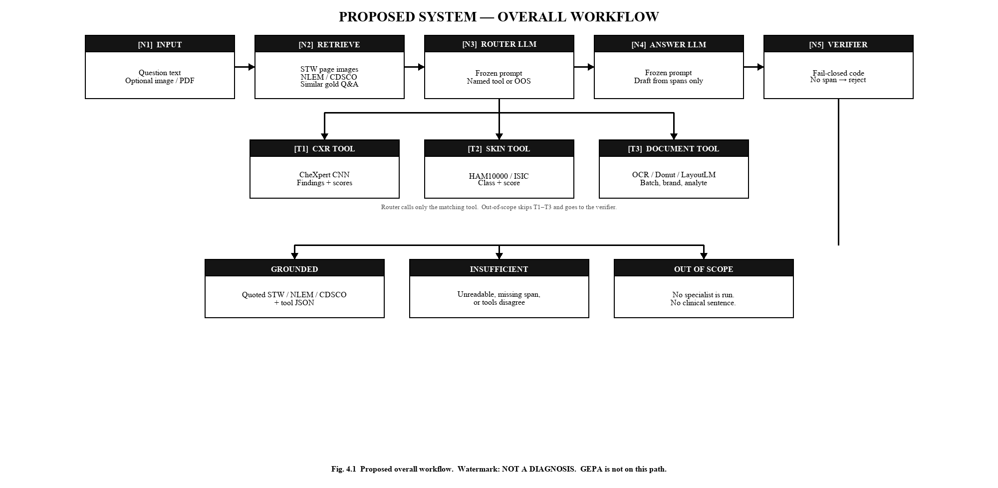
06 · SERVE-TIME WORKFLOW
07 / 10
Question in. One tool call. Official span. Then a card — or silence.
Graphic Era Deemed to be University · B.Tech CSE Core · Phase-1 Synopsis · September 2026
Notes:
Walk left to right: retrieve → router emits a name → host runs the function → writer drafts only from spans + JSON → verifier.

Slide 8
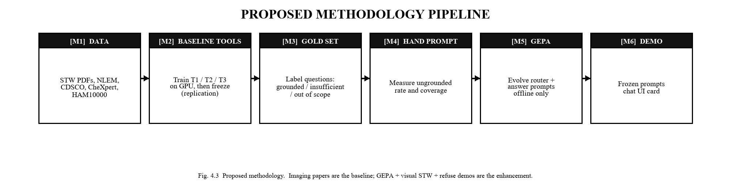
07 · METHODOLOGY
08 / 10
Replicate the tools. Then evolve the prompts. Do not mix the two.
BASELINE · what we train
ENHANCEMENT · what we freeze as text
CheXpert CXR net, patient-level splits, U-ones / U-zeros reported honestly against Irvin et al.
HAM10000 / ISIC skin net, split by lesion_id.
Document OCR/KIE; synthetic packs + self-collected OTC photos. No patient Rx.
Visual STW retrieve (ColPali-class). Student box IDs on pages actually used.
In-context demonstrations that include near-miss refusals.
GEPA on train only. Best Pareto prompt is frozen. No genetic search per user.
Graphic Era Deemed to be University · B.Tech CSE Core · Phase-1 Synopsis · September 2026
Notes:
If GEPA loses to a hand prompt, we write that. No SOTA claim unless earned on the official split.

Slide 9
08 · EVALUATION
09 / 10
What will be measured. Nothing is claimed as a result today.
Specialist replication
Product metrics
CheXpert AUROC / F1 on the official split. ISIC accuracy / macro-F1, lesion-id splits. Document field-F1 and exact batch match.
Coverage. Ungrounded rate. Correct refuse. Coverage-versus-ungrounded Pareto. These are the enhancement.
Ablations
Not reported
Hand prompt vs GEPA vs refusal-aware ICL vs visual STW. If an enhancement does not win, that is reported.
Diagnostic accuracy vs radiologists. Lives saved. Invented percentages. “98% cancer.”
Graphic Era Deemed to be University · B.Tech CSE Core · Phase-1 Synopsis · September 2026
Notes:
Gold Q&A set does not exist as a download. STW box IDs must be labelled. Say that if asked “is the data ready?”

Slide 10
09 · SCOPE AND CLOSE
10 / 10
What we will do. What we will not claim.
WILL
WILL NOT
Train and freeze CXR, skin, and document tools on public research sets.
Register lookups over NLEM, CDSCO, and STW pages.
Build a gold set that includes refusals.
Evolve prompts with GEPA, freeze them, demo a watermarked card.
Pretrain or doctor-fine-tune the large language model.
Deploy in a live clinic or use real hospital charts without ethics.
Auto-prescribe, auto-dial, or claim a reduction in disease burden.
Report a number we have not measured.
Thank you.
Pranav Maheshwari · GE-232023518 · Guide: Dr. Narayan Chaturvedi · MP2026CSE344
Questions.
Graphic Era Deemed to be University · B.Tech CSE Core · Phase-1 Synopsis · September 2026
Notes:
Close on honesty. Hardware: laptop 16 GB; campus GPU for LLM serving and GEPA, not because DenseNet needs a B200.

