Slide 1
AIML
FINAL EVALUATION
BREAST CANCER DETECTION
Team Details: Fanatic (15):
Pranav Gupta (2210990666)
Pranshul Sondhi(2210990669)
Pratham Paul Singh(2210990675)
Raghav Dua(2210990697)
Faculty Coordinator:
Dr. Kirandeep Singh
Chitkara University Institute of Engineering and Technology,
Chitkara University, Punjab

Slide 2
Contents
Introduction
Problem Statement
Objectives
Technical Details
Data Description
Dataset Snippets
Model Evaluation
Result and Analysis
Conclusion
Reference Links

Slide 3
Introduction
Welcome to our presentation on revolutionizing breast cancer detection using cutting-edge AI and machine learning technologies. Breast cancer remains a significant health challenge worldwide. Early detection is crucial for effective treatment and survival rates.
Traditional methods have limitations, including human error and subjectivity. In response to this challenge, we present our innovative AI/ML-based breast cancer detection system.
This project aims to harness the power of artificial intelligence and machine learning to improve early detection rates and patient outcomes.
Our approach is not only about detection but also about prevention and education, emphasizing the importance of proactive healthcare practices and awareness initiatives.
Join us as we explore the potential of AI to transform breast cancer detection and pave the way for a healthier future.

Slide 4
Problem Statement
“How can we harness Artificial Intelligence and Machine Learning techniques to create a predictive model for breast cancer detection, offering valuable insights for medical professionals to enhance diagnostic accuracy and improve patient care?”

Slide 5
Objective
Using Python libraries including Pandas, NumPy, and Scikit-learn, the project aims to preprocess the data, handle missing values, and ensure data quality. Additionally, advanced data visualization techniques using libraries like Plotly will be applied to gain meaningful insights from the dataset. Constructing a predictive model for breast cancer detection utilizing Support Vector Machines (SVM), Decision Trees, and Random Forest algorithms.
Assess the efficacy of each model in predicting cancer diagnosis outcomes, comparing their performance against conventional machine learning approaches.
Investigate the role of different features in influencing cancer detection accuracy, including tumor size, tumor grade, hormone receptor status, and patient age.
Offer insights into the nuances of breast cancer diagnosis and the variables influencing detection outcomes across SVM, Decision Trees, and Random Forest models.

Slide 6



Technical Details
We employed Python as our primary programming language for model implementation.
Our Preferred IDE include Jupyter Notebook and Kaggle.
We used Python Libraries such as Pandas, Numpy, Matplotlib, Sklearn.

Slide 7
Flow Chart
Reading Dataset
Data Cleaning
Data Visualization
Training data
Learning algorithm
SVM
Decision Tree
Logistic Regression
Outlier detection
K Neighbour
Random Forest
Model Evaluation

Slide 8
Algorithm
Logistic Regression: A statistical method for binary classification, estimating the probability of a binary outcome by fitting data to a logistic function.
Support Vector Machine (SVM): A powerful algorithm for classification tasks, finding the hyperplane that best separates data points of different classes in a high-dimensional feature space.
Decision Tree: A tree-like model where each internal node represents a feature, branching based on decision criteria, leading to leaf nodes that represent class labels.
Random Forest: An ensemble learning method that constructs multiple decision trees and combines their predictions through averaging or voting, enhancing robustness and generalization performance.
K-Nearest Neighbors (KNN): A simple yet effective algorithm for classification and regression tasks, where the class of a data point is determined by a majority vote of its k nearest neighbors in the feature space. It relies on the assumption that similar data points tend to belong to the same class.

Slide 9
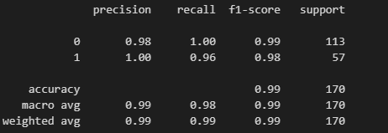
ML MODEL 1 : LOGISTIC REGRESSION
Logistic regression is a statistical
method used to model the
relationship between one or more
independent variables and a binary
outcome, predicting the probability
of occurrence of an event.
It is performed to classify
observations into one of two or more discrete categories based on input features.
Logistic regression tells us about the likelihood of an event occurring based on the values of the independent variables and provides probabilities associated with each class label.

Slide 10
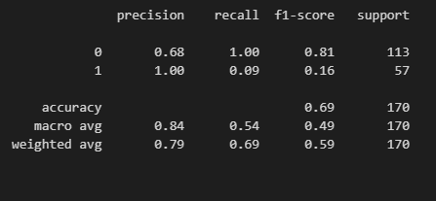
ML MODEL 2 : SUPPORT VECTOR MACHINE
SVM (Support Vector Machine) is a supervised machine learning algorithm used for classification and regression tasks.
It is performed to find the hyperplane that best separates different classes in the feature space.
SVM tells us about the data by identifying the optimal decision boundary that maximizes the margin between classes, providing effective classification and generalization performance.

Slide 11
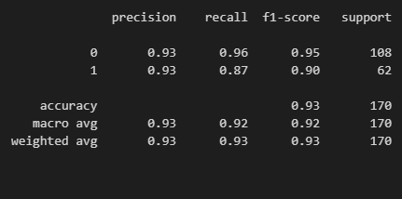
ML MODEL 3 : DECISION TREE
Decision Tree is a predictive modeling technique that recursively splits the dataset into subsets based on the value of input features to make decisions.
Performed for: Classification and regression tasks, as it's versatile and interpretable.
Tells us about the data: Reveals the most significant variables, their relationships, and the decision-making process, aiding in understanding and predicting outcomes.

Slide 12
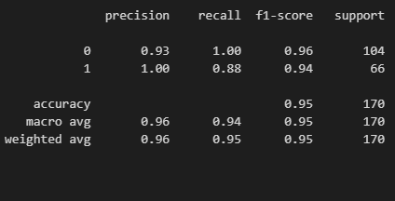
ML MODEL 4 : KNEIGHBORS CLASSIFIER
K-Nearest Neighbors (KNN) is a simple yet powerful algorithm for classification and regression tasks. It operates by classifying a data point based on the majority class of its k nearest neighbors in the feature space.
The algorithm relies on the assumption that similar data points tend to belong to the same class or exhibit similar behavior in the case of regression tasks.
One of its key advantages is its ability to adapt to the underlying data distribution, making it particularly effective for non-linear and non-parametric tasks.
However, KNN's performance can be sensitive to the choice of k and the distance metric used, requiring careful tuning for optimal results.

Slide 13
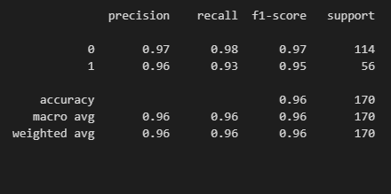
ML MODEL 5 : RANDOM FOREST
Random Forest is an ensemble learning method that constructs multiple decision trees during training and outputs the mode of the classes (classification) or mean prediction (regression) of the individual trees.
It is performed to improve the predictive accuracy and control overfitting by averaging the predictions of multiple decision trees.
It tells us about the importance of different features in predicting the target variable and provides insights into the relationships between features and the target.

Slide 14
Data Description
The dataset comprises comprehensive information related to breast cancer diagnosis, encompassing various.
Key features include tumor size, texture, perimeter, area, and smoothness, alongside other important metrics like concavity, symmetry, and fractal dimension, offering a detailed profile for analysis.
Additionally, contextual factors are included, providing crucial insights into the complexity of breast cancer diagnosis.
Data preprocessing steps were meticulously executed, encompassing data cleaning, handling missing values, encoding categorical variables, and scaling numerical features, ensuring data integrity and consistency.
Exploratory data analysis (EDA) was subsequently performed to unveil underlying patterns, distributions, and correlations within the dataset, guiding feature selection and model development processes, thereby enhancing the predictive accuracy of the system.

Slide 15
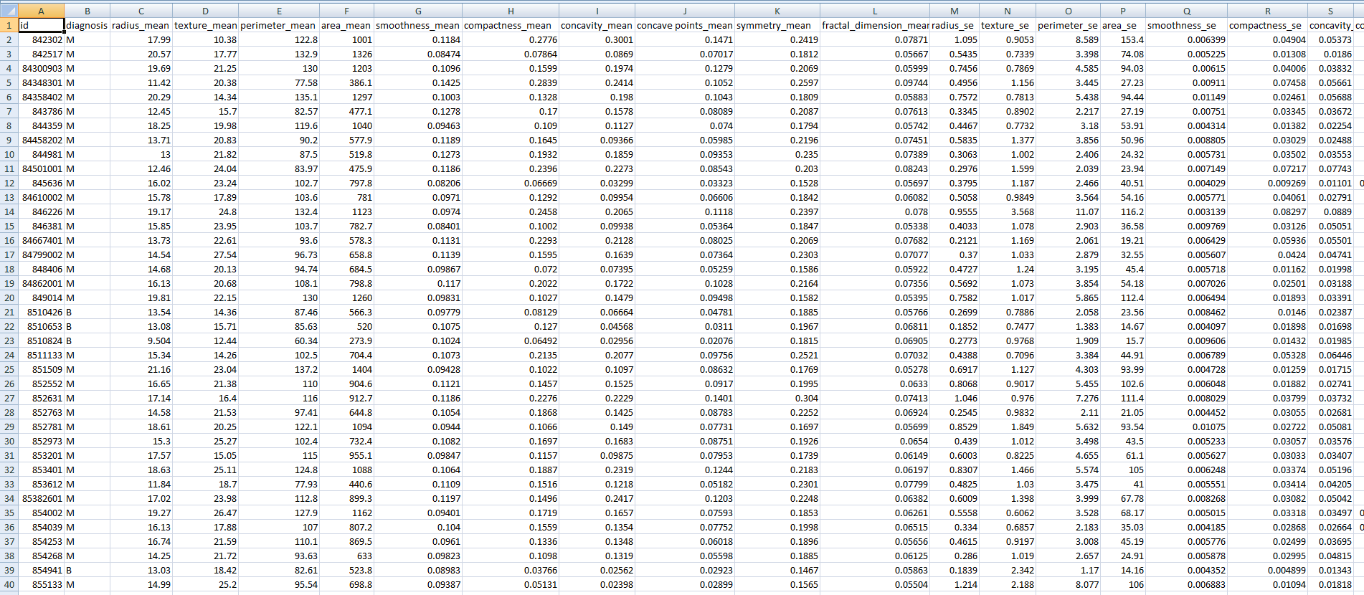
DATASET SNIPPETS

Slide 16
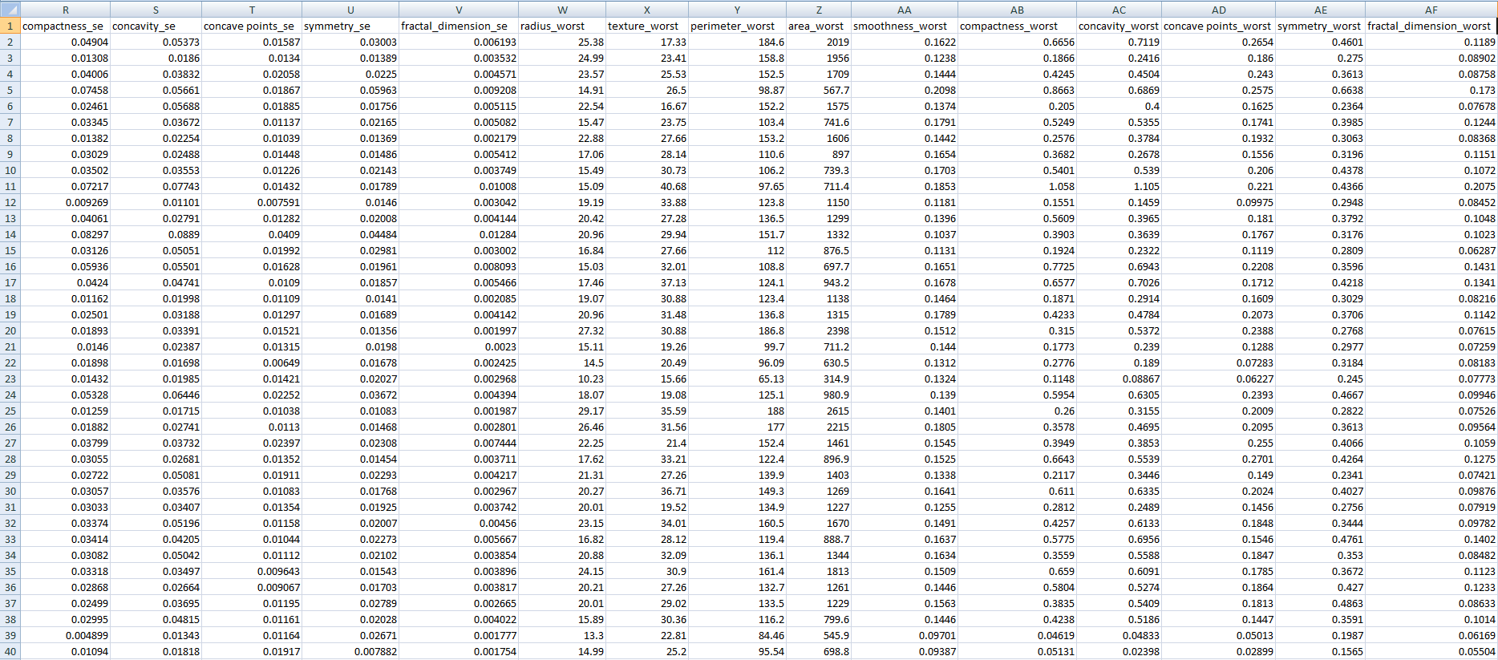
DATASET SNIPPETS

Slide 17
Model Evaluation
Our project utilized five distinct machine learning models, each playing a crucial role in achieving our final outcome:
Logistic Regression: Demonstrating exceptional performance with 98.82% accuracy, Logistic Regression provided a solid foundation.
2. Support Vector Machine (SVM): Though achieving a lower accuracy of 69.41%, SVM offered valuable insights into complex patterns.
3. Decision Tree Classifier: With 92.94% accuracy, Decision Trees effectively captured intricate decision boundaries.
4. Random Forest Classifier: This model excelled with 96.47% accuracy, leveraging ensemble learning to improve predictive performance.
5. K-Neighbors Classifier: Scoring 95.29% accuracy, K-Neighbors Classifier captured local patterns effectively.
These models, with their diverse strengths and capabilities, collectively contributed to a comprehensive diagnostic framework for breast cancer detection, enhancing the reliability and accuracy of our predictions.

Slide 18
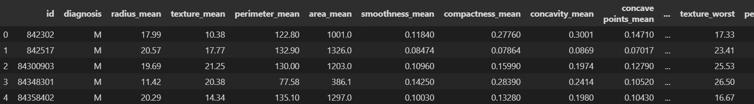
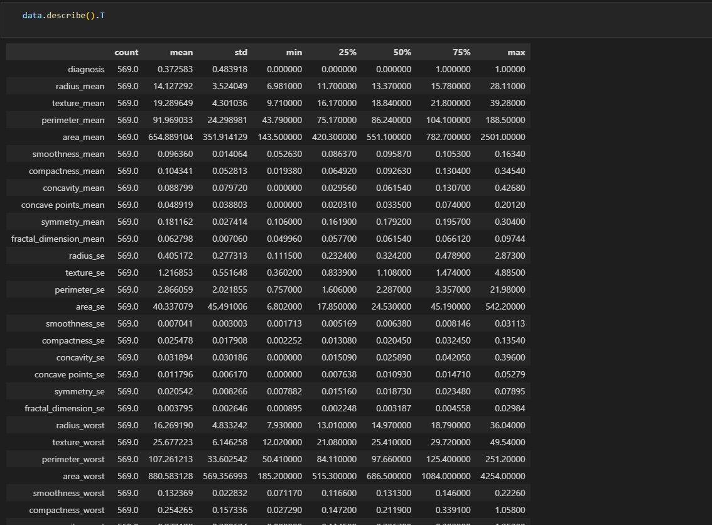
Data
Fig.1
Fig.2

Slide 19
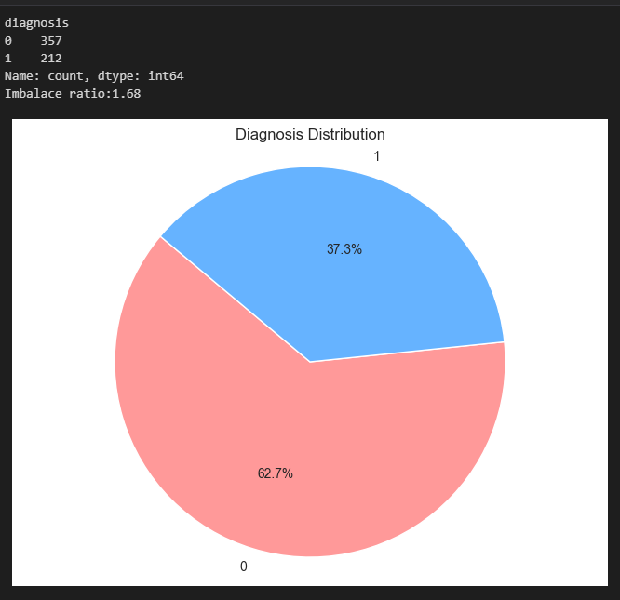
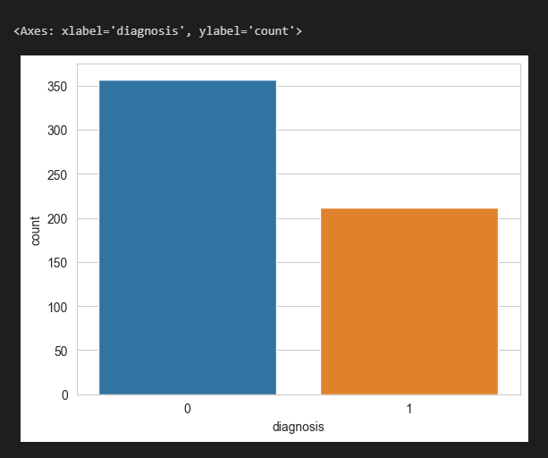
Result & Analysis
Fig.2
Fig.4

Slide 20
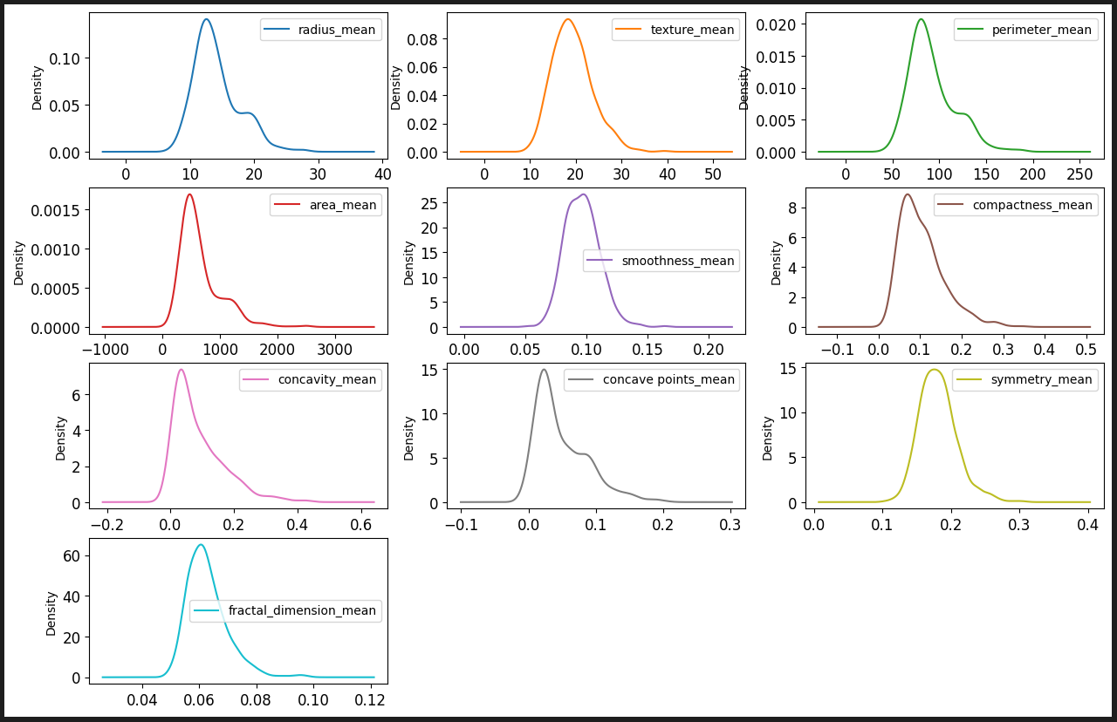
Result & Analysis
Fig.1
Fig.5

Slide 21
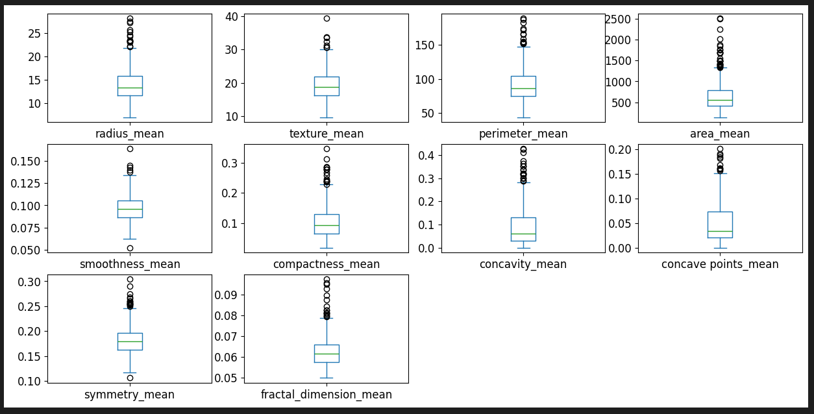
Result & Analysis
Fig.6

Slide 22
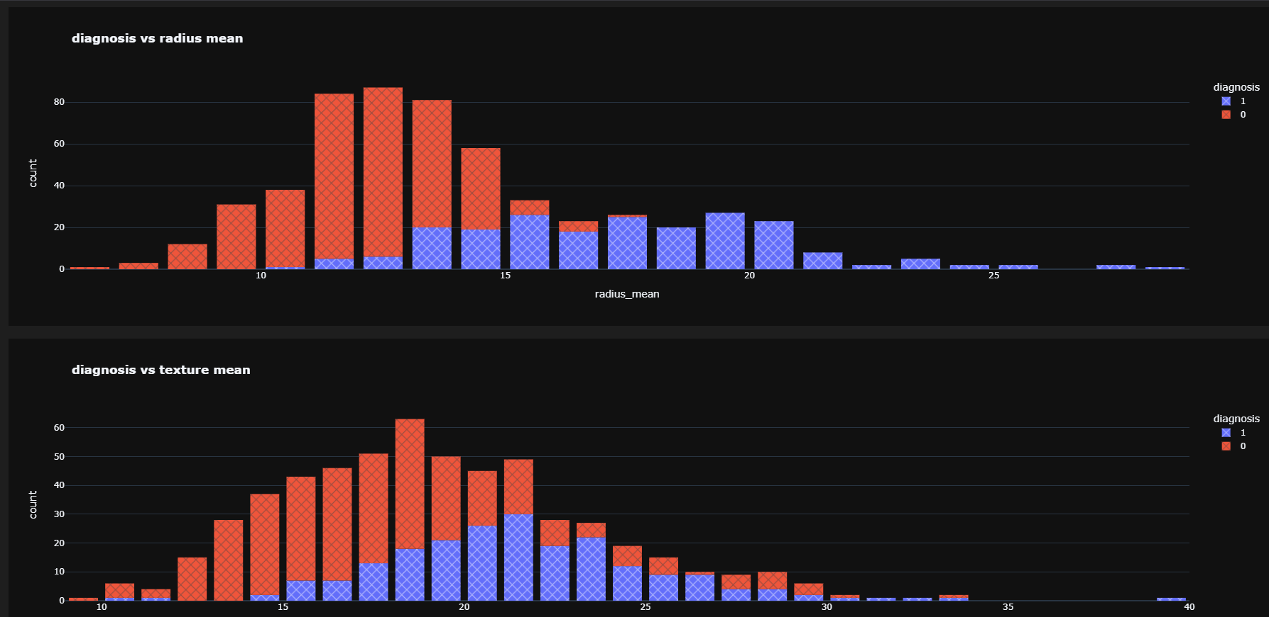
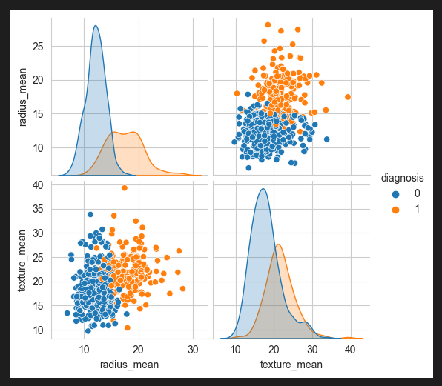
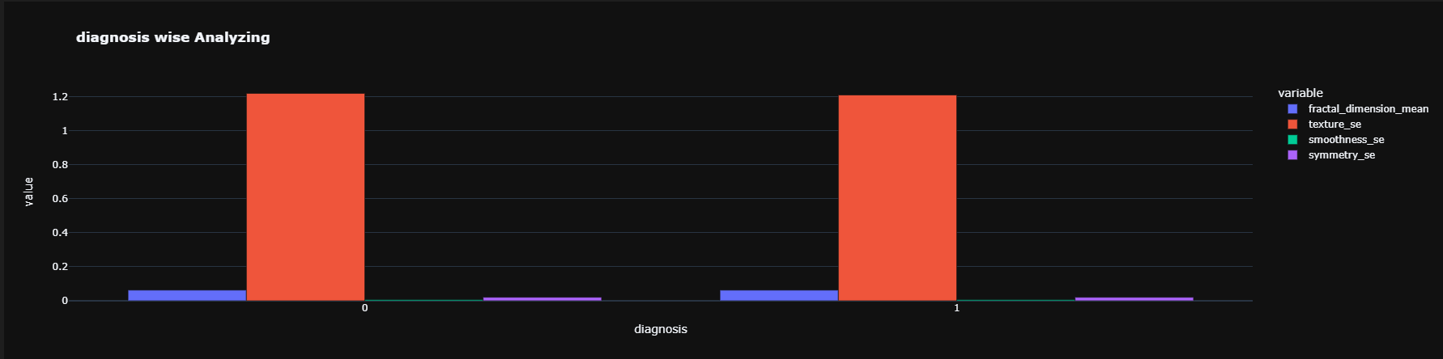
Result & Analysis
Fig.8
Fig.7
Fig.9

Slide 23
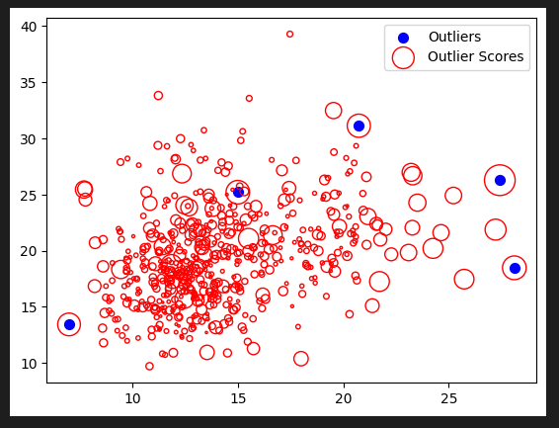
Result & Analysis
Fig.10

Slide 24
Conclusion
Key Findings: The project effectively showcased the utility of Support Vector Machines (SVM), Decision Trees, and Random Forest algorithms in breast cancer detection, surpassing conventional methods in predictive accuracy.
Impact: The developed models offer valuable insights into the intricate patterns of breast cancer diagnosis, enabling medical professionals to make informed decisions and treatment strategies tailored to individual patients.
Future Prospects: Continued refinement and enhancement of the algorithms could yield even more precise diagnostic capabilities, paving the way for broader applications in healthcare analytics and personalized medicine.
Overall Contribution: The project significantly advances the field of medical diagnostics by leveraging AI and ML technologies, highlighting the potential of data-driven approaches in revolutionizing healthcare decision-making and improving patient outcomes.

Slide 25
References/Links used
https://www.kaggle.com/code/vikasukani/breast-cancer-prediction-using-machine-learning
https://en.wikipedia.org/wiki/Breast_cancer

Slide 26
Thank You

