Slide 1
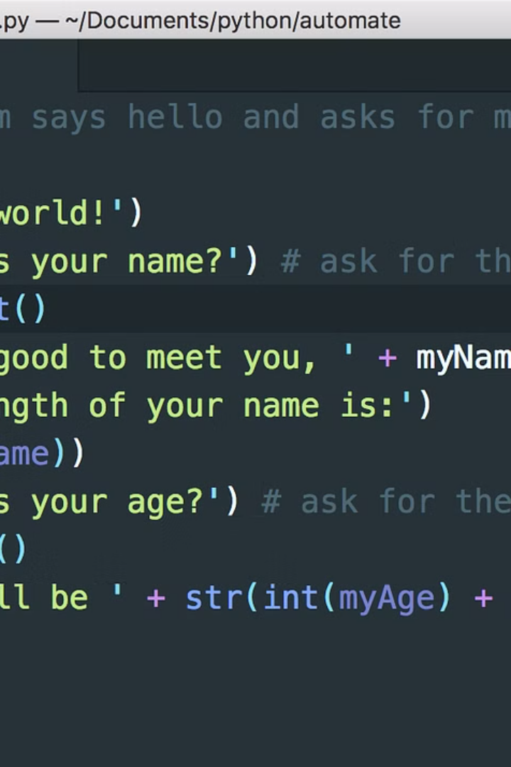
Introduction to the Python code
As a powerful and widely-used programming language, Python is known for its simplicity and readability. It's versatile and can be used for a wide range of applications, from web development to data analysis.
Pranav Kumar
2210990667

Slide 2
Installation of the qrcode library
Easy Installation
Compatibility
The qrcode library can be easily installed using pip, a package manager for Python.
It is compatible with different versions of Python, making it accessible to a wide range of developers.

Slide 3

Importing necessary modules
1
qrcode
2
PIL
Import the qrcode module to generate the QR code.
Utilize the PIL module to display the QR code.
3
IPython
Import the IPython module for code display.

Slide 4
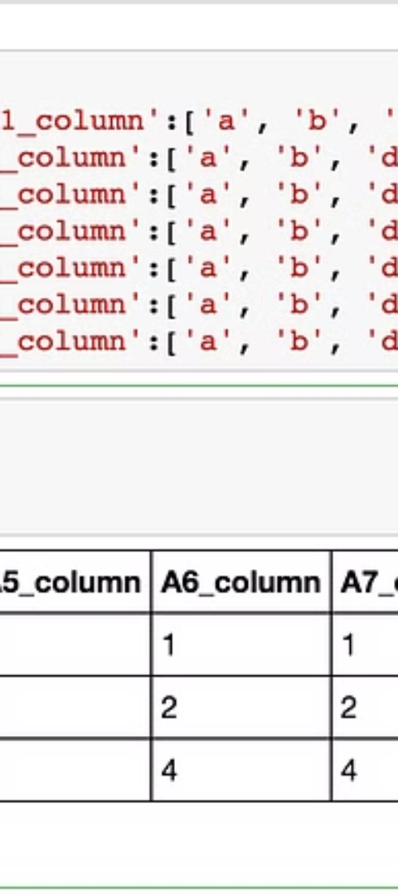


Displaying the code using IPython
Code Display
Utilize IPython's functionalities to display the Python code.
Rich Output
The use of IPython allows for rich and interactive code output.

Slide 5

Defining the purpose of the code
Clarity and Communication
Information Sharing
The code aims to effectively communicate information or data through the generated QR code.
It facilitates the sharing of data in a concise and efficient manner.

Slide 6
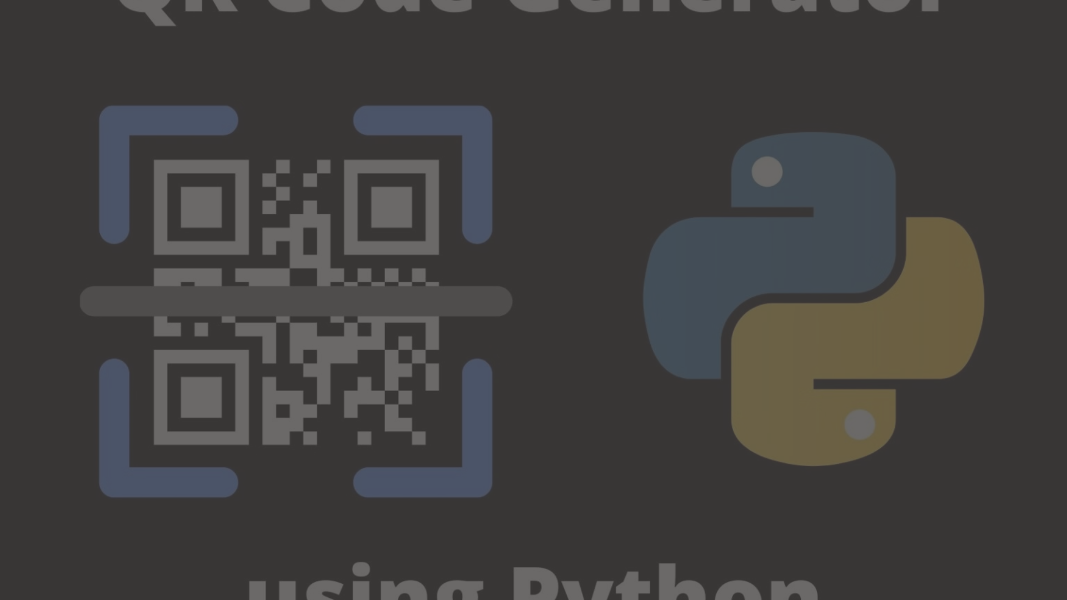
Generating a QR code using the qrcode library
Create Content
1
Input the content or data that needs to be encoded into the QR code.
2
Configure QR Code
Use the qrcode library to configure the specific details of the generated QR code.
Generate QR Code
3
Execute the code to generate the QR code based on the provided content.

Slide 7


Displaying the QR code using PIL
Visualization
Efficiency
Use the PIL library to display the visually encoded data as a QR code.
PIL library offers efficient methods for rendering and processing images.

Slide 8
Conclusion and final remarks
1
2
3
Effective Communication
Efficiency
Convenience
The QR code serves as an effective means of communicating data.
The process is efficient for encoding and decoding information.
It provides a convenient way to share important data or information.

