Slide 1
IEEE EMBS AI/ML Model for Detection and Prediction For Neurological Conditions like Epilepsy
Introduction
By Pranit Gore & Aditya Mane
Team Name: Team Zero Gravity
Team ID: PNC-50

Slide 2
This Presentation includes:
What is epilepsy and what are seizures?
Importance of Seizure Detection
What is EEG ?
Existing problems with manual detection.
Project goals

Slide 3
What is epilepsy and what are seizures?
Epilepsy is a brain disorder that causes recurring, unprovoked seizures. Your doctor may diagnose you with epilepsy if you have two unprovoked seizures or one unprovoked seizure with a high risk of more. Not all seizures are the result of epilepsy. Seizures may relate to a brain injury or a family trait, but often the cause is completely unknown.
Seizures are sudden surges of abnormal and excessive electrical activity in your brain and can affect how you appear or act. Where and how the seizure presents itself can have profound effects.
Epilepsy is common. It's estimated that 1.2% of people in the United States have active epilepsy, according to the Centers for Disease Control and Prevention.
Seizure symptoms can vary widely. Some people may lose awareness during a seizure while others don't. Some people stare blankly for a few seconds during a seizure. Others may repeatedly twitch their arms or legs, movements known as convulsions.

Slide 4
Importance of Seizure Detection
Some seizures rarely cause problems for people. Overall, the chance of injury is higher for people with uncontrolled seizures. The type of injuries a person may get depends on the type of seizure, how long the seizure lasts, where the seizure occurs, and if it develops into an emergency.
Seizures can lead to:
Loss of consciousness or awareness
Physical injuries
Emotional trauma
Sudden Unexpected Death in Epilepsy (SUDEP)
Seizure detection enables timely help, reducing the risk of injury or death.
It Helps neurologists track seizure patterns and adjust medication or therapies.

Slide 5
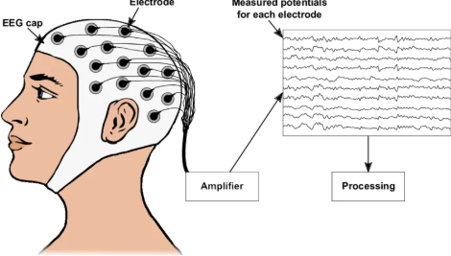
What is eeg?
An electroencephalogram (EEG) is a test that measures electrical activity in the brain. This test also is called an EEG.
The test uses small, metal discs called electrodes that attach to the scalp. Brain cells communicate via electrical impulses, and this activity shows up as wavy lines on an EEG recording. Brain cells are active all the time, even during sleep.
An EEG is one of the main tests to help diagnose epilepsy. An EEG also can play a role in diagnosing other brain conditions.

Slide 6
WHY IS EEG DONE?
An EEG can find changes in brain activity that might aid in diagnosing brain conditions, especially epilepsy or another seizure condition. An EEG also might be helpful for diagnosing or treating:
Brain tumors.
Brain damage from a head injury.
Brain disease that can have a variety of causes, known as encephalopathy.
Inflammation of the brain, such as herpes encephalitis.
Stroke.
Sleep conditions.
An EEG also might be used to confirm brain death in someone in a coma. A continuous EEG is used to help find the right level of anesthesia for someone in a medically induced coma.

Slide 7
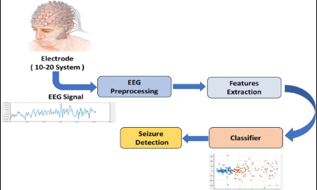
Existing problems with manual detection
Epilepsy diagnosis often relies on long-term EEG recordings, which can span hours or even days. Manually reviewing these recordings to identify seizure events is a very time-intensive task, requiring expert neurologists to dedicate significant amounts of time
Modern EEG equipment can generate massive amounts of data, making manual analysis increasingly difficult and impractical. This abundance of data exacerbates the time-consuming nature of manual review and increases the likelihood of missed seizures.

Slide 8
Our Project goals
Develop an AI/ML-based system to detect and predict neurological conditions like epilepsy using EEG signals.
Focus on real-time detection of epileptic seizures from the CHB-MIT Scalp EEG dataset.
Use machine learning and deep learning techniques to analyze EEG waveforms for seizure patterns.
Create a working prototype that can take EEG input and classify it as seizure or non-seizure.
Design an interactive dashboard using Power BI to visualize patient-wise seizure data and patterns.
Conduct thorough literature review and signal analysis to support a research publication.

Slide 9
References
EEG In Epilepsies: https://www.ncbi.nlm.nih.gov/books/NBK390347/
Epilepsy Symptoms and causes: https://www.mayoclinic.org/diseases-conditions/epilepsy/symptoms-causes/syc-20350093
Understanding Seizures: https://www.epilepsy.com/what-is-epilepsy/understanding-seizures
Types of Seizures: https://www.epilepsy.com/what-is-epilepsy/seizure-types
EEG Seizure Challenges and Future Trends: https://link.springer.com/article/10.1007/s11042-023-15052-2

