Slide 1


IDEA TITLE:
Portable EEG-Based Device for Real-Time Epileptic Seizure Detection and Prediction

Slide 2
Epilepsy is a long-term, noncommunicable brain disease that affects people of all ages.
According to the World Health Organization, about 50 million people around the world have epilepsy.
It is estimated that up to 70% of those living with epilepsy could be free of seizures if they receive the right diagnosis and treatment.
The latest global data from 2021 suggests that idiopathic epilepsy caused around 140,000 deaths worldwide that year.
The Neurology Center for Epilepsy and Seizures reports that the costs specifically related to epilepsy range from $1,022 to $19,749 per year for general epilepsy populations.
Interpreting EEG data is difficult and lacks real-time seizure prediction, which makes it hard for patients to trust the results. It also takes neurologists a long time to make immediate interpretations.
Our inspiration for this project came from a conversation with a faculty member whose son faces severe epilepsy; the need for real-time monitoring became personally important to us.
PROBLEM STATEMENT

Slide 3
Over the past twenty years, research in epileptic seizure detection has shifted from traditional EEG interpretation to automated AI-based analysis. Early studies (Thurman et al., WHO) highlighted the global impact of epilepsy and the need for real-time diagnostic tools. Classical signal processing methods, such as Fourier Transform (Welch, 1967), Wavelet Transform (Subasi, 2006), and time-frequency analysis (Tzallas, 2009), provided important insights into EEG characteristics but were not adaptable for different patients.
Recent research (Tanveer, 2018; Sharan, 2023; Reddy, 2020) has centered on feature optimization, Hjorth parameters, and higher-order statistics to improve understanding and efficiency. Despite significant advances in algorithms, most studies still rely on offline datasets like the Bonn EEG Database. This limited clinical use, points out to a significant gap between research and practical application, which our project aims to address.
LITERATURE SURVEY / STATICS / GRAPHS
Method | Core Technique | Avg. Accuracy | Reference
FFT (Spectral) | Frequency domain analysis | 80–85% | Welch, 1967
Wavelet Transform + SVM | Multiresolution analysis | 90% | Subasi, 2006
CNN-LSTM Hybrid | Deep learning | 95-96% | Ullah, 2018; Shoeibi, 2021
Hjorth + Entropy Features | Statistical learning | 92–95% | Tanveer, 2018
NeuroPulse Ensemble (Ours) | 13 Statistical features Wavelet & Lyapunov FFT & STFT | 97%+ | Present Study
Despite rapid advancements in AI-driven EEG analysis, real-time, portable, and affordable clinical systems are still missing, forming the core motivation for our company’s mission!

Slide 4
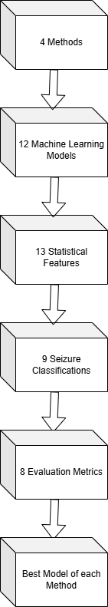
Accuracy, Precision, Recall, F1-Score, ROC-AUC, Log Loss, MCC, and Cohen’s Kappa.
CRITICAL OBSERVATIONS AND FINDINGS
Statistical Features, STFT, FFT, Wavelet & Lyapunov Exponents
Best Selected Performer:
XGBoost (97%+)
Random Forest, Extra Trees, SVM, Logistic Regression, Decision Tree, Naïve Bayes, KNN, Gradient Boosting, XGBoost, MLP Classifier, Voting Ensemble, and QDA.
Mean, Variance, Line Length, Delta Power, Theta Power, Alpha Power, Beta Power, Sample Entropy, Activity, Mobility, Complexity, Skewness, and Kurtosis.
We’ve done deep experimentation, validated results, and have quantifiable evidence for our innovation.
Z/N/O/F/S, Z/ALL, N/ALL, O/ALL, F/ALL, S/ALL, Z/S, ZO/S, and ZO/NF/S.
Accuracy, Precision, Recall, F1-Score, ROC-AUC, Log Loss, MCC, and Cohen’s Kappa.
STASTICAL FEATURES:
Extra Trees (98.8%)
STFT:
Voting Ensemble-Random Forest (99.7%)
FFT:
Random Forest (90%)
Wavelet & Lyapunov:
XGBoost
(98.3%)

Slide 5
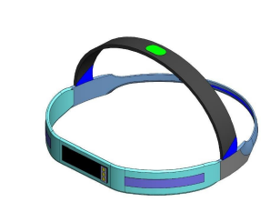
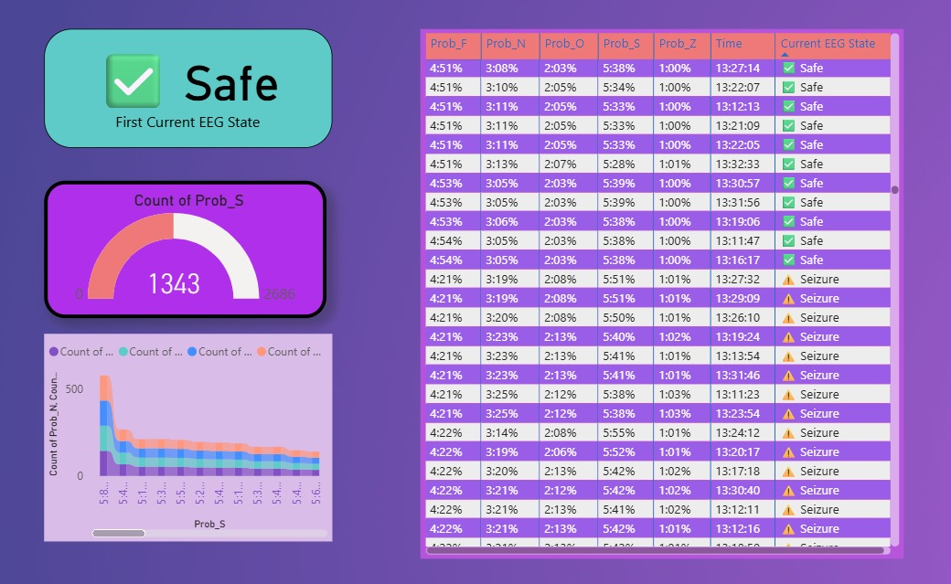
SOLUTION / IDEATION BRIEF DESCRIPTION
Portable Seizure Detector
(UK Design Patent #6469734)
www.gov.uk.in
A lightweight, wearable EEG headband equipped with 8 dry electrodes designed to record real-time brainwave activity.
The device integrates a signal amplifier (ADS1299) and Wi-Fi/Bluetooth module to transmit EEG data directly to a cloud-connected system for AI-based seizure detection and prediction.
Its portable design enables continuous patient monitoring at home or in clinical environments.
Integrated Display Functionality:
1. For Patients: A Simple understandable dashboard, alert system, features changing modes, easy download and data manipulation , chargeable display for daily usage covering all the aspects that user can easily interpret and take immediate action if required.
2. For Doctors: An easy access communication portal with patients for immediate notification, important reminders and extracting deep insights of patient’s condition

Slide 6
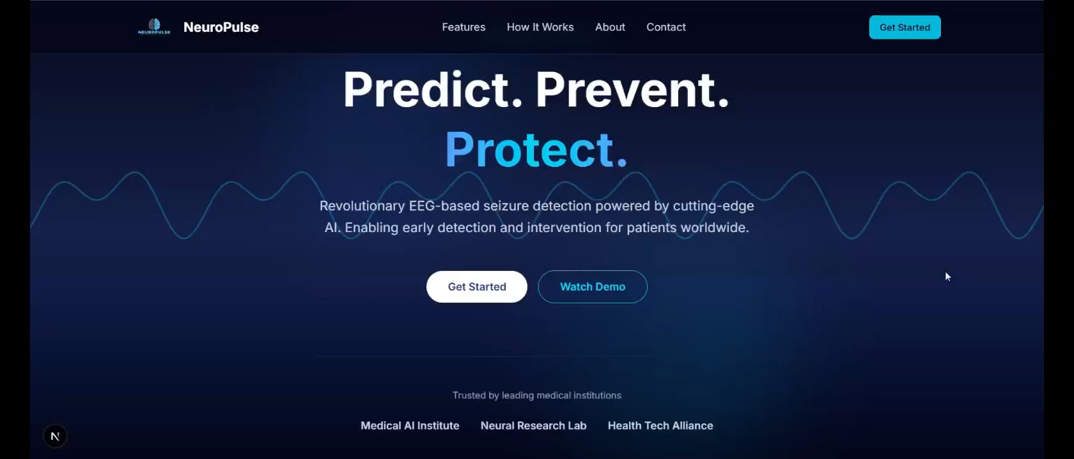
SOLUTION / IDEATION BRIEF DESCRIPTION

Slide 7
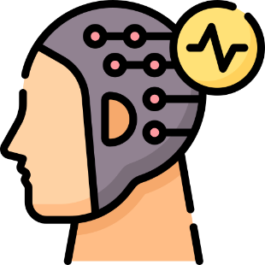


01.
EEG Data Acquisition & Transmission
The portable headband records real-time EEG signals using 8 dry electrodes. These signals are amplified and transmitted to the display for the patients and via Wi-Fi/Bluetooth to the cloud for the doctor’s analysis.
WORKING OF THE SOLUTION
02.
AI-Based Detection & Prediction
The EEG signals are processed using 13 Statistical Features, FFT, STFT, Lyapunov and Wavelet Transforms for getting the best accuracy during the live analysis and if early irregularities are detected, system predicts a potential seizure within 30 minutes.
Real-Time Dashboard & Alerts
03.
The results are displayed on the Power BI dashboard, highlighting affected brain regions and dominant frequency bands. The system sends instant alerts to the patient’s and doctor’s portals, enabling immediate response and prescription tracking.

Slide 8
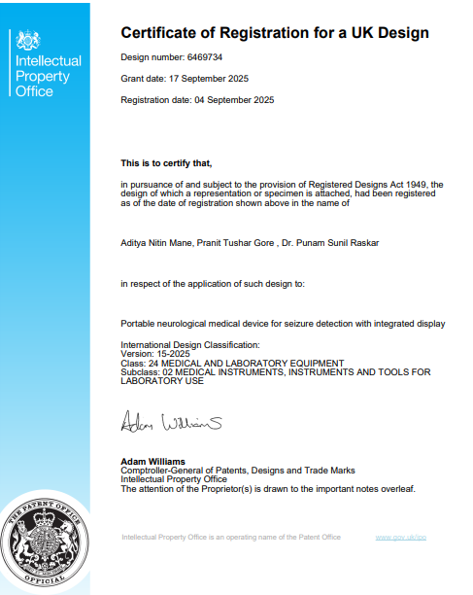
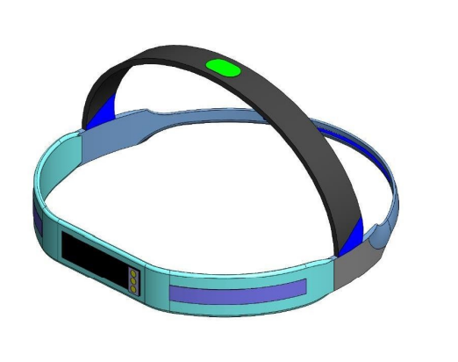
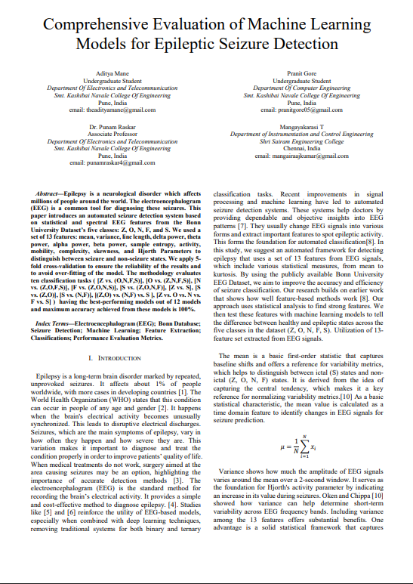
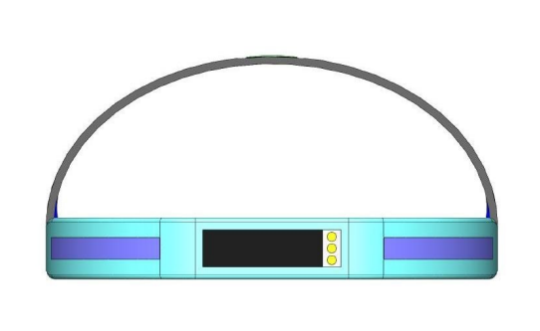
WHAT MAKES OUR SOLUTION STAND OUT

Slide 9
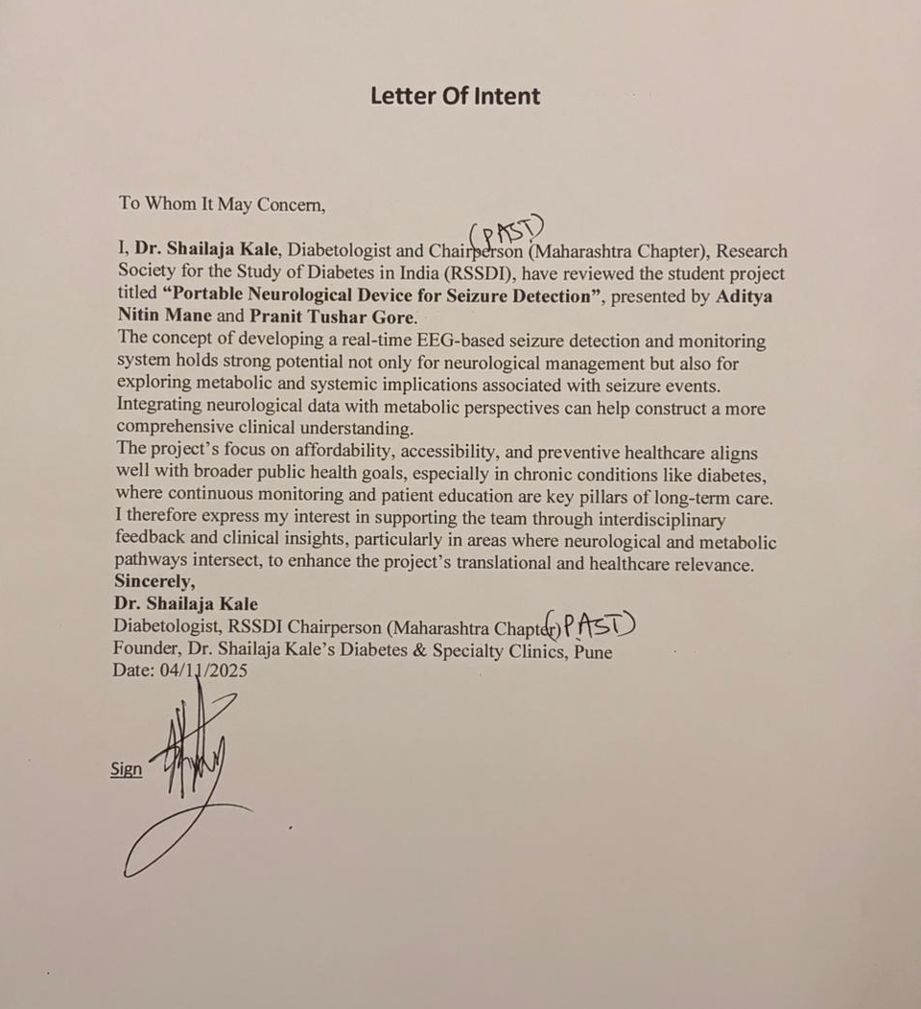
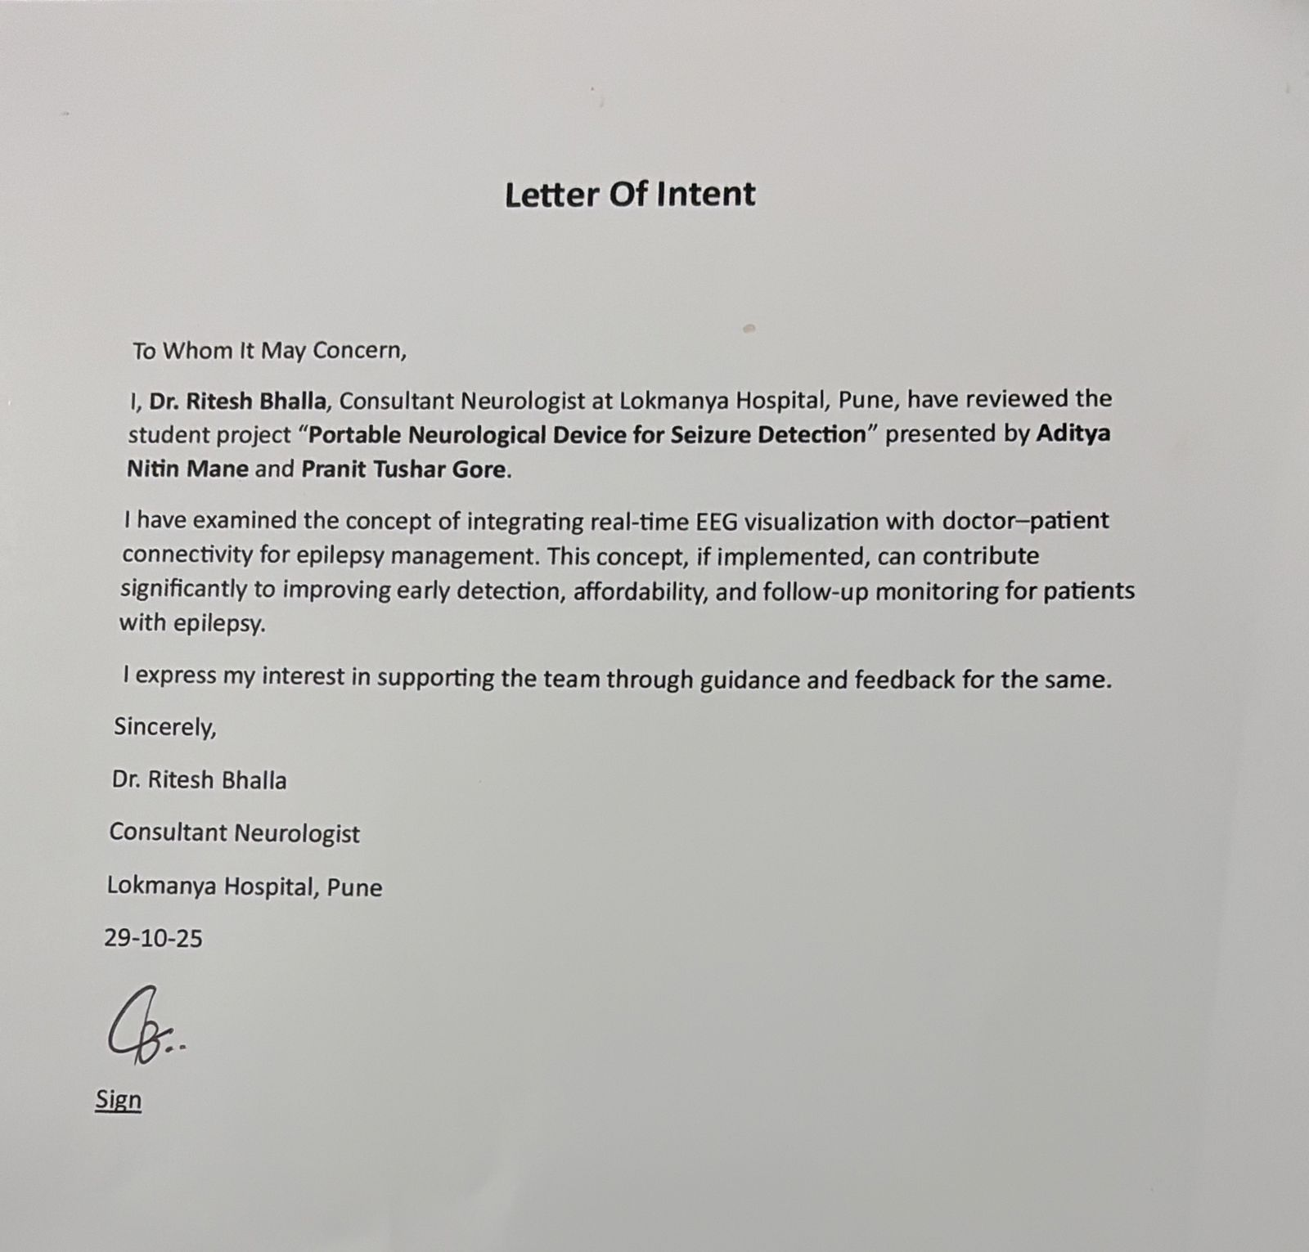
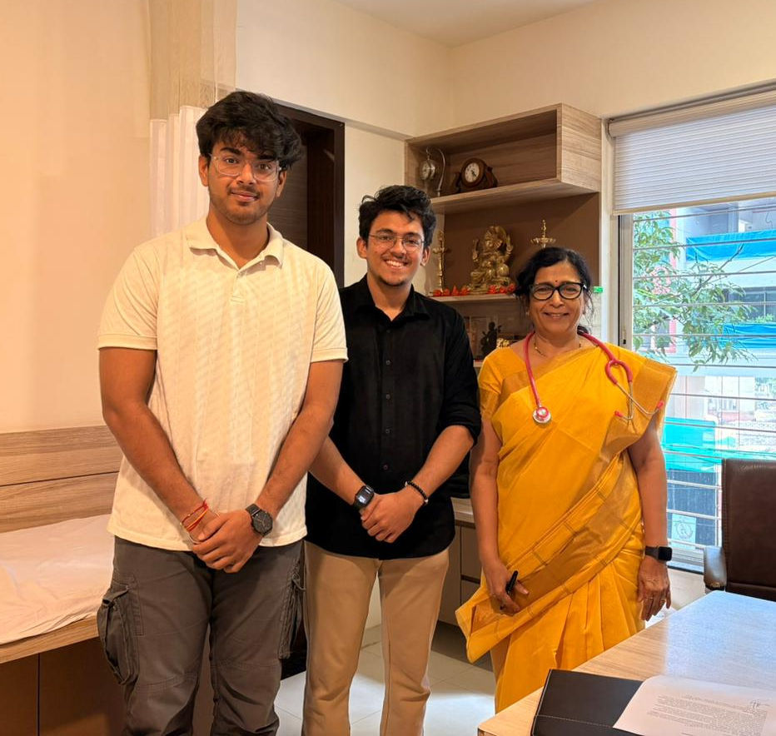
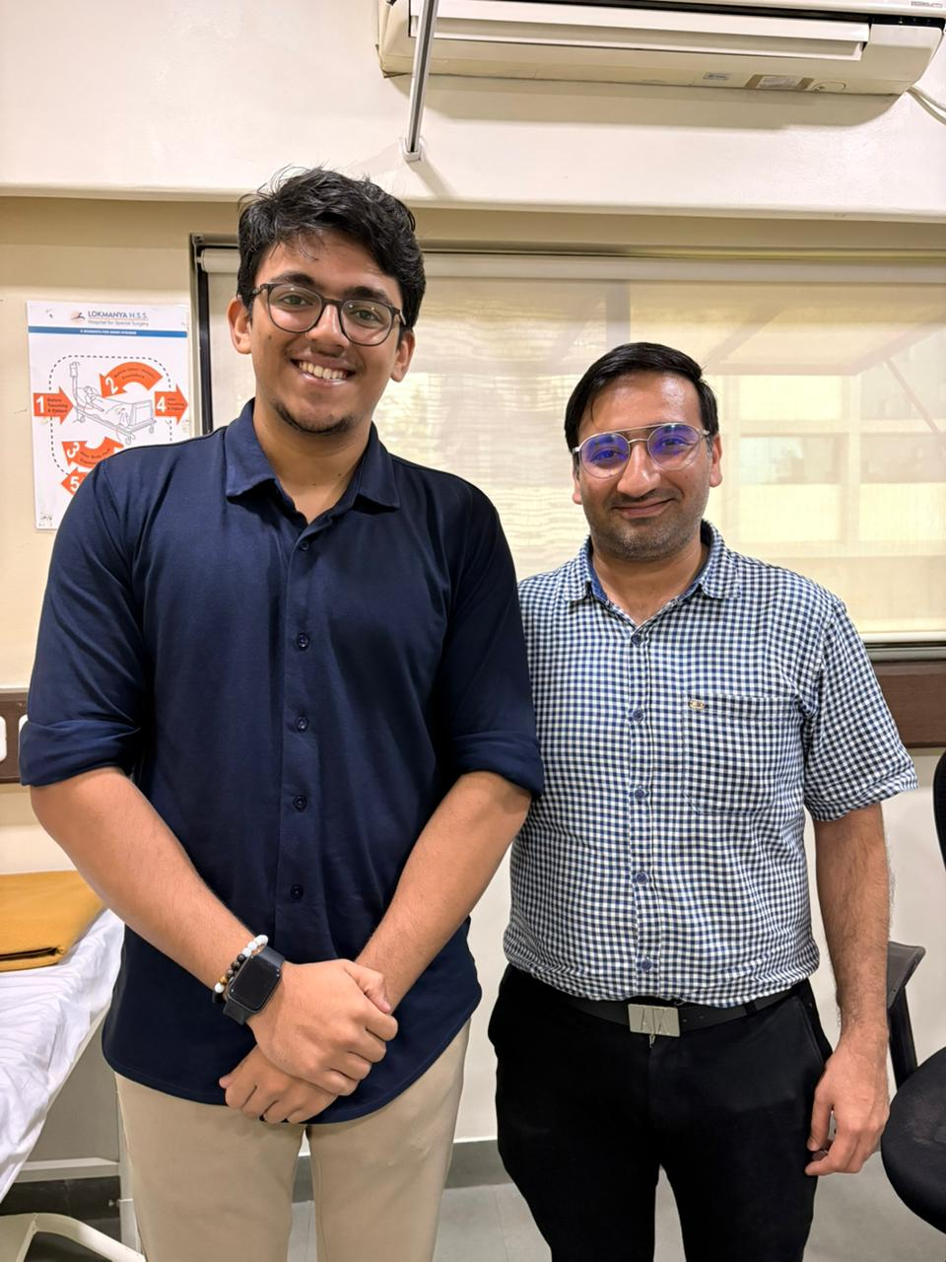
WHAT MAKES OUR SOLUTION STAND OUT
Senior Diabetologist
Dr. Shailaja Kale approved our work, specifying it as “Excellent idea having potential for a startup”
Senior Neurologist Dr. Ritesh Bhalla
And Product Designer Mr. Saurabh Dharmadhikari from Lokmanya Hospital, Pune endorsed this idea and are open to guide and collaborate with us.

Slide 10

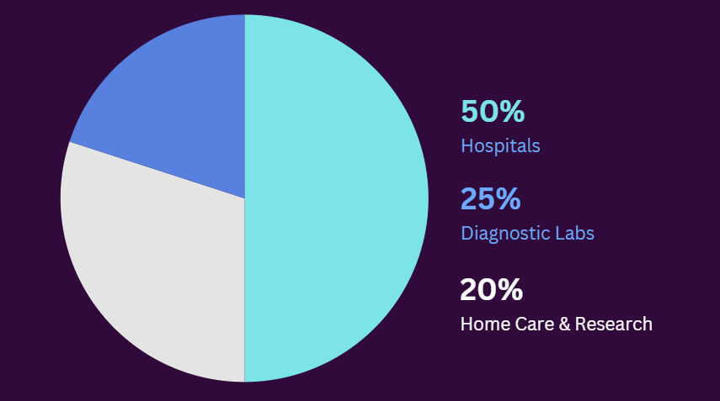
TARGET MARKET AND BUSINESS MODEL
Target Market:
Business Model:
Global Need: 65M+ people with epilepsy worldwide, 10M+ in India (90% untreated). Primary Market: Hospitals, Neurologists, Diagnostic Labs Secondary Market: Research Institutions, Medical Colleges, Home-Care Systems
Partner with DRDO by providing company shares for better company growth and reach
This Portable Seizure Detector will be priced at ₹15,000 to ₹20,000 per unit with basic cloud analysis subscription for the patients. This is lower than the ₹60,000 to ₹1,50,000 cost of standard EEG setups, resulting in more than 60% reduction in price. The initial rollout will target Tier-1 and Tier-2 hospitals, aiming for over 500-1000 installations in the first year through direct sales and partnerships.
Cloud-based dashboard access for doctors will cost ₹499 per month or ₹4999 per year. Predictive analytics, data storage, and visualization dashboards help generate recurring revenue. The estimated profit margin on digital services is 40 to 45 percent.
Integration with IoT health wearables, and pharmaceutical tie-ups for prescription tracking, projected to increase market share by 15–20% annually.

Slide 11
HOW CAN YOUR SOLUTION HELP IMPROVING CURRENT SITUATION?
The current epilepsy management system faces challenges due to expensive EEG tests, a shortage of neurologists, and insufficient continuous monitoring. Our device addresses these issues with a portable, AI-powered EEG device that allows for real-time seizure detection and prediction at a much lower cost than traditional methods.
Through its cloud-based dashboard, our device connects patients and neurologists for easy communication and quick prescriptions. This enables remote EEG tracking, timely interventions, and improved medication adherence. It makes neurological care affordable, accessible, and ongoing, especially in underserved areas.
The lightweight, rechargeable headband has a flexible polymer frame that fits different head shapes and uses eight electrodes for nearly perfect signal accuracy. An embedded audio chip provides real-time voice prompts like "Breathe deeply" when it detects abnormal spikes, helping patients stay calm and react quickly.
If any abnormality in spikes is detected, an immediate alert signal will be sent to nearby doctors and the loved ones.
Our device will detect live seizures in different timeframes. A user can set up his/her EEG device for a specific time range. For example, an individual can set his/her EEG device for 30/60 minutes or more. Meanwhile, he/she can go to sleep or can do another activity.

Slide 12
REFERENCES
World Health Organization. Epilepsy: A Public Health Imperative, WHO, 2019.
D. J. Thurman et al. “Standards for Epidemiologic Studies and Surveillance of Epilepsy,” Epilepsia, vol. 52, pp. 2–26, 2011.
E. Niedermeyer & F. Lopes da Silva. Electroencephalography: Basic Principles, Clinical Applications, and Related Fields, 5th ed., Lippincott Williams & Wilkins, 2005.
I. Ullah et al. “Automated System for Epilepsy Detection Using EEG Brain Signals Based on Deep Learning Approach,” Expert Systems with Applications, vol. 107, pp. 61–71, 2018.
A. Shoeibi et al. “Epileptic Seizures Detection Using Deep Learning Techniques: A Review,” International Journal of Environmental Research and Public Health, vol. 18, no. 11, 5780, 2021.
A. T. Tzallas, M. G. Tsipouras, D. I. Fotiadis. “Epileptic Seizure Detection in EEGs Using Time–Frequency Analysis,” IEEE Transactions on Information Technology in Biomedicine, vol. 13, no. 5, pp. 703–710, 2009.
A. Subasi. “EEG Signal Classification Using Wavelet Transform and Support Vector Machine,” Expert Systems with Applications, vol. 31, no. 2, pp. 320–328, 2006.
R. G. Andrzejak et al. “Nonlinear Deterministic Structures in Time Series of Brain Electrical Activity,” Physical Review E, vol. 64, no. 6, 061907, 2001.
T. Fawcett. “An Introduction to ROC Analysis,” Pattern Recognition Letters, vol. 27, no. 8, pp. 861–874, 2006.
EEG Dataset: University of Bonn, Germany. [Online]. Available: http://epileptologie-bonn.de
Full list of 35 scientific references is included in our IEEE research paper titled “Comprehensive Evaluation of Machine Learning Models for Epileptic Seizure Detection.

Slide 13
EEG Headband: 8 dry electrodes for real-time data acquisition
Microcontroller: ESP32 / Arduino Nano for signal processing
Amplifier Module: ADS1299 (Texas Instruments) for biopotential signals
Wireless Transmission: Wi-Fi / Bluetooth (BLE) for cloud connectivity
TECH STACK
Languages: Python (NumPy, Pandas, SciPy, Scikit-learn, TensorFlow/Keras)
Algorithms: FFT, STFT, Wavelet Transform, Lyapunov Exponents, fine-tuning using statistical methods.
Models: Ensemble ML Model Learning for seizure detection & prediction
Performance: 97%+ accuracy on real patient data.
01.
Hardware & Signal Acquisition
02.
Machine Learning & Signal Processing
EEG Headband: 8 dry electrodes for real-time data acquisition
Microcontroller: ESP32 / Arduino Nano for signal processing
Amplifier Module: ADS1299 (Texas Instruments) for biopotential signals
Wireless Transmission: Wi-Fi / Bluetooth (BLE) for cloud connectivity
TECH STACK
Platform: Microsoft Power BI / Streamlit (prototype testing)
Libraries: Matplotlib, Plotly for EEG signal graphs and heatmaps
Visualization: Frequency bands (α, β, γ, δ), STFT heatmaps, real-time brain region mapping
Output: Doctor–Patient dashboard for tracking signals, medications, and alerts
Frontend: React.js / HTML5 / CSS3 (Responsive UI for portal)
Backend: Node.js / Flask API for data handling
Database: Firebase / MongoDB for patient and doctor records
Cloud Hosting: Azure / AWS for real-time EEG data streaming & alert management
03.
Visualization & Dashboard
04.
Web Infrastructure, App & Cloud Integration

Slide 14

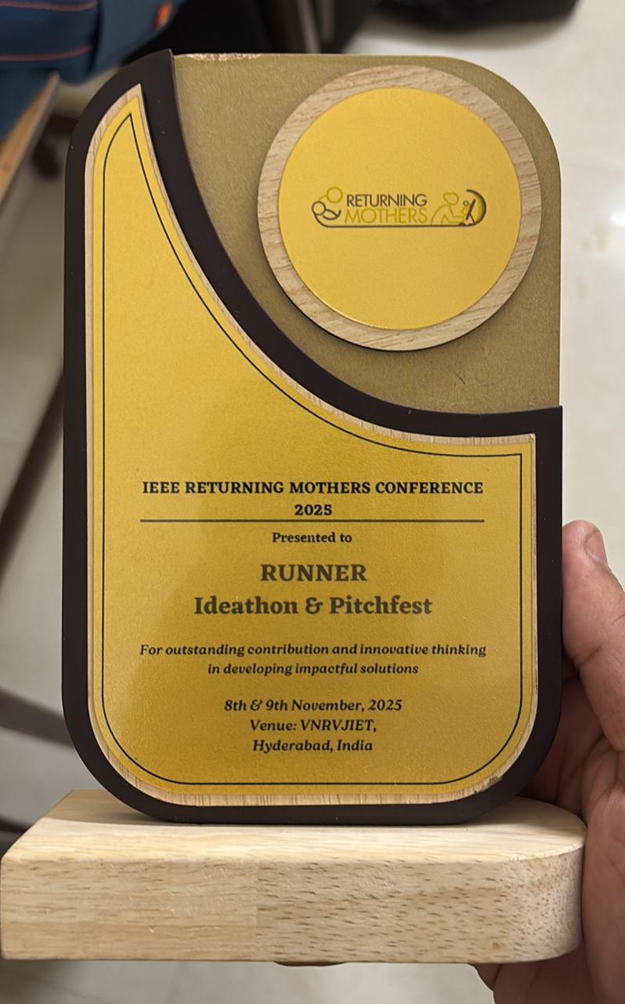
Runner Up at National Level Ideathon & Pitchfest

Slide 15
THANK YOU VERY MUCH!

