Slide 1

Code Refactoring and Bug Fixing

Slide 2
About me
Background ?
I completed my under graduation in B-tech (Aeronautical Engineering).
Why you want to learn Data Science
To cope up with the present Trend and enhance skills set.
Any work experience
I Worked as a Data Analyst for Three years and have a cumulative understanding on Python, SQL and Power BI Tools.
Share your linkedin and github profile urls
(24) SAIPRANEETH ADIGOPULA | LinkedIn
PRANITH1997 (Praneeth) (github.com)

Slide 3
Agenda
Identifying the Bugs in the code
Rectifying the Bugs
Deploying it in the Local Server

Slide 4
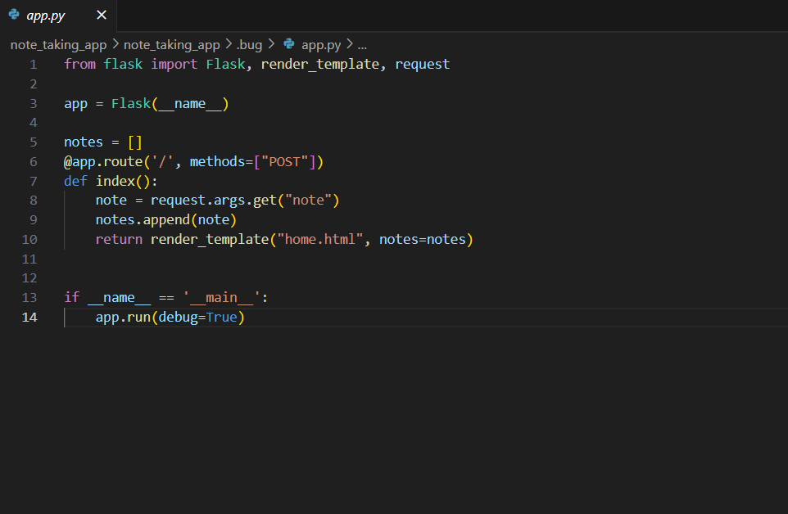
Identifying the Bugs
The current implementation only uses the POST method in the route decorator (@app.route('/')).
To allow clients to access the webpage using the GET method, the route decorator should be modified to include both GET and POST methods.
This change will enable clients to retrieve the webpage content through the URL using the GET method, and also submit form data using the POST method.
In the index function, there is no need to pass integer values.
The purpose of the index function is to handle requests to the root URL and process form data submitted by the client.
The request.form.get("note") method is used to retrieve the string data (note) submitted by the client through a form.
The retrieved string data is then appended to the notes list, which can be used to display the notes on the webpage.

Slide 5
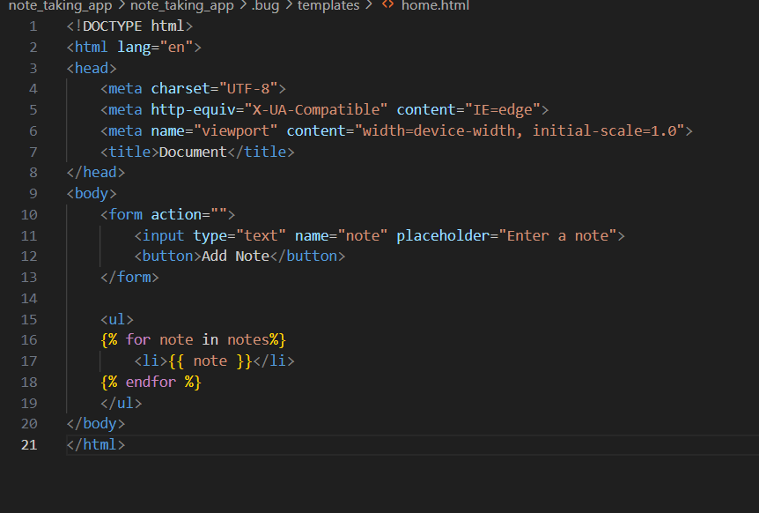
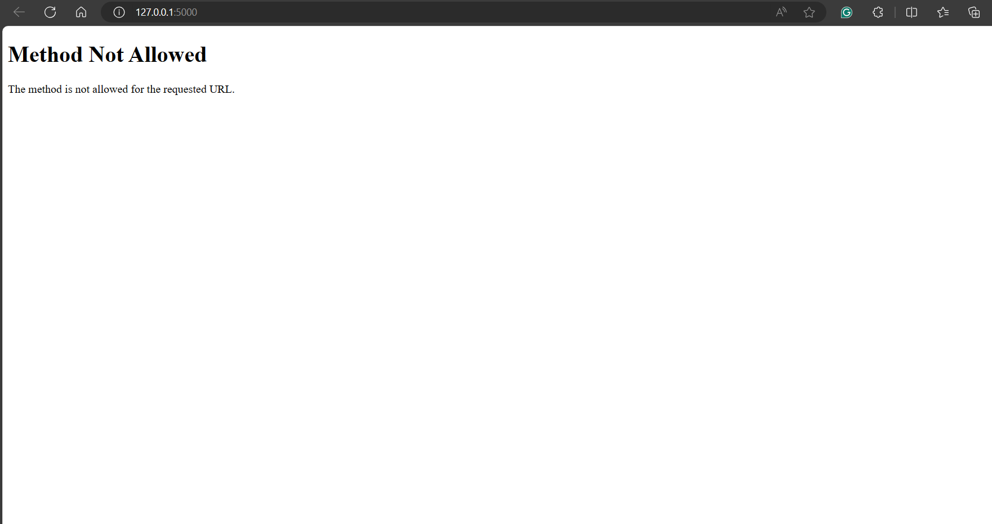
Identifying the Bugs
In the <form> tag, the error is that the action and method attributes are not specified.
Additionally, the <button> tag does not specify the type attribute.

Slide 6
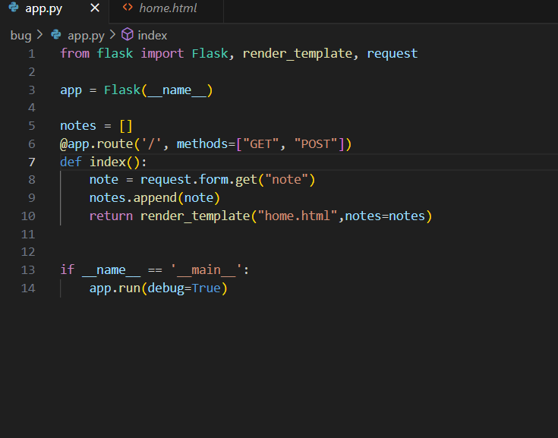
Rectifying the Bugs
An object of the Flask class is created and assigned to the variable app.
The @app.route('/') decorator binds the root URL ('/') to the index function.
The index function handles requests to the root URL, retrieves form data using request.form.get("note"), and appends it to the notes list.
The function returns the rendered template home.html, passing the notes list to the template.
The HTML form in home.html is configured to send data using both GET and POST methods, allowing it to display and add notes.

Slide 7
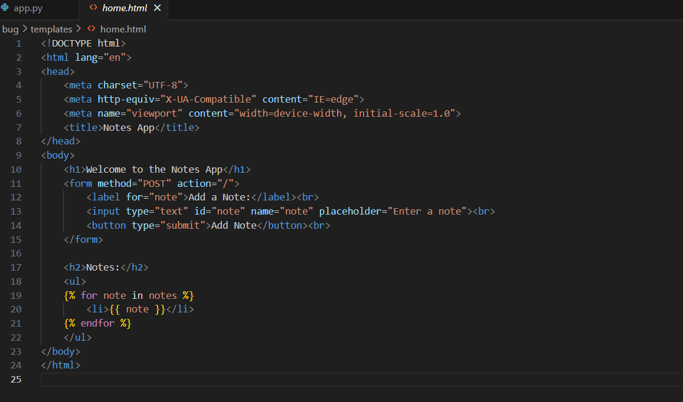
Rectifying the Bugs
First, I specified the type of action and method in the <form> tag. This tells the browser how to handle the form data when it is submitted.
Next, I mentioned the type of the button using the type attribute in the <button> tag. This specifies the behavior of the button.

Slide 8
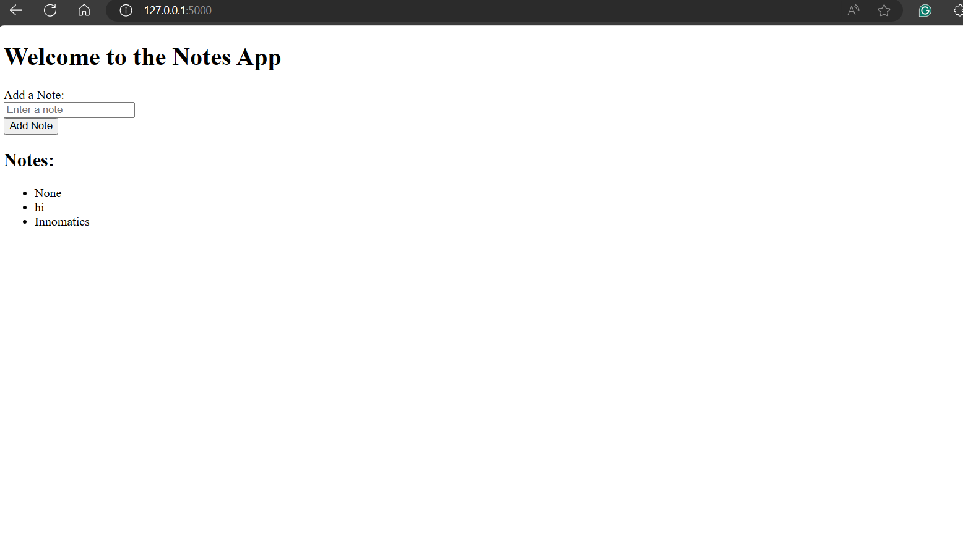
Deploying it in the Local Server

Slide 9

THANK YOU

