Slide 1

EDA ON Aspiring Mind Employment Outcome 2015 (AMEO)

Slide 2
About me
Background ?
(B-tech (Aeronautical Engineering)
Why you want to learn Data Science
To cope up with the present Trend and enhance skills set.
Any work experience
Yes, Worked as a Data Analyst
Share your linkedin and github profile urls
(24) SAIPRANEETH ADIGOPULA | LinkedIn
PRANITH1997 (Praneeth) (github.com)

Slide 3
Agenda
Introduction
Data Understanding
Exploratory Data Analysis:
Data Cleaning Steps
Data Manipulation Steps
Univariate Analysis Steps
Bivariate Analysis Steps
Conclusion

Slide 4
Introduction
The Aspiring Minds Employment Outcome dataset provides insights into the factors influencing salary levels among job seekers.
This analysis aids in understanding the impact of various independent variables on salary, crucial for effective talent management strategies.

Slide 5
Data Understanding
Before analyzing the data, it's crucial to understand its nature and structure. This includes identifying the different variables and their types, as well as gaining an overall understanding of the dataset.

Slide 6

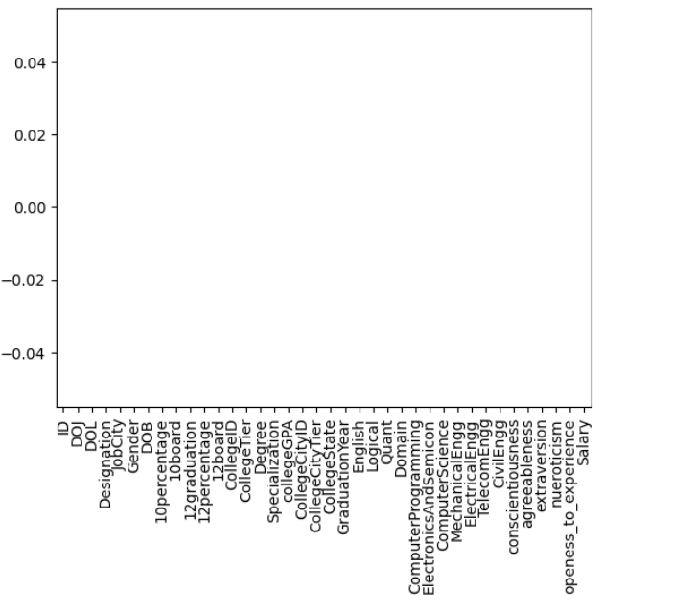
Data Cleaning
Cleaning the data is essential to ensure its accuracy and reliability. This involves handling missing values, removing duplicates, and correcting any inconsistencies in the data that could lead to incorrect analysis.

Slide 7
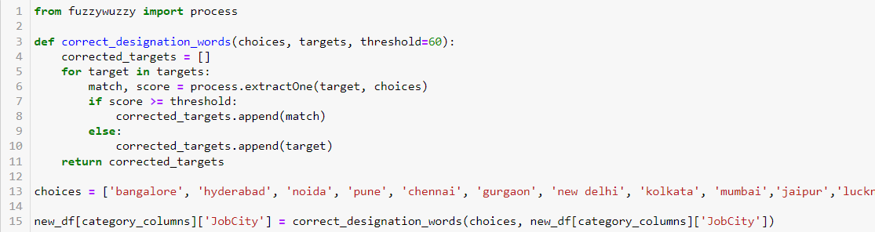
Data Manipulation Steps
Fuzzy Wuzzy is a Python library that offers fuzzy string-matching functionalities, ideal for tasks where exact string matching may not be appropriate due to typos, spelling variations, or data inconsistencies. It uses the Levenshtein distance algorithm to calculate string similarity, providing a score between 0 and 100, where a higher score indicates a closer match. This tool is valuable for various data manipulation tasks, including deduplication, record linkage, and data cleaning, enhancing the accuracy and efficiency of matching words or phrases that are similar but not identical.

Slide 8
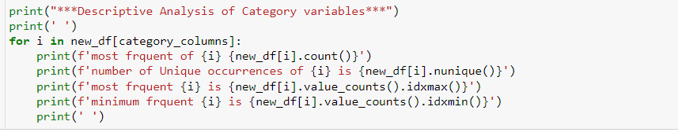
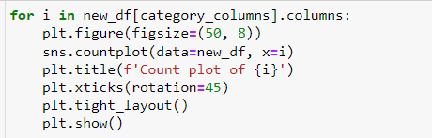
Univariate Analysis
After cleaning the data, it's important to analyze each variable individually to understand its distribution and identify any outliers that may be present. This helps in gaining a clearer understanding of the data and its underlying patterns.

Slide 9
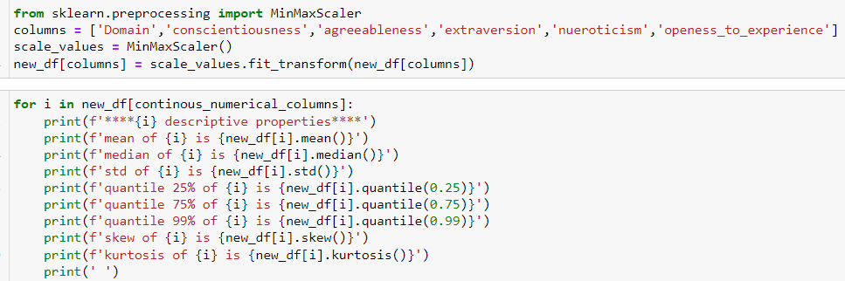
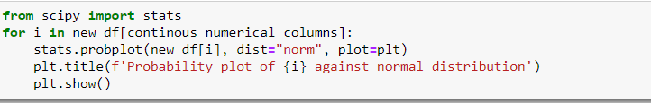
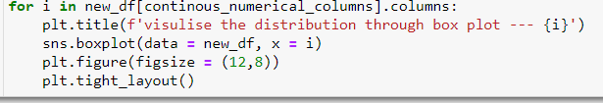

Slide 10
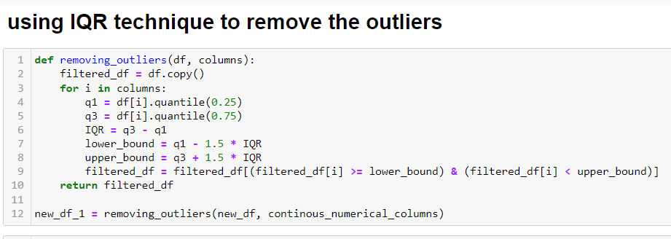
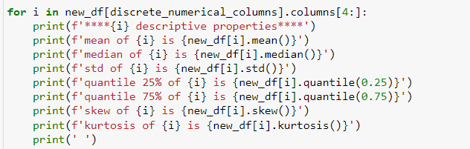
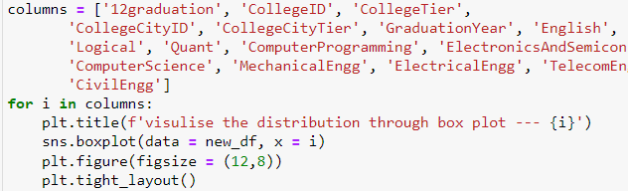

Slide 11
Bivariate or Multivariate Analysis
Once the data has been examined and outliers have been addressed, the next step is to conduct bivariate or multivariate analysis to understand how variables interact with each other. This helps in identifying relationships and patterns within the data, which can provide valuable insights for further analysis.

Slide 12
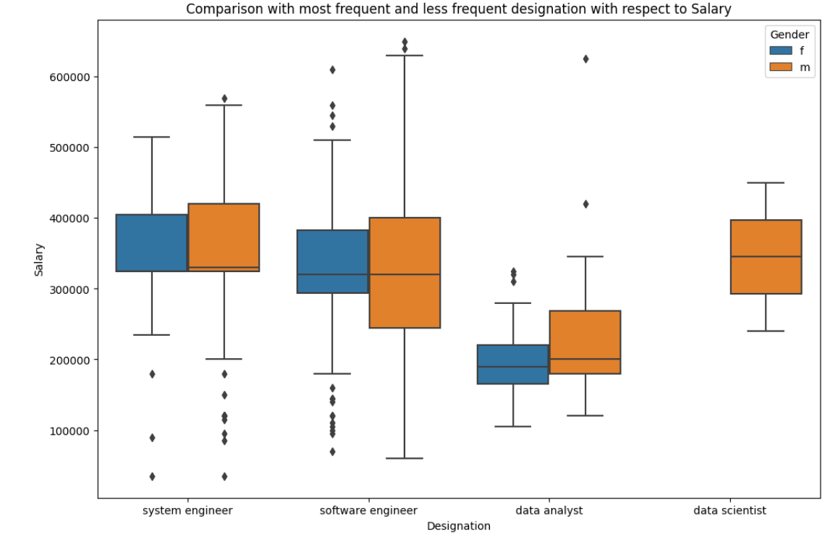
Are people who choose a career as Software Engineer earning more compared to those in less chosen designations? How does this vary between genders?
In comparing the most frequent and less frequent designations by gender, notable differences in salary levels and gender distribution are evident, with Software Engineers earning more, males slightly higher than females, only males working as Data Scientists indicating gender disparity, and both genders having similar salaries as Data Analysts, suggesting a potential gender imbalance in the workforce.

Slide 13
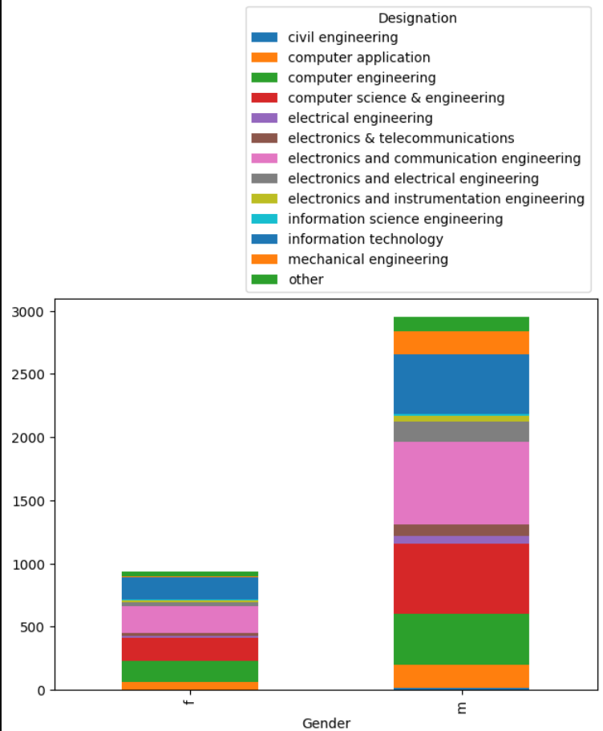
How much money do males and females earn in different cities/designations?
The plot reveals that Bangalore is the predominant job location across designations, indicating its popularity among job seekers. Additionally, it shows that, in general, male ratios are higher than female ratios in most cities, suggesting a gender imbalance in job distribution. However, there are a few cities where the male and female ratios are similar, indicating a more balanced gender distribution in those locations. This observation underscores the importance of considering location-specific factors when analyzing gender disparities in job placements.

Slide 14
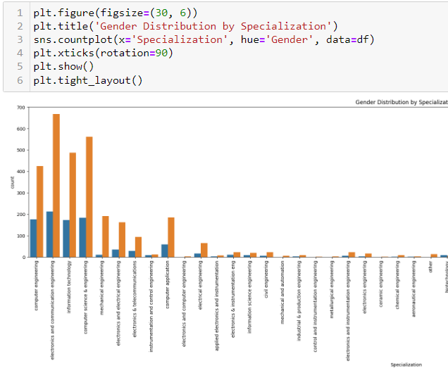
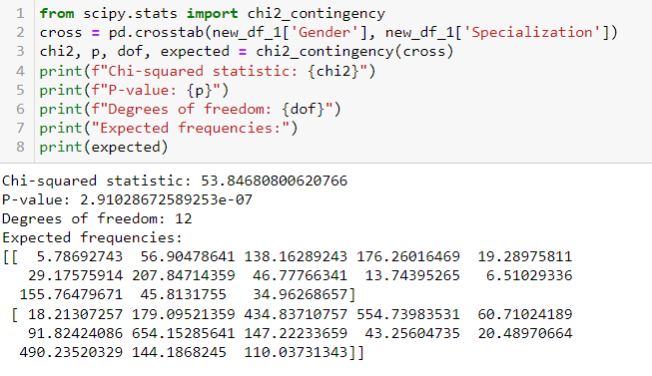
Is there a relationship between gender and specialization? In other words, does the preference for specialization depend on gender?
The analysis shows a strong relationship between gender and specialization, as indicated by a chi-square score of approximately 53% and a p-value of less than 0.05. This suggests that gender and specialization are not independent of each other. The significant chi-square score implies that the observed frequencies of gender and specialization in the dataset differ from what would be expected if the two variables were independent. Therefore, there is evidence to conclude that both gender and specialization are related in the dataset, highlighting the importance of considering both factors in further analysis or decision-making processes.

Slide 15
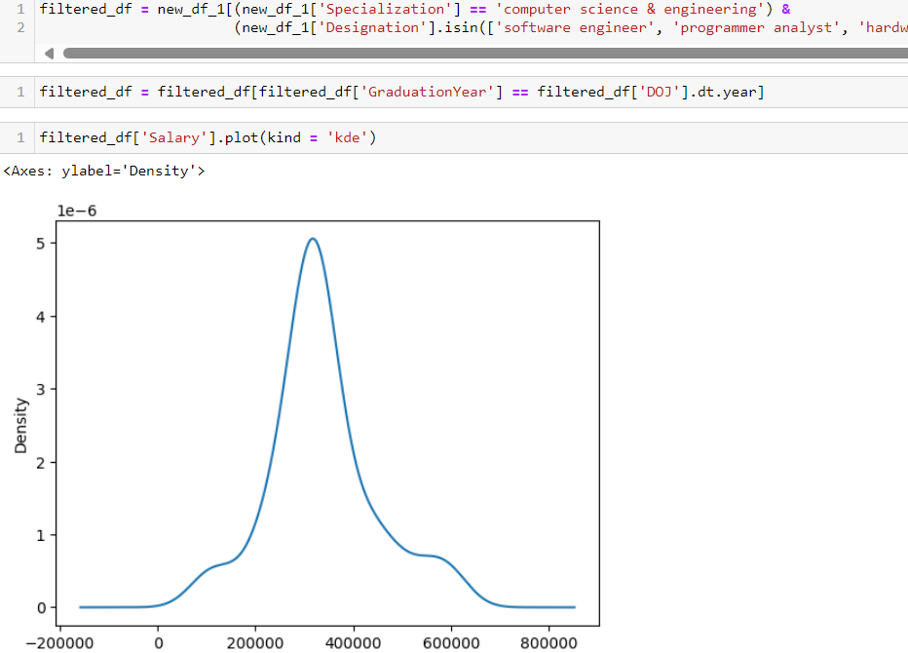
Does the claim made in a Times of India article dated Jan 18, 2019, stating that "After doing your Computer Science Engineering if you take up jobs as a Programming Analyst, Software Engineer, Hardware Engineer and Associate Engineer you can earn up to 2.5-3 lakhs as a fresh graduate" hold true based on the given data?
Freshers in roles like Programming Analyst, Software Engineer, Hardware Engineer, and Associate Engineer earn an average salary of 2.5 to 3 lakhs. These roles represent entry-level positions in the tech industry, with responsibilities ranging from programming analysis to software and hardware development. The observed salary range suggests a standard pay scale for beginners in these fields. This information is valuable for both job seekers and employers, providing insights into salary expectations and industry standards for entry-level tech positions.

Slide 16
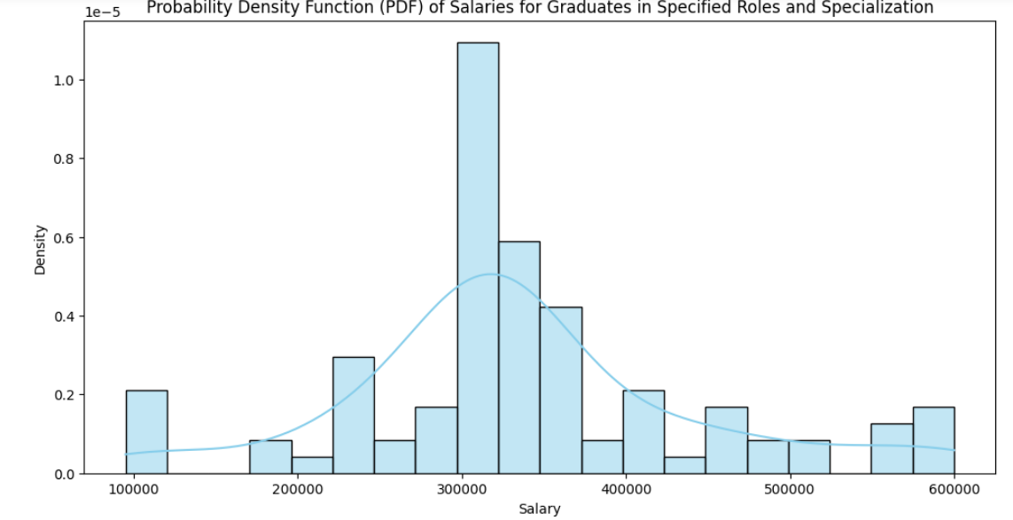
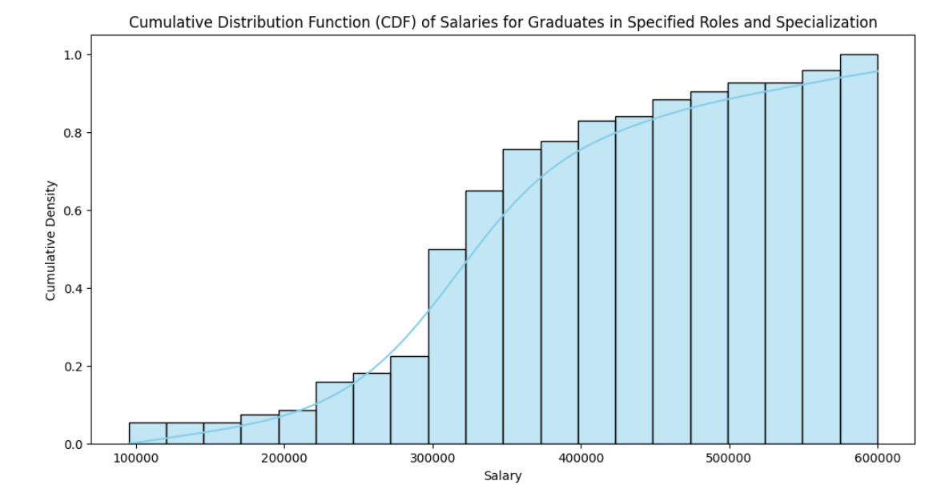

Slide 17
Conclusion
Through exploratory data analysis (EDA) of the Aspiring Minds Employment Outcome dataset, we can infer that individuals with a background in computer science specialization who graduated with first-class distinction and achieved high marks in their 10th, 12th, and graduation, along with scoring well in the AMCAT Computer Programming language assessment, tend to earn a higher salary compared to others. This highlights the importance of these factors in influencing salary levels for computer science graduates and emphasizes the value of a strong educational background and relevant skills in the job market.
​

Slide 18

THANK YOU

