Slide 1
DATA SCIENCE PROJECT | MACHINE LEARNING
Spotify Songs'
Genre Segmentation
Exploratory Data Analysis, Audio-Feature Correlation
& Track Popularity Prediction
Dataset: 32,833 Spotify tracks • 23 attributes • 6 genres • 24 subgenres
TEAM MEMBERS
Source: Kaggle — "30000 Spotify Songs" dataset
Pranshu Tyagi • Kashish Kushwaha • Dhanvi
SPOTIFY SONGS' GENRE SEGMENTATION • PROJECT PRESENTATION
Notes:
Welcome the audience. Introduce the project as an end-to-end data science project on the Spotify Songs dataset — from raw data to a working popularity-prediction model.

Slide 2
PROBLEM STATEMENT
Why This Project Matters
Spotify hosts millions of songs spread across genres and playlists. Every track carries a set of measurable audio characteristics — danceability, energy, acousticness, valence, tempo, and more — that describe how it actually sounds. This project uses those characteristics to explore how songs relate to one another and to understand what drives a track's popularity.
PROJECT OBJECTIVES
AUDIO FEATURES USED
Clean and prepare the raw Spotify dataset
Explore genre, popularity and audio-feature patterns (EDA)
Analyze correlations between audio characteristics
Select the right features for predictive modeling
Build and evaluate models that predict track popularity
Translate the findings into practical, business-relevant insights
Danceability
How suitable a track is for dancing
Energy
Perceived intensity and activity
Valence
Musical positivity / happiness
Acousticness
Likelihood the track is acoustic
Tempo, Loudness, Speechiness, Liveness, Instrumentalness
Additional sonic characteristics
SPOTIFY SONGS' GENRE SEGMENTATION
2
Notes:
Explain that Spotify tracks carry measurable audio characteristics, and that the project uses these to understand songs and predict popularity. Walk through the 6 objectives briefly.

Slide 3
DATASET
Dataset Overview
32,833
23
6
24
10,692
449
TRACKS (ROWS)
COLUMNS
PLAYLIST GENRES
PLAYLIST SUBGENRES
UNIQUE ARTISTS
UNIQUE PLAYLISTS
KEY COLUMNS
GENRE SPLIT
Identifiers
EDM
6,043
track_name, track_artist, track_album_name, playlist_name
Rap
5,746
Categorical
Pop
5,507
playlist_genre, playlist_subgenre
Popularity
R&B
5,431
track_popularity (0–100 scale)
Latin
5,155
Audio Features (numeric)
Rock
4,951
danceability, energy, loudness, speechiness, acousticness, instrumentalness, liveness, valence, tempo, duration_ms, key, mode
Genres are almost evenly represented — no severe class imbalance.
SPOTIFY SONGS' GENRE SEGMENTATION
3
Notes:
Give the audience the scale of the dataset — 32,833 tracks, 23 columns, 6 genres. Point out the near-even genre split so they understand there's no class-imbalance concern.

Slide 4
DATA PREPROCESSING
Getting the Data Model-Ready
Raw Data
32,833 rows
→
Missing /
Duplicate Check
→
Feature
Selection
→
Train-Test
Split (80/20)
→
Feature
Scaling
→
Model-Ready
Data
STEPS ACTUALLY PERFORMED
SCOPE NOTE
Checked for missing values — only 5 rows (out of 32,833) had a missing track/artist/album name; no audio-feature columns were affected
Checked for duplicate rows — none were found (0 duplicates)
Selected 10 numeric audio features as model inputs (X) and track_popularity as the prediction target (y)
Split data into 80% training (26,266 rows) and 20% testing (6,567 rows), random_state = 42
Standardized all features using StandardScaler (zero mean, unit variance) before modeling
Categorical fields such as playlist_genre and playlist_subgenre were explored during EDA but were not one-hot encoded or fed into the regression models — the models use only the 10 numeric audio features listed above. No outlier removal or explicit imputation was required, since missing/duplicate values were negligible.
track_id, track_name, track_artist, album fields, and playlist identifiers were excluded from the model — they are metadata, not audio characteristics.
SPOTIFY SONGS' GENRE SEGMENTATION
4
Notes:
Walk through the preprocessing pipeline left to right. Emphasize that missing values and duplicates were checked and found negligible, and that scaling was applied before modeling.

Slide 5
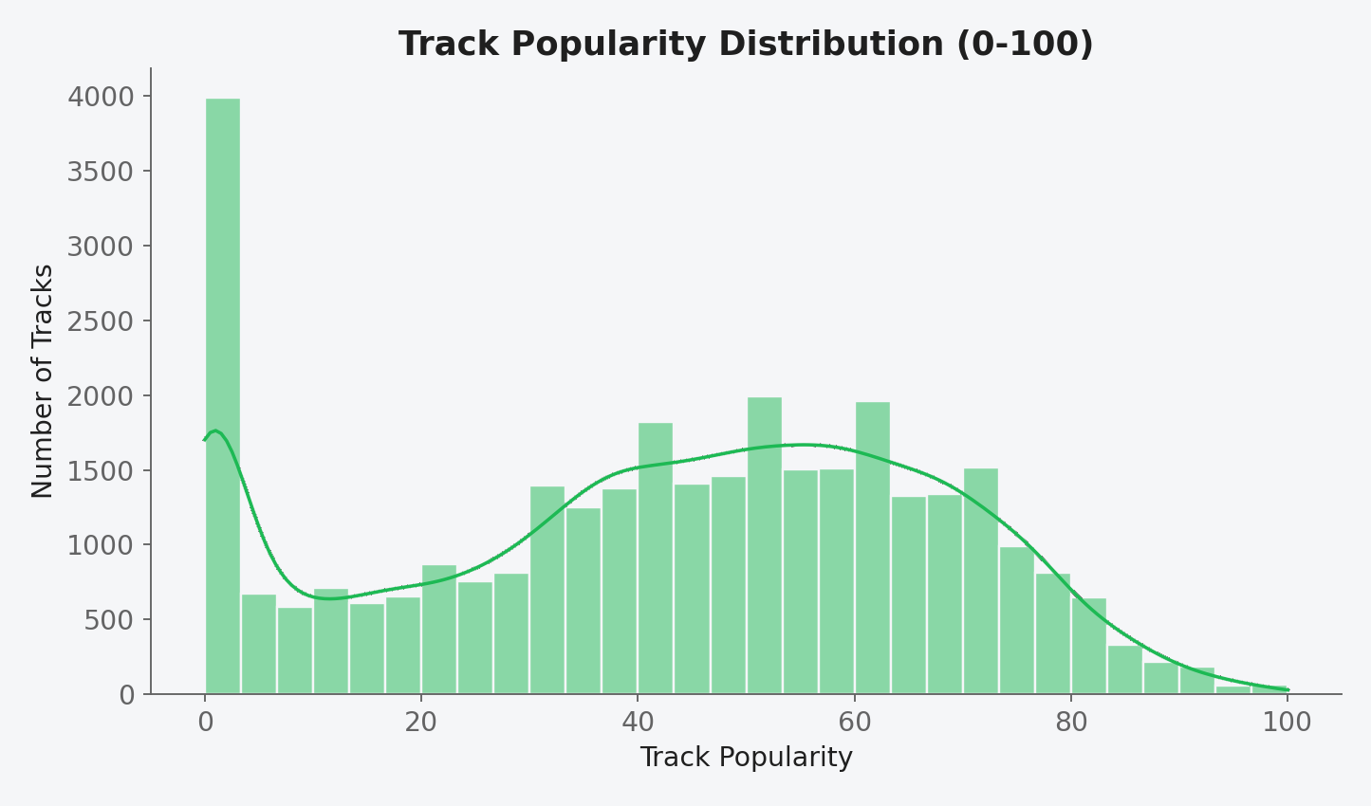
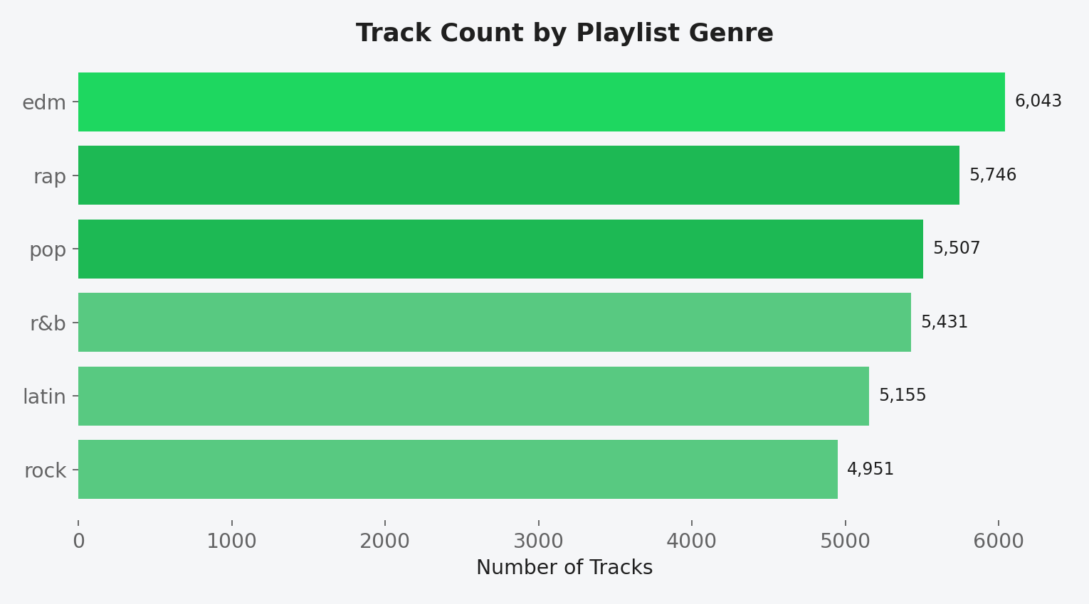
EXPLORATORY DATA ANALYSIS
Popularity & Genre Landscape
Popularity is broadly spread (mean ≈ 42.5, median 45), with a visible cluster of tracks scored 0 — likely lesser-known or newly added songs.
EDM leads with 6,043 tracks; Rock has the fewest at 4,951 — a healthy, near-balanced genre split across the dataset.
SPOTIFY SONGS' GENRE SEGMENTATION
5
Notes:
Show the popularity distribution — note the broad spread and the visible spike near zero. Then show the genre distribution — highlight EDM leading and Rock trailing slightly.

Slide 6
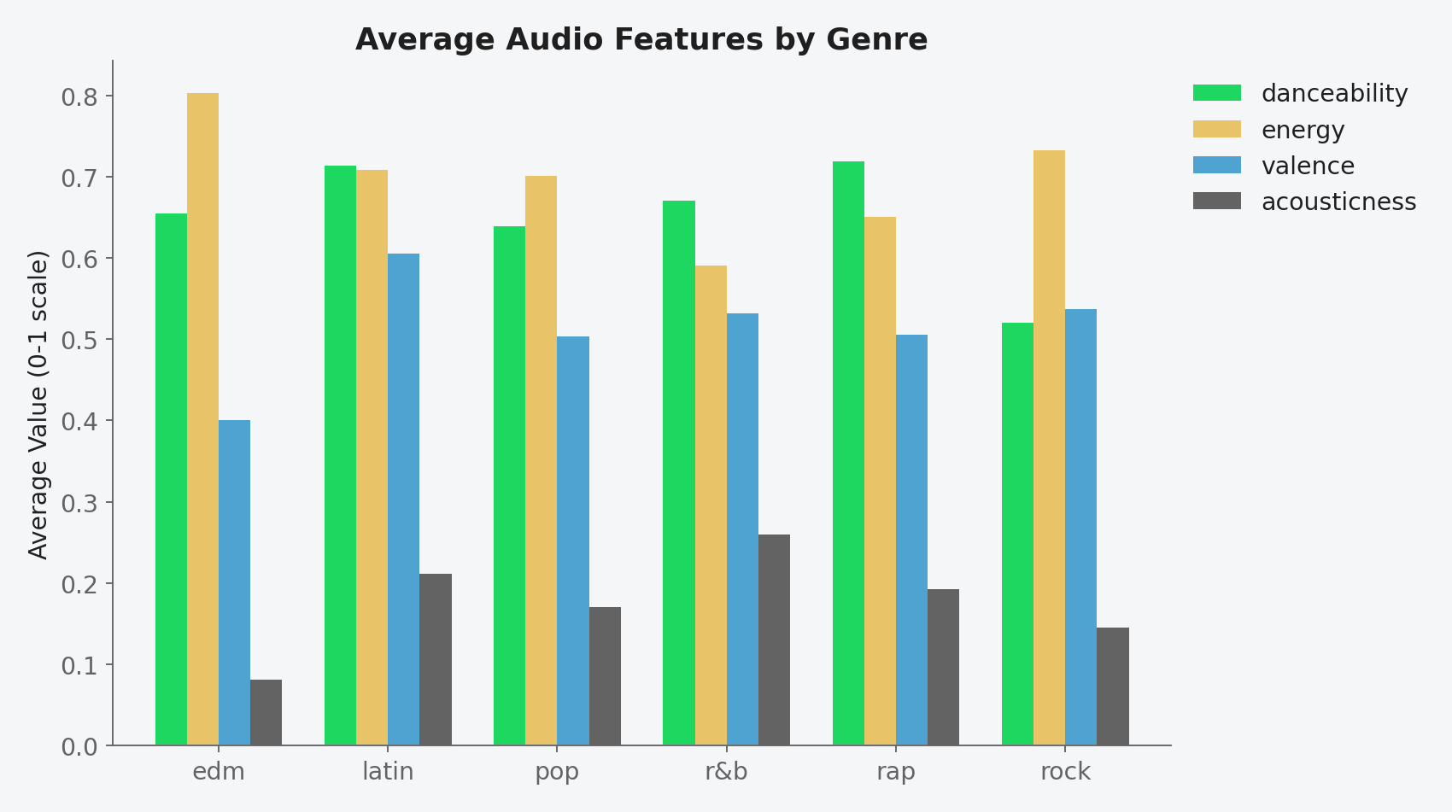
AUDIO FEATURE ANALYSIS
How Genres Differ Sonically
OBSERVATIONS
Rap and Latin score highest on danceability (0.72 & 0.71)
EDM has the highest average energy (0.80) and lowest acousticness (0.08) — fast, electronic, non-acoustic
R&B is the most acoustic genre on average (0.26) and has the lowest energy (0.59)
Latin scores highest on valence (0.61) — the ‘happiest’ sounding genre on average
Rock sits mid-range on energy but lowest on danceability (0.52)
SPOTIFY SONGS' GENRE SEGMENTATION
6
Notes:
Walk through the grouped bar chart genre by genre. Call out EDM's high energy/low acousticness and R&B's high acousticness/low energy as the clearest contrasts.

Slide 7
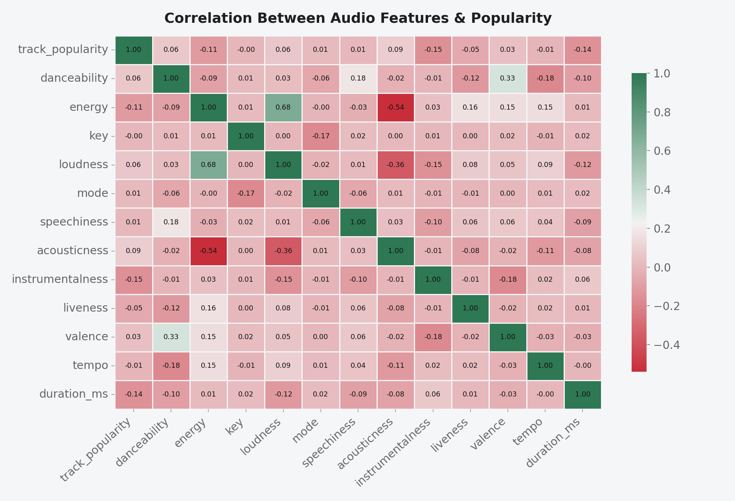
CORRELATION ANALYSIS
How Audio Features Relate to Each Other
KEY RELATIONSHIPS
Energy ↔ Loudness: +0.68
Strongest relationship in the data — louder tracks are perceived as more energetic.
Energy ↔ Acousticness: −0.54
High-energy tracks are far less likely to be acoustic.
Loudness ↔ Acousticness: −0.36
Acoustic tracks tend to be quieter, reinforcing the pattern above.
Popularity ↔ any single feature: weak (max |0.15|)
No individual audio feature strongly predicts popularity on its own.
SPOTIFY SONGS' GENRE SEGMENTATION
7
Notes:
This is the required correlation slide. Point at the heatmap and walk through the three strongest relationships, then highlight that popularity itself has no strong single-feature correlate — this sets up the modeling section.

Slide 8
FEATURE SELECTION
From Raw Audio Features to Model Inputs
No PCA or other dimensionality-reduction technique was applied in this project. Instead, 10 numeric audio features were directly selected as model inputs based on domain relevance, and track_popularity was set as the prediction target.
23 Raw
Columns
→
Remove IDs, Names
& Categorical Text
→
10 Numeric
Audio Features (X)
→
track_popularity
as Target (y)
SELECTED FEATURES (X)
speechiness
acousticness
instrumentalness
liveness
valence
tempo
duration_ms
energy
key
loudness
Target (y): track_popularity (0–100 scale)
SPOTIFY SONGS' GENRE SEGMENTATION
8
Notes:
Explain that no PCA was used — features were selected directly based on domain relevance. Walk through the funnel from 23 raw columns down to 10 numeric features plus the target.

Slide 9
MODELING METHODOLOGY
Predicting Track Popularity
The project frames song popularity as a supervised regression problem: given a track's audio characteristics, predict its popularity score. Two regression algorithms were trained and compared on the same 80/20 train-test split.
BEST MODEL
MODEL 1 — LINEAR REGRESSION
Baseline model — assumes a straight-line relationship between audio features and popularity
Fast, simple, highly interpretable
Trained on StandardScaler-scaled features
MODEL 2 — RANDOM FOREST REGRESSION
Ensemble of 100 decision trees (n_estimators = 100, random_state = 42)
Captures non-linear relationships and feature interactions that linear regression misses
Trained and evaluated on the same scaled train/test split for a fair comparison
Best suited when relationships are linear — a useful reference point.
Selected as the final model — it outperformed Linear Regression on every evaluation metric.
SPOTIFY SONGS' GENRE SEGMENTATION
9
Notes:
Introduce the two models. Spend more time on Random Forest since it's the better performer — explain briefly what an ensemble of decision trees does differently from a linear model.

Slide 10
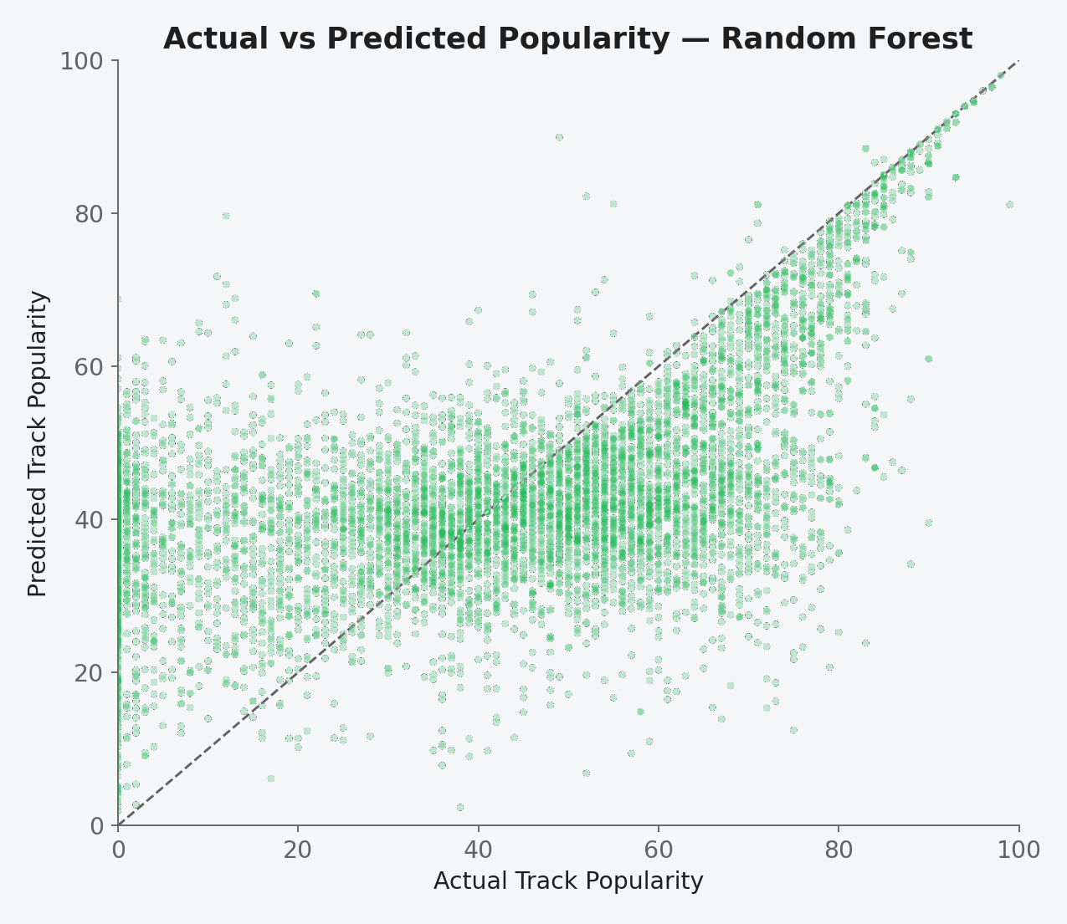
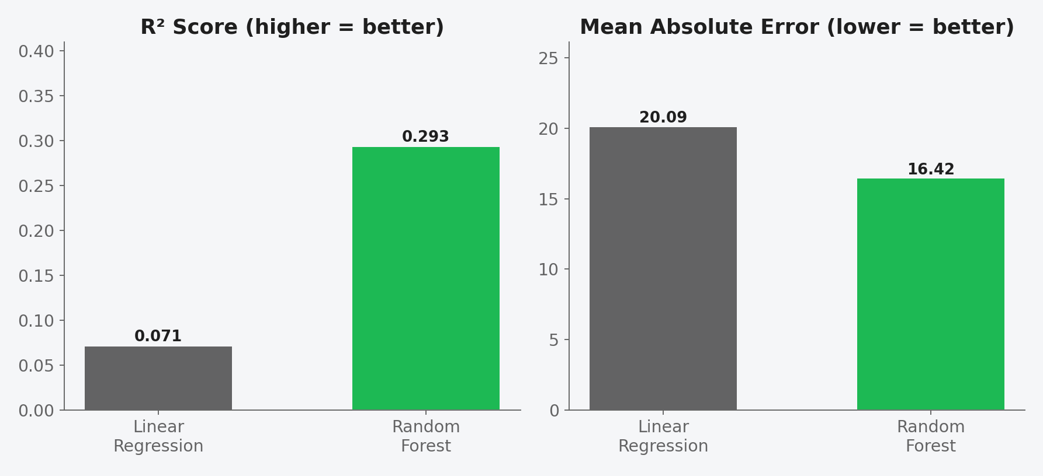
MODEL RESULTS
Model Performance & Comparison
Metric | Linear Regression | Random Forest
MAE (lower is better) | 20.09 | 16.42
RMSE (lower is better) | 24.02 | 20.96
R² Score (higher is better) | 0.071 | 0.293
SPOTIFY SONGS' GENRE SEGMENTATION
10
Notes:
Walk through the scatter plot — points near the diagonal are accurate predictions. Then walk the audience through the R² and MAE comparison, explaining Random Forest's clear edge on both metrics.

Slide 11
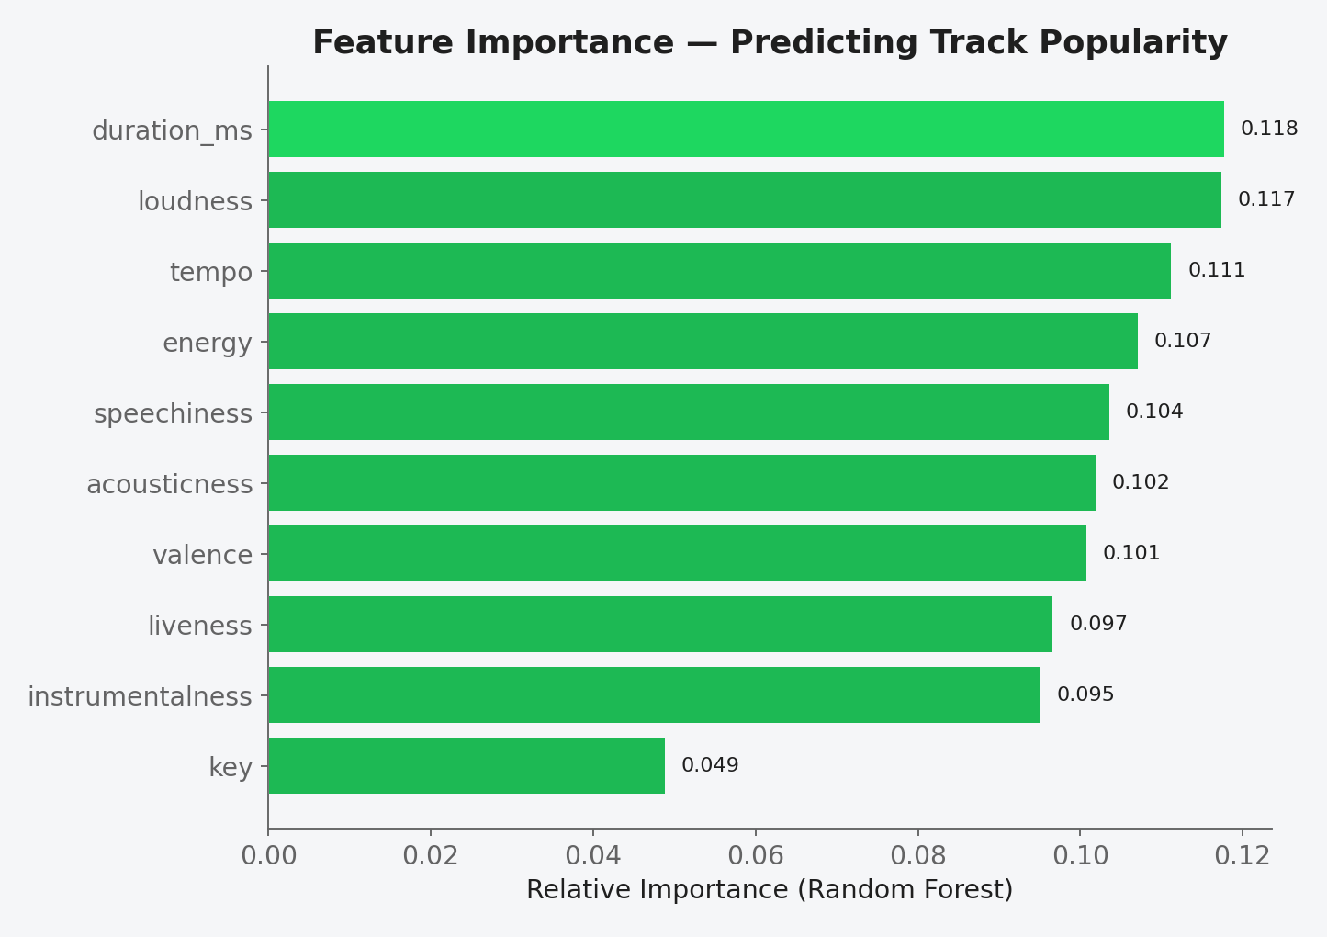
INTERPRETATION
What Actually Drives Predicted Popularity
READING THE RESULT
duration_ms, loudness and tempo carry the most weight (≈11-12% each) in the Random Forest's predictions
key contributes least (≈4.9%) — pitch class has minimal bearing on popularity
Importance is fairly evenly spread across the 10 features — no single feature dominates
This spread, combined with the low R² (0.29), shows that audio characteristics alone only partially explain popularity
Real-world popularity is also shaped by factors outside this dataset — artist fame, marketing, playlist placement, and release timing
SPOTIFY SONGS' GENRE SEGMENTATION
11
Notes:
Explain the feature importance chart — duration, loudness and tempo matter most. Use this to explain why R² is still moderate: popularity depends on more than just audio content.

Slide 12
KEY INSIGHTS
Findings & Practical Value
KEY INSIGHTS
PRACTICAL APPLICATIONS
Genres are near-evenly represented (4,951–6,043 tracks each) — no class-imbalance issues for genre-level analysis
Energy and loudness move together strongly (+0.68); acousticness moves opposite to both
EDM is the highest-energy, least-acoustic genre; R&B is the most acoustic and lowest-energy
No individual audio feature correlates strongly with popularity (max |r| = 0.15, instrumentalness)
Random Forest (R² = 0.293) explains meaningfully more popularity variance than Linear Regression (R² = 0.071), confirming non-linear patterns exist
A&R / Label Screening
Flag tracks whose audio profile resembles historically popular songs before release
Playlist Curation
Use genre-level feature profiles to build sonically consistent playlists
Catalogue Analytics
Understand which sonic traits correlate with performance across a catalogue
Foundation for Recommendations
Audio-feature similarity is a natural building block for song-similarity and recommendation tools (see Future Scope)
SPOTIFY SONGS' GENRE SEGMENTATION
12
Notes:
Summarize the main takeaways in plain language, then pivot to practical applications — how a label, playlist curator, or streaming platform could use this analysis today.

Slide 13
EXTENDING THE PROJECT
NOT YET IMPLEMENTED
Toward a Recommendation System
The current project stops at popularity prediction from audio features. It does not implement clustering, similarity search, or a recommendation engine. The conceptual architecture below shows how this work could be extended — it is proposed future scope, not completed work.
User's Listening
History
→
Extract Audio
Features
→
Cluster / Find
Similar Songs
→
Rank by Similarity
& Popularity
→
Recommended
Songs
WHAT WAS IMPLEMENTED
WHAT WOULD NEED TO BE ADDED
EDA, correlation analysis, and a Random Forest / Linear Regression model that predicts a track's popularity from its audio features.
A clustering step (e.g. K-Means on scaled audio features) to group similar songs, plus a similarity-ranking layer to turn clusters into actual song recommendations.
SPOTIFY SONGS' GENRE SEGMENTATION
13
Notes:
Be transparent here: clarify that clustering and recommendation were not built in this version of the project. Walk through the conceptual pipeline as a proposed next step, not a completed feature.

Slide 14
CONCLUSION
Conclusion & Future Scope
CONCLUSION
FUTURE SCOPE
Analyzed 32,833 Spotify tracks across 6 genres and 24 subgenres using 10 audio features
Found that audio features correlate strongly with each other (e.g. energy ↔ loudness) but only weakly with popularity
Built and compared two regression models; Random Forest (R² = 0.293) clearly outperformed Linear Regression (R² = 0.071)
Identified duration, loudness and tempo as the most influential features for predicting popularity
Confirmed that audio characteristics alone give a partial — not complete — picture of what makes a song popular
Add clustering (e.g. K-Means) to group songs into genuine audio-based segments
Apply PCA to explore feature dimensionality and visualize song similarity in 2D
Incorporate external signals (artist popularity, release date, playlist placement) to improve prediction power
Build a similarity-based or collaborative-filtering recommendation engine
Explore hybrid recommendation approaches and deep-learning audio embeddings
Validate on a larger, more current Spotify dataset
SPOTIFY SONGS' GENRE SEGMENTATION
14
Notes:
Recap what was actually accomplished, then walk through the future scope items as clearly labeled next steps — clustering, PCA, external data, and a full recommendation engine.

Slide 15
Thank You
Questions & Discussion
Spotify Songs' Genre Segmentation — EDA, Correlation Analysis & Popularity Prediction
Notes:
Thank the mentor and audience, and open the floor for questions.

